Slide 1
Social Network Analysis IS 324
Feb 13, 2024
Jaihyun Park

Slide 2
Let’s do the week 4 practice
text-analysis.ipynb from week4 folder
At the bottom of the Jupyter notebook, there is practice.

Slide 3
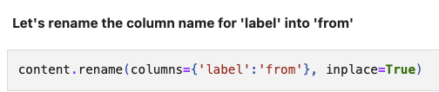
Week 4 practice solution

Slide 4

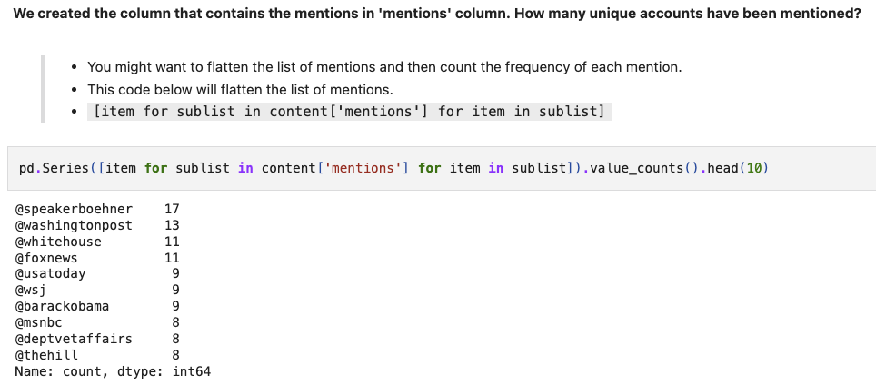
re.findall() returns the list

Slide 5
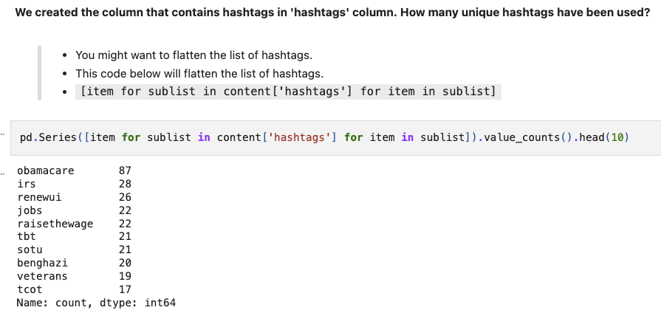
re.findall() returns the list

Slide 6
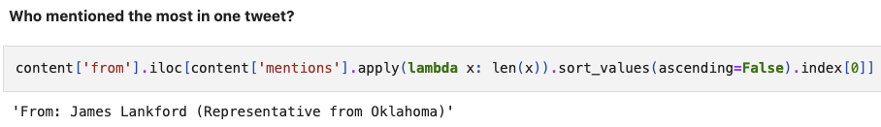
sort_values() for finding who mentioned the most

Slide 7
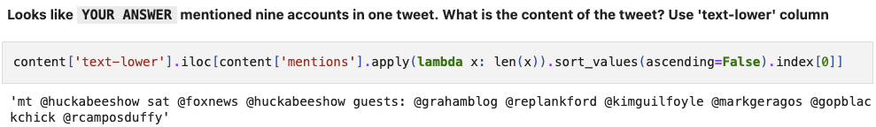
sort_values() for finding who mentioned the most

Slide 8
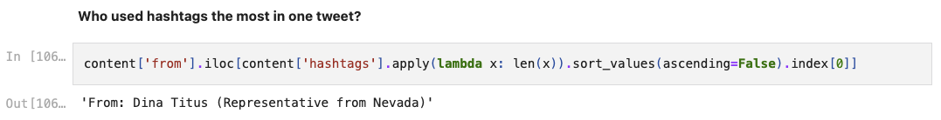
sort_values() for finding who used hashtags the most

Slide 9
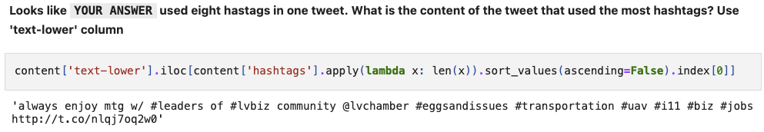
sort_values() for finding who used hashtags the most

Slide 10
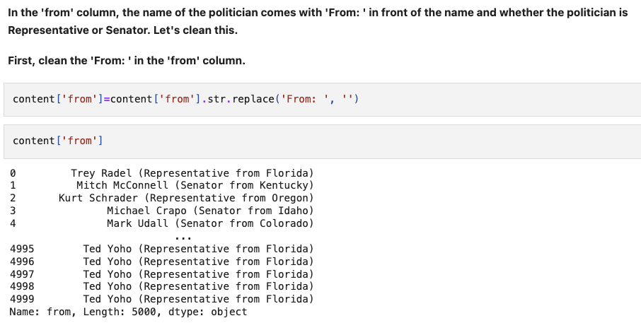
Cleaning ‘from’ column

Slide 11
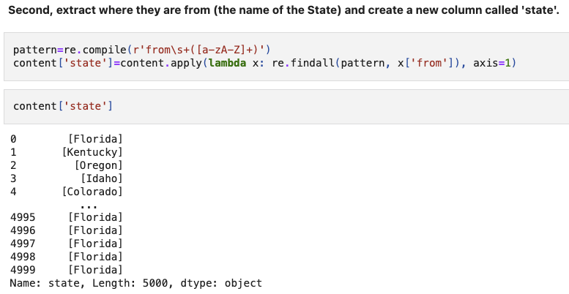
Cleaning ‘from’ column

Slide 12
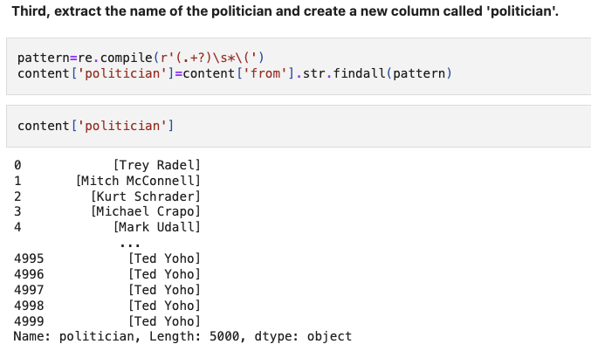
Cleaning ‘from’ column

Slide 13
Social media data into network objects
Nodes can be placed in the list.
[‘apple’, ‘banana’, ‘cat’]
We are going to use tuples to represent edges between nodes.
(‘apple’, ‘banana’)
The entire edges will be in the list of tuples.
[(’apple’, ‘banana’), (‘banana’, ‘cat’)]

Slide 14
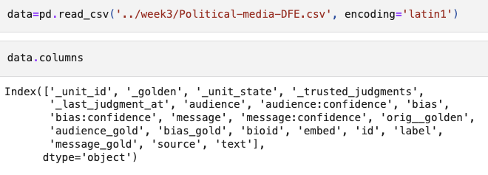
pd.read_csv() to read data

Slide 15
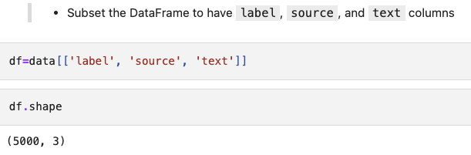
Subsetting the data

Slide 16
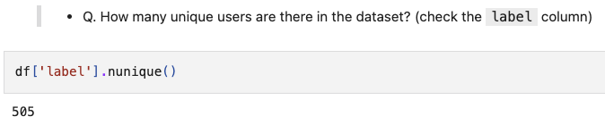
nunique()

Slide 17
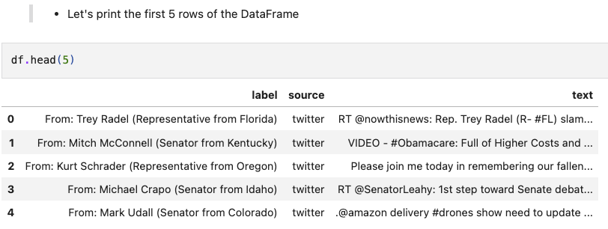
.head()

Slide 18
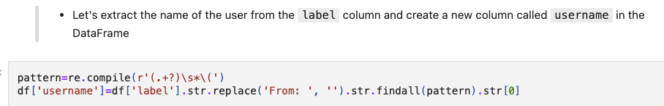
Extract usernames

Slide 19
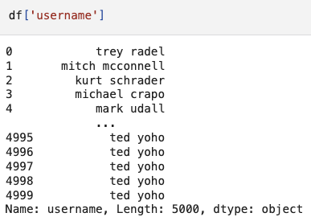

Lowercasing

Slide 20
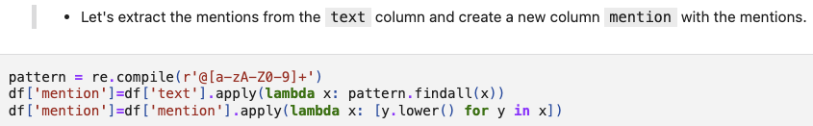
Extract mentions

Slide 21
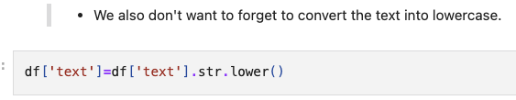
Lowercasing

Slide 22
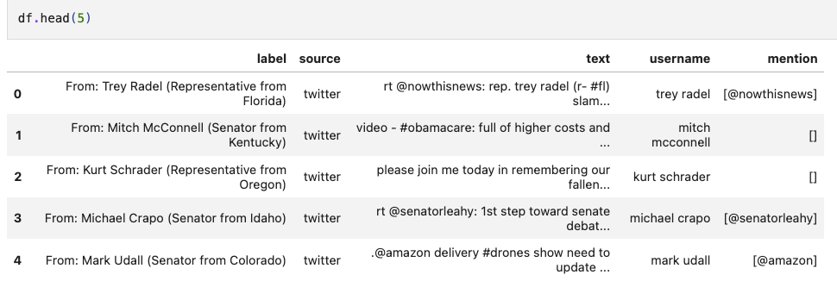
The list is in the mention column

Slide 23
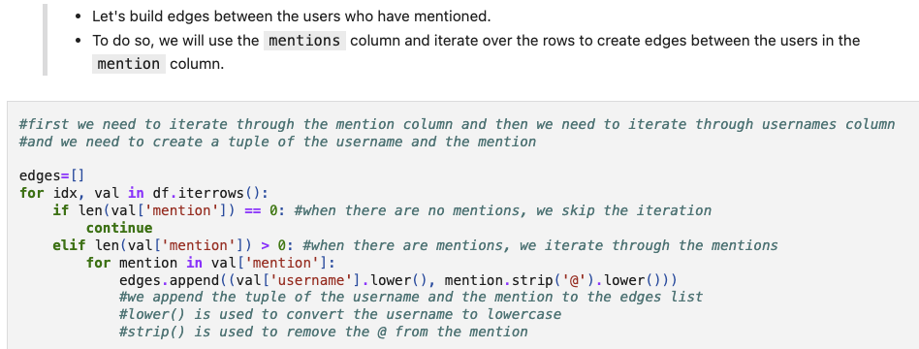
Building edges

Slide 24
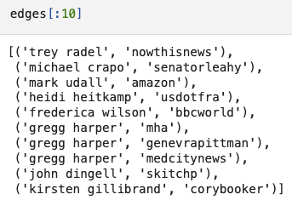
Edges

Slide 25

len()
If you want to find the number of edges in the entire graph, use len()

Slide 26
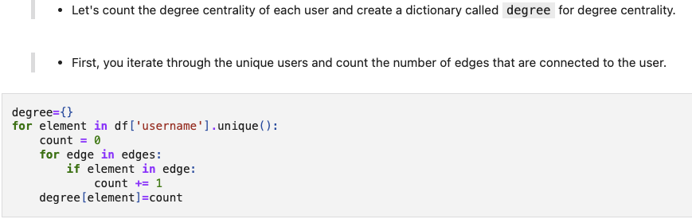
Calculating degree centrality

Slide 27
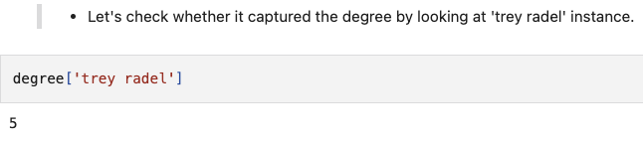
Calculating degree centrality

Slide 28
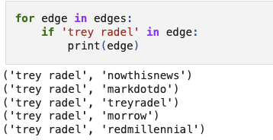
Calculating degree centrality

Slide 29
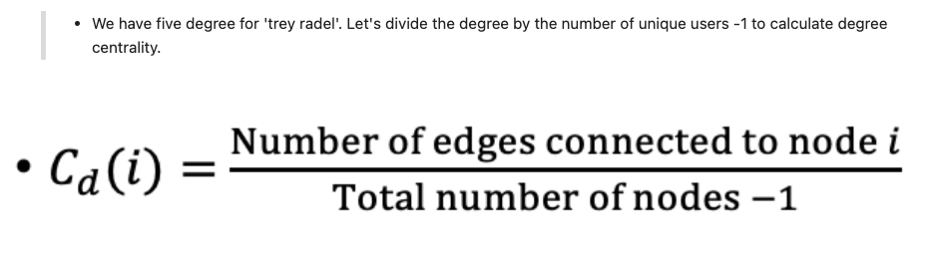
Calculating degree centrality

Slide 30
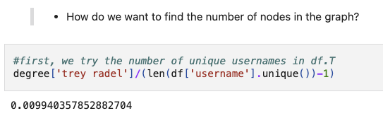
Divide the degree by unique users in the username column?

Slide 31
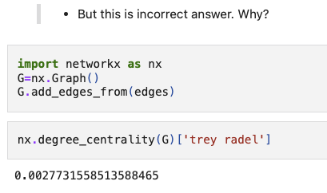
It is incorrect!
If we use network function to calculate degree centrality, the degree centrality score is different from what we calculated before!

Slide 32
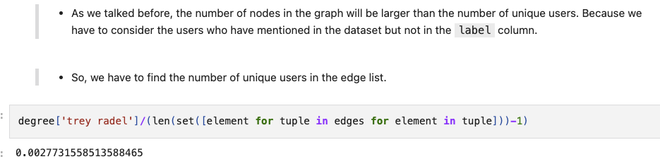
Calculate the degree centrality of specific user

Slide 33
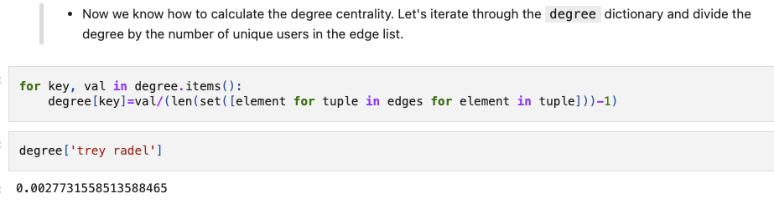
Iteration to calculate the degree centrality

Slide 34
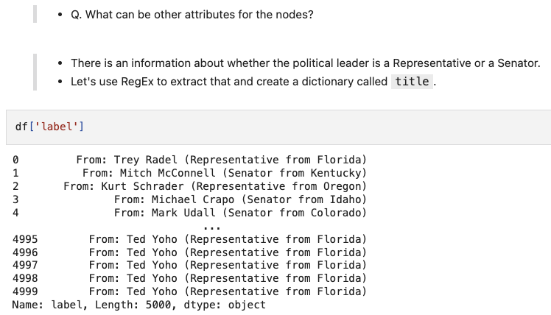
Q. What can be other attributes for the nodes?

Slide 35
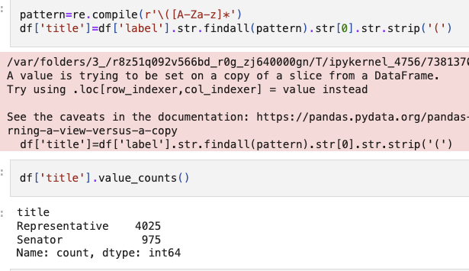
Title attribute (Senator or Representative)

Slide 36

Title attributes (Senator or Representative)
We are placing the username as the key and title as the value in the title dictionary

Slide 37
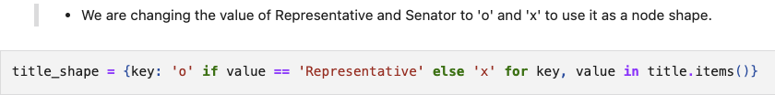
Title attributes into binary shapes

Slide 38
State attribute

Slide 39

State attribute
We are placing the username as the key and state as the value in the state dictionary

Slide 40
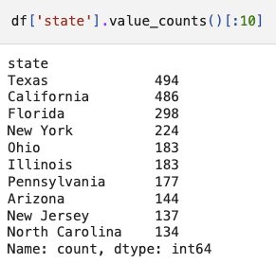
State attributes

Slide 41
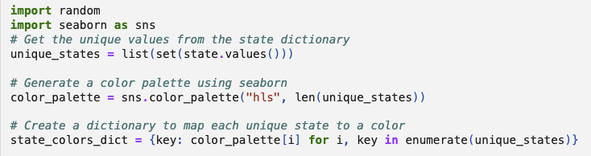
States into colors

Slide 42

Color palette

Slide 43
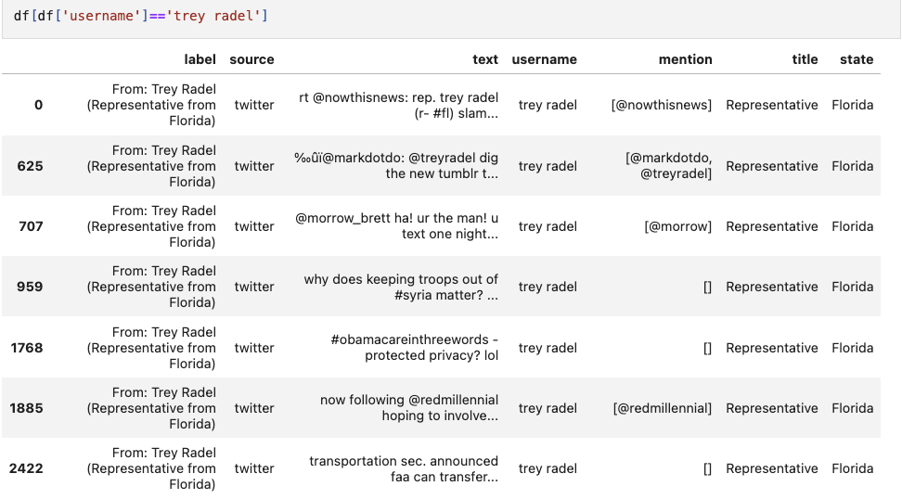
‘trey radel’ is from Florida
Mapt

Slide 44
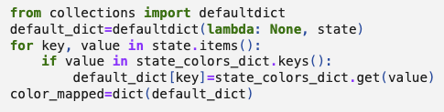

‘trey radel’ has the RGB value

