Slide 1
Social Network Analysis IS 324
Mar 21, 2024
Jaihyun Park

Slide 2
Let’s continue working on week 8 practice
social-media-networkx.ipynb
There is a practice at the bottom of the Jupyter Notebook

Slide 3
Practice solution

Slide 4
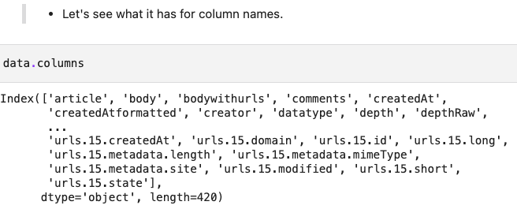
Columns

Slide 5
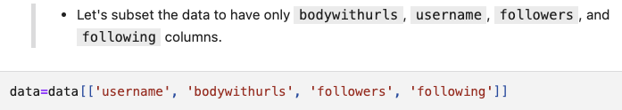
Subsetting

Slide 6
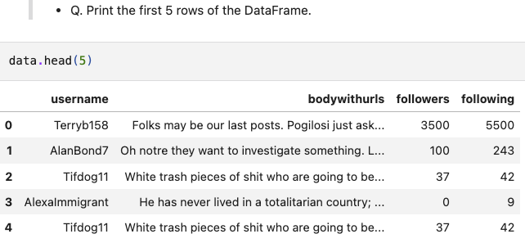
Head

Slide 7
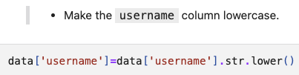
Converting the string into lowercase

Slide 8
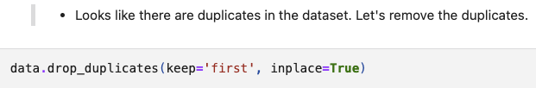
Dropping duplicates

Slide 9
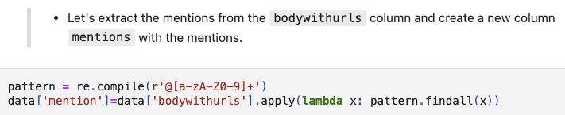
Extracting mentions

Slide 10
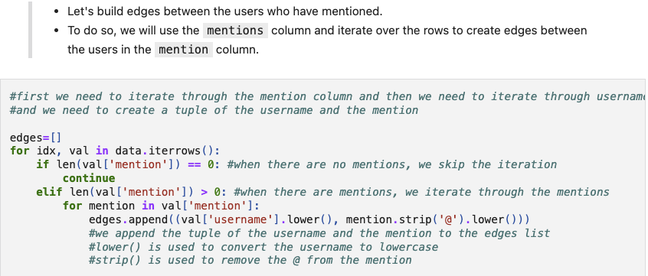
Building edges

Slide 11

Create an empty graph object

Slide 12
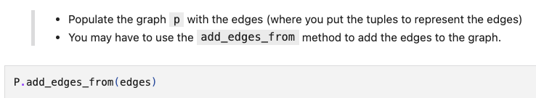
Adding edges to the graph object

Slide 13
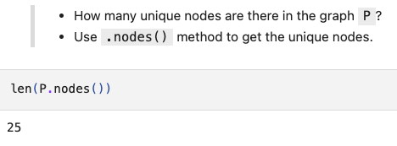
The number of nodes

Slide 14
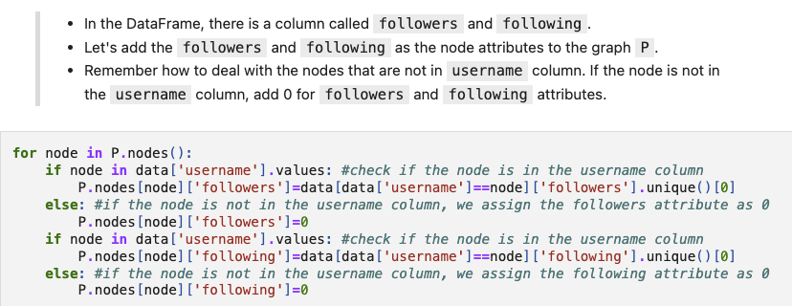
Node attributes (followers and following)

Slide 15
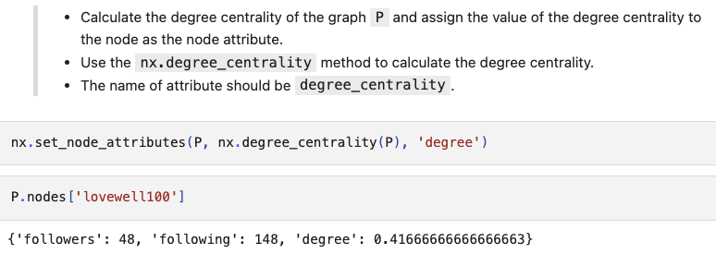
Node attributes (degree centrality)

Slide 16
NetworkX
In continuation of the previous social media networkX class, we will continue practicing networkX using email data.

Slide 17
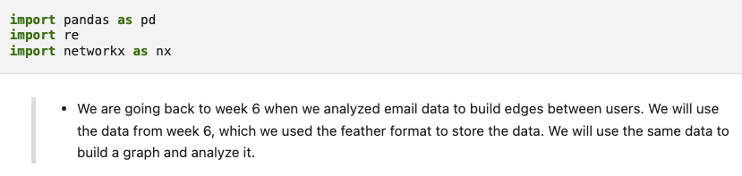
Importing libraries

Slide 18

Read feather file using pandas

Slide 19
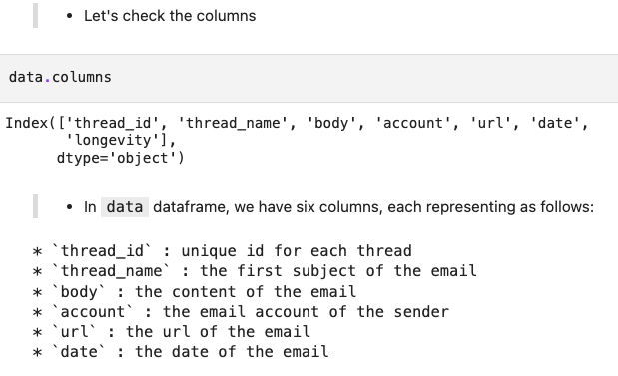
Columns

Slide 20
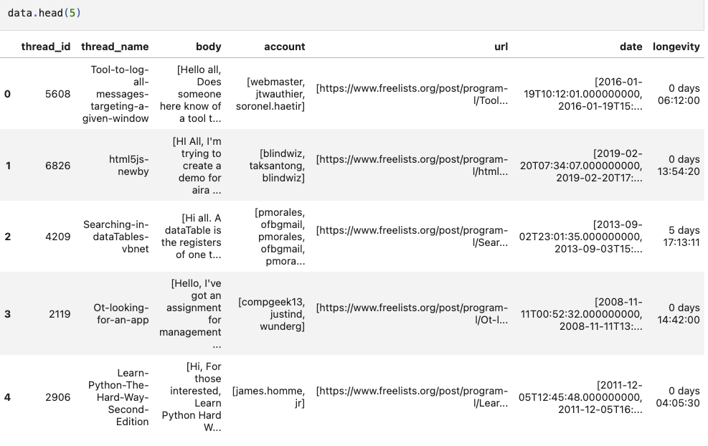
Head

Slide 21
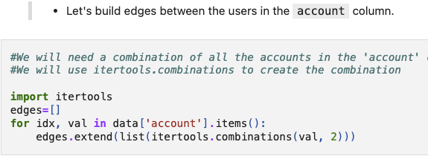
Using combination to build edges

Slide 22
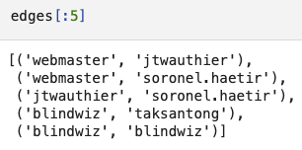
“edges” is the list of tuples

Slide 23
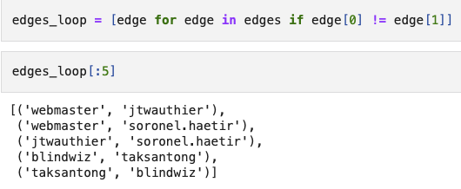
Getting rid of the self-loops

Slide 24
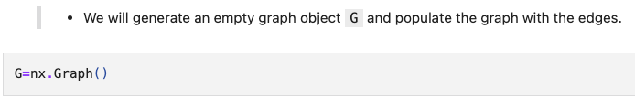
Generating an empty graph object

Slide 25
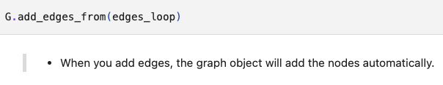
Adding edges from the list of tuples

Slide 26

The number of nodes

Slide 27

Degree centrality

Slide 28

Betweenness centrality

Slide 29

Closeness centrality

Slide 30
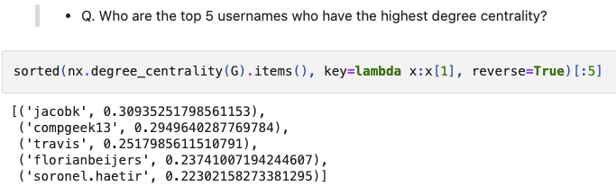
Q. Top 5 users with high degree centrality?

Slide 31
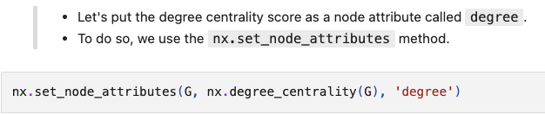
Node attribute (degree centrality)

Slide 32
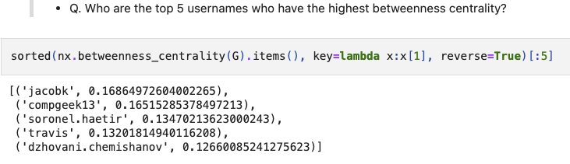
Q. Top 5 users with high betweenness centrality?

Slide 33
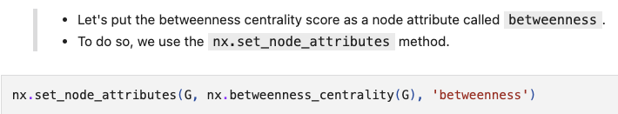
Node attribute (betweenness centrality)

Slide 34
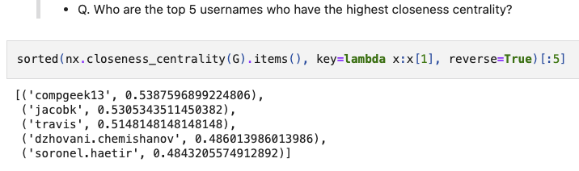
Q. Top 5 users with high closeness centrality?

Slide 35
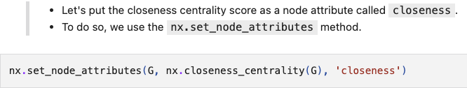
Node attribute (closeness centrality)

Slide 36
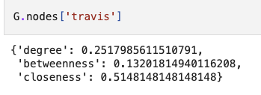
Checking node attributes

Slide 37
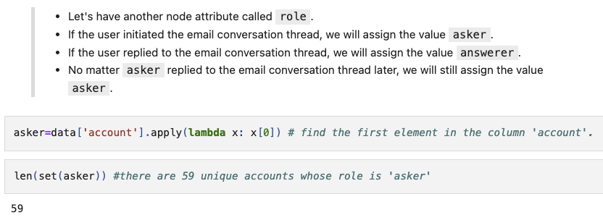
Another node attribute (role={asker, answerer})

Slide 38
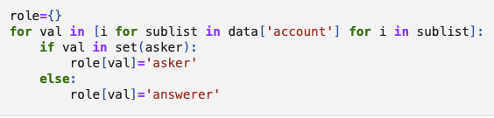
Find who initiated the email thread first

Slide 39
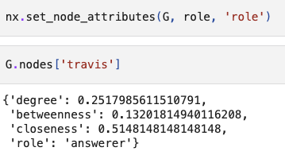
Node attribute (role)

Slide 40
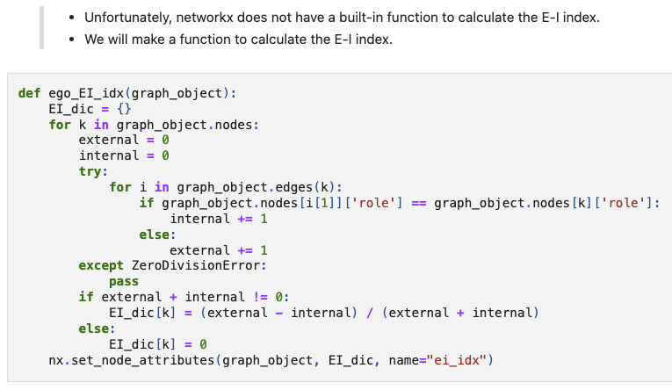
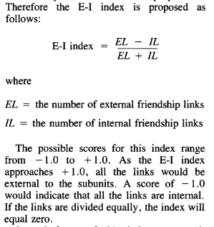
E-I index

Slide 41
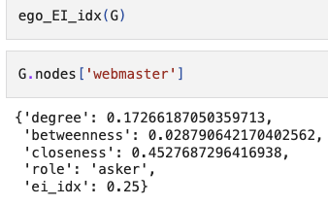
Calculating EI-index and having the node attribute

Slide 42
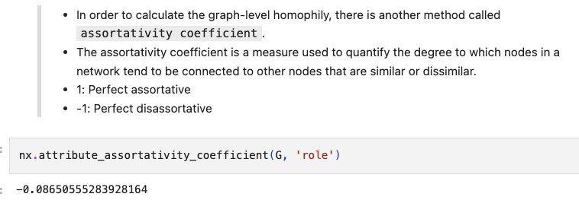
Assortativity coefficient

Slide 43
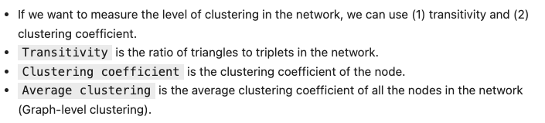
Transitivity & Clustering coefficient

Slide 44
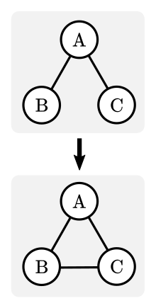


Transitivity

Slide 45
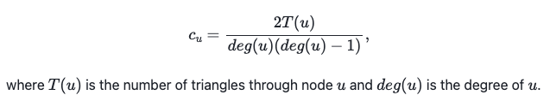

Clustering coefficient

Slide 46
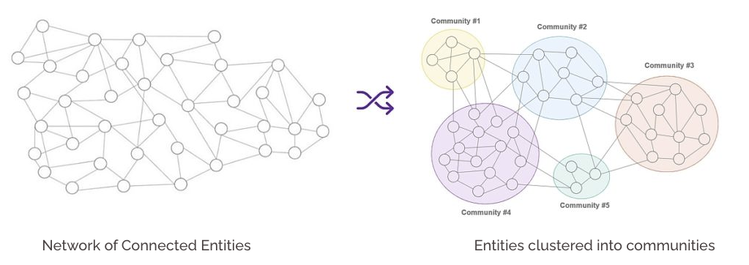
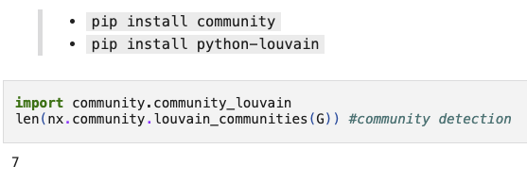
Louvain community detection

