Slide 1
Social Network Analysis IS 324
April 2, 2024
Jaihyun Park

Slide 2
Let’s practice on week 10 Jupyter Notebook
git pull
In week 10 folder, there is email-network.ipynb

Slide 3
Network visualization
In this class, we will use networkx and matplotlib to visualize nodes, edges, and how to place nodes in the blank canvas.
We talked about various node attributes. In political tweets, we had the title of the politician (e.g., ‘Senate’ or ‘Representatives’), and the State they are representing (e.g., ‘Illinois’ or ‘Florida’).
Q. How would you visualize these attributes?

Slide 4
Attributes
We will be focusing on three ways to represent attributes.
(1) Color
(2) Shape
(3) Size

Slide 5
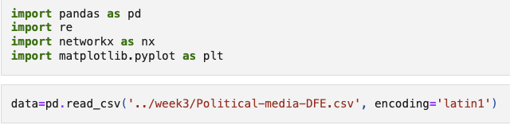
Import libraries

Slide 6
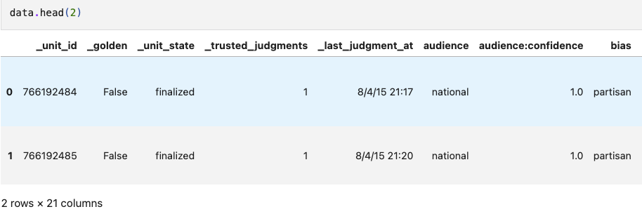
Print a few rows

Slide 7
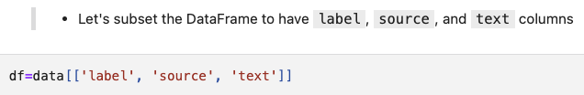
Subsetting dataframe based on columns

Slide 8
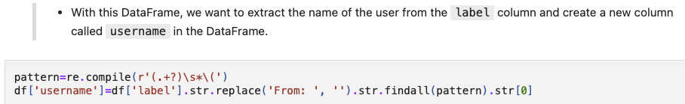
Extracting usernames

Slide 9
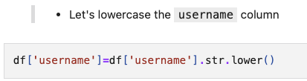
Lowercasing usernames

Slide 10
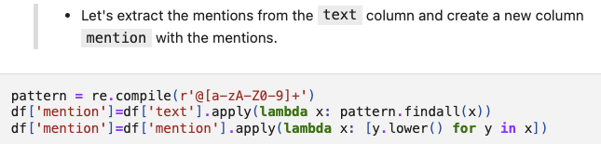
Extracting mentions

Slide 11
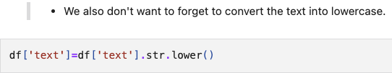
Lowercasing texts

Slide 12
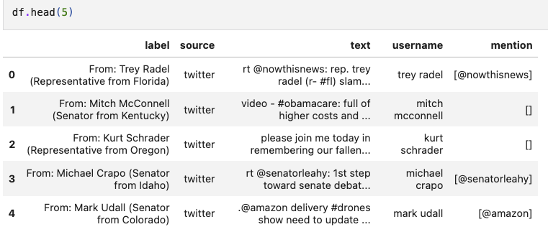
data.head(5)

Slide 13
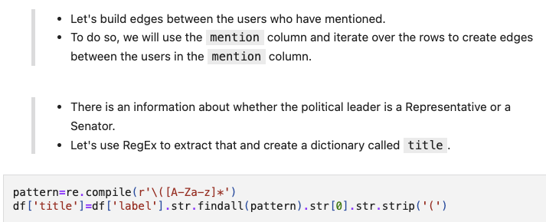
Extracting title

Slide 14
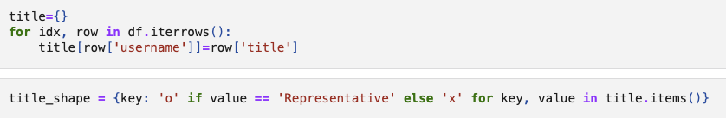
Extracting title

Slide 15
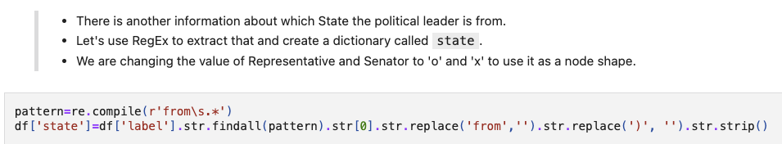

Extracting State

Slide 16
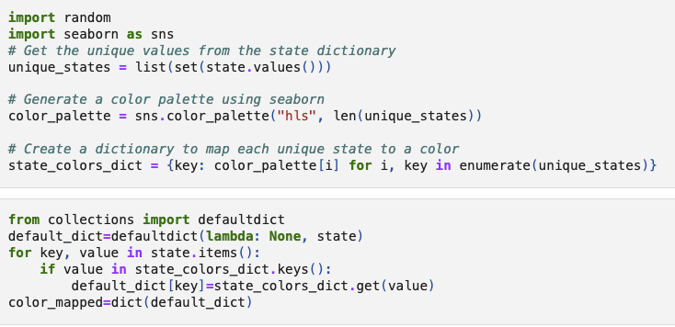
Color for the State

Slide 17
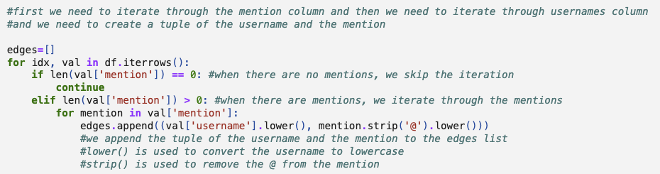
Building edges

Slide 18
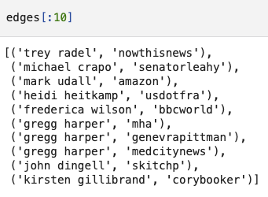
Edges are in the list of tuples

Slide 19
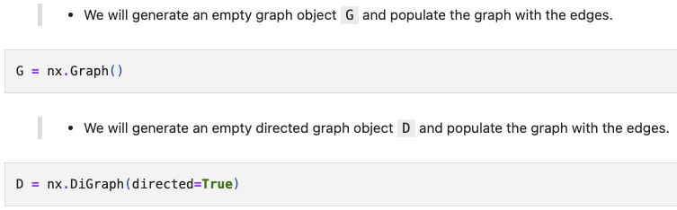
Creating networkX graph object

Slide 20
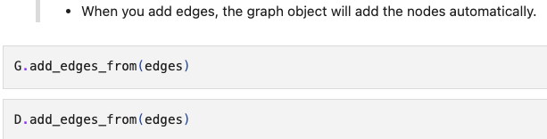
.add_edges_from()

Slide 21
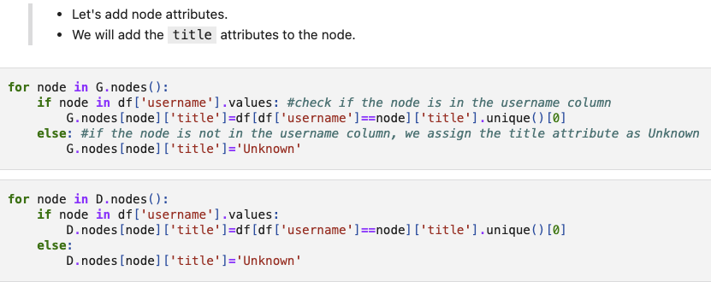
Adding title attributes

Slide 22
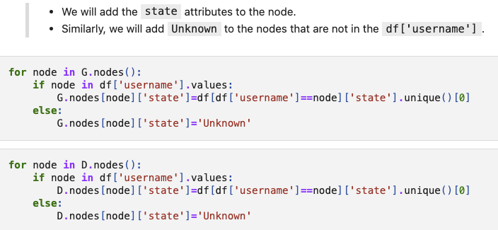
Adding State attributes

Slide 23
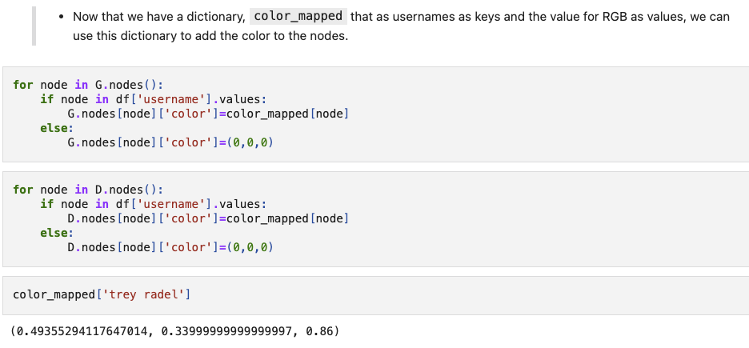
Adding color for State attribute

Slide 24
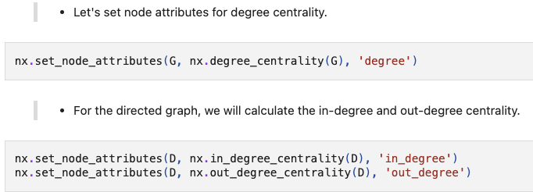
Adding degree centrality as an attribute

Slide 25
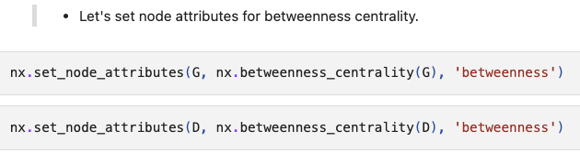
Adding betweenness centrality

Slide 26
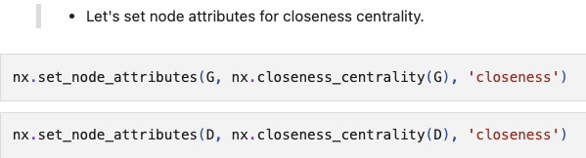
Adding closeness centrality

Slide 27
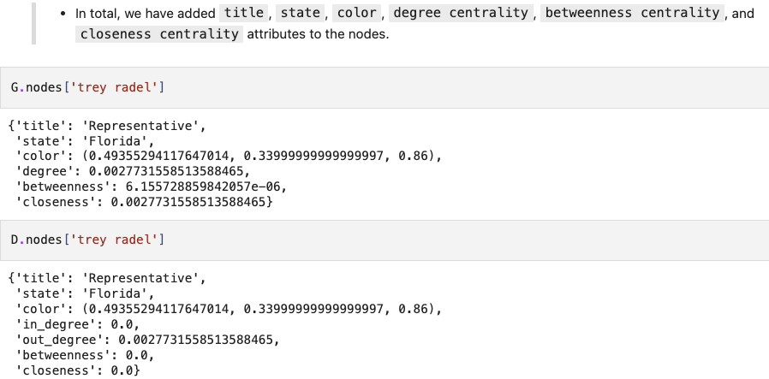
Node attributes

Slide 28
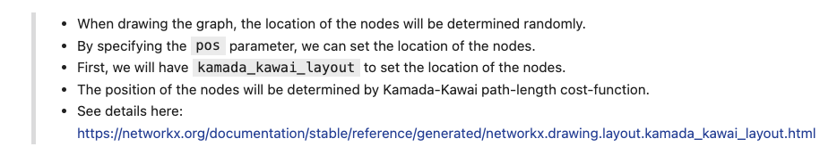
Position

Slide 29
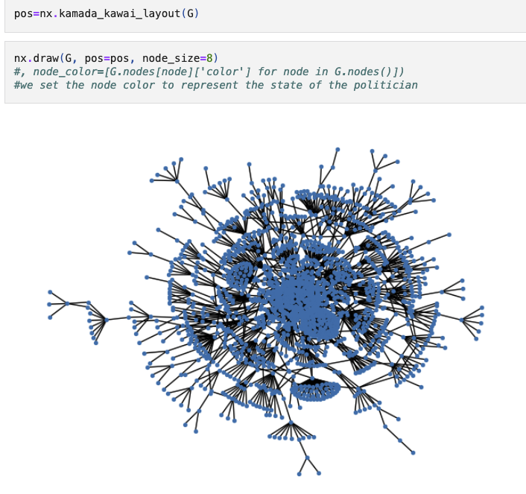
kamada kawai

Slide 30
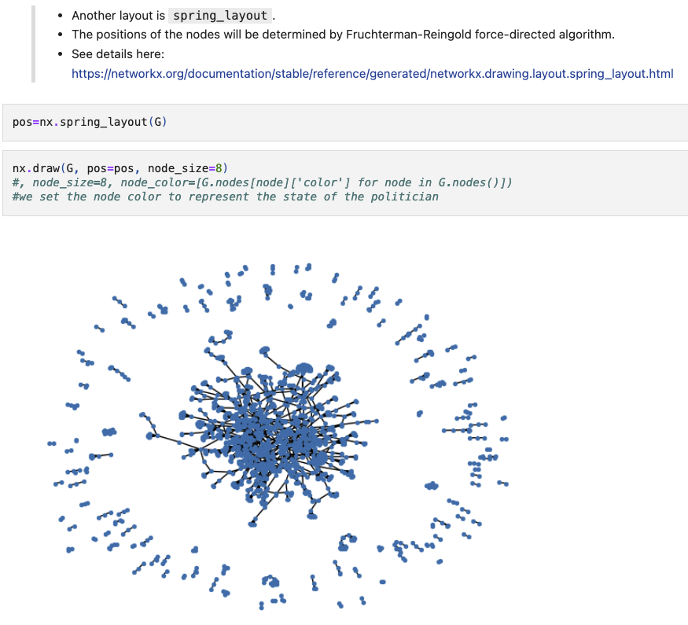
Spring

Slide 31
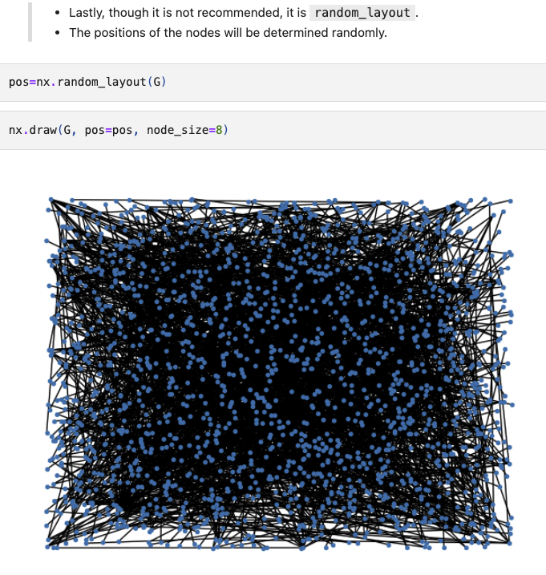
Random

Slide 32
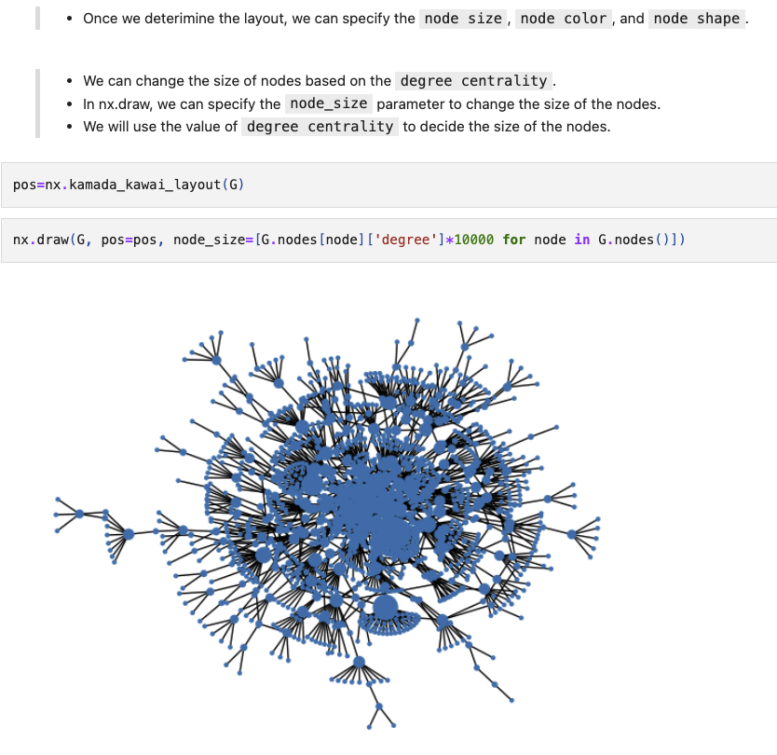
Node size for degree centrality

Slide 33
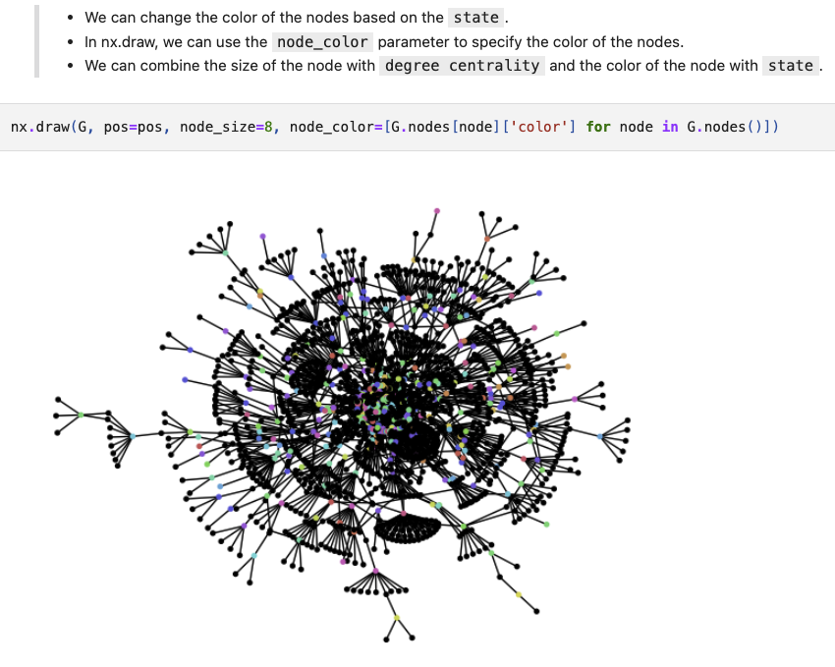
Node color for States

Slide 34
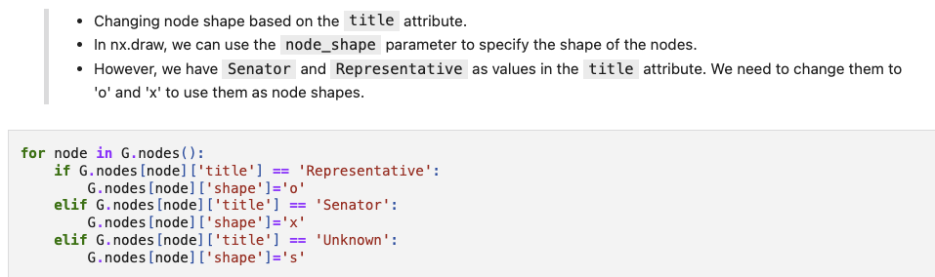
Node shape for title

Slide 35
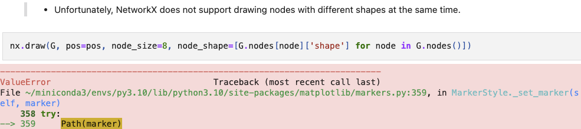
We have to draw network for each node shape

Slide 36
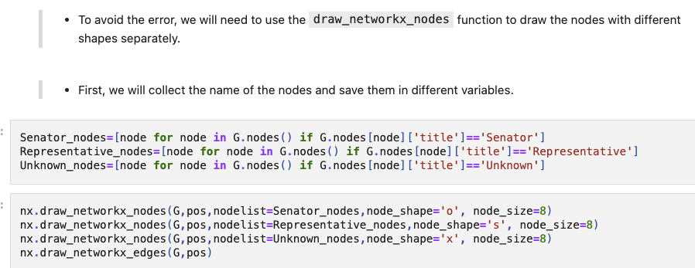
nx.draw_networkx_nodes

Slide 37
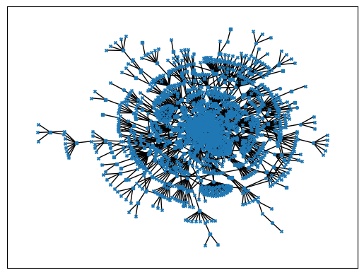

Slide 38
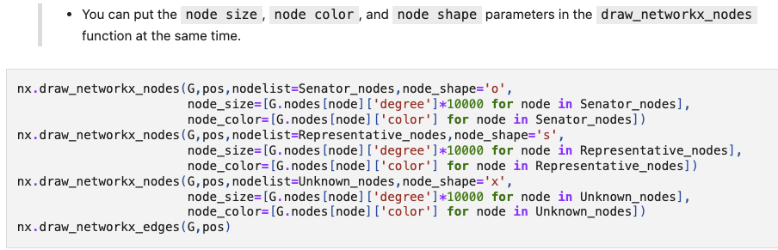
Node size, color, and shape all together

Slide 39
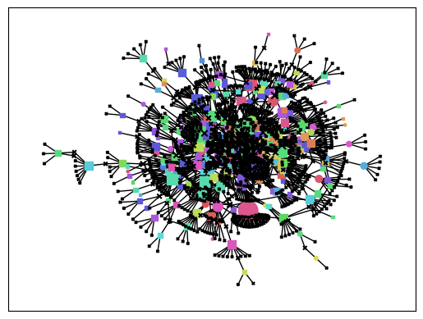

Slide 40
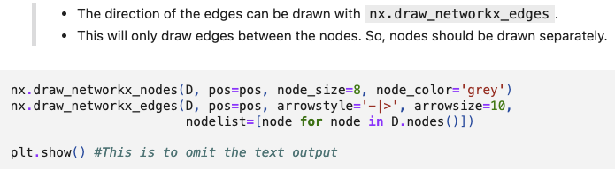
Directed graph

Slide 41
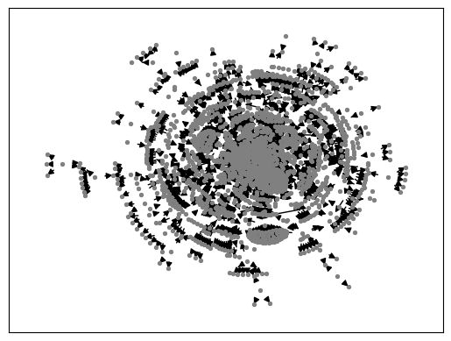

Slide 42
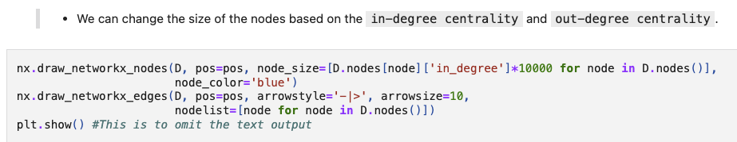
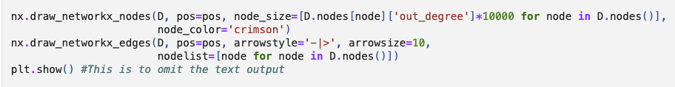
Node size based on in degree and out degree centrality

Slide 43
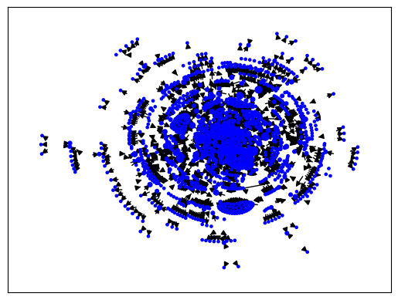
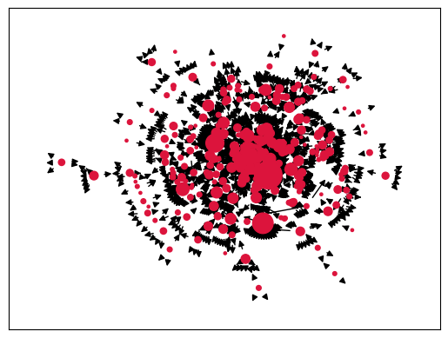
In degree VS out degree Q. Why do they look different?

Slide 44
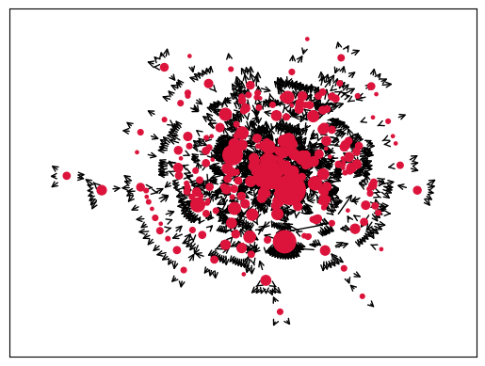
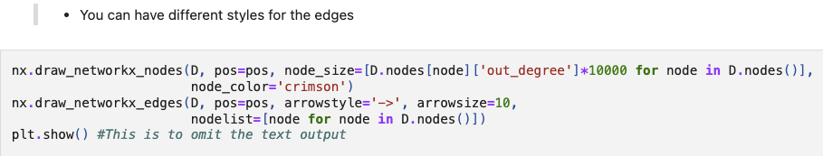
Edge style

Slide 45
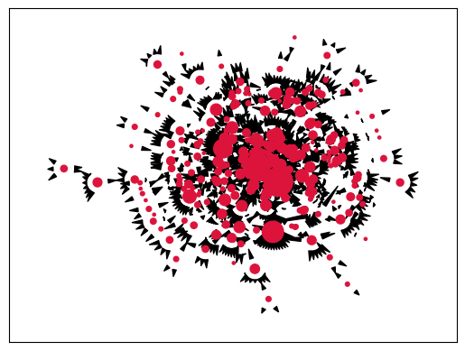
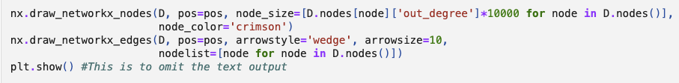
Edge style

Slide 46
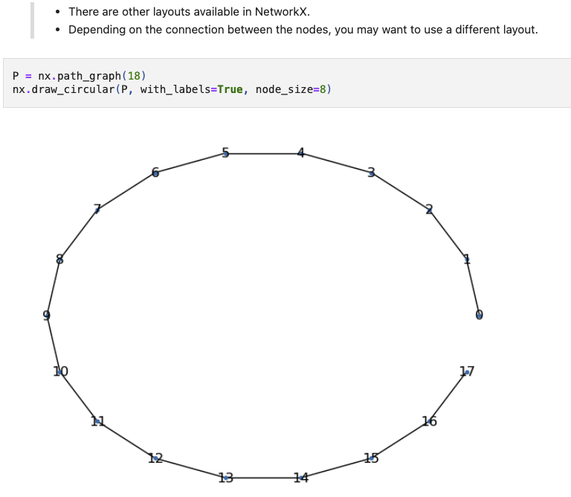
Different layouts: circular

Slide 47
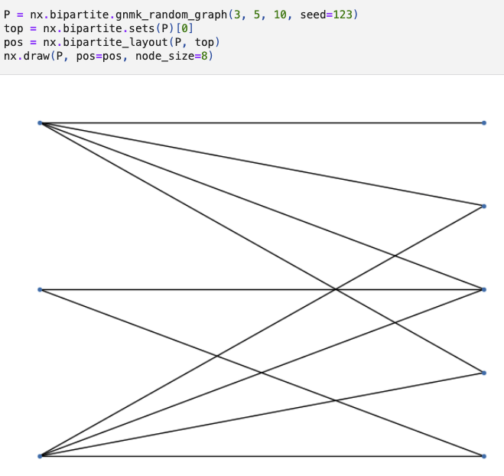
Different layout: bipartite

Slide 48
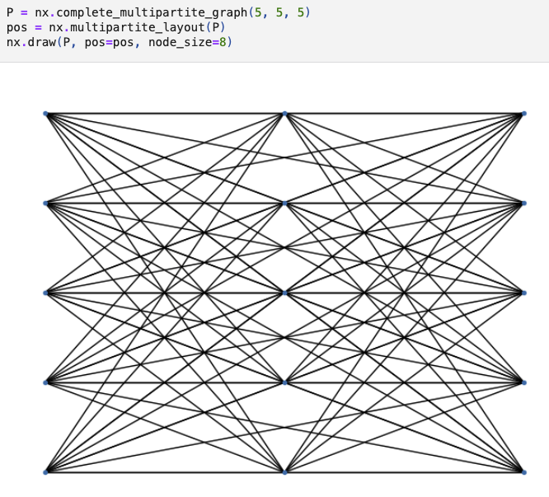
Different layout: multipartite

Slide 49
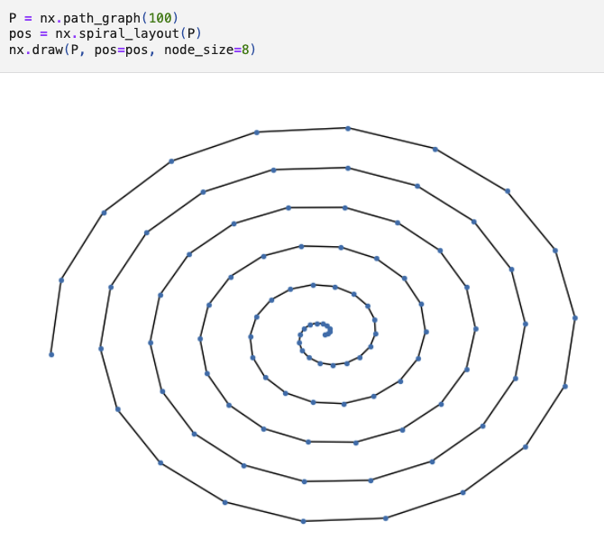
Different layout: spiral

Slide 50
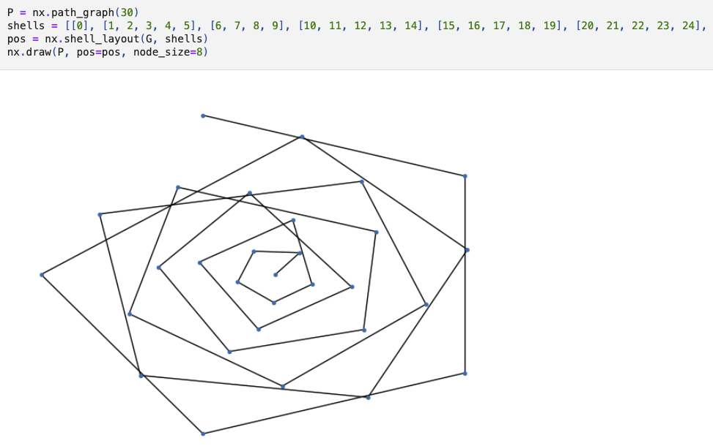
Different layout: shell

