Slide 1
Social Network Analysis IS 324
April 8, 2024
Jaihyun Park

Slide 2
Let’s practice on week 12 Jupyter Notebook
In week 12 folder, there is social-media-viz.ipynb

Slide 3
Network visualization
In this class, we will use NetworkX and matplotlib to visualize nodes, edges, and how to place nodes in the blank canvas.
We talked about various node attributes. In political tweets, we had the title of the politicians (e.g., ‘Senate’ or ‘Representatives’), and the State they are representing (e.g., ‘Illinois’ or ‘Florida’).
Q. How would you visualize these attributes?

Slide 4
Attributes
We will be focusing on three ways to represent attributes.
(1) Color
(2) Shape
(3) Size

Slide 5

Import libraries

Slide 6
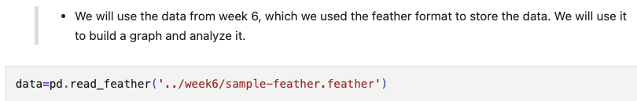
Read the file of email dataset

Slide 7
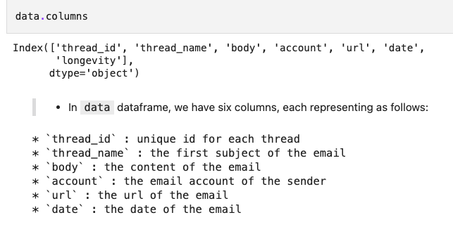
Check columns

Slide 8
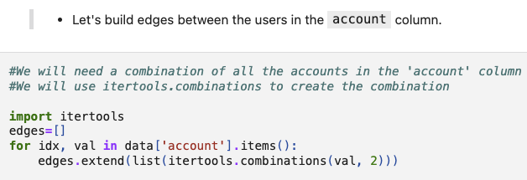
Use combination to build edges

Slide 9
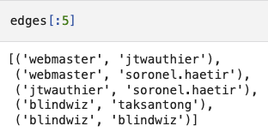
Edges will be built

Slide 10
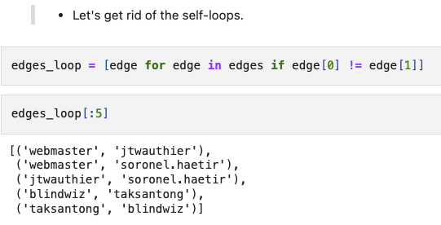
Remove self-loops

Slide 11
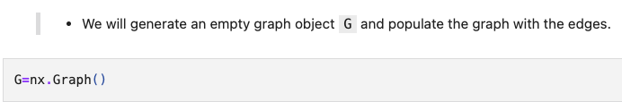
Create an empty graph object

Slide 12

Populate edges

Slide 13
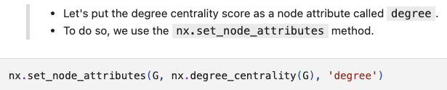
nx.set_node_attributes

Slide 14
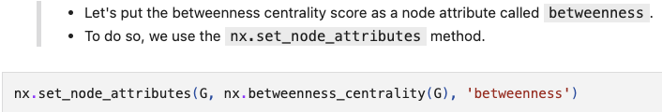
nx.set_node_attributes

Slide 15
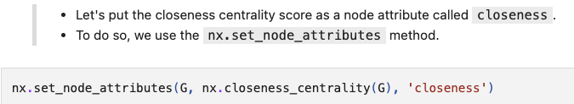
nx.set_node_attributes

Slide 16
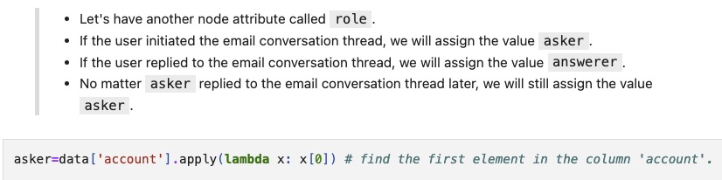
Another attribute, role

Slide 17
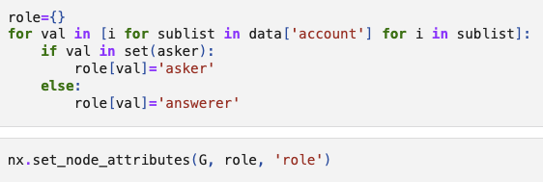
nx.set_node_attributes

Slide 18
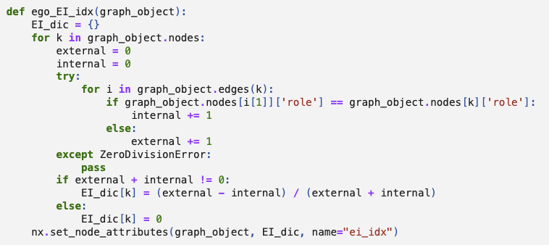
E-I index for role attribute

Slide 19
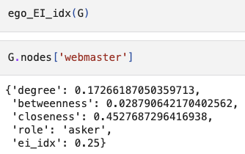
Check all attributes

Slide 20
Visualization
(1) The position of nodes
(2) Attribute
Color
Size
Shape

Slide 21
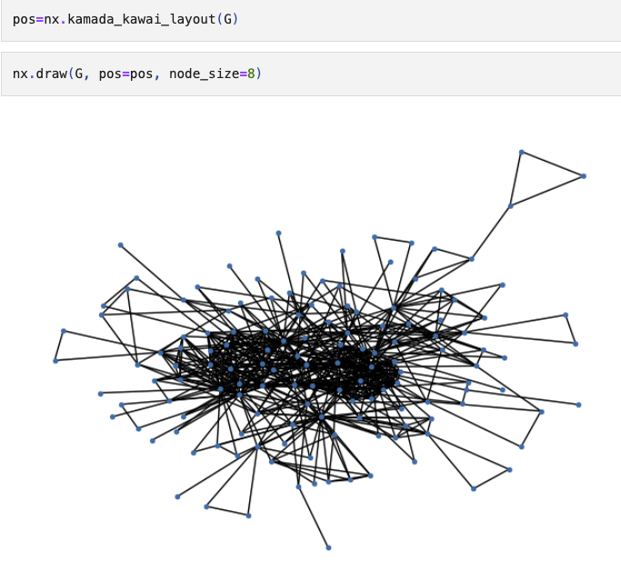
nx.kamada_kawai_layout()

Slide 22
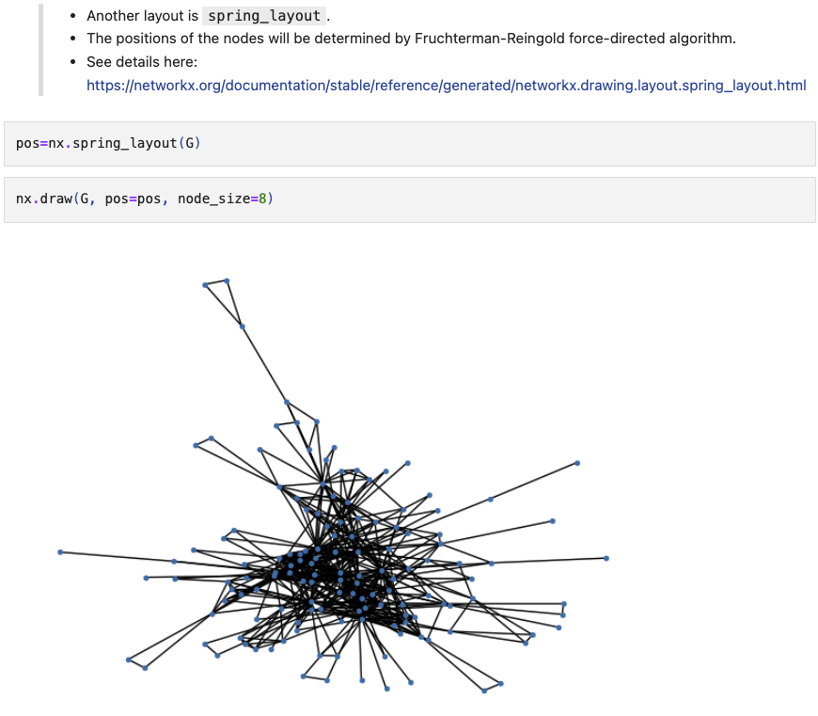
nx.spring_layout()

Slide 23
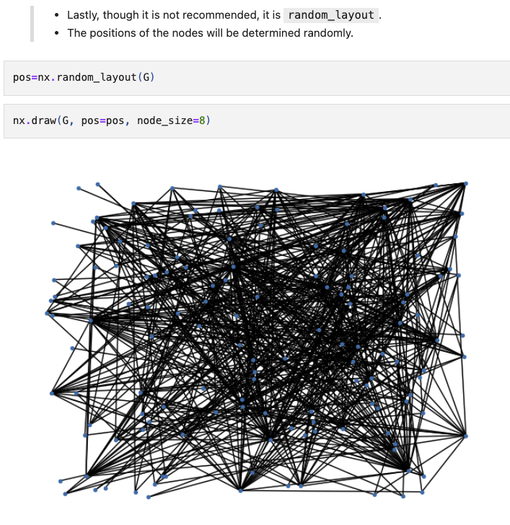
nx.random_layout()

Slide 24
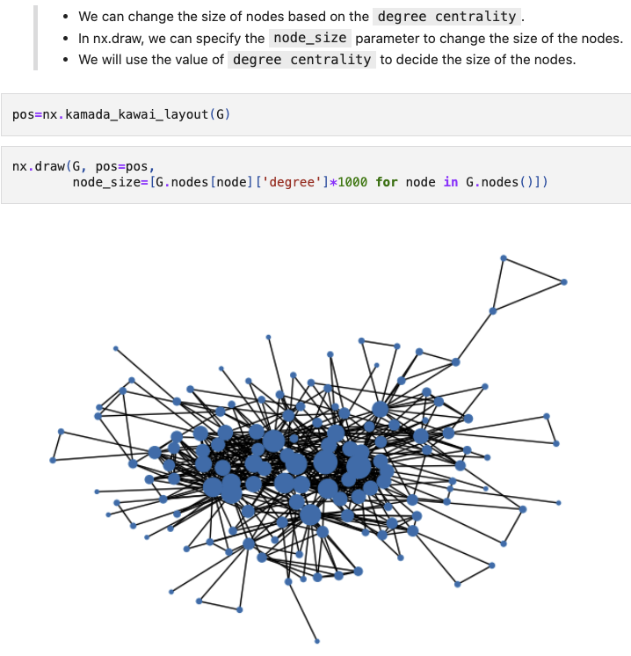
Node size (degree centrality)

Slide 25
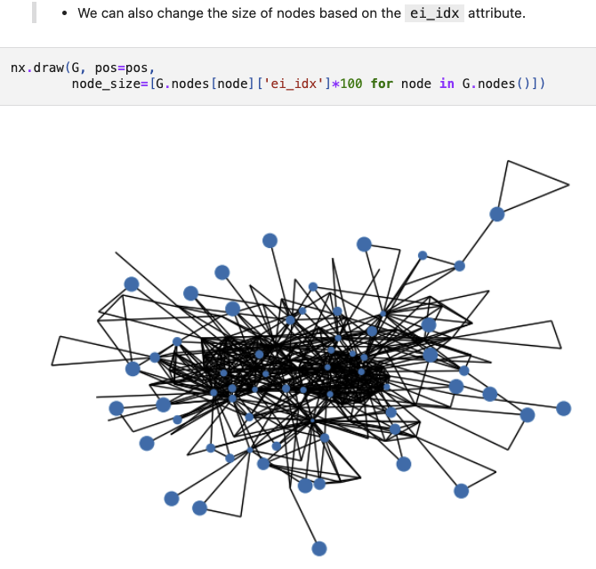
Node size (E-I index)

Slide 26
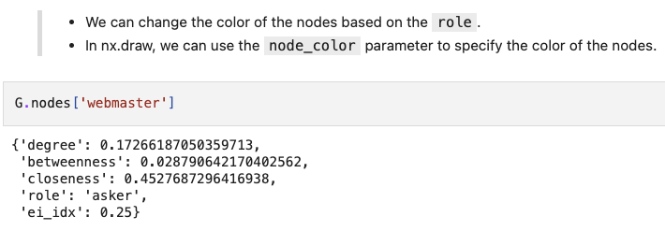
Node color (role)

Slide 27
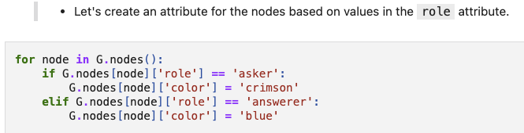
Node color (role)

Slide 28
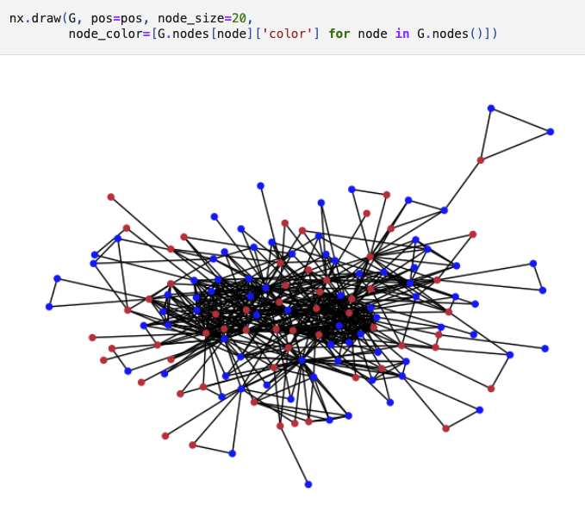
Node color (role)

Slide 29
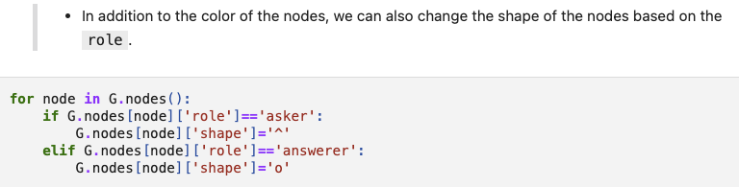
Node shape (role)

Slide 30
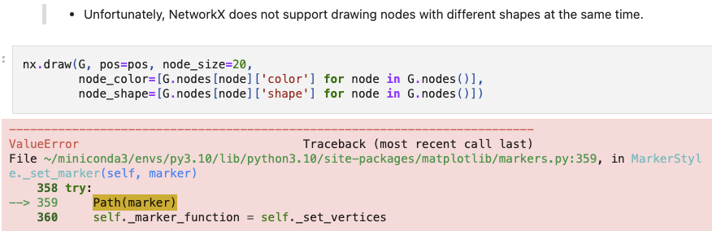
Node shape (role)

Slide 31
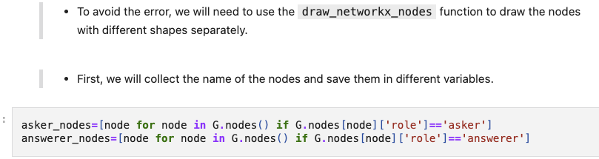
Node shape (role)

Slide 32
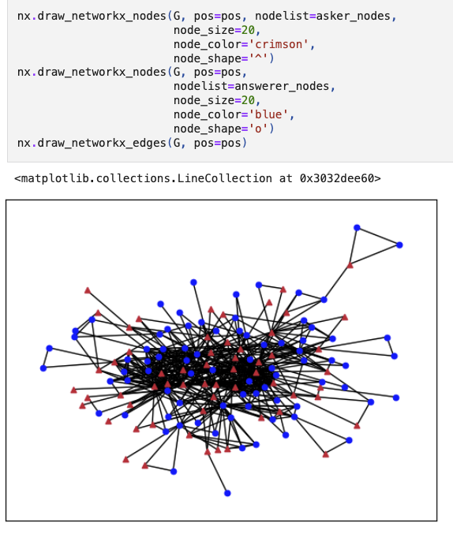
Node shape (role)

Slide 33
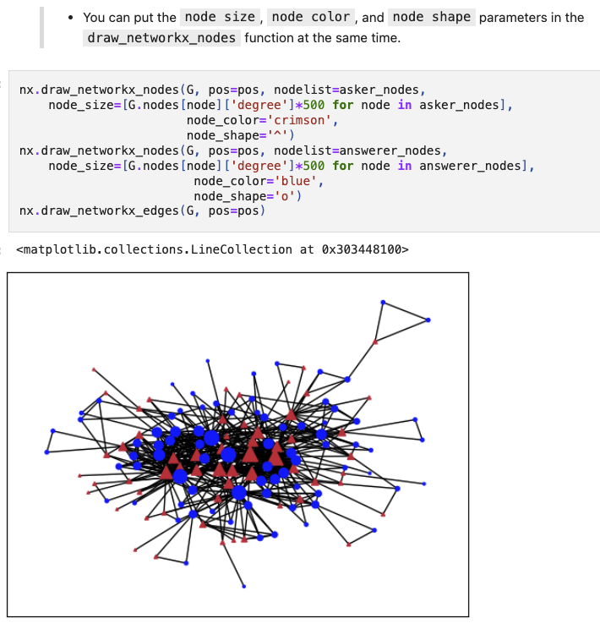
Node size, color, shape

Slide 34
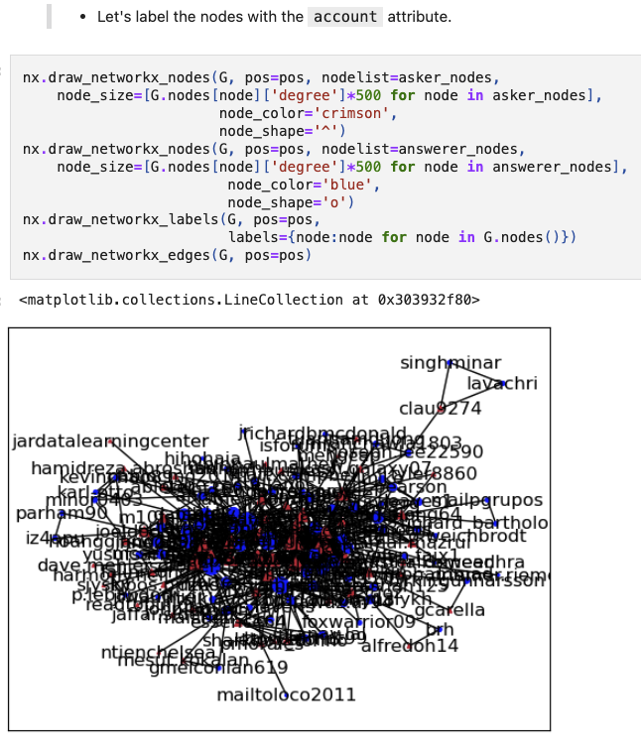
Node label

Slide 35
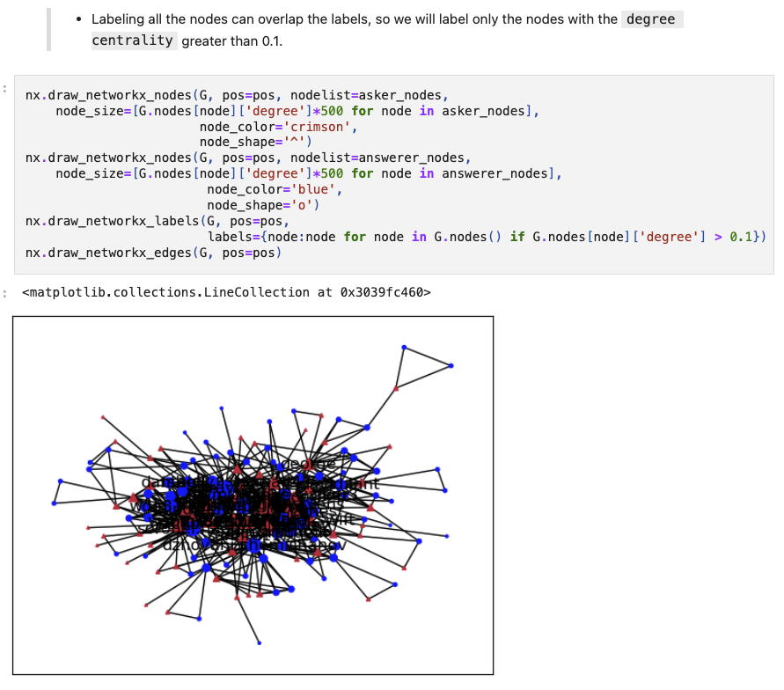
Node label

Slide 36
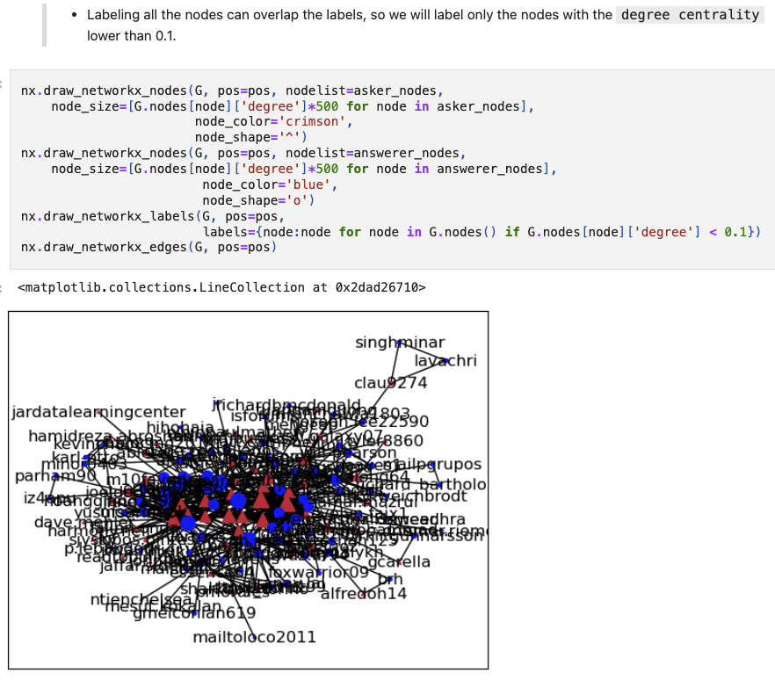
Node label

