Slide 1
Social Network Analysis IS 324
Feb 18, 2024
Jaihyun Park

Slide 2
Let’s keep working on the week 5 practice
social-media.ipynb from week 5 folder
At the bottom of the Jupyter Notebook, there is practice.

Slide 3
Week 5 practice solution

Slide 4
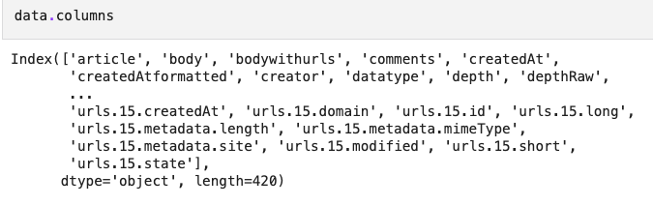
.columns to check columns

Slide 5
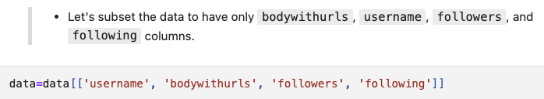
Subsetting dataframe

Slide 6
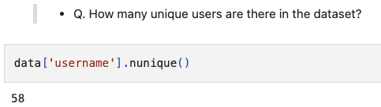
.nunique()

Slide 7
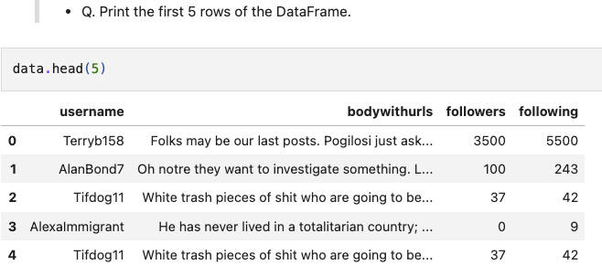
.head() to print first few rows

Slide 8
There are duplicates

Slide 9
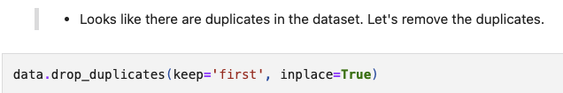
.drop_duplicates() to remove duplicates

Slide 10
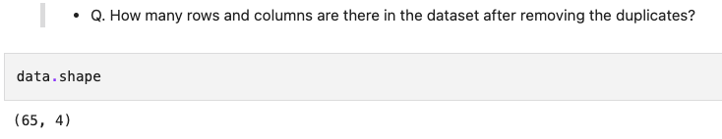
.shape() to check number of rows and columns

Slide 11
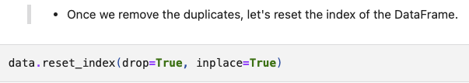
.reset_index() to reset index number

Slide 12
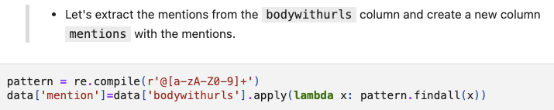
Regex

Slide 13
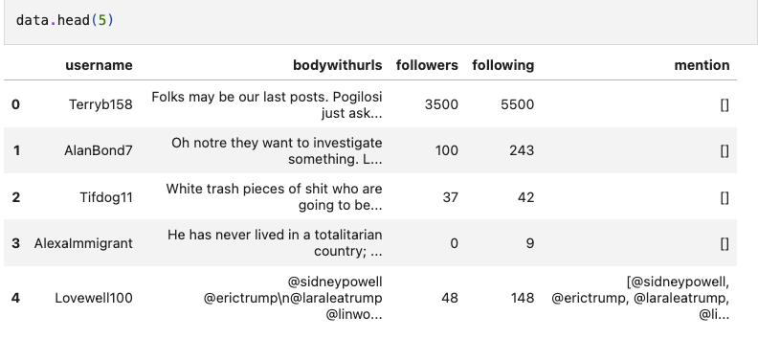
Check mention column

Slide 14
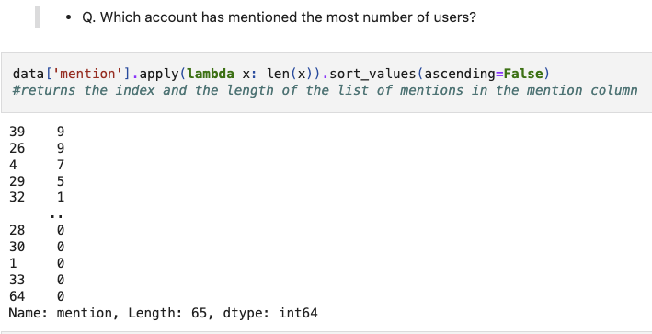
Lambda x: len(x)

Slide 15

Index number 39

Slide 16
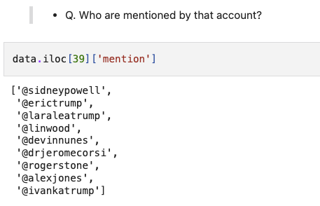
.iloc[]

Slide 17
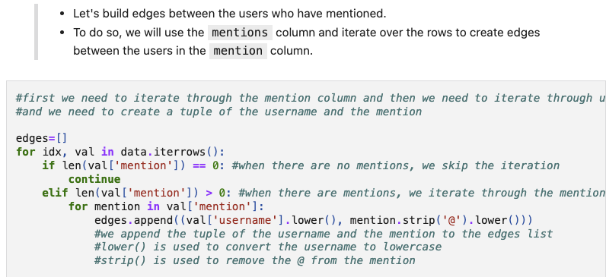
Building edges

Slide 18
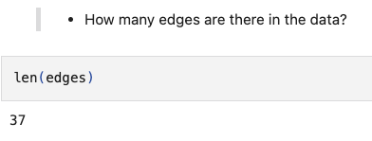
len()

Slide 19
Email network
Email communication can be represented in graph objects.
Another feature we can think about is a thread (reply emails).
In this email network practice, we will do (1) text mining, and (2) build networks.

Slide 20
Feather file
Instead of using pd.read_csv, we will use pd.read_feather
Feather file is a light and faster way of storing dataframe.
For more information: https://github.com/wesm/feather
There may be other required libraries such as pyarrow for feather files
pip install feather-format

Slide 21
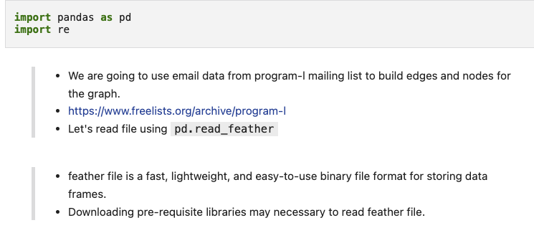
Import libaraies

Slide 22

pd.read_feather()

Slide 23
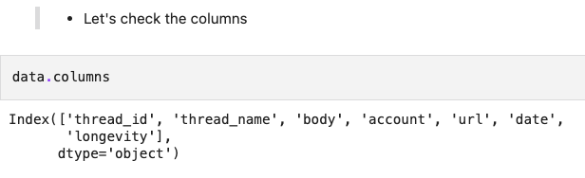
.columns

Slide 24
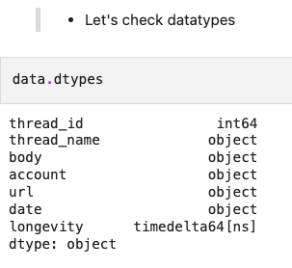
.dtypes

Slide 25
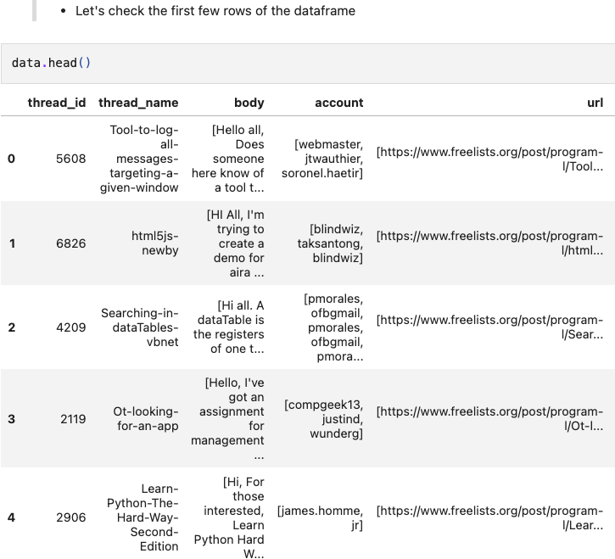
.head()

Slide 26
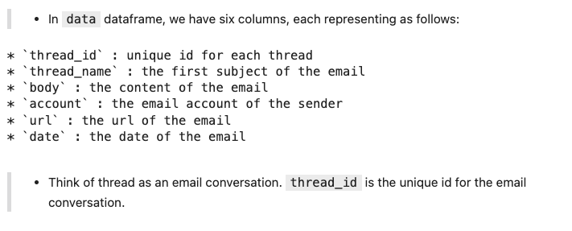
columns

Slide 27
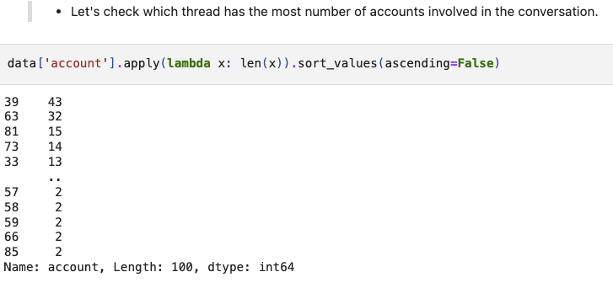
lambda x: len(x)

Slide 28
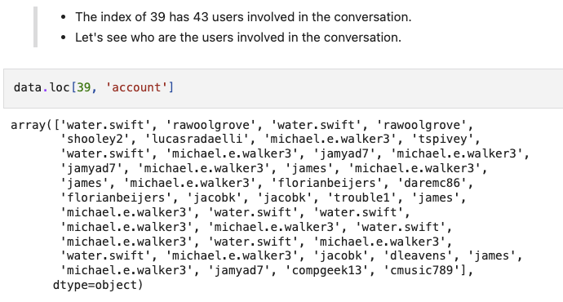
Who is mentioned by the account mentioning most?

Slide 29
Some users are repeating

Slide 30
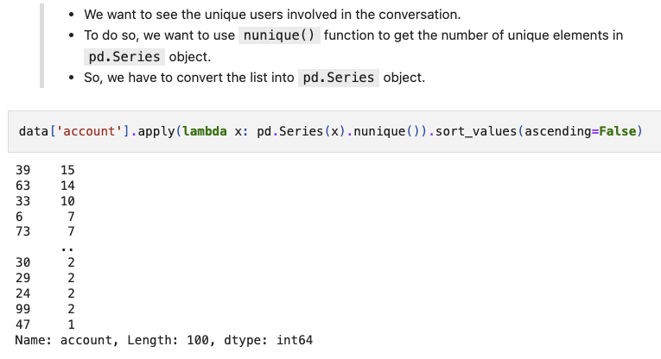
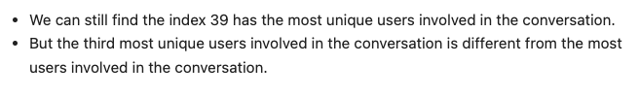
nunique() can only be used on pd.Series object.

Slide 31
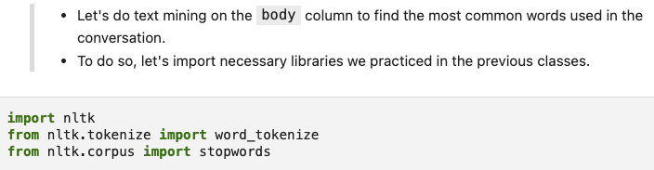
nltk libraries for text mining!

Slide 32
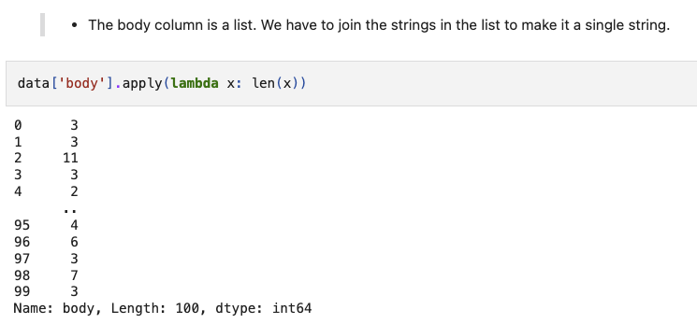
List object in body column

Slide 33
join() all strings in body column

Slide 34
Preprocessing body column

Slide 35
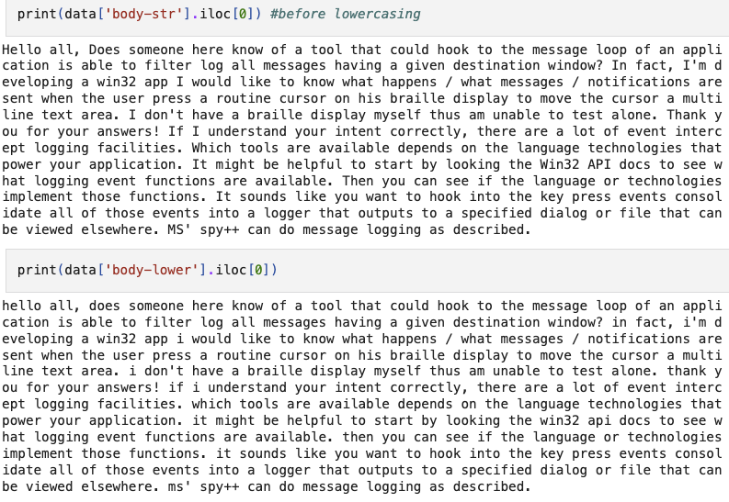
Compare results before lowercasing and after lowercasing

Slide 36
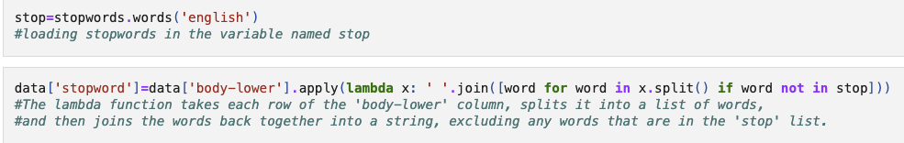
Removing stopwords

Slide 37
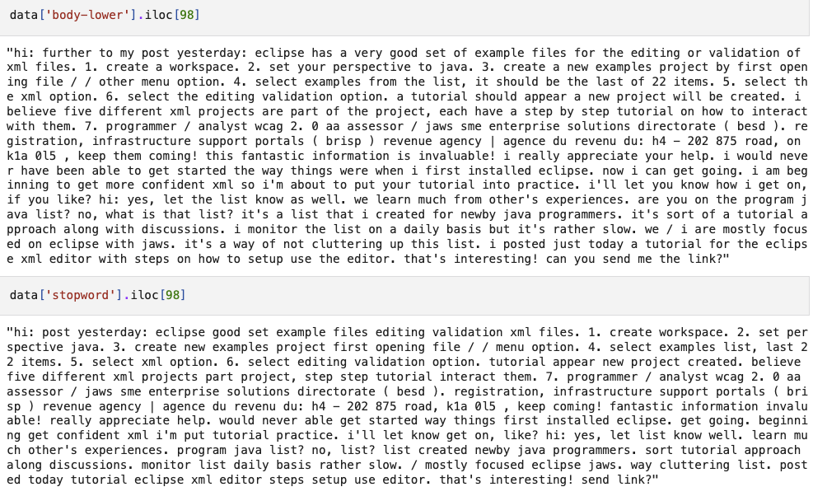
Compare results

Slide 38
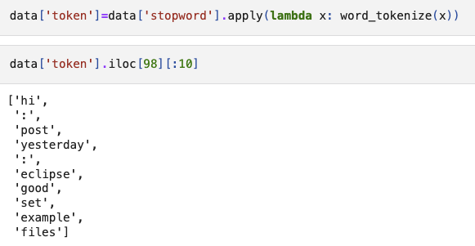
Tokenization

Slide 39
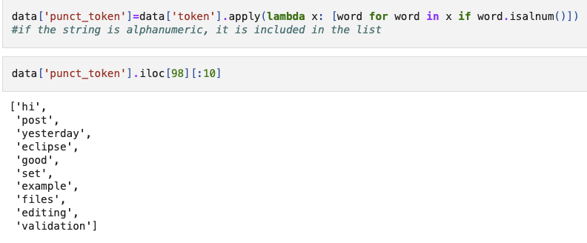
Getting rid of punctuation

Slide 40
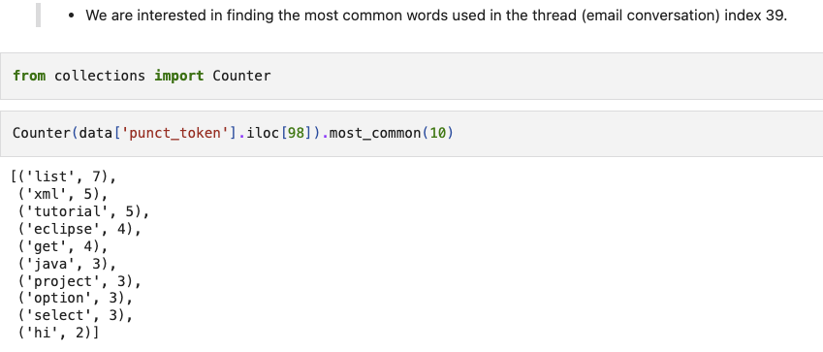
What words are most frequent in the thread that has the most number of users involved?

Slide 41
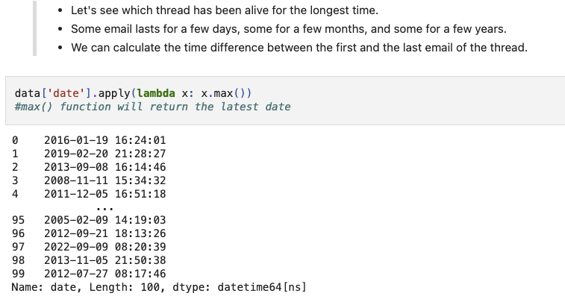
Date column

Slide 42
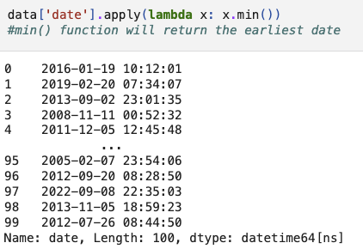
max() for the latest and min() for the earliest

Slide 43
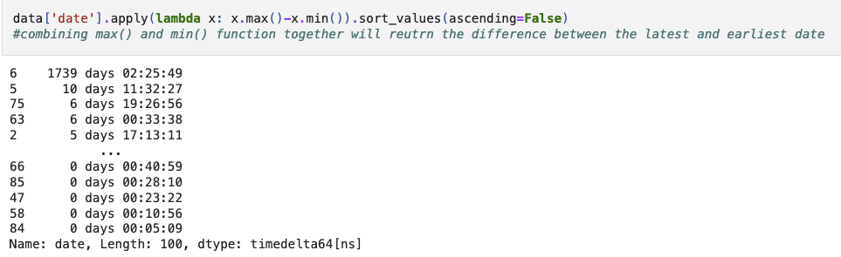
The longest duration of a conversation

Slide 44
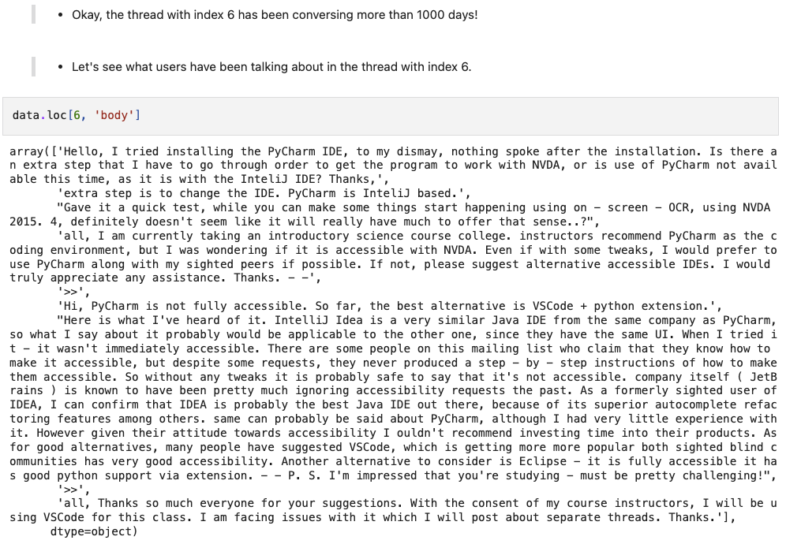
Index 6 has been conversing more than 1000 days! What are they talking?

Slide 45
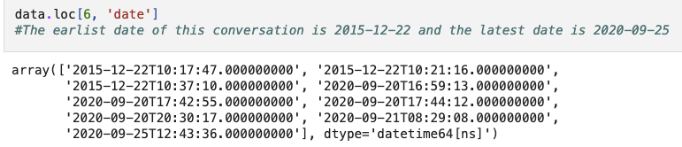
2015 VS. 2020

Slide 46
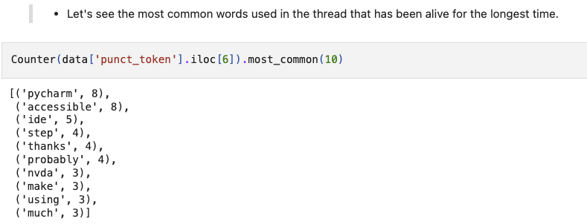
The most frequent words in the thread that has been conversed for the longest time

Slide 47
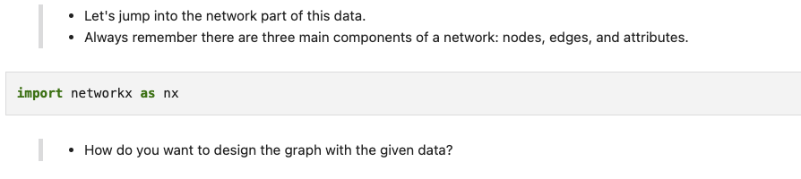
Q. How would you model the thread?

Slide 48
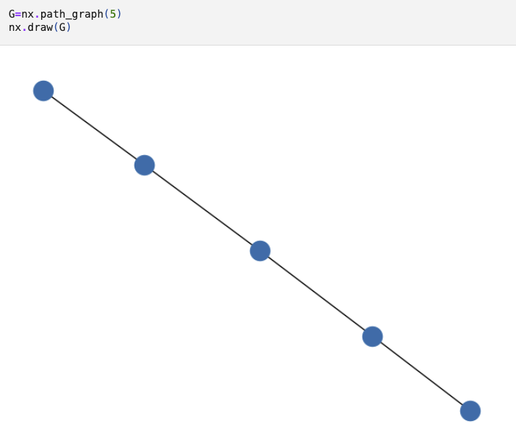
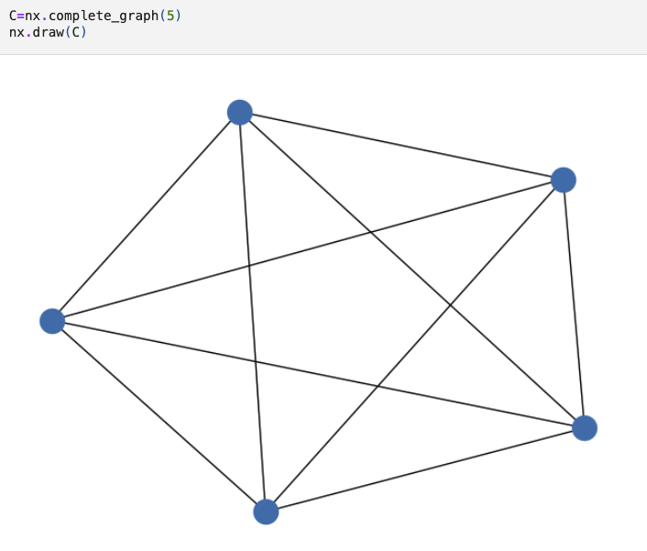
Q. How would you model the thread?

Slide 49
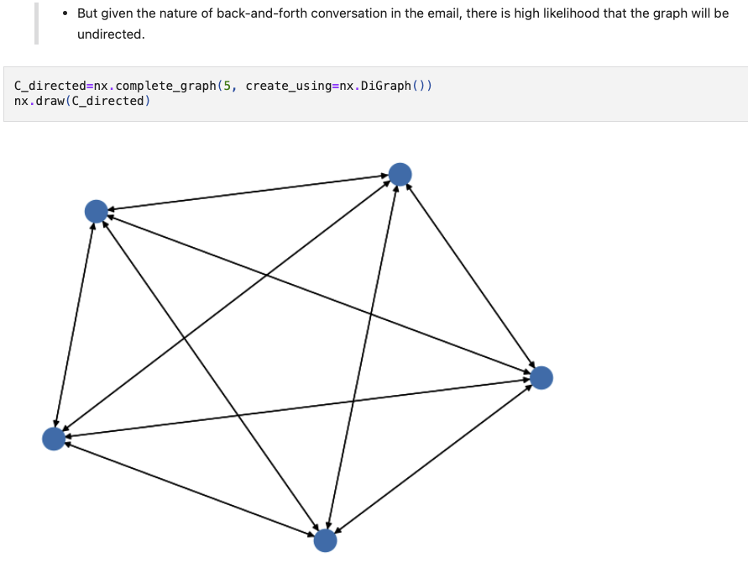
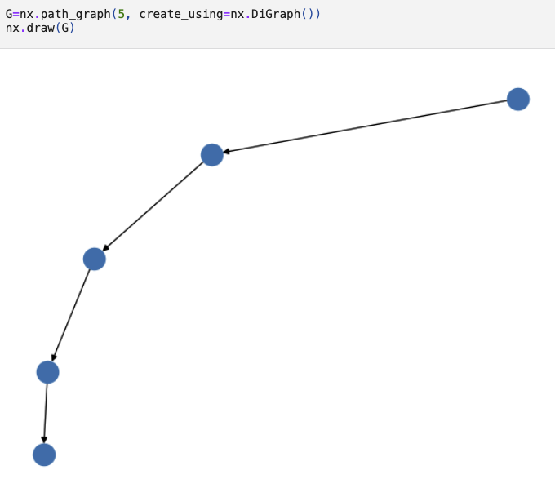
Q. Directionality?

Slide 50
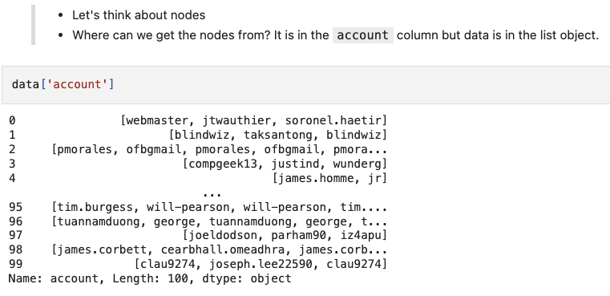
Nodes

Slide 51
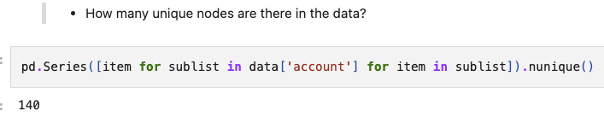
Unique nodes

Slide 52
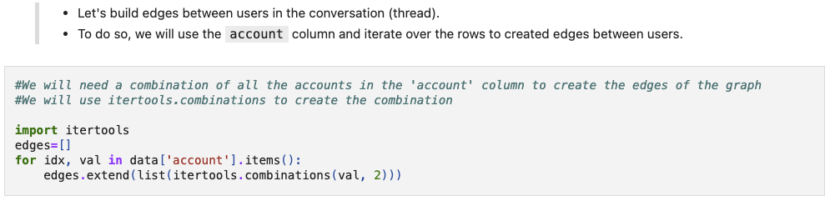
combination

Slide 53
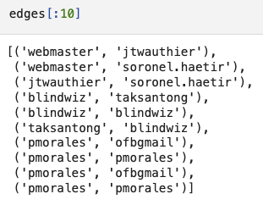
Edges

Slide 54
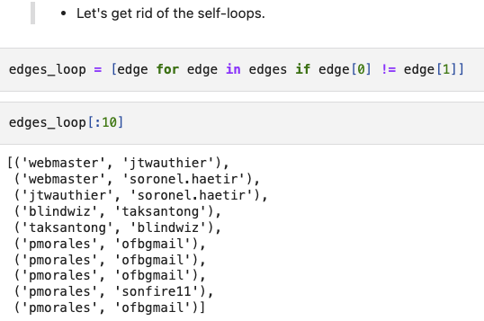
Getting rid of self-loops

Slide 55
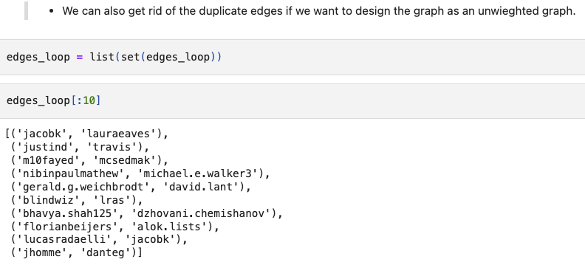
Unweighted graph

Slide 56
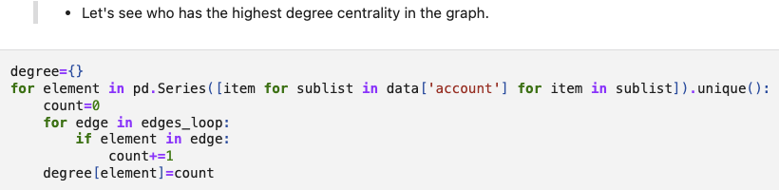
Highest degree centrality

Slide 57
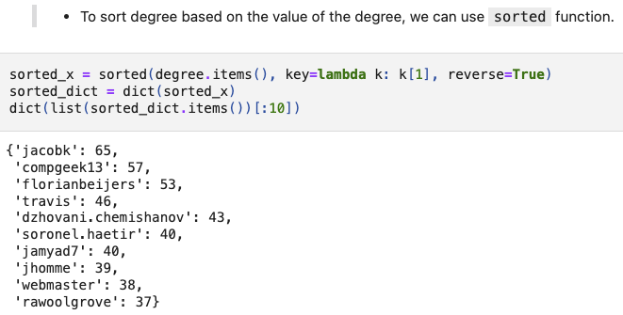
Sorting dictionary

Slide 58
Divide degree by (unique number of nodes -1)

Slide 59
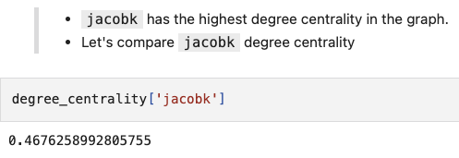
Degree centrality results

