Slide 1

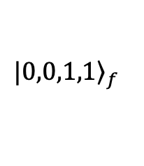

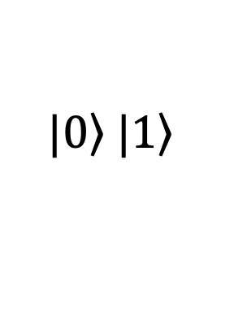

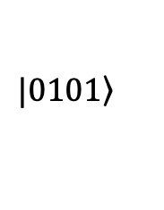
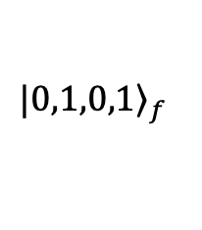
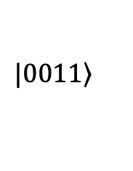
$$|{\left.0,1,0,1\right\rangle }_{f}$$
$$|{\left.0,0,1,1\right\rangle }_{f}$$
$$\left.|0\right\rangle \left.|1\right\rangle$$
$$|{\left.0101\right\rangle }_{ }$$
Fermionic System
${ℋ_{f}=a}_{1}^{†}a_{1}+a_{2}^{†}a_{2}+…$
$$|{\left.0011\right\rangle }_{ }$$
Fermion-to-Qubit Mapping
Qubit System
$$ℋ=XZYI+ZZZZ+…$$
Quantum Compilation
Quantum Circuits
$$R(θ)$$

Slide 2
Anticommutativity
Vacuum State Preservation
Algebraic Independence
Hamiltonian Pauli Weight
Full SAT (Sec. 3)
SAT + Annealing, Ignore Alg. (Sec. 4)
SAT Solver
Boolean Clauses
Encoding

Slide 3

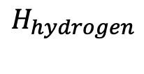
Bravyi-Kitaev
Quantum Circuit Compilation
-
Paulihedral
+
+
$$R(θ)$$
-
$$XXYY,XYZZ,…$$
$$H_{hydrogen}$$
Qiskit
Our Method
VQE
Fermion-to-Qubit Mapping

