Slide 1
Schibsted Coding Challenge 2023
Rating system to make transactions smoother and fight scams
Alba Castaño, Margot DeMaulmont, Roope Vuorenlehto & André Backman

Slide 2
Why?
Improve user experience
Reduce no-shows and cancellations
Reduce the risk of being scammed
Reward serious/honest users

Slide 6
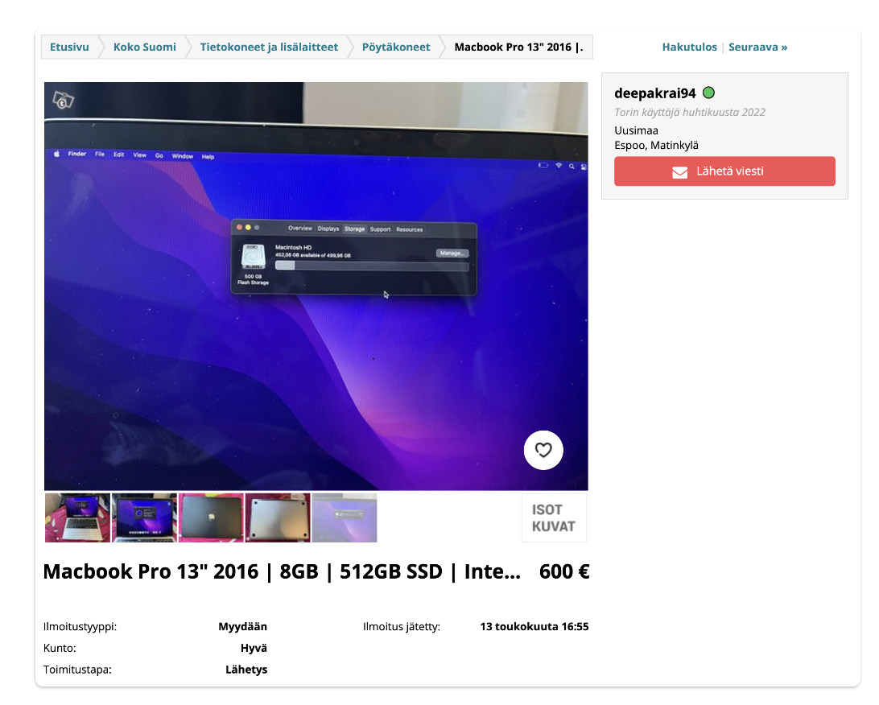
Score is shown in colour

Slide 7
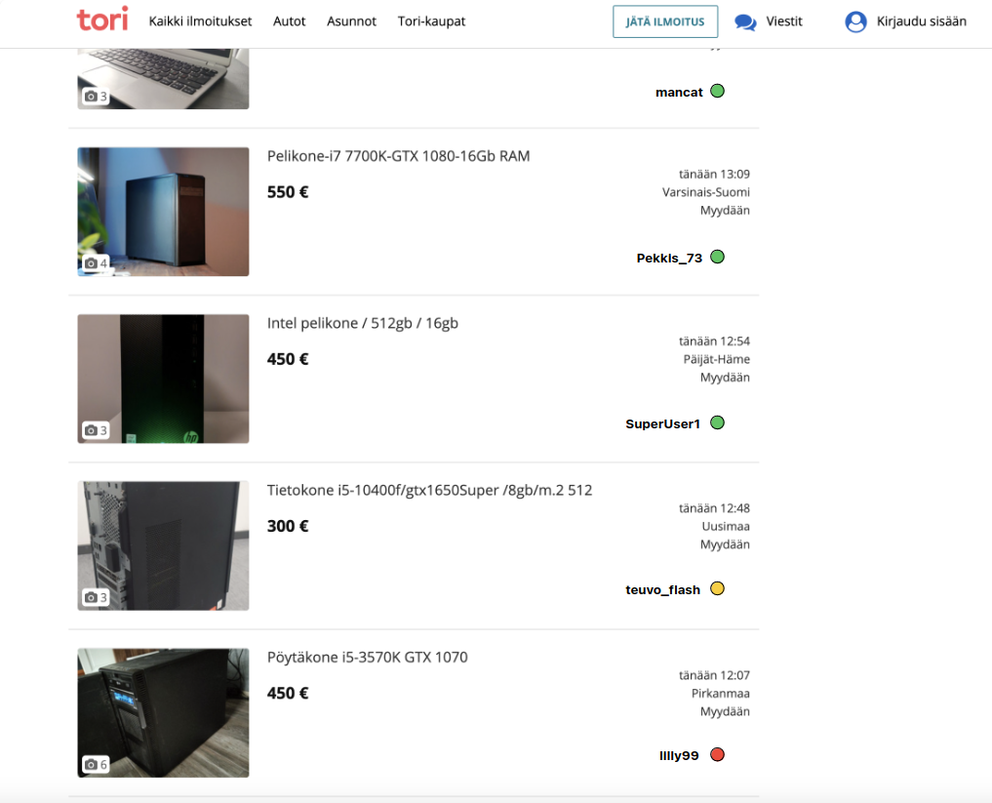
Listings sorted by user rating

Slide 8
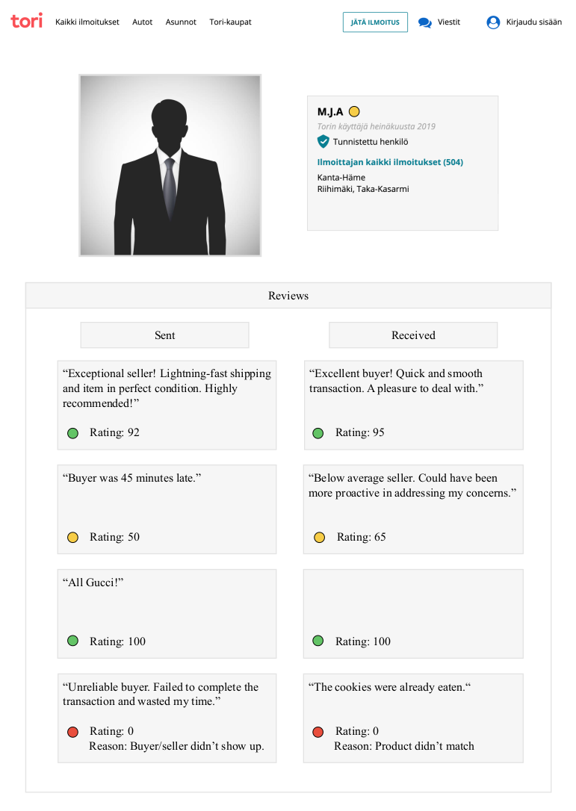
Example of a user’s profile page

