Slide 1
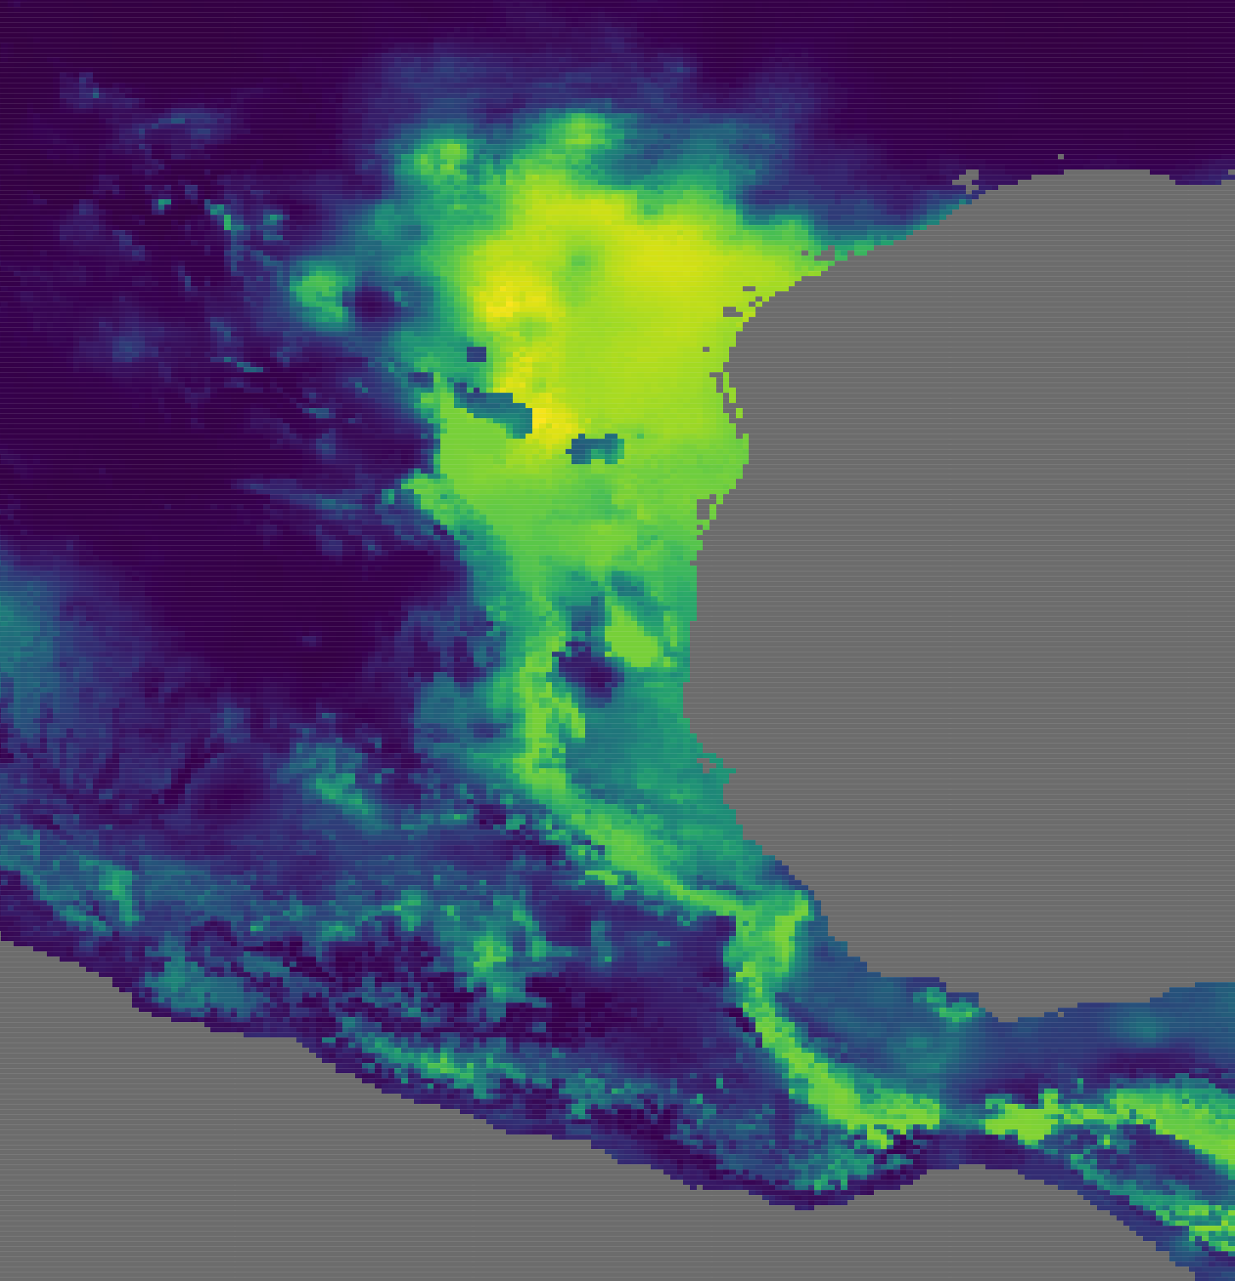
Ecological niche modeling in R: Tips, tricks, and pitfalls
Adrian A. Castellanos
OSOS 2018 Sept. 1

Slide 2
What is an ecological niche model (ENM)?
ENMs predict the abiotic suitability of a species within a range
Require occurrence data, abiotic data, and an algorithm
Recent research is exploring using biotic data in models to improve predictions
Can be broken up into two broad categories:
Presence-only
Presence absence
Can hindcast to past distributions and forecast future distributions based on climate predictions

Slide 3
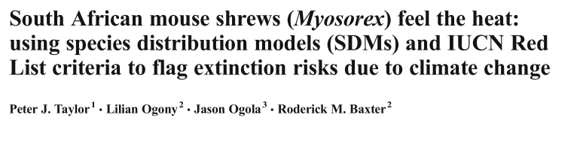

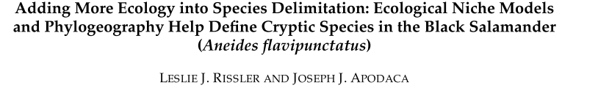
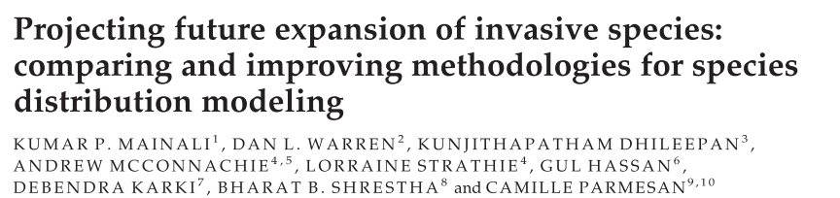
What do people use ENMs for?

Slide 4
Why use R for ENMs?
There is a lot of support as far as packages go (dismo, gbm, maxnet, ENMeval, etc.)
It’s a “one stop shop”
Gather/organize your data, run a model, analyze your data, and visualization in one place
All the “cool” kids are doing it
Using R is the point of this workshop

Slide 5
Module Outline
Gather and prepare species occurrence data
Gather raster data of your chosen bioclimatic variables
Gather background (also called pseudo-absence) data
Building a model (we will use BIOCLIM for our purposes)
Evaluating your model
Additional information
Filtering localities
Removing highly correlated variables
Model comparison
Maxent and Boosted Regression Trees

Slide 6

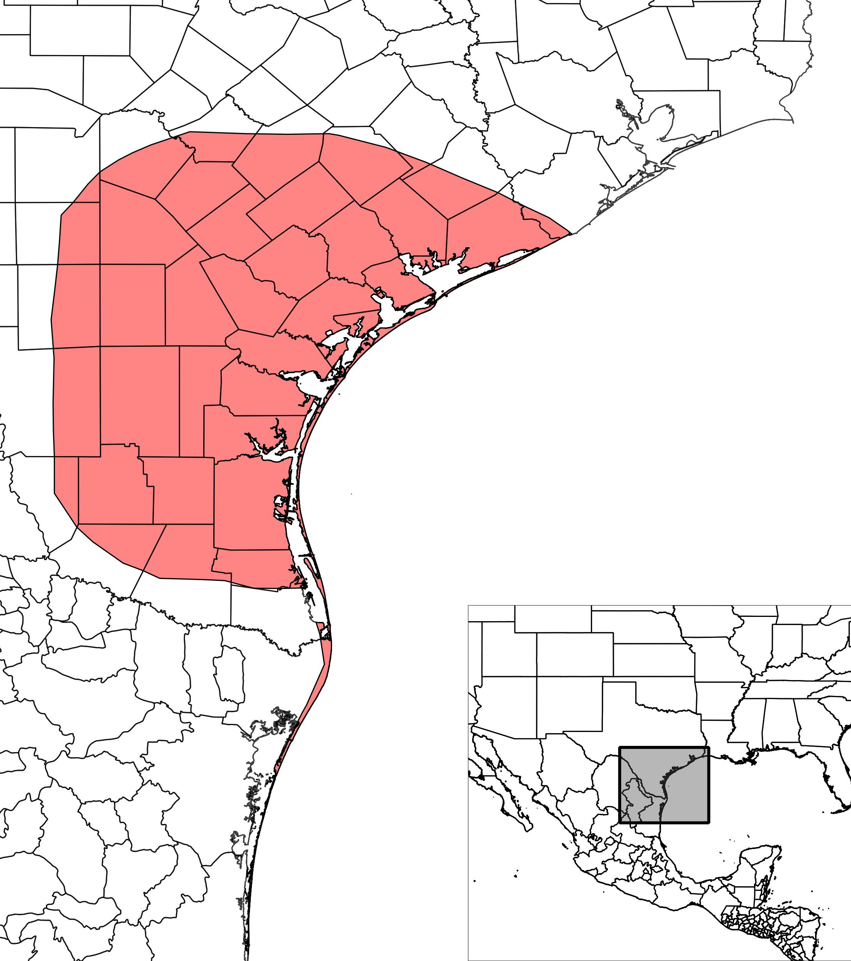
Our example species today!
Dipodomys compactus (Gulf Coast Kangaroo Rat)

Slide 7
What to keep in mind while gathering occurrence data
Save data without coordinates to georeference later
Make sure that records are located where they should be (county, state, country)
Keep in mind the range of your species
Do you trust the sources you are gathering information from?

Slide 8
Does algorithm choice matter?
Yes!
If you have low numbers of presence points, Maxent is your best friend
Numerous machine learning methods (Maxent, random forests, boosted regression trees, etc.) are shown to most of the time outperform older methods
ALSO, be aware of parameter choice
Defaults are not always the best choice!

Slide 9
How do I evaluate my model?
Highly contentious question
Cross validation is often used
Can use AIC for parameter choice
Main statistics I’ve seen are AUC, omission rate, kappa, and the true skills statistic (TSS)

