Slide 1
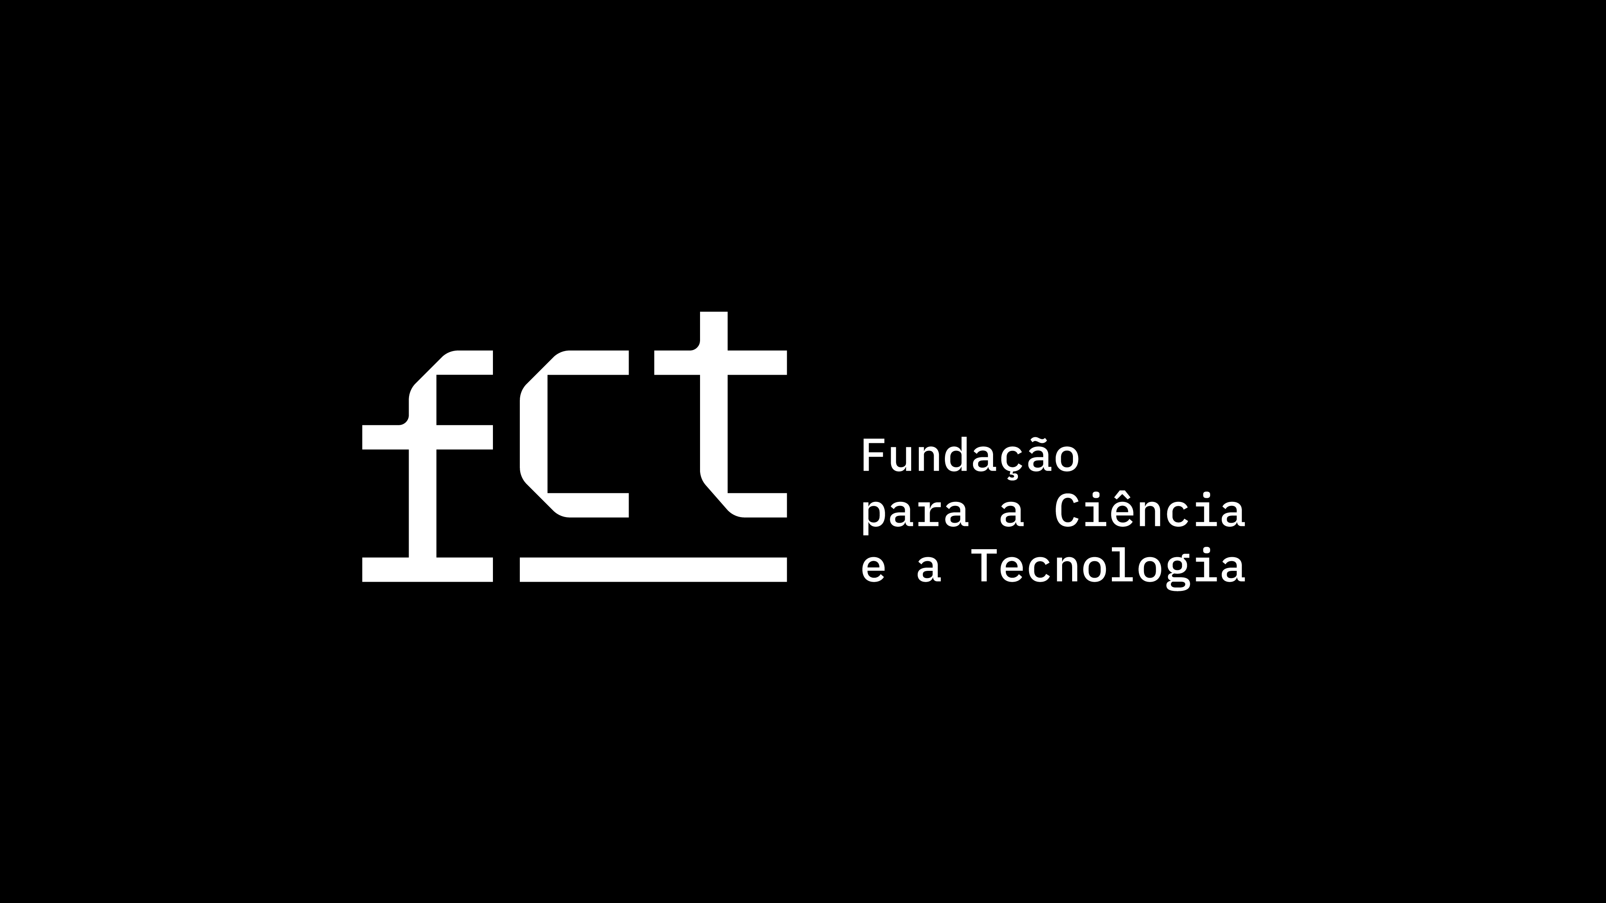

Proof Search in Classical Propositional Logic with Partial Proof Terms
José Espírito Santo and Ana Catarina Sousa
CMAT– University of Minho
WoLLIC 2025 @ Porto
16th July 2025
Notes:
3 parts
*Partial Proof Terms*

Slide 2
1
Motivation & Partial Proof Terms
WoLLIC @ 2025
Proof Search in Classical Propositional Logic with Partial Proof Terms

Slide 3
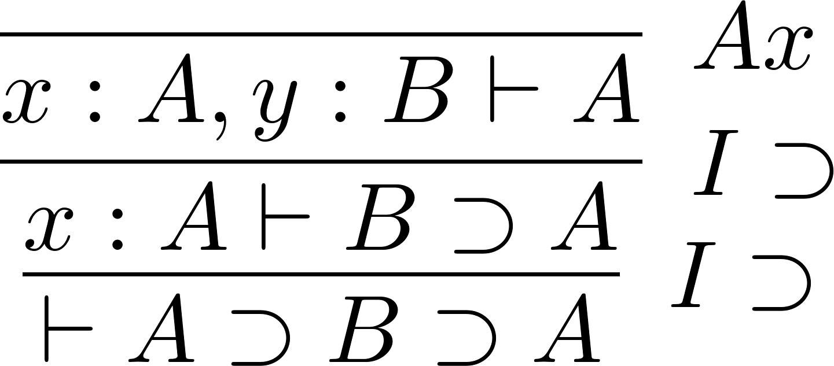
Finished Proof
WoLLIC @ 2025
Motivation & Partial Proof Terms
4

Slide 4
Finished Proof
Curry
Howard Isomorphism
WoLLIC @ 2025
Motivation & Partial Proof Terms
4

Slide 5
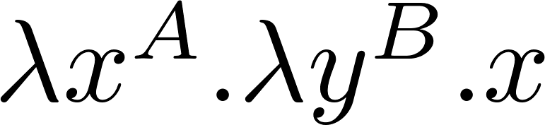
Finished Proof
Proof Term
Curry
Howard Isomorphism
WoLLIC @ 2025
Motivation & Partial Proof Terms
4

Slide 6
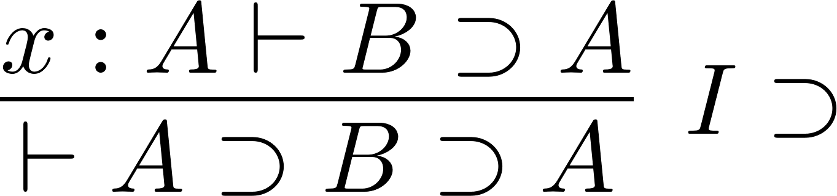
Unfinished Proof
?
WoLLIC @ 2025
Motivation & Partial Proof Terms
5

Slide 7
Unfinished Proof
?
WoLLIC @ 2025
Motivation & Partial Proof Terms
5

Slide 8
Unfinished Proof
?
?
WoLLIC @ 2025
Motivation & Partial Proof Terms
5

Slide 9
Unfinished Proof
?
CICM @ 2024 *
* Espírito Santo, J., Sousa, A.C. (2024). Partial Proof Terms in the Study of Idealized Proof Search.
WoLLIC @ 2025
Motivation & Partial Proof Terms
5

Slide 10
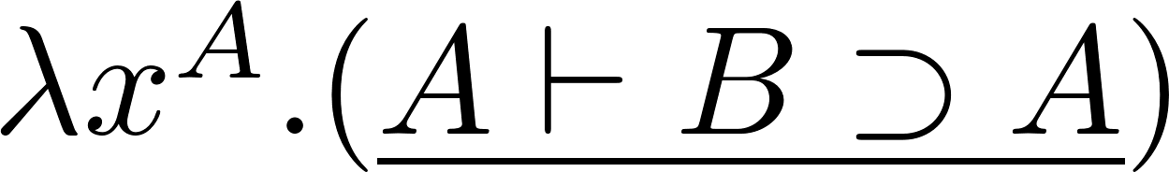
Unfinished Proof
Partial
Proof Term
?
CICM @ 2024 *
* Espírito Santo, J., Sousa, A.C. (2024). Partial Proof Terms in the Study of Idealized Proof Search.
WoLLIC @ 2025
Motivation & Partial Proof Terms
5

Slide 11
Unfinished Proof
Partial
Proof Term
?
CICM @ 2024 *
Formal Sequents
* Espírito Santo, J., Sousa, A.C. (2024). Partial Proof Terms in the Study of Idealized Proof Search.
WoLLIC @ 2025
Motivation & Partial Proof Terms
5
Notes:
Formal sequents, - sequents occuring as components of proof terms;

Slide 12
Unfinished Proof
Partial
Proof Term
?
CICM @ 2024 *
Formal Sequents
Proof Search as Rewriting
* Espírito Santo, J., Sousa, A.C. (2024). Partial Proof Terms in the Study of Idealized Proof Search.
WoLLIC @ 2025
Motivation & Partial Proof Terms
5

Slide 13
Unfinished Proof
CICM @ 2024 *
Partial
Proof Term
?
CICM @ 2024 *
Formal Sequents
Proof Search as Rewriting
Idealized Proof Search
* Espírito Santo, J., Sousa, A.C. (2024). Partial Proof Terms in the Study of Idealized Proof Search.
WoLLIC @ 2025
Motivation & Partial Proof Terms
5
Notes:
THEORETICAL study of proof search without considerations of
control,
effectiveness
implementation.

Slide 14
CICM @ 2024 *
Intuitionistic Logic
* Espírito Santo, J., Sousa, A.C. (2024). Partial Proof Terms in the Study of Idealized Proof Search.
WoLLIC @ 2025
Motivation & Partial Proof Terms
6

Slide 15
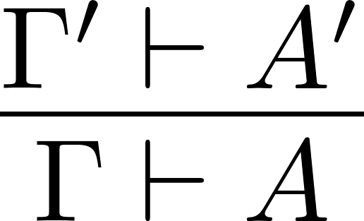
CICM @ 2024 *
Intuitionistic Logic
Sequent Calculus LJT
* Espírito Santo, J., Sousa, A.C. (2024). Partial Proof Terms in the Study of Idealized Proof Search.
WoLLIC @ 2025
Motivation & Partial Proof Terms
6

Slide 16
CICM @ 2024 *
Intuitionistic Logic
Sequent Calculus LJT
Natural Deduction NJT
* Espírito Santo, J., Sousa, A.C. (2024). Partial Proof Terms in the Study of Idealized Proof Search.
WoLLIC @ 2025
Motivation & Partial Proof Terms
6

Slide 17
CICM @ 2024 *
Intuitionistic Logic
?
Sequent Calculus LJT
Natural Deduction NJT
* Espírito Santo, J., Sousa, A.C. (2024). Partial Proof Terms in the Study of Idealized Proof Search.
WoLLIC @ 2025
Motivation & Partial Proof Terms
6

Slide 18
CICM @ 2024 *
Intuitionistic Logic
?
Sequent Calculus LJT
FOCUSING
Natural Deduction NJT
* Espírito Santo, J., Sousa, A.C. (2024). Partial Proof Terms in the Study of Idealized Proof Search.
WoLLIC @ 2025
Motivation & Partial Proof Terms
6

Slide 19

CICM @ 2024 *
Intuitionistic Logic
?
?
Sequent Calculus LJT
FOCUSING
Natural Deduction NJT
* Espírito Santo, J., Sousa, A.C. (2024). Partial Proof Terms in the Study of Idealized Proof Search.
WoLLIC @ 2025
Motivation & Partial Proof Terms
6

Slide 20
CICM @ 2024 *
Intuitionistic Logic
?
?
Sequent Calculus LJT
FOCUSING
Natural Deduction NJT
INTERCALATION
* Espírito Santo, J., Sousa, A.C. (2024). Partial Proof Terms in the Study of Idealized Proof Search.
WoLLIC @ 2025
Motivation & Partial Proof Terms
6

Slide 21

CICM @ 2024 *
Intuitionistic Logic
?
?
Sequent Calculus LJT
FOCUSING
Natural Deduction NJT
INTERCALATION
$$≅$$
* Espírito Santo, J., Sousa, A.C. (2024). Partial Proof Terms in the Study of Idealized Proof Search.
WoLLIC @ 2025
Motivation & Partial Proof Terms
6

Slide 22

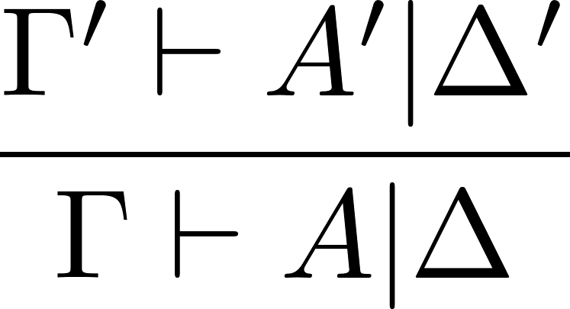
WoLLIC @ 2025
Classical Logic
Intuitionistic Logic
?
?
Sequent Calculus LJT
FOCUSING
Natural Deduction NJT
INTERCALATION
$$≅$$
WoLLIC @ 2025
Motivation & Partial Proof Terms
7

Slide 23
WoLLIC @ 2025
Classical Logic
Sequent Calculus
?
?
FOCUSING
INTERCALATION
$$≅$$
WoLLIC @ 2025
Motivation & Partial Proof Terms
7

Slide 24
WoLLIC @ 2025
Classical Logic
Sequent Calculus LKT
?
?
FOCUSING
INTERCALATION
$$≅$$
WoLLIC @ 2025
Motivation & Partial Proof Terms
7

Slide 25
WoLLIC @ 2025
Classical Logic
Sequent Calculus LKT
?
?
FOCUSING
INTERCALATION
Natural Deduction
$$≅$$
WoLLIC @ 2025
Motivation & Partial Proof Terms
7

Slide 26
WoLLIC @ 2025
Classical Logic
Sequent Calculus LKT
?
?
FOCUSING
INTERCALATION
Natural Deduction NKT
$$≅$$
WoLLIC @ 2025
Motivation & Partial Proof Terms
7

Slide 27
WoLLIC @ 2025
Classical Logic
Sequent Calculus LKT
?
?
FOCUSING
INTERCALATION
FOCUSING
INTERCALATION
Natural Deduction NKT
$$≅$$
WoLLIC @ 2025
Motivation & Partial Proof Terms
7

Slide 28

WoLLIC @ 2025
Classical Logic
Sequent Calculus LKT
?
?
FOCUSING
INTERCALATION
$$≅$$
FOCUSING
INTERCALATION
Natural Deduction NKT
$$≅$$
WoLLIC @ 2025
Motivation & Partial Proof Terms
7
Notes:
Understand if the isomorphism extends to classical logic

Slide 29
2
LKT & Focusing
WoLLIC @ 2025
Proof Search in Classical Propositional Logic with Partial Proof Terms

Slide 30

Roadmap
Proof Search as Normalization
Define a Sequent Calculus LKT
Define Focusing Reduction Rules
Define a Partial Sequent Calculus ${LKT}_{∂}$
Add Proof Terms
to LKT
Focusing
(with words)
Finished Proofs
Proof Search
Partial Proofs
WoLLIC @ 2025
LKT & Focusing
9
Notes:
Overview - have a big picture

Slide 31
LKT
Define a Sequent Calculus LKT
WoLLIC @ 2025
LKT & Focusing
10

Slide 32
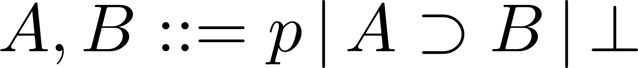
LKT
Formulas
WoLLIC @ 2025
LKT & Focusing
10
Notes:
PROPOSITIONAL VARS
absurdity

Slide 33
LKT
Formulas
Sequents
WoLLIC @ 2025
LKT & Focusing
10

Slide 34
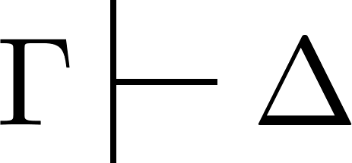
LKT
Formulas
Sequents
WoLLIC @ 2025
LKT & Focusing
10
Notes:
Gamma - set of pairs (variable, formula)
Delta - set of pairs (co-variable, formula)

Slide 35

LKT
Formulas
Sequents
WoLLIC @ 2025
LKT & Focusing
10
Notes:
Selected conclusion on the RHS

Slide 36

LKT
Formulas
Sequents
WoLLIC @ 2025
LKT & Focusing
10
Notes:
Focused formula on the LHS

Slide 37
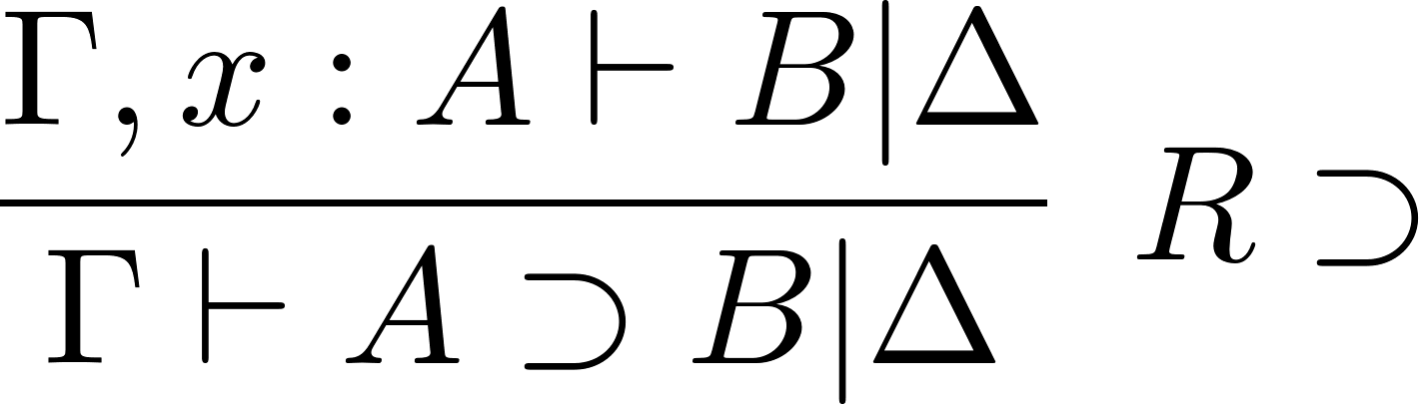
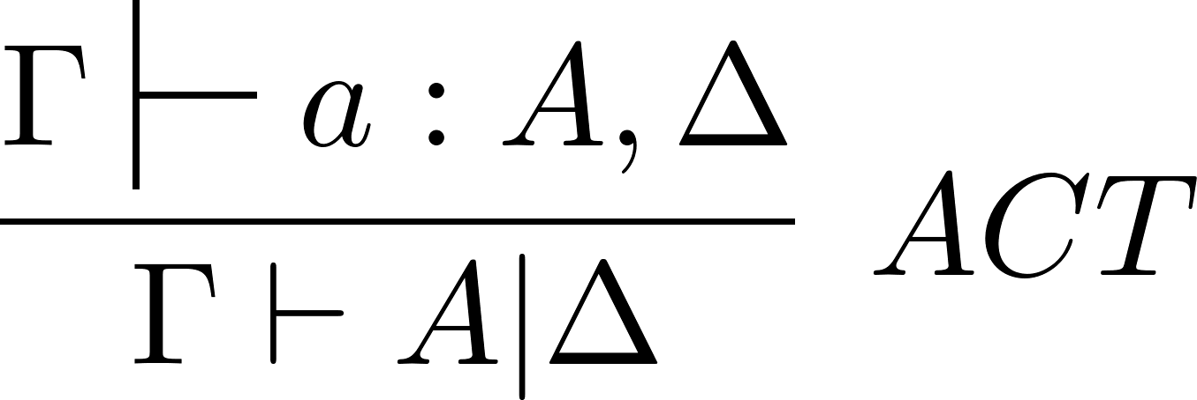
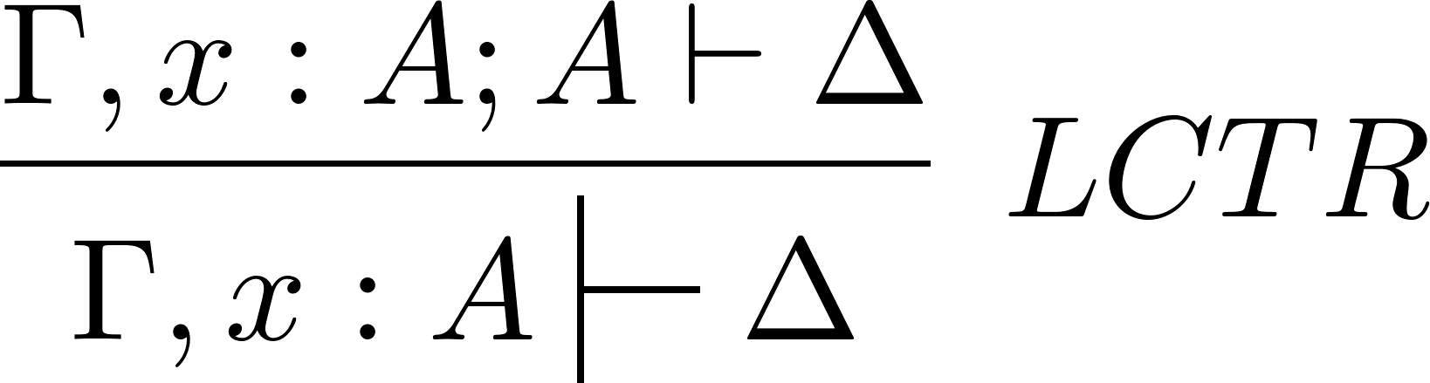
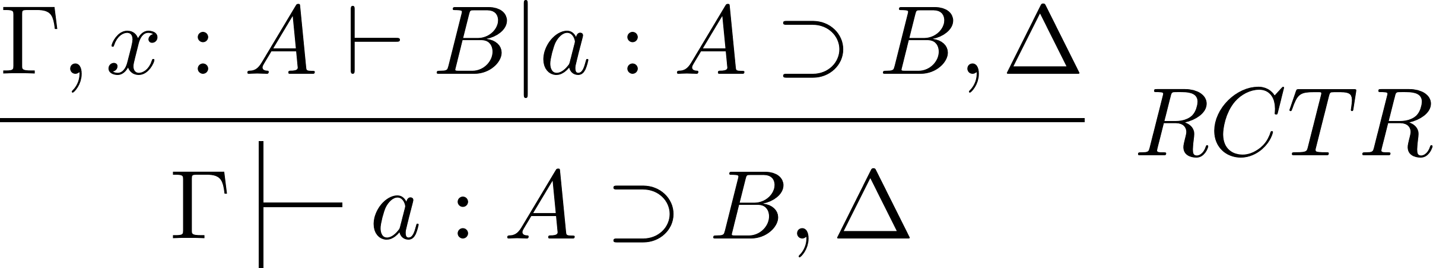
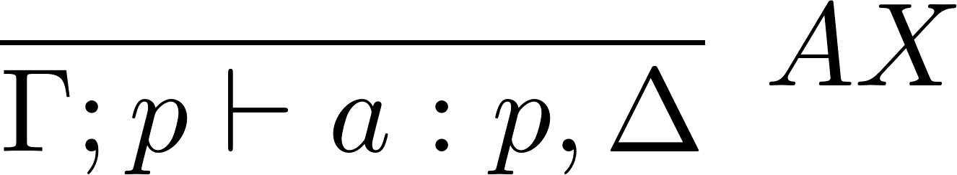
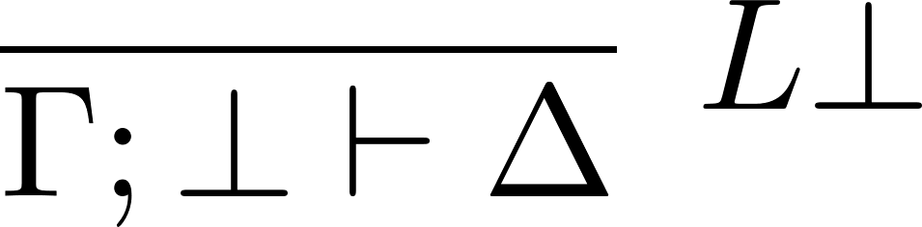
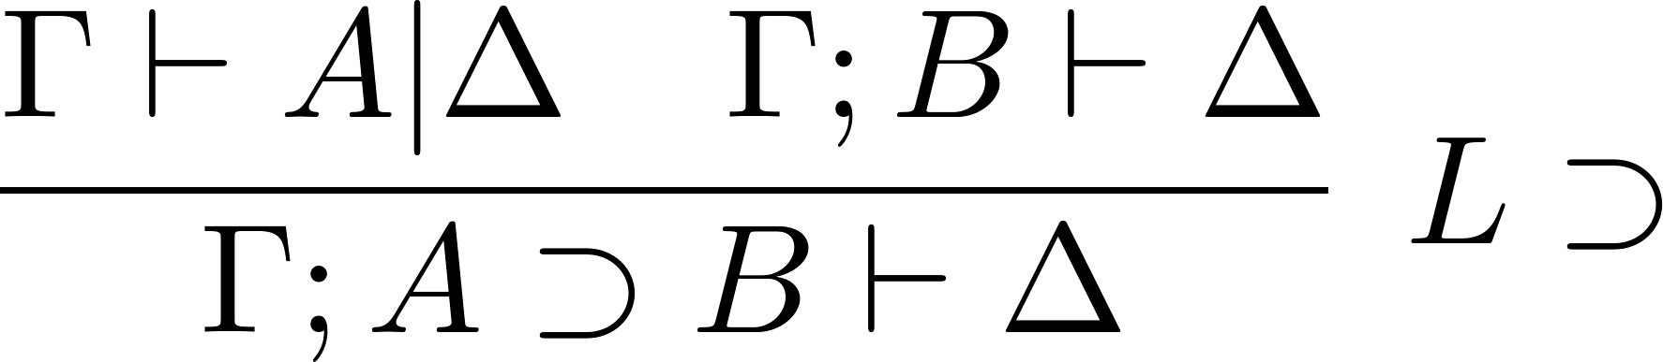
LKT
Formulas
Inference Rules
Sequents
WoLLIC @ 2025
LKT & Focusing
10
Notes:
RCTR - A \imp B introduced and then contracted

Slide 38
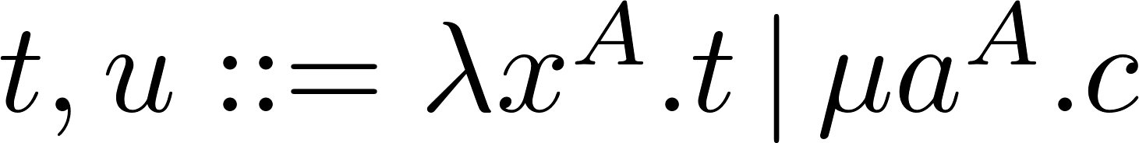
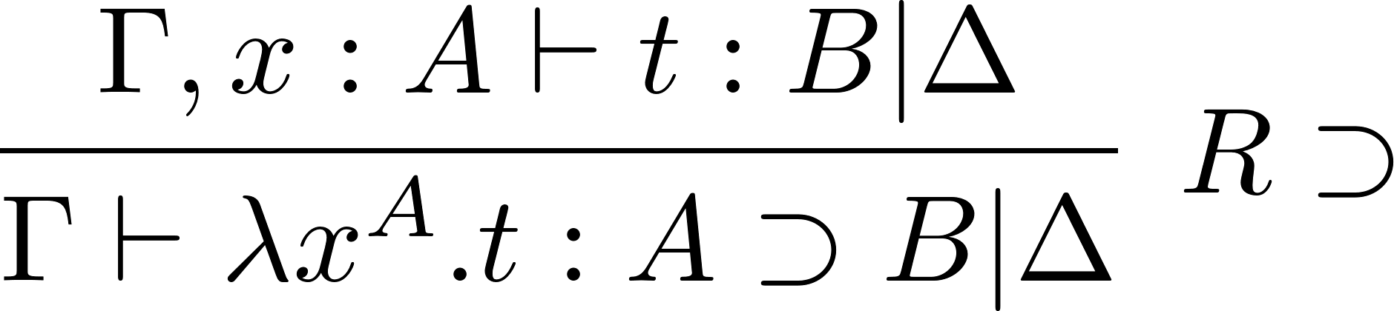
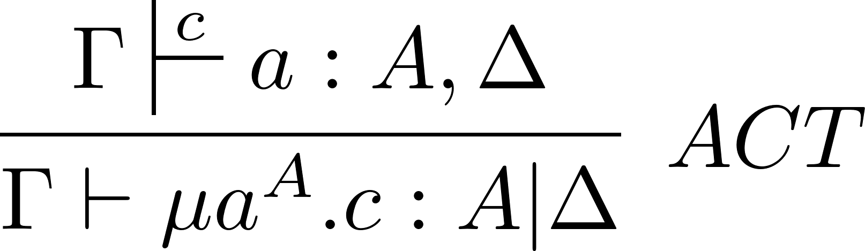
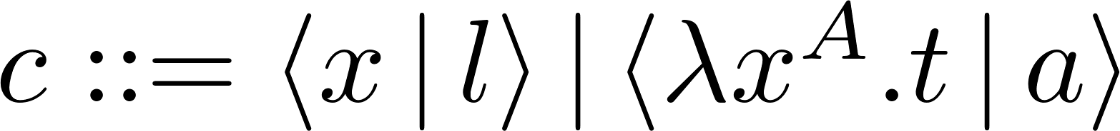
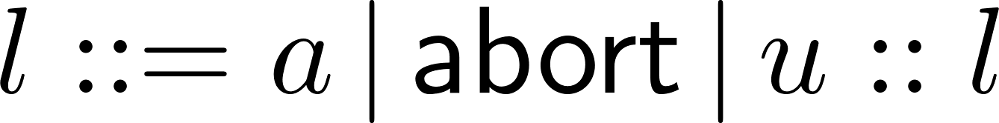
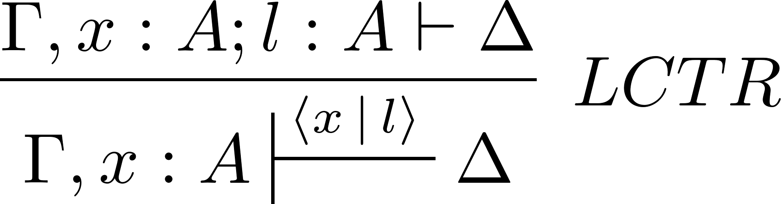
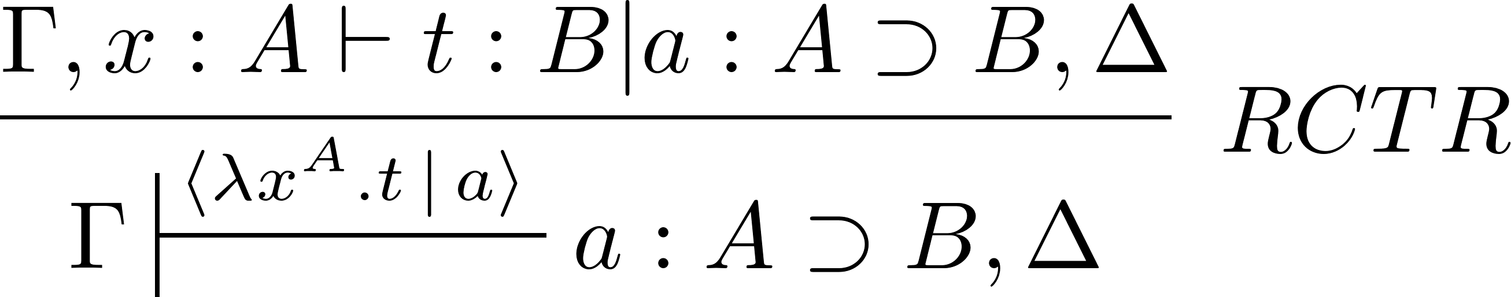
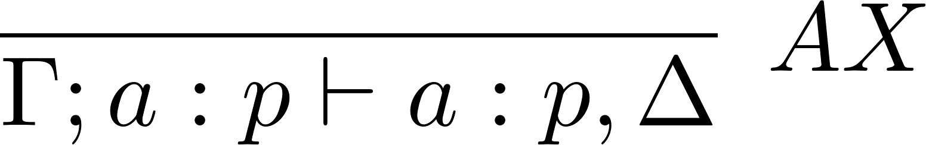
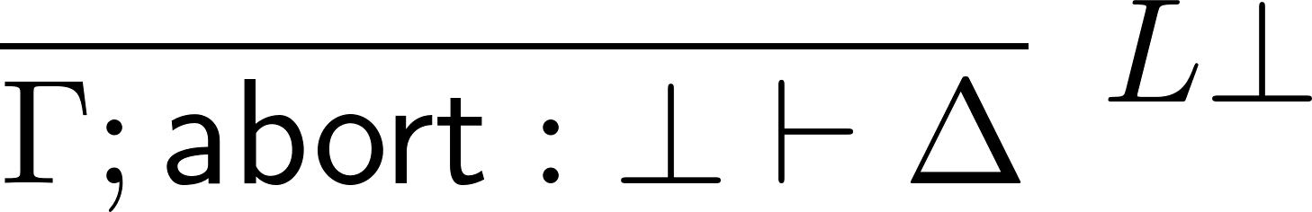

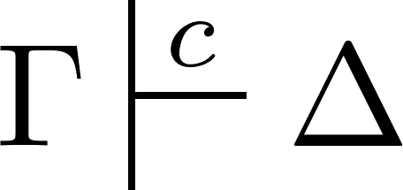
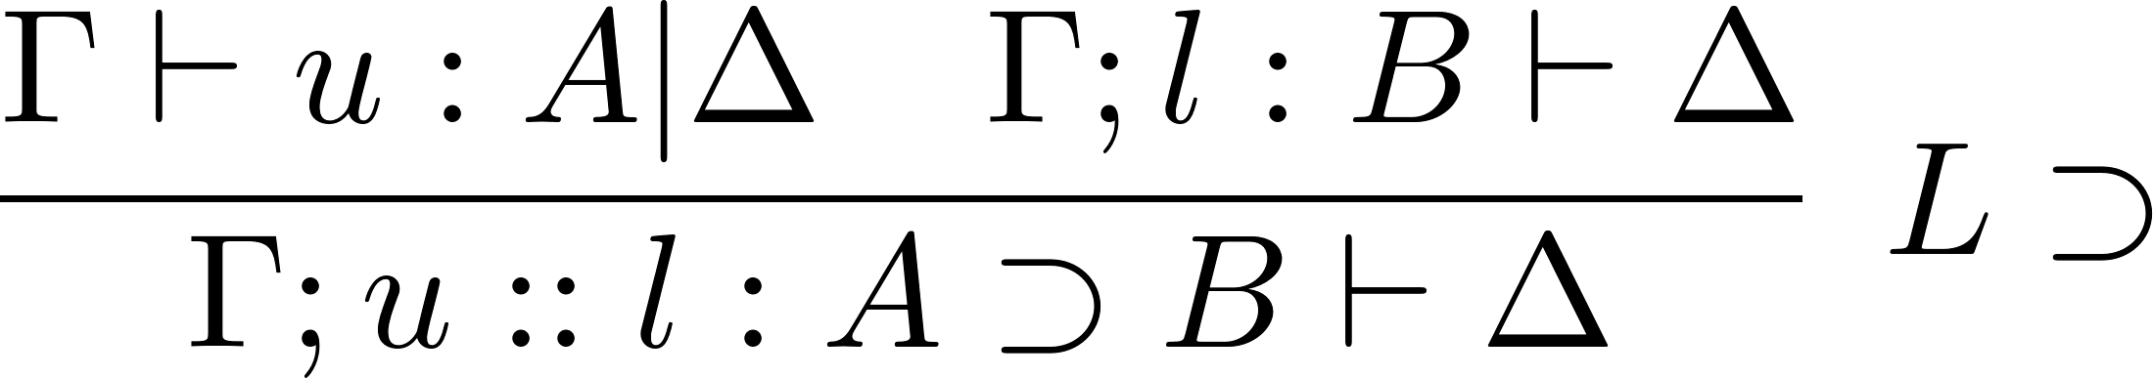

LKT with Proof Terms
Proof Terms
Inference Rules
Add Proof Terms
to LKT
Sequents
WoLLIC @ 2025
LKT & Focusing
11
Notes:
terms
commands
lists

Slide 39
Proof Search - Focusing
Focusing
(with words)
WoLLIC @ 2025
LKT & Focusing
12

Slide 40

Proof Search - Focusing
Finish inversion
RHS
Inversion Phase
Invert $R⊃$
WoLLIC @ 2025
LKT & Focusing
12

Slide 41
Proof Search - Focusing
Finish the focus
Keep the focus
LHS
Focusing Phase
Focus on the LHS
Finish inversion
RHS
Inversion Phase
Invert $R⊃$
WoLLIC @ 2025
LKT & Focusing
12

Slide 42
Proof Search - Focusing
Resume inversion
Finish inversion
RHS
Inversion Phase
Invert $R⊃$
WoLLIC @ 2025
LKT & Focusing
12

Slide 43

FROM LKT TO ${\text{L}\text{K}\text{T}}_{∂}$
Proof Terms
Define a Partial Sequent Calculus ${LKT}_{∂}$
WoLLIC @ 2025
LKT & Focusing
13
Notes:
Partial System to deal with partial derivations

Slide 44
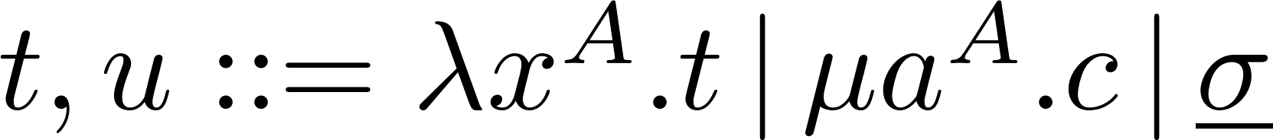
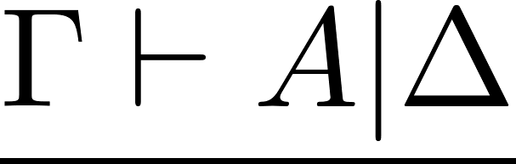
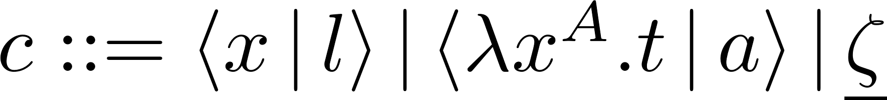
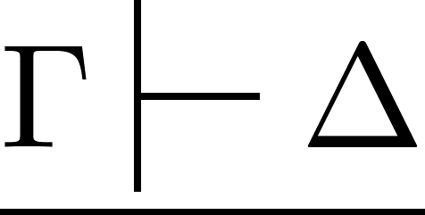
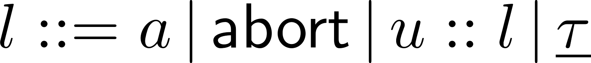

FROM LKT TO ${\text{L}\text{K}\text{T}}_{∂}$
Partial Proof Terms
Formal Sequents
WoLLIC @ 2025
LKT & Focusing
13
Notes:
Partial Proof Terms: proof terms with occurrences of formal sequents;

Slide 45



FROM LKT TO ${\text{L}\text{K}\text{T}}_{∂}$
Partial Proof Terms
Partial Sequents
Proof State
Goal Sequent
Record of the Search
Proof Obligations
WoLLIC @ 2025
LKT & Focusing
13
Notes:
LHS - set of proof obligations
partial proof term - record of search
type - goal sequent

Slide 46
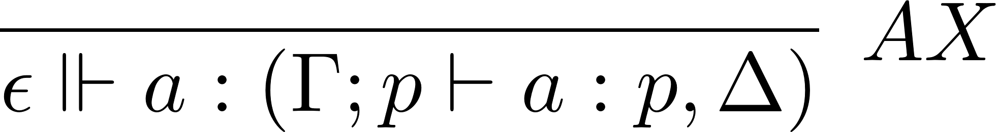

FROM LKT TO ${\text{L}\text{K}\text{T}}_{∂}$
Inference Rules
LKT
$${\text{LKT}}_{∂ }$$
WoLLIC @ 2025
LKT & Focusing
13
Notes:
Partial derivations - LJT∂
formalize incomplete proofs found in the proof search process => need inference rules

Slide 47
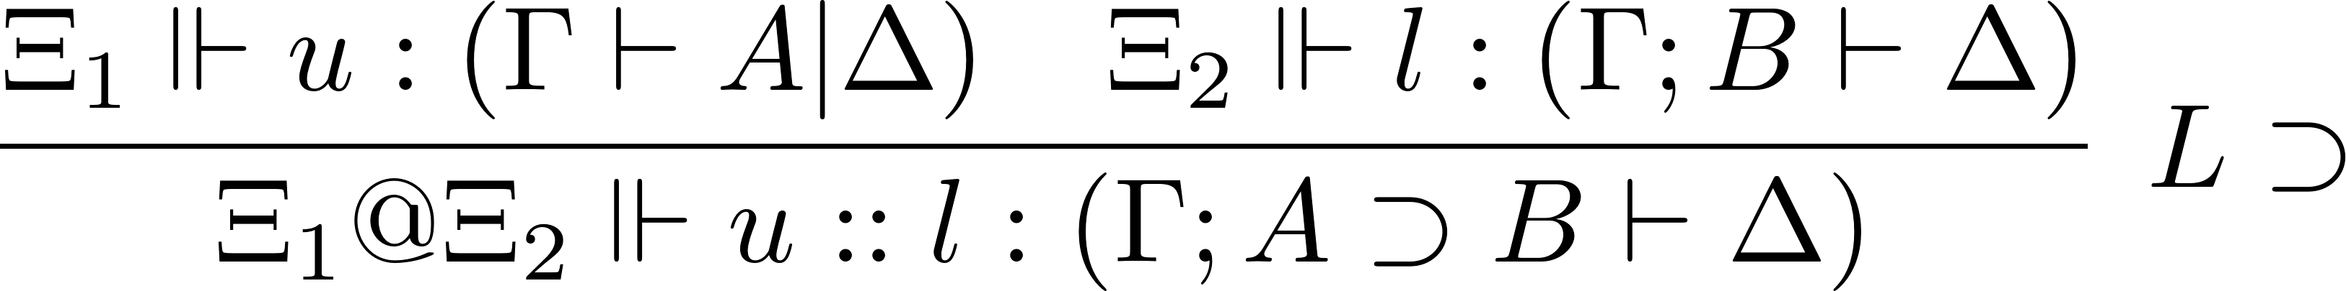
FROM LKT TO ${\text{L}\text{K}\text{T}}_{∂}$
Inference Rules
LKT
$${\text{LKT}}_{∂ }$$
WoLLIC @ 2025
LKT & Focusing
13

Slide 48
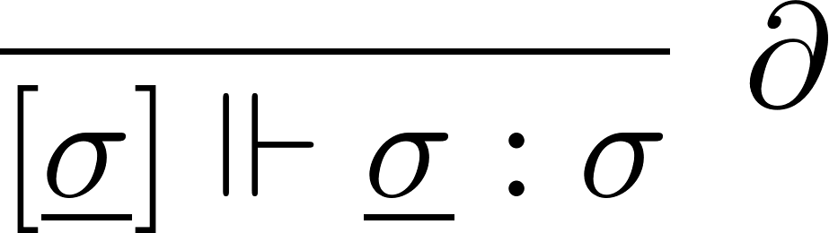
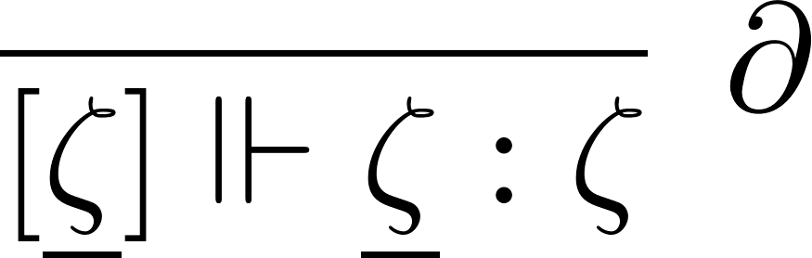
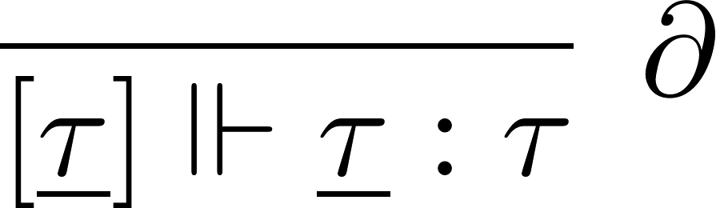
FROM LKT TO ${\text{L}\text{K}\text{T}}_{∂}$
Inference Rules
LKT
$${\text{LKT}}_{∂ }$$
WoLLIC @ 2025
LKT & Focusing
13
Notes:
Proof obligations are created

Slide 49
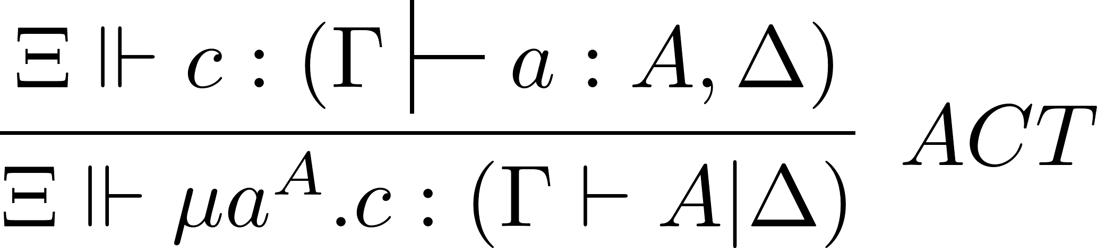
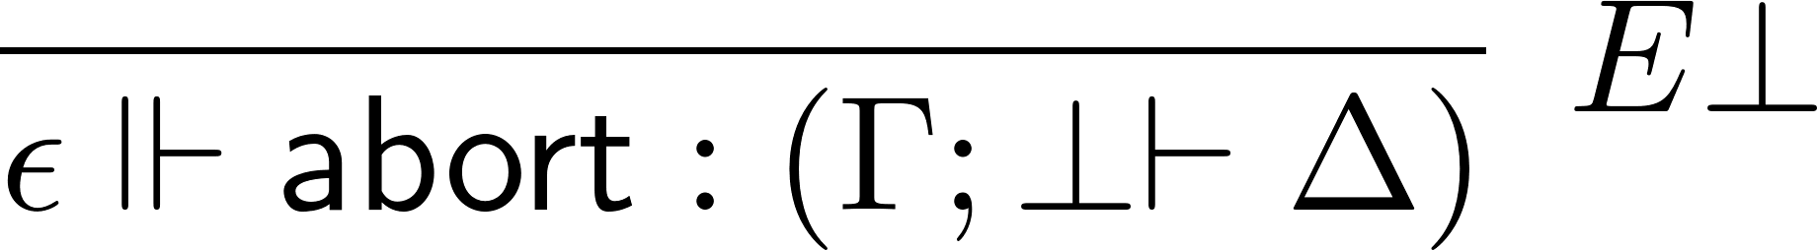
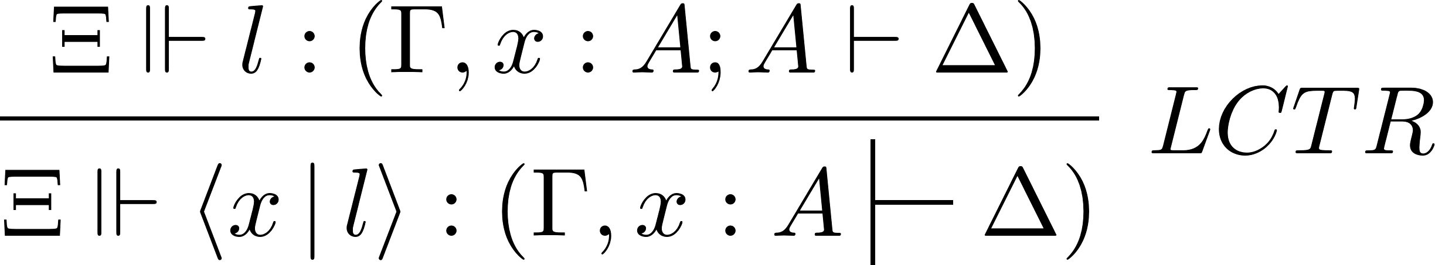
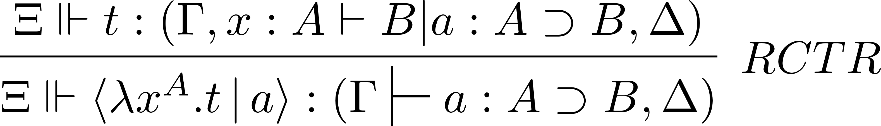
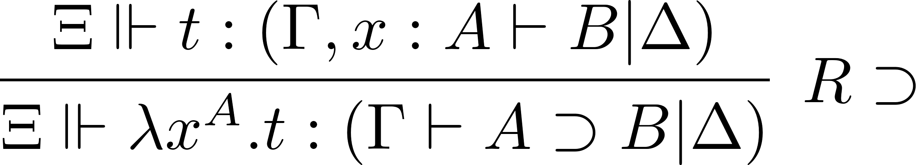
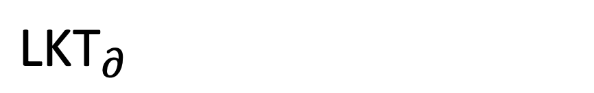
$${\text{L}\text{K}\text{T}}_{∂}$$
Inference Rules
WoLLIC @ 2025
LKT & Focusing
9

Slide 50
Reduction Rules
Define Focusing Reduction Rules
WoLLIC @ 2025
LKT & Focusing
14

Slide 51
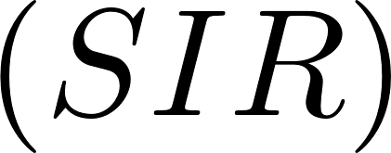
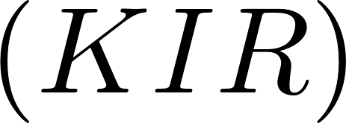
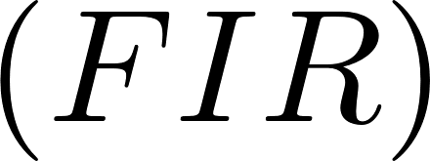
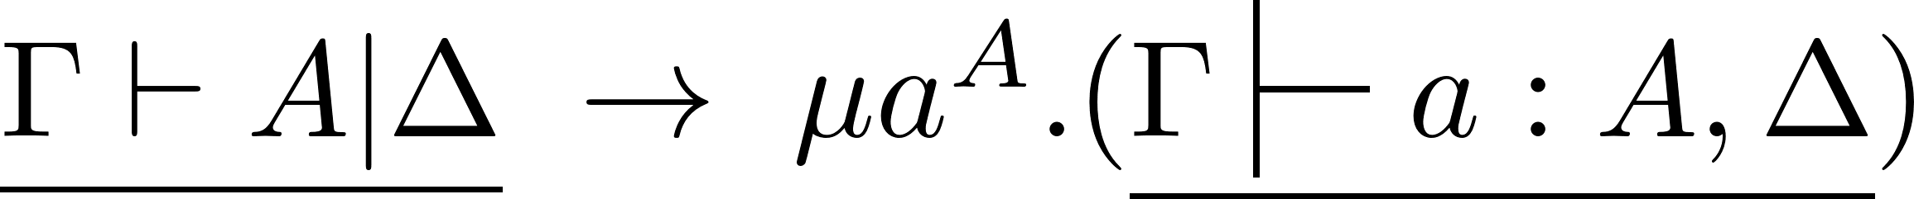
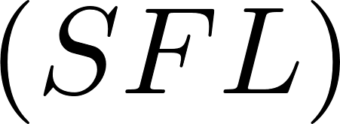
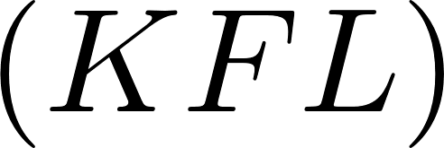




Reduction Rules
WoLLIC @ 2025
LKT & Focusing
14
Notes:
• Redexes are formal sequents;
• Reduction builds the record of the search.
• One reduction rule for each inference rule;
• The reduction rule tells how to use the inference rule during proof search;

Slide 52


Example – Peirce’s Law
Informal Derivation
?
Reduction Sequence
WoLLIC @ 2025
LKT & Focusing
15

Slide 53


Example – Peirce’s Law
Informal Derivation
?
Reduction Sequence
WoLLIC @ 2025
LKT & Focusing
15

Slide 54

Example – Peirce’s Law
Informal Derivation
?
Reduction Sequence
WoLLIC @ 2025
LKT & Focusing
15

Slide 55
Example – Peirce’s Law
Informal Derivation
?
…
Reduction Sequence
…
WoLLIC @ 2025
LKT & Focusing
15

Slide 56

Example – Peirce’s Law
Informal Derivation
?
…
Reduction Sequence
…
WoLLIC @ 2025
LKT & Focusing
15

Slide 57

Example – Peirce’s Law
Informal Derivation
?
…
Reduction Sequence
WoLLIC @ 2025
LKT & Focusing
15

Slide 58
Example – Peirce’s Law
Informal Derivation
?
…
Reduction Sequence
WoLLIC @ 2025
LKT & Focusing
15

Slide 59

Example – Peirce’s Law
Informal Derivation
?
?
…
Reduction Sequence
WoLLIC @ 2025
LKT & Focusing
15

Slide 60


Example – Peirce’s Law
Informal Derivation
?
…
Reduction Sequence
WoLLIC @ 2025
LKT & Focusing
15

Slide 61

Example – Peirce’s Law
Informal Derivation
?
…
Reduction Sequence
WoLLIC @ 2025
LKT & Focusing
15

Slide 62

Example – Peirce’s Law
Informal Derivation
?
…
Reduction Sequence
WoLLIC @ 2025
LKT & Focusing
15

Slide 63

Example – Peirce’s Law
Informal Derivation
?
…
Reduction Sequence
WoLLIC @ 2025
LKT & Focusing
15

Slide 64

Example – Peirce’s Law
Informal Derivation
?
…
Reduction Sequence
WoLLIC @ 2025
LKT & Focusing
15

Slide 65

Example – Peirce’s Law
Informal Derivation
?
…
Reduction Sequence
WoLLIC @ 2025
LKT & Focusing
15

Slide 66

Example – Peirce’s Law
Informal Derivation
…
Reduction Sequence
WoLLIC @ 2025
LKT & Focusing
15

Slide 67

Example – Peirce’s Law
WoLLIC @ 2025
LKT & Focusing
15
Notes:
total term

Slide 68








Results
Conservativity
LKT derives
iff ${\text{LKT}}_{∂}$ derives
Record of Serch
If
then
Subject Reduction
If
and
then there is
such that
and
WoLLIC @ 2025
LKT & Focusing
16
Notes:
Derivability is partial derivability from the empty set of proof obligations.
If a sequent is derivable in the partial system, then the proof term t records a run of proof search.

Slide 69


Main Result
Proof Search as Normalization
LKT derives
iff
proof search succeeds
formal sequent normalizes
WoLLIC @ 2025
LKT & Focusing
17

Slide 70
3
NKT & Intercalation
WoLLIC @ 2025
Proof Search in Classical Propositional Logic with Partial Proof Terms

Slide 71

Bidirectional Natural Deduction
Define a Natural Deduction NKT
Define Intercalation Reduction Rules
Define a Partial Natural Deduction ${NKT}_{∂}$
Add Proof Terms
to NKT
Intercalation
(with words)
Finished Proofs
Proof Search
Partial Proofs
WoLLIC @ 2025
NKT & Intercalation
19

Slide 72




Bidirectional Natural Deduction
Sequents
Define a Natural Deduction NKT
Inference Rules
Finished Proofs
WoLLIC @ 2025
NKT & Intercalation
19

Slide 73





Bidirectional Natural Deduction
Sequents
Proof Terms
Add Proof Terms
to NKT
Finished Proofs
WoLLIC @ 2025
NKT & Intercalation
20
Notes:
terms M
statements S
neutral terms H

Slide 74
Proof Search - Intercalation
Intercalation
(with words)
WoLLIC @ 2025
NKT & Intercalation
21

Slide 75

Proof Search - Intercalation
Finish inversion
Inversion Phase
(bottom-up)
Invert $I⊃$
WoLLIC @ 2025
NKT & Intercalation
21

Slide 76



Proof Search - Intercalation
Focus A$∈Γ$
Keep the focus
Focus Down Phase
(top-down)
Finish the focus
Finish inversion
Inversion Phase
(bottom-up)
Invert $I⊃$
WoLLIC @ 2025
NKT & Intercalation
21

Slide 77

Proof Search - Intercalation
Resume inversion
Finish inversion
Inversion Phase
(bottom-up)
Invert $I⊃$
WoLLIC @ 2025
NKT & Intercalation
21

Slide 78

FROM NKT TO ${\text{N}\text{K}\text{T}}_{∂}$
Proof Terms
Define a Partial Natural Deduction ${NKT}_{∂}$
Partial Proofs
WoLLIC @ 2025
NKT & Intercalation
22

Slide 79




FROM NKT TO ${\text{N}\text{K}\text{T}}_{∂}$
Partial Proof Terms
Define a Partial Natural Deduction ${NKT}_{∂}$
Inference Rules
Partial Proofs
WoLLIC @ 2025
NKT & Intercalation
22
Notes:
Proof Terms - one kind of formal sequent does not constitute, by itself, a partial proof term
ab(H,\rho) gap between the sequent rho obtained according to H and the sequent Gamma \vdash delta

Slide 80
Reduction Rules
Define Intercalation Reduction Rules
WoLLIC @ 2025
NKT & Intercalation
24

Slide 81




Reduction Rules
WoLLIC @ 2025
NKT & Intercalation
24
Notes:
Some redexes are not formal sequents.

Slide 82


Main Result
Proof Search as Normalization
NKT derives
iff
proof search succeeds
formal sequent normalizes
WoLLIC @ 2025
NKT & Intercalation
23

Slide 83
4
Focusing vs Intercalation
WoLLIC @ 2025
Proof Search in Classical Propositional Logic with Partial Proof Terms

Slide 84






Theorem of Idealized Proof Search
Proof Search in LKT
(following focusing)
$${LKT}_{∂}≅{NKT}_{∂}$$
$LKT≅NKT$
$$≅$$
Proof Search in NKT
(following intercalation)
WoLLIC @ 2025
Focusing vs Intercalation
26

Slide 85
Thank you!
WoLLIC @ 2025
Proof Search in Classical Propositional Logic with Partial Proof Terms

