Slide 1
Python: Introduction

Slide 2
Python: Features
Simple, yet powerful Simple and minimalistic language. Program feels almost like English
Easy to learn Extraordinarily simple syntax
Open Source and Large community Free software and very large active community
Portable Python programs work on all platforms without any modifications
Interpreted No hassle of compiling the code.
Multi-Paradigm Language
Structured
Object Oriented
Notes:
Python is a simple and minimalistic language. Reading a good Python program feels almost like reading English, although very strict English! This pseudo-code nature of Python is one of its greatest strengths. It allows you to concentrate on the solution to the problem rather than the language itself.
Python has an extraordinarily simple syntax
(4) Due to its open-source nature, Python has been ported to (i.e. changed to make it work on) many platforms. All your Python programs can work on any of these platforms without requiring any changes at all if you are careful enough to avoid any system-dependent features.
A program written in a compiled language like C or C++ is converted from the source language i.e. C or C++ into a language that is spoken by your computer (binary code i.e. 0s and 1s) using a compiler with various flags and options. When you run the program, the linker/loader software copies the program from hard disk to memory and starts running it. Python, on the other hand, does not need compilation to binary. You just run the program directly from the source code. Internally, Python converts the source code into an intermediate form called bytecodes and then translates this into the native language of your computer and then runs it. All this, actually, makes using Python much easier since you don't have to worry about compiling the program, making sure that the proper libraries are linked and loaded, etc. This also makes your Python programs much more portable, since you can just copy your Python program onto another computer and it just works!
Python supports procedure-oriented programming as well as object-oriented programming. In procedure-oriented languages, the program is built around procedures or functions which are nothing but reusable pieces of programs. In object-oriented languages, the program is built around objects which combine data and functionality. Python has a very powerful but simplistic way of doing OOP, especially when compared to big languages like C++ or Java.

Slide 3
Philosophy
Beautiful is better than ugly
Explicit is better than implicit
Simple is better than complex
Complex is better than complicated
Readability counts
Notes:
From Python Wiki page
PEP 20 guidelines

Slide 4
Installing Python
Python can be installed in two ways.
Note: Make sure you know the version of your Operating System (32-bit or 64-bit).
Download and install Python 3.5 from Python’s Official website. This is a standalone version of Python.
Install Anaconda (Python 3.5) from Continuum Analytics. This installs Python bundled with several other Python modules.
A video will be available in this week’s module to assist in installation of Python/Anaconda.
There is not much difference between Python and Anaconda, except for the fact that Anaconda comes with additional modules. However, these modules can be installed in the standalone version using pip command.
In these tutorials, pip commands will be provided whenever additional modules are needed to be imported.

Slide 5
Fire up!
Open Command Prompt (Windows) or Terminal (Linux/OS X)
Type python. The command prompt must look as shown.
Note:
If you get a [‘python' is not recognized as an internal or external command] error, add Python directory to System PATH
If multiple versions of Python are installed, it is necessary to specify with version
Ex: python3 in Linux

Slide 6
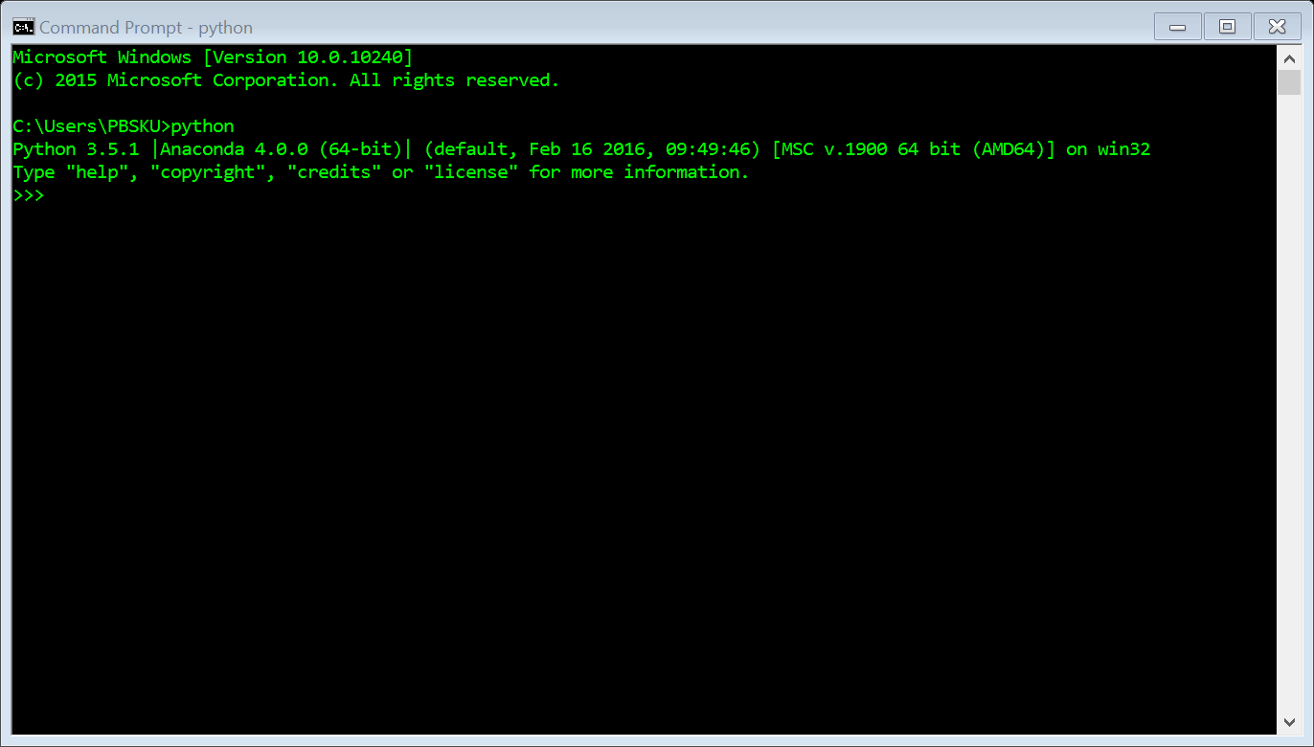

Slide 7
Let’s go ahead!
Now that Python is up and running, let’s start exploring the world of Python.

