Slide 1
StandUpTracker
Upload

Slide 2
StandUpTracker
Select a Team
Team 1
Team 2
Team 3
Team 4
Select a Day
Add a Note
Edit a Note
Delete
Upload a Note
Manage a Team
Add a Member
Delete Member
Contact List

Slide 3
StandUpTracker
Select a Team
Team 1
Anne
Trevor
Cheghali
Ryan Sanders
Tim Brown

Slide 4
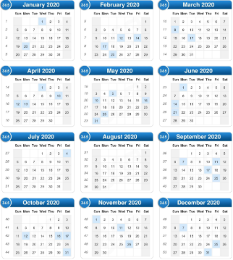
StandUpTracker
Select a Day

Slide 5
StandUpTracker
Add a Note

Slide 6
StandUpTracker
Add a Member
Team 1
Adam Henderson

Slide 7
StandUpTracker
User Name
Password

