Slide 8
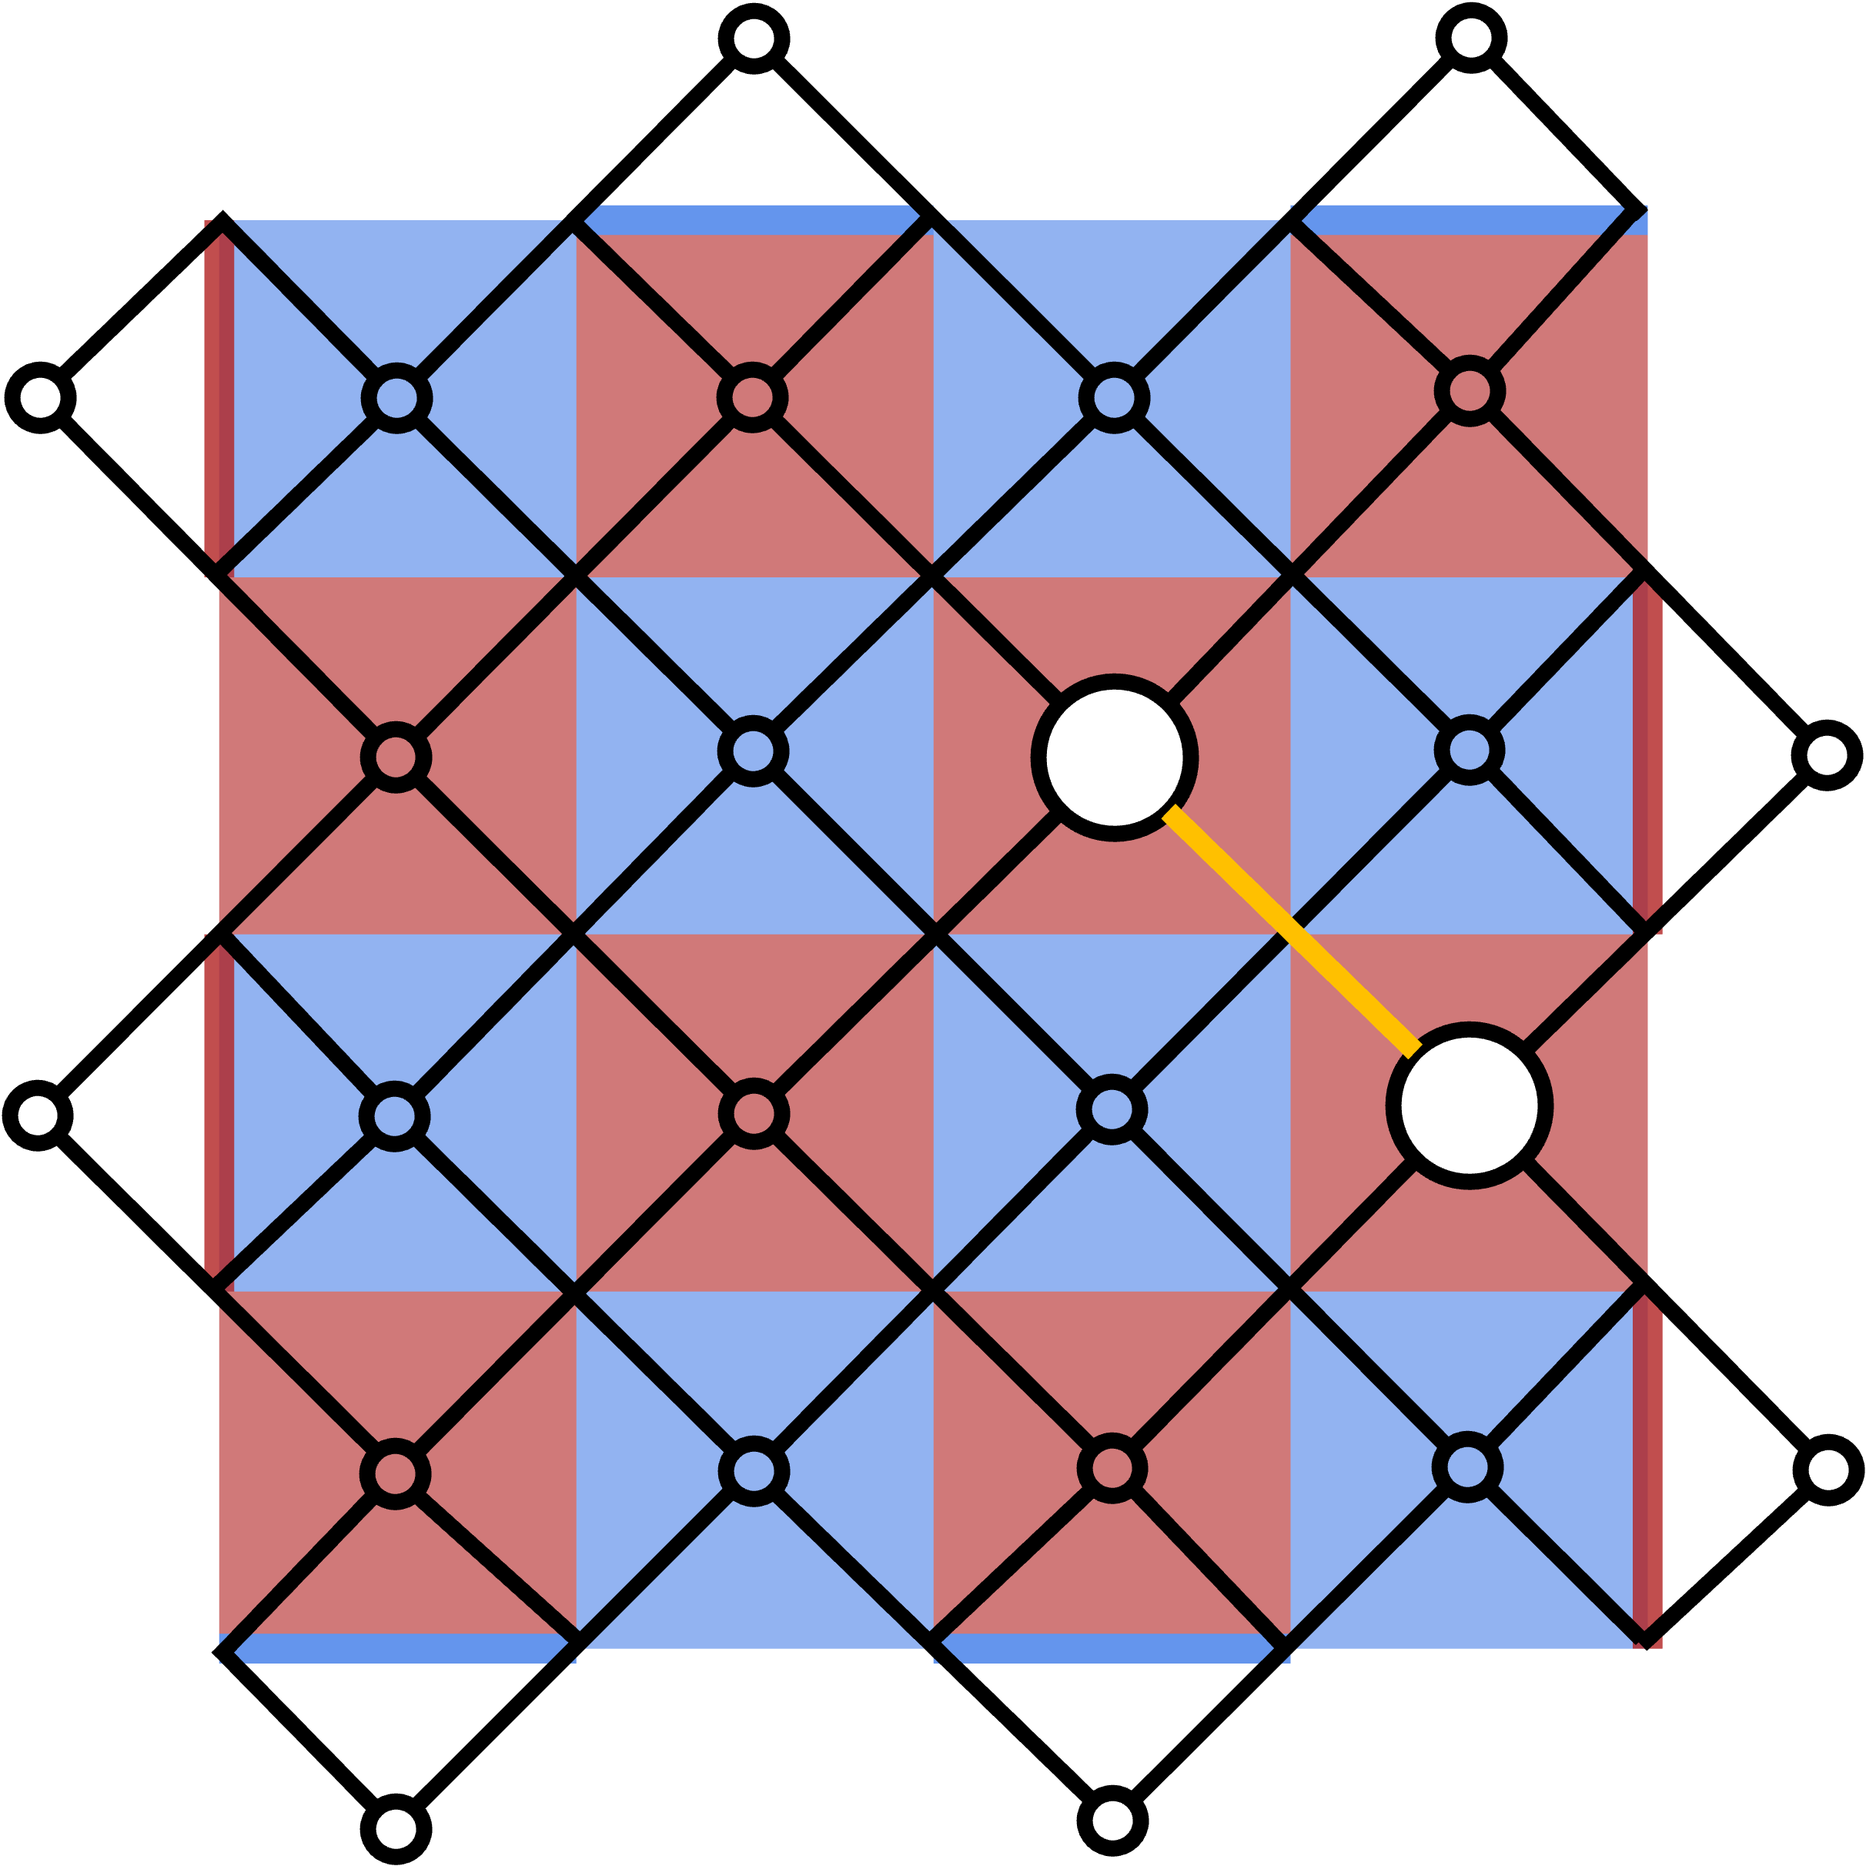
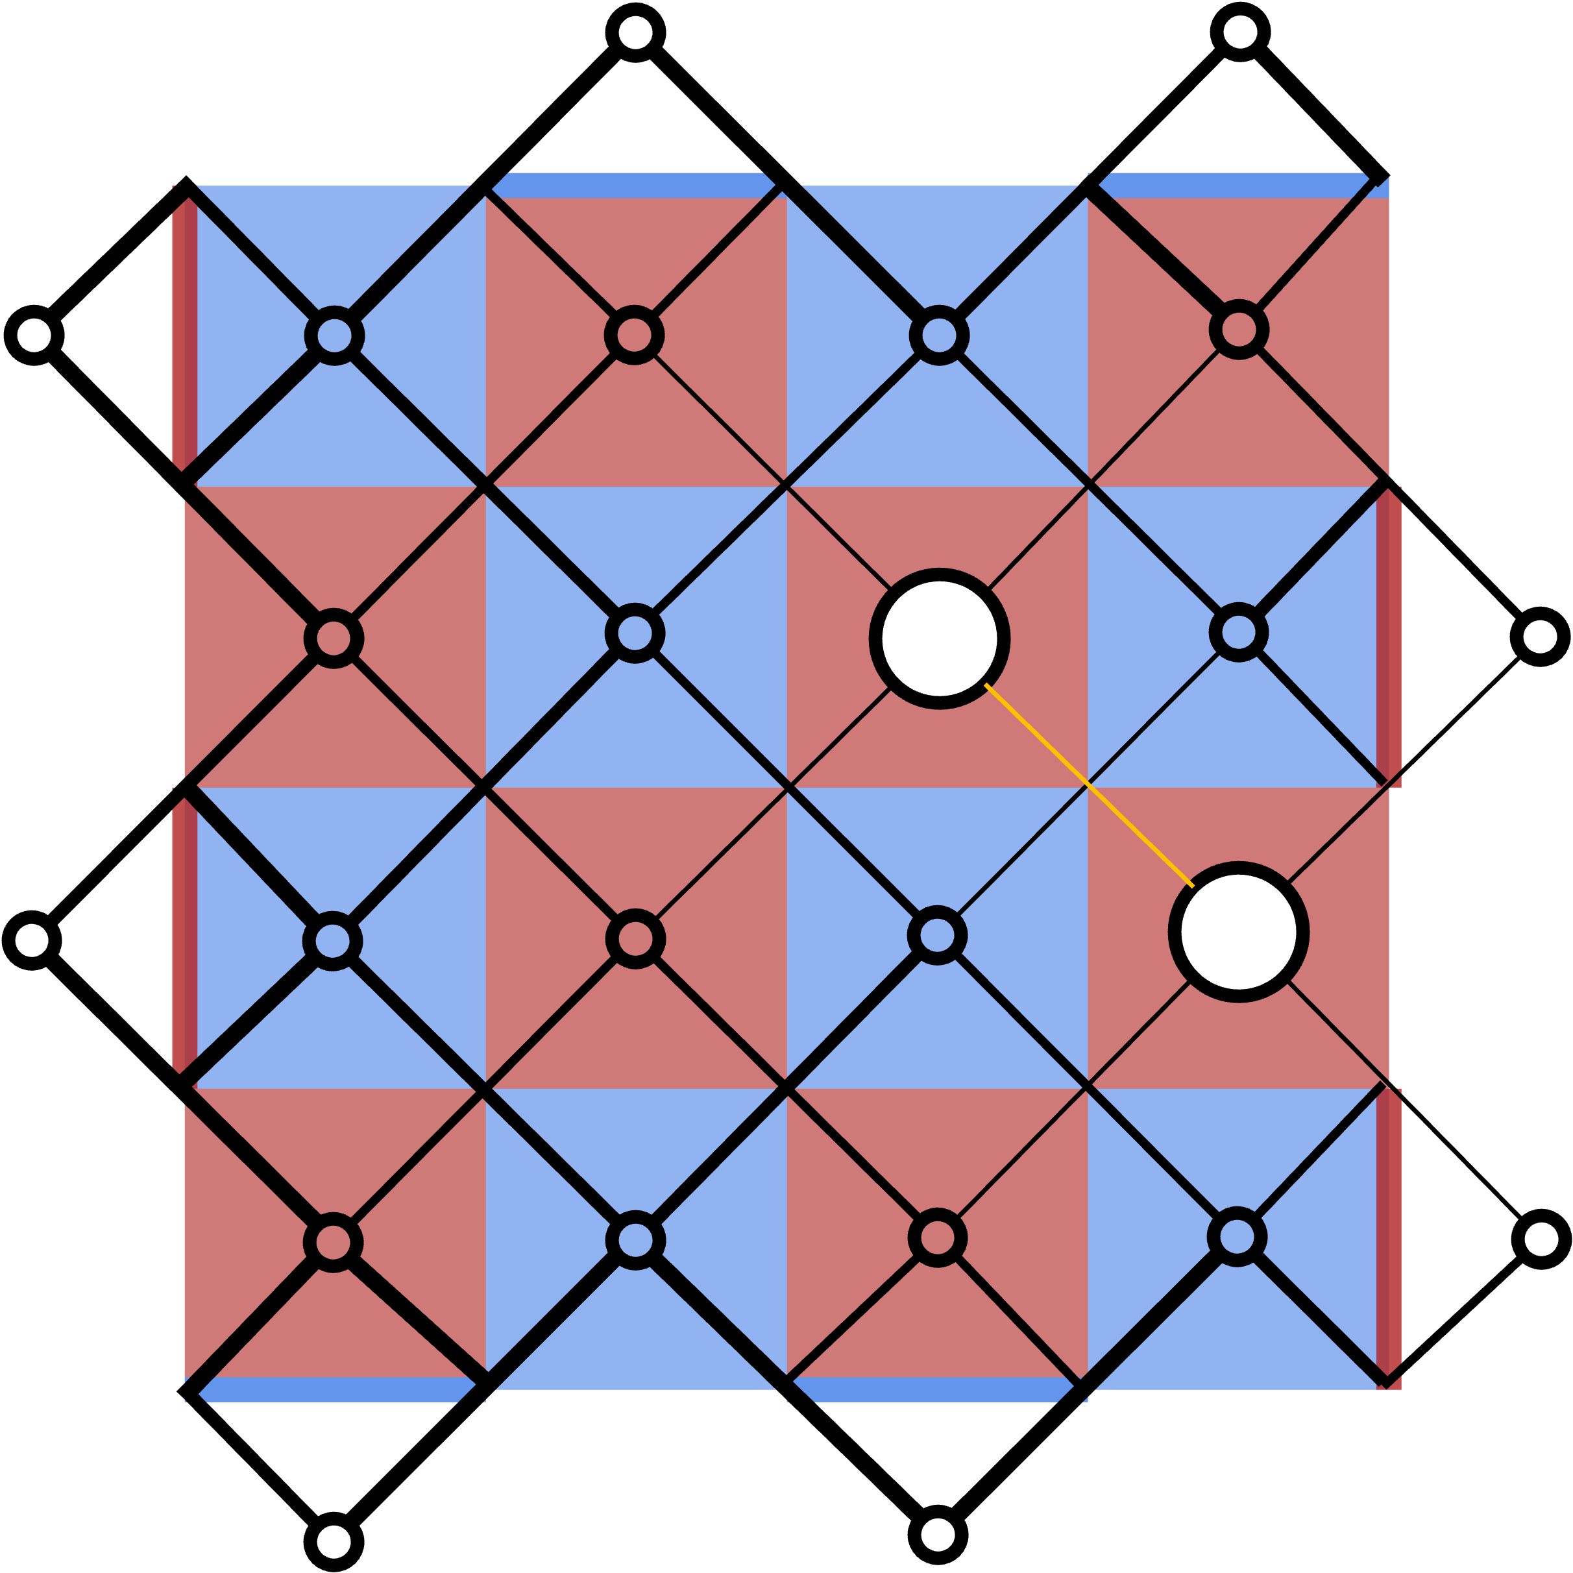
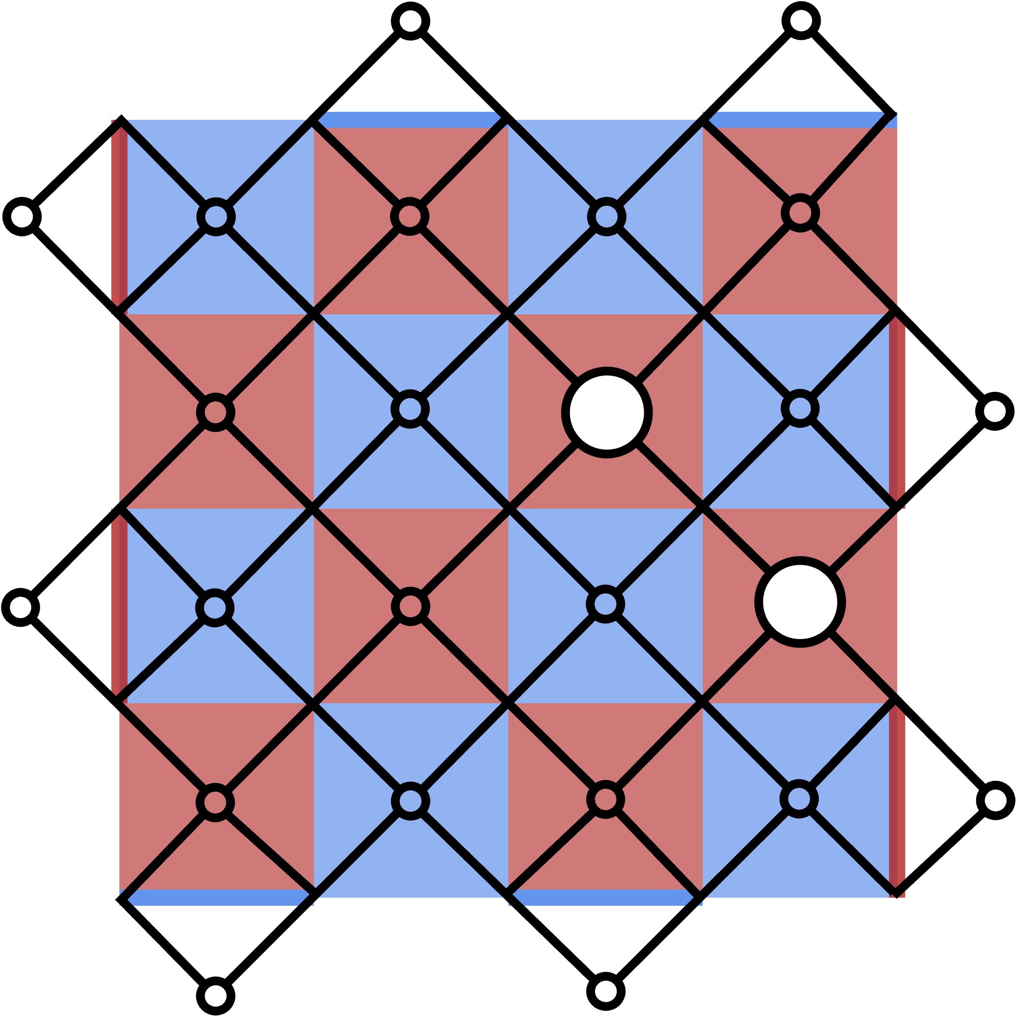
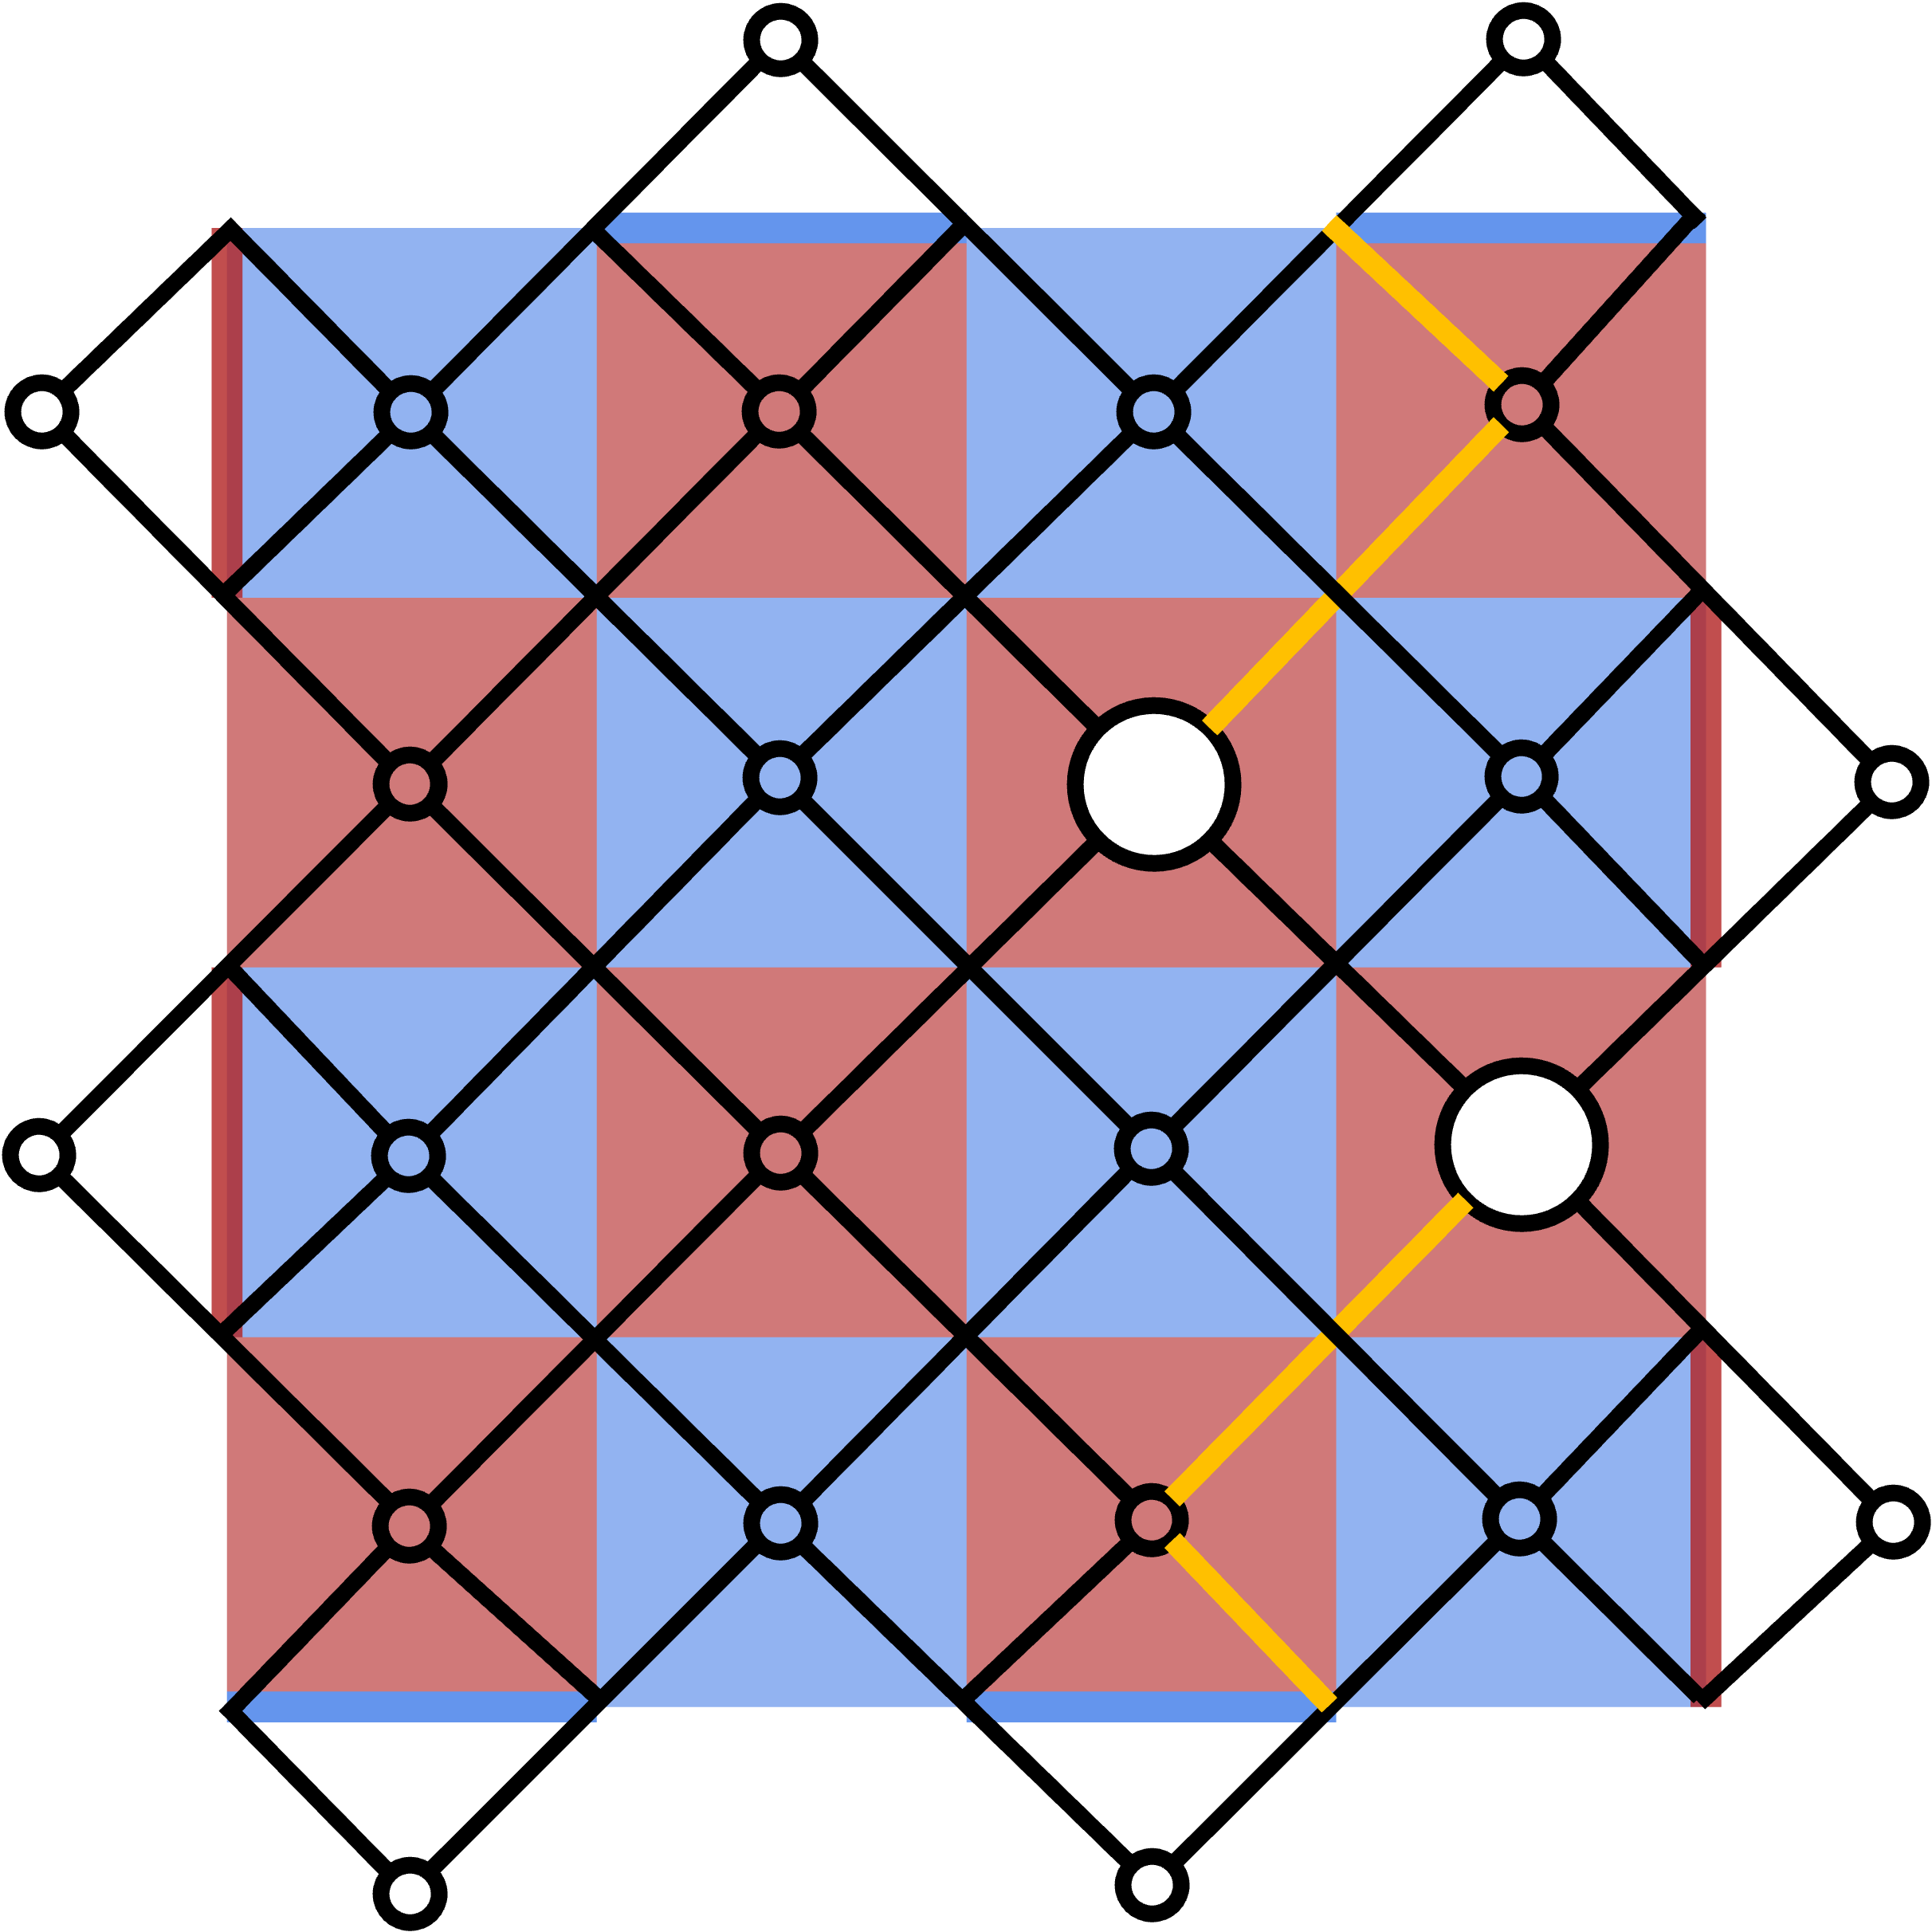
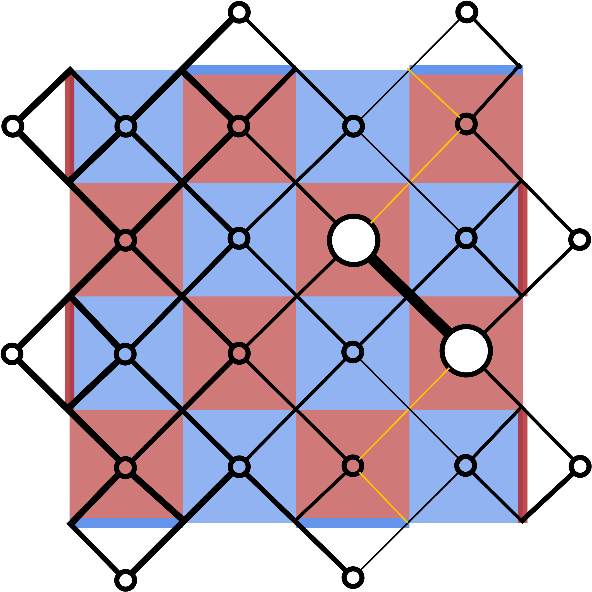
Initial syndrome
Find minimum weight correction
Adjust hyperedge weights

Slide 9
Fig 10

Slide 12
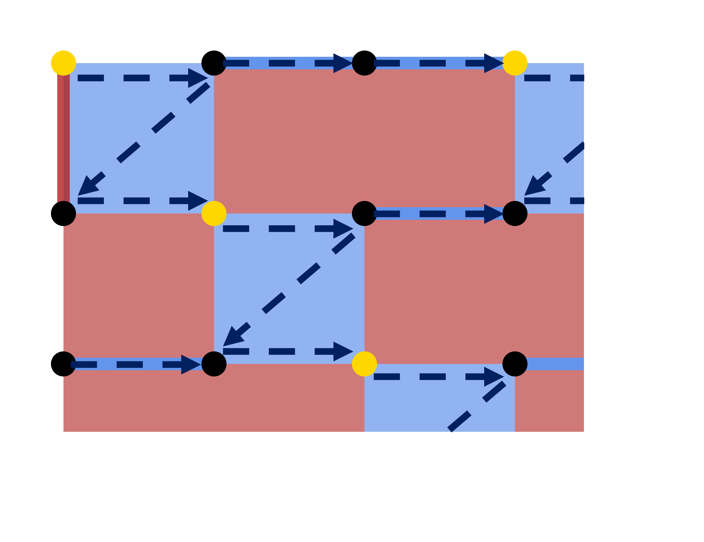
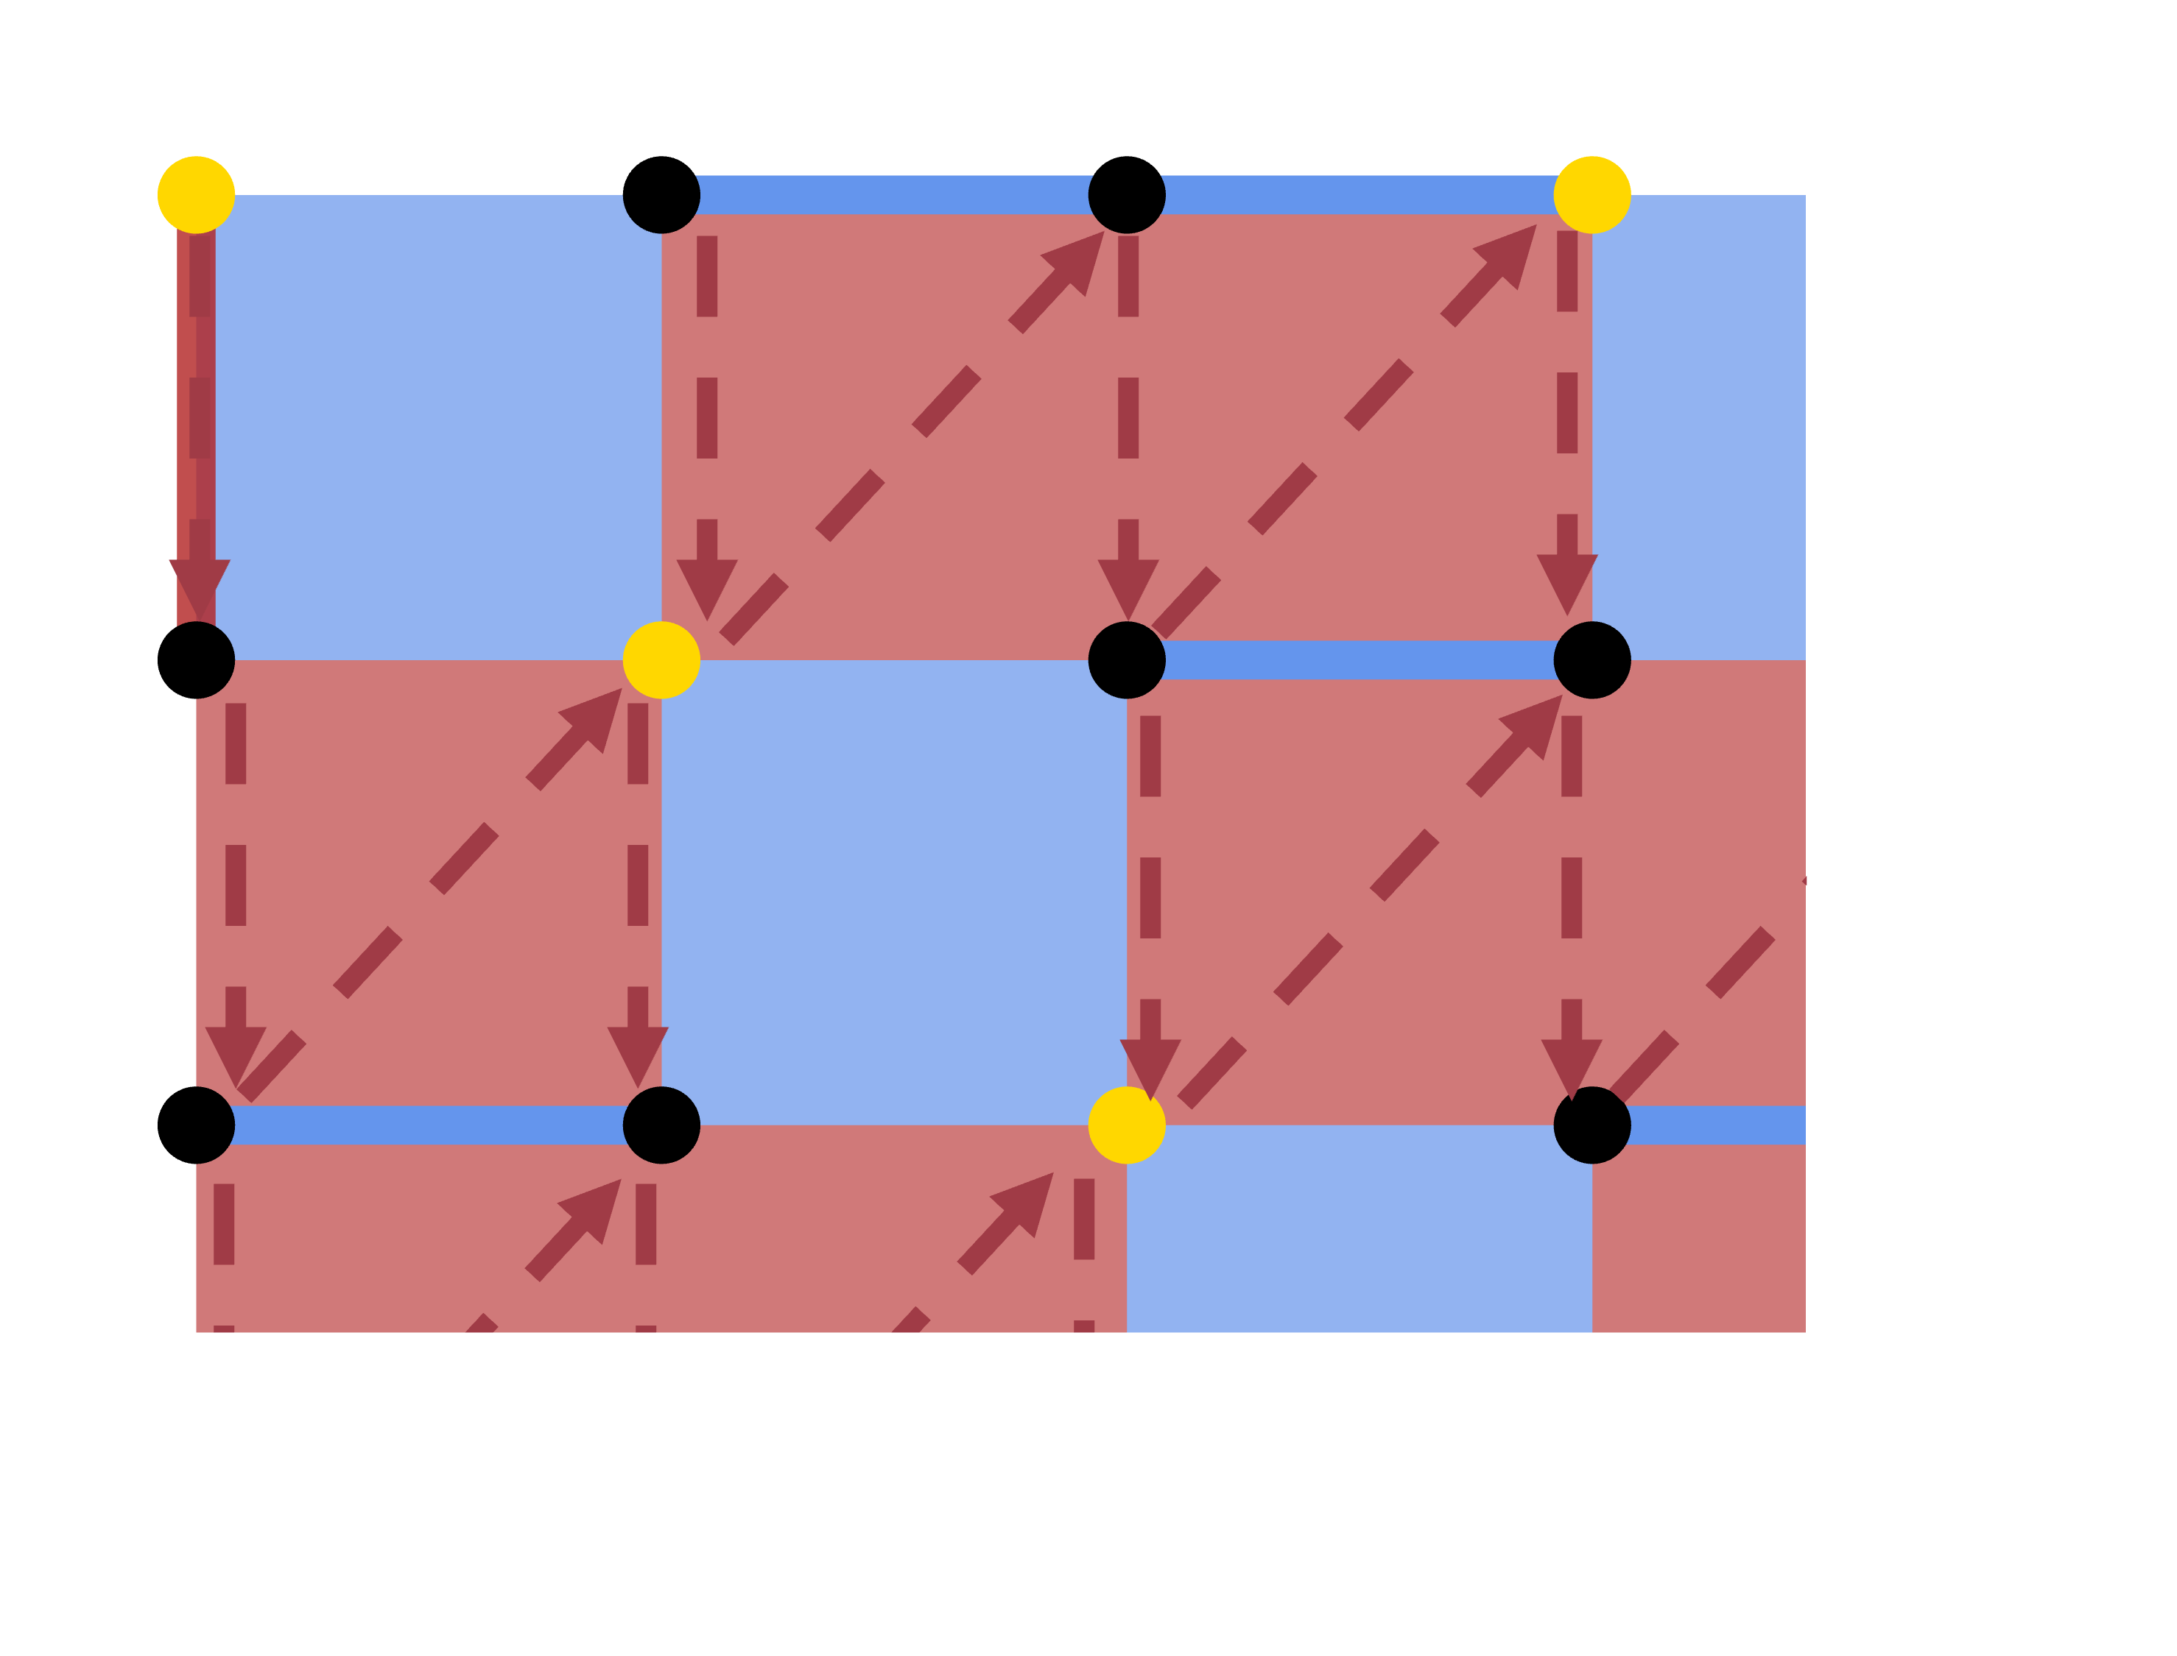

Slide 13
Fig 11

Slide 14
Y

Slide 16
X

Slide 18
Z

Slide 19
Z

Slide 21
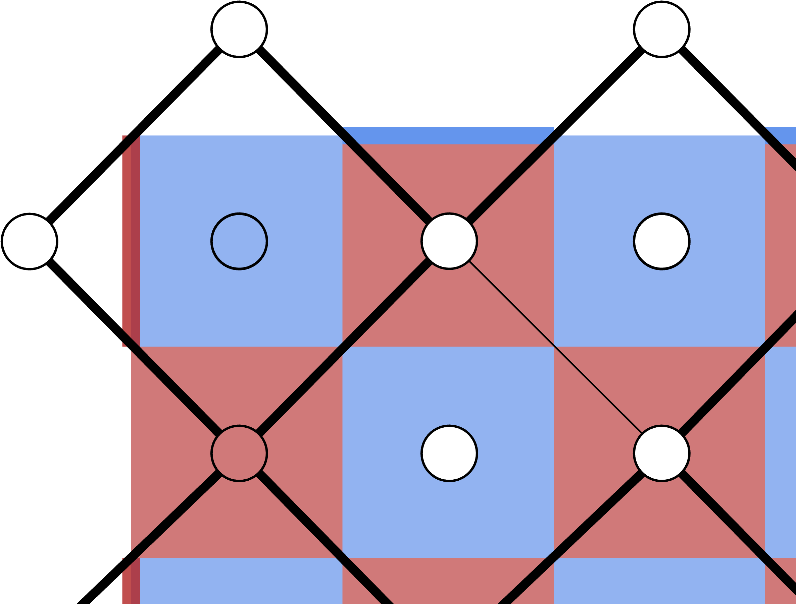
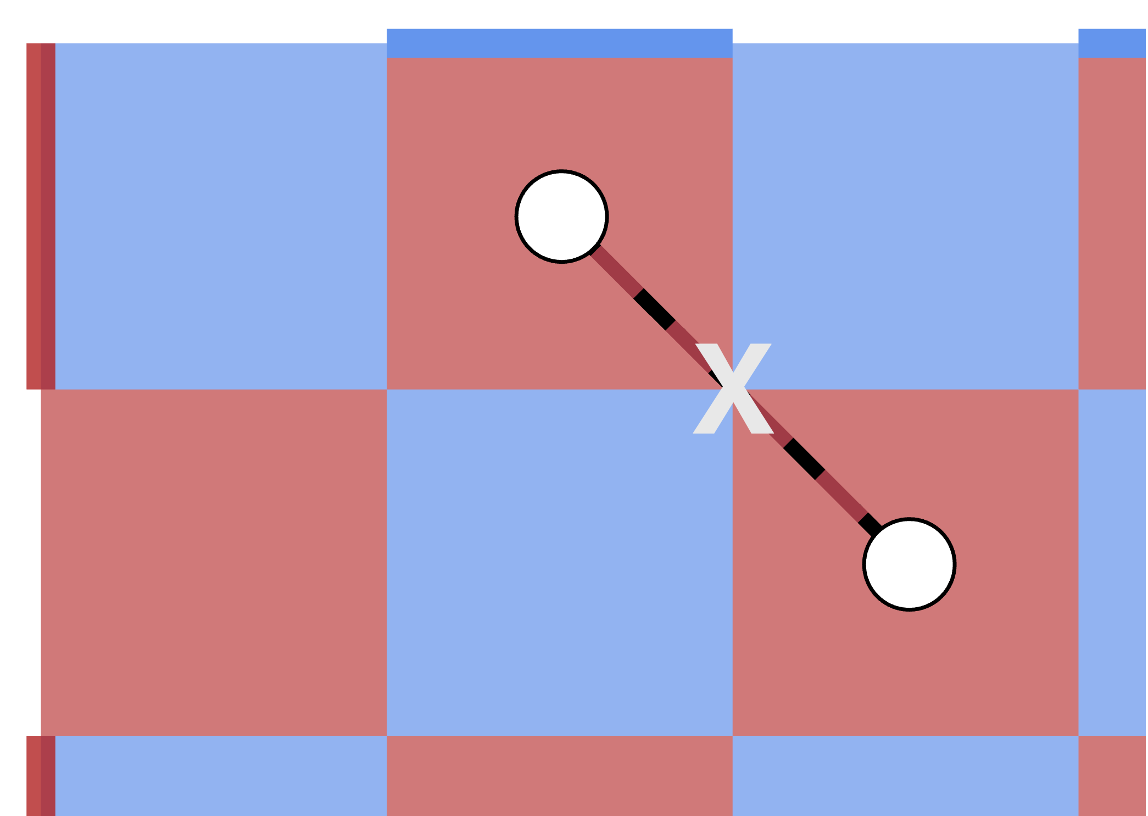
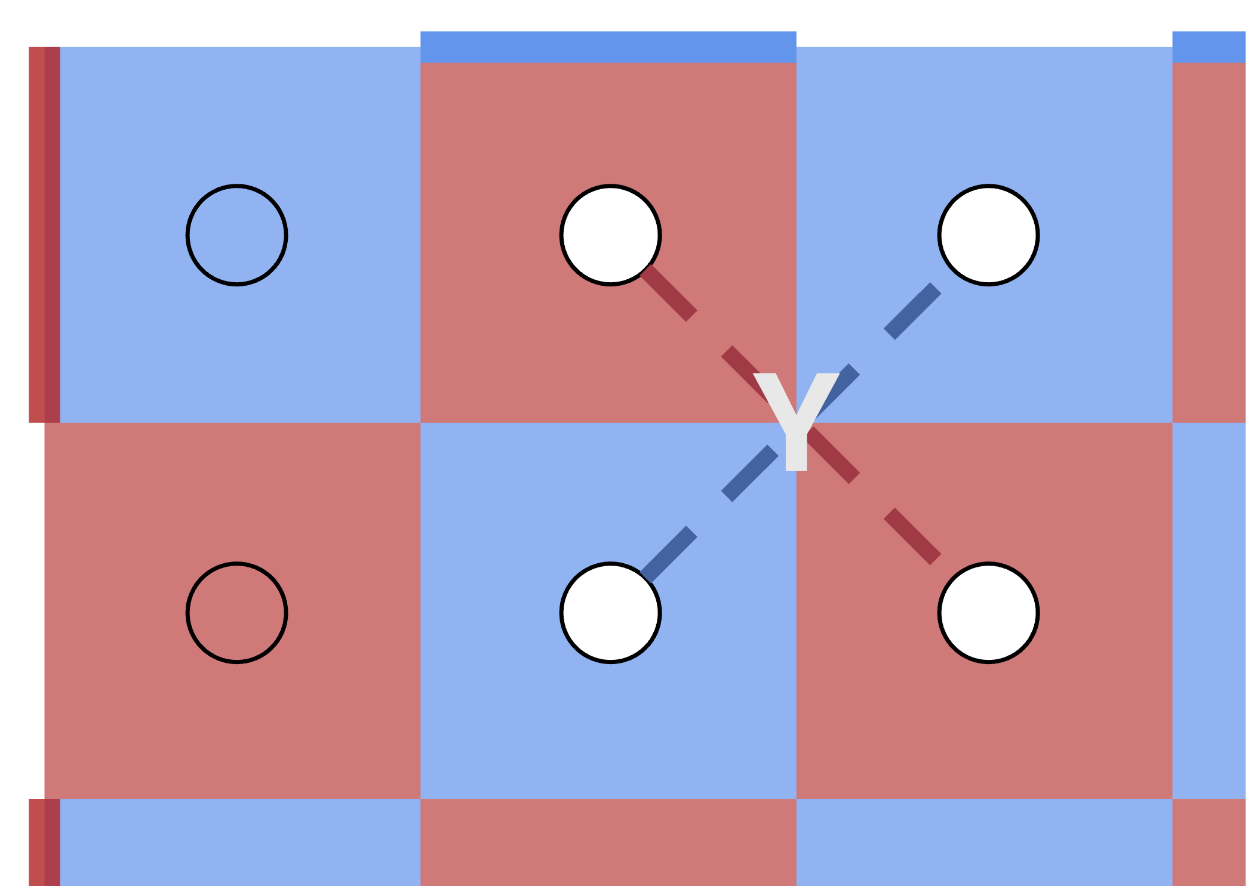
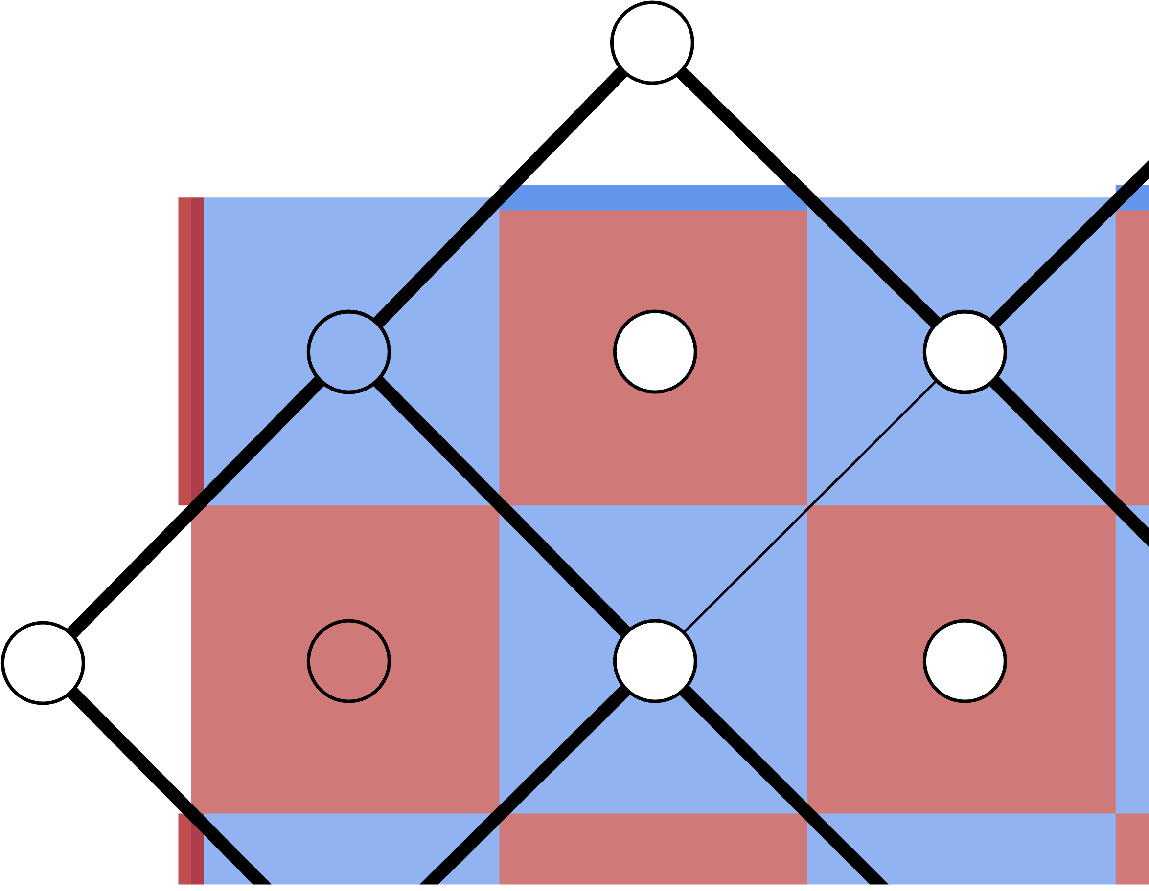
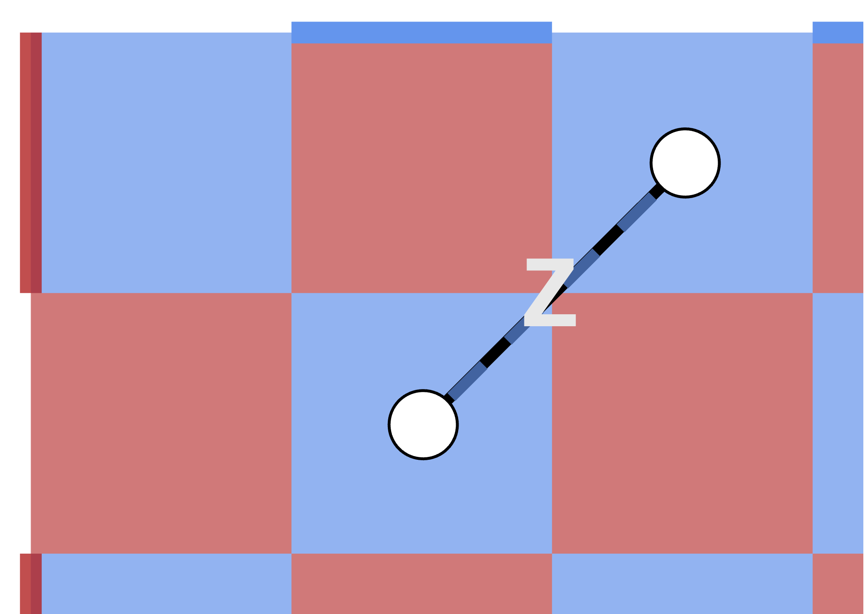
Initial syndrome
Decomposition contribution
Edge weight adjustment
Z-memory
X-memory

Slide 22
Fig 12

Slide 25
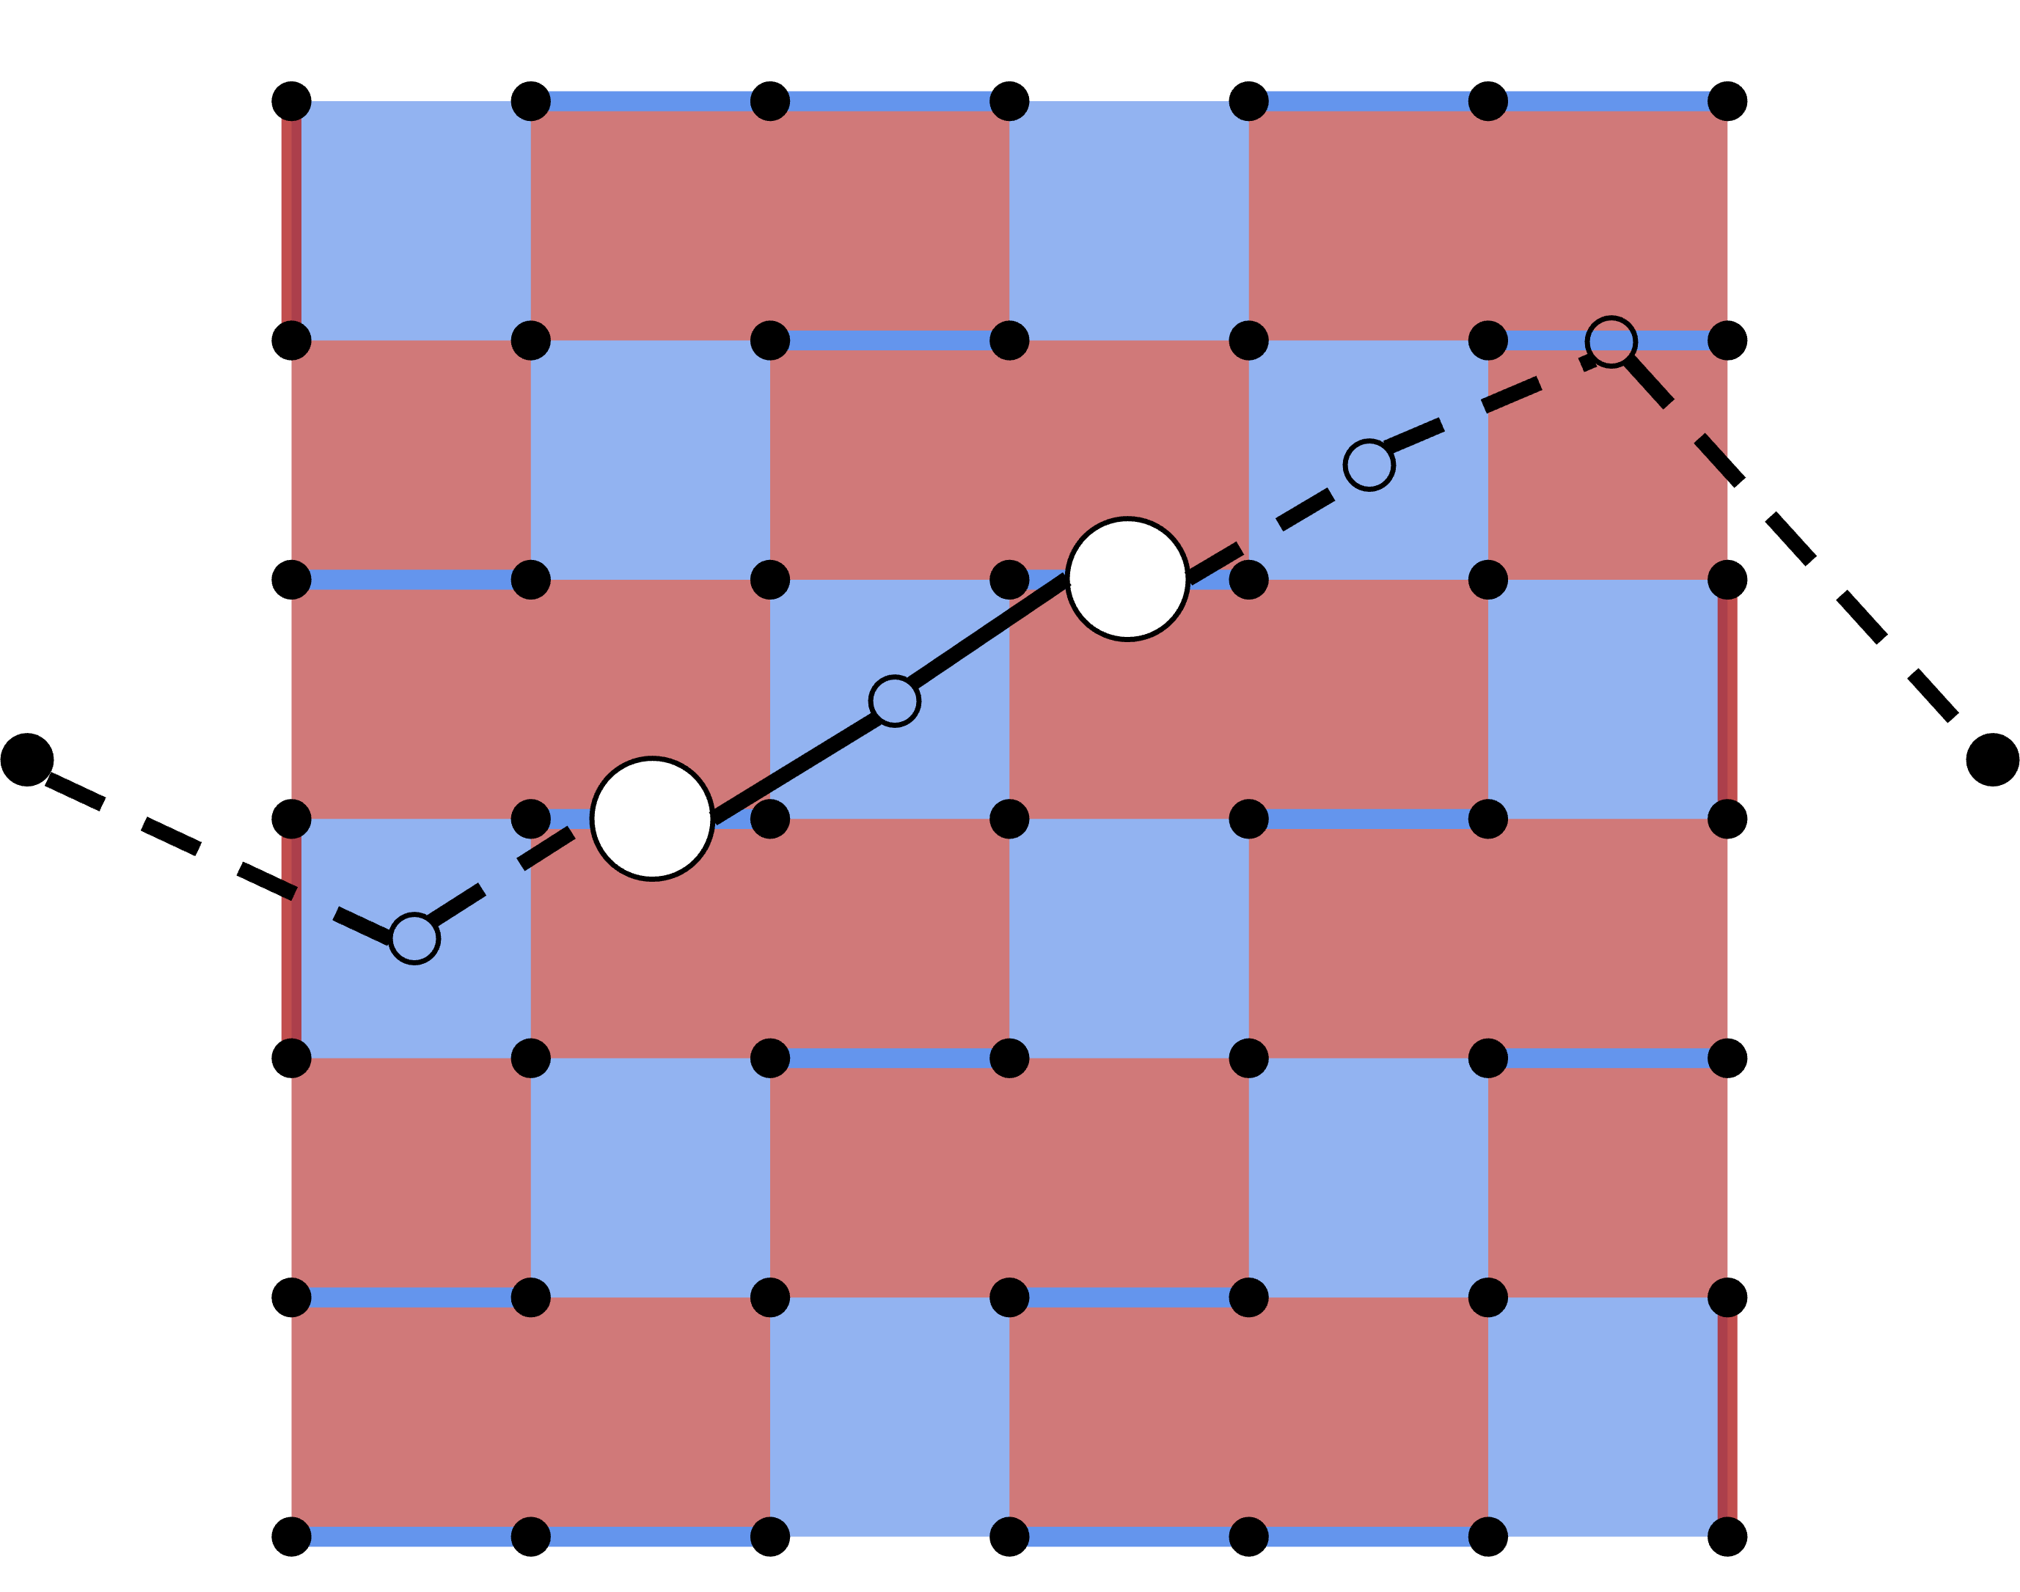
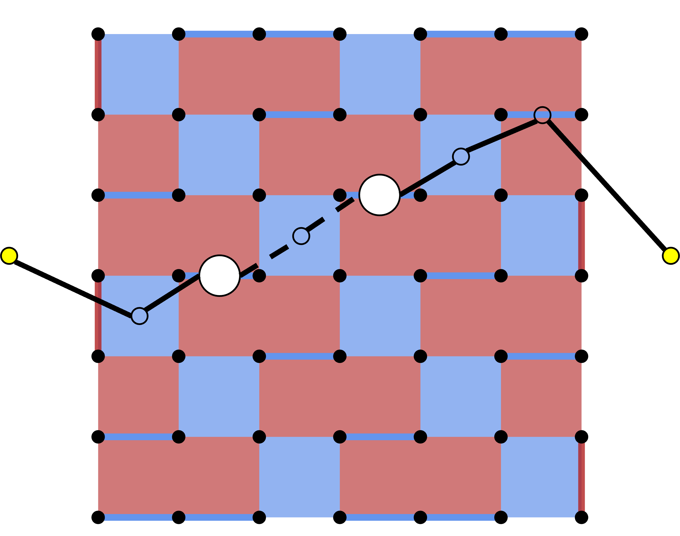

Slide 26






$$1$$
$$2$$
$$3$$
q1
$$4$$
$$5$$
$$6$$

Slide 27
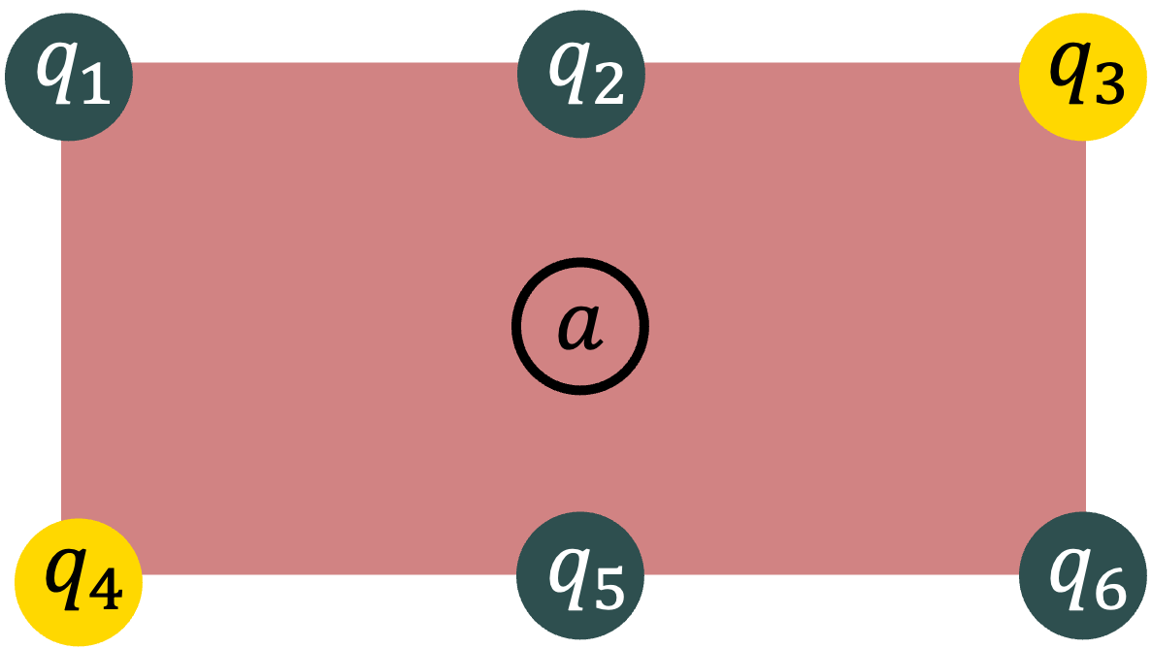

$$s$$

Slide 28
