Slide 1
Application of Network Methods for Yelp Review Recommendation
SI 608
Adharsh Murali, Andrew Barber, Koki Sasagawa, Phil Robinson

Slide 2
Objective
Implement a review recommendation system personalized to users based on Collaborative Filtering
Yelp reviews can be sorted by newest, oldest, highest rated, lowest rated, Yelp elites and “Yelp sort”
Our goal is to allow users to sort reviews based on users similar to themselves
Measure performance by predicting the users’ rating of a restaurant he/she/they have not visited using network methods to analyze similar neighbors.

Slide 3
Dataset: Yelp Dataset Challenge
The data is provided by Yelp for a competition aiming to encourage research and analysis by the community which can lead to many discoveries.
5,996,996 Total Reviews
188,593 Businesses
440,865 Users
280,992 Pictures (not used)
In total: 7.35 GB of data

Slide 4
Challenges
The yelp dataset is not structured as network data to begin with.
Network methods tend to be memory inefficient; due to the size of the yelp data, we cannot feasibly apply some of these methods
Yelp does not have a distinct “similarity” rating to use as a baseline. This makes evaluation difficult
Notes:
Required us to think about the different network structures we could create from this dataset
Several filtering steps were taken to reduce the data and keep computational costs reasonable. (number of edges rapidly increase as nodes grow)

Slide 5
Filtering
Filter data to include only open businesses from a particular state (e.g., Arizona)
Decreased the number of businesses by ~ 70%
Limit our scope to a specific category of restaurants (e.g., Chinese)
33,575 users, 538 businesses, 47,359 reviews
Created a custom test/train split for the filtered data
Filtered one more time to remove any users that only had one review
Created a custom split, based on a standard .75/.25 split
Custom aspect is mostly random; if it comes across a user_id that isn’t represented in the train data, it will automatically put that instance of user_id, business_id, stars in the train
On further findings of that user_id, .75/.25 applies
All user_id and business_id are represented in test and train
Notes:
Select open restaurants only since suggestions about closed restaurants do not help. Filter restaurants by state since in practical sense, users will look for stores within a state when using the app.
Group restaurant by category to keep reviews relevant to each other.

Slide 6
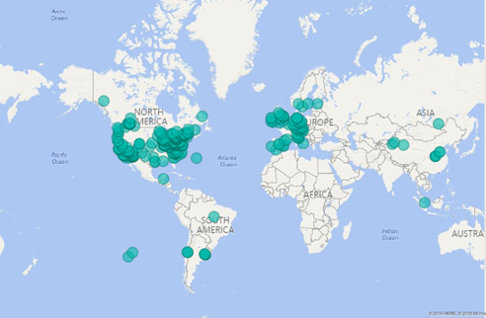
Geographic Distribution of All Businesses
Notes:
Globally, businesses are widely distributed, but at most we are only interested in results reseasonlably close to the user (out of context buisnesses not hepful)

Slide 7
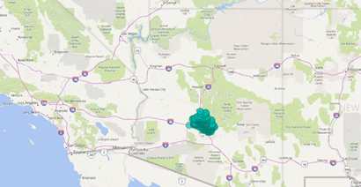
Geographic Distribution of Filtered Restaurants

Slide 8
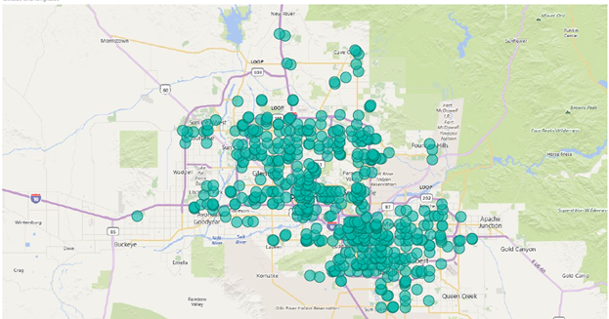
Geographic Distribution of Filtered Restaurants
Notes:
Lower level, more local visual representation shows dense clustering of businesses,
Shows Phoenix area

Slide 9
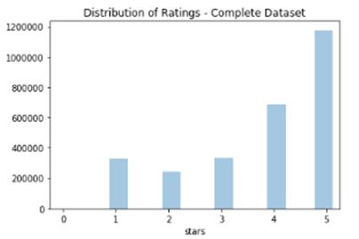
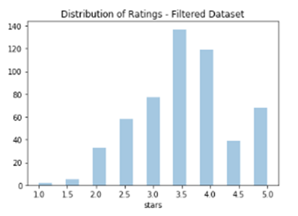
Distribution of Business Ratings
Notes:
Normal distribution

Slide 10
Networks Used
User-business bipartite graph
Edge attribute is the rating user gives a restaurant on 5-star scale
User-user one-mode projection
Weights are the number of restaurants two users rated
Used for Breadth-first search and Eigenvalue methods
User-categories bipartite graph
Categories: American, Italian, Indian, Mexican
Edges present in graph if a user had rated a restaurant in the category, otherwise no edge present
Used for Jaccard Similarity and Adamic/Adar methods

Slide 11
Methods
The collaborative filtering was done based on the concept of Homophily.
Rationale for implementation of Homophily
The two nodes are similar if they can be reached with low number of steps and there are multiple paths between them (BFS).
The two nodes are similar if they share common neighbors with each other (Jaccard/Adamic Adar).
Evaluation: because no standard for user-user similarity exists on Yelp, we used our similarity metric to predict target-user’s rating

Slide 12
Ditance-based
Initially, a community is built with all the reviewers to a business.
All shortest paths to target user are computed using the Breadth First Traversal method.
Based on the number of paths and distance from the queried user the reviewers are ranked.
Evaluation: Take average rating of top 10 most similar users

Slide 13
EigenVector Centrality
A one mode projection of the User-business Bipartite graph is created.
The importance of a node is computed using the EigenVector Centrality.
The intuition is that centrality depends on your neighbors and how central they are.
Query a user and ratings are assigned based on the ratings of the most influential node in business user subgraph.
Evaluation: Taking the average of most influential nodes in the subgraph.

Slide 14
Jaccard and Adamic/Adar
Utilize user-category bipartite graph
Query the business
Generate ego network of node and neighbors.
Take the top highest similarity score nodes and inherit the average of their ratings.

Slide 15
Results
Method | RMSE
BASELINE (Average rating for business) | 1.26
JACCARD | 1.77
ADAMIC/ADAR | 1.60
Distance-based | 1.27
EigenCentrality | 1.35

Slide 16
Conclusion
Difficult to beat baseline.
This tells us that reviewers may be swayed to rate restaurants as others have rated them, making the business’s average rating the best metric for predicting user rating
Using a smaller, more diverse set of categories measure a stronger “connection” between users, giving better Jaccard coefficients and Adamic/Adar index values
Distance-based performed better than Jaccard and Adamic/Adar
Defining similarity based on users who share interests based on types of restaurant not as effective as as defining similarity based on specific restaurants mutually visited

Slide 17
Future Directions
Apply these methods to different locations/business categories.
Perform External Validation using actual users of Yelp to understand the true potential of the application.
Use user similarity to suggest restaurants to user

