Slide 1
Clustering in Python
Austin Cory Bart
Virginia Tech
October 13, 2016

Slide 2
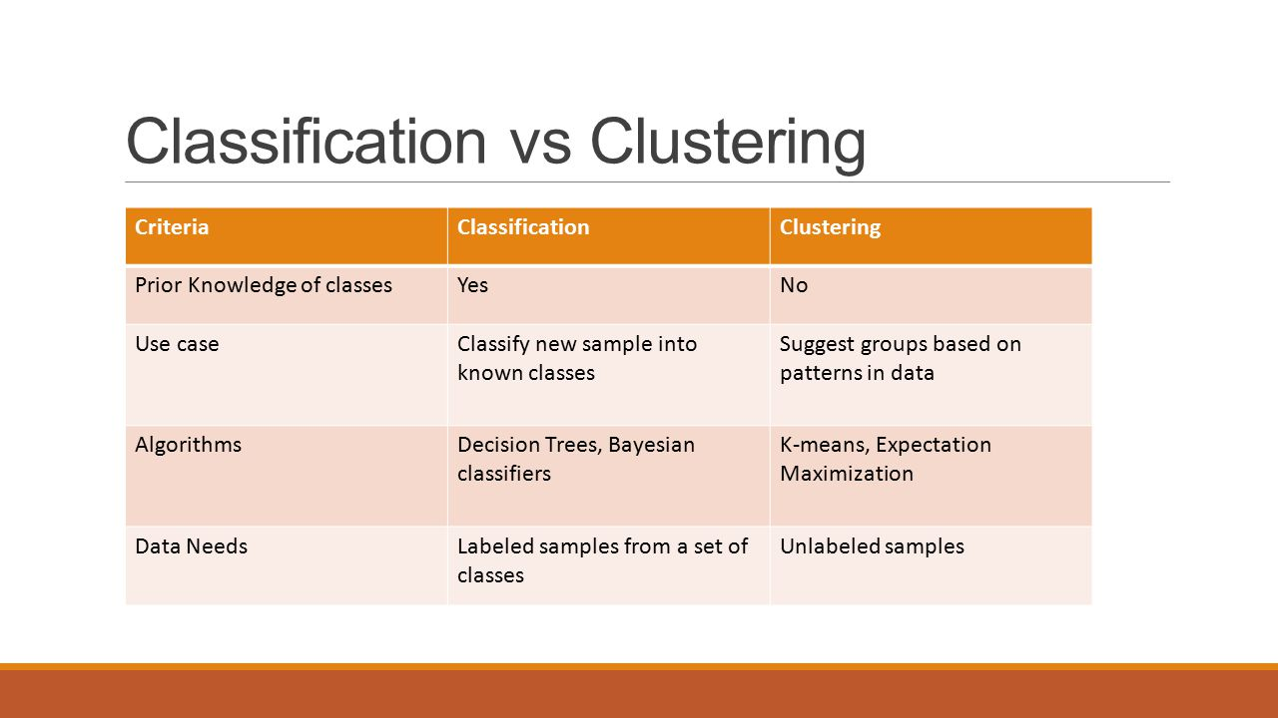
Classification vs. Clustering

Slide 3
Applications
How should I group my students?
How should I bin my students’ grades?
What kinds of students do I have?
What kinds of behaviors do students have?
Dutt, Ashish, et al. "Clustering algorithms applied in educational data mining." International Journal of Information and Electronics Engineering 5.2 (2015): 112.
Can I predict my students’ final marks?
Lopez, Manuel Ignacio, et al. "Classification via Clustering for Predicting Final Marks Based on Student Participation in Forums." International Educational Data Mining Society (2012).
Ahmed, Abeer Badr El Din, and Ibrahim Sayed Elaraby. "Data Mining: A prediction for Student's Performance Using Classification Method." World Journal of Computer Application and Technology 2.2 (2014): 43-47.

Slide 4
K-Means: Intuition
K: “Number of”, Means: “Centroids”
Minimize intra-distance, maximize inter-distance
Typically, optimizes using Euclidean distance

Slide 5
Process
Obtain/preprocess data
Standardize data
Remove outliers
Run KMeans Algorithm
Interpret Clusters

Slide 6
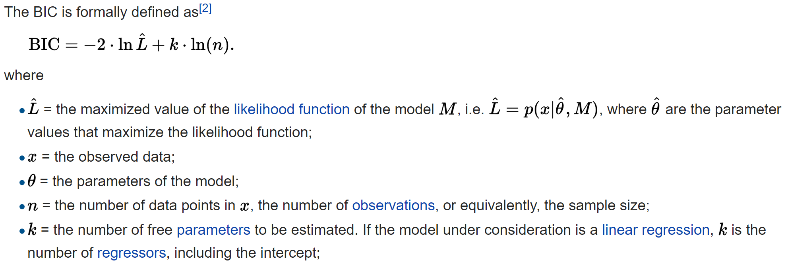
KMeans Questions
How do I pick my “K”?
Mostly, guess
BIC (Bayesian Information Criterion)

Slide 7
KMeans Questions
How do I know what my clusters represent?
You have to look at the data

Slide 8
KMeans Questions
What to do about categorical data?
Use a different algorithm, e.g., K-Modes
http://www.cs.ust.hk/~qyang/Teaching/537/Papers/huang98extensions.pdf
Hamming distance instead of Euclidean distance

Slide 9
KMeans Questions
What should I initialize with?
Typically, random is fine
Or initial values if you have priors

Slide 10
Sample Datasets
VT CS Department Grades (http://ir.vt.edu/data/courseGrade.html)
Name | Courses Taught | Upper Levels | Average Course Size | First Year | Latest Year | GPA | As | Bs | Cs | Ds | Fs
Last name | Since 2003 | # > CS3114 | # of students | Year that they taught |  | Average GPA | Percentages out of 100
Allevato | 21 | 0 | 37.047 | 2010 | 2013 | 3.308 | 50.004 | 38.128 | 8.209 | 1.485 | 2.152
Arthur | 33 | 33 | 40.333 | 2003 | 2015 | 3.303 | 55.893 | 28.339 | 9.981 | 3.312 | 2.481
Back | 23 | 20 | 23.043 | 2004 | 2015 | 3.145 | 45.291 | 35.452 | 13.417 | 1.921 | 3.904

Slide 11
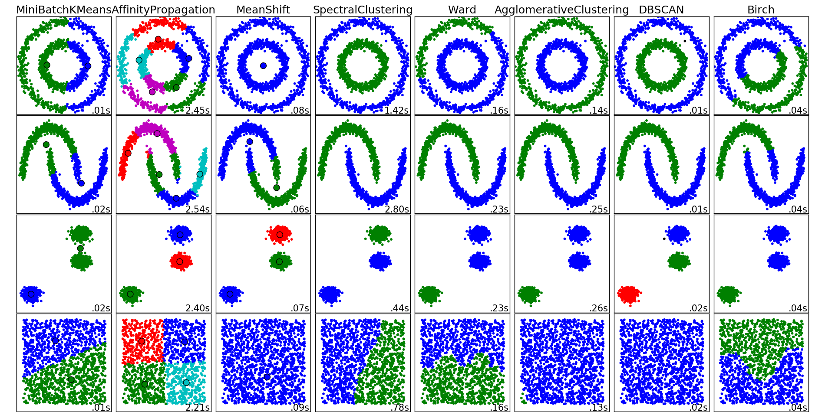

Slide 12
Let’s talk about our data
Features?
N?
Time-oriented?

Slide 13
Potential Groupings
Assignments
Students
Student Actions

