Slide 1
Really Pushing my Buttons Affordances in Block Interfaces
Austin Cory Bart, Luke Gusukuma, Dennis Kafura
Computer Science
Virginia Tech

Slide 2
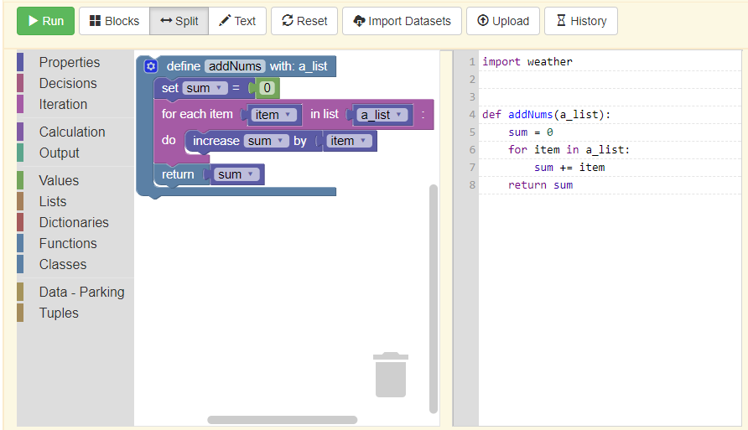
BlockPy: Dual Block/Text Python via Blockly + Skulpt
How do we design the block/text interface?
A. C. Bart, J. Tibau, D. Kafura, E. Tilevich, C. A. Shaffer, Design and Evaluation of a Block-based Environment with a Data Science Context, IEEE Transactions on Emerging Topics in Computing '17. May, 2017.
A. C. Bart, J. Tibau, E. Tilevich, C. A. Shaffer, D. Kafura, BlockPy: An Open Access Data-Science Environment for Introductory Programmers, IEEE Computer '17. May, 2017.
A. C. Bart, J. Tibau, E. Tilevich, C. A. Shaffer, D. Kafura, Implementing an Open-access, Data Science Programming Environment for Learners, COMPSAC '16, Atlanta, Georgia. June 10-15, 2016.
A. C. Bart, E. Tilevich, C. A. Shaffer, D. Kafura, Position Paper: From Interest to Usefulness with BlockPy, a Block-based, Educational Environment, Blocks & Beyond '15, Atlanta, Georgia. October 21-23, 2015.

Slide 3

I need to…
Explain the purpose of the block
Add new elements inside
Colorize the block so that users associate it with similar blocks
Remove elements
Reorder existing elements
Prevent statements from being added as elements
Show how [] (square brackets) are used in the python code

Slide 4

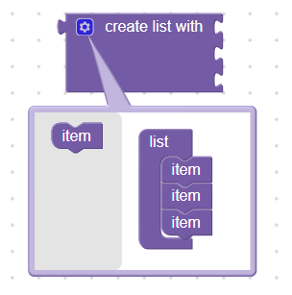

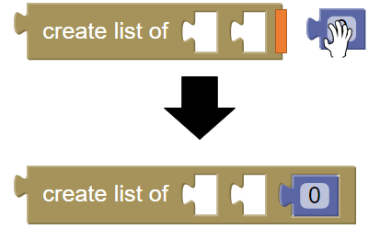

Innovative Interfaces
Block Buttons
Mutators
Keyboard Entry Blocks
Contextual Awareness
Block Components

Slide 5
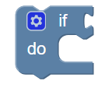
What is this block?

Slide 6

Translations

Slide 7

Complex Code
Function Decorator
Dictionary unpacking
Keyword parameter
Variable arguments

Slide 8
Design Questions
How do we minimize cognitive load?
What cues make it obvious?
How do we help those who don't understand?
What exposes the "true language" underneath best?
…
Can we have a list of tips and trade-offs?

Slide 9
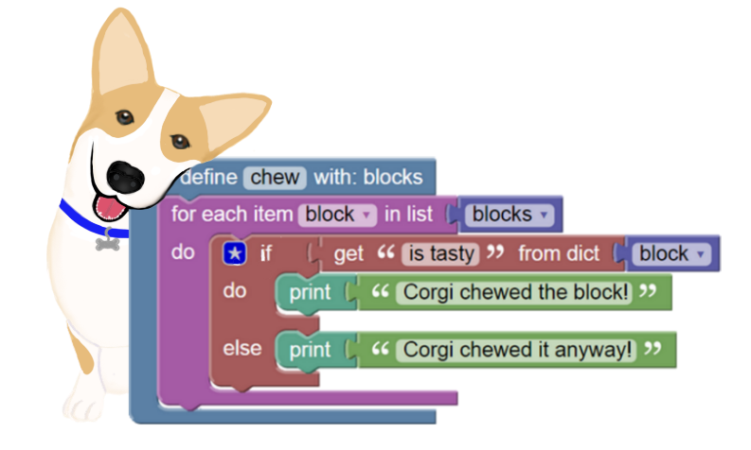
Thanks!
http://blockpy.com

