Slide 1



Send:
Rows 0-20, Columns “id”, “year”, “burglaries”, etc.
Receive:
Programmatic Data Objects
Send:
get_crimes(20, “USA”)
Receive:
List of Crime records
Local
Server
Send:
http://think.cs.vt.edu/crime?limit=20&location=USA
Receive:
[{“id”: 1, “year”: 2013, “burglaries”: 217, …}, …]
Routing Layer
Student Code
Client Library
Database Layer
Offline Data Cache
Big Data File

Slide 2
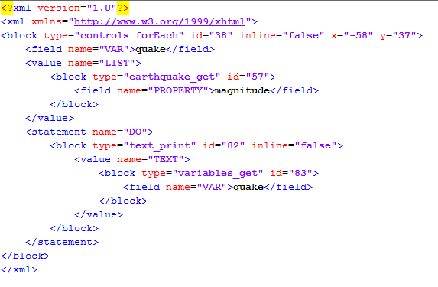
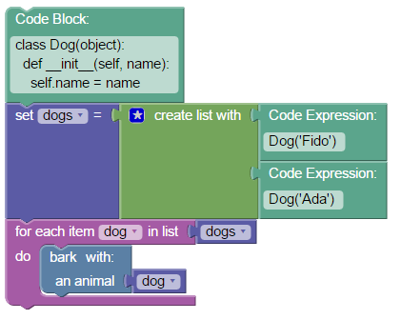
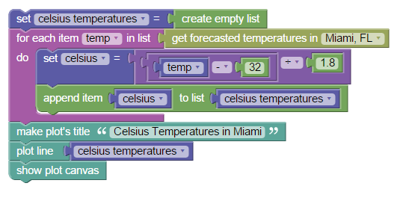
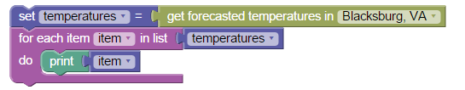

Slide 3
(1A) User triggers a change
Or
(1B) Client reloads page, and an entry is found in the LocalStorage
(2) Change is stored in LocalStorage
Client
Server
(3) Change is sent to server
(4) Server successfully stores change
(5) Server reports successful change to client
(6) Client clears entry in LocalStorage

Slide 4
Skulpt
Python
Code
System libraries
Blockly
APIs
Core Blocks
Python Blocks
MatPlotLib
API Blocks
CORGIS
Blockly
XML
Py2Block
JSON
Mappings

Slide 5
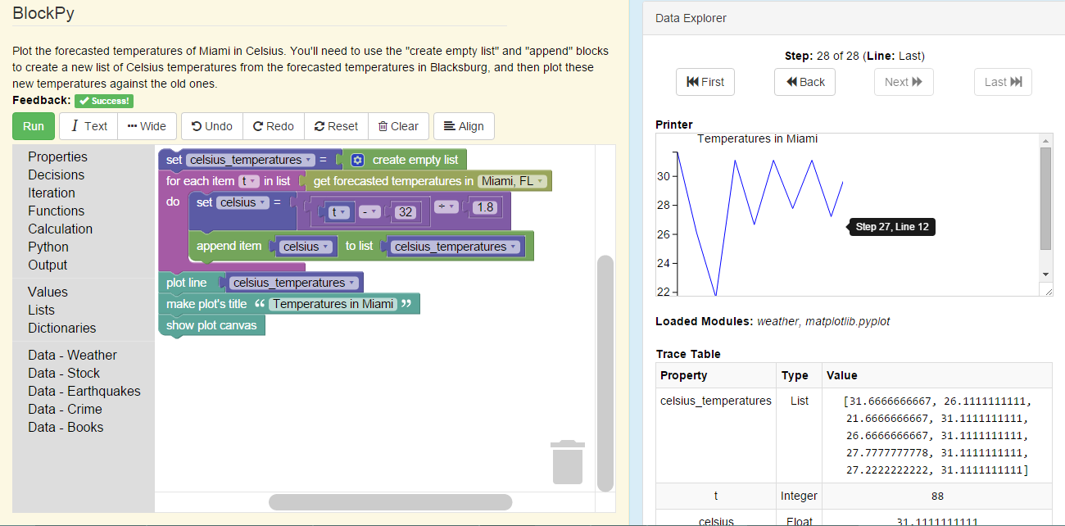

Slide 6
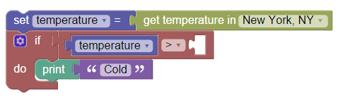
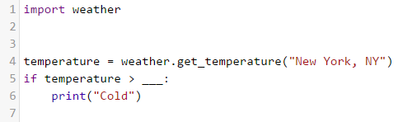
Python
Code
Skulpt
Blockly
System libraries
Core Blocks
APIs
Python Blocks
MatPlotLib
API Blocks
CORGIS
Blockly
XML
Py2Block
JSON
Mappings

Slide 7
Text
Blocks

Slide 8
Context
Content
CS-0 …
CS-1 …
CS-2 …
Big Data Course
CS-3 …
Primarily Motivational
“Frame Story”
Example: Use a simple for loop to iterate over a list of 20 weather reports and find the average temperature.
Primarily Cognitive
Assessed Information
Example: You have 20 gigabytes of weather reports, how can you find the average temperature efficiently?

