Slide 1
My Research
Austin Cory Bart

Slide 2
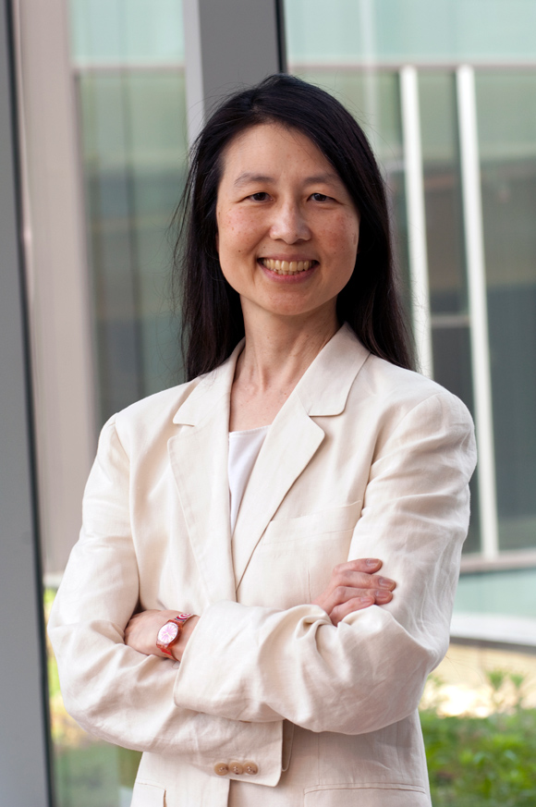
“Computational Thinking”
"Computational Thinking is the thought processes involved in formulating problems and their solutions so that the solutions are represented in a form that can be effectively carried out by an information-processing agent.“
-Jeanette Wing, 2006

Slide 3
Popular
Definitions
Universities
CMU
Google
CS Principles
CSTA
NSF
Brown
Princeton
NUI Maynooth
DePaul
Washington State
Charlseton
…

Slide 4
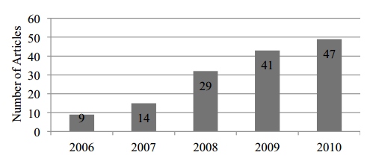
Much publications
Papers published
But quality?
26%: have an operational definition
17% have an evaluation
11% go beyond superficial
28% involve non-CS majors
18% involved education experts

Slide 5
Virginia Tech 5 Year Plan
“Computational thinking and informatics/digital fluency are becoming basic skills needed in all disciplines. Since an effective general education program includes providing strong foundations for the major courses of study while facilitating the integration of a broad base of knowledge, we will become a leader in providing innovative, creative approaches to general education. To this end, Virginia Tech will comprehensively evaluate and modify the current Curriculum for Liberal Education to embrace alternate pathways to a general education and to incorporate computational thinking and informatics/digital fluency as basic skills for all students, thereby enabling our students to be engaged citizens and life-long learners”
-A Plan for a New Horizon, Envisioning Virginia Tech, 2012-2018

Slide 6
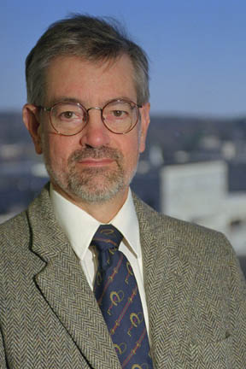
People – Dr. Dennis Kafura
Computer Science Professor
Serving on VT Committee
Computational Thinking Seminar
Computational Thinking Course

Slide 7

People – Austin Cory Bart
PhD Computer Science Student
CS Education/Software Engineering

Slide 8
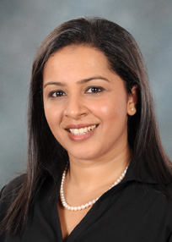
People – Bushra Chowdhury
PhD Engineering Education Student

Slide 9
Learning Objectives
Virginia Tech students will be able to realize the utility of computation in their profession or field of study thus being more competitive in their area of creative work.
Virginia Tech students will have a sense of inquiry in other fields thus developing a richer intellectual perspective on disparate ways of knowing.
Virginia Tech students will be able to cope with challenges that are complex and of large scale thus being more effective in the most demanding domains.
Virginia Tech students will be able to cope with rapid changes in information technology thus sustaining their creative leverage throughout their careers.
Virginia Tech students will have a basis on which to judge the societal impacts of computing and information technologies thus being more informed members of society.

Slide 10
Prior Courses
Introduction to Software Design (Java)
Introduction to Media Computation (Jython)
Intro to Programming in Python (Python)
CT4CS

Slide 11
CS-2984: “Introduction to Computational Thinking”
Non- CS majors
Area 5
25 students
One-off
Not a programming course
But still programming
Cohort Model
Active Learning

Slide 12
CS-2984: “Introduction to Computational Thinking”
Major | Count
Psychology | 4
Fine Arts | 3
Finance | 2
General Engineering | 2
History | 2
English | 2
Biology | 2
Animal and Poultry Science | 1
Business Information Technology | 1
Humanities, Science, and Environment | 1
Political Science | 1
Communications | 1
Apparel, Housing, and Resource Management | 1
International Studies | 1
Economics | 1
Total | 25

Slide 13
Course Outline
Introduction
NetLogo
Blockly
Python
Symposium
Project

Slide 14
Hypothesis
Contextualization will improve students motivation and cognition
We can create technology (libraries) that will contextualize

Slide 15







RealTimeWeb
“Conditional”
“Recursion”
“Abstract Data Type”
“Map-Filter-Foldr”
“Balanced Binary Tree”
“Fibonacci”
“Function”

Slide 16
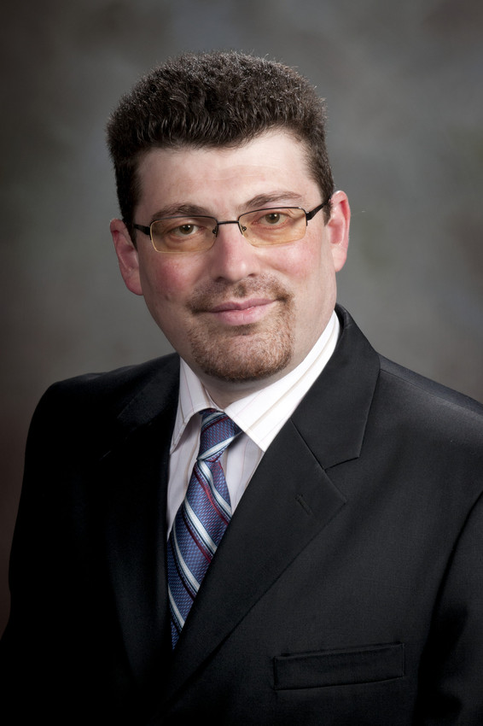
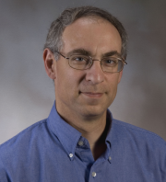
Dr.s Tilevich and Shaffer
RealTimeWeb

Slide 17
Libraries
https://github.com/RealTimeWeb/earthquakes/tree/master/python

Slide 18


Mock Data Streams
get-posts(“askreddit”)
http://reddit.com/r/askreddit/top.json
Local Cache Lookup
HTTP GET
{“kind”: “listing”, “status”: “success”, “response” : …}
Dictionary of Posts

Slide 19
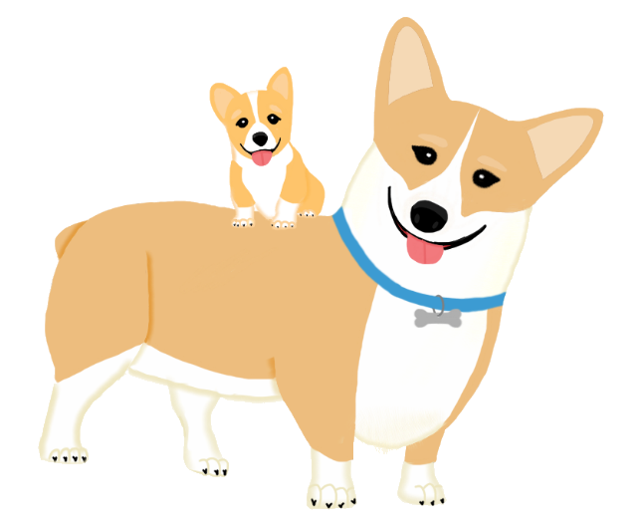
New Direction:
Collections Of
Real-time
Giant
Interesting
Situated
Datasets

Slide 20
Goals for a library
Dead-easy interface
Returns Python primitives – no classes
Tests
Documentation (internal and external)
Scaffolded function signatures
Returns int - get_temperature -> 92, -44, 37
Returns string – get_weather -> “rainy”, “snowy”, “clear”
Returns list – get_temperature_forecasts -> [92, 93, 90, 95]
Returns dict – get_report -> {“weather”: “rainy”, “temperature”: 92}
Returns list of dicts – get_forecast_reports -> [ {“weather” : …}, {“weather”: …”}, …]

Slide 21
Goals for the Summer
Minimum
Stretch
15 targeted libraries (one for each major)
5 general purpose libraries
Well-defined problems for each library
Idea of what Research is like
30 targeted libraries (two for each major)
15 general purpose libraries
2-3 well-defined problems for each library
Clear idea of what Research is like

Slide 22
Goals for this week
Time | Goal
Day 1 | Overview of Project, Introduction to Python
Day 2 | More Python?, Git
Day 3 | Hacking on a RealTimeWeb library
Day 4

Slide 23
Programming Rules
Spaces, no tabs
PEP-8
Document intelligently
Test
Commit Regularly

Slide 24
Software
Python 2.7
Python 3.3
Git

Slide 25
Python is not Java
Classes are the answer very rarely
We love first-order functions
Duck Typing
If-elseif-else is not a replacement for a Switch
Getters and Setters have died in a fire
Think “foreach”, not “for”

Slide 26
Warm-up assignments
http://interactivepython.org/runestone/static/thinkcspy/toc.html

Slide 27
Resources
http://i.imgur.com/WRuJV6r.png
http://interactivepython.org/runestone/static/thinkcspy/toc.html#

