Slide 1
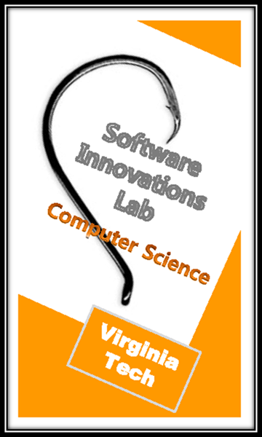

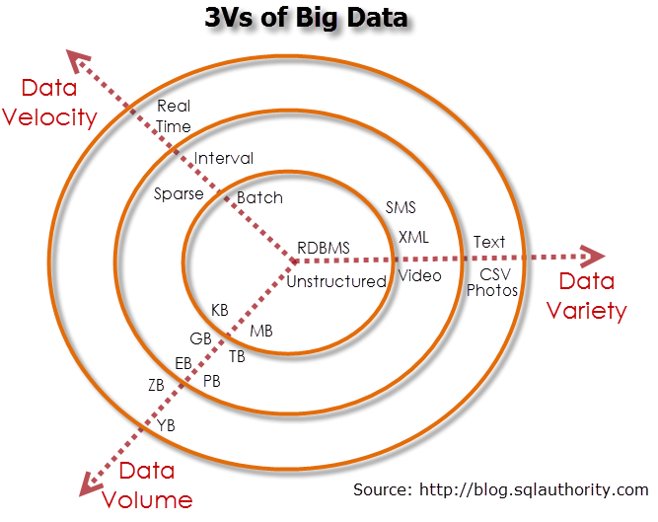




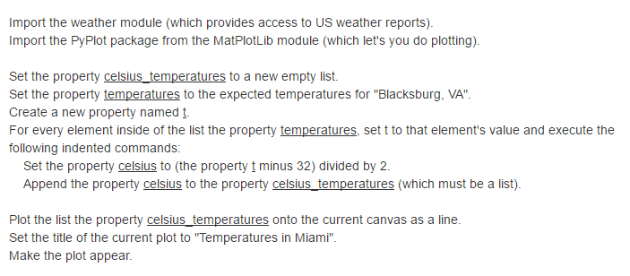
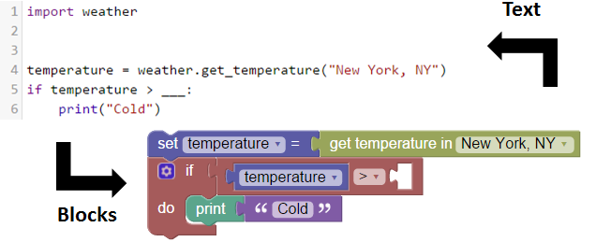

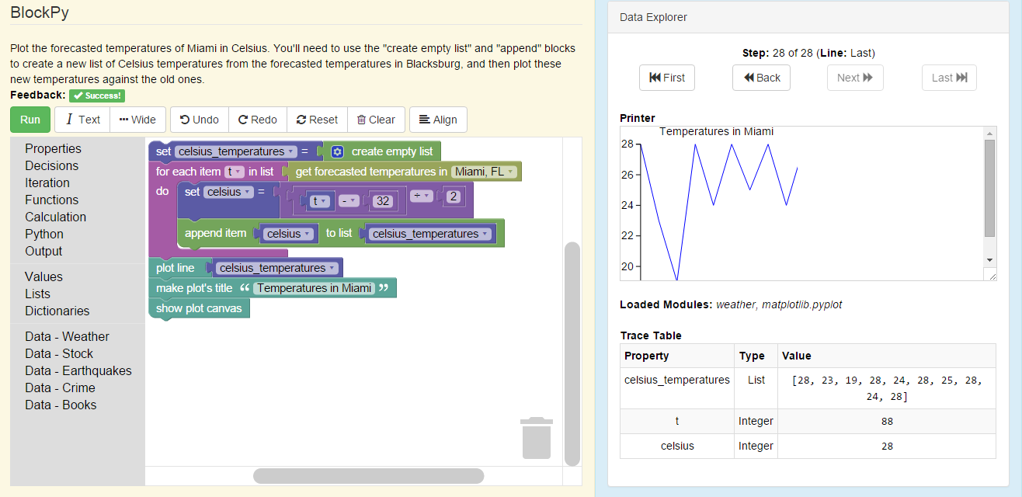

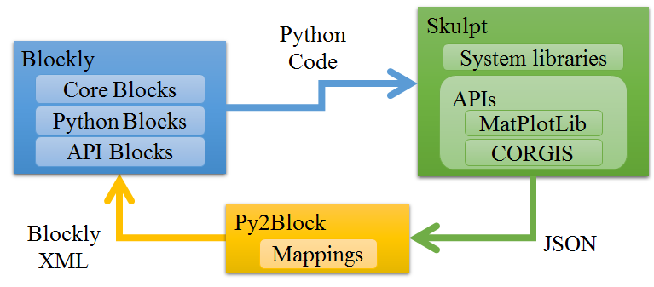

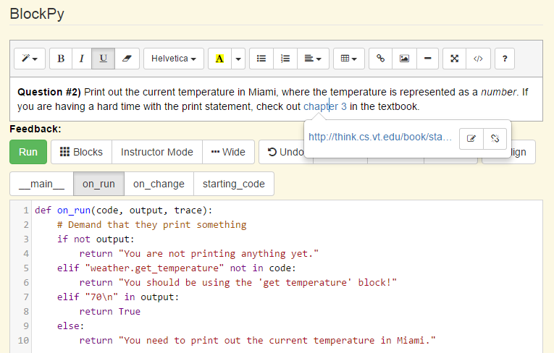









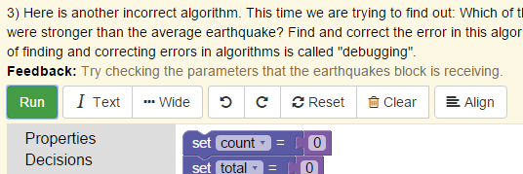









Situating Computational Thinking with Big Data: BlockPy and CORGIS
Austin Cory Bart, Javier Tibau, Bushra Chowdhury, Dr. Dennis Kafura, Dr. Clifford A. Shaffer, Dr. Eli Tilevich
Problem and Motivation
Relevant Theories and Background
Pedagogy
“
To this end, Virginia Tech will comprehensively evaluate and modify the current Curriculum for Liberal Education to … incorporate computational thinking and informatics/digital fluency as basic skills for all students, thereby enabling our students to be engaged citizens and life-long learners.”
Sources of motivation as modelled by the MUSIC Model of Academic Motivation
eMpowerment
Usefulness
Success
Interest
Caring
Theory of Big Data
“Introduction to Computational Thinking”
2 instructors (Senior and Associate)
Fall 2014: 24 students , 70% male
Spring 2015: 40 students, 60% female, 3 UTAs
Spring 2016: 50 students, 50% female, 4 UTAs
20 different majors from 5 different colleges
3-phase course with repeated emphasis on core objectives
Computational Thinking: New requirement at Virginia Tech for 24,000+ undergraduates
Represents a movement in higher education to bring computing to everyone
The primary challenges here are
Engage a diversity of different majors
Scale the learning experience to thousands
Many existing approaches exist: Math, Animation, Games, Robots, Web/Mobile Dev, Simulations, Image Manipulation, … But are these really authentic and useful for all?
We join with a small but growing initiative of research initiatives that use Big Data as an authentic, motivating learning context for students.
(1) NetLogo
(2) BlockPy
(3) Python
Abstraction and Modelling
Algorithms
Open-ended Final Projects
Class Strategy
Staff are guides, not talking heads
Only a quarter of classtime is lecture
Early focus on paper-and-pencil topics
All material situated in Big Data context
Educational Theories
Situated Learning
Constructivism
Socio-cognitivism
Active Learning
Problem-based Learning
Cooperative Learning
Mastery Learning
Instructional Design
“Conditional”
“Recursion”
Learning Objectives
Abstraction
Algorithms
Visualizations
Social Impacts
Cohort model
Interdisciplinary teams
5-6 students
Free to work together
Support network
“Fibonacci”
“Balanced Binary Tree”
“Function”
“… Information that cannot be handled with traditional methods…”^{[5]}
Technology
BlockPy
Block-based programming using BlockPy
Local Python execution with Skulpt
Automatic, interactive feedback through static analysis and output checking
Code-aligned Property Explorer
English-text explanation of code
Real-time bi-directional mapping with Python code for deep transfer
Plot visualization blocks
CORIGS datasets blocks
Interaction logging for advanced analysis
Integration with Canvas through LTI
Automatic English Explanation
Dual Block/Text Conversion
CORGIS Datasets Project
Collection of Real-time, Giant, Interesting datasetS
Over 35 ready-to-use datasets in a wide variety of subjects
Free, open-source
Beginner-friendly interface
Goal is to support Python, Java, Racket, and Android
Internal scaffolding for managing high velocity and high volume datasets
(get-weather ...)
.searchBusinesses()
.get_stocks()
[...]
Real-Time
Web Service
Client Library
Data Munging Logic
Block-Text Conversion Architecture
Sampled Local Cache for offline access
Large
Data File
Instructor Interface
Automatic, Guided Feedback
Social Link Sharing
International Events
Weather Forecasts
UCR Crime Statistics
Stock Logs
Local Businesses
Dairy Herd
Measurements
Magic the Gathering cards
Disease
Statistics
Geocoding
Endangered Species Registers
Earthquake Reports
Twitter Tweets
Government
Records
Motivational Data
Conclusions and Future Work
Overall Lessons
Survey data gathered from the first offering indicates students enjoyed the experience
Authentic assessment of student final projects suggests positive learning gains
Plan to leverage the Computational Thinking Concept Inventory for context comparison
Longitudinal analysis to determine the course’s impact on students long-term success
Pedagogical Lessons
Social interaction is key – as class continues to scale, the human element must be retained
Students definitely appreciated the more active lessons (as expected from literature)
Success (Self-efficacy) and Self-regulation is of growing importance
Technology Lessons
Building up problems is hard, especially if they have feedback – need more tools for this
NetLogo doesn’t fit in well – needs to be replaced with BlockPy/Python material
As we embrace more and more learners, we need more and more datasets; eventually we will want to look into artificially created datasets
References
[1] A. C. Bart, et al., “Implementing an Open-access, Data Science Programming Environment for Learners”, COMPSAC '16, Atlanta, Georgia. June 10-15, 2016.
[2] Bart, A. C., et al. “Transforming introductory computer science projects via real-time web data.” SIGCSE. 2014.
[3] Anderson, C. “The end of theory.” Wired magazine, 16, 2008.
[4] Anderson, R. E., et al. "Introductory programming meets the real world: using real problems and data in CS1." SIGCSE. 2014.
[5] Carter, L. “Why students with an apparent aptitude for computer science don't choose to major in computer science.” ACM. p. 27-31 (2006).
[6] Jones, B. D. “Motivating Students to Engage in Learning: The MUSIC Model of Academic Motivation.” International Journal of Teaching and Learning in Higher Education 21.2 (2009)
[7] Manyika, J. , et al. “Big data: The next frontier for innovation, competition, and productivity.” (2011).
[8] Office of the Senior Vice President and Provost. “Academic implementation strategy for a plan for a new horizon: Envisioning Virginia Tech 2013-2018.” Technical report, 2013.
This material is based upon work supported by the National Science Foundation, grant TUES-1140318, and the National Science Foundation Graduate Research Fellowship, Grant No. DGE 0822220

