Slide 1


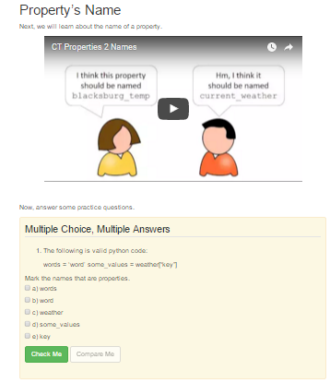
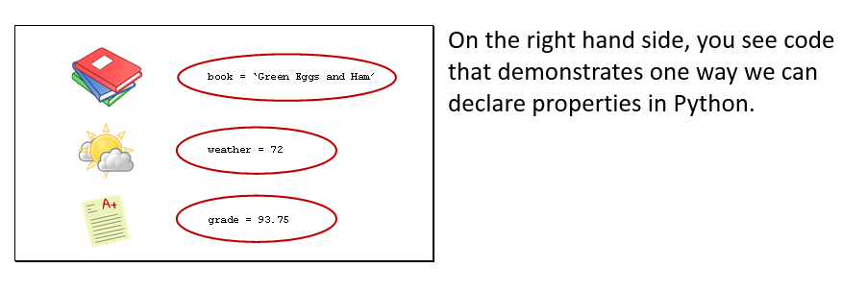
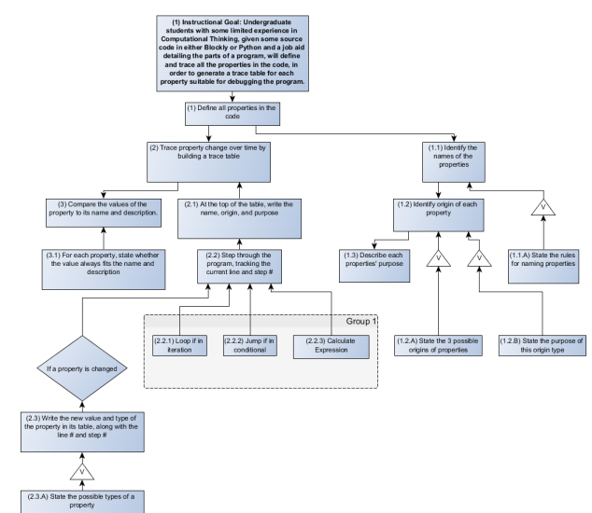
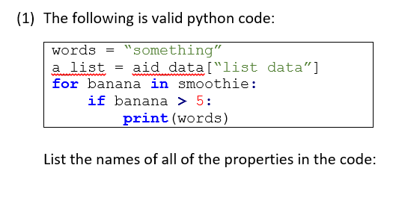
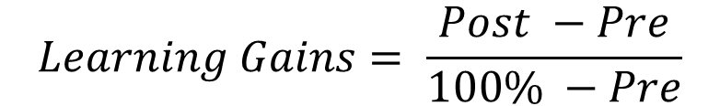
Applying Formal Models of Instructional Design to Measurably Improve Learning in Introductory Computing
Austin Cory Bart working under Eli Tilevich, Clifford A. Shaffer, Dennis Kafura
Instructional Design
“The systematic design of learning experiences that give measurable results by following a well-defined process.” [1, 3]
A theory of teaching, orthogonal to theories of learning.
Highly comparable to Software Engineering, but predates it
Applications in higher education, industrial training, and K-12 education
Computer Science Education
Most existing research ironically only suggests how Software Engineering techniques can be applied to Instructional Design [2, 5].
The remainder approaches the subfield by focusing on pedagogical tactics rather than a holistic design life cycle. [4]
Observation: Most CS Educators don’t follow formal methods when developing their learning experiences.
Research Questions
What does the Instructional Design life cycle look like in practice?
What are the advantages and disadvantages of applying ID to CS Education?
What practical actions can an educator take to improve their rigor?
Methodology
Practical case studies applying the model
Understanding variables in Computational Thinking course
Designing a 5-day workshop on Computer Science
Written observations and reflections
List all the variables used in the code
Identify the names of the variables
State the rules for naming variables (Verbal information)
Identify binding of each variable…
Balance deep assessment with rapid feedback
Same test for the pre- and post-.
What is the learner is able to do after instruction?
Define abstraction
Trace variables in code
Create a program
Explore topics in Compilers
Avoid fuzzy goals by using observable verbs
Actual development
Establish domain/level of knowledge
Sequence and cluster presentation and participation activities
(2) Conduct Instructional Analysis
(10) Revise Instruction
(1) Identify Instructional Goals
(4) Write Performance Objectives
(5) Develop Assessment Instruments
(6) Develop Instructional Strategy
(7) Develop Instructional Materials
(8) Conduct Formative Evaluation
1) Gain attention
2) List objectives
4) Present the content
6) Elicit performance
7) Provide feedback
8) Assess performance
9) Enhance transfer
Preinstructional Activities
Presentation Activities
Learner Participation
Assessment
5) Provide guidance
Follow-through
3) Stimulate recall
(3) Analyze Learners and Contexts
Gain Attention: This is crucial to completing your final project
List Objectives: Students will be able to …
Stimulate Recall:
(9) Conduct Summative Evaluation
Performance Conditions | Given some source code in python…
Desired Behavior | … learners will list the name and origin and trace the value and type…
Judging Criteria | … of every variable in the code.
$$Learning Gains= \frac{Post −Pre}{100\% −Pre}$$
Usability Studies: 1-1, Small Group, Field Trial
Characteristic | Computational Thinking | Computer Science Workshop
Age | Freshman-Senior | High-school Juniors
Gender | 50% male/female | 75% male/female
Majors | Mostly non-STEM | STEM
Metacognition | Relatively low | Relatively high
Interests | Varied | Relatively homogenous
Self-efficacy | Low | Medium
… | … | …
Judgement criteria for a goal, moderated by the learners traits.
Largely a formality, can be quite tedious
Quantitative Data Results
Learner | Pre | Post | Gains
1-1: #1 | .378 | 1 | 1
1-1: #2 | .518 | 1 | 1
1-1: #3 | .357 | .846 | .761
SG: #1 | .217 | .933 | .914
SG: #2 | .546 | 1 | 1
SG: #3 | .643 | .910 | .749
SG: #4 | .327 | .800 | .703
SG: #5 | .694 | .910 | .706
Average | .460 | .925 | .825
Distribution, averages, variances, and outliers
Performance Conditions | Given the term “Abstraction”
Desired Behavior | … learners will be able to give a definition…
Judging Criteria | …. That includes the concept of simplification and an example.
Qualitative Data Results
Confusion about “purpose” of a variable
Some of the videos ended abruptly
The recap at the end was very helpful
Video audio was too low
Potential Advantages
Measured gains
Focused instruction
Simplified replication
Whether for dissemination, revision, or collaboration
Potential Disadvantages
Too much assessment
Recognize diminishing returns
Railroading pedagogy
Stay flexibile
Time-consuming
Over 24 hours to create 30 minutes of instruction
Moderate process vs. product
Practical Takeaways
Focus first on what concretely describing what to teach
Plan tests early to measure student progress
Match your instructional strategy to design patterns
Evaluate your materials
Document your process
References
[1] Dick, W., Carey L., and Carey, J. O.. "The systematic design of instruction." (2005).
[2] Douglas, I. "Instructional design based on reusable learning objects: Applying lessons of object-oriented software engineering to learning systems design." Frontiers in Education Conference, 2001. 31st. Vol. 3. IEEE.
[3] Gagne, R. M., Wager, W. W., Golas, K. C., Keller, J. M., et al. (2005). Principles of instructional design.
[4] Hadjerrouit, S. "Learner-centered web-based instruction in software engineering." Education, IEEE Transactions on 48.1 (2005): 99-104.
[5] Tripp, S. D., and Bichelmeyer, B.. "Rapid prototyping: An alternative instructional design strategy." Educational Technology Research and Development 38.1 (1990): 31-44.
This material is based upon work supported by the National Science Foundation Graduate Research Fellowship, Grant No. DGE 0822220

