Slide 1


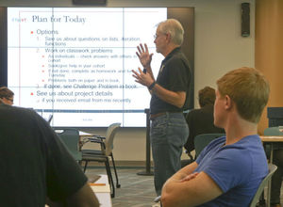


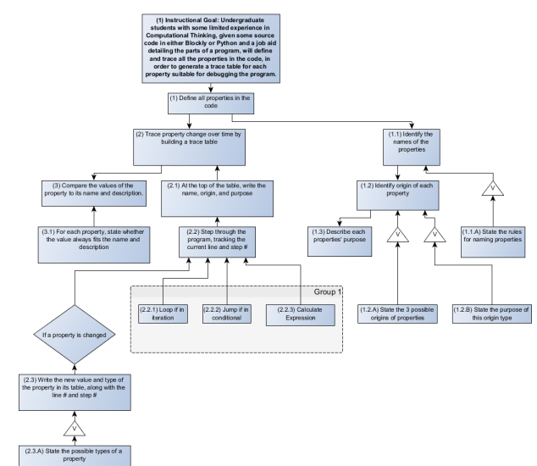
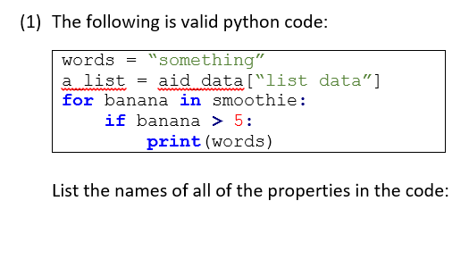
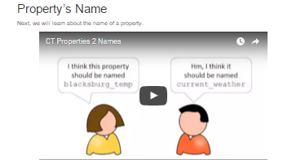



Applying Formal Models of Instructional Design to Measurably Improve Learning in Introductory Computing
Austin Cory Bart working under Eli Tilevich, Clifford A. Shaffer, Dennis Kafura
Instructional Design
Computer Science Education
Research Questions
What does the Instructional Design life cycle look like in practice for Computer Science Education?
What are the advantages and disadvantages of applying Instructional Design to CS Education?
What practical actions should a CS educator take based off Instructional Design best practices?
Methodology
“The systematic design of learning experiences that give measurable results by following a well-defined process.” [1, 3]
A theory of teaching, orthogonal to theories of learning.
Highly comparable to Software Engineering, but predates it
Applications in higher education, industrial training, and K-12 education
ID
Most prior research suggests how Software Engineering techniques can be applied to Instructional Design [2, 5].
The remainder focuses on pedagogical tactics rather than a holistic life-cycle. [4]
Core Assumption: Most CS Educators don’t use formal methods when developing their instruction.
Practical case studies applying the model
Understanding variables in Computational Thinking course for non-major students
Designing a 5-day workshop on Computer Science for rising high-schoolers
Review literature, observations, reflections
(1) Identify Instructional Goals
What is the learner able to do after instruction?
(2) Conduct Instructional Analysis
Decompose the expert performance into observable steps.
(3) Analyze Learners and Contexts
Understand the learners and environments as well as you can.
Remember
Verbal Information
Define abstraction
List control flow structures
Intellectual Skills
Analyze a program’s runtime
Trace variables in code
Cognitive Strategies
Explore topics in Compilers
…
Avoid fuzzy goals (e.g, “understand abstraction”) by using observable verbs
Not a list of teaching steps!
List all the variables used in the code
Identify the names of the variables
State the rules for naming variables (Verbal information)
Identify binding of each variable…
Characteristic | CT Tracing | CS Workshop
Age | Freshman-Senior | High-school Juniors
Gender | 50% male/female | 75% male/female
Majors | Mostly non-STEM | STEM
Interests | Varied | Unknown – survey
Self-efficacy | Low | Medium
… | … | …
Distribution, averages, variances, and outliers
Understand
Helps coordinate designers
Apply
Establish domain/level of knowledge, a la Bloom’s Taxonomy or Gagne’s Learning Domains
Analyze
Establishes what we know and also what we don’t know
Evaluate
Flowcharts to diagram complex Intellectual Skills
Create
(4) Write Performance Objectives Judgement criteria for each goal and subgoal, moderated by the learners traits.
(5) Develop Assessment Instruments
Create pre-, post-, and practice assessments to measure learners.
(6) Develop Instructional Strategy High-level “architecture” of your instruction, matched to models
Conditions | Given some source code in python…
Desired Behavior | … learners will trace the value and type…
Judging Criteria | … of every variable in the code.
Specifies what these learners should be able to do, as opposed to an expert
 | Generic | Specialized
Manual | Essay Short response | Program creation
Automatic | Multiple-choice True/false Fill-in-the-blank Apply formula | Trace execution Structured program creation
Preinstructional Activities
Motivate Lesson
List Objectives
Stimulate Recall
Assessments
Pre? Post? Entry skills?
Follow-through
Hand-out? Transfer?
Presentation | Participation
Watch an introductory video on variables | Answer multiple choice questions on properties
Watch a video on variable naming rules | Circle all variables in a program
… | …
Conditions | Given the term “Abstraction”
Desired Behavior | … learners will be able to give a definition…
Judging Criteria | …. Including all components in the rubric
Largely a formality, can be quite tedious
Balance deep assessment with rapid feedback
Same test for the pre and post.
Organize based on learning theories
(7) Develop Instructional Materials Actual development of necessary presentations, hand-outs, etc.
(8) Conduct Formative Evaluation
Gather data using 1-1, small groups, and field trials to evaluate the materials.
(9) Revise Instruction
Based on the data gathered, iterate on the materials, assessments, objective, etc.
Just as Software Engineering doesn’t enforce particular code, Instructional Design doesn’t dictate material design or delivery.
Qualitative survey and interview results
Confusion about “identifying purpose” of a variable
Some of the videos ended too abruptly
Video audio was too low
The recap at the end was very helpful
Learner | Pre | Post | Gains
1-1: #1 | .378 | 1 | 1
1-1: #2 | .518 | 1 | 1
1-1: #3 | .357 | .846 | .761
SG: #1 | .217 | .933 | .914
SG: #2 | .546 | 1 | 1
SG: #3 | .643 | .910 | .749
SG: #4 | .327 | .800 | .703
SG: #5 | .694 | .910 | .706
Average | .460 | .925 | .825
Quantitative data results, suitable for analysis, e.g., Item-Response Theory
Planned Revisions
Remove learning objective about “explaining a variable’s purpose”
Move assessment to an automatically graded system
Re-record audio on videos
…
(10) Summative Evaluation
Use external experts and impact analysis before dissemination
Largely unused in academia due to the difficulty in conducting longitudinal impact analyses and the limited dissemination.
Potential Trade-offs
Practical Takeaways
Instructors should…
Focus first on what learners can do after instruction
Plan tests before development to focus instruction
Match your instructional strategy to design patterns
Evaluate your materials for improvements, quality
Document your process
Instructional Design has potential as a technique for rigorously improving and evaluating instruction, and merits further study.
References
[1] Dick, W., Carey L., and Carey, J. O.. "The systematic design of instruction." (2005).
[2] Douglas, I. "Instructional design based on reusable learning objects: Applying lessons of object-oriented software engineering to learning systems design." Frontiers in Education Conference, 2001. 31st. Vol. 3. IEEE.
[3] Gagne, R. M., Wager, W. W., Golas, K. C., Keller, J. M., et al. (2005). Principles of instructional design.
[4] Hadjerrouit, S. "Learner-centered web-based instruction in software engineering." Education, IEEE Transactions on 48.1 (2005): 99-104.
[5] Tripp, S. D., and Bichelmeyer, B.. "Rapid prototyping: An alternative instructional design strategy." Educational Technology Research and Development 38.1 (1990): 31-44.
This material is based upon work supported by the National Science Foundation Graduate Research Fellowship, Grant No. DGE 0822220
Measured gains: Very clear and obvious improvements or performance
Focused instruction: Strong connection between assessments and instruction
Early Errors: Designing before developing catches some kinds of problems early
Simplified replication: Improves dissemination, revision, and collaboration
Too much assessment: Recognize diminishing returns and testing fatigue
Railroading pedagogy: Stay flexible and open to revising your materials
Time-consuming: Short-term increases to workload, over 24 hours and 30 pages in one of our case studies. Moderate the process vs. the product.

