Slide 1
From Interest to Usefulness with BlockPy a Block-based, Educational Environment
Austin Cory Bart, Eli Tilevich, Clifford A. Shaffer, Dennis Kafura
Blocks & Beyond 2015, Atlanta, GA

Slide 2
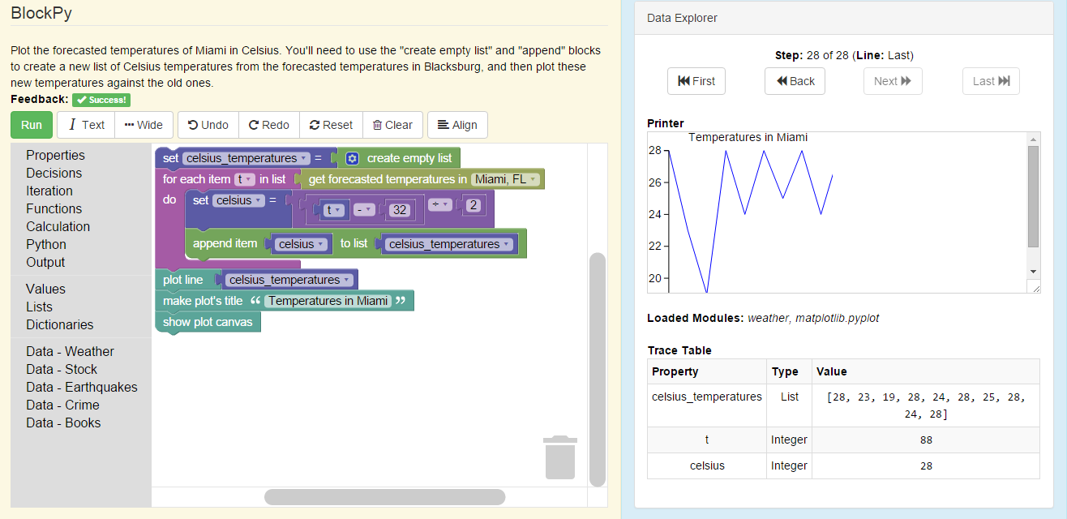
Overview
BlockPy
Dual Text/Blocks
Data Science
Guided Practice
“Serious Blocks”
Free, open-source web-based environment: www.blockpy.com

Slide 3
Target Audience
Undergraduate
Non-CS majors
With no prior programming

Slide 4

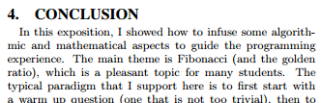
Contexts: Math and Business
Pure Math (e.g., Fibonacci)
Saad Mneimneh. 2015. Fibonacci in The Curriculum: Not Just a Bad Recurrence. In Proceedings of the 46th ACM Technical Symposium on Computer Science Education (SIGCSE '15). ACM, New York, NY, USA, 253-258.

Slide 5
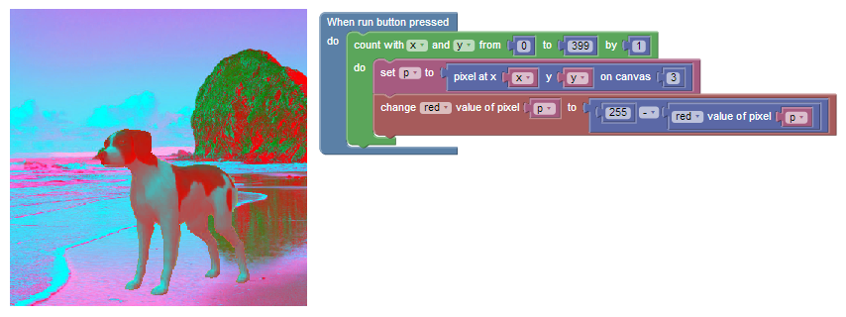

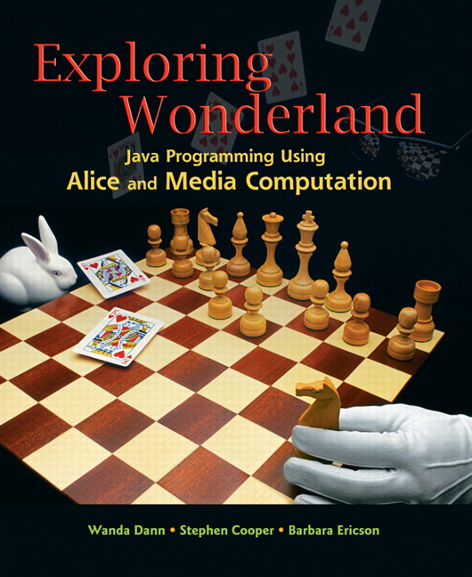
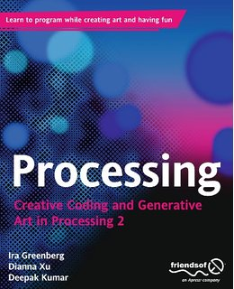

Fun to the rescue!
*Mark Guzdial and Allison Elliott Tew. 2006. Imagineering inauthentic legitimate peripheral participation: an instructional design approach for motivating computing education. In Proceedings of the second international workshop on Computing education research (ICER '06). ACM, New York, NY, USA, 51-58. DOI=10.1145/1151588.1151597 http://doi.acm.org/10.1145/1151588.1151597

Slide 6



Diverse Majors
… with Rich Knowledge
English
Biological Sciences
Animal Sciences
Education
Theater Arts
History
Building Construction

Slide 7
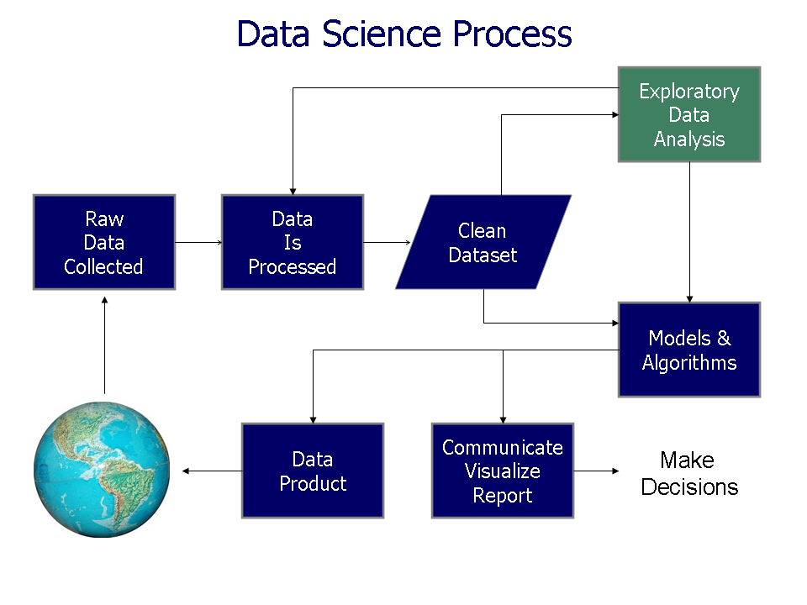
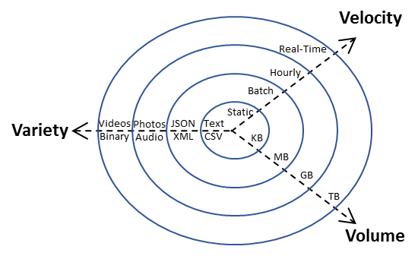
Big Idea: Real-World Data

Slide 8
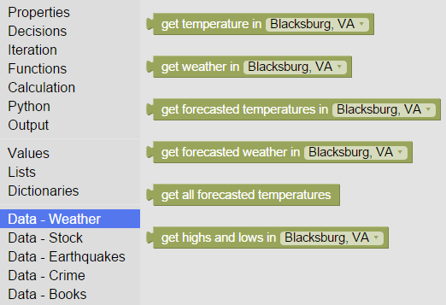

Data Blocks
Collections Of
Real-time
Giant
Interesting
Situated
Datasets

Slide 9
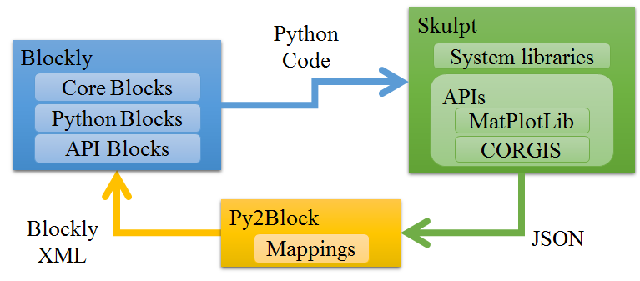
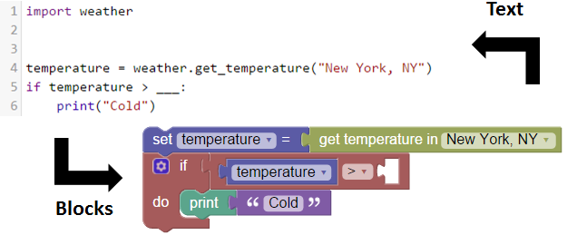
Mutual Language Translation

Slide 10
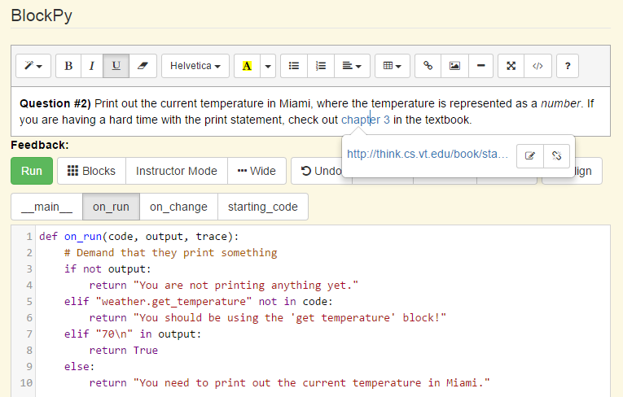
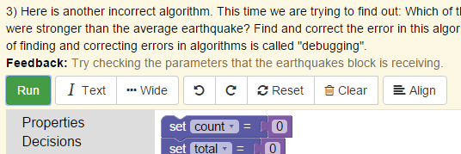
Guided Practice Problems

Slide 11
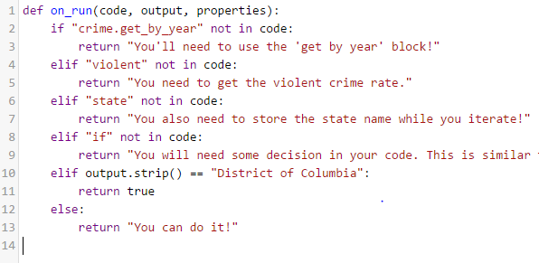
Instructor-Supplied Code
Source Code as string
List of console output
Variable traces

Slide 12
Interesting Problems
Student Tracking/Modeling
Program Analysis
Improved UI
Forcing the transition

Slide 13
Try it now!
www.blockpy.com
Free, open-source

Slide 14

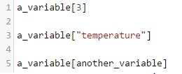


Mutual Language Translation
"Impossible in a dynamic language!"

Slide 15
Yes, and our programs are different
<10-15 lines of code
Limited control flow: for-each, if, ...
Only built-in types (int, float, str, dict, list)
Forbid re-typing
We can say roughly what it should look like

Slide 16
Static type inference?
"Giving people a dynamically-typed language does not mean that they write dynamically-typed programs."
Aycock, John. "Aggressive type inference." language 1050 (2009): 18.
Assume any given variable is given a type, and use regular flow-insensitive program analysis.

Slide 17

Problem Student Identification
Which students needs help?

Slide 18
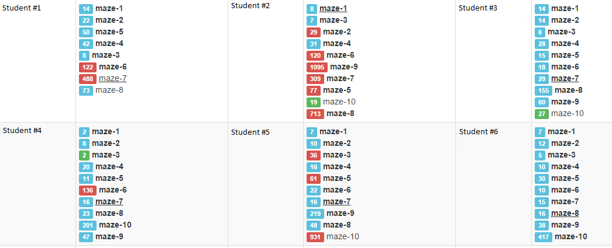
Submission Count in Blockly Dashboard
Danger Student!
Incompletes
Faster than class average
Average Student
Slower than class average

Slide 19

Python
Python is now the most popular introductory teaching language at top U.S. universities
8 of the top 10 CS institutions in CS0 or CS1
27 of the top 39 CS institutions in CS0 or CS1
pgbovine.net/CACM-python-most-popular-teaching-language.htm

