Slide 1
Motivating Introductory Computing with Student-Driven Datasets
Austin Cory bart
Research defense
Nov 29, 2016

Slide 2
Outline
Thesis and research questions
Prelim Work
Schedule
Papers published
Dissertation outline

Slide 3
My Thesis
A Data Science context can effectively motivate introductory computing students, particularly those not pursuing CS as their major.

Slide 4
Research Questions
How do introductory computing students become motivated? (Chapter 2.a, Lit Review)
How does Data Science compare to other introductory contexts? (Chapter 2.b , Lit Review)
What affordances and barriers does Data Science offer as an introductory context? (Chapter 2.c , Lit Review)
How can technology support Data Science as a learning context? (Chapter 3 , Technology)
What is the impact of a data science context, as opposed to other course components, on student motivation and course outcomes? (Chapter 4, Study)

Slide 5
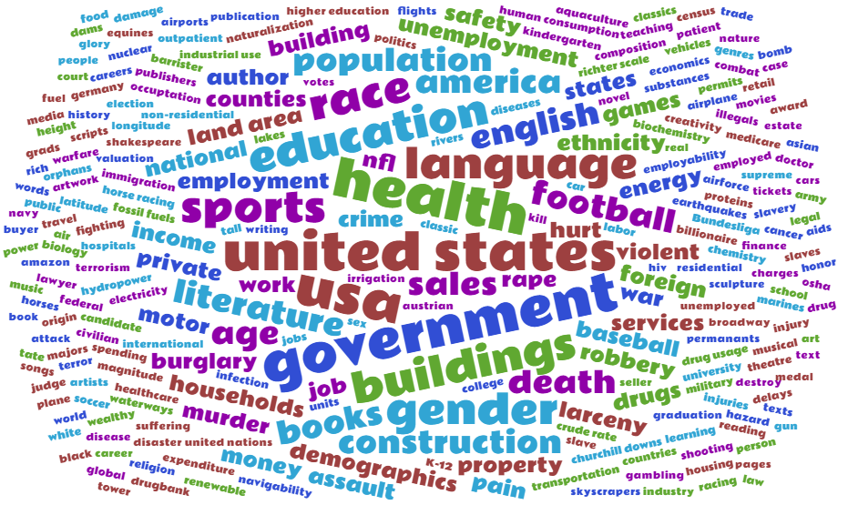
Prelim Work - Technology
Many new CORGIS Datasets
Currently at ~43

Slide 6
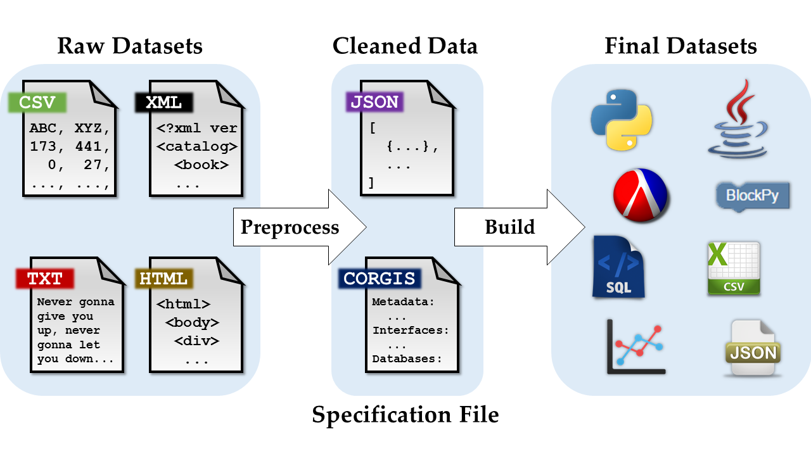
Prelim Work - Technology
CORGIS Builder
Simplifies dataset maintenance

Slide 7
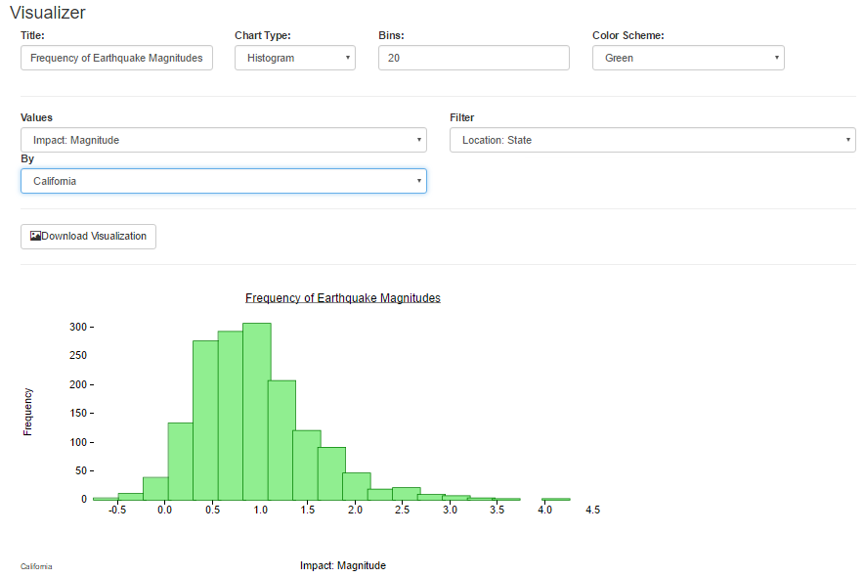
Prelim Work - Technology
CORGIS Visualizer
Easy interaction with datasets

Slide 8
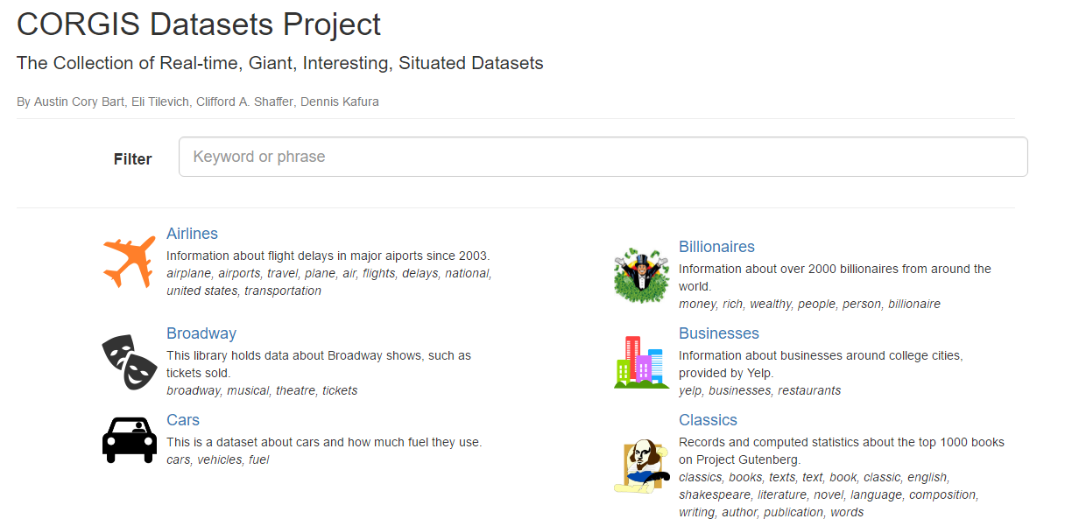
Prelim Work - Technology
CORGIS Website
Dynamically-generated
Searchable

Slide 9
Prelim Work - Motivation
Data Collection
Fall 2015 (N=40)
Spring 2016 (N=50) – Analyzed for TOCE submission
Fall 2016 (N=100) – In process of analyzing
Survey Design
2 surveys (3 in Fall) for Pre/Post
5x5 grid of questions (MUSIC vs. Course Components)
Intent to Continue Questions
Demographics
Free Response questions (MUSIC + completely open)

Slide 10
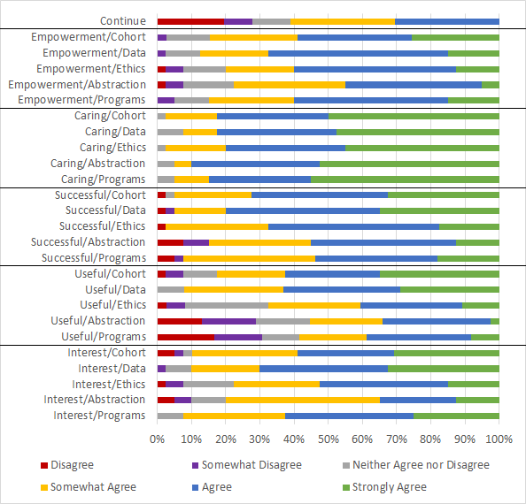
Prelim Work - Motivation
Students were motivated
Usefulness of Data Science outweighed Usefulness of Programming
Caring was particularly high
Little intent to continue, and actually decreased from the start of the semester (-1.03**, std=.34)

Slide 11
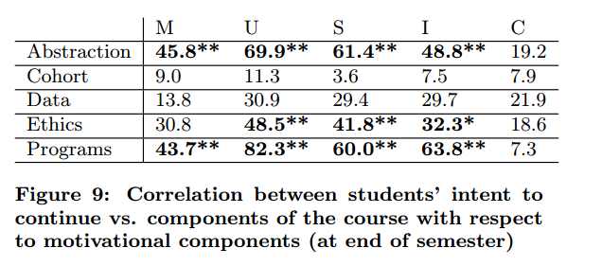
Prelim Work - Motivation
Usefulness is strongly correlated with intent to continue

Slide 12
Schedule
Technology work:
Improve the tooling for the validation of datasets to simplify the development process (By Final Defense)
Finish documenting datasets (Before SIGCSE)
Extend CORGIS Builder to enable generation of SQL datasets (Before SIGCSE)
Evaluation work:
Collect and analyze new student data from Fall 2016 semester (Before February)
Papers
TETC/TLT submission: December 1
TOCE paper: January
CSE paper: April
Final Defense: Noon on March 20

Slide 13
Papers (Accepted)
A. C. Bart, R. Whitcomb, E. Tilevich, C. A. Shaffer, D. Kafura, Computing with CORGIS: Diverse, Real-world Datasets for Introductory Computing, SIGCSE '17, Seattle, Washington. March, 2017. (accepted)
A. C. Bart, J. Tibau, E. Tilevich, C. A. Shaffer, D. Kafura, Implementing an Open-access, Data Science Programming Environment for Learners, COMPSAC '16, Atlanta, Georgia. June 10-15, 2016. (Abstract only)
D. Kafura, A. C. Bart, B. Chowdhury, Design and Preliminary Results From a Computational Thinking Course. ITiCSE'15, Vilnius, Lithuania. July 6-8, 2015.
A. C. Bart, J. Riddle, O. Saleem, B. Chowdhury, E. Tilevich, C. A. Shaffer, D. Kafura, Motivating Students with Big Data: CORGIS and MUSIC, Splash-E '14, Portland, Oregon. October 21-23, 2014. (no formal proceedings)
A. C. Bart, E. Tilevich, T. Allevato, S. Hall, C. A. Shaffer, Transforming Introductory Computer Science Projects via Real-Time Web Data, SIGCSE '14, Atlanta, Georgia. March 5-8, 2014.
A. C. Bart, E. Tilevich, C. A. Shaffer, T. Allevato, S. Hall, Using Real-Time Web Data to Enrich Introductory Computer Science Projects, Splash-E '13, Indianapolis, Indiana. October 26-31, 2013. (no formal proceedings)

Slide 14
Papers (Tangential)
A. C. Bart, C. A. Shaffer. Instructional Design is to Teaching as Software Engineering is to Programming. SIGCSE '16. Kansas City, MO. March 2-5, 2016. (Published)
A. C. Bart, J. Tibau, E. Tilevich, C. A. Shaffer, D. Kafura, Implementing an Open-access, Data Science Programming Environment for Learners, IEEE Computer. May 15, 2016. (Submitted)
TETC/TLT paper on data gathered in Spring 2016 about BlockPy usage. This is tangentially related to my dissertation, since BlockPy is a CORGIS consumer (First draft written, being submitted before Dec 1).
CSE journal paper on Instructional Design in Computer Science Education. This is tangentially related to some of the learning theory used in my dissertation. (First draft written, needs an extensive rewrite before submission)

Slide 15
Dissertation Outline
Introduction
Literature Review
Technology
Student Impact
Conclusions

Slide 16
Pre-prelim work
Technology:
RTW
Studies:
Introductory computing contexts: N=472
Interest/Usefulness in Intro courses: N=268

Slide 17
“Preparing Educational Datasets for Introductory Computing Courses”
A case study of the design of 50 datasets
Common problems
Unstandardized data
Little structure
Joining data
Encoded values
…
Common student misconceptions
Assuming data is time-oriented
Skipping documentation
…

