Slide 1
Initial Report
CT Course S16 - Semester endLast Modified: 06/16/2015

Slide 2
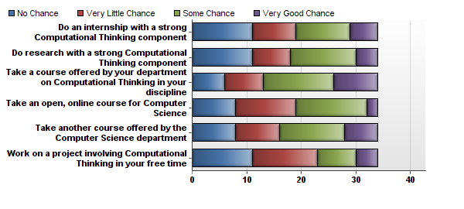
4. Do you think you will you continue your education on ComputationalThinking through any of the fo...

Slide 3
4. Do you think you will you continue your education on ComputationalThinking through any of the fo...
Statistic | Take another course offered by the Computer Science department | Take a course offered by your department on Computational Thinking in your discipline | Take an open, online course for Computer Science | Do an internship with a strong Computational Thinking component | Do research with a strong Computational Thinking component | Work on a project involving Computational Thinking in your free time
Min Value | 1 | 1 | 1 | 1 | 1 | 1
Max Value | 4 | 4 | 4 | 4 | 4 | 4
Mean | 2.47 | 2.68 | 2.26 | 2.26 | 2.26 | 2.12
Variance | 1.11 | 1.07 | 0.81 | 1.17 | 1.11 | 1.02
Standard Deviation | 1.05 | 1.04 | 0.90 | 1.08 | 1.05 | 1.01
Total Responses | 34 | 34 | 34 | 34 | 34 | 34

Slide 4
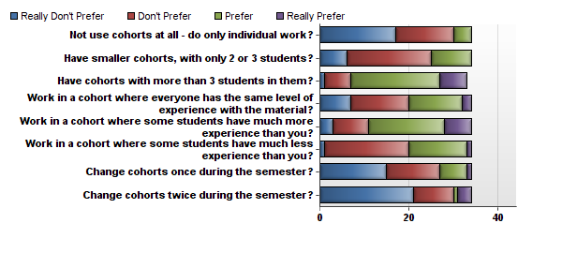
5. To what extent would you prefer to...

Slide 5
5. To what extent would you prefer to...
Statistic | Not use cohorts at all - do only individual work? | Have smaller cohorts, with only 2 or 3 students? | Have cohorts with more than 3 students in them? | Work in a cohort where everyone has the same level of experience with the material? | Work in a cohort where some students have much more experience than you? | Work in a cohort where some students have much less experience than you? | Change cohorts once during the semester? | Change cohorts twice during the semester?
Min Value | 1 | 1 | 1 | 1 | 1 | 1 | 1 | 1
Max Value | 3 | 3 | 4 | 4 | 4 | 4 | 4 | 4
Mean | 1.62 | 2.09 | 2.94 | 2.26 | 2.76 | 2.41 | 1.79 | 1.59
Variance | 0.49 | 0.45 | 0.50 | 0.75 | 0.73 | 0.37 | 0.71 | 0.86
Standard Deviation | 0.70 | 0.67 | 0.70 | 0.86 | 0.85 | 0.61 | 0.84 | 0.92
Total Responses | 34 | 34 | 33 | 34 | 34 | 34 | 34 | 34

Slide 6
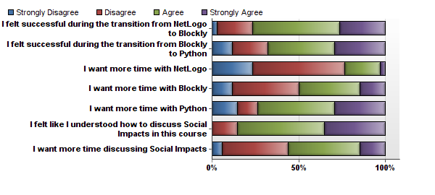
6. At this point, you have used NetLogo, Blockly, andPython. Please respond to each of the followin...

Slide 7
6. At this point, you have used NetLogo, Blockly, andPython. Please respond to each of the followin...
Statistic | I felt successful during the transition from NetLogo to Blockly | I felt successful during the transition from Blockly to Python | I want more time with NetLogo | I want more time with Blockly | I want more time with Python | I felt like I understood how to discuss Social Impacts in this course | I want more time discussing Social Impacts
Min Value | 1 | 1 | 1 | 1 | 1 | 2 | 1
Max Value | 4 | 4 | 4 | 4 | 4 | 4 | 4
Mean | 3.00 | 2.85 | 2.03 | 2.53 | 2.88 | 3.21 | 2.65
Variance | 0.61 | 0.98 | 0.57 | 0.80 | 1.02 | 0.47 | 0.66
Standard Deviation | 0.78 | 0.99 | 0.76 | 0.90 | 1.01 | 0.69 | 0.81
Total Responses | 34 | 34 | 34 | 34 | 34 | 34 | 34

Slide 8
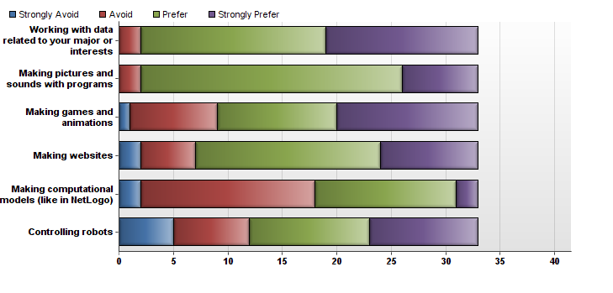
7. Other schools teach Computational Thinking in different ways. Consider these different styles, an...

Slide 9
7. Other schools teach Computational Thinking in different ways. Consider these different styles, an...
Statistic | Working with data related to your major or interests | Making pictures and sounds with programs | Making games and animations | Making websites | Making computational models (like in NetLogo) | Controlling robots
Min Value | 70 | 70 | 69 | 69 | 69 | 69
Max Value | 72 | 72 | 72 | 72 | 72 | 72
Mean | 71.36 | 71.15 | 71.09 | 71.00 | 70.45 | 70.79
Variance | 0.36 | 0.26 | 0.77 | 0.69 | 0.51 | 1.11
Standard Deviation | 0.60 | 0.51 | 0.88 | 0.83 | 0.71 | 1.05
Total Responses | 33 | 33 | 33 | 33 | 33 | 33

Slide 10
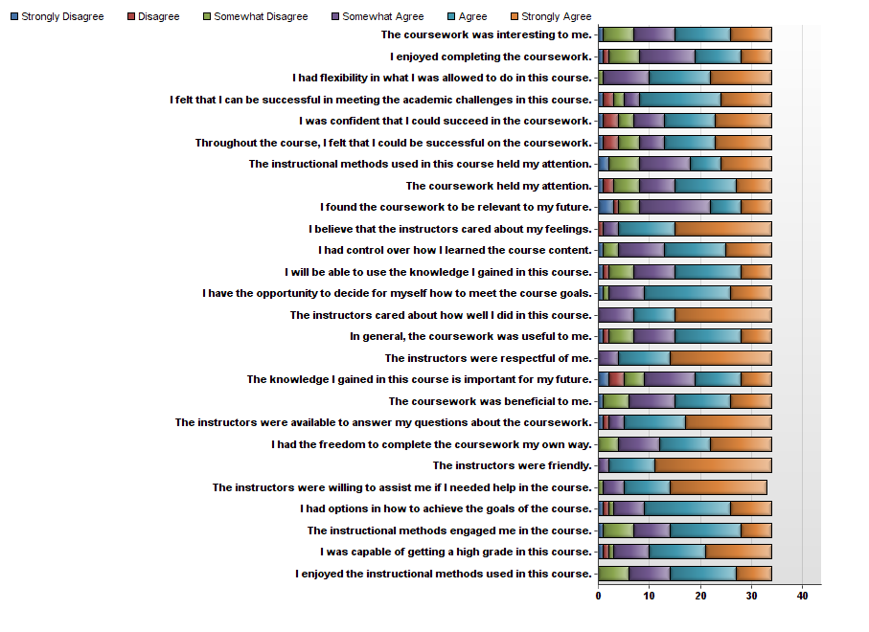
8. Note that the word “coursework” refers to anything that you did inthe course so far, including a...

