Slide 1
Motivating and Engaging Introductory Computing with Student-Driven Datasets
Austin Cory Bart

Slide 2

About Me
Austin Cory Bart
Starting 4th Year
Computer Science PhD
Learning Sciences Certification
Software Engineering + Education

Slide 3

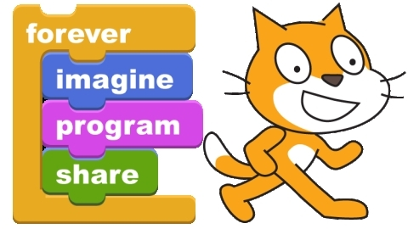
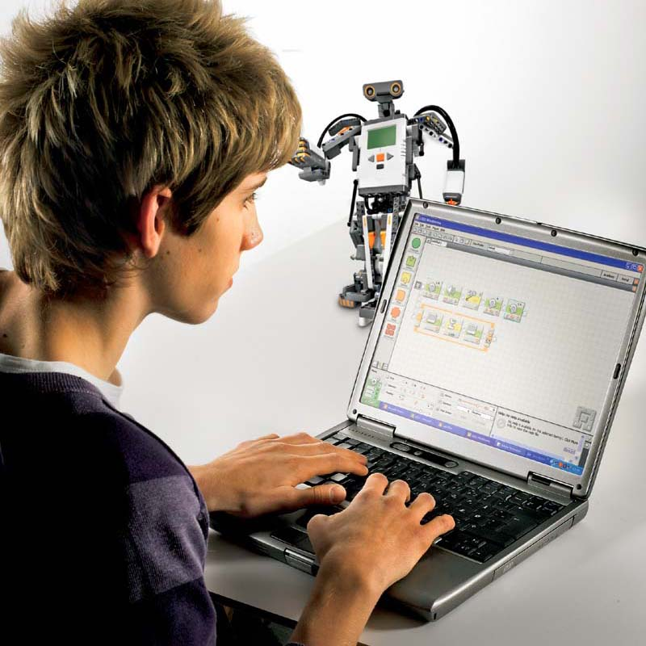
Introductory Computing Contexts

Slide 4

Imagineering Paper
Paper by Guzdial, Tew in 2006
Media Computation as an “Imagineered Authentic Experience”
*Mark Guzdial and Allison Elliott Tew. 2006. Imagineering inauthentic legitimate peripheral participation: an instructional design approach for motivating computing education. In Proceedings of the second international workshop on Computing education research (ICER '06). ACM, New York, NY, USA, 51-58. DOI=10.1145/1151588.1151597 http://doi.acm.org/10.1145/1151588.1151597

Slide 5
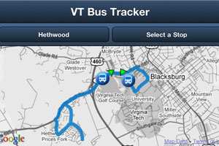


VT Bus Tracking API
Dr. Eli Tilevich
Dr. Cliff Shaffer

Slide 6





RealTimeWeb
Client Library
Online
Web Service
(get-weather ...)
[.searchBusinesses()]
[.getEarthquakes()]
[.get_stocks()]
[...]
Local Cache File
Eli Tilevich, Clifford A. Shaffer, and Austin Cory Bart. 2014. Creating stimulating, relevant, and manageable introductory computer science projects that utilize real-time web-based data (abstract only). In Proceedings of the 45th ACM technical symposium on Computer science education (SIGCSE '14). ACM, New York, NY, USA, 743-743. DOI=10.1145/2538862.2539002
Austin Cory Bart, Eli Tilevich, Simin Hall, Tony Allevato, and Clifford A. Shaffer. 2014. Transforming introductory computer science projects via real-time web data. In Proceedings of the 45th ACM technical symposium on Computer science education (SIGCSE '14). ACM, New York, NY, USA, 289-294. DOI=10.1145/2538862.2538941
A. C. Bart, E. Tilevich, C. A. Shaffer, T. Allevato, S. Hall, Using Real-Time Web Data to Enrich Introductory Computer Science Projects, Splash-E '13, Indianapolis, Indiana. October 26-31, 2013.

Slide 7
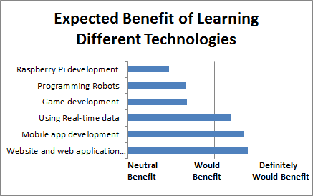
Evaluation
Mostly positive results
Not much impact
Hard to get access to learner population

Slide 8
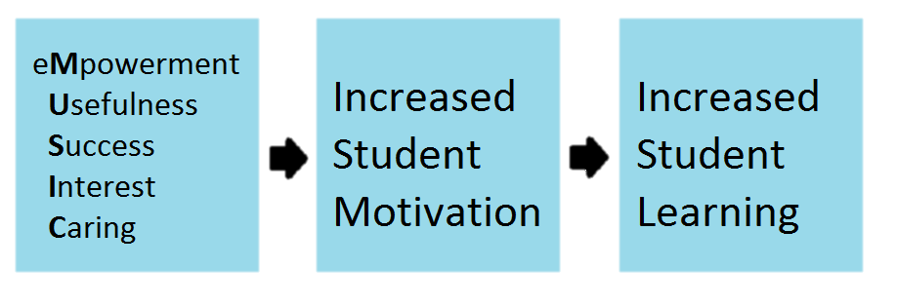
MUSIC Model of Academic Motivation
Jones, B. D. (2009). Motivating students to engage in learning: The MUSIC model of academic motivation. International Journal of Teaching and Learning in Higher Education, 21 (2), 272-285.

Slide 9
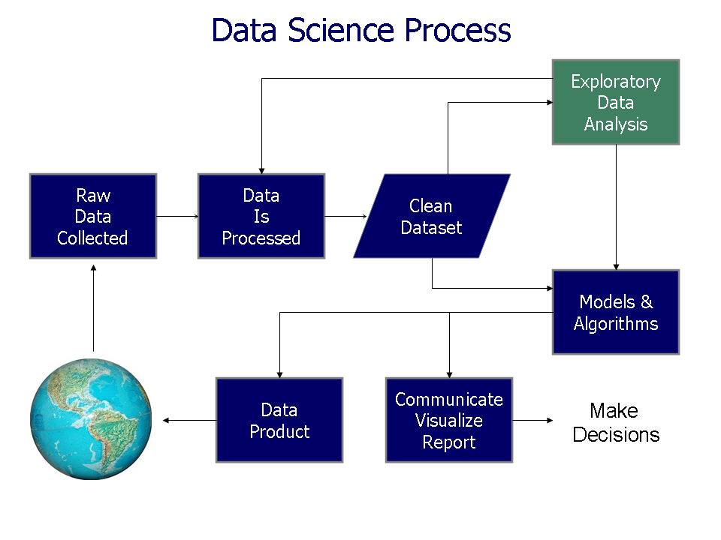
Data Science

Slide 10
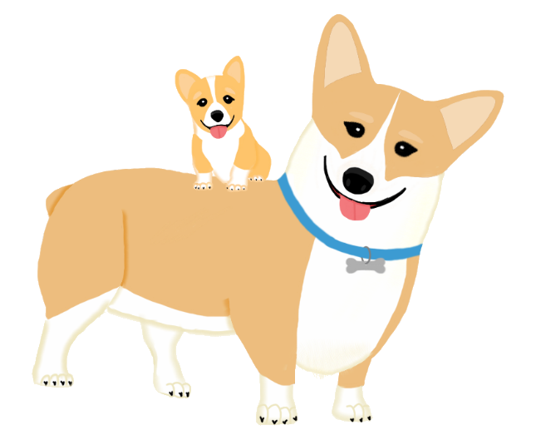
Collections Of
Real-time
Giant
Interesting
Situated
Datasets

Slide 11
Learner Population
High Maturity
Low Domain Identification

Slide 12
Computational Thinking Course

Slide 13
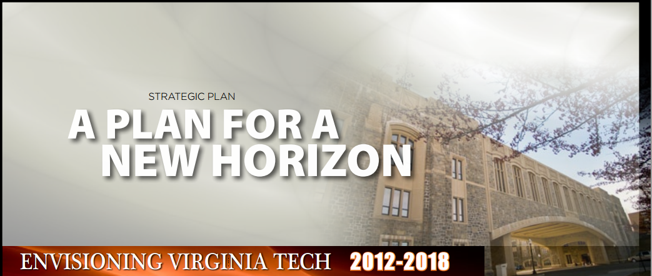
For all VT Students

Slide 14

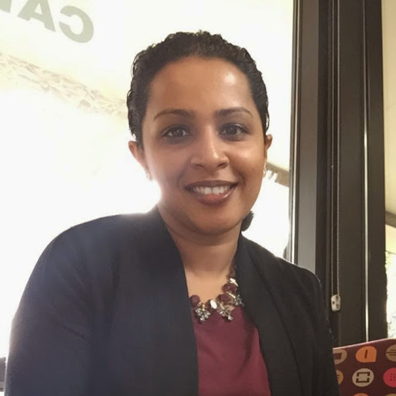
People
Dr. Dennis Kafura
Bushra Chowdhury

Slide 15
Novel Features
Cohort System
Active Learning

Slide 16
Course Overview
Course Topic
Introduction
1 Week
Computational Modelling
NetLogo
3 Weeks
Algorithms
Blockly (Python)
3 Weeks
Big Data
IDLE (Python)
4 Weeks
Conclusion
1 Week

Slide 17
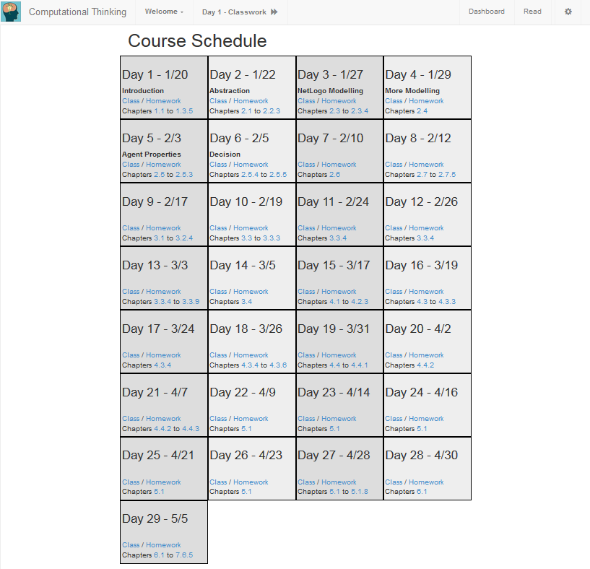
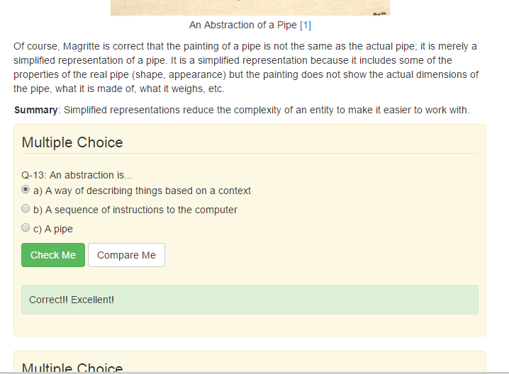
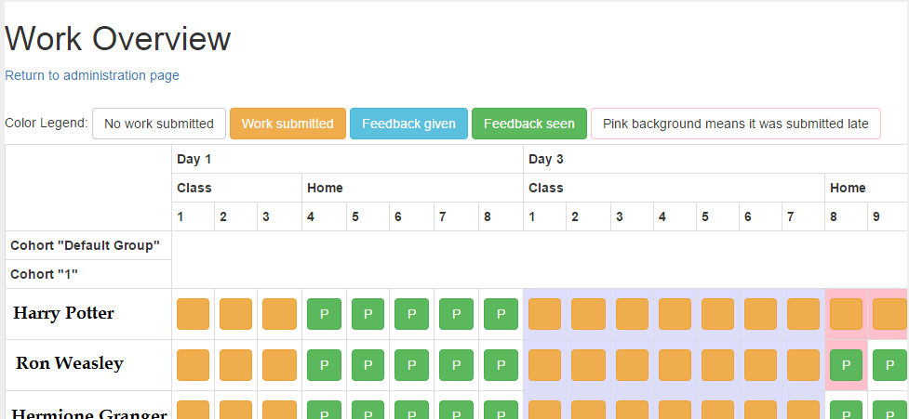
“Rhinestone”

Slide 18
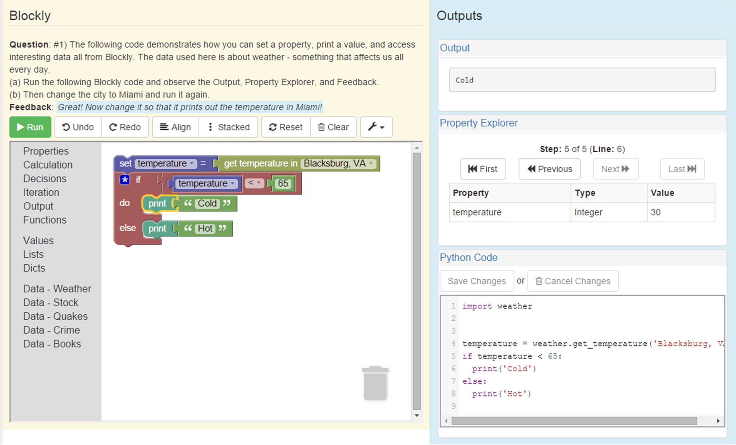

Slide 19
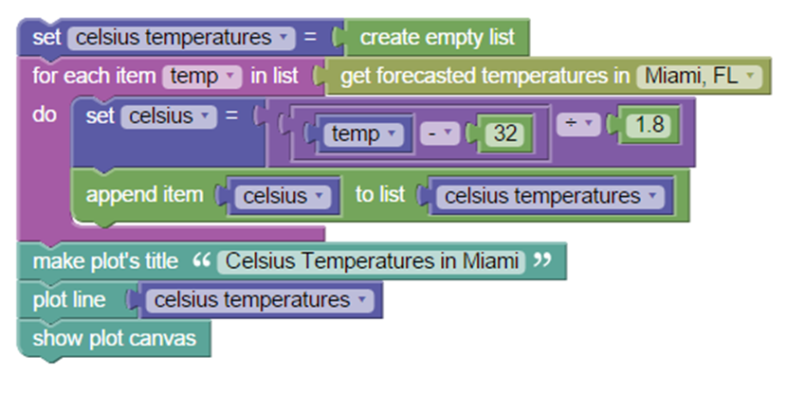
Data Science Blocks

Slide 20
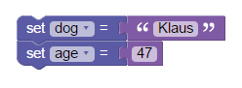
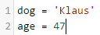
Mutual Language Transformation
Skulpt
Builtins
CodeMirror
Blockly
APIs
Python
Core Blocks
MatPlotLib
+Python Blocks
Tkinter
+API Blocks
Tengolo
Python Generator
CORGIS
JS/JSON
XML
Python-to-Blockly AST Converter
Mappings

Slide 21
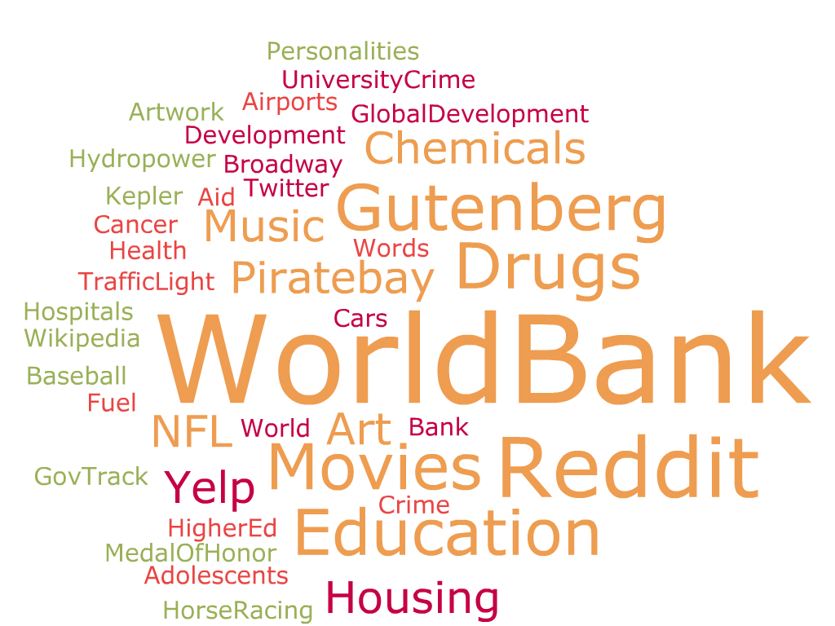
Final Project
Authentic Assessment
Using a dataset
Make Visualizations
Answer a question
Present

Slide 22
Course Overview
Course Topic
Survey
Introduction
1 Week
Computational Modelling
NetLogo
3 Weeks
Algorithms
Blockly (Python)
3 Weeks
Survey
Big Data
IDLE (Python)
4 Weeks
Conclusion
Survey
1 Week

Slide 23
Demographics
Fall 2014: 26, 30% women
Spring 2015: 35, 60% women
Majors: Science, Art, Engineering, Agriculture, etc.
Fall 2016: 65?

Slide 24
Methodology

Slide 25
Agree
Disagree

Slide 26
Fall 2014, Usefulness to Long-term Goals by Resource
(Self-report, N=20)

Slide 27
Fall 2014, Interestingness of Resource
(Self-report, N=20)

Slide 28
Spring 2015, Qualitative Results
Interest
Usefulness
empowerment
NetLogo (-10, +2)
Python (+8)
Blockly (+10, -8)
Project (+7)
Data Analysis (+7)
CT (+7)
Python (+6)
Coding (+5)
Project(+14)
Overall(+6)

Slide 29
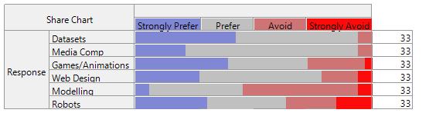
Other schools teach Computational Thinking in different ways. Consider these different styles, and indicate how much you would prefer or avoid them.

Slide 30
Survey questions
First survey was anonymized – Middle and End were not.
MMAMI (MUSIC Model of Academic Motivation Inventory) results
4-point likert questions
Qualitative questions according to MUSIC model
Coded and summarized

Slide 31
My Research
How can we get/prepare/organize datasets for students?
How do we ensure uniform difficulty?
What content is a necessary consequence of this context?
How do we evaluate this context for motivational value?
Is Data Science a good (or best?) context?
Does the context make an impact on the students?

