Slide 1


Gembar + Gembox Update
Charlie Becquet
Device Group
February 3, 2025

Slide 2
Test Results and Analysis
Gembar User Test Updates Gembar Big Vacuum High Temperature Test Gembar Intense Test Gembar High Temperature and Humidity Test Gembar Long Puff Test Gembox User Test Updates Necessary Design Changes for Gembox
Gembox Big Vacuum High Temperature Test Gembox Intense Test Gembox Viscosity Compatibility Test Gembox High Temperature and Humidity Test Gembox Long Puff Test Sensory Comparison of New Incense Sticks with Oil Coil Gembar + Gembox Incense Test Updates

Slide 3

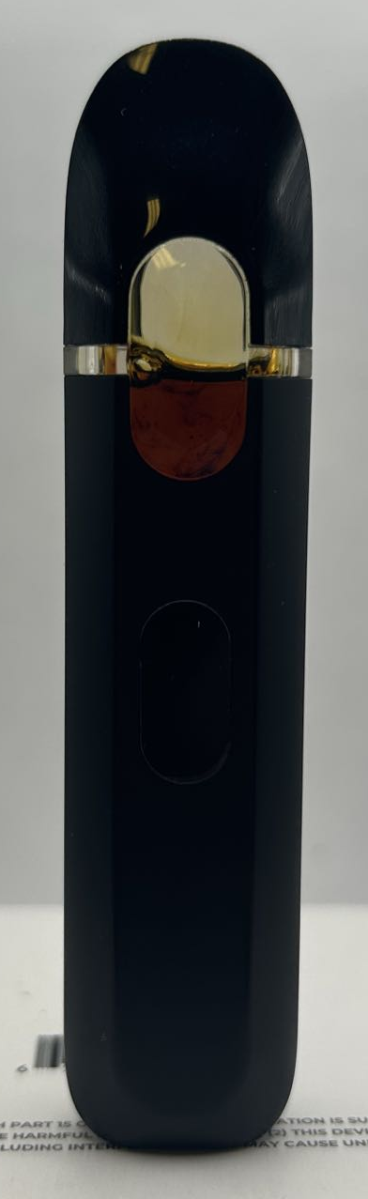
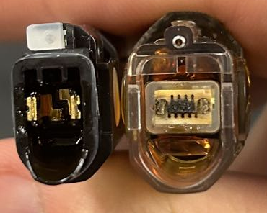
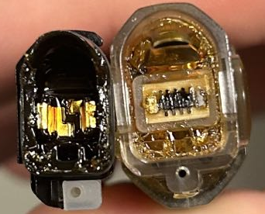
Gembar User Test Update
Sample | Username | Deal Date | Filled Media | Filling Volume | Resistance Before Use | Issuance Date | Progress | Return Date | Resistance After Collection | Voltage | Power | Issues? | Comments?
1-13 Batch User-1 | Charlie | 1/2/2025 | 1.1 mcp D9 | 2mL | 2.3 | 1/13/2025 | 75% | 1/24/2025 | 2.3 | 3.2 | 4.45217391 | Lost equipment on the lab bench yesterday. No issues before this. | Good performance
1-13 Batch User-2 | Leon | 1/2/2025 | 1.1 mcp D9 | 2mL | 2.3 | 1/13/2025 | 90% | 1/23/2025 | 2.3 | 3.2 | 4.45217391 | No issues | Good performance
1-13 Batch User-3 | Nellie | 1/2/2025 | 1.1 mcp D9 | 2mL | 2.3 | 1/13/2025 | 60% | 1/22/2025 | 2.3 | 3.2 | 4.45217391 | Stopped activating at remaining 60% | Failure seems to be due to poor connection of the pin. The heater is not damaged, and the resistance is nominal.
1-13 Batch User-4 | Jordan | 1/2/2025 | 1.1 mcp D9 | 2mL | 2.3 | 1/13/2025 | 50% |  |  | 3.2 | 4.45217391 | No issues so far
1-22 Batch User-5 ROSIN | Charlie | 1/29/2025 | MPX Rosin | 2mL | 2.3 | 1/29/2025 | 60% |  |  | 3.2 | 4.45217391 | Slight discoloration
2-3 Batch User-1 | Charlie | 2/4/2025 | 663kcp D9 | 2mL | 2.3 | 2/5/2025 | 0% |  |  | 3.2 | 4.45
2-3 Batch User-2 | Isabel | 2/4/2025 | 663kcp D9 | 2mL | 2.3 | 2/5/2025 | 0% |  |  | 3.2 | 4.45
2-3 Batch User-3 | Leland | 2/4/2025 | 663kcp D9 | 2mL | 2.3 | 2/5/2025 | 0% |  |  | 3.2 | 4.45
1-22 Batch User-5 Rosin
1-13 Batch User-3
1-13 Batch User-2
Gembar's user testing is promising. So far, there has only been 1 failure, which seems to be a pin connection issue. The discoloration of the rosin does not seem as obvious compared to Gembox. In user testing, leakage is small. Three additional new batch samples were filled and distributed today.

Slide 4
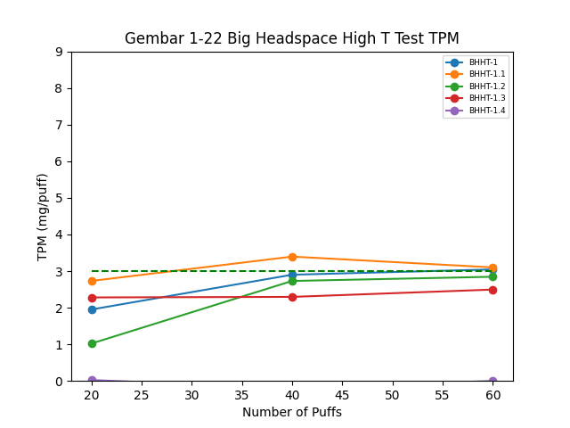
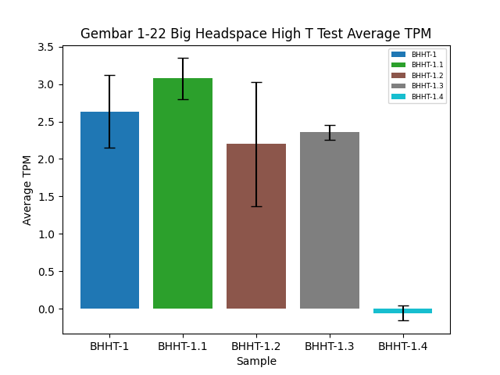
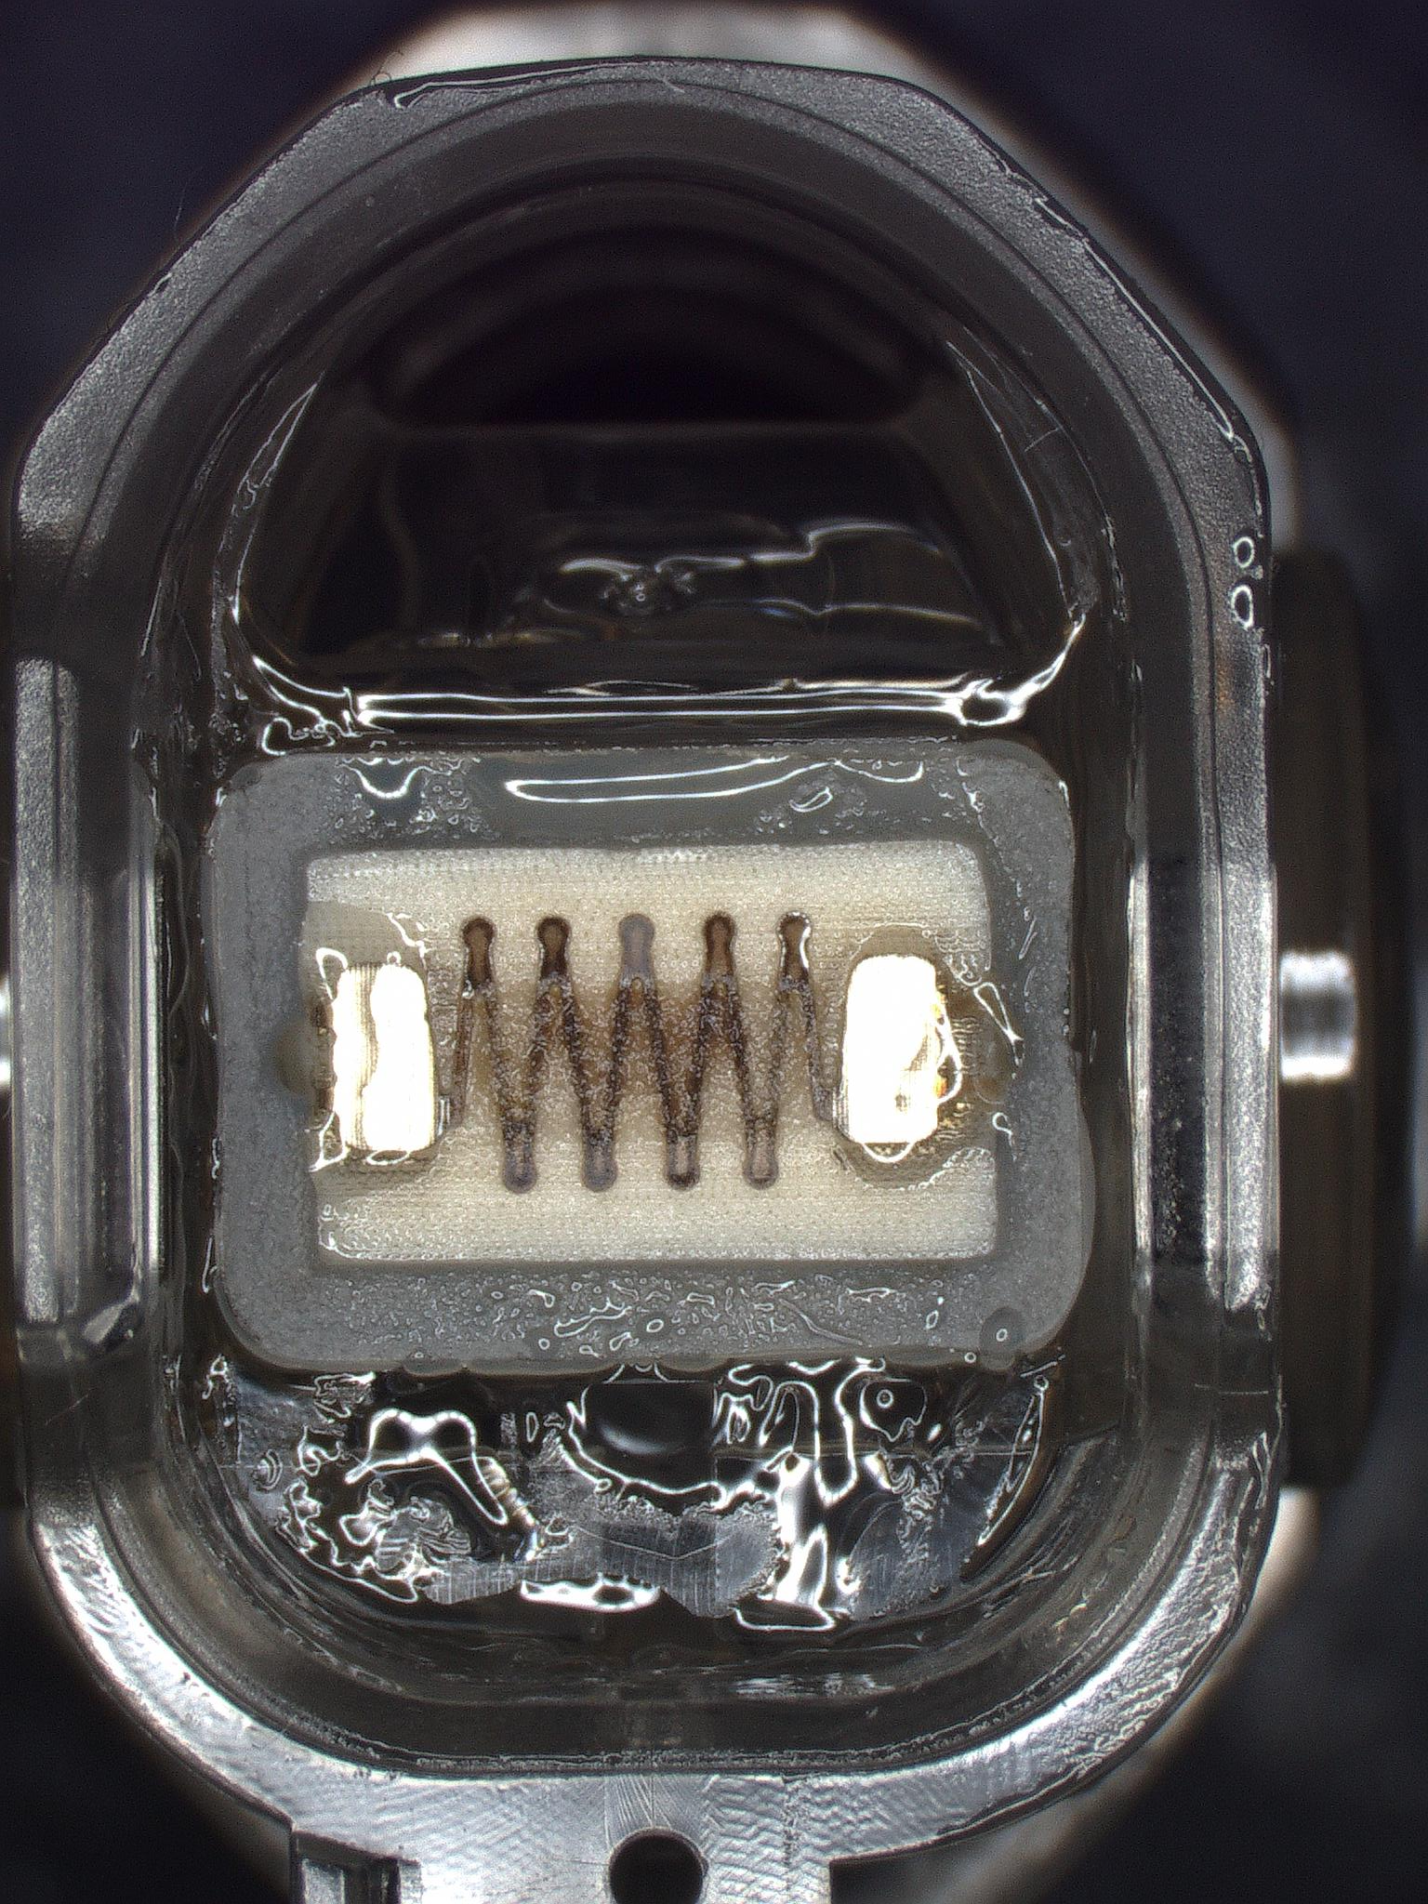
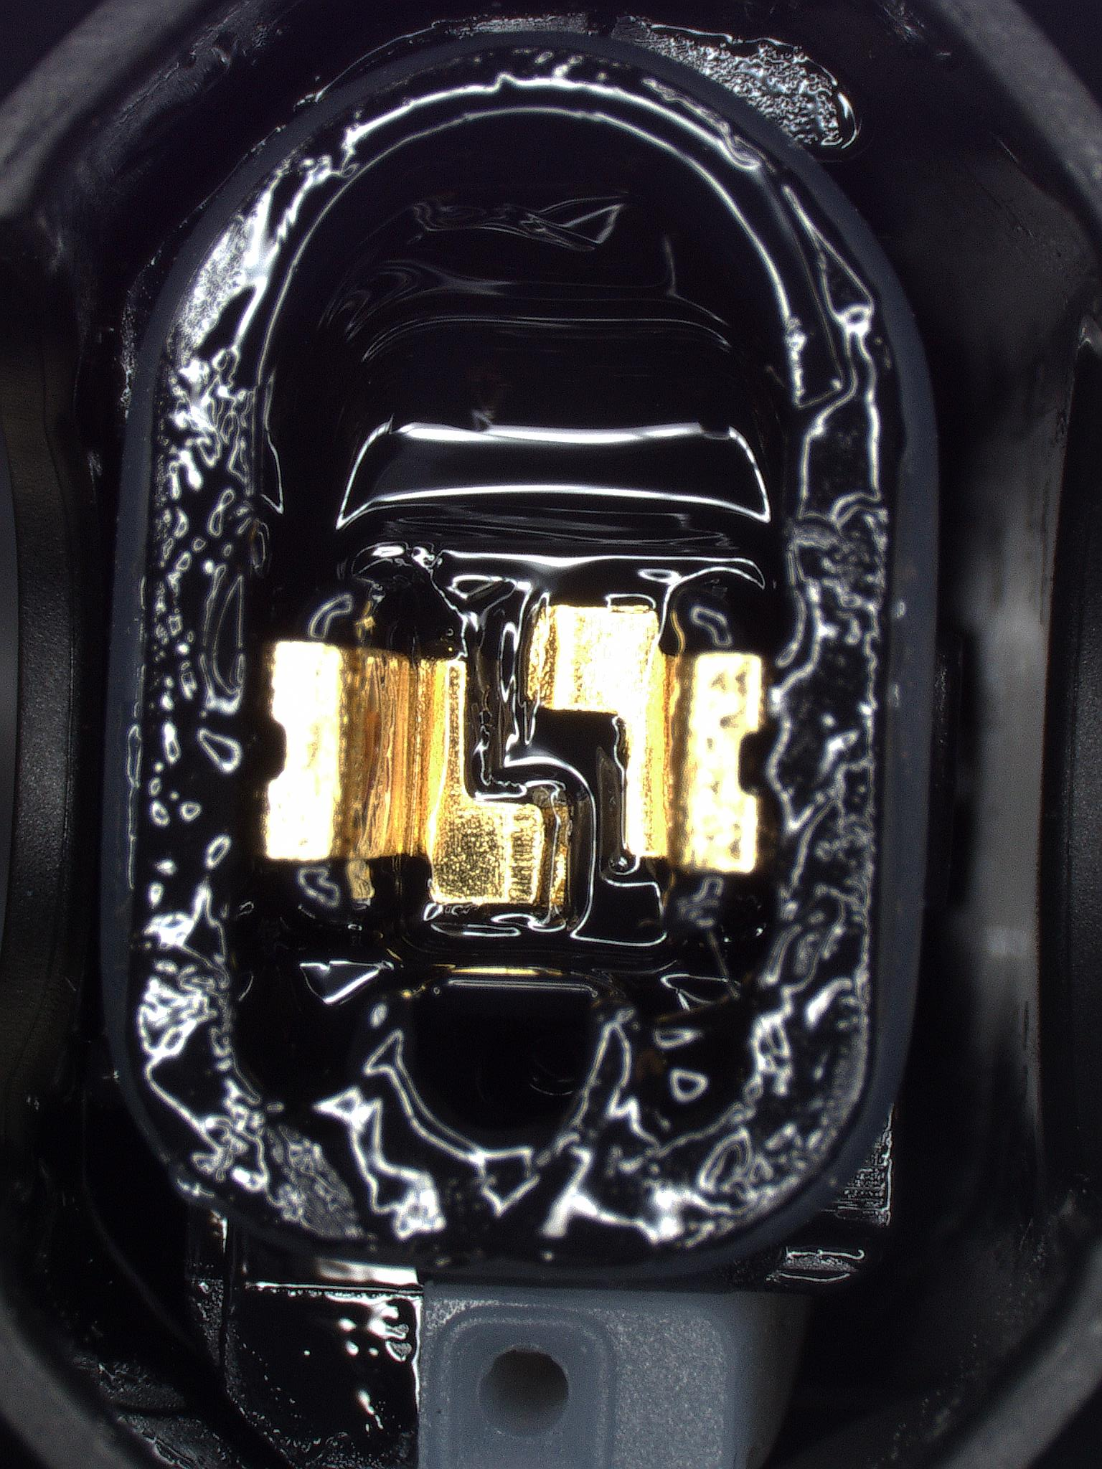
Gembar 1-22 Large Top Empty High T Test Results
Design and Oil | Power | Resistance | Political Power | TPM (mg/puff) and Standard Deviation | Inhale Pressure (kPa) | SDR Result | Notes
Gembar BHHT-1 800kcp D8 | 4.45W | 2.3 | 60mL/3s/30s | 2.63, 0.49 | 0.464 | Pass | No blockage
Gembar BHHT-2 800kcp D8 | 4.45W | 2.3 | 60mL/3s/30s | 3.07, 0.27 | 0.379 | Tentative Pass | No blockage, low pull force
Gembar BHHT-3 800kcp D8 | 4.45W | 2.3 | 60mL/3s/30s | 2.2, 0.83 | 0.296 | Tentative Pass | No blockage, low pull force
Gembar BHHT-4 800kcp D8 | 4.45W | 2.3 | 60mL/3s/30s | 2.36, 0.1 | 0.692 | Pass | No blockage
Gembar BHHT-5 800kcp D8 | 4.45W | 2.3 | 60mL/3s/30s | 0,0 | 0.382 | Fail | No blockage, no activation

Slide 5
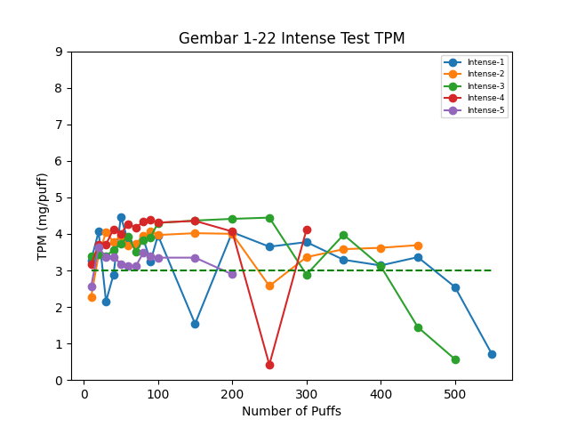
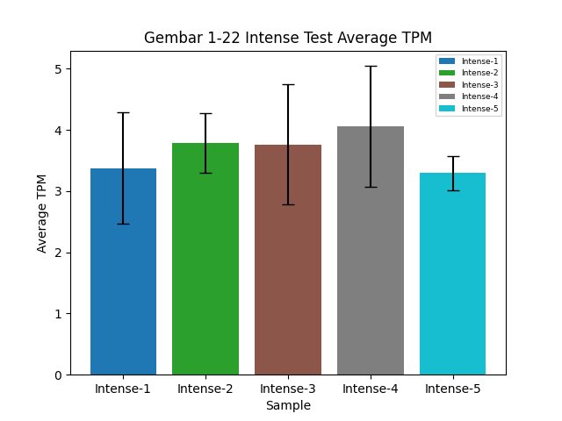
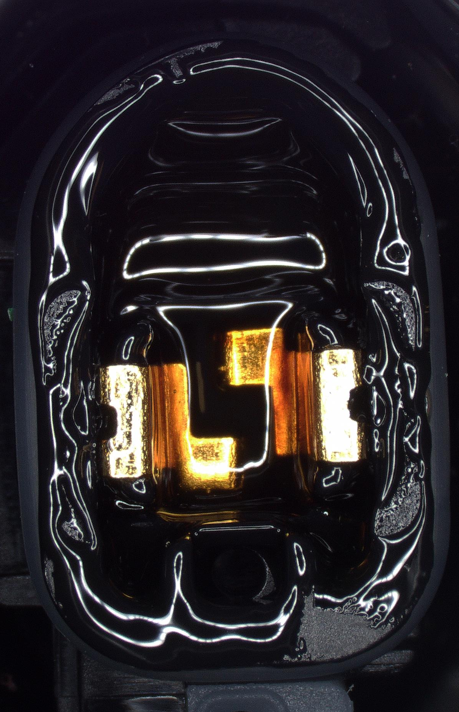
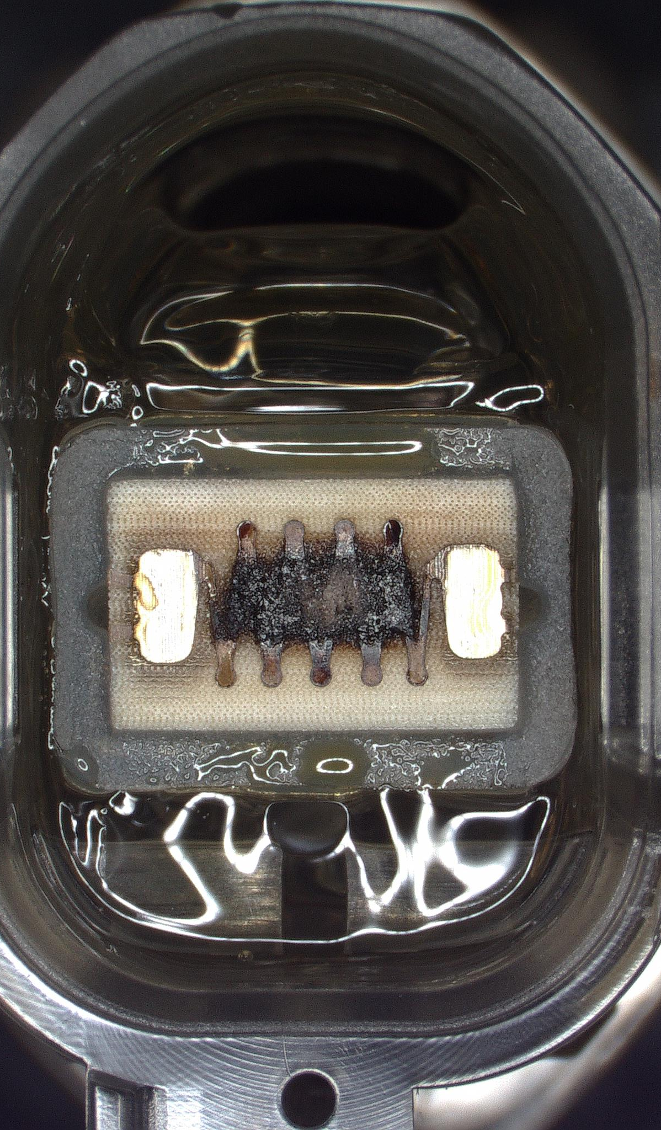
Gembar 1-22 Intense Test Results
Design and Oil | Power | Resistance | Regime | TPM (mg/puff) and Standard Deviation | Usage Efficiency (%) | SDR Result | Notes
Gembar Intense-1 800kcp D8 | 4.45W | 2.3 | 200mL/3s/30s | 3.38, 0.91 | 79.0% | Pass | Sample completely empty – 79% usage efficiency
Gembar Intense-2 800kcp D8 | 4.45W | 2.3 | 200mL/3s/30s | 3.79, 0.49 | N/A | Ongoing
Gembar Intense-3 800kcp D8 | 4.45W | 2.3 | 200mL/3s/30s | 3.76, 0.98 | N/A | Ongoing
Gembar Intense-4 800kcp D8 | 4.45W | 2.3 | 200mL/3s/30s | 4.06, 0.99 | N/A | Ongoing
Gembar Intense-5 800kcp D8 | 4.45W | 2.3 | 200mL/3s/30s | 3.3, 0.28 | N/A | Ongoing
The air inlet wall successfully prevented clogging

Slide 6
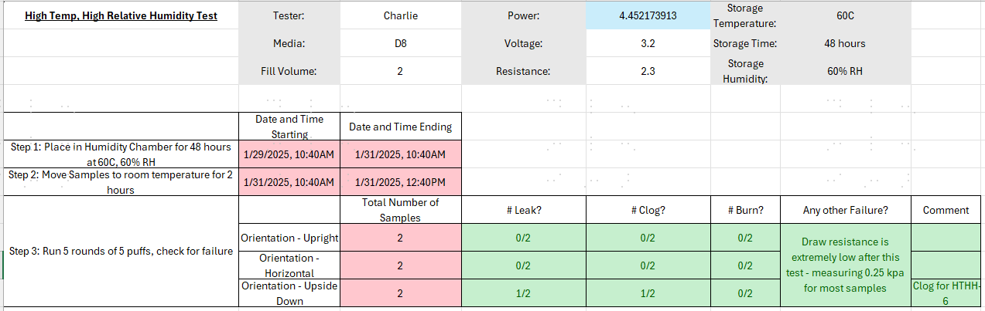
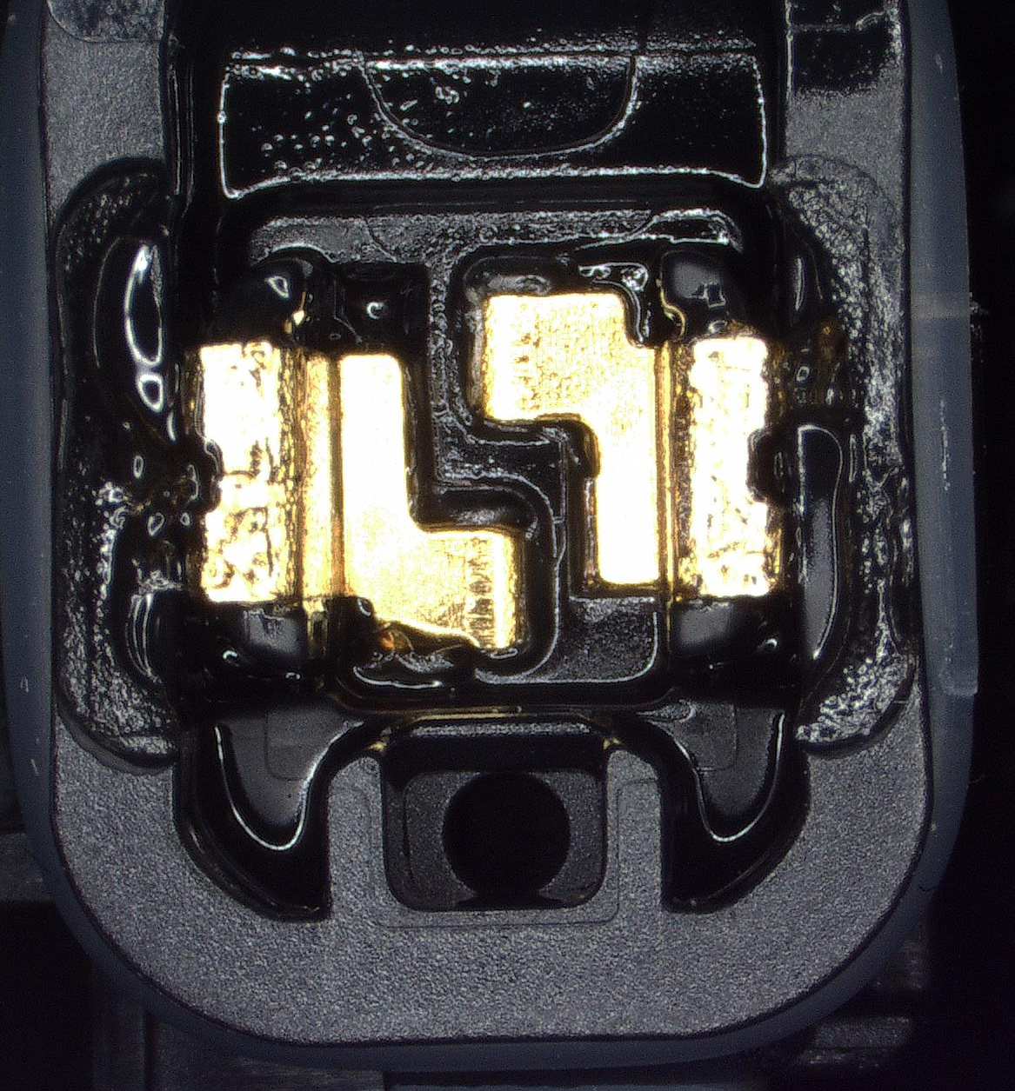
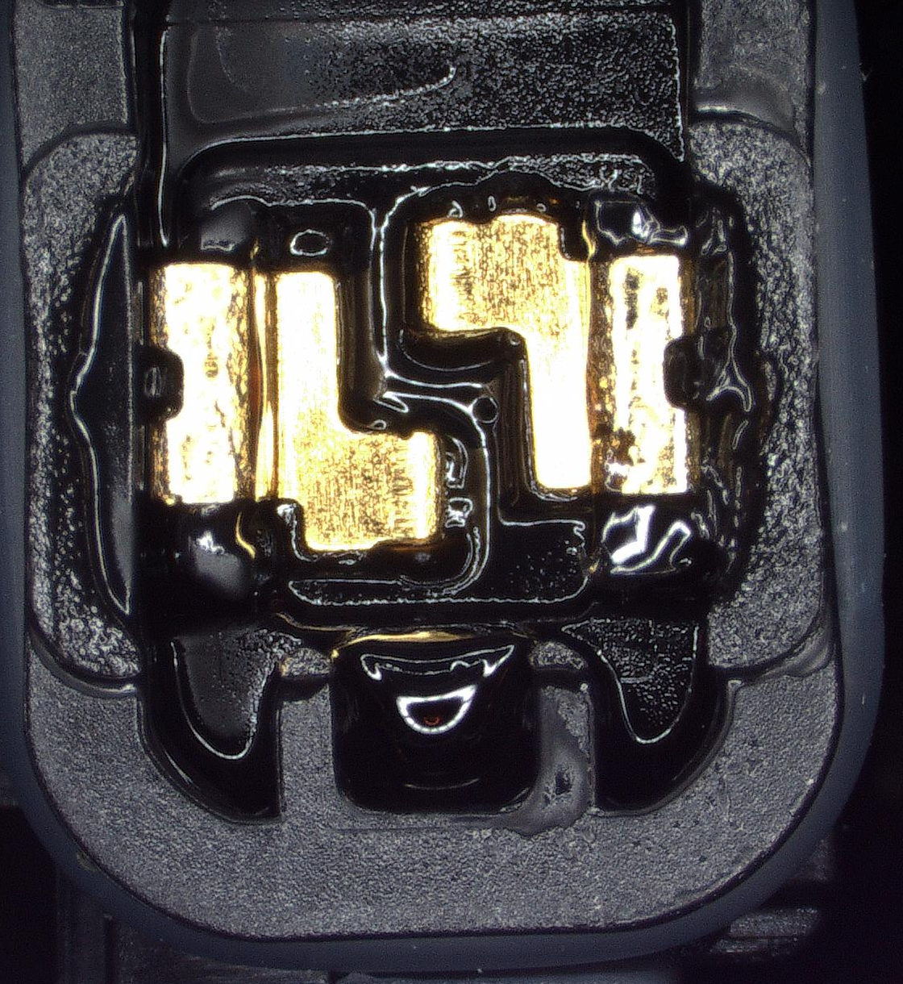
Gembar 1-22 High Temperature and High Humidity Results
HTHH-1: Upright direction, clean air inlet.
HTHH-2: Inverted direction, blocked air inlet.
This is a very small failure - please be careful to find solutions that may lead to more blockages. I suggest using dual air inlets like the CPS2910 team did.

Slide 7
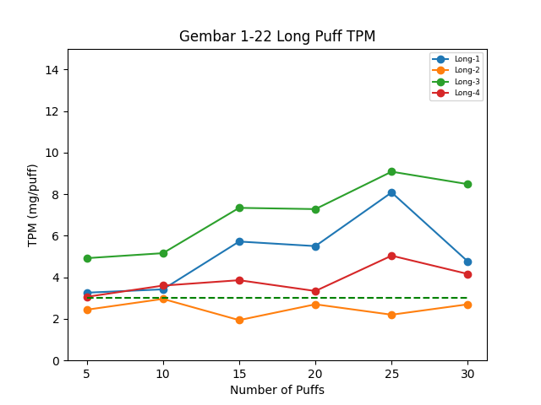
Gembar 1-22 Long Puff Test Results
Design and Oil | Power | Resistance | Power Regime | Pull Resistance (kPa) | SDR Result | Notes
Gembar Long-1 700kcp D8 | 4.45W | 2.3 | 100mL/5s, 160mL/8s, 200mL/10s | 0.696 | Pass | No problems
Gembar Long-2 700kcp D8 | 4.45W | 2.3 |  | 0.365 | Tentative Pass | Low suction and low TPM. No burning or other issues.
Gembar Long-3 700kcp D8 | 4.45W | 2.3 |  | 0.798 | Pass | No problems
Gembar Long-4 700kcp D8 | 4.45W | 2.3 |  | 0.586 | Tentative Pass | Low TPM, longer suction time, but no burning
5s Puff
8s Puff
10s Puff

Slide 8
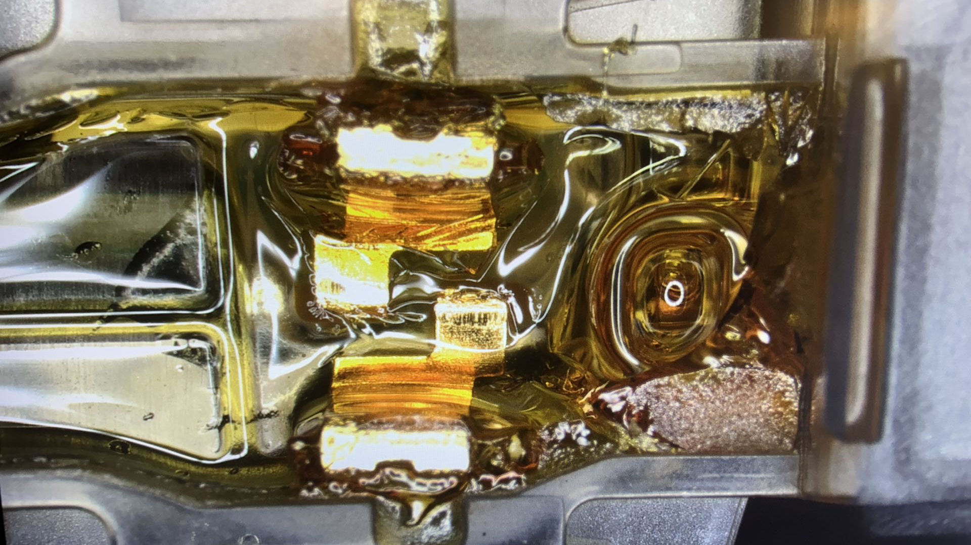
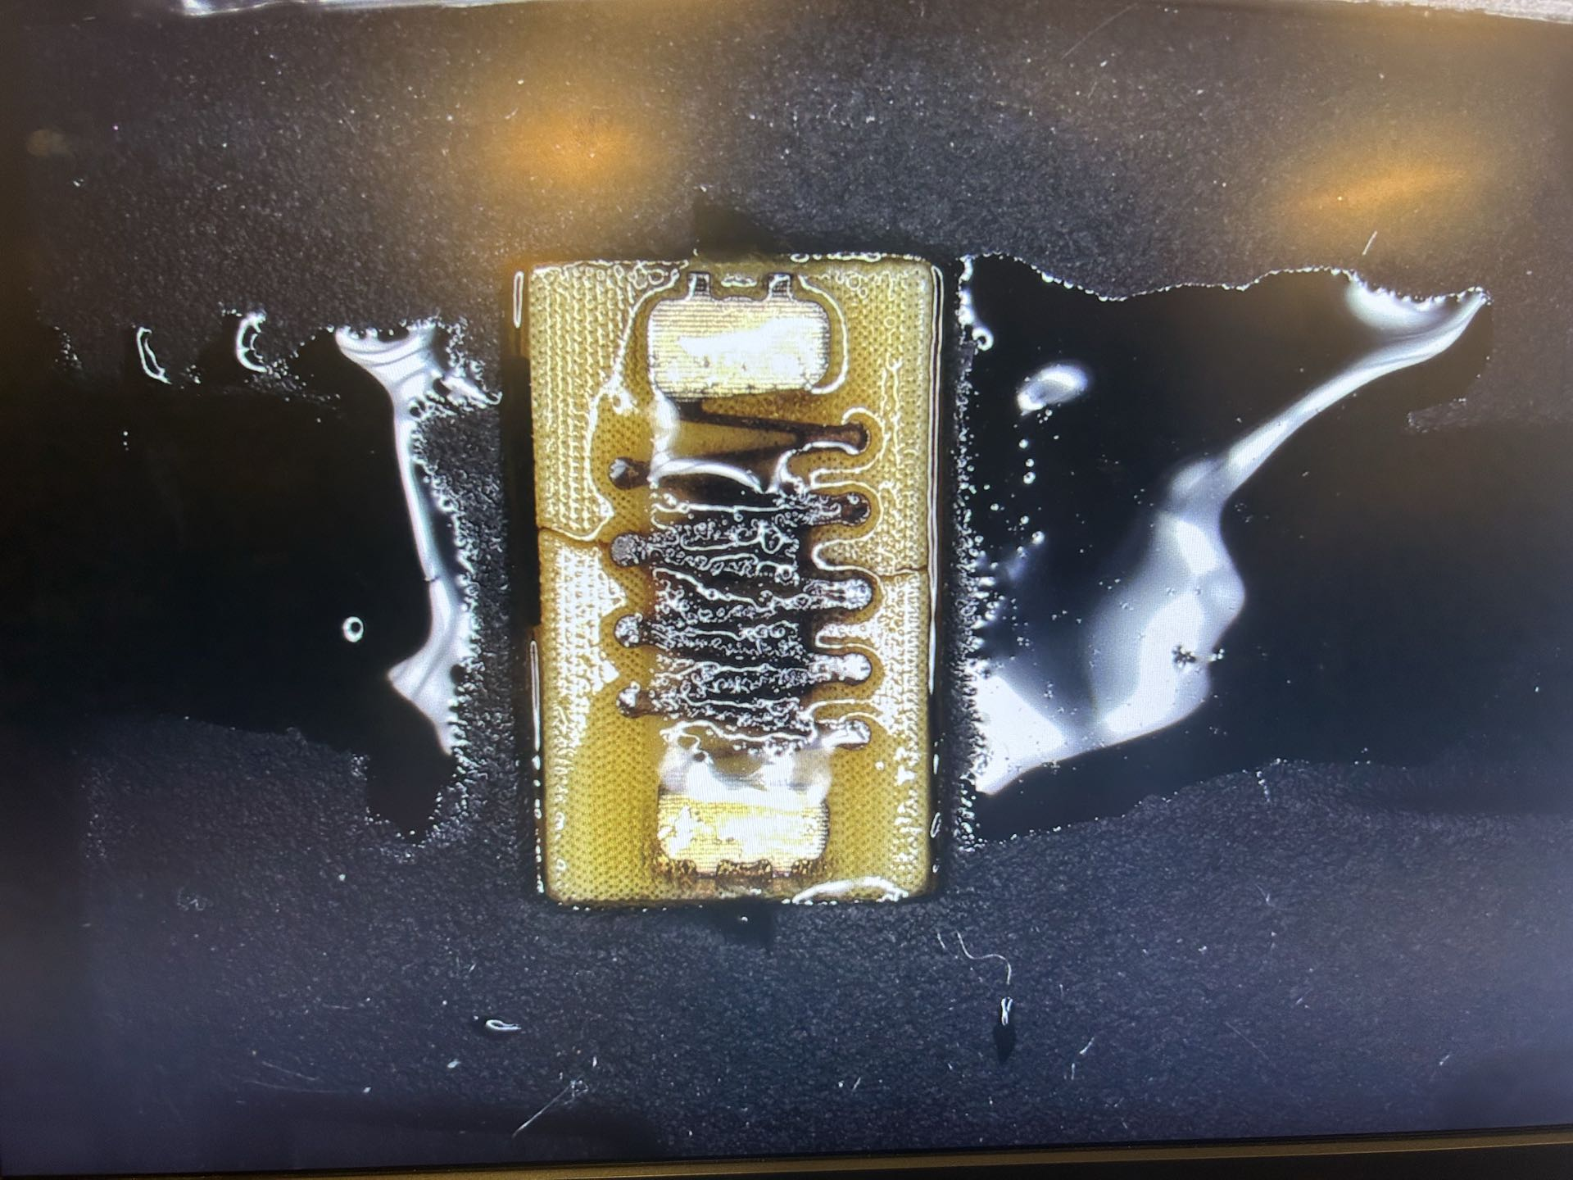
Gembox User Testing Update
Sample | Username | Transaction Date | Media Filled | Fill Volume | Resistance Before Use | Issue Date | Progress | Return Date | Resistance After Collection | Voltage | Power | Problem? | Comment?
1-13 Batch Rosin-1 | Charlie | 1/15/2025 | MPX Rosin | 2 | 2.3 | 1/15/2025 | 30% | 1/21/2025 | 2.3 | 3.2 | 4.45 | Clog | Sample quickly clogged at the inlet
1-13 Batch Rosin-2 | Leland | 1/15/2025 | MPX Rosin | 2 | 2.3 | 1/15/2025 | 50% |  | 2.3 | 3.2 | 4.45 |  | Leland's sample still did not clog.
1-13 Batch D9-1 | Charlie | 1/15/2025 | 800kcp D9 | 2 | 2.3 | 1/15/2025 | 40% | 2/3/2025 | 2.3 | 3.2 | 4.45 | Clog | Inlet blockage
1-13 Batch D9-2 | Leon | 1/15/2025 | 800kcp D9 | 2 | 2.3 | 1/15/2025 | 50% | 1/22/2025 | 2.3 | 3.2 | 4.45 | Clog | Inlet blockage
12-11 Batch Rosin-1 | Charlie | 1/17/2025 | MPX Rosin | 2 | 2.3 | 1/17/2025 | 80% | 1/29/2025 | 2.3 | 3.2 | 4.45 | Clog | Will clog inlet after using 80%. Severe discoloration
12-11 Batch Rosin-2 (1mL) | Jim | 1/22/2025 | MPX Rosin | 1 | 2.3 | 1/22/2025 | 20% |  | 2.3 | 3.2 | 4.45 |  | No update available for now.
1-13 Batch D9-2 – Clogs when less than 50% remaining
Insufficient user testing on D9 - Focus has been mainly on Gembar and the 510 model. Significant modifications are needed for the angle of the inlet and the gasket above the inlet. In rosin user testing, the 12-11 batches with walls around the inlet performed best. However, there is not enough D9 data to support this.
Vapor Pathway – Expecting oil here
Wrong direction – We should not see oil here

Slide 9
Necessary Design Changes for Gembox
Observe these three figures. The first figure shows unnecessary condensation directly above the air inlet. This increases the risk of clogging and further reduces overall efficiency. The second figure prevents unnecessary steam reflection and condensation above the air inlet. This simple modification is necessary to prevent air inlet clogging. The third figure reintroduces the air inlet wall present in the batch from 2024/12/11. This will reduce oil leakage into the air inlet space by 75%. User testing with rosin showed that this reduced clogging.
Figure 1: Current Gembox Vapor Pathway (Front cross-section - without pins)
Figure 2: Improved Gembox Steam Passage (Front cross-section - without pins)
1-13 Batch D9-2 – Clogged at 50% remaining
Vapor Pathway – Expecting oil here
Wrong direction – We should not see oil here
Figure 3: Improved Gembox Steam Passage + Air Inlet Wall (Front cross-section - without dowels)
The air inlet wall has two purposes: to prevent oil entry and to direct air directly to the heater.
The inlet wall is transparent for easy viewing.
When making design changes: ensure adherence to proper Design of Experiments (DoE) procedures. This means that all modifications should be isolated and tested before implementing the final design.

Slide 10
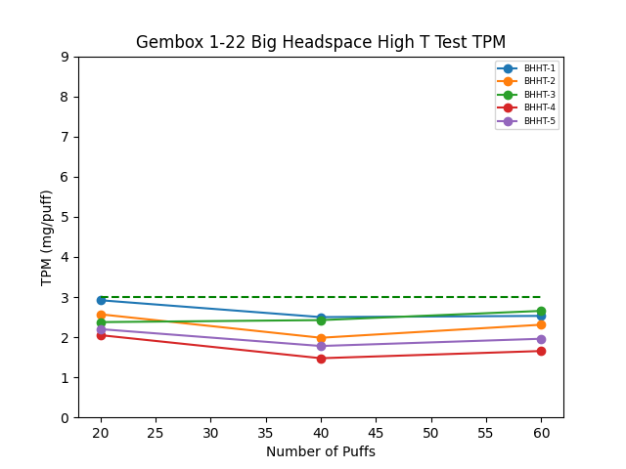
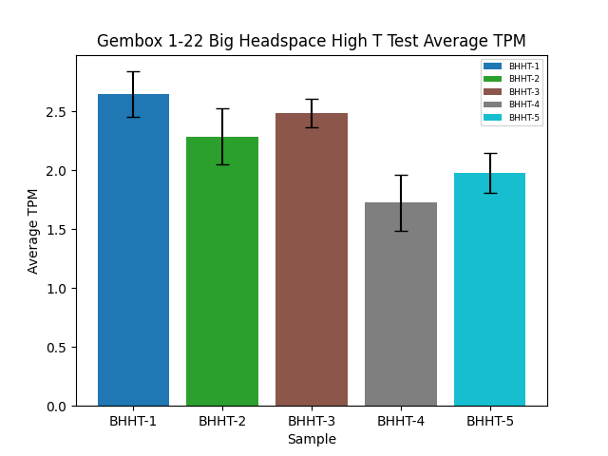
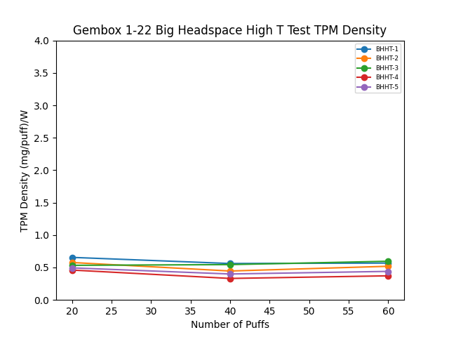
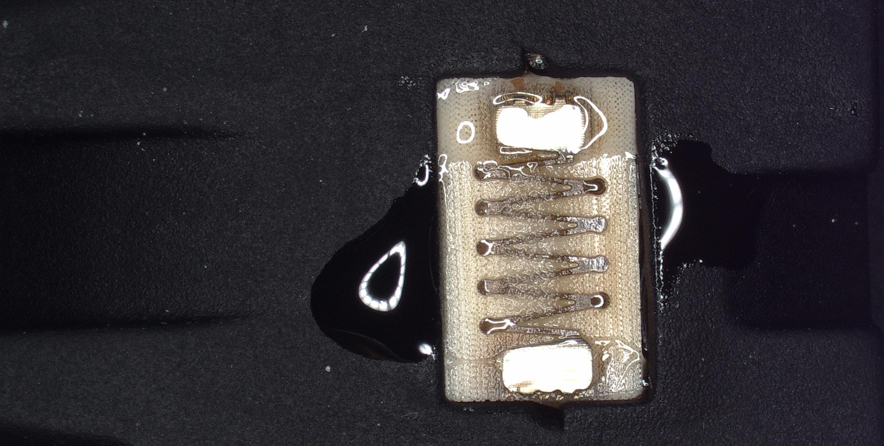
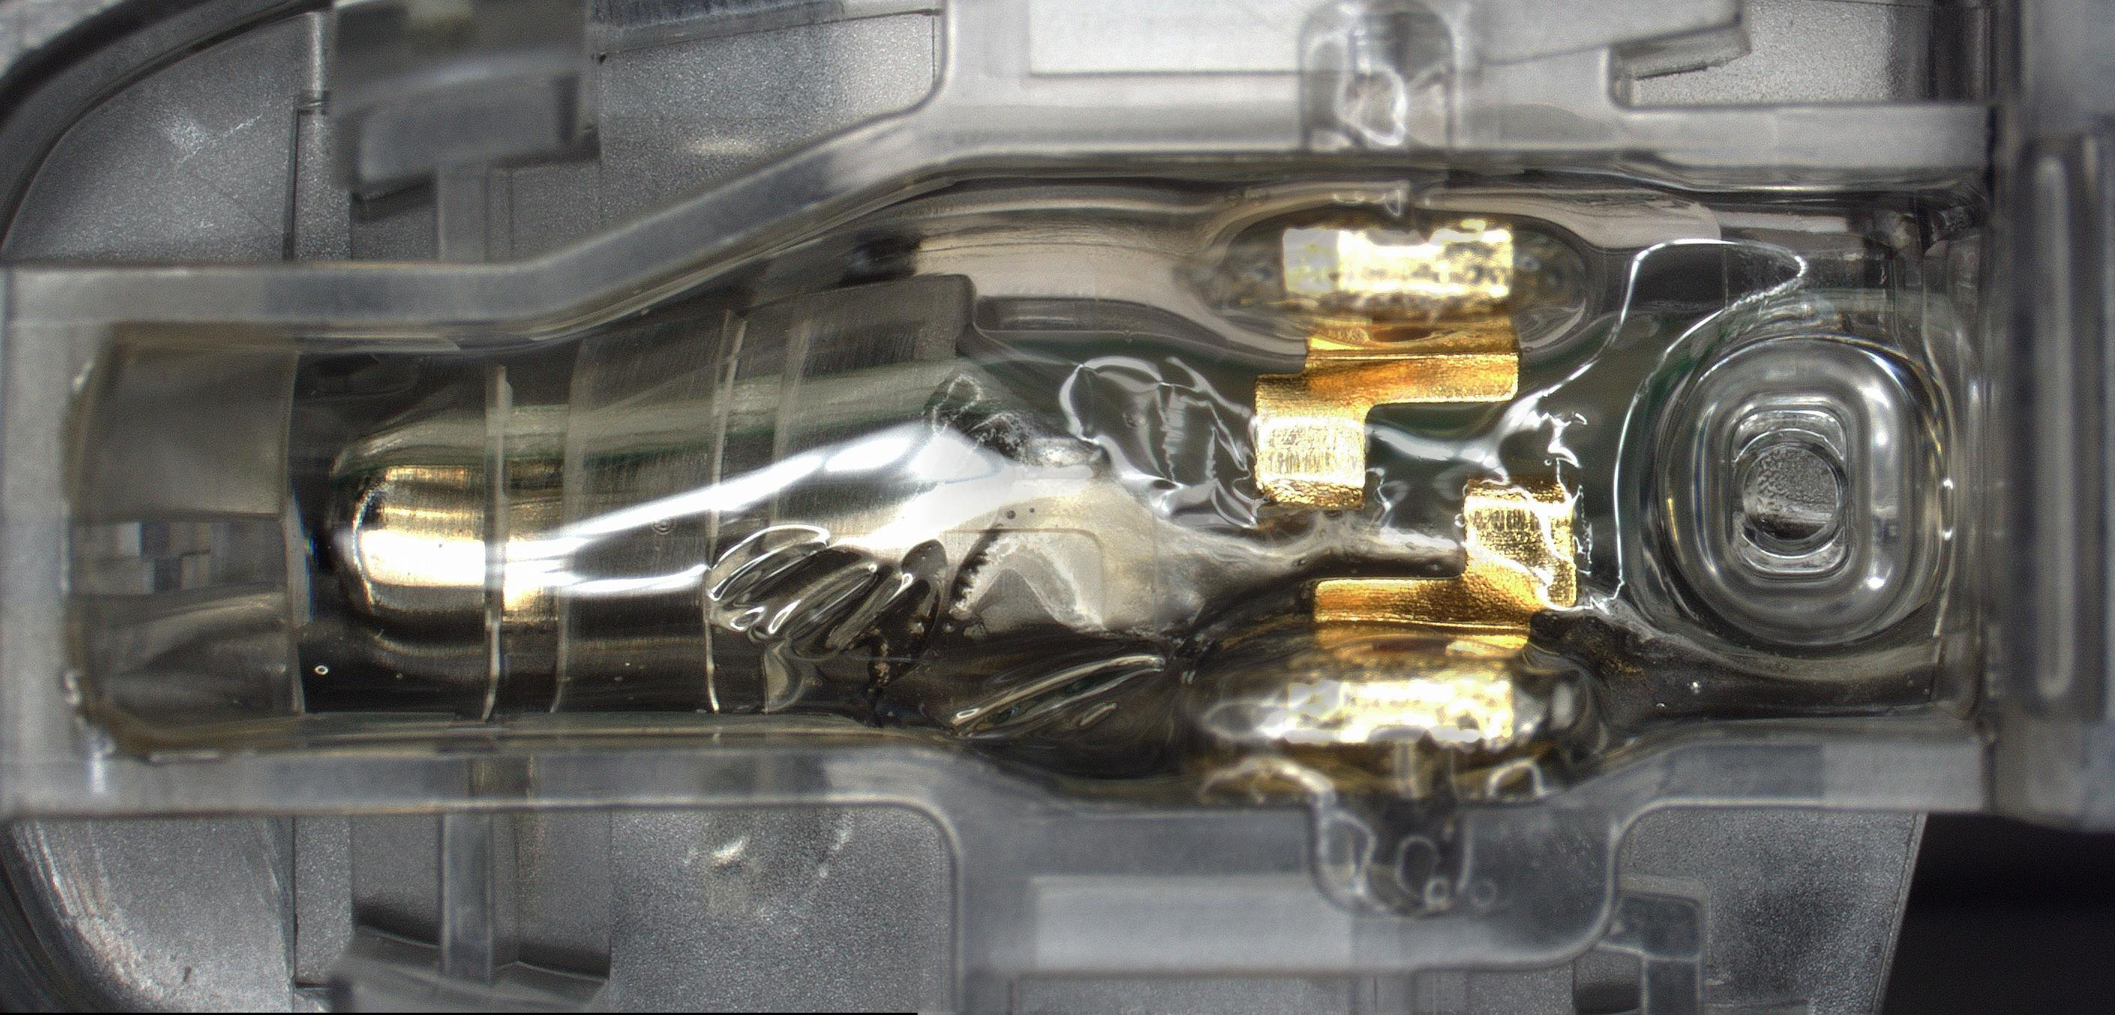
Gembox 1-22 Big Headspace High T Test Results
Design and Oil | Power | Resistance | Regime | TPM (mg/puff) and Standard Deviation | Draw Pressure (kPa) | SDR Result
Gembox BHHT-1 800kcp D8 | 4.45W | 2.3 | 60mL/3s/30s | 2.65, 0.19 | 0.498 | Pass
Gembox BHHT-2 800kcp D8 | 4.45W | 2.3 | 60mL/3s/30s | 2.29, 0.24 | 0.531 | Pass
Gembox BHHT-3 800kcp D8 | 4.45W | 2.3 | 60mL/3s/30s | 2.49, 0.12 | 0.608 | Pass
Gembox BHHT-4 800kcp D8 | 4.45W | 2.3 | 60mL/3s/30s | 1.73, 0.24 | 0.802 | Pass
Gembox BHHT-5 800kcp D8 | 4.45W | 2.3 | 60mL/3s/30s | 1.98, 0.17 | 0.628 | Pass
Due to the slope here, oil will accumulate above the inlet - remove it!

Slide 11
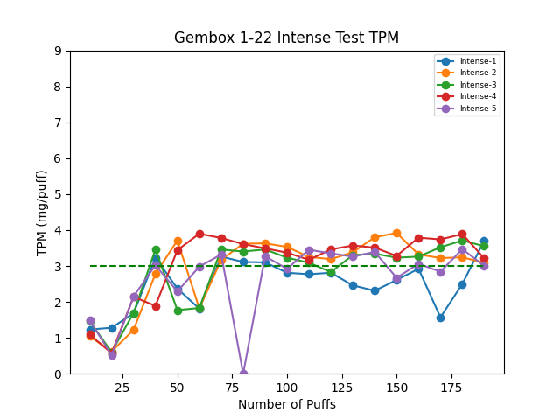
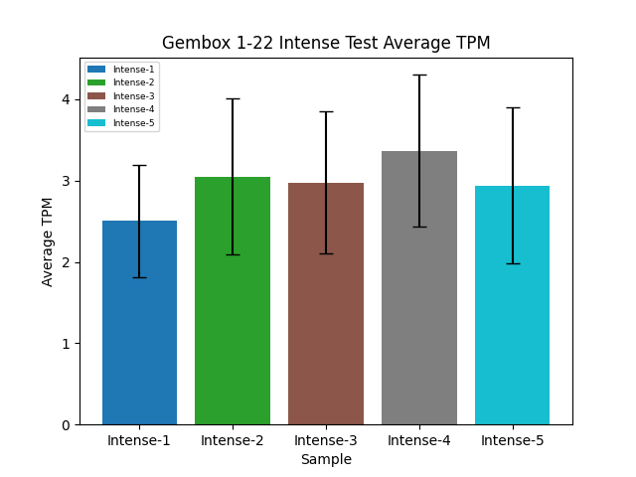
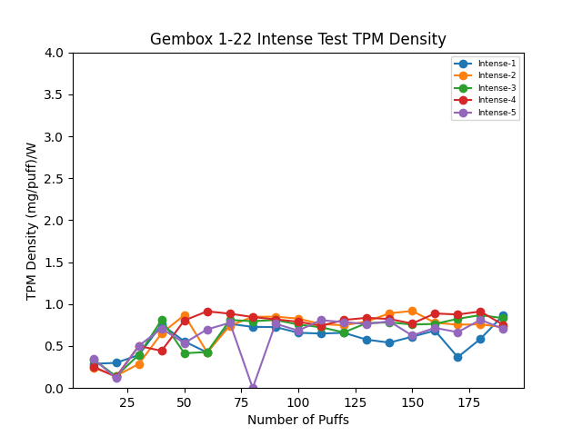
Gembox 1-22 Intense Test Results
Design and Oil | Power | Resistance | Regime | TPM (mg/puff) and Standard Deviation | SDR Result | Notes
Gembox Intense-1 800kcp D8 | 4.45W | 2.3 | 200mL/3s/30s | 2.5, 0.69 | Ongoing | Testing is ongoing. Efficiency will be reported next week.
Gembox Intense-2 800kcp D8 | 4.45W | 2.3 | 200mL/3s/30s | 3.05, 0.96 | Ongoing
Gembox Intense-3 800kcp D8 | 4.45W | 2.3 | 200mL/3s/30s | 2.98, 0.88 | Ongoing
Gembox Intense-4 800kcp D8 | 4.45W | 2.3 | 200mL/3s/30s | 3.37, 0.93 | Ongoing
Gembox Intense-5 800kcp D8 | 4.45W | 2.3 | 200mL/3s/30s | 2.94, 0.96 | Ongoing
Performance seems fine so far. The initial low TPM was due to the atomizer issue.

Slide 12
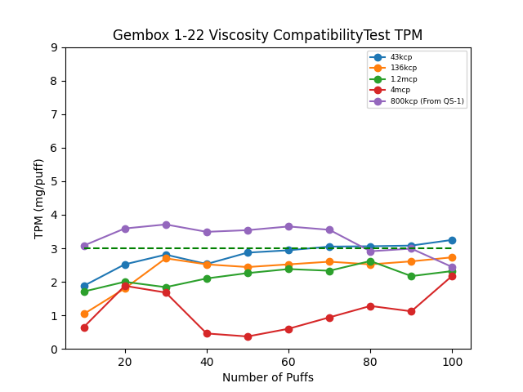
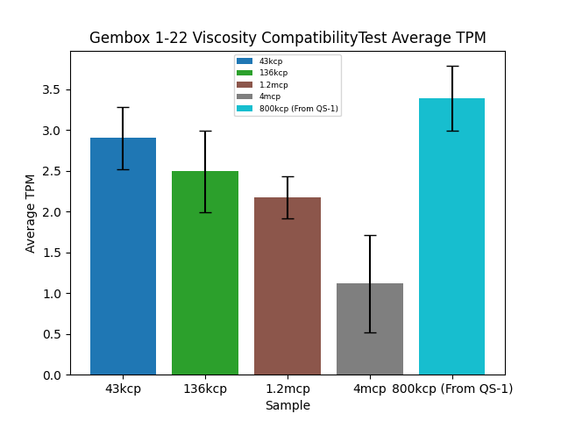
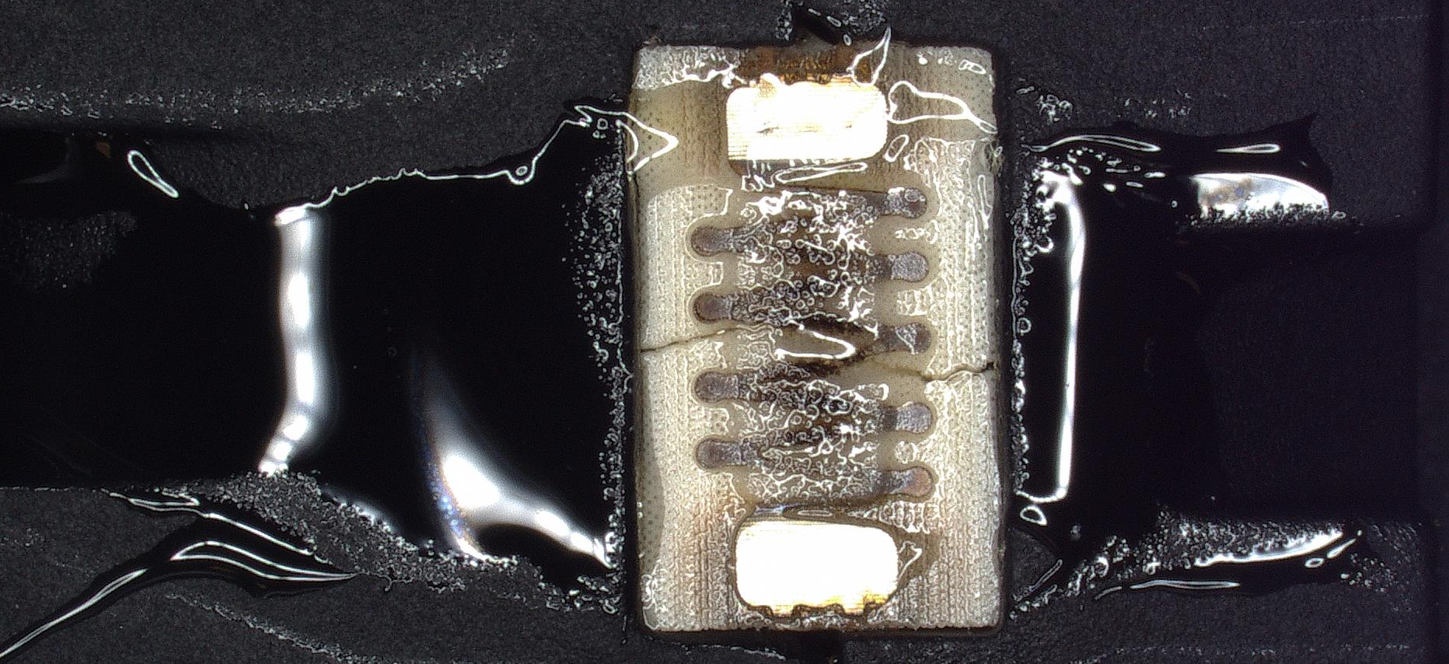
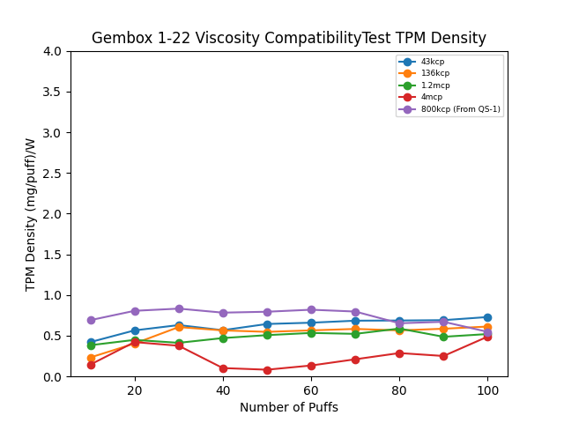
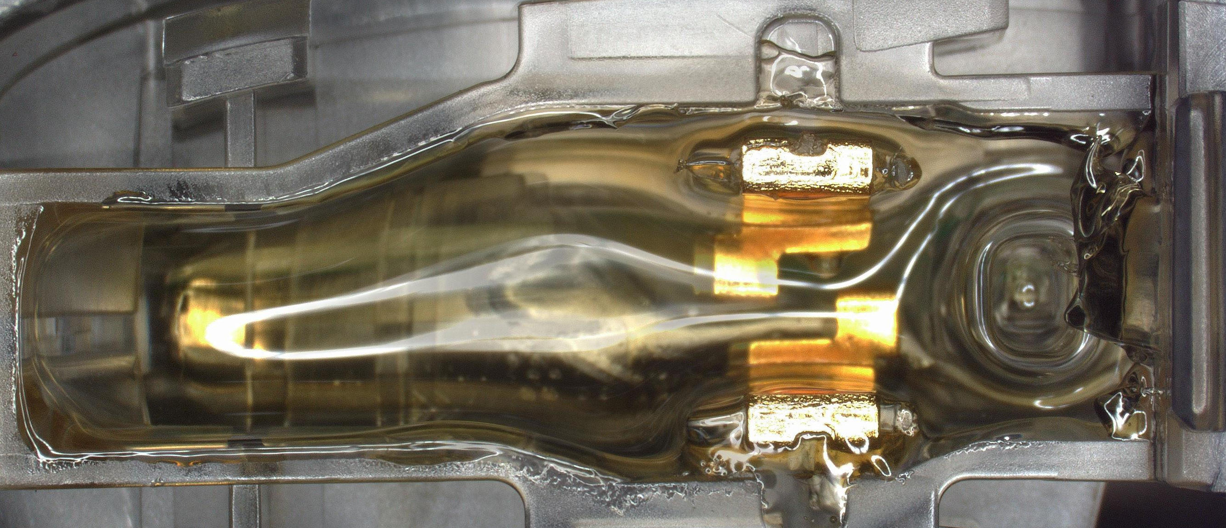
Viscosity Compatibility Test Results for Gembox 1-22
Design and Oil | Power (voltage set to 3.2V) | Resistance | Regime | TPM (mg/puff) and Standard Deviation | SDR Result | Notes
Gembox 43kcp D8 | 4.45W | 2.3 | 60mL/3s/30s | 2.9, 0.38 | Pass
Gembox 136kcp D8 | 4.45W | 2.3 | 60mL/3s/30s | 2.49, 0.5 | Pass
Gembox 1.2mcp D8 | 4.45W | 2.3 | 60mL/3s/30s | 2.17, 0.26 | Pass
Gembox 4mcp D8 | 4.45W | 2.3 | 60mL/3s/30s | 1.12, 0.6 | Tentative Pass | The low TPM is mainly due to a thicker bubble. When properly moisturized, the TPM is ~2 mg/puff.
Gembox (From QS-1, 3.4V) 800kcp D8 | 5W (3.4V*) | 2.3 | 60mL/3s/30s | 3.39, 0.4 | Pass
The TPM of the 4mcp oil decreased because a thick bubble on the heater blocked the coil absorption.
The heating element for the 43kcp D8 sample seems to be broken. Oil was observed above the air inlet, which could eventually cause clogging. The side walls of the air inlet should minimize this issue. Leakage behind the heater indicates a risk of further clogging. We should study increasing the distance between the air inlet and the heater.

Slide 13
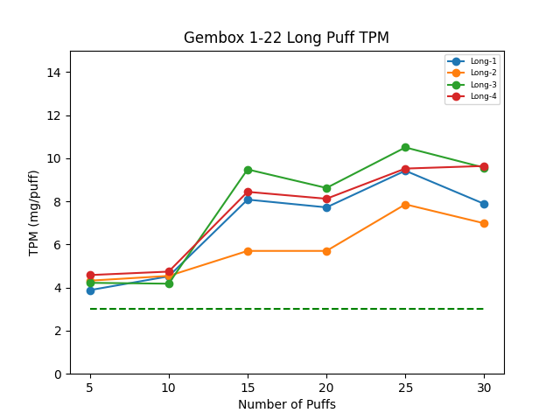
Gembox 1-22 Long Puff Test Results
Design and Oil | Power | Resistance | Regime | Draw Resistance | SDR Result | Notes
Gembox Long-1 700kcp D8 | 4.45W | 2.3 | 100mL/5s, 160mL/8s, 200mL/10s | 0.842 | No problem
Gembox Long-2 700kcp D8 | 4.45W | 2.3 |  | 0.528 | No problem
Gembox Long-3 700kcp D8 | 4.45W | 2.3 |  | 1.032 | No problem
Gembox Long-4 700kcp D8 | 4.45W | 2.3 |  | 0.392 | Draw Resistance is very low | No activation problem even under low draw force
5s Puff
8s Blow
10s Blow

Slide 14
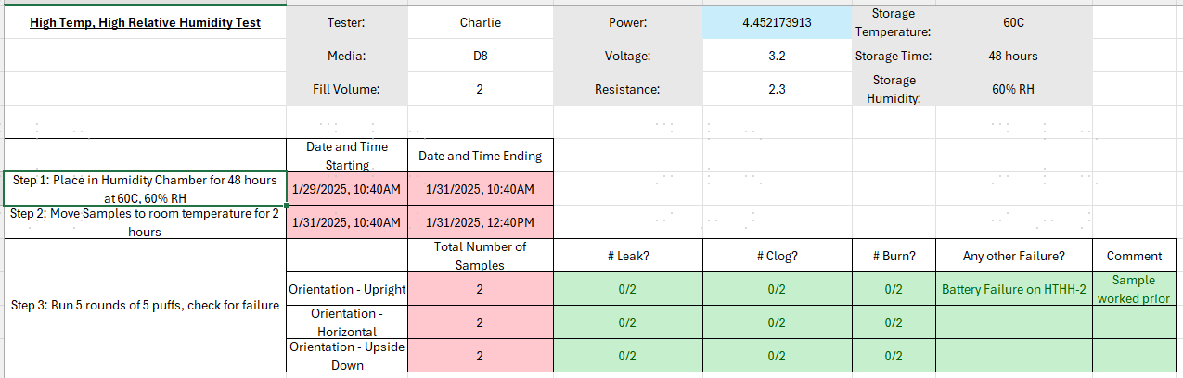
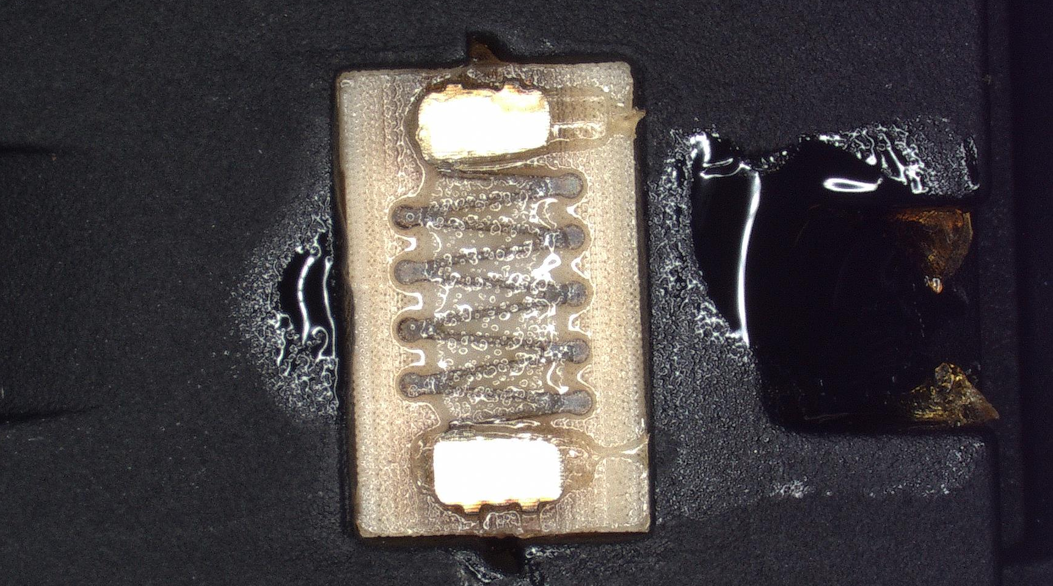
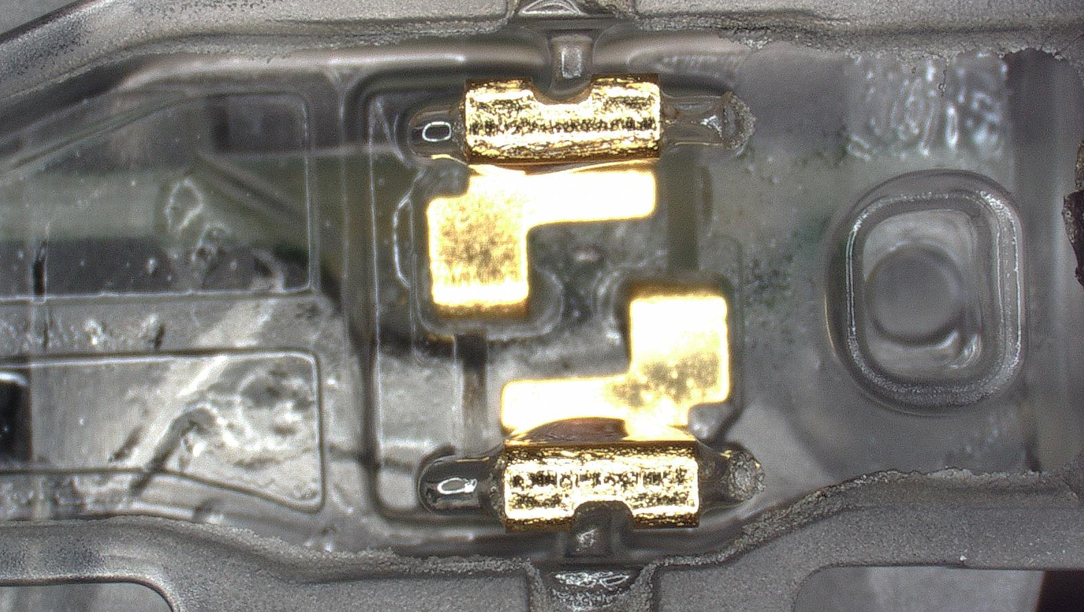
Gembox 1-22 High Temperature and High Humidity Results
HTHH-6
Leakage only occurs behind the steam path. This indicates the slope on the silicon diaphragm.

Slide 15
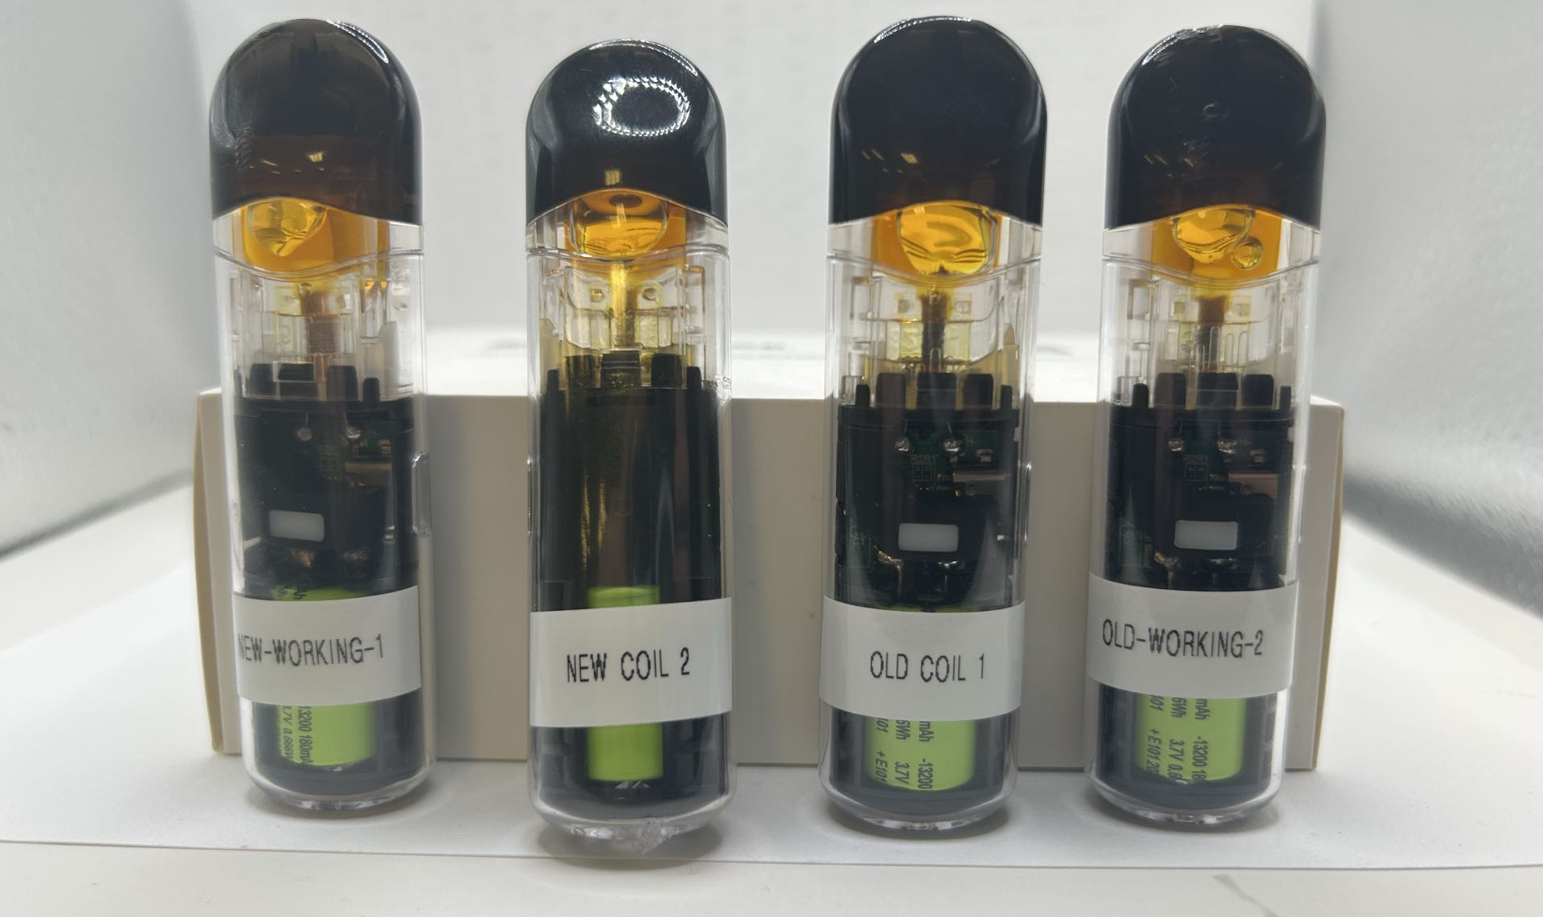
Olibanum Stick New vs Old Coil Sensory Comparison
Ranking (1 is best)
Objective: To identify any differences between the new and old coils. The test passes if the new coil is better than or equal to the old coil.
User | 1 | 2 | 3 | 4
Nellie | New Coil 2 | New-Working-1 | Old Coil 1 | Old-Working-2
Leland | Old Coil 1 | New-Working-1 | New Coil 2 | Old-Working-2
Charlie | Old Coil 1 | New-Working-1 | New Coil 2 | Old-Working-2
Based on 3 rapid sensory tests, there does not appear to be a significant difference between the new and old coils. Old-working-2 was consistently the worst, while new-working-1 was consistently second best.

Slide 16
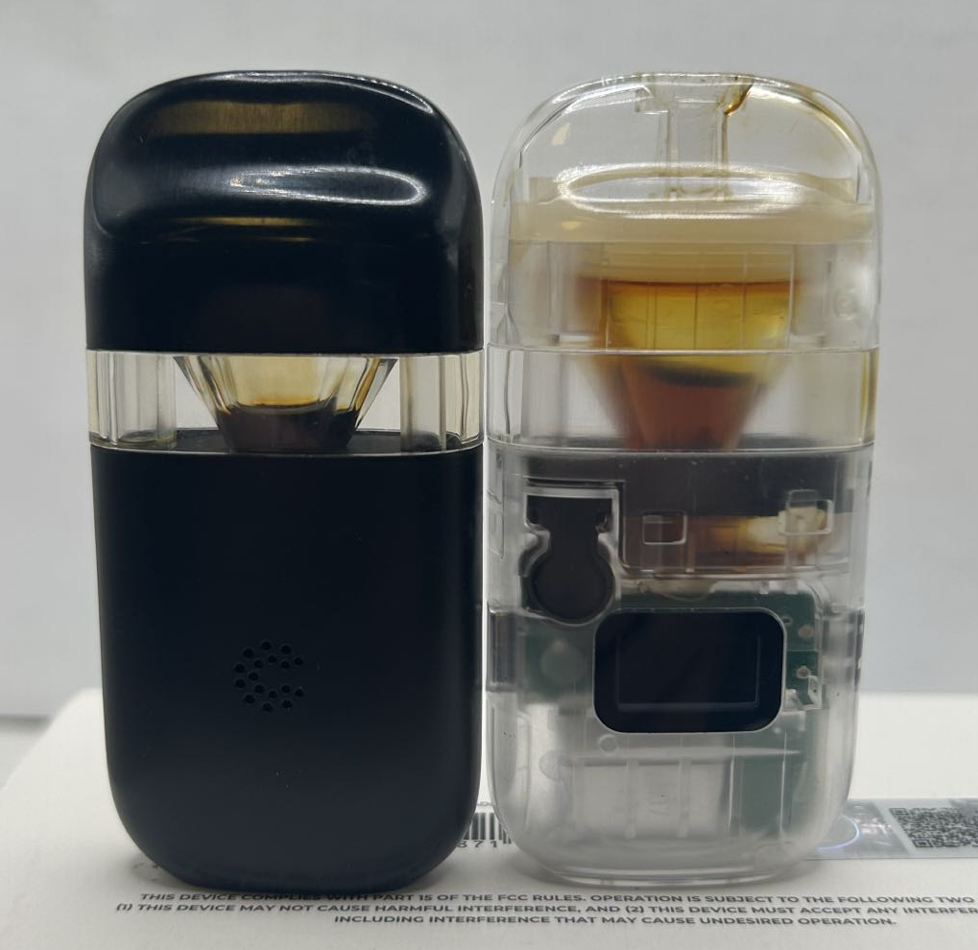
Gembar + Gembox Pine Cologne Test Update
Gembar: Currently undergoing a 2mL pine cologne user test with a usage rate of 50%. Discoloration was observed, but no noticeable change in odor. No clogging or oil leakage to date. Gembox: Sample for the 2mL pine cologne user test clogged. The batch from December 11, 2024 (black casing) clogged for the first time with approximately 20% oil remaining. The batch from 1-22-2025 (transparent casing) started clogging at 50% remaining and experienced severe clogging at 40% remaining. This further illustrates the advantage of the old air intake. Discoloration becomes very obvious as the oil level decreases.

Slide 17
Thank you

