Slide 1
Test Automation using Ruby
By Vishal Mishra

Slide 2
What will be covered:
THE RUBY LANGUAGE
WHAT IS WATIR & WHAT USERS SAY
HOW TO GET STARTED WITH RUBY AND WATIR
THE DOM LOCATORS TREE OF LIFE
CODE EXAMPLES
DEBUGGIN WITH IRB
ANY GUI AUTOMATION – AUTOIT AND SIKULI
BEHAVIOUR DRIVEN DEVELOPMENT: CUCUMBER & RSPEC
CONTINUOUS INTEGRATION WITH JENKINS
INTEGRATION WITH SAUCE LABS
RAKE & RSPEC
FEW WORDS ABOUT THE CODE & STRUCTURE (JAVA VS RUBY)
TOOLS FOR ACCESSING DOM ELEMENTS
Notes:
Scope of this presentation is to make everyone familiar with Ruby language and right after start writing his/her first automated scripts not only for testing needs but also for day to day tasks.
THE RUBY LANGUAGE
WHAT IS WATIR
WATIR-WEBDRIVER FEATURES
WHAT USERS SAY
HOW TO GET STARTED WITH RUBY AND WATIR
READY FOR SOME CODE?
OPEN A WEB PAGE AND SHOW TITLE AND TEXT
COLLECTIONS OF ELEMENTS
THE DOM
FINDING <HTML> ELEMENTS IN DOM
THE DOM LOCATORS TREE OF LIFE
INTERACTION WITH DOM
ANY GUI AUTOMATION
BDD: RUBY AND CUCUMBER
CREATE CODE FOR YOUR FEATURES
RUNNING THE SCRIPTS
DEBUGGIN WITH IRB
TOOLS FOR ACCESSING DOM ELEMENTS
USEFUL TOOLS/IDEs
FEW WORDS ABOUT THE CODE AND STRUCTURE

Slide 3


THE RUBY LANGUAGE
Dynamic
Easy to understand syntax
Easy to use interpreter
Object oriented
Cross-platform
Powerful class libraries
Massive online support communities base
Notes:
Five Ways That Ruby Is Better Than Java: http://jroller.com/rolsen/date/20060118
More info on ruby: http://www.youtube.com/watch?v=fYIEV_6xhck

Slide 4











WHAT IS WATIR
Why use Watir?
Free
Powerful
Simple
Excellent Support
It uses Ruby
Broad usage.
Web Applications Testing in Ruby
Free open-source tool
Ruby library which runs almost any browser
Results oriented
Unlimited possibilities
Cross-platform
Massive online support communities base
Multiple browser windows/tabs.
JavaScript events.
Frames / iframes / modal dialogs.
Supports visible and invisible runs
Headless / PhantomJS.
Capturing of the screens
Notes:
A free, open-source functional testing tool for web applications.
It is a Ruby library which drives almost any browser the same way people do, clicks links, fills in forms, and presses buttons.
Watir also checks results, such as whether expected text appears on the page or not.
Because it’s build on Ruby, you have the power to connect to databases, read data files, save screenshots, manipulate the file system, export to CSV and XML, structure your code into reusable libraries
Free;Powerful;Simple ;Excellent Support;It uses Ruby, a full-featured object oriented scripting language
Broad usage in high level client base.

Slide 5


WHAT USERS SAY
“…WATIR is by far the most complete web testing framework out here--that doesn't cost an arm and a leg.
“Ruby is an awesome language and Watir
is just too cool. It does things that other
companies (ie. QTP, IBM/Rational, Mercury, Segue,
etc) charge thousands and thousands of dollars a seat for.
Notes:
-Watir forum boards are the most active and well supported that I have seen. You can post a question and is just a short period of time get someone (most of the time the architects of the framework!) who will steer you in the right direct, give you a work around to get over any roadblocks, or add it to the framework if it doesn't currently exist. That is the reason I switched and tell everyone interested that Ruby is the way to go!
-Now that I'm gettin' the hang of Ruby and Watir, I'm starting to automate everything I do on the web. Even the simple things like logging in to web sites, searches, you name it.
(source: www.watir.com)

Slide 6
HOW TO GET STARTED WITH RUBY AND WATIR
Download and install Ruby.
Install rubygems: gem update --system
Install DevKit
Download and install ChromeDriver.
Install Watir-Webdriver: gem install watir-webdriver
Open CMD, type: irb
Type: require 'watir-webdriver'
Type: browser = Watir::Browser.start 'endava.com'
Notes:
1. Install ruby - use the www.rubyinstaller.org/downloads/ link, download and install latest version.
2. Update gems (http://rubygems.org/) with the following ruby command prompt (Start -> Programs -> Ruby 1.9.3 -> Start Command Prompt with Ruby): gem update --system
3. Download DevKit, that makes it easy to build and use native C/C++ extensions. We'd need that for Opera and Chrome support. Follow the install instructions in: https://github.com/oneclick/rubyinstaller/wiki/Development-Kit
4. For Google Chrome, additionally, we'd need to install the library. Go to http://code.google.com/p/chromedriver/downloads/list and download latest version. Unzip the file and put it in any folder that is in your PATH. (For example C:\Ruby1.9.3\Bin)
5. Install Watir-Webdriver gem in ruby command prompt (Start -> Programs -> Ruby 1.9.3 -> Start Command Prompt with Ruby): “gem install watir-webdriver”. Read the User's Guide (http://wtr.rubyforge.org/watir_user_guide.html), documentation, examples and tests for reference. (http://wiki.openqa.org/display/WTR/FAQ)
6. Ruby command prompt: cmd -> C:\Windows\System32\cmd.exe /E:ON /K C:\Ruby193\bin\setrbvars.bat -> Enter -> irb -> Enter

Slide 7
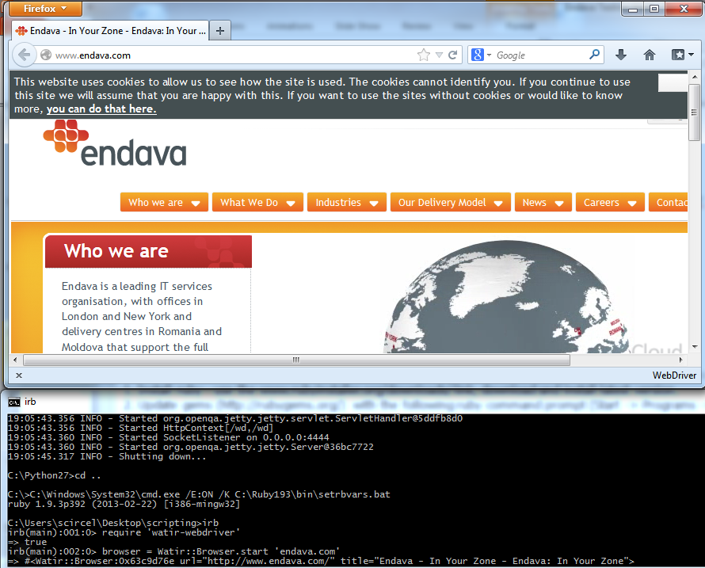

Slide 8
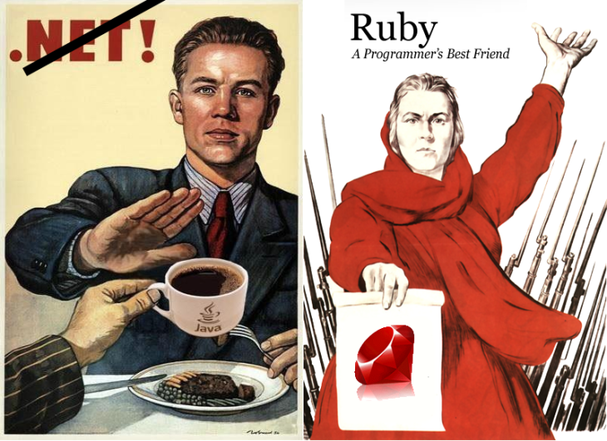
READY FOR SOME CODE?
Notes:
Source: http://nnedbedb.wordpress.com/2013/02/26/%D1%80%D0%BE%D0%B4%D0%B8%D0%BD%D0%B0-%D0%BC%D0%B0%D1%82%D1%8C-%D0%B7%D0%BE%D0%B2%D1%91%D1%82/

Slide 9
OPEN A WEB PAGE AND SHOW TITLE AND TEXT
require 'watir-webdriver'
b = Watir::Browser.new :chrome
b.goto 'endava.com'
Returns current title of the page
b.title
Returns current text elements of the page
b.text

Slide 10
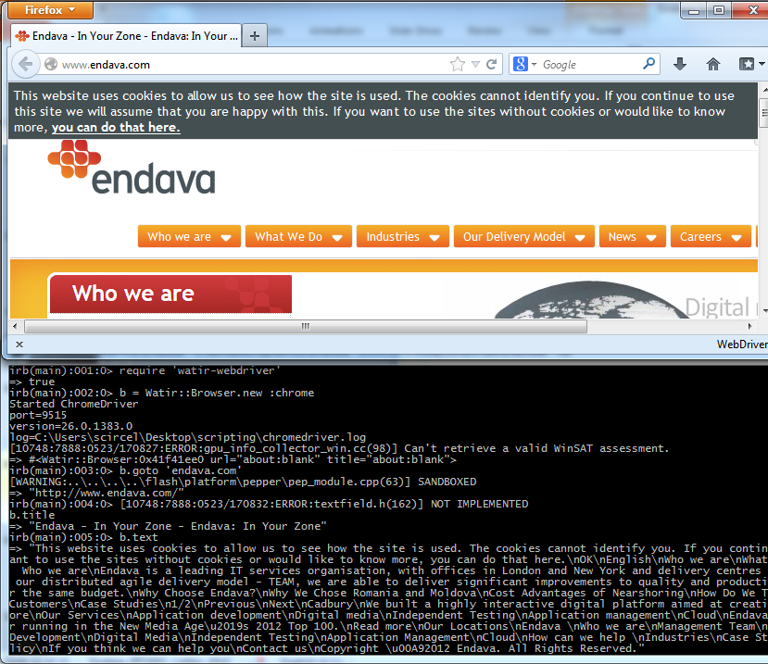

Slide 11
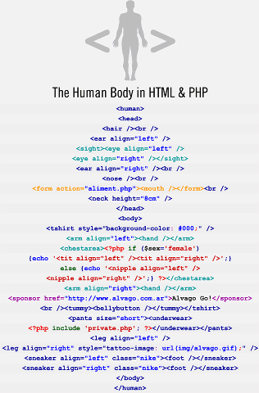
THE DOM
Notes:
Document Object Model
The Document Object Model (DOM) is a cross-platform and language-independent convention for representing and interacting with objects in HTML, XHTML and XML documents. Objects in the DOM tree may be addressed and manipulated by using methods on the objects. The public interface of a DOM is specified in its API.

Slide 12
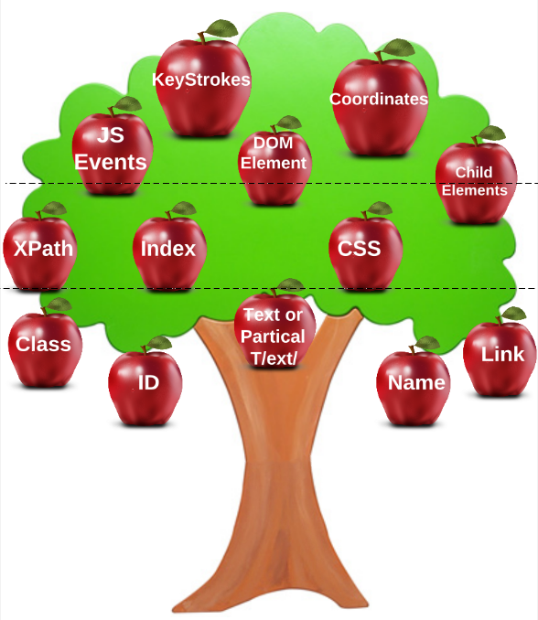
THE DOM LOCATORS TREE OF LIFE
TextBox | browser.text_field(:name, “name”).set “Value”
Button | browser.button(:text, /text/).click
DropDownList | browser.select_list(:id, “id”).set “Value”
CheckBox | browser.checkbox(:class, “class_id”).click
RadioButton | browser.radio(:class, “class_id”).click
HyperLink | browser.link(:href, “URL”).click
Form | browser.form(:name, “name”).set “Value”
Frame | browser.frame(:id, “frame1”).use
And many, many more (div, label, image, etc…)…

Slide 13
INTERACTION WITH DOM
Interaction with DOM
b.link(:text, 'Careers').hover
b.link(:text, 'Working at Endava').click
Small conditional validation test
if b.text.include? 'Smart, Open, Thoughtful, Trusted, Agile'
puts 'Test passed.'
else
puts 'Test failed.'
end

Slide 14
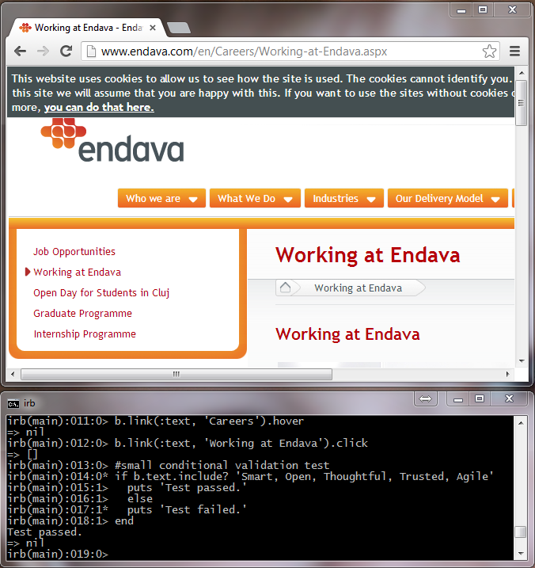

Slide 15
COLLECTIONS OF ELEMENTS
Returns all text links of the page
b.links.each {|x| unless x.text.empty? or x.text.nil?; puts x.text; end }
Returns all text of the page which is enclosed in <span> tags.
b.spans.each {|x| unless x.text.empty? or x.text.nil?; puts x.text; end }
Returns all images url’s of the page.
b.imgs.each {|x| puts x.src }
Writes all images’ url’s to a new array
a = Array.new
b.imgs.each {|x| a.push(x.src) }
puts a

Slide 16
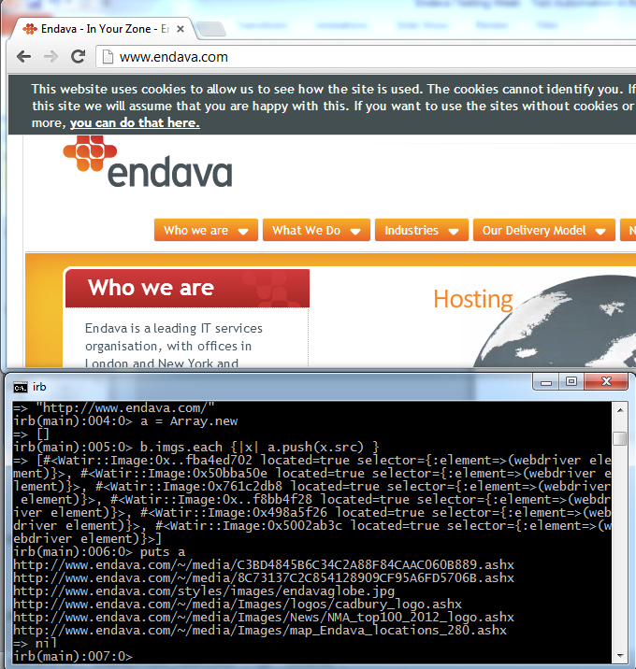

Slide 17
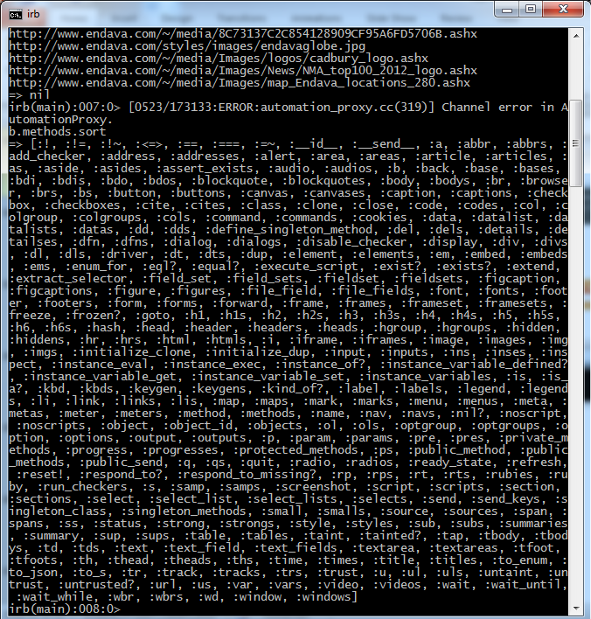
DEBUGGIN WITH IRB
IRB = Interactive Ruby Shell; Command line-like interface that allows immediate running of Ruby script. Great for debugging one line at a time, rather then having to run through an entire script. Great for testing single lines

Slide 18
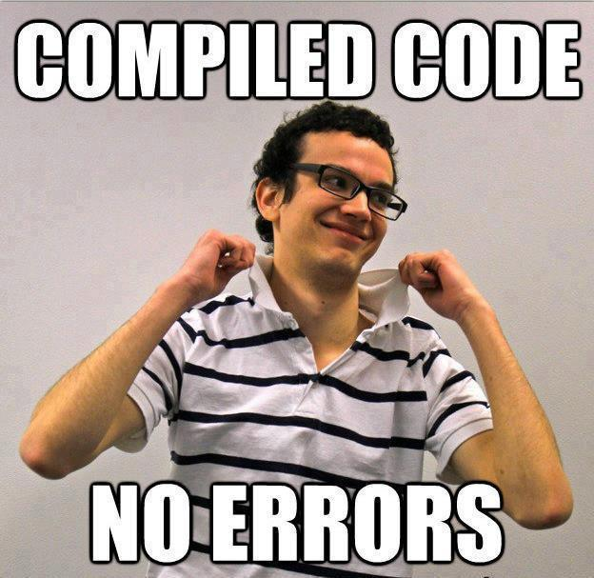

Slide 19
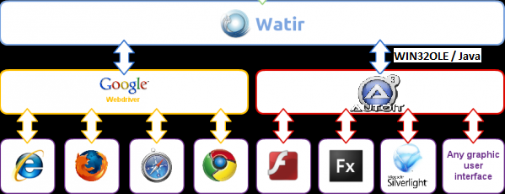
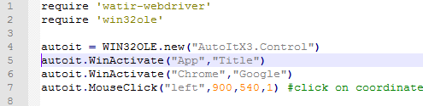
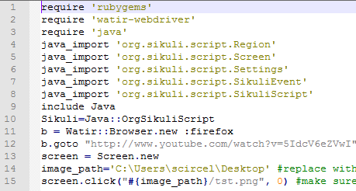
ANY GUI AUTOMATION – AUTOIT AND SIKULI
Simple AutoIT Example
Simple Sikuli Example (on jRuby)
Notes:
Flash, Silveright and/or any GUI Automation with Ruby and AutoIT or jRuby with Sikuli
More examples in our svn @http://mdsvn.endava.net/svn/qa/testautomation/ruby

Slide 20
BEHAVIOUR DRIVEN DEVELOPMENT (BDD): CUCUMBER & RSPEC
Install the necessary gems by running:
gem install 'cucumber'
gem install 'watir-webdriver'
gem install 'rspec-expectations‘
Setup Env.rb (next slide)
Create GoogleSearch.feature:
Feature:
"When I go to the Google search page, and search for an item, I expect to see some reference to that item in the result summary.“
Scenario: 1. Search BDD in Google (Positive)
Given that I have gone to the Google page
When I add "BDD" to the search box
And click the Search Button
Then " behavior-driven development" should be mentioned in the results
Notes:
There tends to be a strong ongoing association between Agile and Open-Source automation tools today. Many make good inroads on the attempt to connect the elaboration of requirements with automated tests, step for step. This way, the test is performing as closely as possible, what the client actually asked for, or agreed in the elaboration process. One such tool is Cucumber. It is designed to allow you to execute feature documentation written in plain text.
Prerequisites: It is assumed that before using this example you have the following Installed: • Ruby • Watir gem for Ruby • Cucumber gem for Ruby
I will use a simple example that uses the Google search engine in this case: Let’s say the user story is something like: ‘When I go to the Google search page, and search for an item, I expect to see some reference to that item in the result summary.’
Cucumber uses the keywords “Given”, “When”, “And” “Then” to build this into useable syntax.
So I create for example, a file, called GoogleSearch.feature containing:
Feature: ‘When I go to the Google search page, and search for an item, I expect to see some reference to that item in the result summary.’

Slide 21
CREATE CODE FOR YOUR FEATURES
Given /^that I have gone to the Google page$/ do
@browser.goto('www.google.com')
end
When /^I add "(.*)" to the search box$/ do |item|
@browser.text_field(:name, 'q').set(item)
end
And /^click the Search Button$/ do
@browser.button(:name, 'btnG').click
end
Then /"(.*)" should be mentioned in the results/ do |text|
@browser.text.should =~ /#{text}/
End
Run using the following command: cucumber GoogleSearch.feature
Notes:
This gives us executable code for every Given, When and Then statement we have used.
To run it we issue the following command line cucumber GoogleSearch.feature
In order to run all pre-set in batch run:
C:\Users\scircel\Desktop\scripting\qa\testautomation\ruby\cucumber>cucumber features –s

Slide 22
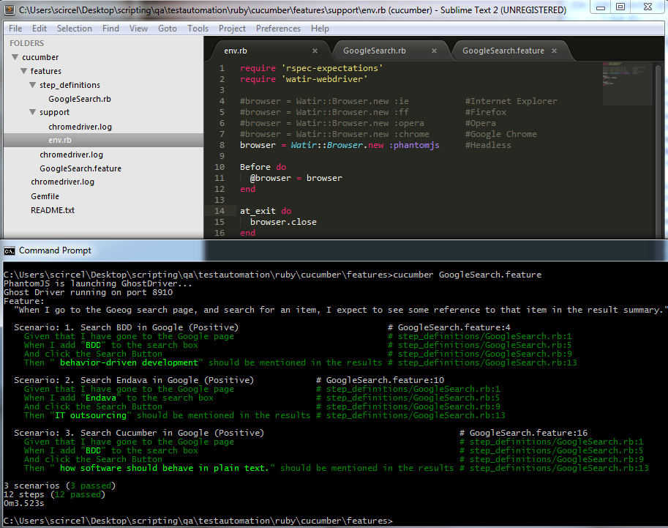
Notes:
An example of Ruby and Cucumber BDD framework can be found here: http://mdsvn.endava.net/svn/qa/testautomation/ruby/cucumber

Slide 23
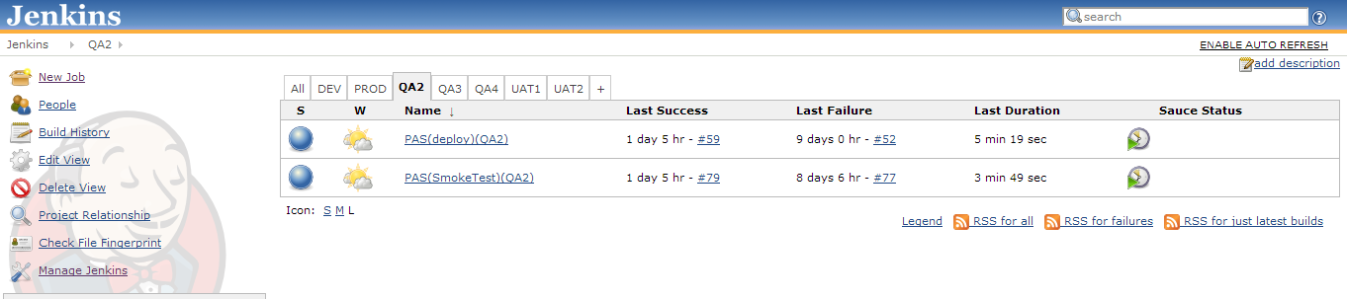
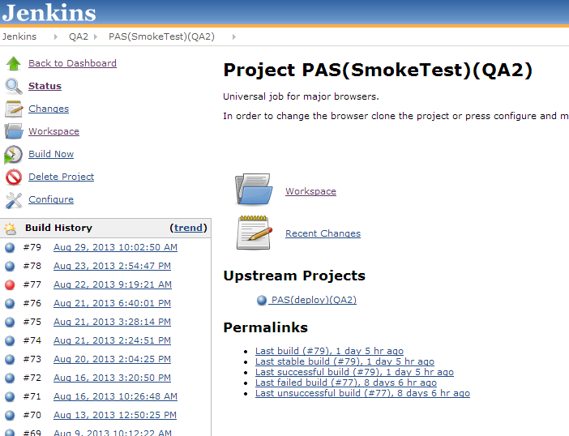
CONTINUOUS INTEGRATION WITH JENKINS

Slide 24
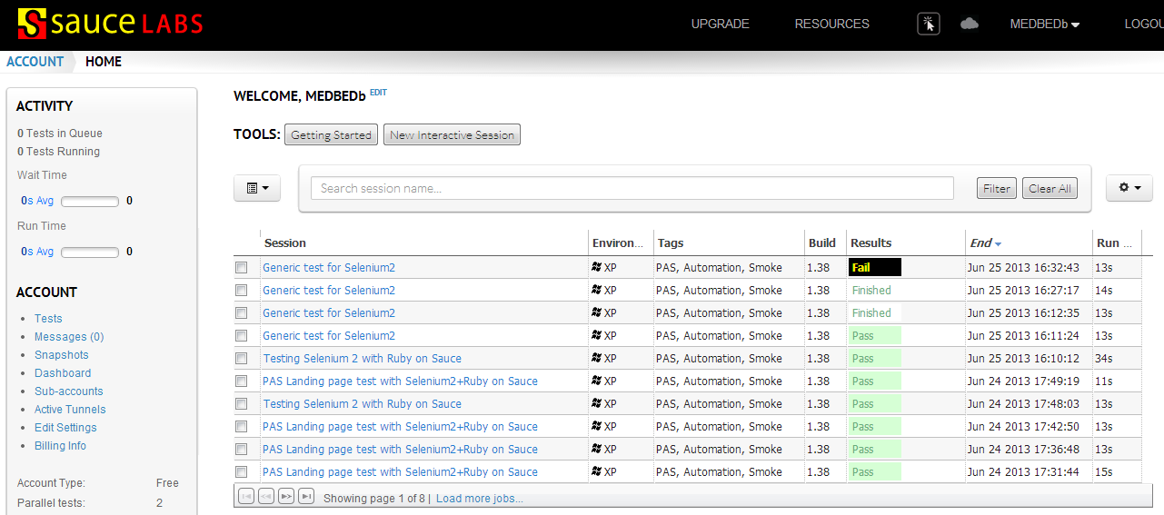
INTEGRATION WITH SAUCE LABS

Slide 25
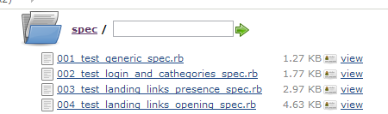
RAKE – RUNNING SCRIPTS GROUPED IN TASKS.
require 'rspec/core/rake_task'
RSpec::Core::RakeTask.new(:spec) do |t|
t.pattern = FileList['spec/*_spec.rb']
t.rspec_opts = '--format html > ./results.html'
end
task :default => :spec

Slide 26
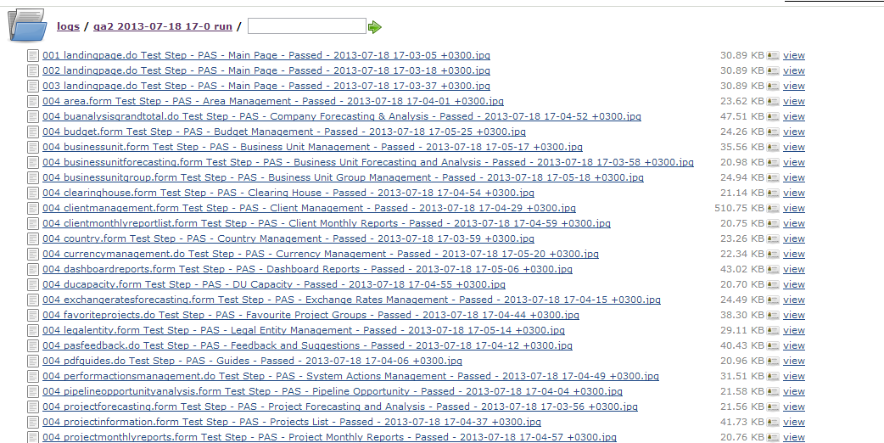
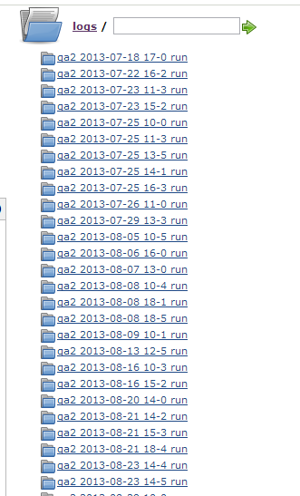
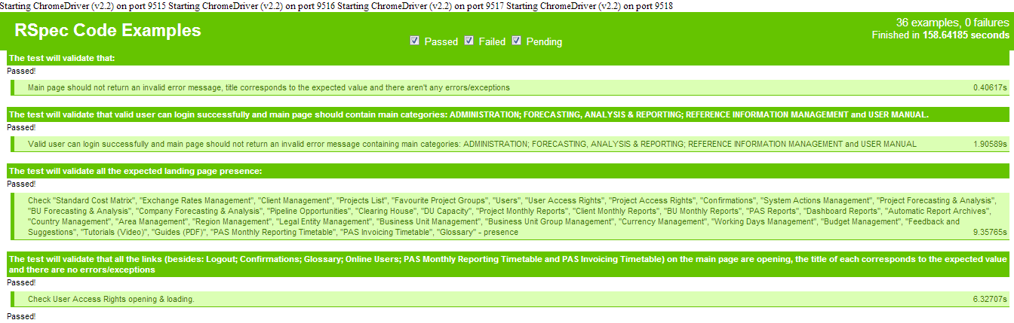
RSPEC AND EXTENSIVE LOGGING

Slide 27
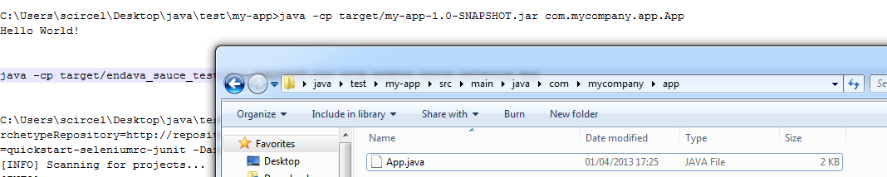
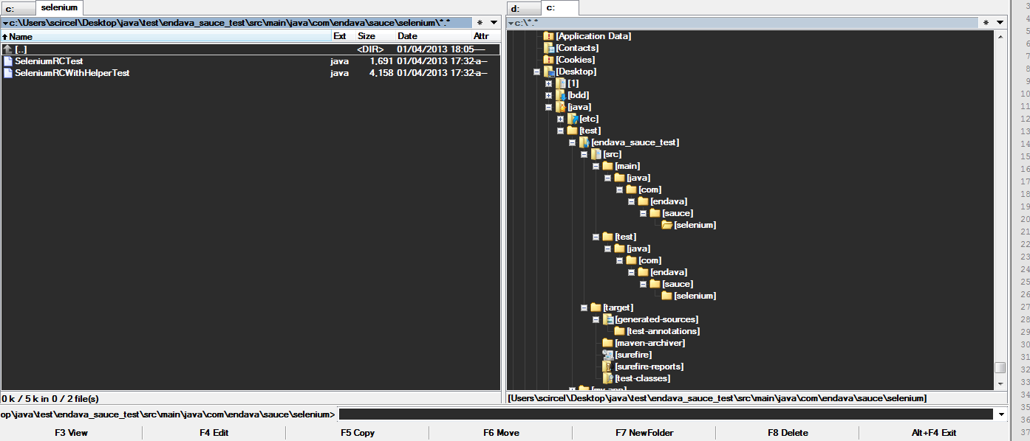
FEW WORDS ABOUT THE CODE & STRUCTURE (JAVA VS RUBY)
Notes:
::::Comparison of Sauce automation framework implemenation using Webdriver on Java and Maven VS Webdriver on Ruby :::
The code:
Java: p1 - http://d.pr/i/de3Q; http://d.pr/i/RSND p2 - http://prntscr.com/yqfzc; p3 - http://prntscr.com/yqg4t
Ruby: (on Slide29)
The Structure:
Java: http://prntscr.com/yqgsl
Ruby: http://prntscr.com/yqh25
(detailed rb http://prntscr.com/yqgxu)
The Setup:
Java:
1. Install JDK
2. Install Maven
3. Configure Maven
4. Configure JDK
5. mvn archetype:generate ..
6. mvn package
7. java -cp target/endava_sauce_test-1.1-SNAPSHOT.jar com.endava.sauce.selenium.App
http://prntscr.com/yqcak %) %) %)
Java & Selenium setup and details
http://www.wunderkraut.com/blog/creating-and-running-a-simple-selenium-webdriver-test/2011-09-15
Ruby:
1. Install Ruby
2. gem update --system
3. gem install selenium-webdriver
4. ruby script.rb
The results:
on RUBY: http://www.webpagescreenshot.info/img/528532-41201361959PM
on Java: http://www.webpagescreenshot.info/img/478714-41201360705PM
Next steps: running cucumber on Ruby within Sauce:
git clone http://github.com/sgrove/cucumber_sauce.git
gem install cucumber selenium-client parallel
Add your Sauce Labs username and api-key to ondemand.yml
Optionally edit one of the browser*.yml files to specify which browsers you want to run
(C:\Ruby193\bin\setrbvars.bat)
Run: rake cucumber_sauce

Slide 28
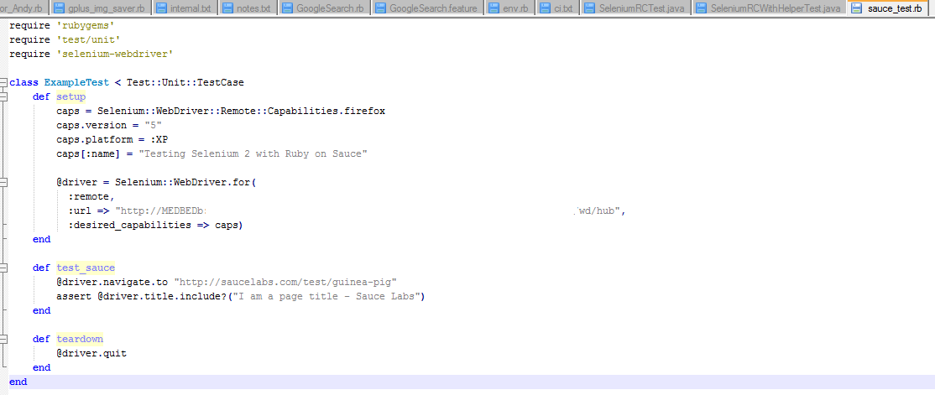
JAVA
Java code: p1 - http://d.pr/i/de3Q; http://d.pr/i/RSND
p2 - http://prntscr.com/yqfzc
p3 - http://prntscr.com/yqg4t
Java Structure: http://prntscr.com/yqgsl
RUBY
http://prntscr.com/yqh25 (detailed rb http://prntscr.com/yqgxu)
Notes:
Screens removed due to large size of file.

Slide 29



TOOLS FOR ACCESSING DOM ELEMENTS
FireBug
Xpath Checker
WATIR::SupportsSubElements
IE Developer Tool bar
USEFUL TOOLS/IDEs
Sublime
Notepad++
Notes:
Notepad++ (A good light-weight editor supporting Ruby code orthography and stylistics)
IE Developer Toolbar: (Lets you explore the HTML elements behind the visible elements on a web page by clicking on the elements
Xpath Checker: An interactive editor for XPath expressions. Choose 'View XPath' in the context menu and it will show the editor. You can edit the XPath expression and it incrementally updates the results.
FireBug (Excellent FireFox extension for identifying HTML elements while writing scripts.)
WATIR::SupportsSubElements (Watir API for accessing html elements)

Slide 30


QUESTIONS ?…

Slide 31
Thanks

