Slide 1

Coursera IBM Capstone Project
The Battle of the neighborhoods
Suitable location for a sandwich shop in New Orleans, USA

Slide 2

Coursera IBM Capstone Project
What will be on this presentation:
1. A description of the problem and a discussion of the background
2. A description of the data and how it will be used to solve the problem
3. Methodology and data analysis
4. Discussion and conclusions

Slide 3
Coursera IBM Capstone Project
A description of the problem and a discussion of the background
People need to eat, someone said.
Mia loves to cook and her friends say that she makes "the greatest and best" sandwiches they ever had. She is happy to constantly ear about it, that she decided to try to open a small place.
She lives in New Orleans, USA and she is looking for a good location and cheap but more important, a place where she can be successful.
There are lots of factors that are in place that could tank really fast the business if she makes the wrong choices, so she decided to talk to some friends and asked for our help.
The goal is to look at the available data and help her to decide for the best location.
The task is to help to make a decision that makes sense for her, in this case to look for possible locations that are suitable.
The idea from Mia is to have a small sandwich shop in New Orleans, USA.

Slide 4
Coursera IBM Capstone Project
Criteria for the location
New Orleans is world-famous for its food. There cuisine is unique that combines local Creole, haute Creole and New Orleans French cuisines. There local ingredients are French, Spanish, Italian, African, Native American, Cajun, Chinese, and a of Cuban to combine and produce a recognizable New Orleans flavour.

Slide 5
Coursera IBM Capstone Project
Data requirements
In 1980 the New Orleans City Planning Commission divided the city into 13 planning districts and 72 distinct neighborhoods. After the Katrina and 50% less population, the reality is not reflected here.
The data regarding the districts in New Orleans needs to be researched and a usable source identified. If it is found but is not in a usable form, data wrangling and cleaning will have to be performed.
The data will be used as input for the Foursquare API. That data output from the Foursquare API will be used to explore or compare districts around New Orleans, identifying the high traffic areas where consumers go for shopping, dining and entertainment as the logical and possible areas where to open this kind of business.

Slide 6
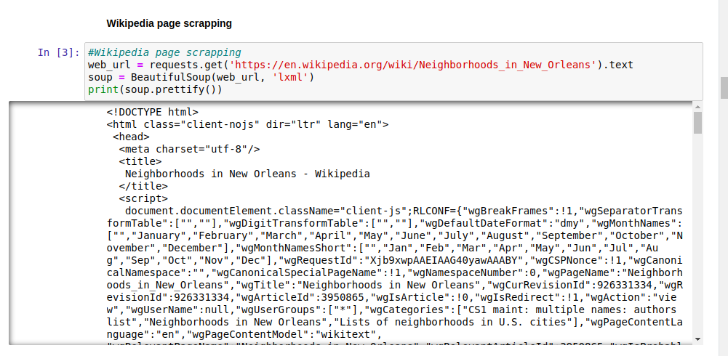
Coursera IBM Capstone Project
Methodology

Slide 7
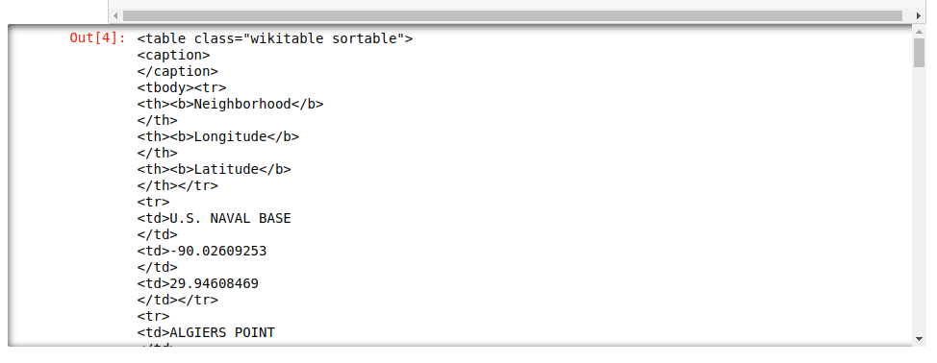
Coursera IBM Capstone Project
Methodology

Slide 8
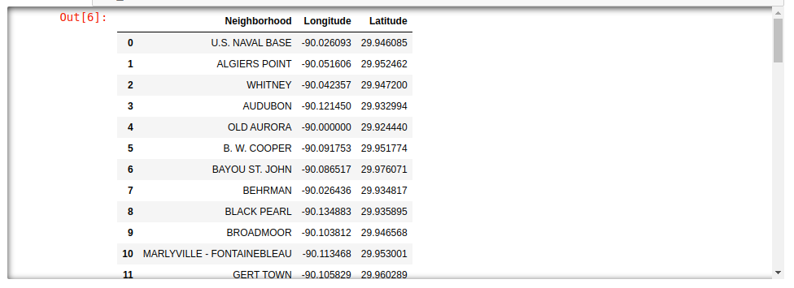
Coursera IBM Capstone Project
Methodology

Slide 9
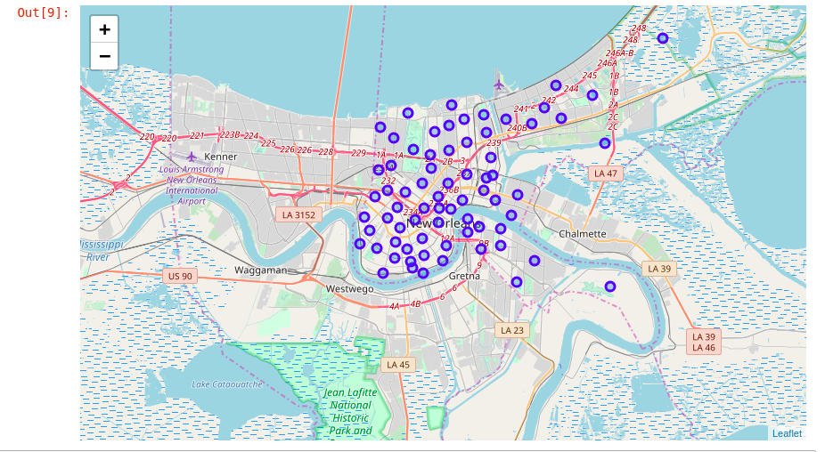
Coursera IBM Capstone Project
Methodology

Slide 10
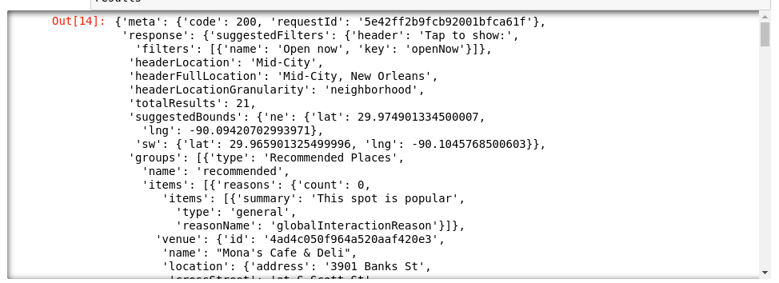
Coursera IBM Capstone Project
Methodology

Slide 11
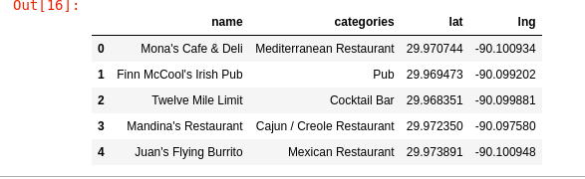
Coursera IBM Capstone Project
Methodology

Slide 12
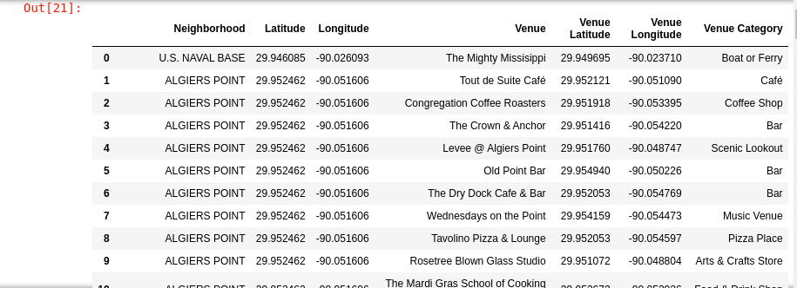
Coursera IBM Capstone Project
Methodology

Slide 13
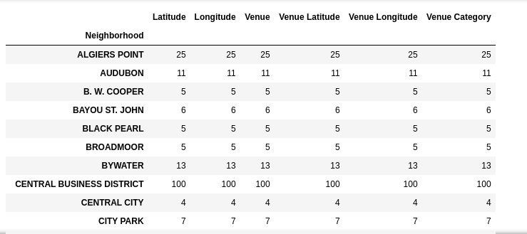
Coursera IBM Capstone Project
Methodology

Slide 14
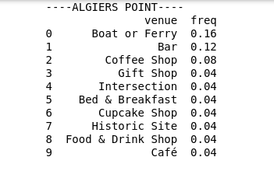
Coursera IBM Capstone Project
Methodology

Slide 15
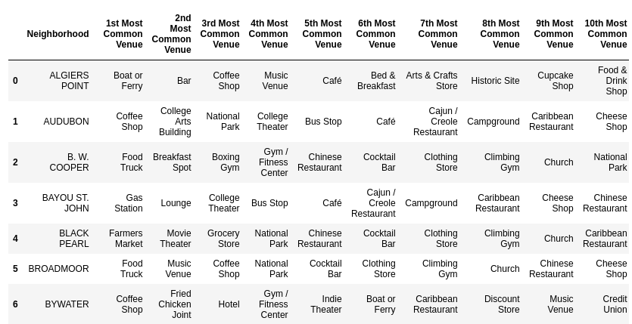
Coursera IBM Capstone Project
Methodology

Slide 16
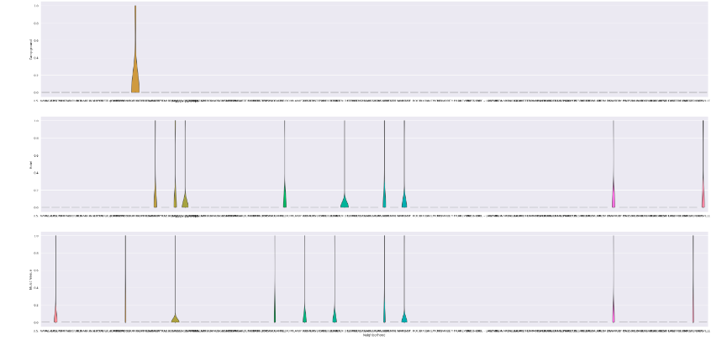
Coursera IBM Capstone Project
Methodology

Slide 17
Coursera IBM Capstone Project
Data analysis and location data:
FourSquare location data will be used to explore and compare neighborhoods in New Orleans
Data manipulation to derive conclusions or other subset of data from the initial data
Use of data visualisation and statistical analysis
Visualization:
Plotting the results of a data set to better understand the data by visualisation

Slide 18
Coursera IBM Capstone Project
Conclusions
Data is data and for sure with the same data, things could have being manipulated in a different way, with different set of data sources. The analysis made here was with my limited knowledge on the subject and lot of internet search to how to meet the wanted result.
But at the end learned new things, and that is always positive.

