Slide 1


Generative Pre-Training of Graph Neural Networks
Ziniu Hu¹, Yuxiao Dong², Kuansan Wang², Kai-Wei Chang¹, Yizhou Sun¹
¹University of California, Los Angeles
²Microsoft Research, Redmond
Notes:
Hello everyone, my name is Ziniu Hu, a Ph.D. student from UCLA. I’m going to share our work: “Generative pre-training of Graph Neural Networks”
This is a joint work with Yuxiao Dong, Kuansan Wang From Microsoft Research Redmond, and Prof. Kai-Wei Chang and Yizhou Sun from UCLA.

Slide 2
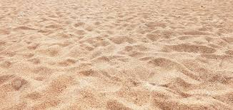

Learning from Unlabeled Data
Labeled Data
Expensive, Scarce
Unlabeled Data
Accessible, Abundant (1000 X more)
Notes:
The success of machine learning is largely relied on data. However, high-quality labeled data is often expensive to obtain, or scarce for training large model. On the contrary, unlabeled data is much easier to access in a large amount, which can be thousand times more than labeled data.

Slide 3

Learning from Unlabeled Data
Anomaly Detection on Graph:
Labeled Nodes: Malicious Account (scarce)
Unlabeled Nodes: The whole Graph (abundant)
Notes:
For example, when doing anomaly detection on graph, the malicious account should be annotated by experts, while the size of the whole unlabelled network can be billion-scale.

Slide 4
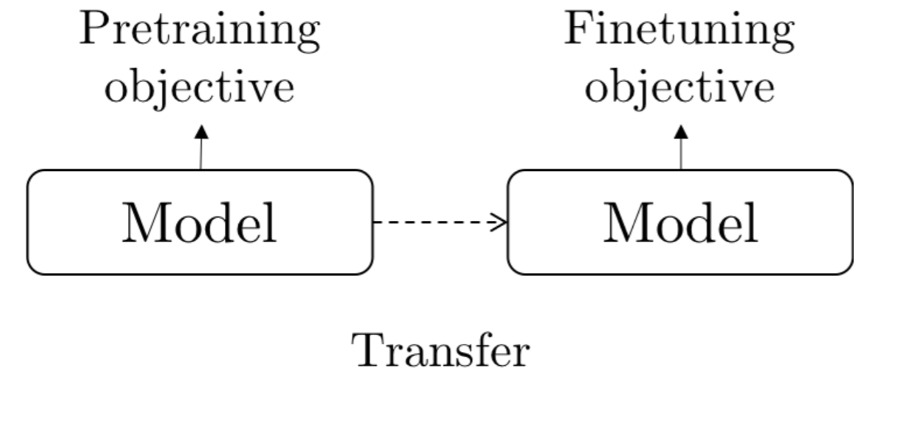
Unsupervised Pre-Training
w/ Abundant
Unlabeled Data
w/ Few
Labeled Data
Notes:
A standard paradigm for learning from unlabeled data is a unsupervised pre-training. Its goal is to allow a machine learning model to initialize its parameters learned from pre-training tasks with abundant unlabeled data. As there exist commonality between the pre-training and the downstream tasks, the pre-trained knowledge can help the model generalize well even with few labeled data.

Slide 5
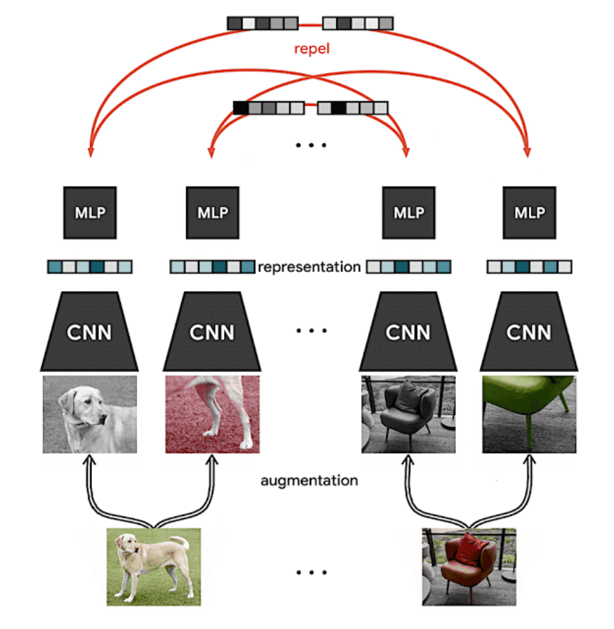
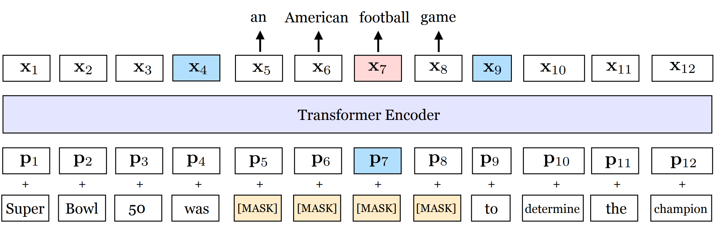
Unsupervised Pre-Training in NLP and CV
Recent progress of pre-training in NLP and CV shows that we can train very deep models (Transformer, ResNet) with unlabeled data to learn generic knowledge.
Yinhan Liu et al. RoBERTa: A Robustly Optimized BERT Pretraining Approach
Ting Chen et al. A Simple Framework for Contrastive Learning of Visual Representations
Notes:
Pre-training has shown superior in boosting the performance of many applications in natural language processing and computer vision.
In NLP domain, the huge success of BERT and its variant has shown that the task to reconstruct the masked input language can help learn very deep transformer model.
Also, in CV domain, recent work like SimCLR has shown to pre-train ResNet with contrastive task, which is detecting whether two image snippet comes from the same image,

Slide 6
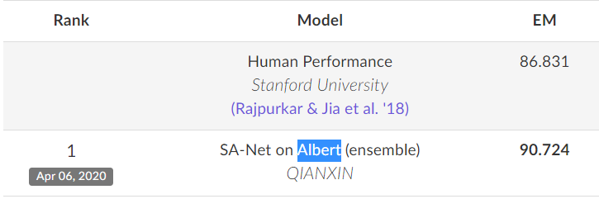
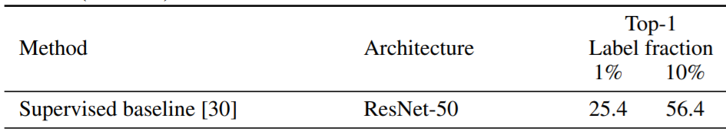
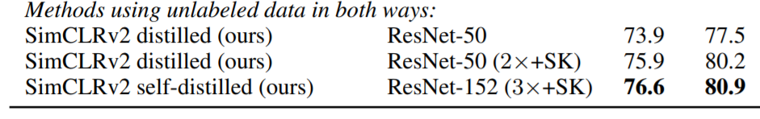
Unsupervised Pre-Training in NLP and CV
Recent progress of pre-training in NLP and CV shows that we can train very deep models (Transformer, ResNet) with unlabeled data to learn generic knowledge.
The deep pre-trained model can be applied and benefit various downstream tasks with few labeled data.
Leaderboard of Squard 2.0
SimCLR results on ImageNet
Notes:
In both domains, the pre-trained deep model can serve as a backbone model and significantly improve the performance of various downstream tasks, such as question answering, image recognition. These success showed that unlabeled data itself contain rich semantic knowledge, and thus a model that can well capture the data distribution is able to benefit for downstream tasks.

Slide 7
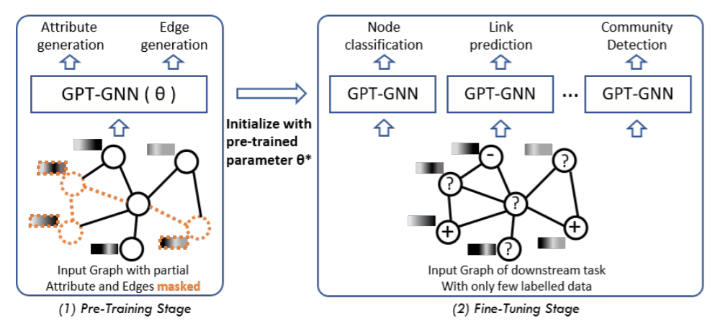
Can we pre-train GNN on graphs?
GPT-GNN: Generative Pretraining of Graph Neural Networks:
Pre-train from large-scale attributed graphs
Fine-tune for unseen tasks on the graphs of the similar domain.
Pre-training task: reconstruct both the structure and attributes of the graphs.
Notes:
Inspired by these developments, we propose to pre-train graph neural networks.
The goal of the pre-training is to empower GNNs to capture the intrinsic structural and semantic properties of the graph, so that it can easily generalize to any downstream tasks with few labels.
In this work, we specifically focus on large-scale attributed graphs.

Slide 8

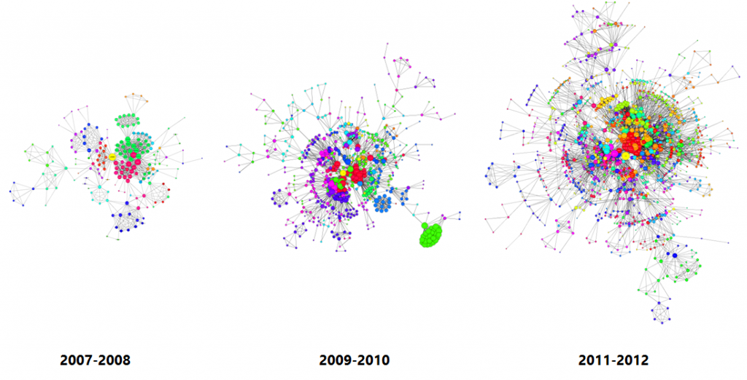
Pre-Training GNN via Generation
Model the graph distribution by learning to reconstruct the attributed graph.
Apple’s Internal Innovation Network
Notes:
To learn a general GNN model without labeled data on a graph, the first question is: how to design a suitable unsupervised learning task over the graph?
We propose to Model the graph distribution by directly learning to reconstruct the attributed graph. For example, if we can correctly predict how a Apple’s innovation network is evolved, the pre-trained model should capture the structural and semantic knowledge of this graph, which will be beneficial to related downstream tasks.

Slide 9
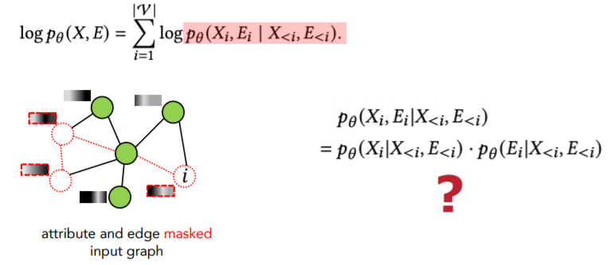
Pre-Training GNN via Generation
Model the graph distribution by learning to reconstruct the attributed graph.
Notes:
Following the existing discrete generation methods, we autoregressively factorize the probability objective, which means that, the nodes in the graph come in an order, and the links are generated by connecting the new arriving nodes to all existing nodes.

Slide 10
Pre-Training GNN via Generation
Model the graph distribution by learning to reconstruct the attributed graph.
We factorize the conditional generative probability of each node into two terms:
Attribute (X_{i}) Generation
Edge (E_{i}) Generation
Lose the dependency between X_{i} and E_{i}
Notes:
As we’d like to capture both attribute and structure information, we need to factorize the conditional generative probability for each node into two terms, the attribute and edge generation.
However, a naïve decomposition will neglect the dependency between each node’s attribute with its own edges, which is very essential for GNN modelling.

Slide 11
Factorizing Attributed Graph Generation
To maintain the dependency between attribute and structure, we incorporate observed edges, and decompose the generation into two coupled steps:
Given observed edges, generate node attributes;
Given observed edges and generated attributes, generate masked edges.
Notes:
Therefore, to maintain the dependency between attribute and structure, we incorporate a variable to represent observed edges, and decompose the generation into two coupled steps.
In the first step, we are given a set of observed edges, and generate node attributes,
In the second step, we leverage the attribute information to generate remaining edges.
We present a concrete example in academic

Slide 12
Factorizing Attributed Graph Generation
To maintain the dependency between attribute and structure, we incorporate observed edges, and decompose the generation into two coupled steps:
Given observed edges, generate node attributes;
Given observed edges and generated attributes, generate masked edges.
Author 1
Published at 2012
DM
Paper 1
……
……
KDD
Author 2
Input
Notes:
present a concrete example in academic graph here.
Suppose we’d like to generate a new paper node, whose title is considered as attribute, and authors, venue, cited papers are connected edges.

Slide 13
Factorizing Attributed Graph Generation
To maintain the dependency between attribute and structure, we incorporate observed edges, and decompose the generation into two coupled steps:
Given observed edges, generate node attributes;
Given observed edges and generated attributes, generate masked edges.
Author 1
Published at 2012
DM
Paper 1
……
……
KDD
Author 2
Input
Notes:
We first mask out some edges, and regard the remaining ones as observed edges.

Slide 14
Factorizing Attributed Graph Generation
To maintain the dependency between attribute and structure, we incorporate observed edges, and decompose the generation into two coupled steps:
Given observed edges, generate node attributes;
Given observed edges and generated attributes, generate masked edges.
Author 1
Published at 2012
DM
Paper 1
……
……
1: Generate Node Attribute
KDD
Author 2
Input
Notes:
The first step is to use the remaining edges to predict this paper’s title, which can help capture the dependency between the attribute and neighborhood nodes, such as Data Mining.

Slide 15
Factorizing Attributed Graph Generation
To maintain the dependency between attribute and structure, we incorporate observed edges, and decompose the generation into two coupled steps:
Given observed edges, generate node attributes;
Given observed edges and generated attributes, generate masked edges.
2: Generate masked edges
Author 1
Published at 2012
DM
Paper 1
2: Generate masked edges
……
……
KDD
Author 2
Input
Notes:
Next, we use both the observed edge and generated attribute to predict the remaining edges, such as authors, published venue, citations. In this way, we can also capture the dependency between attribute and masked edges, such as KDD.

Slide 16
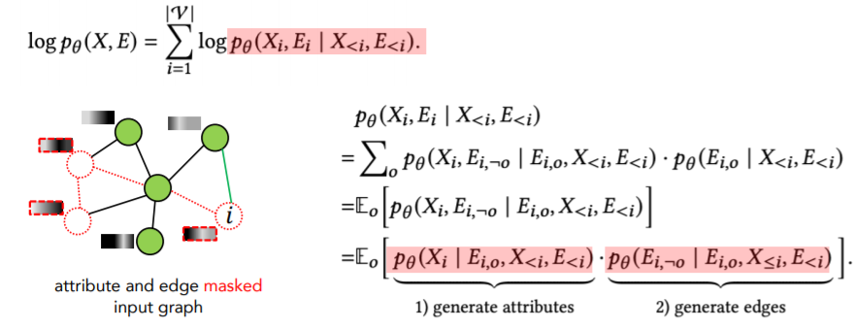
Factorizing Attributed Graph Generation
Model the graph distribution by learning to reconstruct the attributed graph.
We factorize the graph likelihood into two terms:
Attribute Generation
Edge Generation
Notes:
Formally, we can write down the decomposition. With random masking of the edges, the expectation of our generation task is equivalent to the whole graph distribution.

Slide 17
Efficient Parallel Training
We desire to parallelize the generation for all the nodes, by running GNN only once for each graph.
However, Edge Generation requires attribute, which will leak to Attribute Generation.
Notes:
For the sake of efficiency, we desire to compute the loss of attribute and edge generations by running GNN only once for each graph.
However, when doing edge generation, we will utilize the attribute information, which will leak to the attribute generation task.

Slide 18
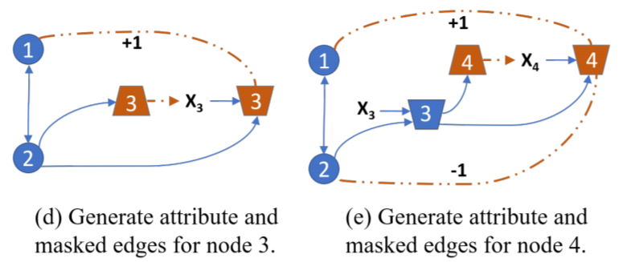
Efficient Parallel Training
We desire to parallelize the generation for all the nodes, by running GNN only once for each graph.
However, Edge Generation requires attribute, which will leak to Attribute Generation.
Our solution: we split each node into two types: Attribute Generation Nodes and Edge Generation Nodes. For Attribute Generation Nodes, input are replaced by a shared [Mask] token.
Notes:
To avoid information leakage, we split each node into two types of nodes: •
Attribute Generation Nodes. We masked out the attributes of these nodes and replace them with a dummy token and learned a shared vector to represent it† .
Edge Generation Nodes. For these nodes, we keep their attributes and put them as input.
After running GNN over the graph, we’ll get the two sets of node representation of each node, which will be used for the two generation tasks.

Slide 19
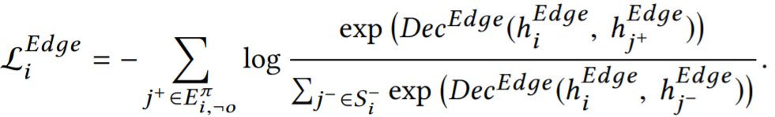
Deal with large-scale Graphs
To pre-train GNNs on graphs that are too large to fit into the hardware, we adopt LADIES sampling algorithm¹ for mini-batch training.
However, to estimate the contrastive loss it’s required to go over all nodes.
To enrich the negative samples, we adopt Adaptive Queue, which stores previously calculated node representations, which can enlarge the negative sample size.
Difan Zou et al. Layer-Dependent Importance Sampling for Training Deep and Large Graph Convolutional Networks, NeurIPS’19
Notes:
To pre-train GNNs on graphs that are too large to fit into the hardware, we sample subgraphs for training.
To estimate the edge loss, it is required to go over all nodes of the input graph as denominator. However, we only have access to the sampled nodes in a subgraph for estimating this loss, making the (self-)supervision only focus on local signals.
To alleviate this issue, we propose the Adaptive Queue, which stores node representations in previously-sampled subgraphs as negative samples, which can enlarge the negative sample size

Slide 20
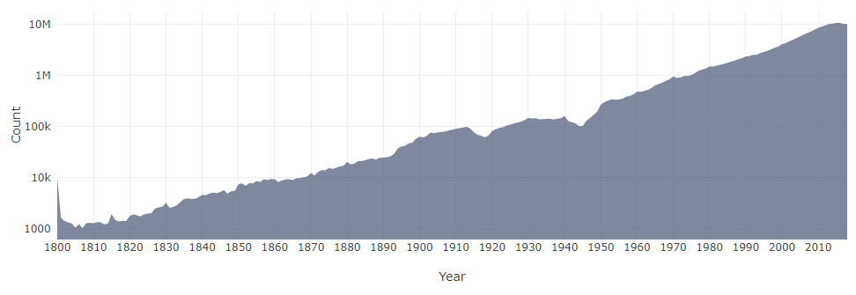
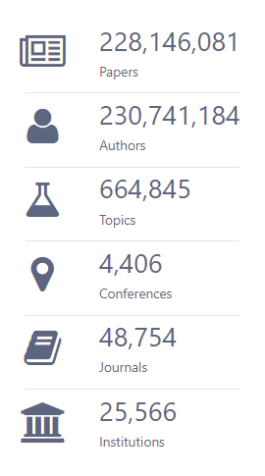

Evaluation Datasets
We choose two large-scale heterogeneous graphs as evaluation:
Microsoft Open Academic Graph (OAG)
Amazon Review Recommendation (Amazon)
82.8 million reviews
20.9 million users
9.3 million products.
Notes:
To evaluate the performance of GPT-GNN, we conduct experiments on two large-scale heterogenous graphs.
The first one is Microsoft Academic Graph (OAG), which contains more than 200 million nodes and 2.3 billion edges. The other is Amazon Recommendation datasets.

Slide 21
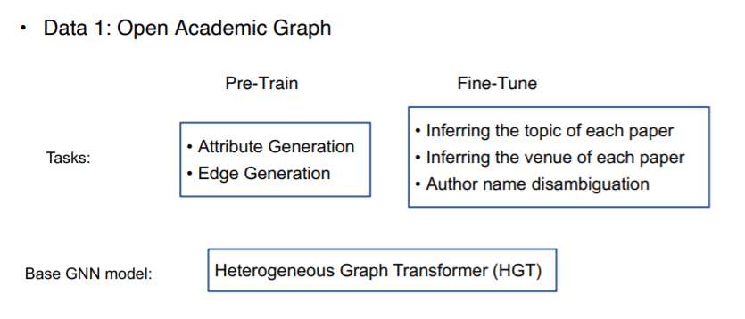
Evaluation Datasets
Ziniu Hu et al. Heterogeneous Graph Transformer, WWW’20
Notes:
Here we focus on the discussion of Open Academic Graph Datasets.
The fine-tuning task is inferring the topic and venue of each paper and author name disambiguation. We mainly utilize Heterogenous Graph Transformer as our base model.

Slide 22
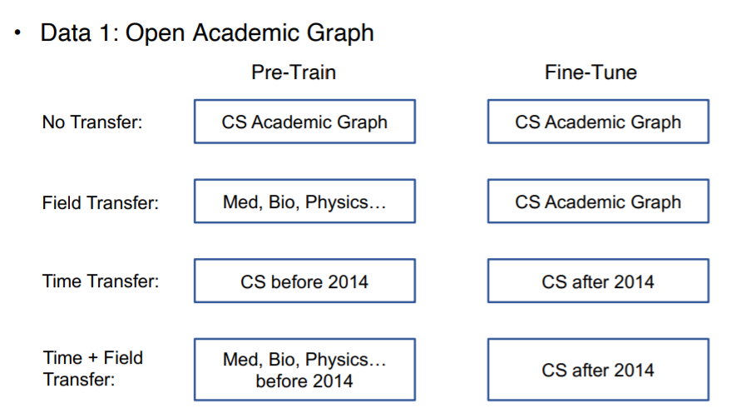
Evaluation Datasets
Notes:
To mimic real-world domain transfer setting, we choose nodes of some specific domains for pre-training, and conduct downstream evaluation to a different domain.
Specifically, in Field Transfer, we use all the papers except CS for pre-training, and use CS papers for fine-tuning. In Time Transfer, we use CS paper before 2014 for pre-training, and CS papers after 2014 for fine-tuning.
We also consider combine the two transfer together, which becomes the most challenging setting.

Slide 23
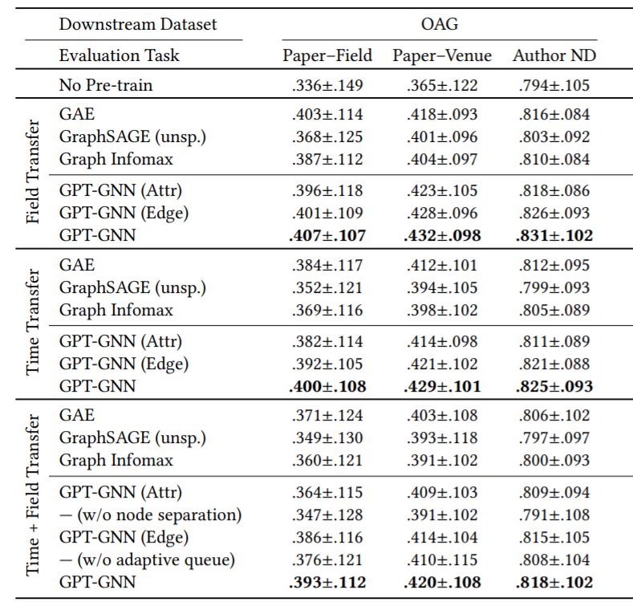
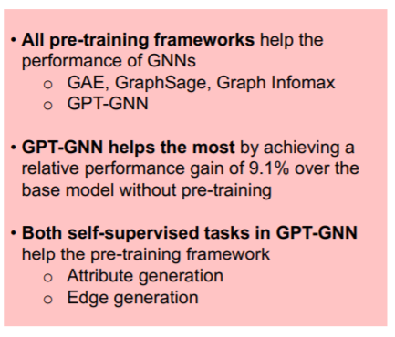
Notes:
Overall, our proposed GPT-GNN consistently enhances the downstream task performance and outperforms other baselines under different settings, and it achieves performance gain of 9.1%.
The two generation tasks are all helpful, and the combined version is the best pre-training task.

Slide 24
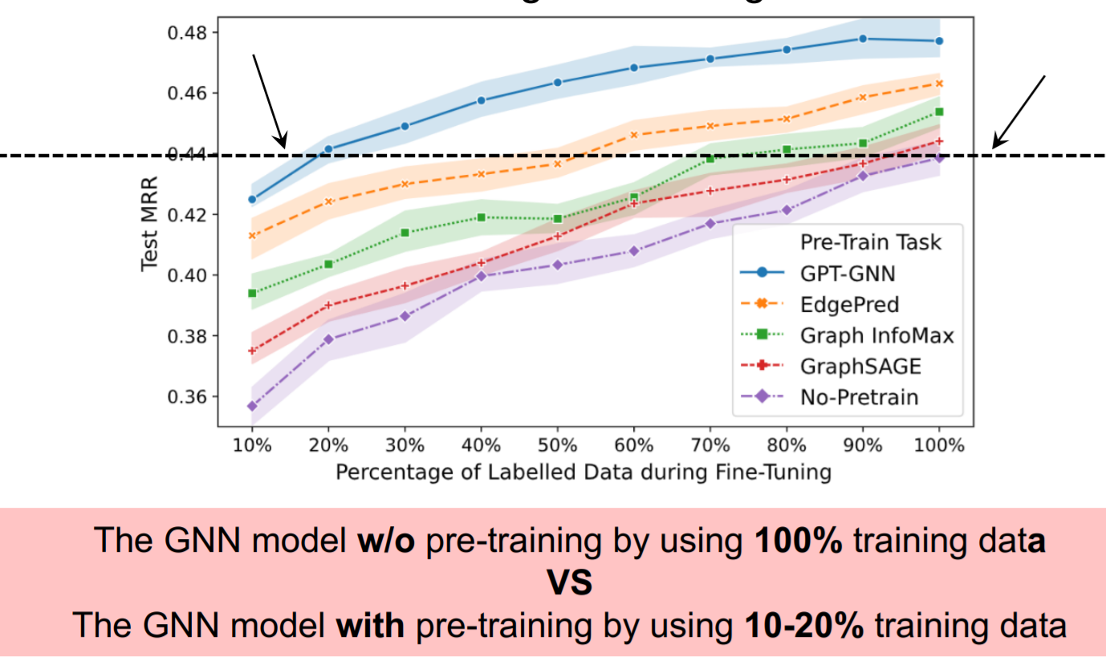
The Promise of Generative Pre-training
Notes:
We also evaluate the promise of our proposed pre-training method under different percentage of labelled data. As is shown, GPT-GNN consistently improve the downstream task performance.
In addition, we can see that with-pre-training, the performance with only 20% label data is higher than direct supervised learning with 100% data. This shows the effectiveness of pre-training, especially when the label is scarce.

Slide 25
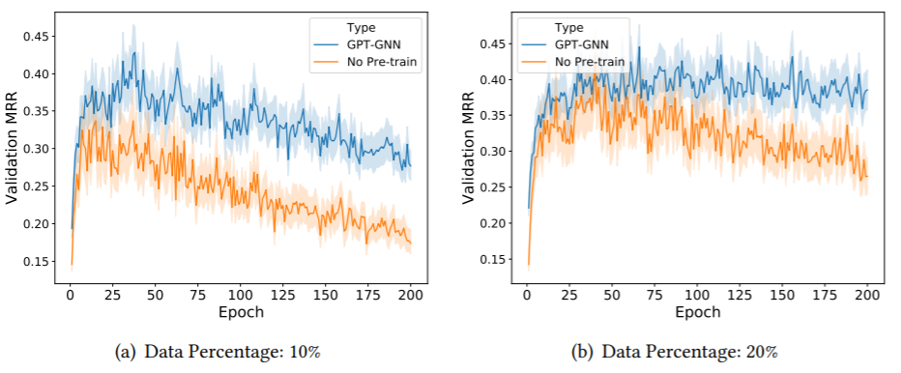
The Promise of Generative Pre-training
Notes:
We also show the loss curve with and without pre-training. With pre-training, the model can achieve higher generalization performance and more robust to over-fitting.

Slide 26
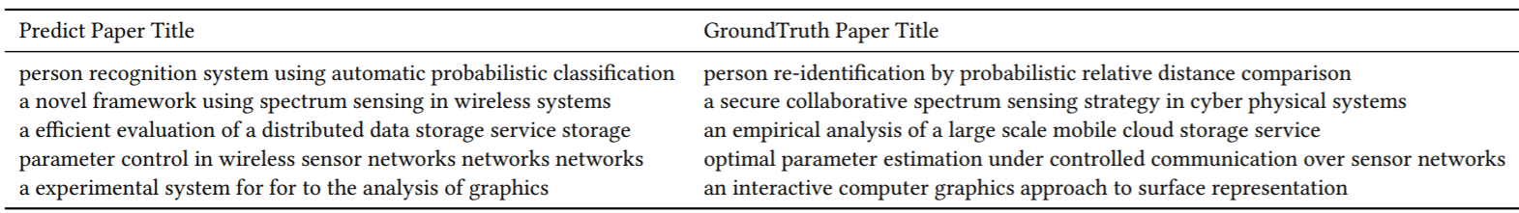
The Promise of Generative Pre-training
Notes:
Also, we show the generated title in our pre-training task. It seems that the model can indeed capture the overall semantic of each paper only utilize their neighborhood.

Slide 27
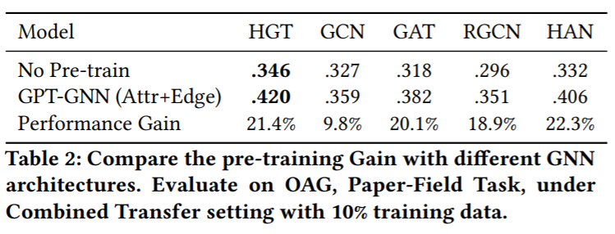
The Promise of Generative Pre-training
GPT-GNN can consistently improve performance for various GNN models.
A more expressive GNN model (as HGT) can receive higher performance gain.
Notes:
We also show that GPT-GNN can consistently improve the performance for various GNN models, but a more expressive model as HGT can receive higher performance gain.

Slide 28
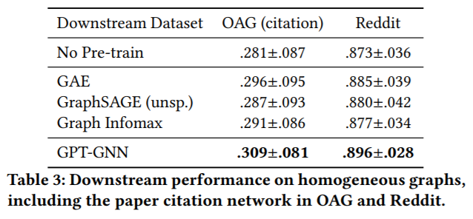
The Promise of Generative Pre-training
GPT-GNN can consistently improve performance for various GNN models.
A more expressive GNN model (as HGT) can receive higher performance gain.
GPT-GNN can also be utilized for homogeneous graphs and get the highest performance gain.
Notes:
Finally, we show that GPT-GNN can be utilized for homogenous graphs and get the highest performance gain.

Slide 29
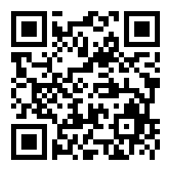
Thanks for listening!
Code and Dataset
are available:

