Slide 1
Heterogeneous Graph Transformer
Ziniu Hu¹, Yuxiao Dong², Kuansan Wang², Yizhou Sun¹
¹University of California, Los Angeles
²Microsoft Research, Redmond

Slide 2



Heterogeneous Graph
Paper
$$t$$
Write
Cite
Heterogeneous graphs can model complex systems
Nodes are labeled with multiple types
Edges between nodes have multiple relationships
It’s flexible to capture rich semantic knowledge.
$$s_{1}$$
$$s_{2}$$
Author
Paper

Slide 3
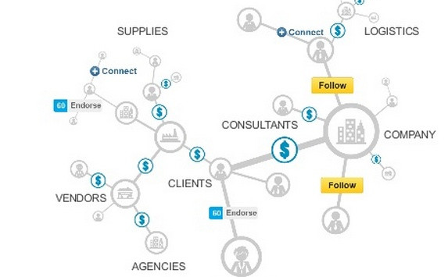
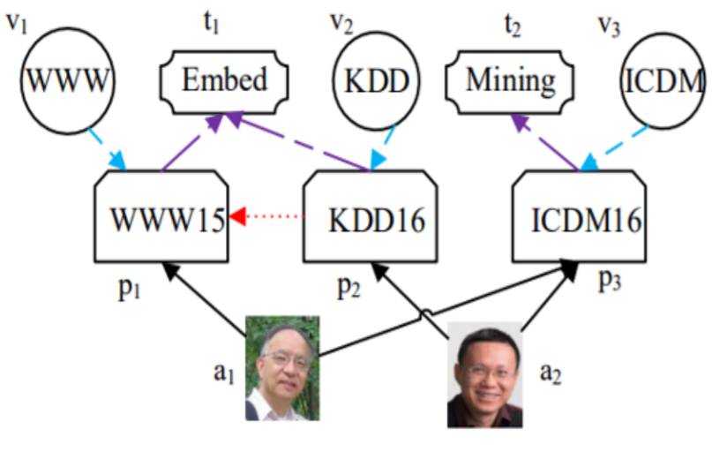
Heterogeneous Graph
Paper
$$t$$
Write
Cite
Heterogeneous graphs can model complex systems
Nodes are labeled with multiple types
Edges between nodes have multiple relationships
It’s flexible to capture rich semantic knowledge.
$$s_{1}$$
$$s_{2}$$
Author
Paper
Example: Academic Graph
Example: LinkedIn Economic Graph

Slide 4
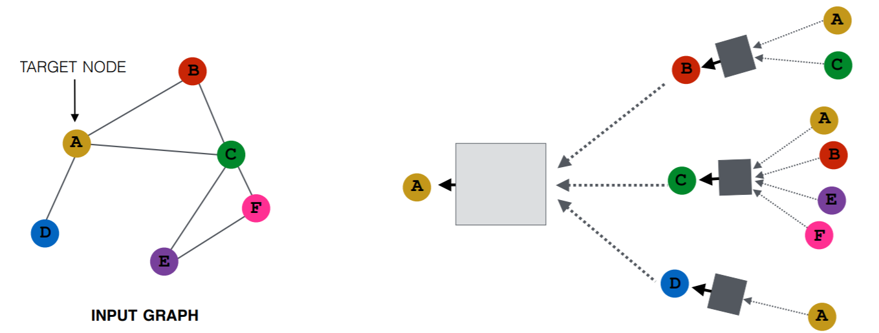
Graph Neural Networks (GNNs)
Key Idea: Each node aggregates information from its neighborhood to get contextualized node embedding.
Limitation: Most GNNs focus on homogeneous graph.
Aggregate neighbor’s information
Neural Transformation

Slide 5
Challenges for handling heterogeneous graph
Different types of nodes/edges have own feature distribution
Node: Papers have text features, while authors have affiliation features
Edge: Co-authorship is different with citation

Slide 6
Challenges for handling heterogeneous graph
Different types of nodes/edges have own feature distribution
Node: Papers have text features, while authors have affiliation features
Edge: Co-authorship is different with citation
Graph can be dynamic and large-scale
KDD in 1990 is more related to database, but it’s closer to machine learning in recent years
The number of papers doubles every 12 years, and now reaches billion

Slide 7



Meta-Relation-based Parametrization
Introduce node- and edge- dependent attention
Leverage meta relation <source node type, edge type, target node type> to parameterize attention and message passing weight.
Can automatically learn and extract meaningful “meta paths”
Paper
$$t$$
W_{<Author, Write, Paper>}
=W_{Author} W_{Write} W_{Paper}
W_{<Paper, Cite, Paper>}
=W_{Paper} W_{Cite} W_{Paper}
Write
Cite
$$s_{1}$$
$$s_{2}$$
Author
Paper

Slide 8






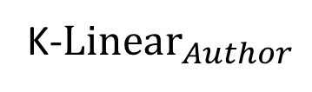

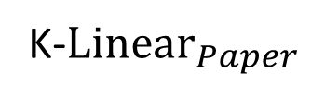


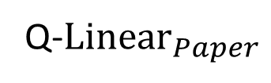


Heterogeneous Mutual Attention
Paper
$$t$$
Q-$Linear_{Paper}$
$$Query[t]$$
Write
Cite
$$Key[s_{1}]$$
$$W_{Cite}^{ATT}$$
$$Att[s1,t]$$
$$s_{2}$$
K-$Linear_{Paper}$
Paper
…
…
$$Query[t]$$
$$s_{1}$$
$$W_{Write}^{ATT}$$
$$Att[s2,t]$$
K-$Linear_{Author}$
$$Key[s_{2}]$$
Author

Slide 9
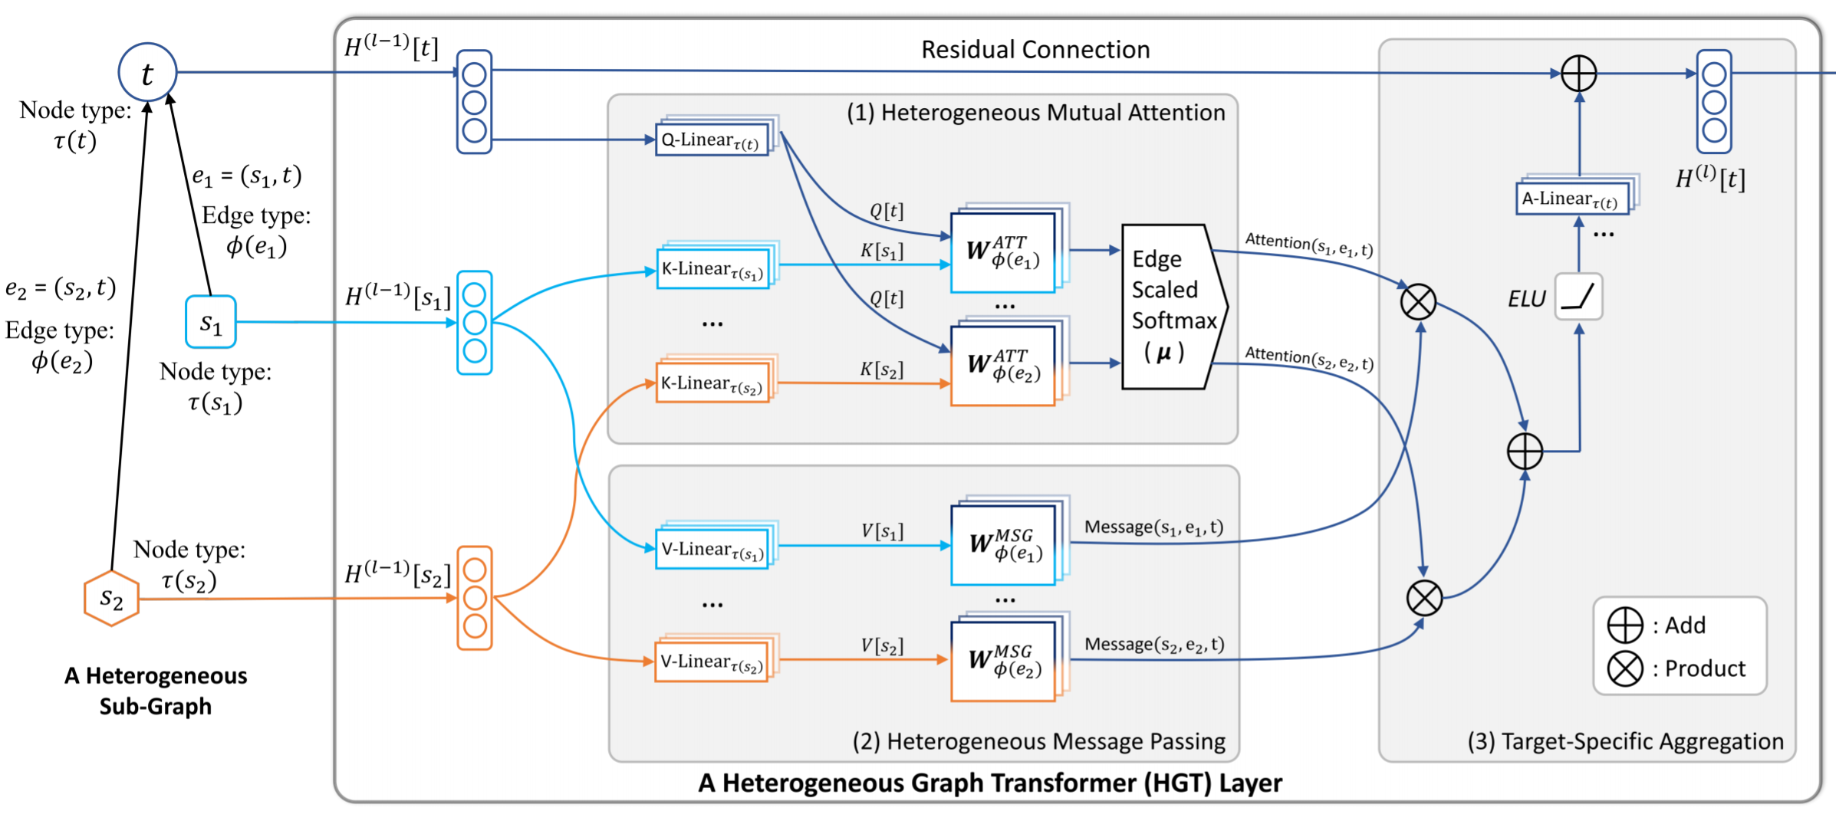
Heterogeneous Graph Transformer

Slide 10
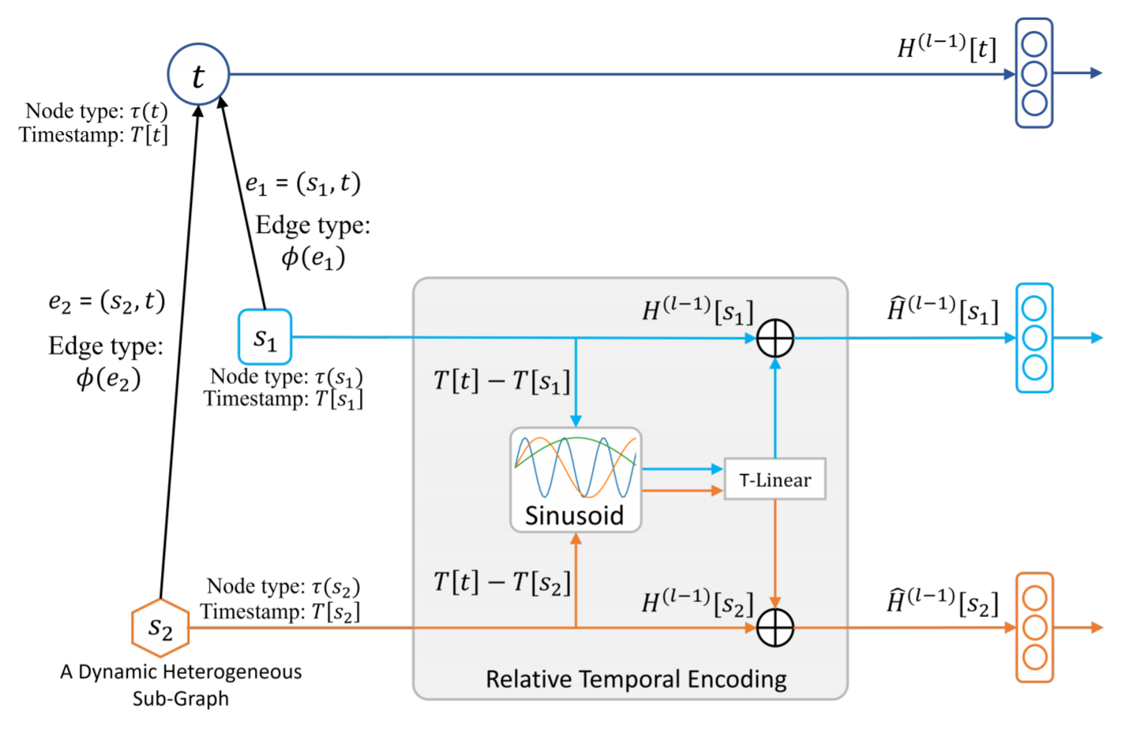
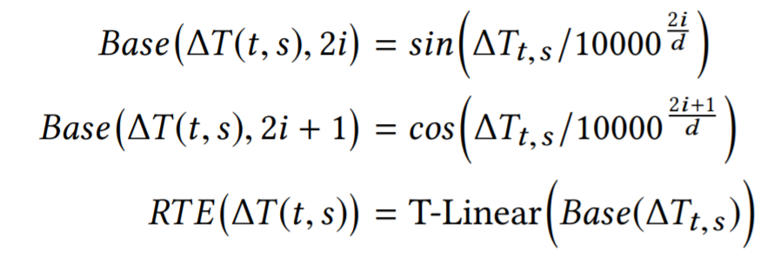
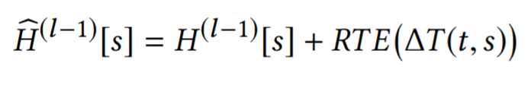
Relative Temporal Encoding
To handle graph dynamics:
Instead of slicing the input graph into different timestamp
We propose to maintain all edges in different times and adopt RTE to encode time.

Slide 11
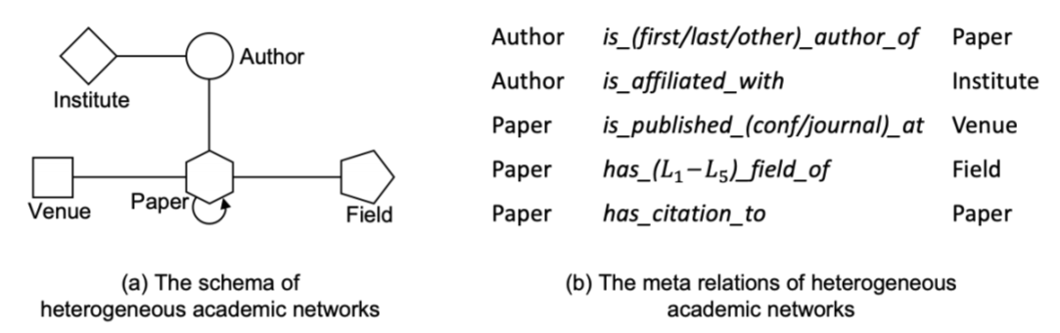
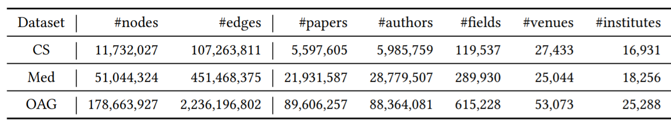
Evaluation on Open Academic Graph (OAG)
We evaluate on OAG, the largest publicly available heterogeneous academic dataset.
We propose an efficient Heterogeneous Mini-Batch Graph Sampling algorithm to enable both HGT and traditional GNNs handle Web-scale heterogeneous graph.

Slide 12
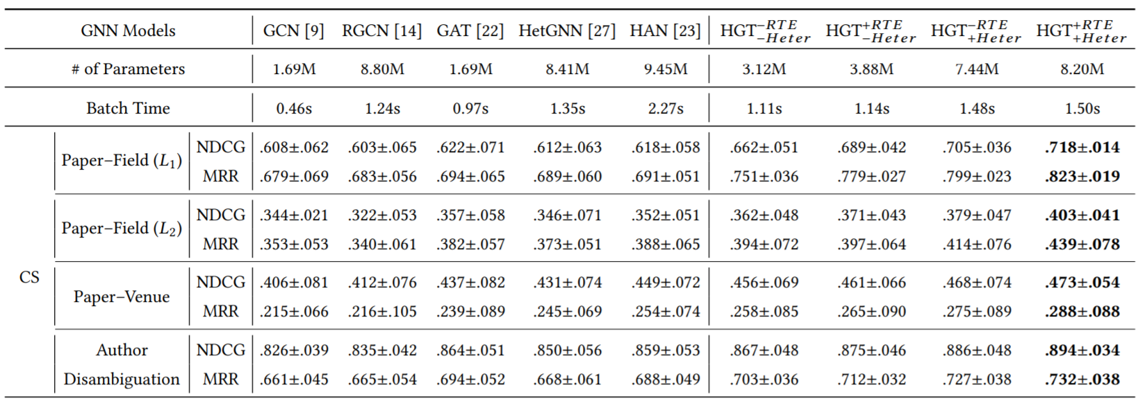
Evaluation Results
The proposed HGT model consistently outperforms all the state-of-the-art GNN baselines by 9%–21% on various downstream tasks.

Slide 13
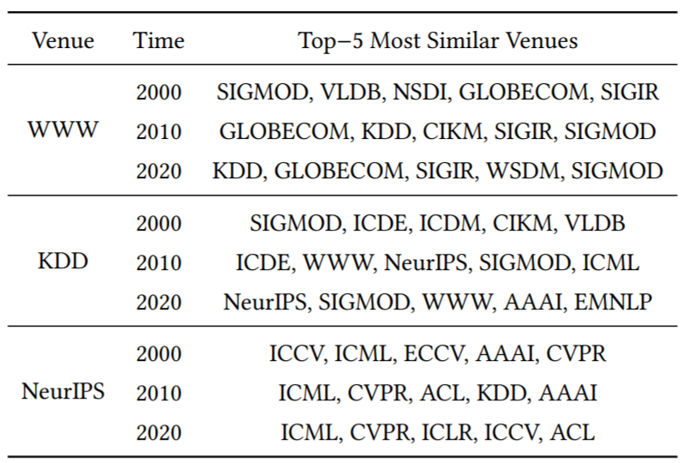
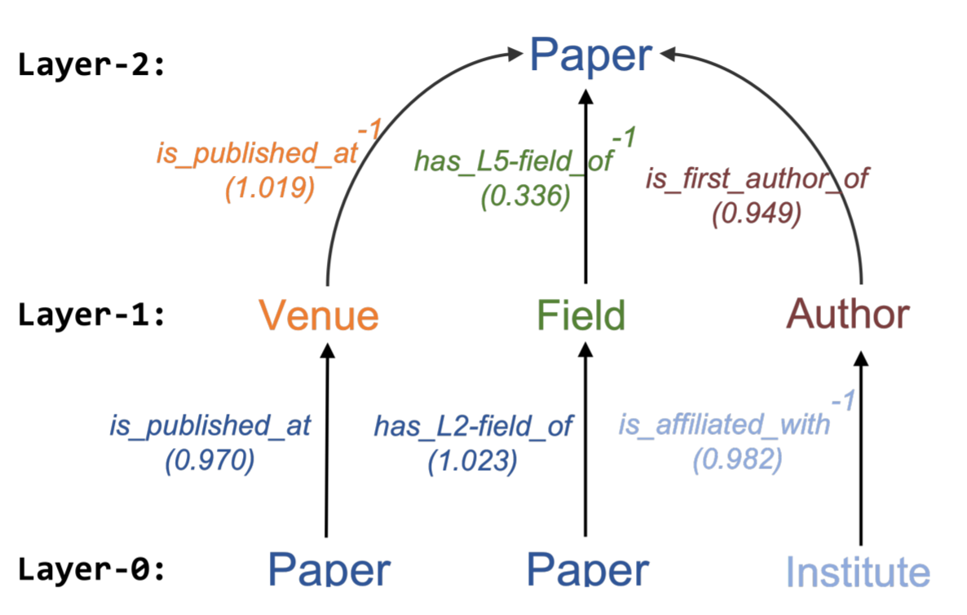
Case Studies
Conferences’ topics changed over time.
The relative temporal encoding can help capture this temporal evolution.
HGT can implicitly extract meta paths for specific downstream tasks, without manual customization.

Slide 14
Contribution of Heterogeneous Graph Transformer
To handle graph heterogeneity
We use meta-relation-triplet to parametrize weights
Model can automatically detect useful meta paths without manual design
To handle graph dynamics and large-scale
We design Relative Temporal Encoding to represent dynamic graph
To handle large-scale graph
We design Heterogeneous Mini-Batch Graph Sampling algorithm to conduct efficient training on billion-scale heterogeneous graph

Slide 15
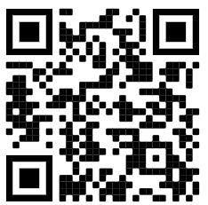
Thanks for Listening
The code and dataset is available at: https://github.com/acbull/pyHGT

