Slide 1
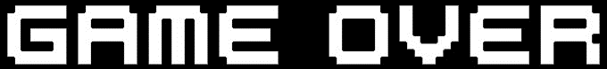
MAIN MENU
PLAY
LEADERBOARD
EXIT

Slide 2






