Slide 1

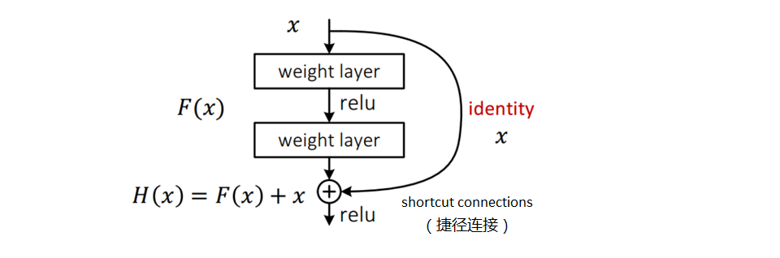
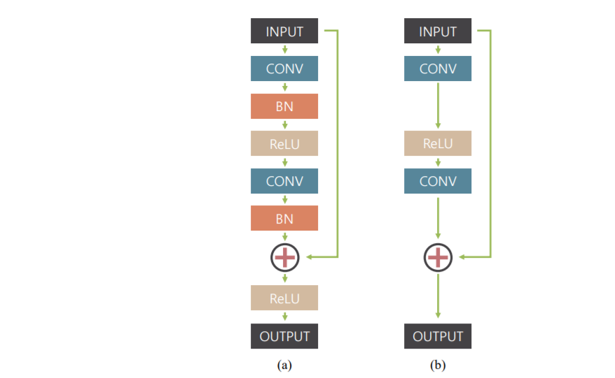

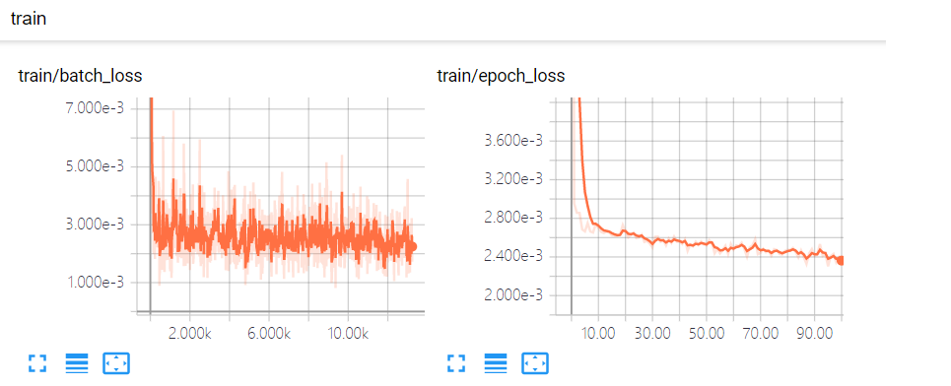
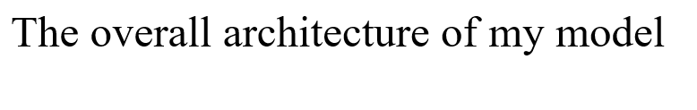
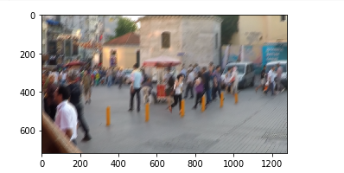
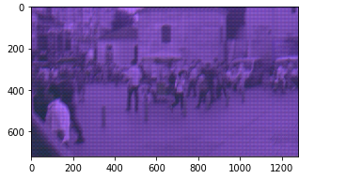
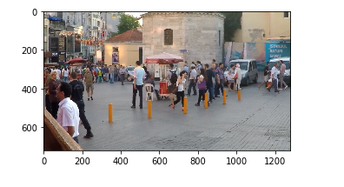
School of Computing, University of South China
Introduction:
Approach:
The camera shake and fast moving objects will cause blurred images, and the change of depth of field will further blur the images. For traditional methods, it is almost impossible to estimate the "blur kernel" corresponding to each pixel. Therefore, traditional methods often need to make assumptions about fuzzy sources and parameterize "blur kernel". Obviously, this kind of method is not enough to solve the image blur caused by various complicated factors in practice。Convolutional neural network can extract complex features from images, so that the model can adapt to various scenes. In this tutorial, CVPR2017' s deep multi-scale convolutional neural network for dynamic scene de blurring is taken as an example to complete the task of image deblurring.
1.data preparation
The data is down-sampled, and in order to reduce the overhead, the patch-based method is adopted, and data enhancement is used to prevent over-fitting. Patch-based here means that each input image is randomly cropped to get a picture with the size of path_size, and then input into the model for training
2.Model building
The residual module removes the Batch Normalization(BN) layer because the batch size is small during training, and removing BN layer can accelerate the training speed. At the same time, in order to speed up the convergence speed in training, the nonlinear element ReLU in the last layer is also removed.
The reasons are:
(1) It can build a deeper network and increase the receptive field.
(2) The fuzzy image and the clear image are similar in numerical value, so the residual error is more conducive to model learning.
3.Loss function and optimizer
Here we use Adam optimizer. The initial learning rate is lr, which is more automatic than SGD. In practice, there are few parameters to be adjusted, but it should be noted that it uses more memory than SGD.
The loss function uses the most common mean square loss function (MSELoss):
4.In tensorboard, you can observe the change process of loss during training, as shown in the following figure
Architecture:
The model adopts CNN in the form of residual error, and the input and output are in the form of Gaussian pyramid. The whole network structure consists of three similar CNN, which correspond
to each layer of the input pyramid. At the front of the network is a coarest level network with the lowest resolution, and at the end of this subnet is an "upconvolution layer", which enlarges the reconstructed low-resolution image into a high-resolution image, and then connects it with the input of a higher-level subnet as the input of the upper-level network.In this paper, the residual module removes the Batch Normalization(BN) layer, because the batch size is small during training, and removing BN layer can accelerate the training speed. At the same time, in order to speed up the convergence in training, the nonlinear element ReLU in the last layer is also removed.
Experiments & Results:
Show and save the results
Conclusions :
Advantages of CNN in image processing
1.First of all, based on image recognition and classification, it has the characteristics of non-contact and high precision, especially in the process of living body detection, recognition and classification.
2.Convolutional neural network CNN and many network models derived from it can directly take image data as input, which not only does not need complex operations such as manual image preprocessing and extra feature extraction, but also makes the image processing reach the level of manpower with its unique fine-grained feature extraction method

