Slide 1
Device label requirements
A. Bilato
V.0.0.4 x/06/2019
Rev.3.5 – December 19 st 2014

Slide 2
Introduction
This is an extract of the labels standard for CAREL devices.
We have reported the part required to USR.
In short some label data will be used to do the provisioning of the device, in this way we are able to register the gateway in our cloud system without error.

Slide 3
Label mandatory content #1
The label content contain both a QR Code and the textual data.
The fields order are important, we want to create a future proof system but also a way to recognize easily the content of the QR Code.
Due to the fact that we want to support virtually every device type, some fields may have different values for the same position. An example some device have a MAC other an IMEI.

Slide 4
Label contents overview #2
Each field is separate from the others by a “pipe” character 0x7C.
The first field is a number that identify the schema of the following data, but take in mind that the following data are always present and in these fixed position, other additional data must be standardized or customized for the final OEM.
The field 2 must contain the Part number
The field 3 must contain the Serial number ;
serialized by USR with a maximum of xx characters
The field 4 must contain the unique identifier (MAC or IMEI)
The field 5 must contain the Carel Control Value (CCV);
a CRC16 (with ModBus polynomial) of the field 2 and 4, excluding the “pipe”.
In case of manual typing of the data to avoid mistyping the user must digit also the CCV, that assure that the typed data are correct.
The reason behind the fact that the CCV is on field 2 and 4 is due to that this is the only fields required for the on-line registration, and don’t depends on the other data.

Slide 5
Label content #3
Production date;
The is the production date in the format YYYYMMDD.
Revision;
is the HW revision.

Slide 6
Label content #4
Field no. | Field content | Example
1 | Table Type | 1
2 | Part Number | GTW000MWT0
3 | Serial Number | 12345678
4 | Unique Identifier (MAC or IMEI) | D8B04CBDA314
5 | Carel control value (2 byte hex) | 2D46
6 | Production date | 20190816
7 | Revision | 1.03

Slide 7
Label contents example
Below the content of a QR Code that show you the above rule with optional fields.
For WiFi gateway
1|GTW000MWT0|12345678|D8B04CBDA314|2D46|20190816|1.030
For 2G gateway
1|GTW000MGP0|12345678|864041032033001|8209|20190816|1.00

Slide 8
Label layout constraint
Every product have different needs, so that the layout change product by product, the constraint you need to take in mind are :
White boundary around the QR;
these must be 3mm, but in some case reduce to no less than 2,5mm.
The printer resolution;
we assume that you use a 300dpi printer

Slide 9
LABEL EXAMPLE

Slide 10
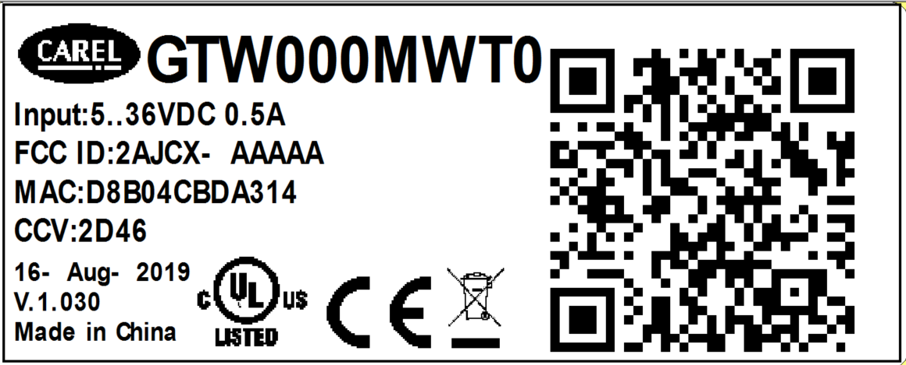
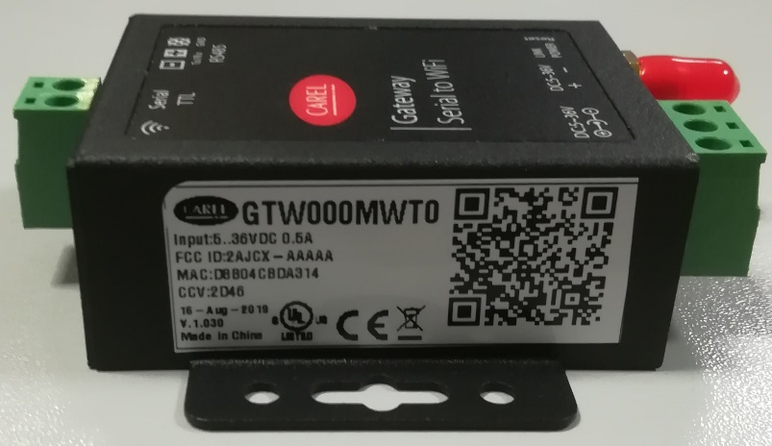
WiFi – GTW000MWT0

Slide 11
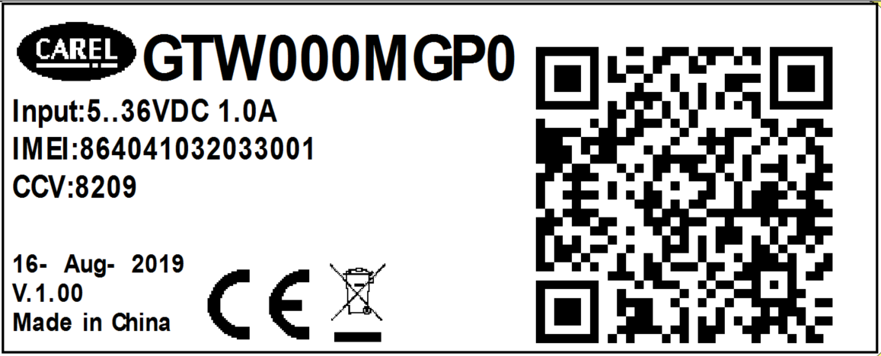
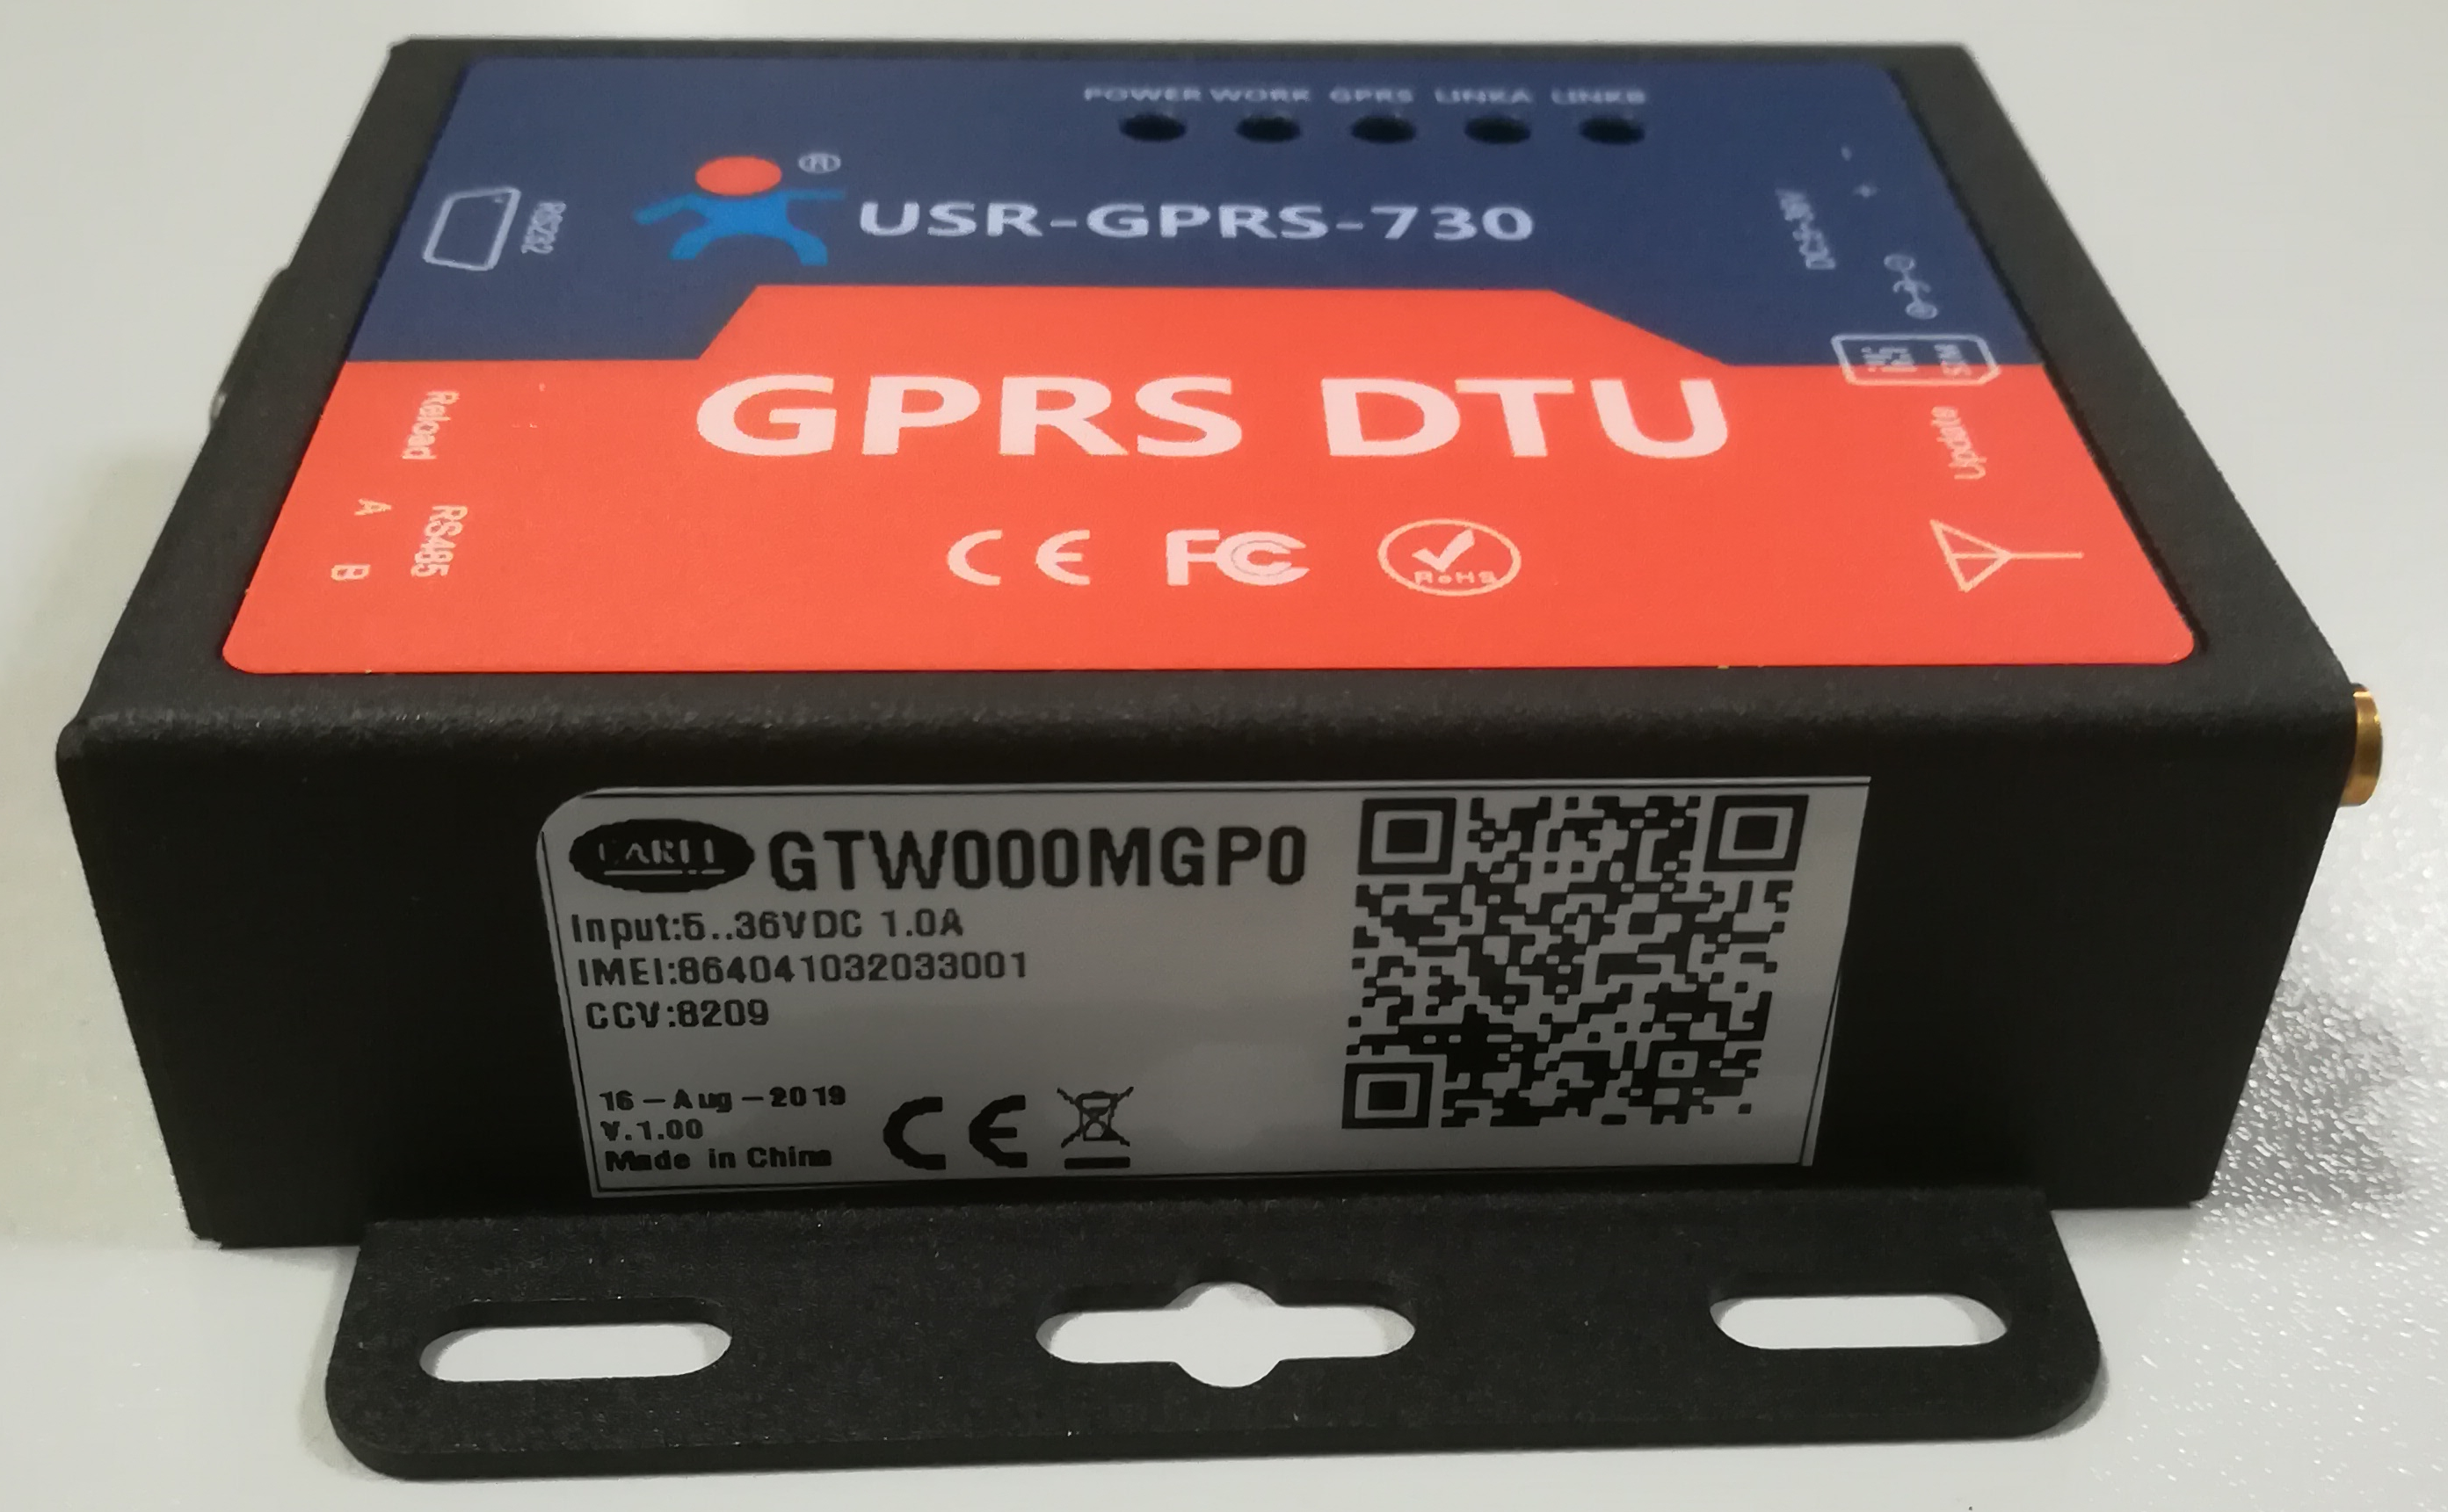
2G – GTW000MGP0

Slide 12


