Slide 1





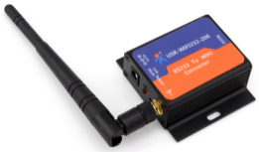

General architecture from a logical point of view
tERA/Armilla Sever
Configuration portal
Data View
..
Model update /
FW update
GWME Configuration
1st time
File server
Subscritions
notification
Updates
Internet
Subscritions
notification
MQTT Broker
GWME
Publishing
Values
UUID

Slide 2

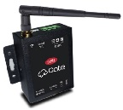
General architecture from a logical point of view
Portal Server
Configuration portal
Data View
..
Model update /
FW update
File server
CGM_WiFi
1st time config.
Subscritions
notification
Updates
Internet
Subscritions
notification
MQTT Broker
Cloud Gate Mini
Publishing
Values
Monitored Device
NTP server

