Slide 1

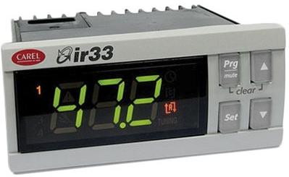
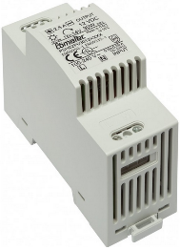

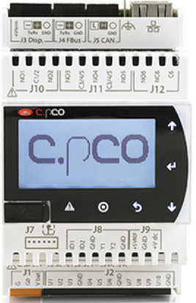
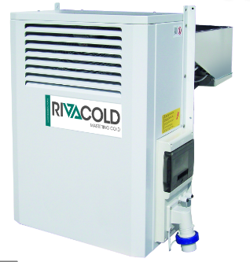
GME – connections
Power Supply
IR33
TTL
bCU
Power Supply
RS485
RS485
Power Supply

Slide 2
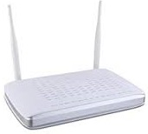



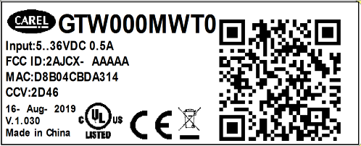
GME WiFi – 1st time configuration
Type router
SSID
Password
Router
- SSID
- Password
Router
Internal GME AP
Device
Server

Slide 3

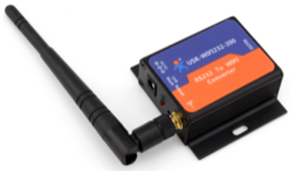
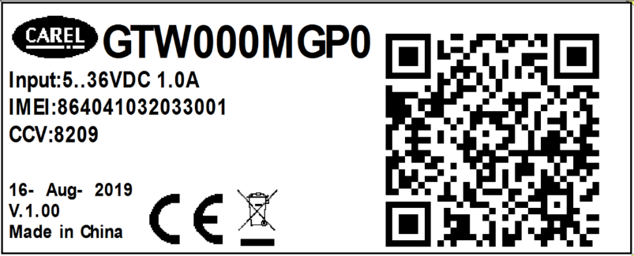
GME 2G – 1st time configuration
SIM pre-installed
No configuration required
GSM
Server

