Slide 1


Accel-Sim: An Extensible Simulation Framework for Validated GPU Modeling
Mahmoud Khairy, Zhesheng Shen, Tor M. Aamodt, Timothy G. Rogers
ISCA 2020 – 6/2/2020

Slide 2



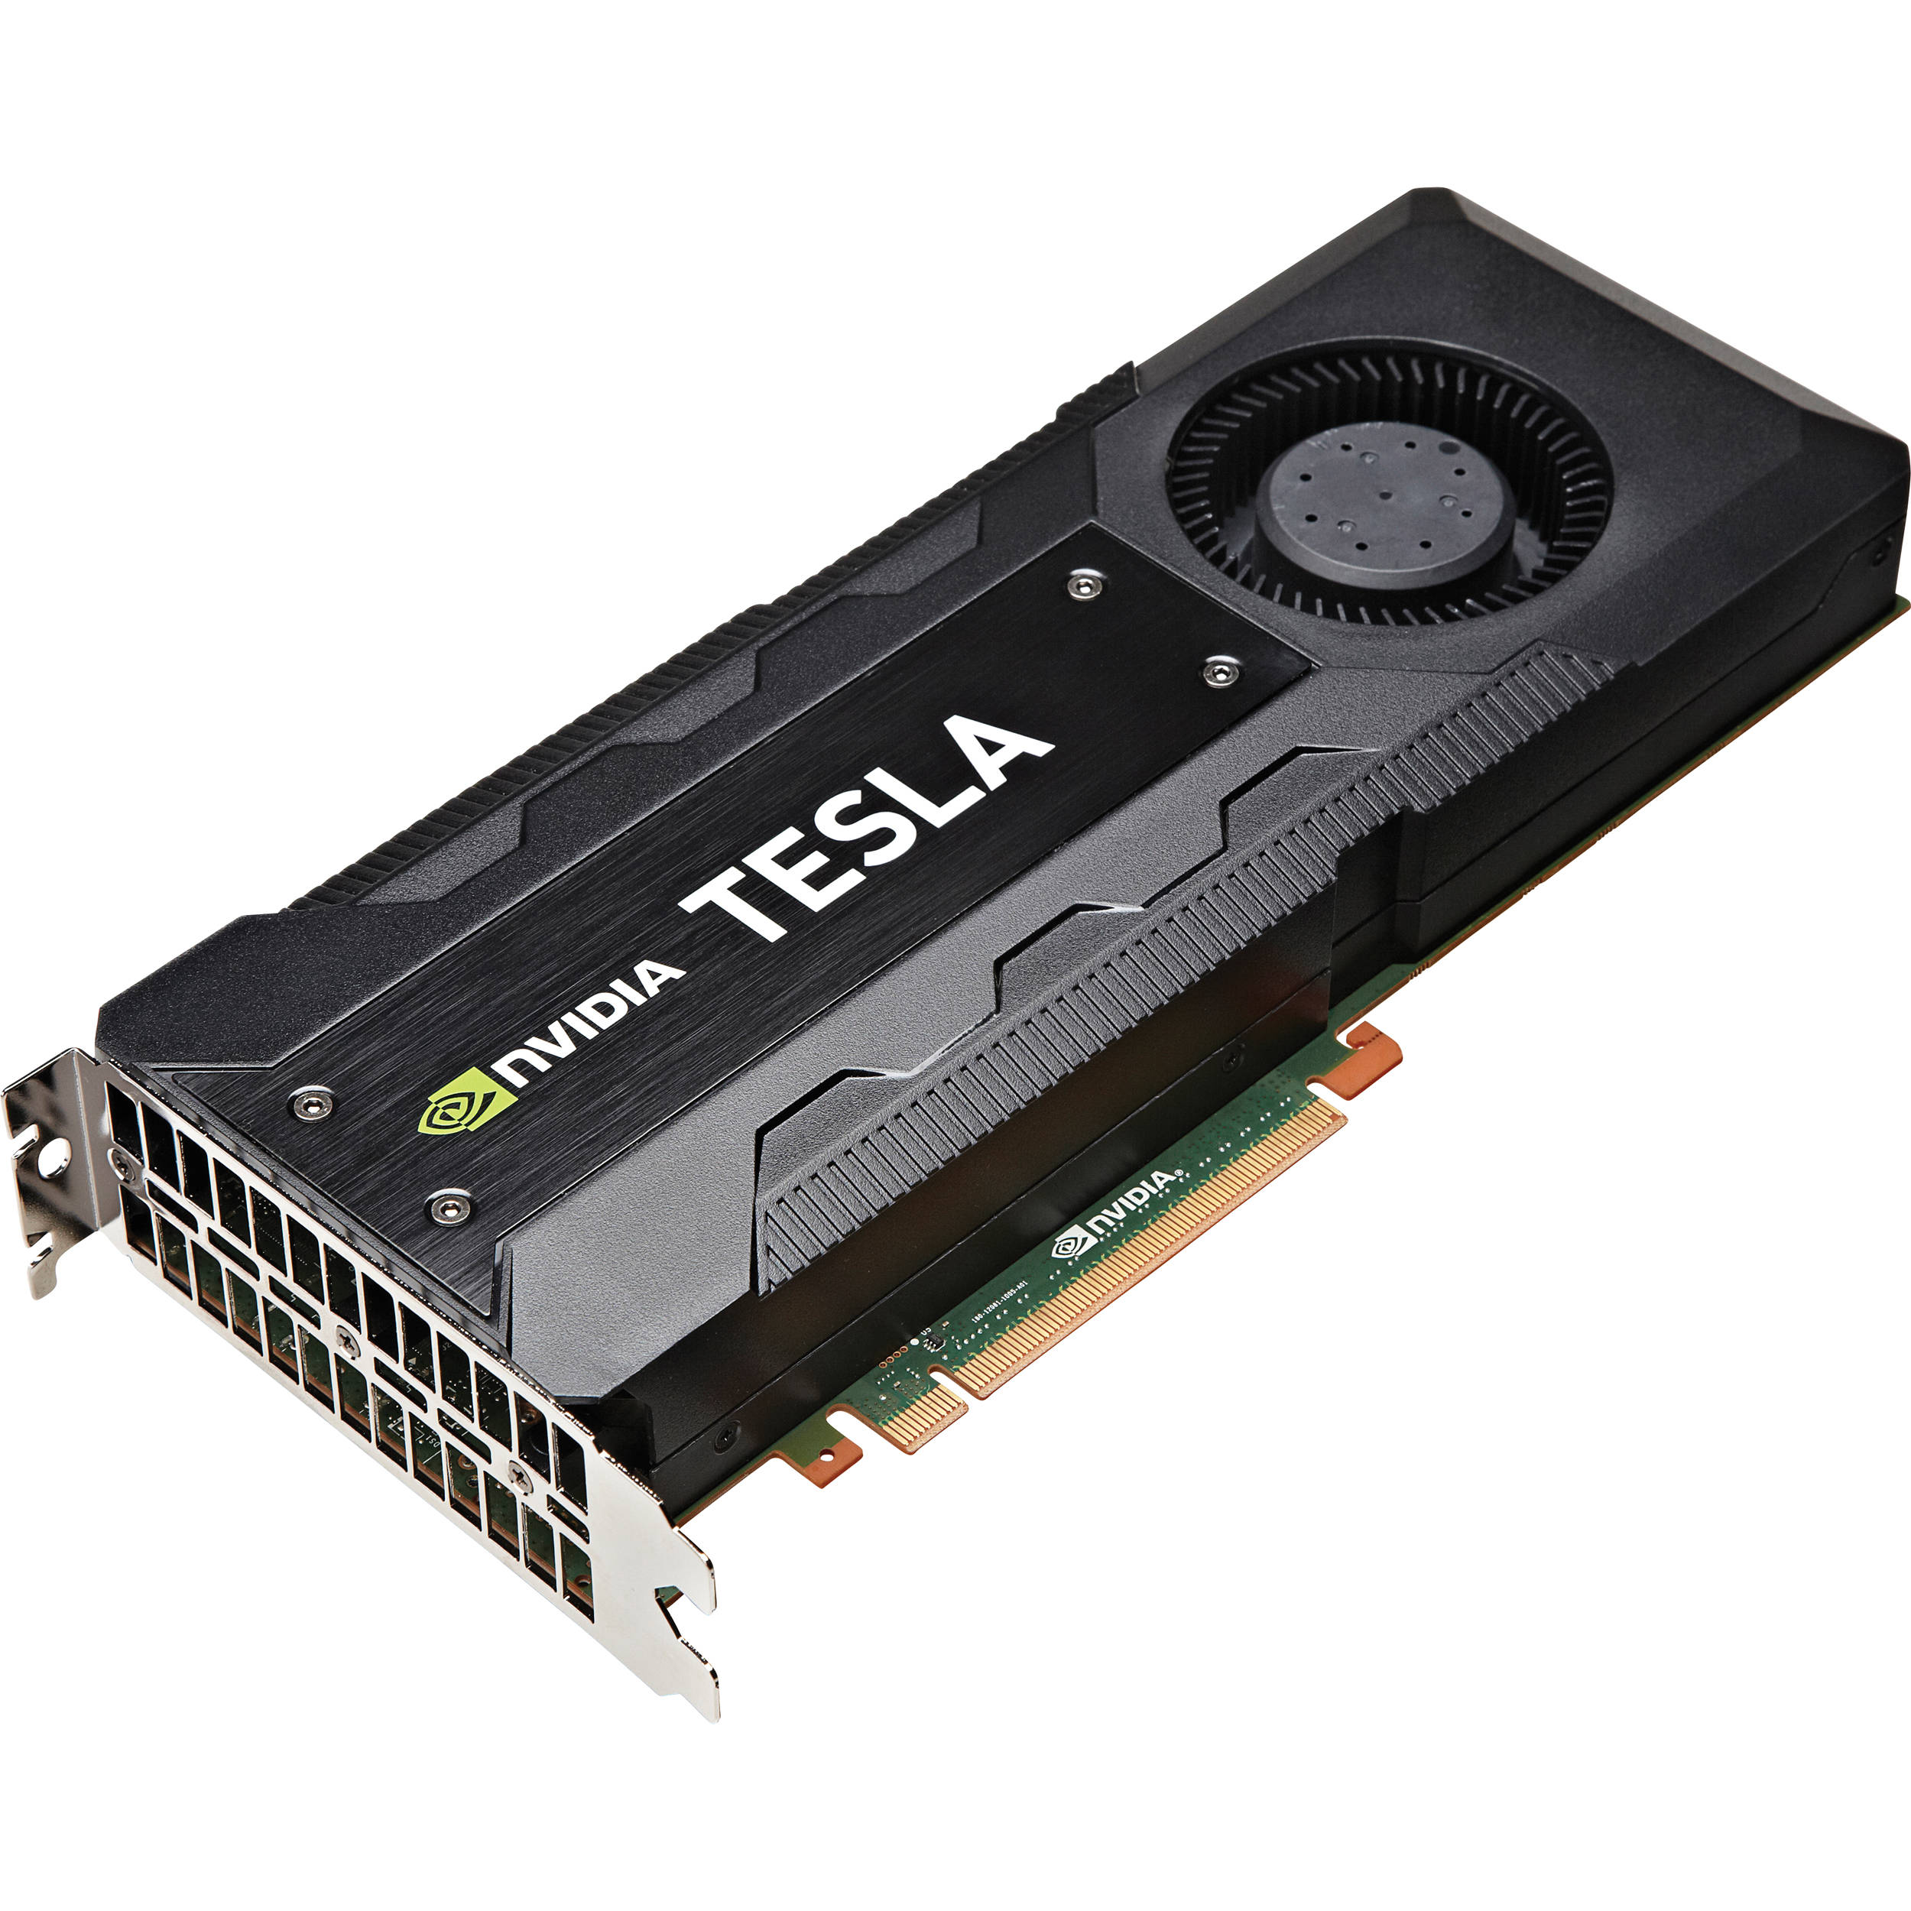



Accerlator Era!
GPU is a programmable accelerator
that satisfy many application’s demands.
New era of innovation space and creative ideas!
AI/Machine Learning
Data Analytics
Bioinformatics
4K Gaming/VR
Autonomous Vehicles
HPC
Notes:
There is no doubt we have witnessed the rise of new emerging applications, such as AI, Data Analytics, Bioinformatics, VR, Autonomous vehicles, and HPC
With the slow growth of moore’s law, a new era of hardware acceleration has begun and still evolving to improve the performance of these applications.
GPU, in particular, is a programmable Accerlator that satisfy many application’s demands and has been used to accelerate these emerging workloads.
We believe a new era of innovation space and creative ideas are required to further improve GPU architecture for these emerging workloads.

Slide 3
Architecture Simulators
Simulation is commonly used to estimate the effectiveness of a new architectural design idea.
Academic researchers typically ask this question “How does my new idea compare to the real state-of-the-art designs found in the market?!”
Notes:
Architecture simulation tool is commonly used to estimate the effectiveness of a new architectural design idea and studying the workloads bottlenecks.
Academic researchers typically ask themselves this question “How does my new idea compare to the real state-of-the-art designs found in the market?!”

Slide 4

Architecture Simulators
Simulation is commonly used to estimate the effectiveness of a new architectural design idea.
Academic researchers typically ask this question “How does my new idea compare to the real state-of-the-art designs found in the market?!”
The simulation tools used by industry are often not released for open use.
Research cannot look ahead, if its baseline assumptions are too far behind!
Accuracy Gap
Academic Simulators
Industrial Designs/ Simulators
Incorrect baseline assumptions
→ unrealistic issues or incorrect conclusions
Notes:
Unfortunately, The simulation tools used by industry are often not released for open use. And the exact details of industrial designs are not disclosed
This may lead to an accuracy gap between academic simulators and industrial designs.
This gap is caused by incorrect baseline assumptions in academic simulators.
Incorrect baseline assumptions may lead to unrealistic issues or incorrect conclusions that are not relevant to state-of-the-art designs already being used in industry.
The takeaway from this is that: Research cannot look ahead, if it baseline assumptions are too far behind.

Slide 5
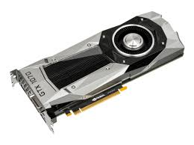
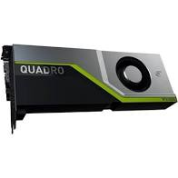
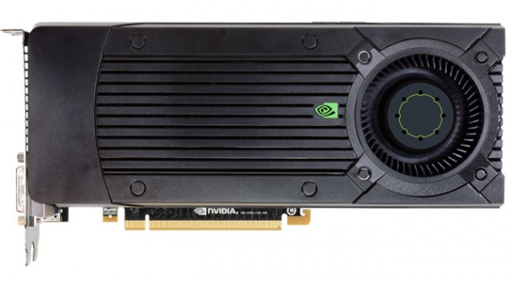
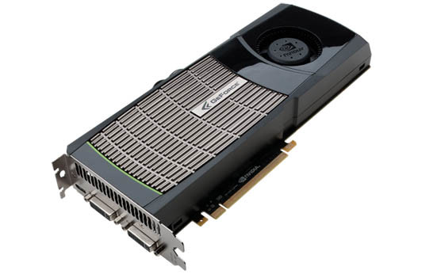
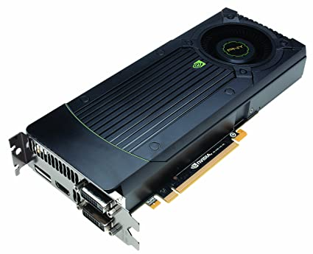
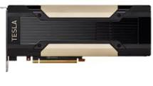
GPU Accelerators are Evolving Rapidly!
Pascal
mISA sm60
Unified memory
HBM
FP16 support
Streaming l1 cache
Kepler
mISA sm30
DP unit
Dynamic Parallelism
Dual issue
Turing
mISA sm75
New tensor cores
RT-cores
UDP cores
Hopper
??
2009
2011
2013
2015
2017
2019
2021
Fermi
mISA sm20
Caches/Atomics
Dual warp scheduler
Maxwell
mISA sm50
Subcore model
Volta
mISA sm70
Scoped synchronization
Tensor cores & INT unit
Independent threads SIMT
Cooperative Groups
Unified adaptive cache
Ampere
mISA sm80
Sparse tensor cores
Asynchronous copy and barriers
HBM2
New machine ISA and architecture designs every 1-2 years!
We show here an example of Nvidia GPU. Similar trend was observed for other GPU vendors.
Notes:
GPU Accerlators, in particular, are evolving so rapidly.
The figure shows the timeline of Nvidia GPU generations in the last decade. Similar trend was also observed for other GPU vendors.
As we can see, over the last decade, 7 different GPU generations were released with new architectural improvements.
We are almost having new machine ISA and architectural design every year and a half.

Slide 6
GPU Accelerators are Evolving Rapidly!
Pascal
mISA sm60
Unified memory
HBM
FP16 support
Streaming l1 cache
Kepler
mISA sm30
DP unit
Dynamic Parallelism
Dual issue
Turing
mISA sm75
New tensor cores
RT-cores
UDP cores
Hopper
??
How can academic open-source simulators keep up with industrial designs quickly and accurately?
2009
2011
2013
2015
2017
2019
2021
Fermi
mISA sm20
Caches/Atomics
Dual warp scheduler
Maxwell
mISA sm50
Subcore model
Volta
mISA sm70
Scoped synchronization
Tensor cores & INT unit
Independent threads SIMT
Cooperative Groups
Unified adaptive cache
Ampere
mISA sm80
Sparse tensor cores
Asynchronous copy and barriers
HBM2
New machine ISA and architecture designs every 1-2 years!
We show here an example of Nvidia GPU. Similar trend was observed for other GPU vendors.
Notes:
The question here is, How can academic open-source simulators keep up with these industrial designs quickly and accurately?
This makes the problem of GPU academic simulator more difficult. It is not only because the industrial simulators and details are not disclosed but also the architecture designs are changing so rapidly.

Slide 7
Three Drawbacks of Contemporary GPU Simulation
ISA Abstraction
Less-Detailed
Performance Model
Lacking of Ongoing
Validation
Notes:
There are three drawbacks of Contemporary GPU Simulation: instruction set architecture abstraction, less-detailed performance model and lacking of ongoing validation.
First, we will discuss the ISA Abstraction.

Slide 8
Virtual ISA vs Machine ISA
GPU architectures have widely embraced the use of a virtual ISA (vISA)
Virtual ISA
(e.g. Nvidia PTX)
Well-documented
Backward compatible
Higher Software Layers
JIT Compilation
Hardware
Machine ISA
(e.g. Nvidia SASS)
Final program representation
Register allocation & Compiler optimizations
Poorly documented
Not backward compatible
Notes:
GPU architectures have widely embraced the use of a virtual ISA (vISA) which provides hardware vendors with tremendous flexibility to make ISA and architectural changes while still maintaining binary compatibility
Virtual ISA (such as Nvidia PTX) is the ISA that is exposed to the higher software layers
Virtual ISA is well documented and backward compatible.
However, a different ISA, named machine ISA (such as Nvidia SASS) is used by hardware
During the runtime, a just-in-time compilation converts the vISA to mISA.
The machine ISA is the final program representation that contains register allocation and compiler optimizations. Whereas vISA assumes infinite register space and naïve instruction scheduling.
Unfortunately, The machine ISA is poorly documented and not backward compatible. The Backward compatibility is guaranteed by the vISA.

Slide 9
Supporting Machine ISA for GPU Simulation
(1) Accuracy
mISA is the final program representation.
(2) Functionality
Started from CUDA 9, CuDNN and CuBLAS are written in hand-tuned SASS.
Ability to study cutting-edge deep learning workloads.
Challenges:
mISA is not well documented.
mISA is not backward compatible!
mISA rapidly changes => a lot of engineering work to emulate new ISA.
Notes:
Now, it is obvious we need to support the machine ISA for GPU simulation. This is because:
accuracy, as we have just mentioned mISA is the final program representation.
And functionality, Started from CUDA 9, the CUDA deep learning frameworks, CUDNN and CuBLAS are written in hand-tuned SASS without PTX representation.
So, in order to be able to run and study cutting-edge deep learning workloads on GPU, we need to support SASS simulation.
However, as we mentioned earlier, mISA is not well documented and not Backward compatible! And this makes supporting mISA very challenging. Moreover, it changes so rapidly, this will require a lot of engineering work to emulate the new ISA in case of emulation-based simulation is used.

Slide 10
Three Drawbacks of Contemporary GPU Simulation
ISA Abstraction
Less-Detailed
Performance Model
Lacking of Ongoing
Validation
Notes:
The other two drawbacks are less-detailed and non-validated performance model

Slide 11
Less-Detailed Non-Validated Performance Model
Ideas
Ideas
Ideas
Good ideas
Design B
Design B
Design B
Good ideas
As the level of simulation detail increases and keep up-to-date with industry, the space of effective ideas shrinks and potentially moves.
Good ideas
Design A
Design A
Design A
Design C
Design C
Design C
Design D
Design D
Design D
Design E
Design E
Design E
No Simulator: Intuition
Semi-Detailed or Out-of-date Simulation
More-Detailed Up-to-date Simulation
Notes:
To discuss the impact of these two drawbacks, we show in this figure, an abstraction representation of the architectural ideas landscape.
The architecture design is represented as a collection of good ideas and ineffective bad ideas.
First, at the begging of the design process, we usually start with intuitions about some good ideas without a simulation evaluation.
Then, we develop simulators in order to study the effectiveness of these new ideas. We keep good ideas for further evaluation such as designs A, C and D in the figure, while we throw out other ineffective ideas, such as Designs B and E
However, If we add more details in the simulator and validate it with the state-of-the-art design.
We may have the scenario where Designs C and D, which seem to be good ideas in the old less-detailed simulator are actually not effective when we add more details to the simulator and make it up-to-date with contemporary designs.
vice versa, other ideas that are used to be ineffective in old simulator, such as B, is actually seems to be promising when we add more details in the simulator.
The takeaway from this is that, As the level of simulation detail increases and keep up-to-date with industry, the space of effective ideas shrinks and potentially moves, and this shows how important to keep our academic simulators validated versus contemporary designs.

Slide 12
Open-source GPU Simulation Landscape
MGPSIM
MacSim
Gem5-APU
Multi2-Sim
GPGPU-Sim 3.x
Support virtual ISA => Not always an accurate representation.
Support execution-driven old machine ISA → Challenging to keep up with industry.
Validated for one architecture → lack a systematic methodology to validate and model new architectural designs quickly.
Validated on a handful of workloads.
Does not support hand-tuned mISA libs (e.g. Volta CuDNN).
Notes:
Over the last decade, several academic GPU simulators have been developed. However, these simulators do not address the challenges that we have just discussed.
For example:
They Support virtual ISA which is Not always an accurate representation.
They support execution-driven old machine ISA which makes it very challenging to keep up with industry.
They are validated for one particular architecture and lack a systematic methodology to validate and model new architectural designs quickly.
They are validated on a handful of workloads.
Finally, they do no support hand-tuned mISA libs, such as Volta CuDNN

Slide 13
Challenges Summary
How do academic researchers quickly simulate a new, often undocumented mISA every year and a half?
Once functionally correct, how are changes to the architecture detected and modeled?
What is a sustainable, rigorous validation mechanism to ensure that new baselines are still tracking industrial designs?
Accel-Sim, a new simulation framework, that is designed to address all three challenges!
Notes:
To summarize challenges that we have discussed till now.
First, How do academic researchers quickly simulate a new, often undocumented mISA every year and a half?
Second, Once functionally correct, how are changes to the architecture detected and modeled?
Third, What is a sustainable, rigorous validation mechanism to ensure that new baselines are still tracking industrial designs?
Accel-Sim is a new simulation framework, that is designed to address all three challenges

Slide 14
Agenda
Background and Motivation
Accel-Sim Overview.
Accel-Sim Flexibility Study.
Detailed Accel-Sim Correlation.
Accel-Sim vs GPGPU-Sim 3.x.
Case Studies.
Conclusion.
Notes:
Now, we will show an overview of Accel-sim

Slide 15
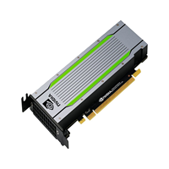
Accel-Sim
Detailed
Correlation Graphs
Accel-Sim Tracer
ISA Def file
SASS traces
Correlation Guidance
(“FADD”, FPU)
(“IADD”, INT)
……
Accel-Sim Trace-Driven SASS Frontend
Configurable GPGPU-Sim
Perf Model
HW_Def.h file
ISA-Ind. Format
GPGPU-Sim
PTX Emulation
Accel-Sim
Correlator
#define WARP_SIZE 32
#define SM_NUM 80
………
Simulation stats
Accel-Sim
Tuner
Config Files
Hardware stats
Accel-Sim uBench suite
New HW
Notes:
This figure shows an end-to-end overview of Accel-sim simulation framework.
Accel-Sim is composed of four basic components.

Slide 16
Accel-Sim
Detailed
Correlation Graphs
Accel-Sim Tracer
ISA Def file
SASS traces
Correlation Guidance
(“FADD”, FPU)
(“IADD”, INT)
……
Accel-Sim Trace-Driven SASS Frontend
Configurable GPGPU-Sim
Perf Model
HW_Def.h file
ISA-Ind. Format
GPGPU-Sim
PTX Emulation
Accel-Sim
Correlator
#define WARP_SIZE 32
#define SM_NUM 80
………
Simulation stats
Accel-Sim
Tuner
Config Files
Hardware stats
Accel-Sim uBench suite
New HW
(1) A Flexible frontend
Notes:
First a flexible frontend that supports trace-driven simulation of contemporary machine ISA and execution-driven simulation of NVIDIA’s virtual ISA

Slide 17
Accel-Sim
Detailed
Correlation Graphs
Accel-Sim Tracer
ISA Def file
SASS traces
GPGPU-Sim 4.0
Correlation Guidance
(“FADD”, FPU)
(“IADD”, INT)
……
Accel-Sim Trace-Driven SASS Frontend
Configurable GPGPU-Sim
Perf Model
HW_Def.h file
ISA-Ind. Format
GPGPU-Sim
PTX Emulation
Accel-Sim
Correlator
#define WARP_SIZE 32
#define SM_NUM 80
………
Simulation stats
Accel-Sim
Tuner
Config Files
Hardware stats
Accel-Sim uBench suite
New HW
(2) Flexible and detailed performance model (GPGPU-sim 4.x)
Notes:
Second a flexible and detailed performance model that built on top of GPGPU-sim 3.x and is released as new version in this work.

Slide 18
Accel-Sim
Detailed
Correlation Graphs
Accel-Sim Tracer
ISA Def file
SASS traces
Correlation Guidance
(“FADD”, FPU)
(“IADD”, INT)
……
Accel-Sim Trace-Driven SASS Frontend
Configurable GPGPU-Sim
Perf Model
HW_Def.h file
ISA-Ind. Format
GPGPU-Sim
PTX Emulation
Accel-Sim
Correlator
#define WARP_SIZE 32
#define SM_NUM 80
………
Simulation stats
Accel-Sim
Tuner
Config Files
Hardware stats
Accel-Sim uBench suite
New HW
(3) Tuner and targeted microbenchmarks
Notes:
Third, an automated parameter tuner and a set of targeted GPU microbenchmarks that are useful for adapting Accel-Sim to model new designs quickly

Slide 19
Accel-Sim
Detailed
Correlation Graphs
Accel-Sim Tracer
ISA Def file
SASS traces
Correlation Guidance
(“FADD”, FPU)
(“IADD”, INT)
……
Accel-Sim Trace-Driven SASS Frontend
Configurable GPGPU-Sim
Perf Model
HW_Def.h file
ISA-Ind. Format
GPGPU-Sim
PTX Emulation
Accel-Sim
Correlator
#define WARP_SIZE 32
#define SM_NUM 80
………
Simulation stats
Accel-Sim
Tuner
Config Files
Hardware stats
Accel-Sim uBench suite
New HW
(4) Correlator
Notes:
Fourth, a correlation tool that automates the process of generating counter-by-counter correlation data and graphs between simulator and hardware

Slide 20
Accel-Sim
Detailed
Correlation Graphs
Accel-Sim Tracer
ISA Def file
SASS traces
Correlation Guidance
(“FADD”, FPU)
(“IADD”, INT)
……
Accel-Sim Trace-Driven SASS Frontend
Configurable GPGPU-Sim
Perf Model
HW_Def.h file
ISA-Ind. Format
GPGPU-Sim
PTX Emulation
Accel-Sim
Correlator
#define WARP_SIZE 32
#define SM_NUM 80
………
Simulation stats
Accel-Sim
Tuner
Config Files
Hardware stats
Accel-Sim uBench suite
New HW
(1) A Flexible frontend
Notes:
Now, we will discuss each component in details, and we start with the frontend

Slide 21

Trace-driven SASS Frontend
Traces generated using NVBit binary instrumentation tool*.
Advantages:
Simulate the most up-to-date accurate machine ISA (SASS) in new cards without implementing the ISA’s functional model.
Running the hand-tuned mISA libraries (CuDNN)
Higher simulation speed.
Drawbacks:
Large traces size.
Very difficult to study designs on the data values stored and global synchronization mechanisms.
Traces compression, trace important kernels
Support PTX execution-driven
*Villa, Oreste, et al. "NVBit: A Dynamic Binary Instrumentation Framework for NVIDIA GPUs." MICRO. 2019.
Notes:
Our frontend supports trace-driven SASS simulation.
Our traces generated using NVBit binary instrumentation tool
The advantages of supporting trace-driven SASS are:
Simulating the most up-to-date accurate machine ISA in new cards without implementing the ISA’s functional model.
Second, Running the hand-tuned mISA libraries (like CuDNN)
And we will be able to achieve Higher simulation speed compared to execution-driven by skipping the functional model overhead.
However, trace-driven has two drawbacks:
The first one is the large traces size for some workloads.
And, second, it is going to be very difficult to study designs on the data values stored in memory or doing research on global synchronization mechanisms.
To overcome these issues: we support traces compression, and trace important kernels when the workloads traces are too large. We also make our frontend flexible to support PTX execution-driven to enable research on memory data values and synchronization.

Slide 22
Flexible Frontend
Trace-Driven SASS Frontend
GPU ISA-independent representation
(Active mask, PC, Execution unit, addresses, …… )
Performance Model
ISA-Ind. format
GPGPU-Sim
PTX Emulation
Notes:
We make our frontend flexible to support both SASS trace-driven and PTX execution-driven. We achieve this by embracing ISA-independent representation. The independent representation contains all the information necessary to perform timing simulation, such as (1) the instruction’s control flow (like the active mask and PC), (2) the instruction’s datapath information (such as registers and execution unit) and (3) memory addresses for ld/st instructions.
The intermediate format is integrated into the Performance Model.
Then, the trace-driven and execution-driven frontend translates their instruction stream into the ISA-independent format.

Slide 23
Accel-Sim
Detailed
Correlation Graphs
Accel-Sim Tracer
ISA Def file
SASS traces
GPGPU-Sim 4.0
Correlation Guidance
(“FADD”, FPU)
(“IADD”, INT)
……
Accel-Sim Trace-Driven SASS Frontend
Configurable GPGPU-Sim
Perf Model
HW_Def.h file
ISA-Ind. Format
GPGPU-Sim
PTX Emulation
Accel-Sim
Correlator
#define WARP_SIZE 32
#define SM_NUM 80
………
Simulation stats
Accel-Sim
Tuner
Config Files
Hardware stats
Accel-Sim uBench suite
New HW
(2) Flexible and detailed performance model (GPGPU-sim 4.x)
Notes:
The second piece is the performance model

Slide 24
Core Model: Increasing Flexibility
Kepler’s Shared Model
Volta’s Subcore Model
Warp
Scheduler
…..
Warp
Scheduler
Sub-core
Sub-core
Warp
Scheduler
Warp
Scheduler
Register File
Ability to add
new EU without updating codebase
(e.g. tensor cores)
Register File
Register File
…..
Exec Units
.
.
.
.
.
Exec Units
Exec Units
EU1
.
.
.
.
.
.
.
.
.
.
EU2
EU1
EU1
EU2
EU2
L1Cache
Shared Memory
Unified L1/Shared Memory
Notes:
Our performance model is built on top of GPGPU-sim version 3.x and is released as a new version 4.0.
In the new core model, we increased the flexibility to model contemporary and future GPU generations. For example, we are able to model the kepler’s shared core model where warp schedulers are sharing the execution units and register file.
Also, the new core model is flexible enough to build the Volta subcore model, where warp schedulers are isolated and only share the L1 cache and shared memory.
Also, in trace-driven mode, we provide the flexibility and ability to add new execution units without the need to update the codebase. This ensures that when GPU vendor adds new Domain-specific execution unit, such as tensor cores, we can adapt our model to this and add the new execution unit very quickly.

Slide 25
Memory Model: Increasing Details
SM
SM
…..
SM
Sectored, banked,
streaming and adaptive
L1 caches.
L1 Cache
L1 Cache
L1 Cache
IPOLY Hashing
everywhere.
(reduce bank and
cache set conflicts)
Ensure you build a sound and fair baseline that closes to the contemporary GPU designs.
Interconnection Network
Write-aware caches
L2 Cache
L2 Cache
L2 Cache
…..
GDDR and HBM modeling.
HBM
/GDDR
Channel
HBM
/GDDR
Channel
…..
HBM
/GDDR
Channel
Notes:
In the memory model, we increased the details to reflect the advances in contemporary designs. For example:
The caches are sectored, banked, streaming and adaptive,
We added advanced IPOLY hashing everywhere in the memory system to reduce bank and cache set conflicts and alleviate contention.
We developed a write-aware cache policy that is implemented in modern GPU architectures.
We model GDDR and the modern High bandwidth memory.
What we aim here from this is to ensure we build a sound and fair baseline that closes to the contemporary GPU designs.

Slide 26
Accel-Sim
Detailed
Correlation Graphs
Accel-Sim Tracer
ISA Def file
SASS traces
Correlation Guidance
(“FADD”, FPU)
(“IADD”, INT)
……
Accel-Sim Trace-Driven SASS Frontend
Configurable GPGPU-Sim
Perf Model
HW_Def.h file
ISA-Ind. Format
GPGPU-Sim
PTX Emulation
Accel-Sim
Correlator
#define WARP_SIZE 32
#define SM_NUM 80
………
Simulation stats
Accel-Sim
Tuner
Config Files
Hardware stats
Accel-Sim uBench suite
New HW
(3) Tuner, targeted microbenchmarks and (4) Correlator
Notes:
Finally, we will discuss the tuner and correlator

Slide 27

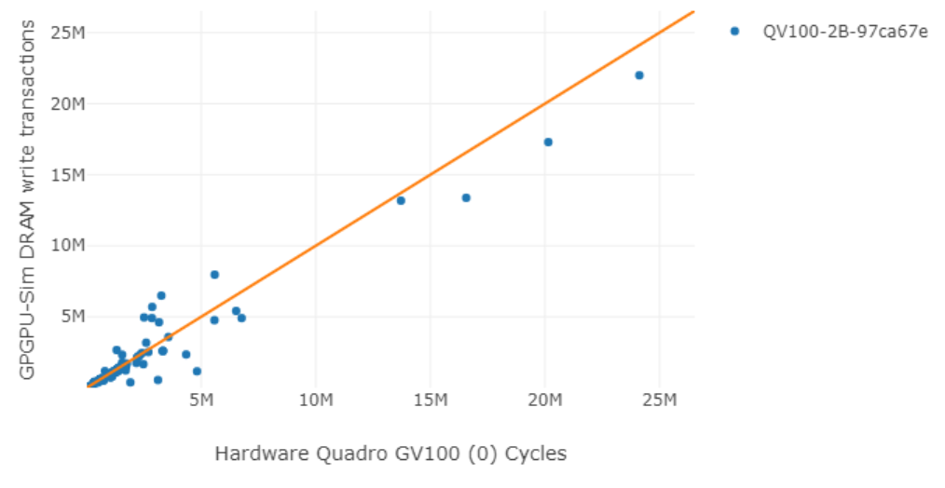
Tuner and Correlator
Microbenchmarks
(cache and EUs configuration)
Detailed
Correlation
Graphs
(20 performance
counters)
Hardware stats
CUDA deviceQuery
(#SMs, ..)
Simulation stats
Tuner
Initial Config file
Tuner’s
Search
TunedConfig file
Correlator
User’s Input HW_def.h
(core/memory model, …)
Unknowns parameters
(warp scheduling,
l2 hashing,
L2 interleaving granularity,
memory scheduling)
Correlation Guidance
( performance bugs or misrepresentations )
Notes:
We run a set of microbenchmarks that demystify the caches, memory and execution units configuration in the hardware.
The tuner reads the outputs of the microbenchmarks and generates an initial config file that reflects the hardware parameters.
For other parameters that cannot be directly determined by our microbenchmarks (such as warp scheduling, L2 cache hashing function, the L2 cache interleaving granularity and memory scheduling), the tuner does an extensive searching by simulates each possible combination of these parameters on a set of microbenchmarks and the combination with the highest average hardware correlation is chosen by the tuner.
Finally, the correlator tool takes hardware statistics and simulation statistics to generate detailed correlation graphs.
The detailed correlation output can be used as a feedback to identify and correct performance bugs or misrepresentations in the simulator and config files.
This process can be repeated till we reach to the point that the model is validated and matches the hardware as much as possible. At this point, researchers can trust the new model and start evaluating their research ideas.

Slide 28
Agenda
Background and Motivation
Accel-Sim Overview.
Accel-Sim Flexibility Study.
Detailed Accel-Sim Correlation.
Accel-Sim vs GPGPU-Sim 3.x.
Case Studies.
Conclusion.
Notes:
Now, we demonstrate the flexibility of Accel-sim to model different GPU generations.

Slide 29
Modeling New GPUs
(1) Generate the traces for all the benchmarks using Accel-Sim’s tracing tool.
(2) We run our microbenchmark suite and automated tuner to configure the performance model’s parameters.
(3) Using Accel-Sim’s correlation tool, we generate a set of graphs for performance counters to validate and improve correlation accuracy.
Notes:
When new GPU card is released, we go through the following steps,
First, we generate the traces for all the benchmarks using Accel-Sim’s tracing tool. By this way we ensure running the correct mISA.
Second, We run our microbenchmark suite and automated tuner to configure the performance model’s parameters. So, we can Keep up with design changes
Third, Using Accel-Sim’s correlation tool, we generate a set of graphs for performance counters to validate and improve correlation accuracy. By this way, we ensure the model matches the HW

Slide 30
Modeling Different GPU Generations
 | Kepler TITAN |  | Pascal TITANX |  | Volta QV100 |  | Turing RTX 2060
 | MAE | Correl | MAE | Correl | MAE | Correl | MAE | Correl
PTX EXEC | 28% | 0.99 | 53% | 0.97 | 34% | 0.98 | 32% | 0.99
SASS Trace | 25% | 0.99 | 30% | 0.97 | 15% | 1.00 | 25% | 0.99
Up to 2X error reduction when applying SASS
Correlation is > 0.97 in all instances and error is <= 30% for all SASS simulation.
Notes:
We followed these steps to model four different GPUs from Kepler to Turing.
In summery, Correlation is > 0.97 in all instances and error is <= 30% for all SASS simulation.
Up to 2X error reduction was achieved in Volta when we move from PTX so SASS simulation

Slide 31
Agenda
Background and Motivation
Accel-Sim Overview.
Accel-Sim Flexibility Study.
Detailed Accel-sim Correlation.
Accel-Sim vs GPGPU-Sim 3.x.
Case Studies.
Conclusion.
Notes:
In the next slides we correlate Accel-sim in details versus stat-of-art GPGPU-sim simulator.

Slide 32
Experimental Setup
140 workloads from Rodinia, Parboil, Polybench, CUDA SDK, our memory microbenchmarks, CUTLASS and Deepbench ML workloads.
Hardware counters are collected using Nvidia’s Profiler from CUDA 10 on Quadro Volta V100.
The GPGPU-sim 3.x model is a best-effort attempt to model the Volta card using GPGPUSim 3.x by scaling compute and memory resources.
Evaluated metrics: Absolute Error and Correlation Coefficient
Notes:
We setup our experiments as following:
We evaluate our correlation over 140 workloads from seven different benchmarks suites.
The Hardware counters are collected using Nvidia’s Profiler from CUDA 10 and we model the modern Quadro Volta V100.
The GPGPU-sim 3.x model is a best-effort attempt to model the Volta card using GPGPUSim 3.x by scaling compute and memory resources.
We evaluate both absolute error and correlation coefficient

Slide 33
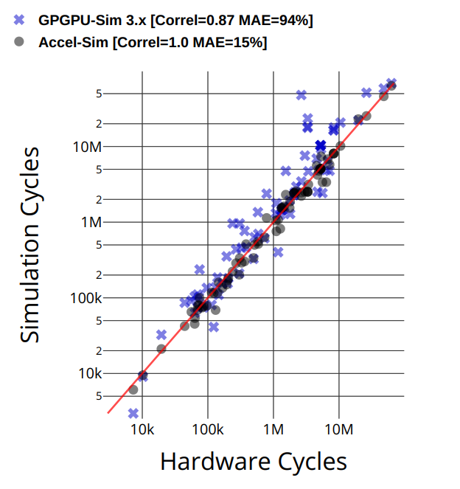
GPGPU-Sim 3.x vs Accel-Sim
Accel-Sim decreases cycle error from 94% to 15%.
More detailed correlation results can be found in the paper.
Notes:
Accel-Sim is able to decreases cycle error from 94% to 15% compared to GPGPUSim
In the figure we correlate Accel-sim and GPGU-sim cycles versus the hardware cycles. GPGPU-sim data are represented as blue points and Accel-sim data are the black points
As we can see, in GPGPU-sim many applications are slower than hardware. This is because GPGPU-sim underestimates some hardware parameters, supports inaccurate PTX and was not validated and tuned versus the hardware. Whereas Accel-sim overcome all these issue.
More detailed correlation results can be found in the paper.

Slide 34
GPGPU-Sim 3.x vs Accel-Sim (cont.)
Error cycle per Benchmark Suite
Benchmarks Suite | #workloads | GPGPU Sim 3.x MAE (%) | Accel-Sim [PTX] MAE (%) | Accel-Sim [SASS] MAE (%)
CUDA SDK | 12 | 13 | 16 | 9
Rodinia | 13 | 32 | 28 | 8
Parboil | 8 | 45 | 37 | 20
Polybench | 10 | 111 | 6 | 4
Microbenchmark | 13 | 37 | 14 | 9
CUTLASS wmma | 10 | 11 | 0.5 | 12
CUTLASS sgemm | 10 | 98 | 54 | 2
Deepbench | 60 | NA | NA | 33
Notes:
Then, we show in this table the mean absolute error for cycle per benchmark suite. We compare GPGPU-sim, Accel-sim [in PTX simulation] and Accel-sim in SASS simulation

Slide 35
GPGPU-Sim 3.x vs Accel-Sim (cont.)
Error cycle per Benchmark Suite
Benchmarks Suite | #workloads | GPGPU Sim 3.x MAE (%) | Accel-Sim [PTX] MAE (%) | Accel-Sim [SASS] MAE (%)
CUDA SDK | 12 | 13 | 16 | 9
Rodinia | 13 | 32 | 28 | 8
Parboil | 8 | 45 | 37 | 20
Polybench | 10 | 111 | 6 | 4
Microbenchmark | 13 | 37 | 14 | 9
CUTLASS wmma | 10 | 11 | 0.5 | 12
CUTLASS sgemm | 10 | 98 | 54 | 2
Deepbench | 60 | NA | NA | 33
Significant improvement from the accurate performance model
Notes:
Some benchmark suites achieve significant improvement from the accurate performance model. In polybench, for example, the error is reduced from 100% to 6%.

Slide 36
GPGPU-Sim 3.x vs Accel-Sim (cont.)
Error cycle per Benchmark Suite
Benchmarks Suite | #workloads | GPGPU Sim 3.x MAE (%) | Accel-Sim [PTX] MAE (%) | Accel-Sim [SASS] MAE (%)
CUDA SDK | 12 | 13 | 16 | 9
Rodinia | 13 | 32 | 28 | 8
Parboil | 8 | 45 | 37 | 20
Polybench | 10 | 111 | 6 | 4
Microbenchmark | 13 | 37 | 14 | 9
CUTLASS wmma | 10 | 11 | 0.5 | 12
CUTLASS sgemm | 10 | 98 | 54 | 2
Deepbench | 60 | NA | NA | 33
Significant improvement from supporting SASS
Notes:
Some other benchmark suites achieve significant improvement from the supporting SASS. In cutlass sgemm, for example, the error is reduced from almost 50% to just 2%.

Slide 37
GPGPU-Sim 3.x vs Accel-Sim (cont.)
Error cycle per Benchmark Suite
Benchmarks Suite | #workloads | GPGPU Sim 3.x MAE (%) | Accel-Sim [PTX] MAE (%) | Accel-Sim [SASS] MAE (%)
CUDA SDK | 12 | 13 | 16 | 9
Rodinia | 13 | 32 | 28 | 8
Parboil | 8 | 45 | 37 | 20
Polybench | 10 | 111 | 6 | 4
Microbenchmark | 13 | 37 | 14 | 9
CUTLASS wmma | 10 | 11 | 0.5 | 12
CUTLASS sgemm | 10 | 98 | 54 | 2
Deepbench | 60 | NA | NA | 33
Only Accel-sim [SASS] can run Deepbench with CuDNN
Notes:
Finally, only Accel-sim With SASS support can run deepbench workloads with CuDNN and achieves 33% error on average.

Slide 38
Agenda
Background and Motivation
Accel-Sim Overview.
Accel-Sim Flexibility Study.
Detailed Accel-Sim Correlation.
Accel-Sim vs GPGPU-Sim 3.x.
Case Studies.
Conclusion.
Notes:
Then we discuss some of benefits of our framework through two cases studies.

Slide 39
Case Studies
We demonstrate two simple case-studies on how incorrect baseline assumptions can hide new areas of opportunity and lead to potentially incorrect design decisions.
Case Study I: L1 Cache Throughput.
Case Study II: Memory Sensitivity.
Evaluating on Volta GPU configuration for Accel-Sim vs GPGPU-Sim 3.x
Notes:
Here, We demonstrate two simple case-studies on how incorrect baseline assumptions can hide new areas of opportunity and lead to potentially incorrect design decisions.
The first case study evaluates L1 cache throughput bottleneck
And in the second case study, we evaluate the memory scheduling senetivity
We show that in Volta GPU configuration for Accel-Sim vs GPGPU-Sim

Slide 40
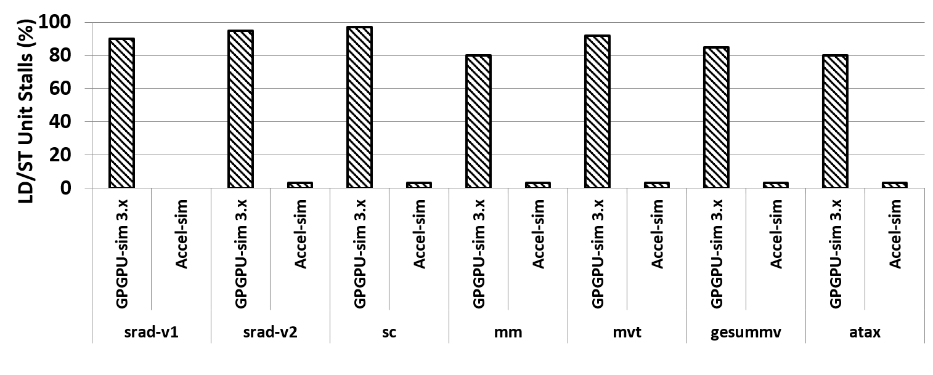
L1 Cache Throughput Bottleneck
The L1 cache throughput bottleneck for GPUs has been well explored in literature.
However, contemporary GPUs are designed such that the L1 cache is no longer a throughput bottleneck.
Thanks to sectored, banked, streaming and adaptive cache in Volta, L1 cache throughput bottleneck has been significantly alleviated.
Notes:
The L1 cache throughput bottleneck for GPUs has been well explored in literature
However, contemporary GPUs are designed such that the L1 cache is no longer a throughput bottleneck.
In this figure, we show the LD/ST unit stalls that reflects the l1 cache contention. We show this on a group of cache senstive apps. As we can see, the L1 cache was a throughput bottleneck in GPGPU-sim however the bottleneck is alleviated in Accel-sim.
Thanks to sectored, banked, streaming and adaptive cache in Volta, L1 cache throughput bottleneck has been significantly alleviated and this is reflected in our Accel-sim model.

Slide 41
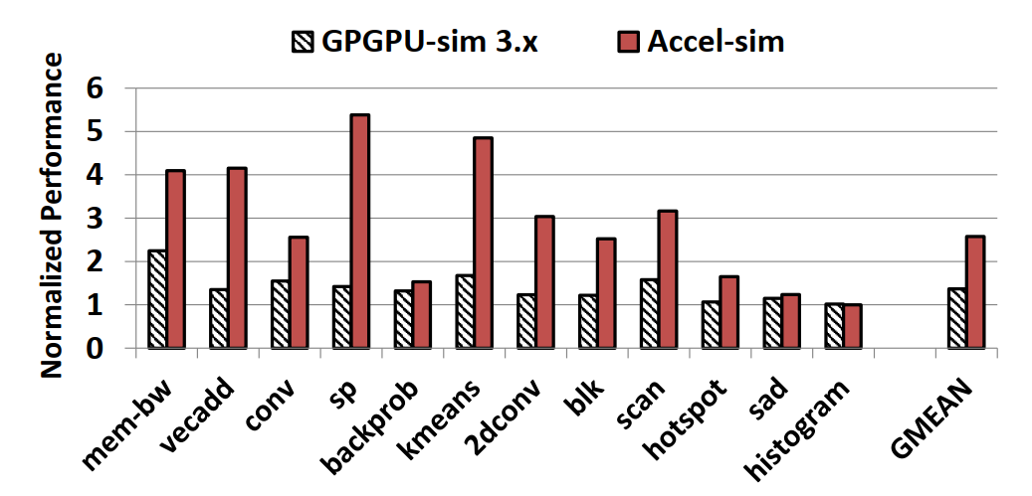
Memory Scheduling Sensitivity
Out-of-order performance
normalized to the FIFO
Accel-sim is
2X more sensitive
In Accel-Sim, the memory scheduling policy is more critical than GPGPU-sim 3.x.
Notes:
In the second case study, We aim to see how much the models are sensitive to the memory scheduling policy. We run advanced out-of-order memory scheduling and normalized to the naive first-come-first-serve memory scheduling. We show that in both GPGPU-sim and Accel-sim
As we can see, Accel-sim is 2X more sensitive.
In Accel-Sim, the memory scheduling policy is more critical than GPGPU-sim.

Slide 42
Discussion
GPU Core
L2 Cache/
DRAM
Throughput Bottleneck
GPU Core
L2 Cache/
DRAM
Notes:
The outcomes from these case studies is that, There used to be a throughput bottleneck at the core-level due to the l1 caches

Slide 43
Discussion
The throughput bottleneck is shifted from the L1 cache to the lower levels of the memory hierarchy.
We believe Accel-Sim opens up a rich new design space in system-level GPU research where core-level memory issues are alleviated and there is increased sensitivity to chip-wide memory issues.
GPU Core
L2 Cache/
DRAM
Throughput Bottleneck
GPU Core
L2 Cache/
DRAM
Notes:
but the bottleneck is shifted from the L1 cache to the lower levels of the memory hierarchy.
We believe Accel-Sim opens up a rich new design space in system-level GPU research where core-level memory issues are alleviated and there is increased sensitivity to chip-wide memory issues.

Slide 44
Agenda
Background and Motivation
Accel-Sim Overview.
Accel-Sim Flexibility Study.
Detailed Accel-Sim Correlation.
Accel-Sim vs GPGPU-Sim 3.x.
Case Studies.
Conclusion.
Notes:
Finally, in conclusion

Slide 45
Conclusion
This paper introduces three innovative mechanisms to help solve the problem of keeping simulators up-to-date with contemporary designs.
Accel-Sim supports new machine ISAs, hand-tuned libraries and enables quick turn-around for modeling new architectures.
Accel-Sim decreases cycle error from 94% in state-of-the-art simulation to 15%.
Accel-Sim enables exploration of system-level issues and deep learning workloads on modern GPUs.
We believe that Accel-Sim will reduce the accuracy gap between industrial and academic simulators on an ongoing basis, increasing the potential impact and the quality of academic research.

Slide 46


Q&A?
https://accel-sim.github.io/
Notes:
For more information about Accel-sim and the source code, this is a link to the Accel-sim website.
Thanks for your listening any any questions are welcomed.
Questions:
1- what about simulation rate? Accuracy vs fidelity tradeoff?
2- Does Accel-sim support ML-Perf simulation?
3- Do you model the recent Nvidia’s Ampere architecture?
4- What is different between GPGPU-sim and Accel-sim?
5- What is the source of 33% error in DeepBench workloads?
6- Can you talk more about the tuner and correlator and how to use them to tune the mode?
7- What open research questions remain?
8- What is the future of this work?
Three:

Slide 47
Thanks!

Slide 48
Backup slides

