Slide 1
main()
Read file1.txt and count words
Read file2.txt and count words
Read file3.txt and count words
Read file4.txt and count words

Slide 2
main()
Read file1.txt and count words
Read file2.txt and count words
Read file3.txt and count words
Read file4.txt and count words

Slide 3
Go Application
Single Core
Single Core
Single Core
Waiting go routines
Go routine
Thread(s)
Go routine
Go routine
Scheduler
Go routine

Slide 4
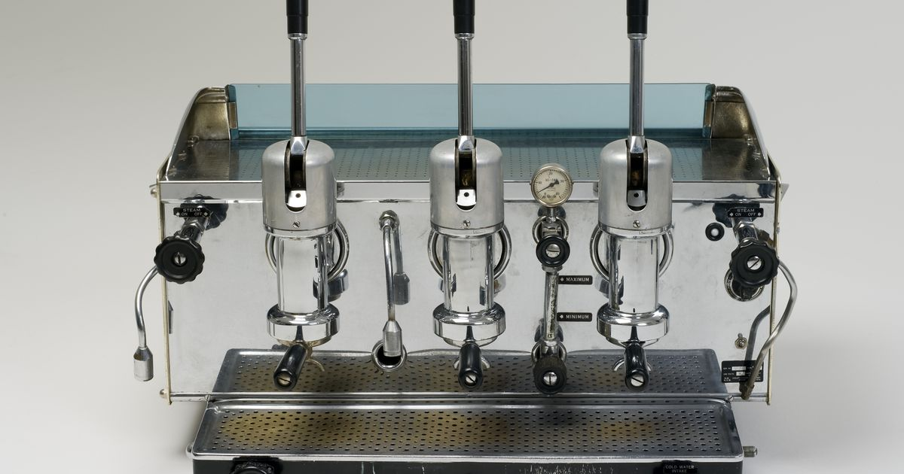

Concurrency is the ability to handle multiple tasks at the same time, executing them one at a time.
Coffee Machine

Slide 5
Concurrency is the ability to handle multiple tasks at the same time, executing them one at a time.
Single Core
Waiting go routines
Go routine
Thread
Go routine
Go routine
Scheduler
Go routine

Slide 6
Parallelism is the ability to execute multiple tasks at the same time
Coffee Machine 1
Coffee Machine 2

Slide 7
Parallelism is the ability to execute multiple tasks at the same time
Single Core 1
Single Core 2
Thread
Waiting go routines
Thread
Waiting go routines
Go routine
Go routine
Go routine
Go routine
Go routine
Go routine
Scheduler
Go routine
Scheduler
Go routine

Slide 8
How to create a go routine?
go <function name>(<parameters>)
Example: go printCountOfWords(file)

Slide 9
main()
Read file1.txt and count words
Finish
Terminated

Slide 10
main()
Read file1.txt and count words
Finish

