Slide 1
Channels : synchronise and communication between go routines
Waitgroups : synchronize go routines

Slide 2
What is a mutex?
A mutex is a mutual exclusion lock.
It is used to synchronize data access.

Slide 3
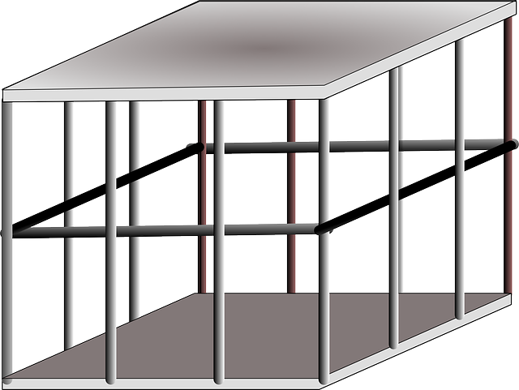



Data

Slide 4
Mutex functions
Function | What it does
Lock() | Locks the mutex. If the lock is already in use, the calling goroutine blocks until the mutex is available.
TryLock() | Tries to lock the mutex, returns true if lock is successful
Unlock() | Unlocks the mutex. The go routine that calls this function does not have to be the same routine that called Lock() in the first place.

Slide 5
Go routine 1
Go routine 2
tempTotalWordCount(50) = totalWordCount(0) + fileWordCount(50)
Sleeps
tempTotalWordCount(60) = totalWordCount(0) + fileWordCount(60)
Sleeps
Awakes
totalWordCount = tempTotalWordCount(60)
Awakes
totalWordCount = tempTotalWordCount(50)

Slide 6
What is a data race?
When 2 go routines access the same variable concurrently and at least one of the access is a write No way to know in which order the operations will take place

