Slide 1
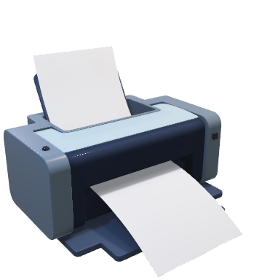
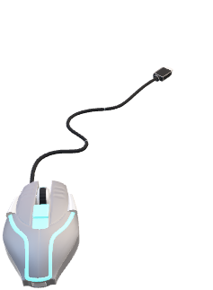
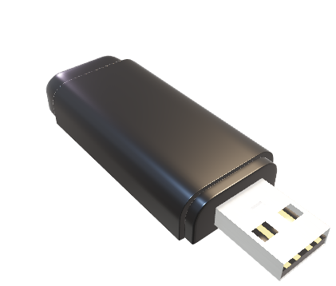
What is an interface?
Generic USB Port

Slide 2
What is an interface?
An interface is a contract that specifies the behaviour of an object
It does not specify an implementation
It is also a type defined using a set of method signatures

Slide 3
How do we create an interface ?
type <interface_name> interface { <function_name_1> <return_value> <function_name_2> <return_value> <function_name_3> <return_value> }

Slide 4
How do we implement an interface ?
Interfaces can be implemented using methods on structs
All methods declared in the interface must be implemented

