Slide 1
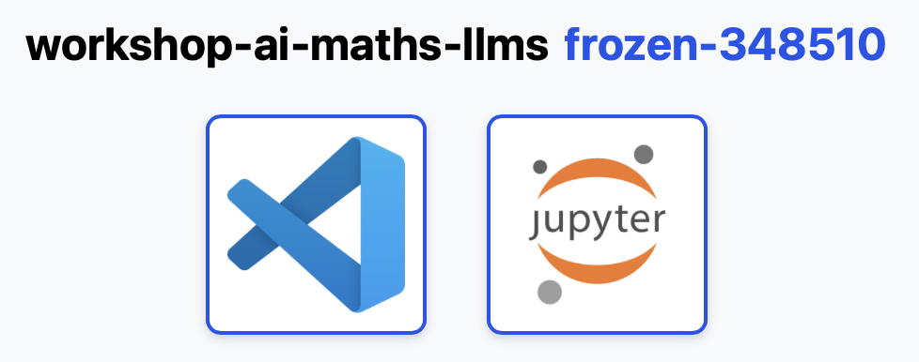


Getting Set Up
Head to pods.acceleratescience.co.uk
Username: local part of workshop registered email (e.g. fingriffin@gmail.com has username fingriffin)
Password: Acceler8
Choose IDE (VSCode or JupyterLab)
Once in the IDE, navigate to notebooks/hands_on_conjecture_engine.ipynb.
Raise your hand if you have any trouble!

