Slide 1
Applications

Slide 2
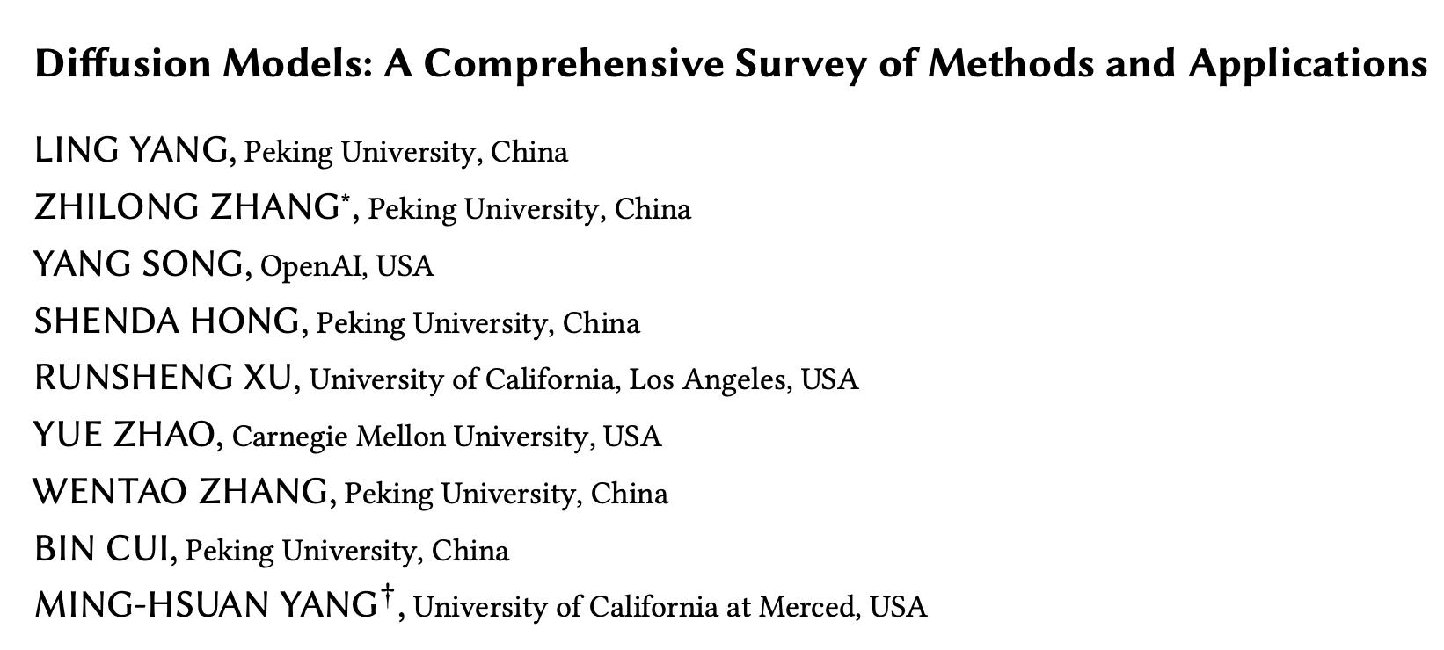
Applications
Overview
Unconditional and Conditional
Computer Vision
Segmentation
Video generation
Point clouds
Anomaly detection
Natural Language Generation
Multi-modal Generation
Text-to-something
Temporal Data Modeling
Time series imputation
Forecasting
Signal processing
Interdisciplinary
Drug design
Materials
Medical imaging
Notes:
Generally across the university I have found that people either haven’t heard of diffusion models, or they simply don’t make the connection between diffusion models and DallE, Midjourney etc.
Importantly, diffusion models are extremely flexible.

Slide 3
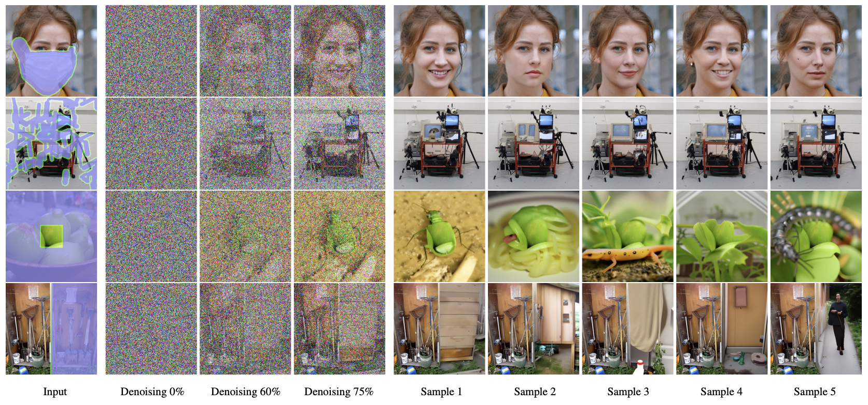
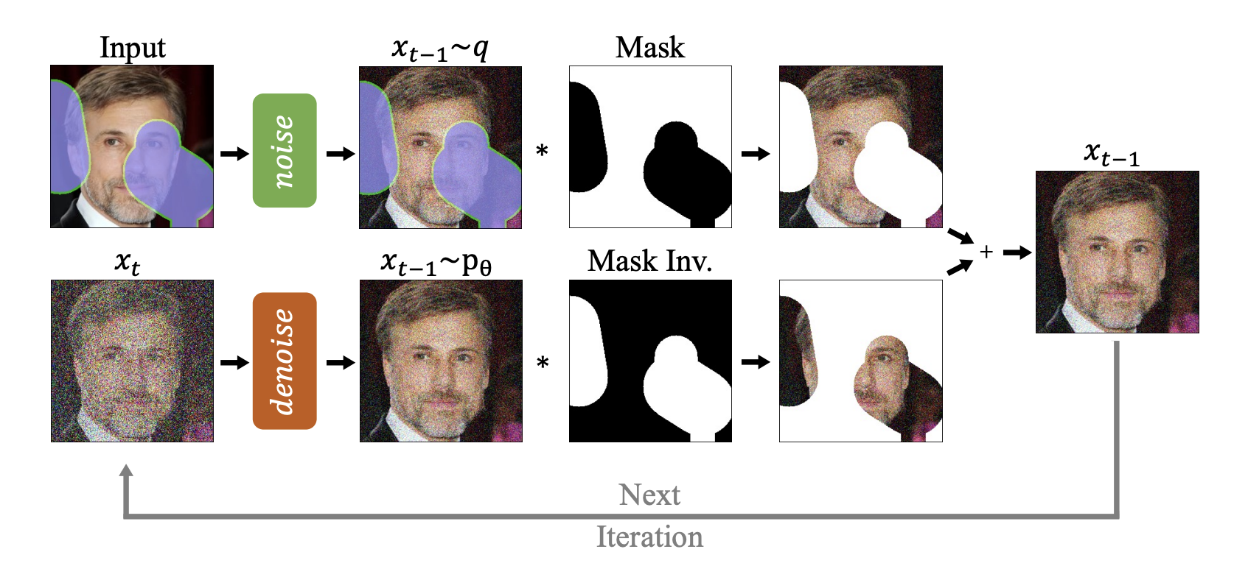
Applications
Computer Vision – inpainting
Notes:
An easy extension is inpainting. This is a feature you might have seen in the new Dall-E on ChatGPT Plus.

Slide 4
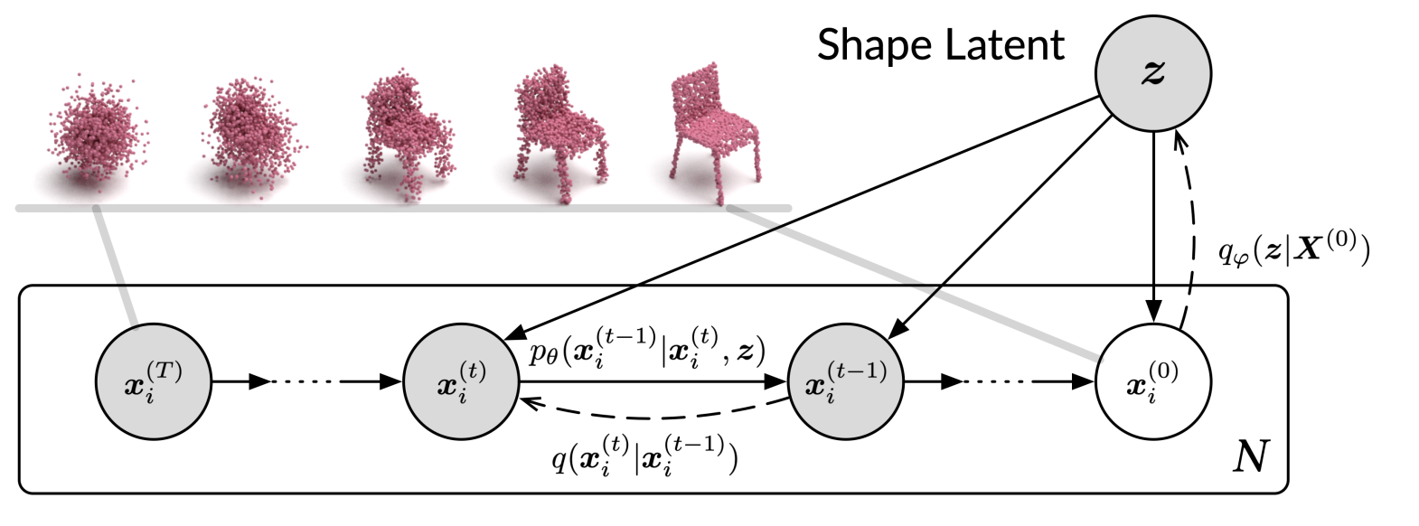
Applications
Computer vision – point cloud generation
Scans often miss information due to partial observation or occlusion.
Use diffusion models to infer missing parts.
Treat the points in a cloud as a set of particles in an evolving thermodynamic system.
Notes:
For anyone who doesn’t know, point clouds are 3D representations of real world objects

Slide 5
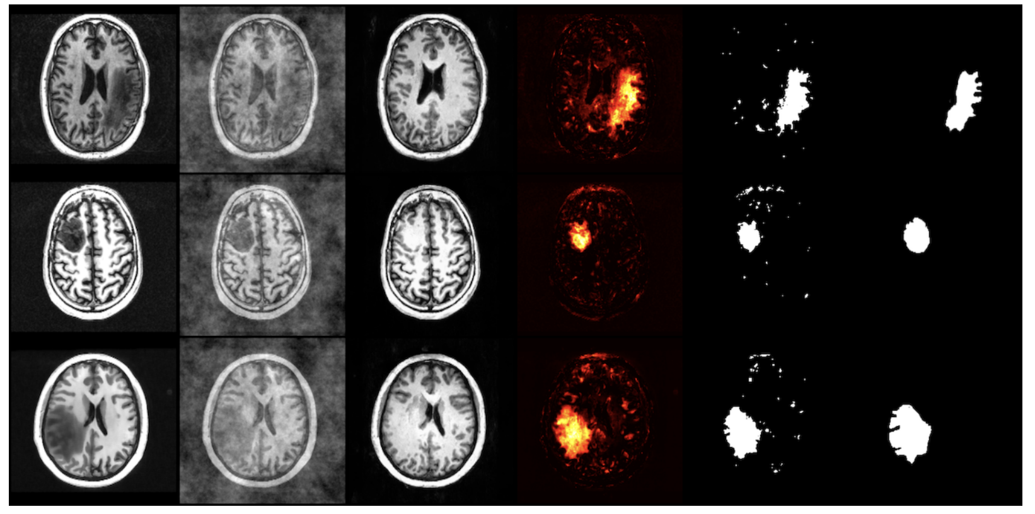
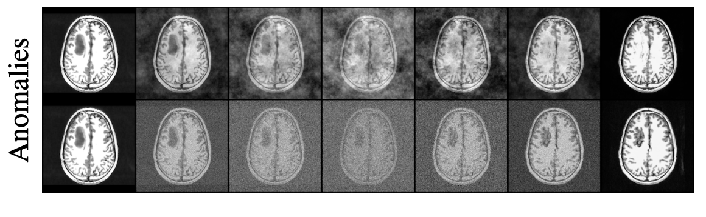
Applications
Computer vision – anomaly detection
AnoDDPM – attempt to “repair” patient data:
Instead of adding Gaussian noise, add power law noise
Notes:
Natural images have a power law distribution of frequencies.
Therefore low frequency components contribute more to the image. Gaussian noise on the other hand has a uniform spectral density. What this means is that low frequency components of partially diffused images do not become corrupted to the same degree as high frequency elements.
When you’re looking for anomalies in images this is bad, because low frequency components are interpreted as being corruption-free and therefore large anomalous regions will simply be reconstructed.

Slide 6
Applications
Natural language generation
Due to the success of ChatGPT, we tend to forget that Stable Diffusion 2 was released BEFORE GPT-4.
It is reasonable to think that there might be some good diffusion-based language models…
…but LLMs are still king in this arena
For a detailed exploration of why see:
https://sander.ai/2023/01/09/diffusion-language.html

Slide 7
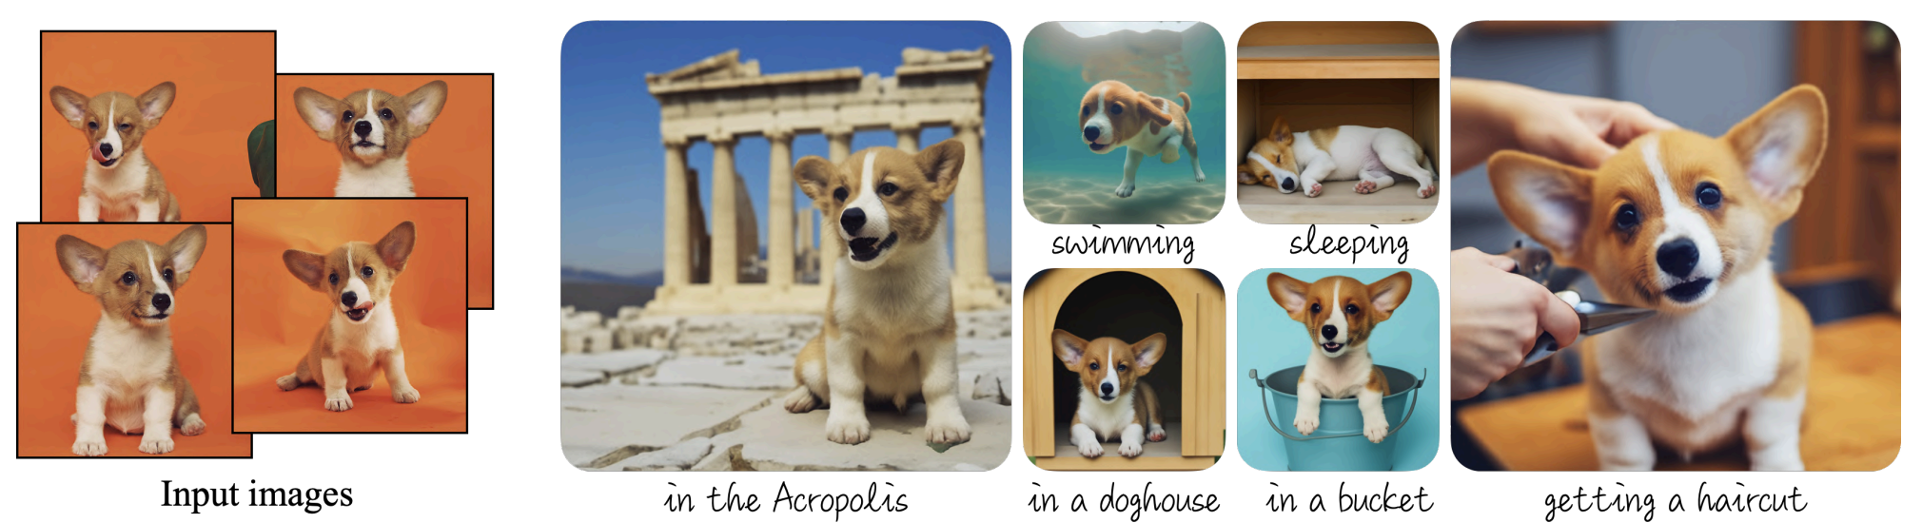
Applications
Multimodal generation – text-to-image
We already covered SD, but there are numerous other models:
DALL-E 1,2 and 3
Imagen
GLIDE
VQ-Diffusion
There are also models which build upon latent diffusion models:
DreamBooth – a method of fine tuning pretrained models

Slide 8
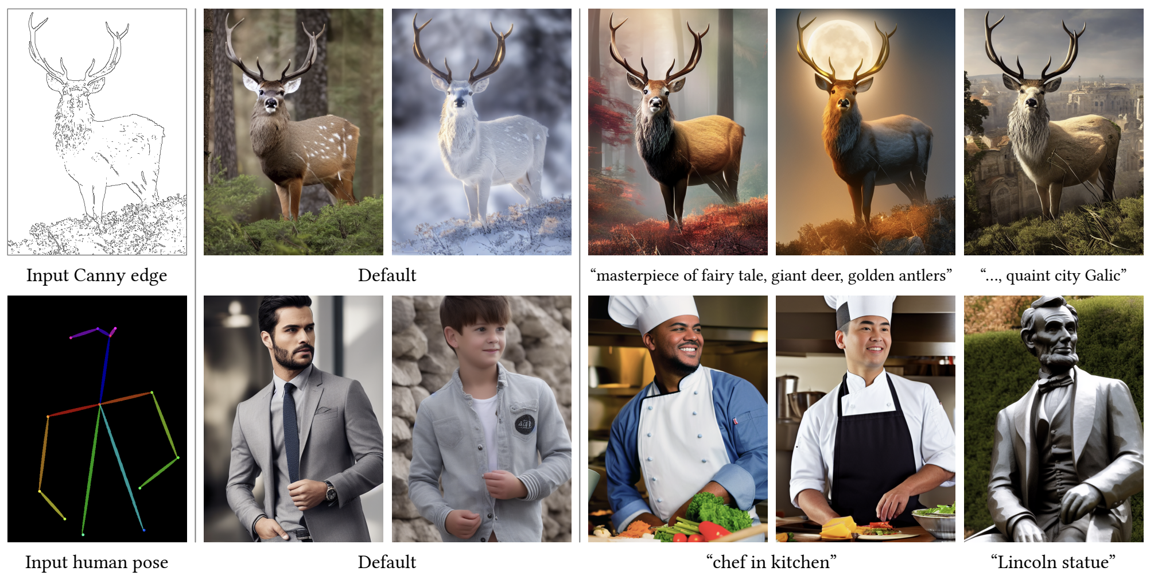
Applications
Multimodal generation – text-to-image
ControlNet – additional spatial conditioning controls:

Slide 9
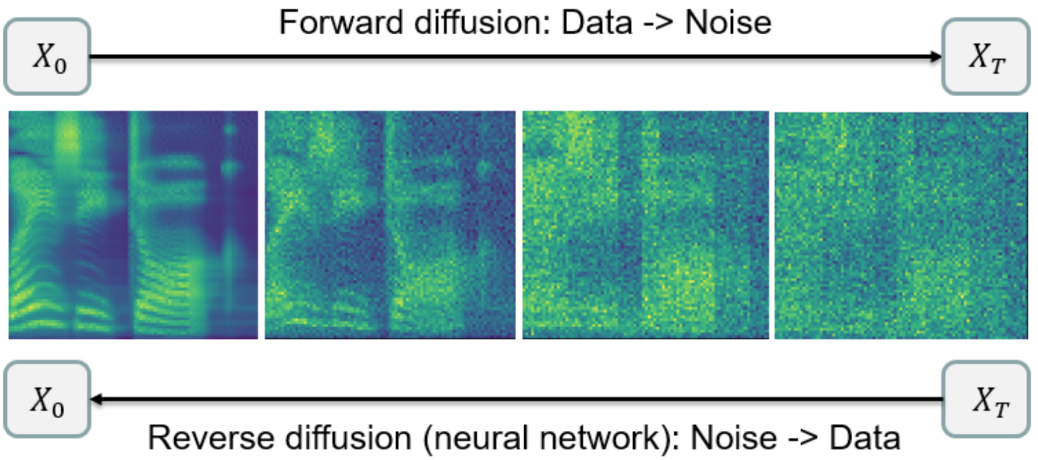
Applications
Multimodal generation – text-to-audio
Grad-TTS – text-to-speech:

Slide 10
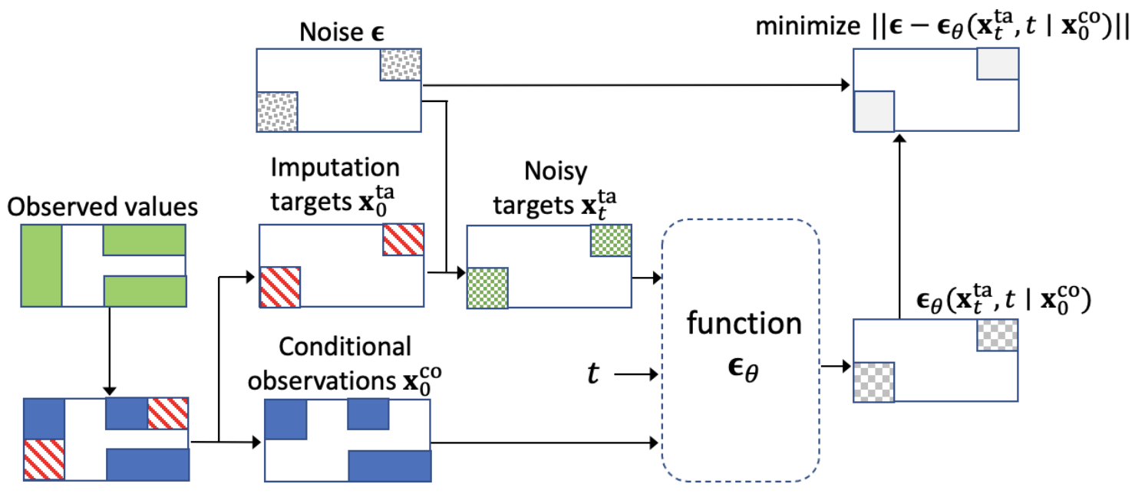
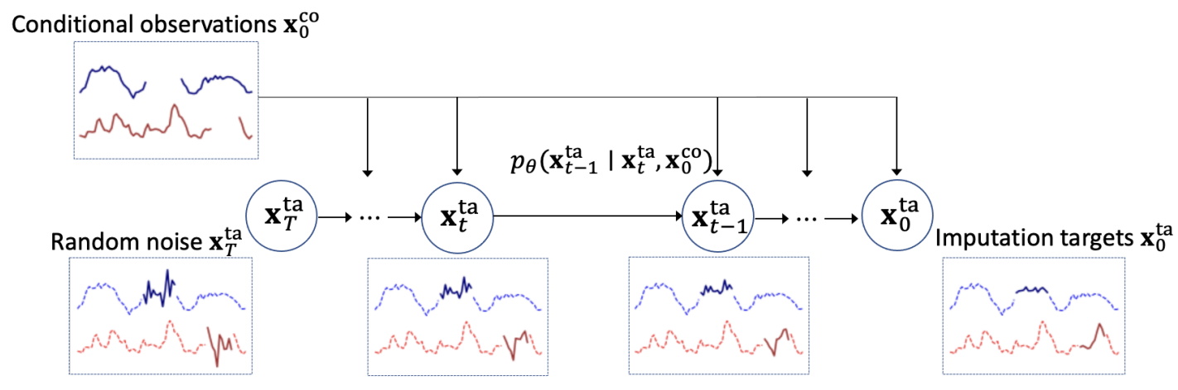
Applications
Temporal data modeling – imputation
Real world time series data often contains missing information
Imputation is the process of filling in that missing data:
Notes:
Conditional Score-based Diffusion Models for Probabilistic Time Series Imputation
Start with random noise on the left and gradually convert to a plausible time-series. Condition on observed results.
We might not have ground truth (or even missing values), so we use inspiration from masked language modelling – separate observed values into conditional information and imputation targets.

Slide 11
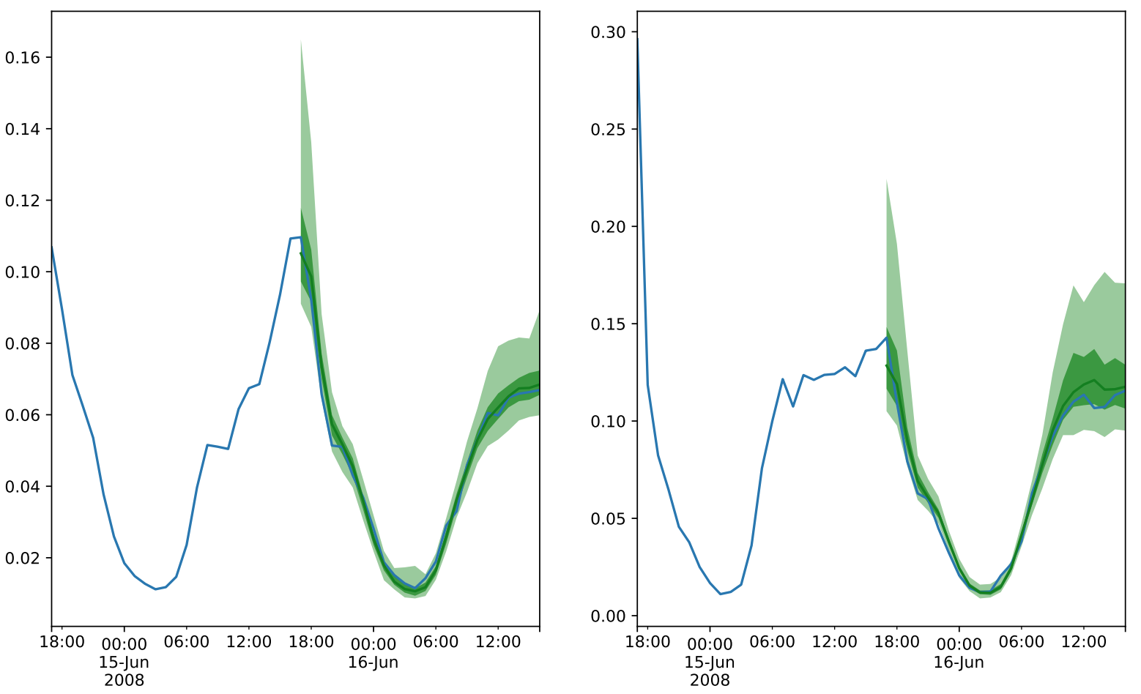
Applications
Temporal data modeling – forecasting
TimeGrad – multivariate probabilistic time series forecasting
Uses a RNN to predict traffic data…

Slide 12
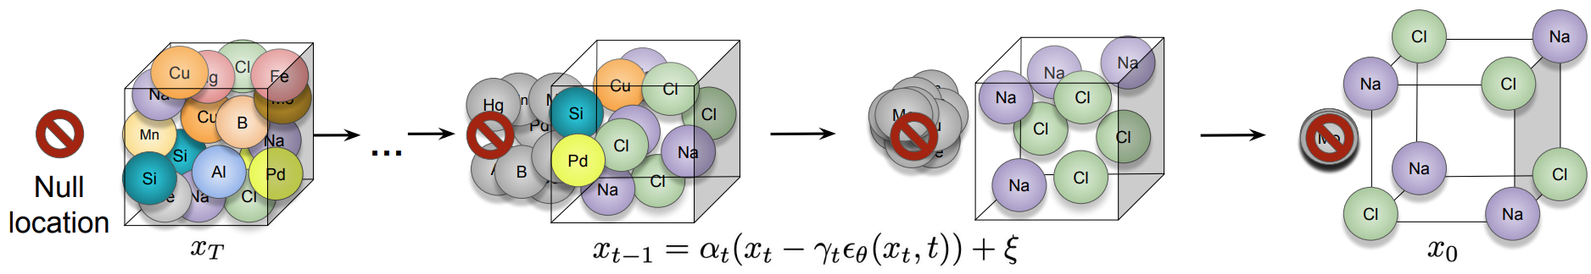
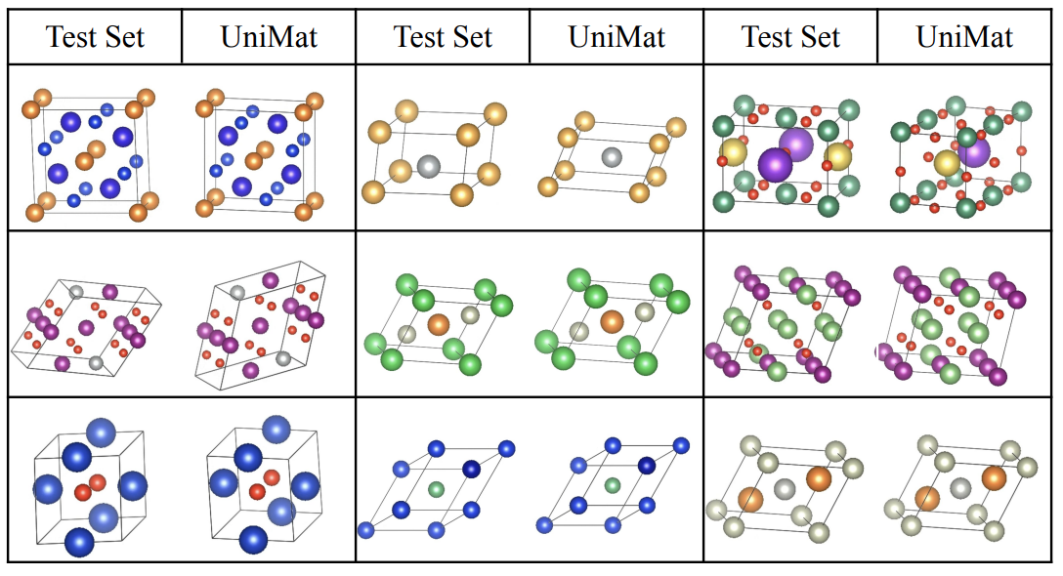
Applications
Materials
Scalable diffusion for Materials Generation, DeepMind

Slide 13
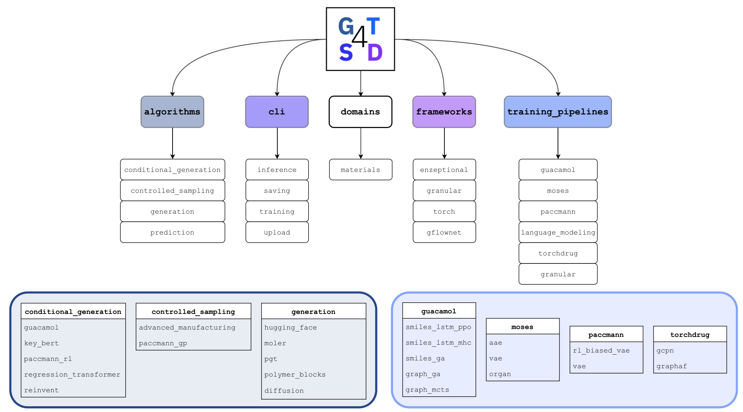
Applications
Materials
Generative toolkit for scientific discovery
Notes:
Molecular structure, text-based SMILES, or graph based
In AlphaFold 2 the final structure was realised using a Structure Module using invariant point attention. For AlphaFold 3 we replaced it with a relatively standard non-equivariant point-cloud diffusion model over all atoms (Algorithm 18 and Main Article Fig. 2b). During training, we train a denoiser to remove Gaussian noise from the positions of all heavy atoms conditioned on the features from the main trunk. The denoiser is based on a modern transformer, but with several modifications to make it more amenable to the task

Slide 14
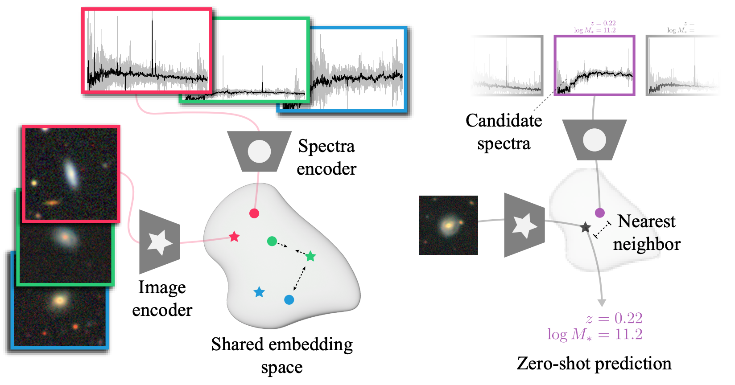
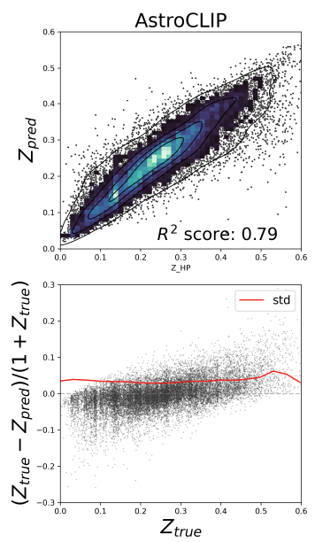
Applications
Astrophysics
AstroCLIP: A Cross-Modal Foundation Model for Galaxies, Parker et al, 2023
Notes:
Galaxy images and spectra are embedded separately by pretraining both an image and a spectrum encoder
These encoders are aligned using a cross-modal contrastive loss
They possess physically meaningful high-level information which can be used for a variety of downstream tasks on which the model was neither trained nor fine-tuned
Used for galaxy red-shift prediction

Slide 15
Evaluating Diffusion Models

Slide 16
Evaluation
How can we effectively evaluate diffusion models?
How you choose to evaluate will be heavily dependent upon the task
The maturity of the metrics will also depend on the task
Evaluation for stable diffusion models will be significantly more advanced than for almost all other fields.
For many tasks, evaluation metrics will be whatever you are familiar with
E.g. for segmentation intersection over union
For imputation RMSE

Slide 17
Evaluation
Stable Diffusion Models – qualitative methods
Involves human assessment of generated images
Quality is measured across a range of aspects:
Compositionality
Image-text alignment
Spatial relations
Outputs are measured for common prompts of varying degrees of difficulty:
DrawBench
PartiPrompts

Slide 18
Evaluation
Stable Diffusion Models – quantitative methods
Text-guided
CLIP score – measures the compatibility of image-caption pairs
Semantic similarity between image and caption
Higher CLIP score is better
CLIP score is highly correlated with human judgement
Image-conditioned
Generate an image with a prompt (e.g. “A picture of a majestic Tonkinese cat.”)
Feed image into the model with a prompt (e.g. “Make the cat into a samurai.”) to produce image A.
Feed image into the model with a second prompt (e.g. “Make the cat into a businesscat.”) to produce image B
We then look at the change in the CLIP score between image A and B and between the change in the two captions
The higher the better
We can also measure the similarity between the original image, and the changed image

Slide 19
Evaluation
Stable Diffusion Models – quantitative methods
Class-conditioned models are pretrained on a class-labeled dataset.
Frechet Inception Distance (FID)
Kernel Inception Distance
Inception Score
FID
Find the Frechet distance between Gaussians fitted to feature representations of Inception.
Use the Inception v3 model and cut off the final classification layer
Get the ImageNet dataset (or a subset of it)
Generate a bunch of images
Stuff both generated and ImageNet images into Inception and get the feature representations
Fit two Gaussians to the representations
Compute the Frechet Distance.
Notes:
FID – Measure of similarity between two datasets

