Slide 1
Introduction to diffusion models
June 2024
Accelerate Programme for Scientific Discovery

Slide 2
Welcome!
About the course
The history of generative AI
Inspiration from physics
Building blocks of diffusion
Where can you get them from
Code!
Code and slides available on:
Accelerate Science GitHub repo
Notes:
Welcome to the Large Language Model workshop.
Just briefly, we’re going to cover an overview of LLMs and how they work, what is available, and how to use them. In the course of this, we’d also like to find out more about what you are proposing to do with LLMs as well.
There will be no actual coding going on here, we’re just going to cover core concepts, but during the course of the workshop, I’ll direct you to some relevant code in the github repo.

Slide 3
Today's Schedule
Introduction to the Accelerate Science Programme
History of Generative AI
Inspiration from Physics
BREAK
Building blocks
VAEs
U-Net
CLIP
LUNCH
DDPM Algorithm
Applications
Data Ethics
BREAK
Evaluation
What’s out there?
No code
Notes:
First, an introduction to the Accelerate programme.
Introduction to LLMs –
- how do they work?
- how are they trained? Pretraining.
- what can we use them for.
- Caveats and popular opinion
What’s out there:
- Where can you get models from?
- What does OpenAI have on offer?
- Open source vs closed source.
- No code solutions
Fine-tuning and quantization
- Methods of fine-tuning
- RAG
- Instruction tuning
- Other tasks
APIs
– How to use the HuggingFace API.
- How to use the OpenAI API.

Slide 4
Accelerate Science Programme
"Accelerate Science pursues research at the interface of AI and the sciences, generating new scientific insights and developing AI methods that can be deployed to advance scientific knowledge."
Notes:
A brief overview of the Accelerate program.
Essentially, our driving goal is to help researchers use AI in their research. It says here that we pursue research at the interface of AI and Science, and you might think that this is limited to the typical STEM subjects, but actually it isn’t. We’re finding more and more that researchers from the Humanities want to utilize machine learning methods, and we’re having to reassess what we think of as traditional science.
We are ultimately here to facilitate this process of integrating AI into research.
Just a brief about us:
I come from a Physics background, where I worked in condensed matter, thin films, and nano and atomic scale devices, and using novel devices to do machine learning. So I approached machine learning from the direction of a researcher with some coding knowledge, but then machine learning and software engineering gradually took over my life. Over the last year, about 90% of my work has been large language model focused.

Slide 5
Accelerate Science Programme
LLM Workshop Goals
We want to:
Support researchers across the university to use AI – that’s diffusion models in this group.
Better understand the challenges that researchers face.
Identify what training courses or software resources we might want the Accelerate Science Programme to create.
Including shared code
Start to build a community of like-minded researchers across the university.
Notes:
At the end of this course, you’ll have the opportunity to provide us with feedback, which is very important to us. If you could take the time to fill it out, then we really would appreciate it.

Slide 6
History of Generative AI

Slide 7
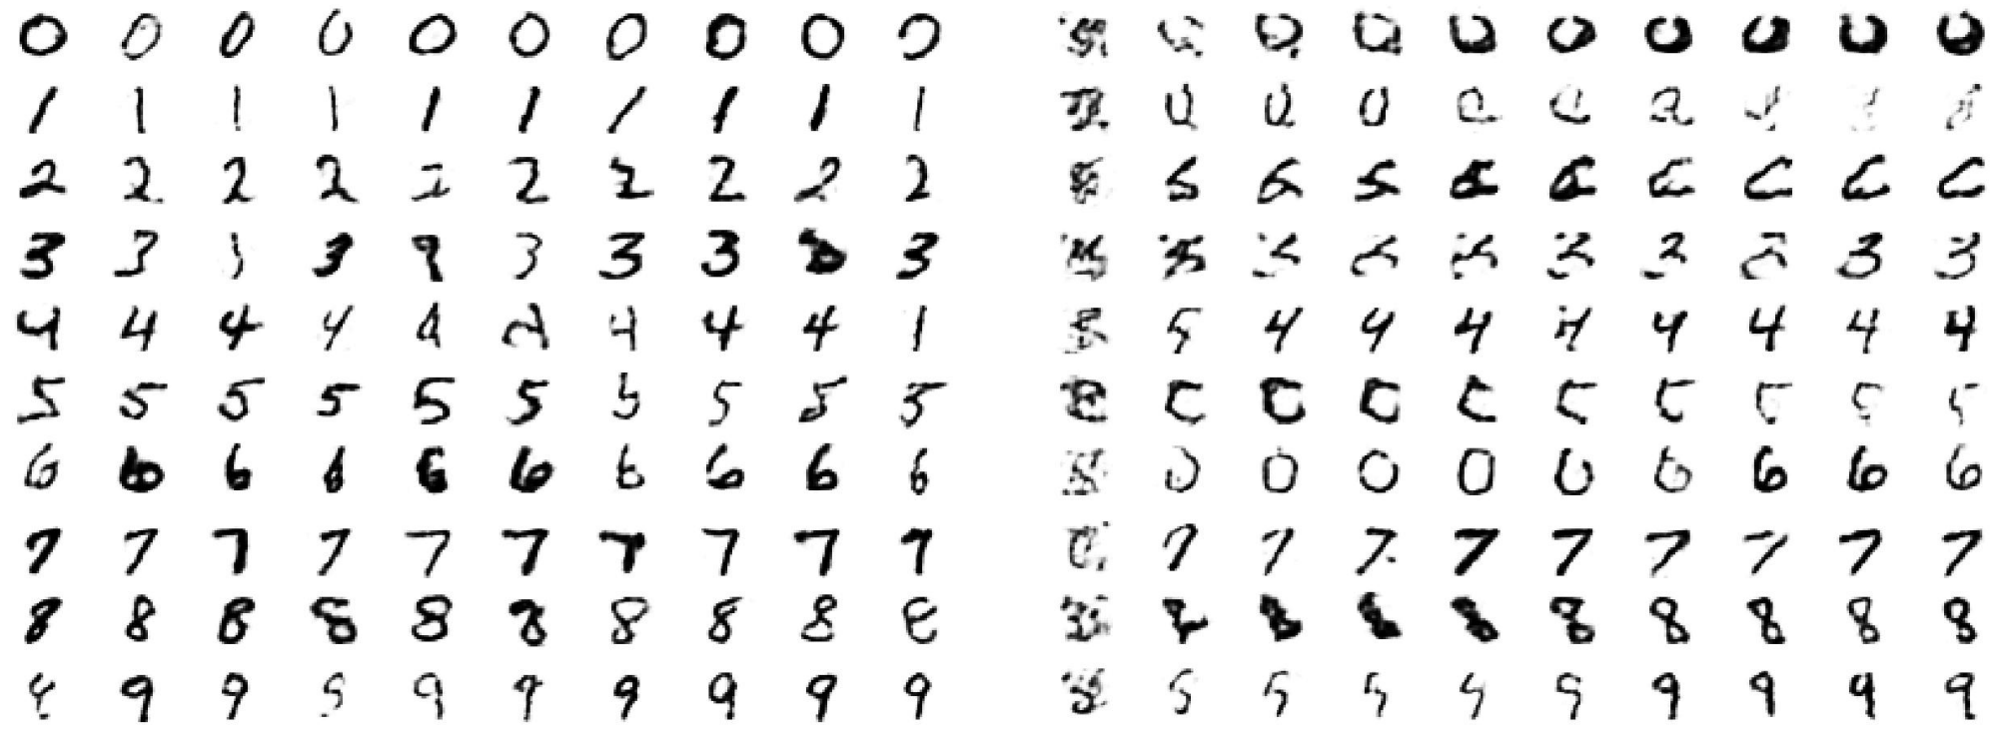
History of Generative AI
GenAI as we know it today really began in the mid 2000s
“A fast learning algorithm for deep belief nets”, 2006, Hinton et al ~ 21k citations
Restricted Boltzmann machines
Hinton, Geoffrey E., Simon Osindero, and Yee-Whye Teh. "A fast learning algorithm for deep belief nets." Neural computation 18.7 (2006): 1527-1554.
Notes:
GenAI interest began to grow in the mid-late 2000s. Geoffrey Hinton revitalized the RBM in 2006 to produce some handwritten digits.

Slide 8
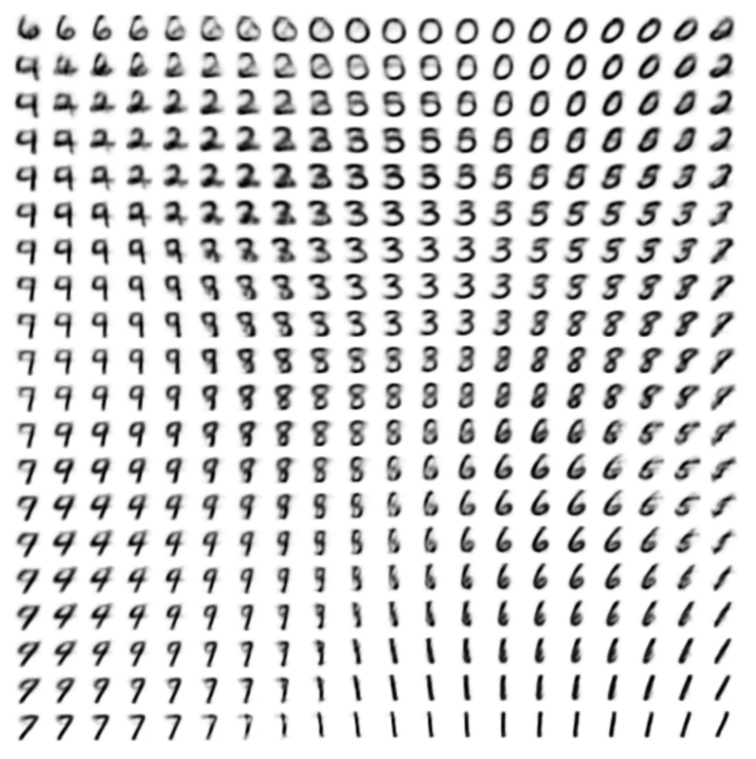
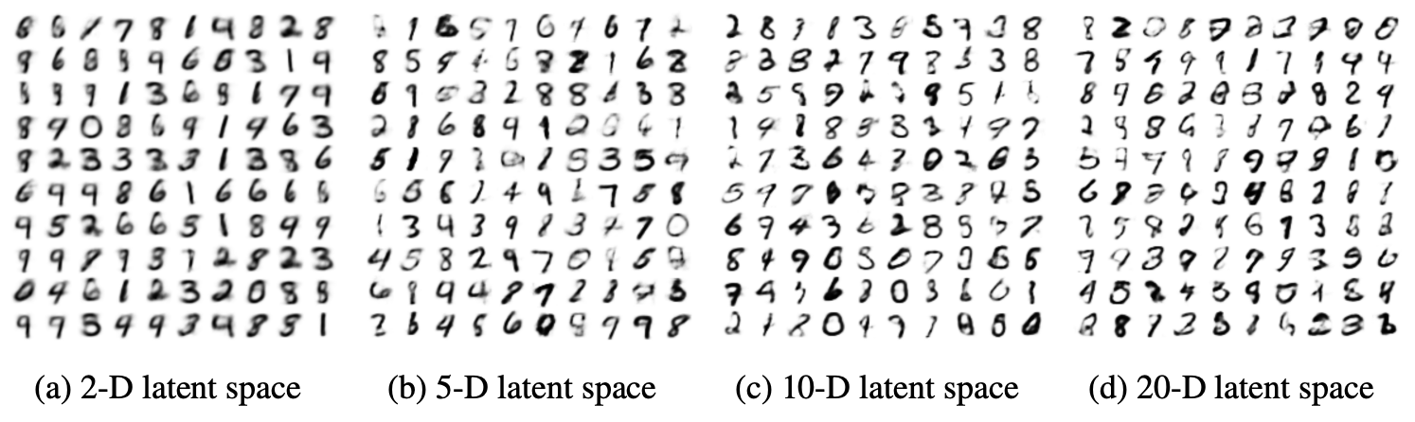
History of Generative AI
Variational Autoencoders
“Auto-Encoding Variational Bayes” Kingma & Weilling, 2013, ~ 36k citations
Connect an encoder and decoder via a probabilistic latent space
We will talk more about this later…
Kingma, Diederik P., and Max Welling. "Auto-encoding variational bayes." arXiv preprint arXiv:1312.6114 (2013).

Slide 9
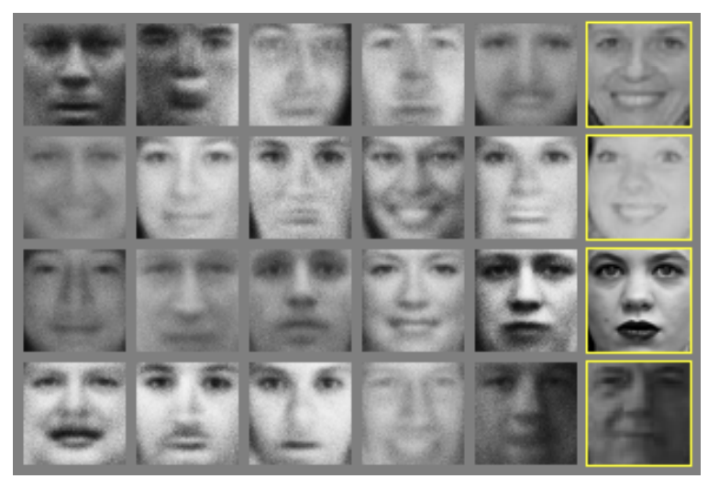
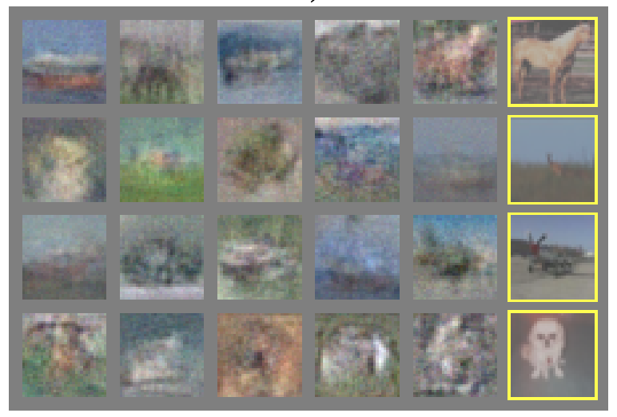
History of Generative AI
Generative Adversarial Networks (GANs)
Generative Adversarial Networks, 2014, Goodfellow et al, ~67k citations
Goodfellow, Ian, et al. "Generative adversarial nets." Advances in neural information processing systems 27 (2014).
Notes:
Then in 2014, we had the Generative Adversarial Network. For a while, GANs reigned supreme

Slide 10
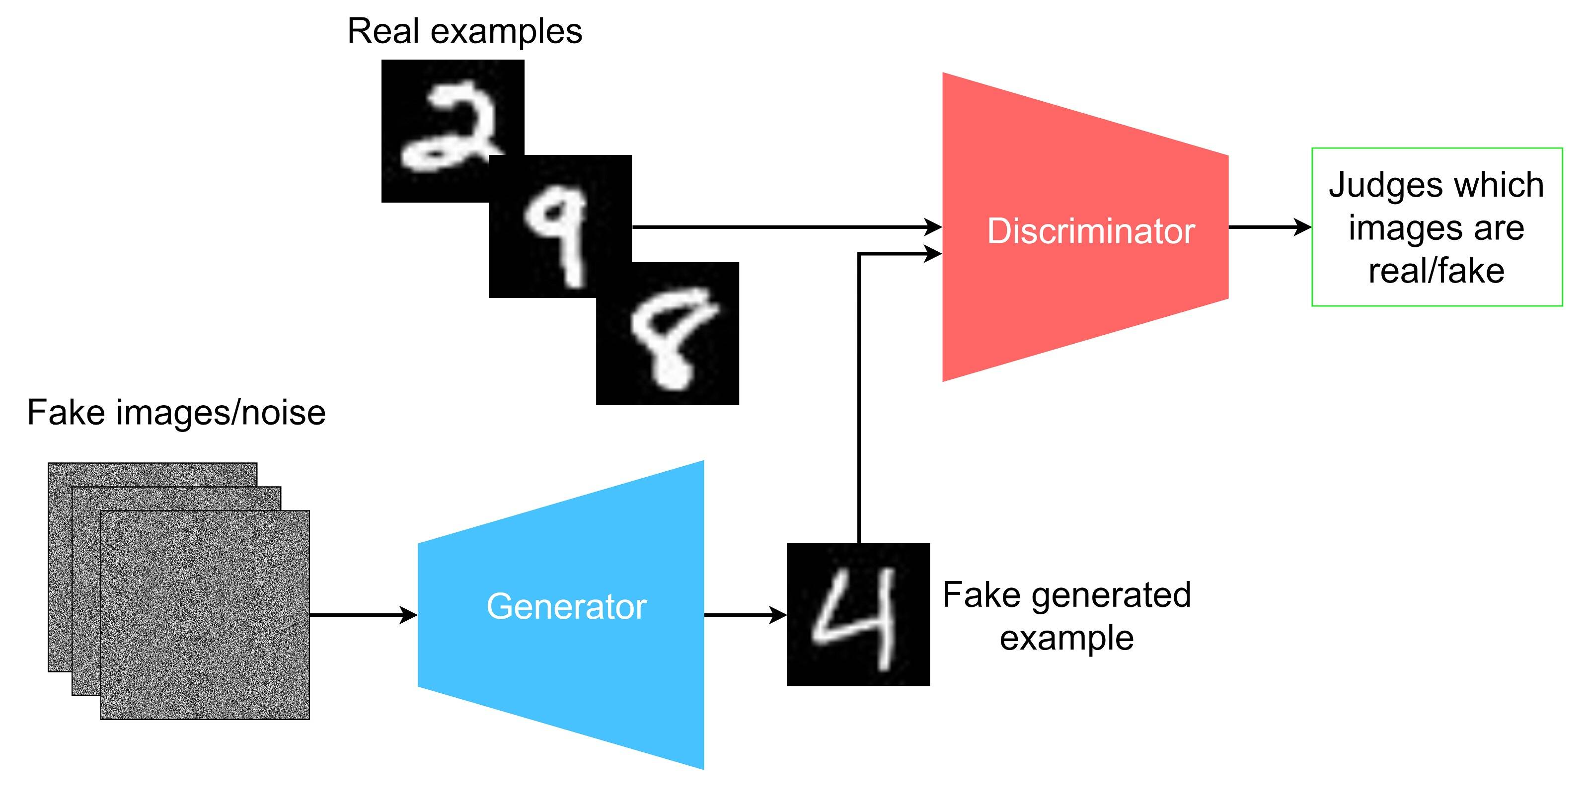
History of Generative AI
GANs
https://developer.ibm.com/articles/generative-adversarial-networks-explained/
Notes:
GANs consist of two networks: a generator and a discriminator.
The job of the generator is to take noise and turn it into images. The job of the discriminator is to tell the difference between the fakes and the reals. So at the end of training, you now have two models: one that is useful for generating fake images, and another that is good at detecting fake images.
The discriminator is usually a binary classifier.
The generator aims to implicitely model the data distribution.
Overview of the training process
Get a batch of real images and labels (all ones)
Pass the real images through the discriminator and get the predicted labels
D_loss_real = BCELoss(real_predicted, real_labels)
Generate random noise in latent space
Pass it into the generator and get some fake images
Pass the fake images through the discriminator and get the predicted labels
D_loss_fake = BCELoss(fake_predicted, fake_labels)
Total loss = D_loss_real + D_loss_fake
Use this loss to adjust the discriminator
We now need to train G to fool D.
Generate fake data, and feed it into D.
BCELoss(fake_predicted, real_labels)
Propogate this loss through G.
So we have two distinct training steps, one for the discriminator and one for the generator. In the first step, the discriminator is presented with the correct labels, because we want it to be good at detecting fakes and real. At this stage, the generator is not updated.
The second training stage is for the generator – the discriminator is fed only generated data all labeled real. The discriminator is not updated.

Slide 11
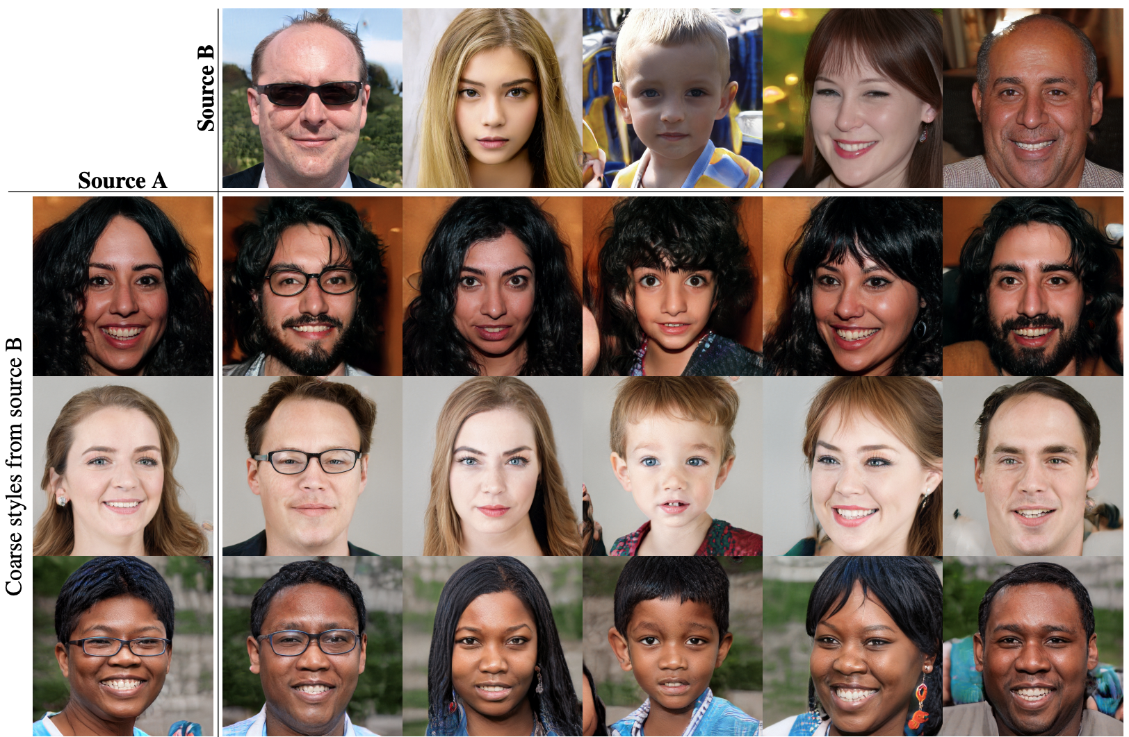
History of Generative AI
GANs
They quickly advanced…
Karras, Tero, Samuli Laine, and Timo Aila. "A style-based generator architecture for generative adversarial networks."
Proceedings of the IEEE/CVF conference on computer vision and pattern recognition. 2019.
Notes:
This is from StyleGAN paper from Nvidia.
A Style-Based Generator Architecture for Generative Adversarial Networks, Karras et al 2019 ~10k citations
Numerous sub-types including CycleGAN and StyleGAN. This is when deepfakes started to become a real issue.

Slide 12
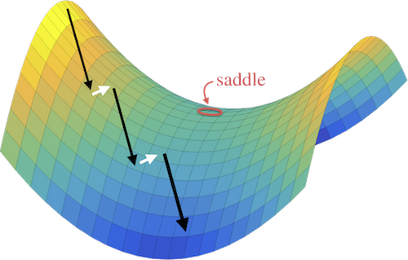
History of Generative AI
GANs
Training GANs is hard
We want to find a point on a saddle that is a minimum about the generator, and a maximum about the discriminator.
We can inject noise into the discriminator using a noise schedule determined by a diffusion model.
Subject to mode collapse
Min, Zhiyu. “Generative adversarial networks, Wasserstein distance and adversarial loss.” Alibaba AliMe X-Lab
Notes:
Mode Collapse – when the GAN learns to map several different input values to same output point

Slide 13
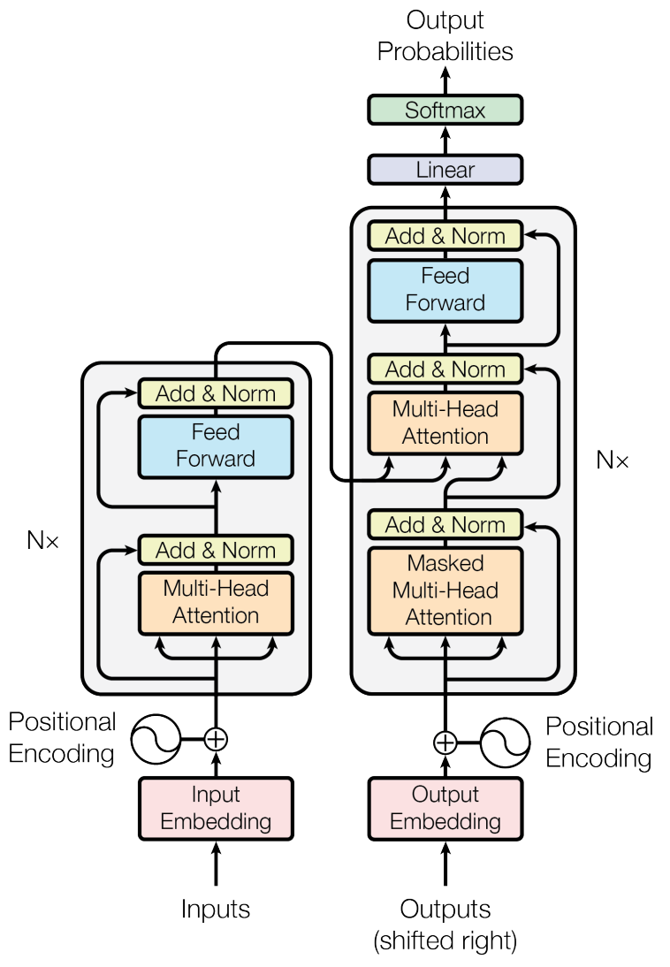

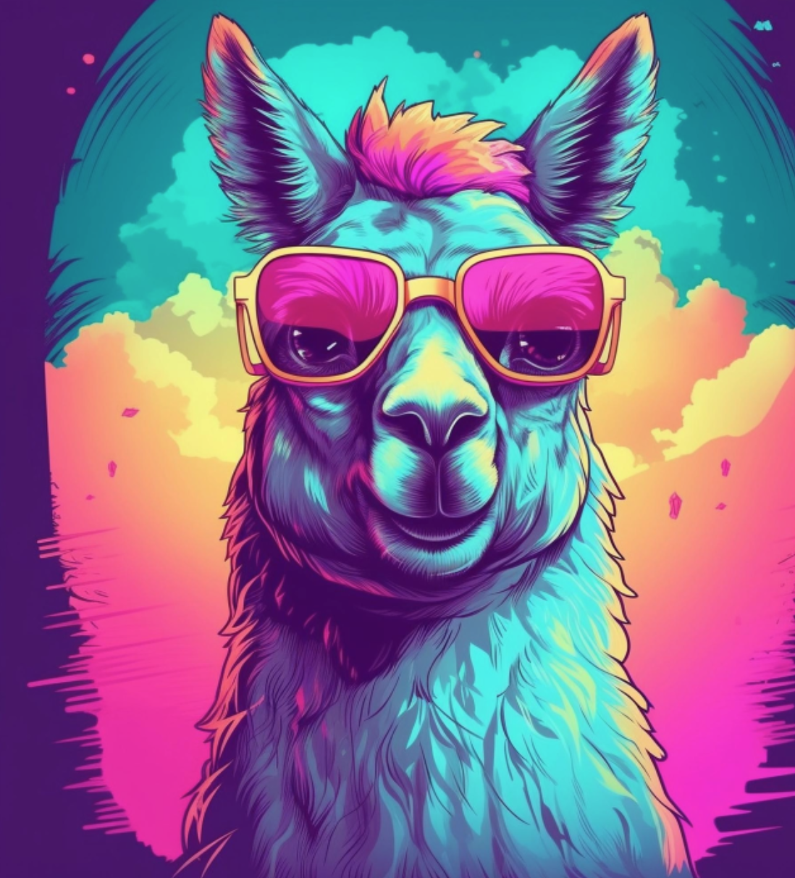
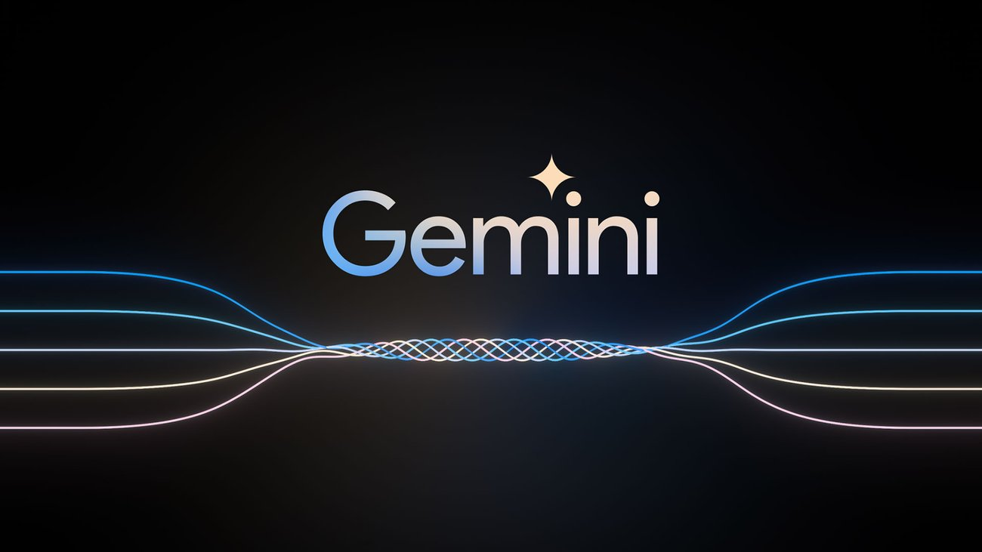
History of Generative AI
We know what has been dominating this space…
“Attention is all you need”, Vaswani et al, 2017, ~ 125k citations
Introduced scaled dot-produce attention and the transformer architecture
Notes:
In 2017, we were introduced to scaled dot product attention.
Since the release of GPT-3.5 in late 2022, and GPT-4 in early 2023, LLMs have dominated the AI landscape.

Slide 14
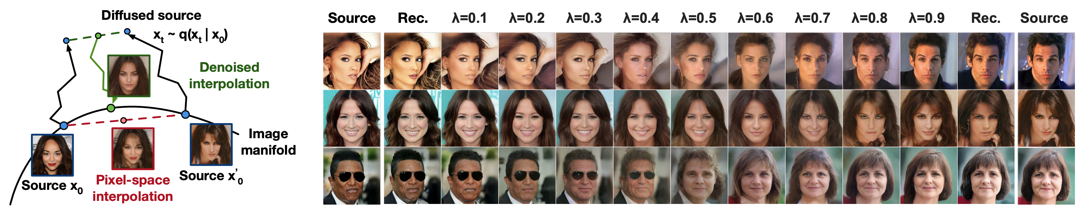
History of Generative AI
Diffusion
Deep unsupervised learning using nonequilibrium thermodynamics, Sohl-Dickstein et al, 2015, ~ 5k citations
Denoising diffusion probabilistic models (DDPM), Ho et al, 2020 ~ 10k citations
High-resolution image synthesis with latent diffusion models, Rombach et al 2022, ~ 8k citations

