Slide 1
DDPM

Slide 2
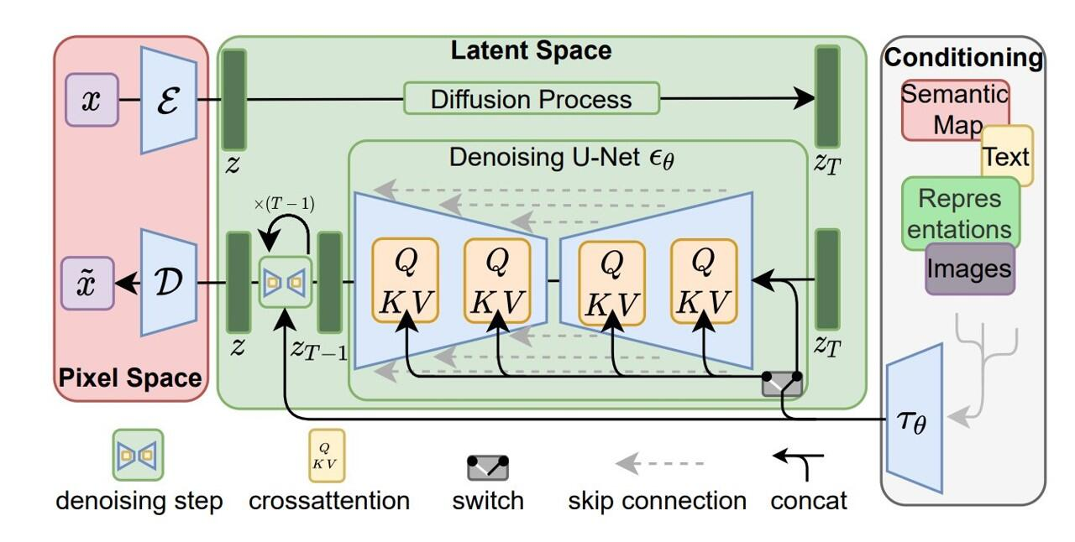





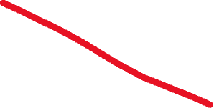
Diffusion
Back to this…
Notes:
We’ve covered these items, so now let’s think about the process itself, and how all of these are combined.

Slide 3
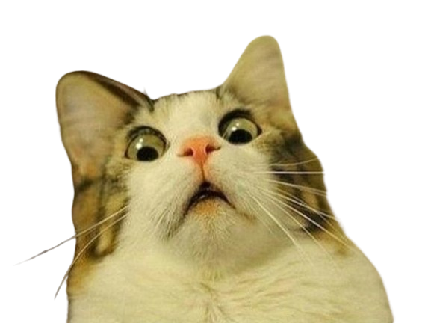
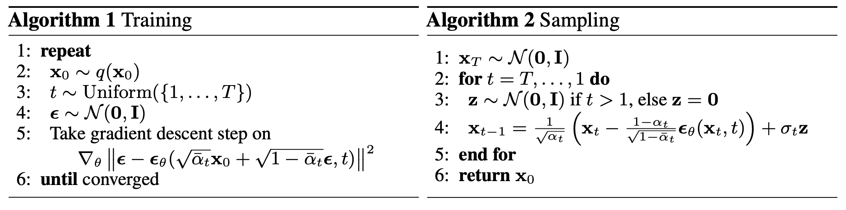
Diffusion
Here is the algorithm for diffusion…
Notes:
Let’s return to this.

Slide 4
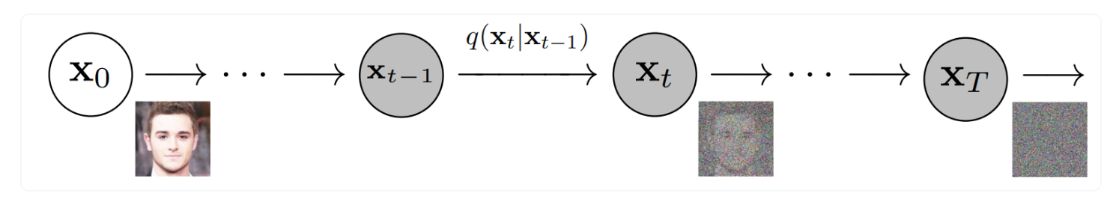
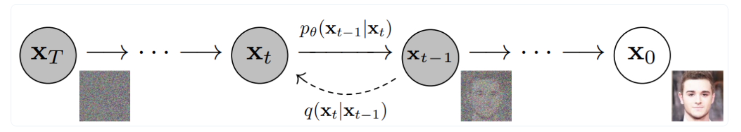
Diffusion
Diffusion models have a forward process and a reverse process...
Forward:
Reverse:
Notes:
In the forward process, noise is gradually added to an image until it becomes blurry, effectively simulating the process of milk diffusing through the coffee.
In the reverse process, we train a model to DENOISE the image gradually until we get back to a complicated distribution.
The key trick is learning this backward process

Slide 5
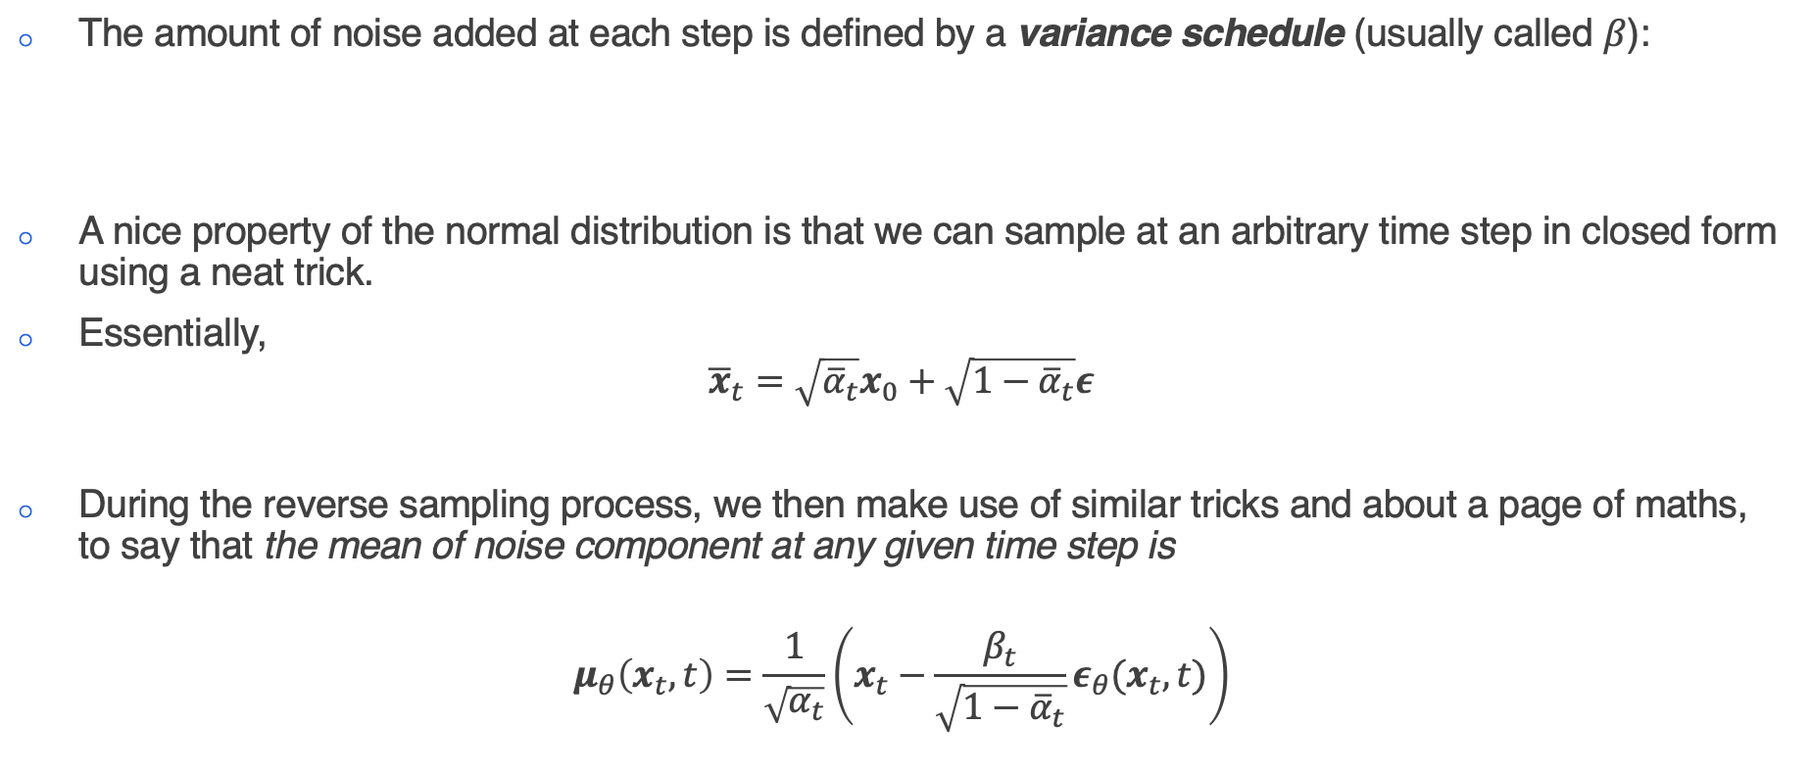
Diffusion
The choice of distribution makes a few things easy for us...
The amount of noise added at each step is defined by a variance schedule (usually called $β$):
A nice property of the normal distribution is that we can sample at an arbitrary time step in closed form using a neat trick.
Essentially,
$${\overline{x}}_{t}=\sqrt{{\overline{α}}_{t}}x_{0}+\sqrt{1−{\overline{α}}_{t}}ε$$
During the reverse sampling process, we then make use of similar tricks and about a page of maths, to say that the mean of noise component at any given time step is
$$μ_{θ}\left(x_{t},t\right)=\frac{1}{\sqrt{α_{t}}}\left(x_{t}−\frac{β_{t}}{\sqrt{1−{\overline{α}}_{t}}}ε_{θ}(x_{t},t)\right)$$
Notes:
Alpha = 1 – beta
Alpha_bar = product of alphas up to this time step
Importantly, we are not adding noise to an image, we are gradually making an image noisier.
Looking at the forward process equation: xₜ = √αₜxₜ₋₁ + √(1-αₜ)ε
Multiplicative Part: √αₜxₜ₋₁
We multiply the previous state by √αₜ
This dampens/scales down the signal
This is why clean data gradually fades away
Additive Part: √(1-αₜ)ε
We add Gaussian noise scaled by √(1-αₜ)
This adds new randomness at each step
The practical difference is crucial:
Pure additive noise would just add more and more noise on top
Pure multiplicative noise would just keep scaling the image down
The combination ensures:
The signal gradually fades (multiplication)
While being replaced by standard Gaussian noise (addition)
The total variance stays normalized (√αₜ and √(1-αₜ) terms sum to 1)
This is why we need the product of alphas - we're tracking how much the original signal has been dampened through multiple multiplication steps, not just how much noise has been added.
And now the reverse process
The μθ represents the mean of the reverse distribution q(xₜ₋₁|xₜ)

Slide 6
Diffusion
What does this mean?
We now know that we can simply take a random image, and add an amount of noise according to our variance schedule.
Instead of having our model predict exactly what the image is (i.e. denoise in one step), we have the model predict the amount of noise added at a particular timestep.
We then subtract this noise from the image, resulting in a slightly less noisy image.
During training, we are ensuring that the model pays very careful attention to when only a very little amount of noise is added, and takes small steps, whereas when much noise is added, we want to model to take bigger steps.
During sample, when we subtract noise from the image, we reinsert the less noisy image back into the model and repeat the process for a certain number of steps.

Slide 7
Diffusion
Here is the algorithm for diffusion…again…
Notes:
Let’s return to this, and walk through step-by-step:
2. Get your original image. This image is the image you have at t = 0.
3. Draw a random timestep.
4. Generate some pure Gaussian Noise.
5.
a. Get the variance that corresponds to the timestep t, and add that amount of noise to your original image.
b. Pass this noisy image, along with t into your U-Net. This will predict the amount of noise added.
c. Find the loss between the predicted added noise, and the total noise.
Why do we calculate the loss on the TOTAL noise? Because it makes the low noise prediction more important – the model should care A LOT about the loss when the predicted noise is low.
In practice, during training you would pick a noise level and then apply a single noise level to multiple images.
Most of our choices in diffusion models is about estimating gradients better. Training every noise level is costly and you don’t have unlimited batch space. We want gradients that are estimating the whole dataset, not a single image.
For sampling:
Get random noise
For each timestep, in reverse
Generate a separate random noise vector if we’re not at the last timestep
Put the noisy image into the model, along with the timestep in order to estimate the noise added.
Scale the estimated noise in reverse to how we scaled it for training
Subtract the noise added at this step from the total noise to get a slightly denoised image
When we hit t = 0, we should have a generated image.

Slide 8
Diffusion
Perhaps this makes more sense now…

Slide 9
Diffusion
Diffusion model paradigms – (un)conditional and classifier(-free)
When we talk about “conditioning” a model, we are usually referring to additional information fed to the model
Unconditional generation is simply following the DDPM algorithm with no text labels.
But we can also just generate content without any guidance – this is unconditional generation
There are a few main types of conditioning mechanisms:
Concatenation
Gradient-based
Cross-attention
Classifier vs classifier-free
Classifier – train an additional classifier to guide the model.
Complicated, begin to approach GANs.
Classifier-free – mix the score estimates of a conditional model and an unconditional model.
Notes:
Before we look at applications, I’d just like to highlight two important ways of using diffusion models – unconditional vs conditional generation.
Concatenation Exactly like it sounds – you take your additional information and concatenate it with intermediate denoised targets in the diffusion process.
Gradient Incorporates a task related gradient. For example, you might have a diffusion model, and then train an additional classifier on noisy images. You then use the gradients to guide the diffusion process towards an arbitrary class label.
Cross-attention Attentional message passing between the guidance and diffusion targets. Usually conducted in a layerwise manner. If you remember back to the architecture of SD, we had these cross attention connections from the guidance process to the layers of Unet.
AdaLN Adaptive normalization layers.
We might want to introduce class information to our model. For example, suppose we are training a model to generate hand-written digits. We might pass in the class label as a feature by concatenating it with the feature maps. But it will only have a weak effect on the model.
Instead we can just train an additional classifier model. At every step of the diffusion process, we just have the model guess the class, and then add the loss to the loss calculation of the diffusion model.

Slide 10
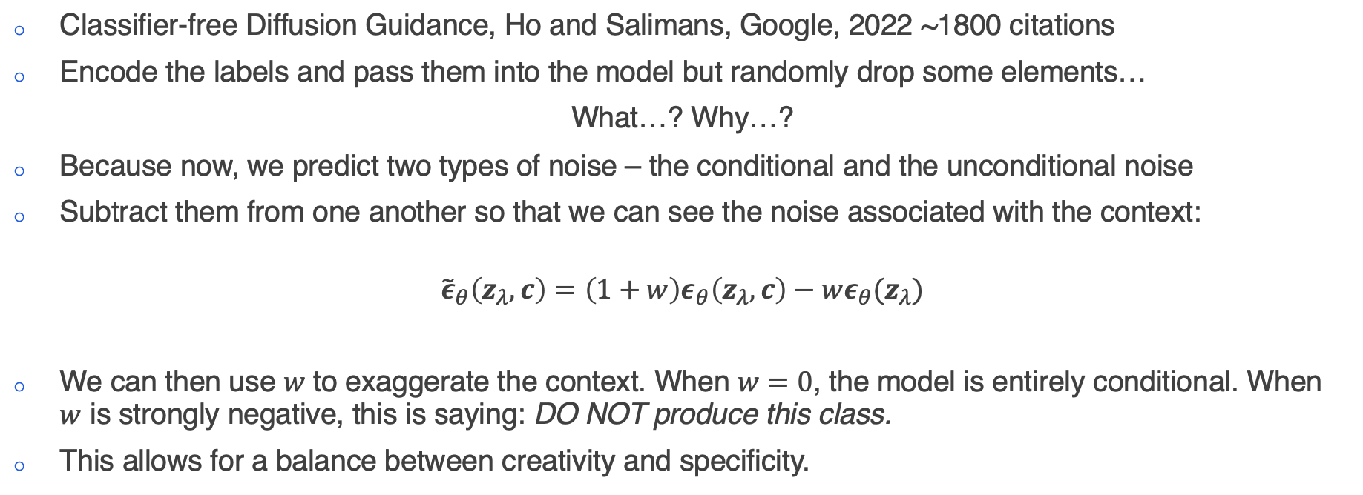
Diffusion
Classifier-free Guidance
Classifier-free Diffusion Guidance, Ho and Salimans, Google, 2022 ~1800 citations
Encode the labels and pass them into the model but randomly drop some elements…
What…? Why…?
Because now, we predict two types of noise – the conditional and the unconditional noise
Subtract them from one another so that we can see the noise associated with the context:
$${\tilde{ε}}_{θ}\left(z_{λ},c\right)=\left(1+w\right)ε_{θ}\left(z_{λ},c\right)−wε_{θ}(z_{λ})$$
We can then use $w$ to exaggerate the context. When $w=0$, the model is entirely conditional. When $w$ is strongly negative, this is saying: DO NOT produce this class.
This allows for a balance between creativity and specificity.
Notes:
Before we look at applications, I’d just like to highlight two important ways of using diffusion models – unconditional vs conditional generation.
Concatenation Exactly like it sounds – you take your additional information and concatenate it with intermediate denoised targets in the diffusion process.
Gradient Incorporates a task related gradient. For example, you might have a diffusion model, and then train an additional classifier on noisy images. You then use the gradients to guide the diffusion process towards an arbitrary class label.
Cross-attention Attentional message passing between the guidance and diffusion targets. Usually conducted in a layerwise manner. If you remember back to the architecture of SD, we had these cross attention connections from the guidance process to the layers of Unet.
AdaLN Adaptive normalization layers.
We might want to introduce class information to our model. For example, suppose we are training a model to generate hand-written digits. We might pass in the class label as a feature by concatenating it with the feature maps. But it will only have a weak effect on the model.
Instead we can just train an additional classifier model. At every step of the diffusion process, we just have the model guess the class, and then add the loss to the loss calculation of the diffusion model.
In classifier free guidance, we will still pass the labels into the model, via an encoding, but now we are going to drop elements from that encoding. Why

