Slide 1
Inspiration from Physics
Notes:
[TIMINGS]
Practice: 20m
Target: 20m
Start time: 10:10
End time: 10:30
[BREAK]
---

Slide 2
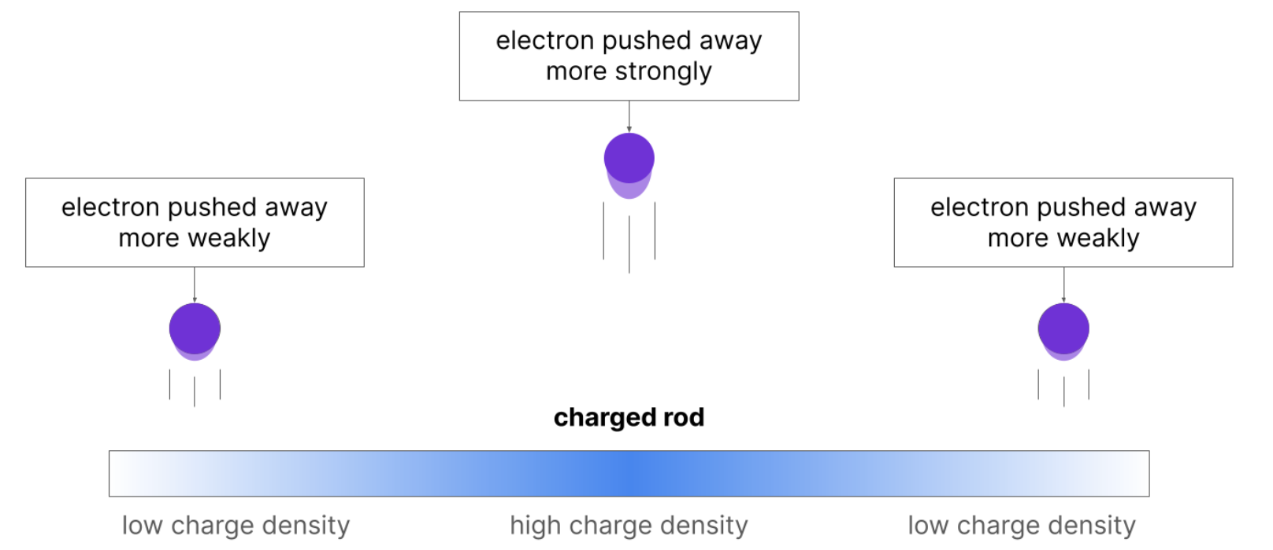
Inspiration from Physics
Charge distributions
Charge distributions are objects that have different amounts of charge depending on where you are on the object.
High negative charge repels electrons strongly, low negative charge repels electrons weakly:
Notes:
Imagine a charge distribution in some object, like a stick in this case.
You might have some large amount of charge in the center of the stick, gradually getting less and less the further out you go.

Slide 3
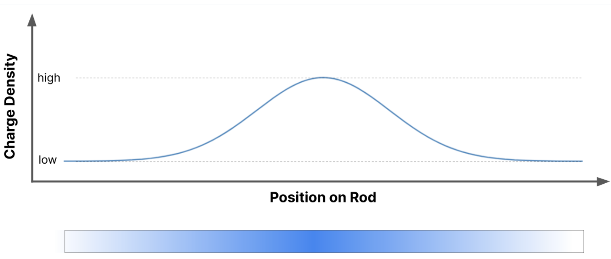
Inspiration from Physics
Charge distributions
If we plot the distribution in the previous slide, we get this distribution – a Gaussian.
Notes:
If you plot location on the x-axis, and charge density on the y-axis, you get this kind of distribution – high charge in the middle, gradually tapering off towards the ends.

Slide 4
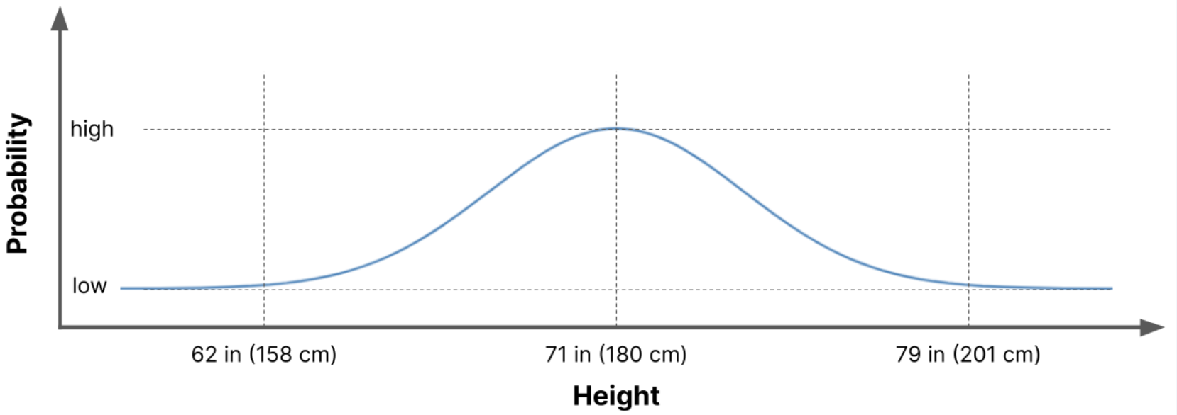
Inspiration from Physics
Probability distributions
Instead of charge density, we can look at how likely the value of something is
This probability density distribution shows the height of human males:
Notes:
Instead of thinking about charge, think about the height of human males. You take a sample of 1 million males, and measure their height. You then define bin sizes, and then you think about how many people fall within a set bin, this is the type of curve you would get.
We call this curve a Gaussian.
The good thing about this distribution, is that you can describe it using only two numbers: the mean and std deviation.

Slide 5
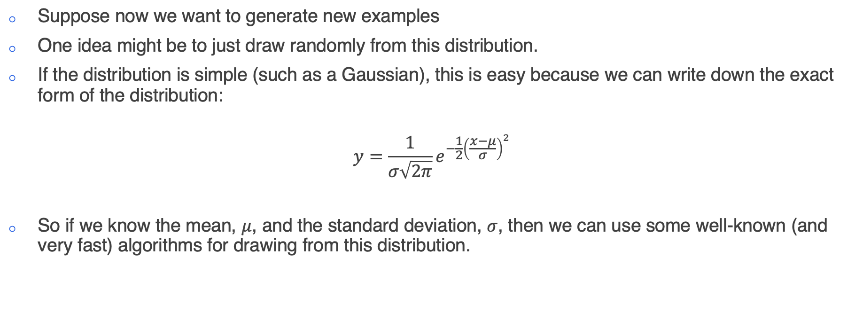
Inspiration from Physics
Generating new data
Suppose now we want to generate new examples
One idea might be to just draw randomly from this distribution.
If the distribution is simple (such as a Gaussian), this is easy because we can write down the exact form of the distribution:
$$y=\frac{1}{σ\sqrt{2π}}e^{−\frac{1}{2}{\left(\frac{x−μ}{σ}\right)}^{2}}$$
So if we know the mean, $μ$, and the standard deviation, $σ$, then we can use some well-known (and very fast) algorithms for drawing from this distribution.
Notes:
There are some sophisticated (and very fast algorithms to draw from a normal distribution)

Slide 6
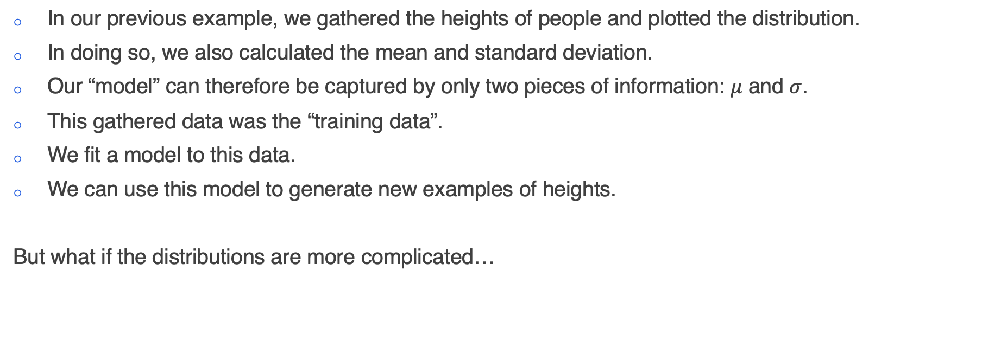
Inspiration from Physics
The training data
In our previous example, we gathered the heights of people and plotted the distribution.
In doing so, we also calculated the mean and standard deviation.
Our “model” can therefore be captured by only two pieces of information: $μ$ and $σ$.
This gathered data was the “training data”.
We fit a model to this data.
We can use this model to generate new examples of heights.
But what if the distributions are more complicated…

Slide 7
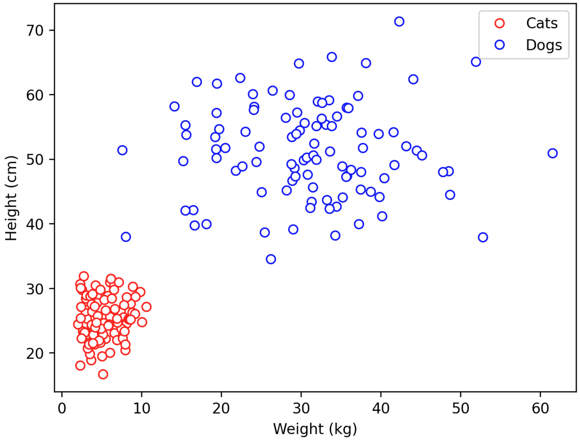
Inspiration from Physics
More complicated distributions
Here is a plot of the height and weight distributions of cats and dogs
Cats are typically smaller and lighter than dogs
We don’t really see much variety in the size and shapes of cat, but dogs can vary quite a lot!

Slide 8
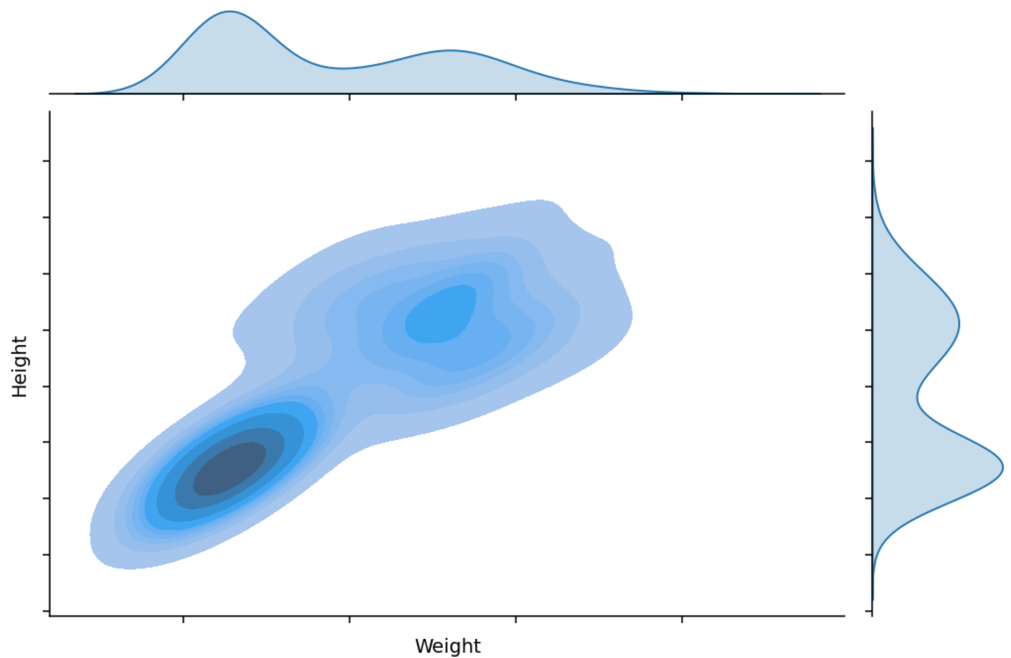
Inspiration from Physics
More complicated distribution…
But how am I supposed to write down the equation to this distribution!
I could guess, and say that it looks like a mixture of two Gaussians.
But what about when we step into higher dimensions and I can’t physically look at the distribution of the data…?
Notes:
I can easily draw from the cat distribution and get a typical cat. But what if this is an image of a cat instead?
An image will contain 512x512 pixels, that’s 262,144 pixels. How do I draw from that?
Just assume all pixels are normally distributed?
Approximate a distribution based on histograms?
What about correlations? Each pixel is not unique! What I actually want to draw from is a joint distribution! And that is not easy to draw from.
While you technically could:
Take many cat images
Create a histogram/distribution for each pixel
Draw from each pixel's distribution independently
The result would look like noise because:
Pixel values are highly correlated with their neighbors
The joint distribution of pixels matters, not just individual distributions
You'd lose all structure and spatial relationships
For example:
If pixel (50,50) is part of a cat's eye and is dark
Then nearby pixels are very likely to also be dark
But pixels on the cat's white fur are likely to be bright
These dependencies aren't captured by independent pixel distributions
Think of it like this:
It's like trying to generate English text by sampling each letter position independently based on letter frequencies
You'd get gibberish because you're ignoring how letters must form valid words
Similarly, pixels must form valid image structures
You cannot model this space directly:
Each pixel can take 256 values and the joint distribution needs to model >200k dimensions. So the number of possible images is 256^200k.
Almost all of these will be garbage, and real images only occupy a tiny subset of these possible images.
With 2 bins per dimension you have 2^200k bins. There are only 2^266 atoms in the universe…

Slide 9
Inspiration from Physics
Let’s revisit the idea of data as a charge distribution…
We have a complicated probability distribution
Let’s now imagine that this is a charge distribution instead
Areas of high charge are strongly repellent
This will cause the distribution to “repel itself” and spread out
As we let this happen for a very long time, it will be very difficult to make out any structure
Here is an example:

Slide 10
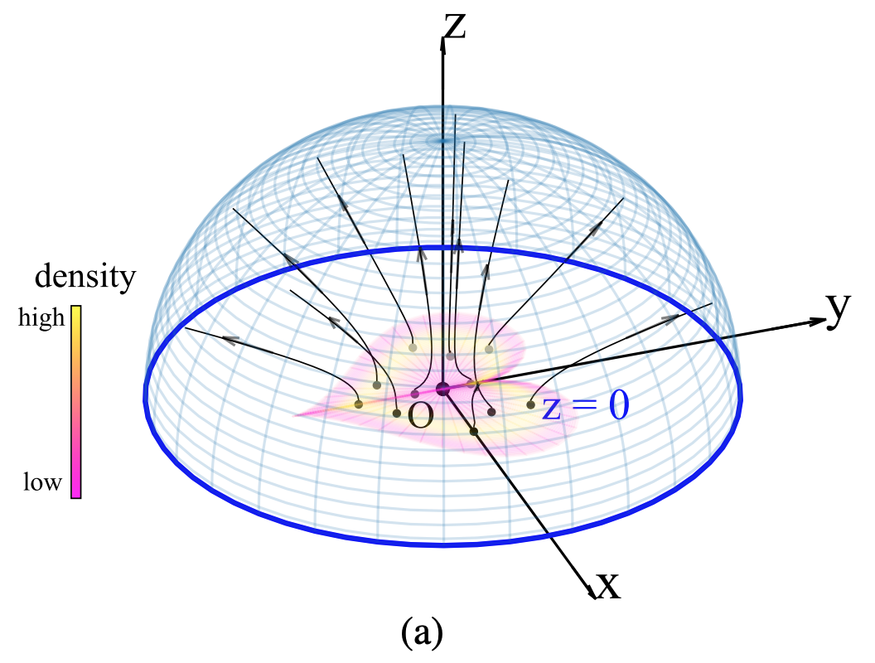
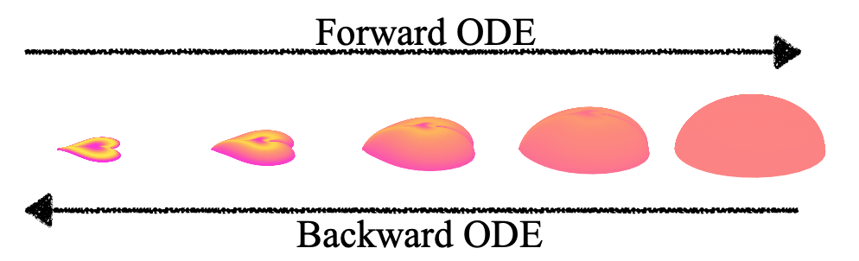
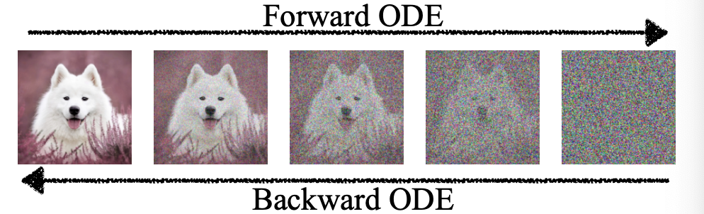
Inspiration from Physics
Start with a complicated distribution…

Slide 11
Inspiration from Physics

Slide 12
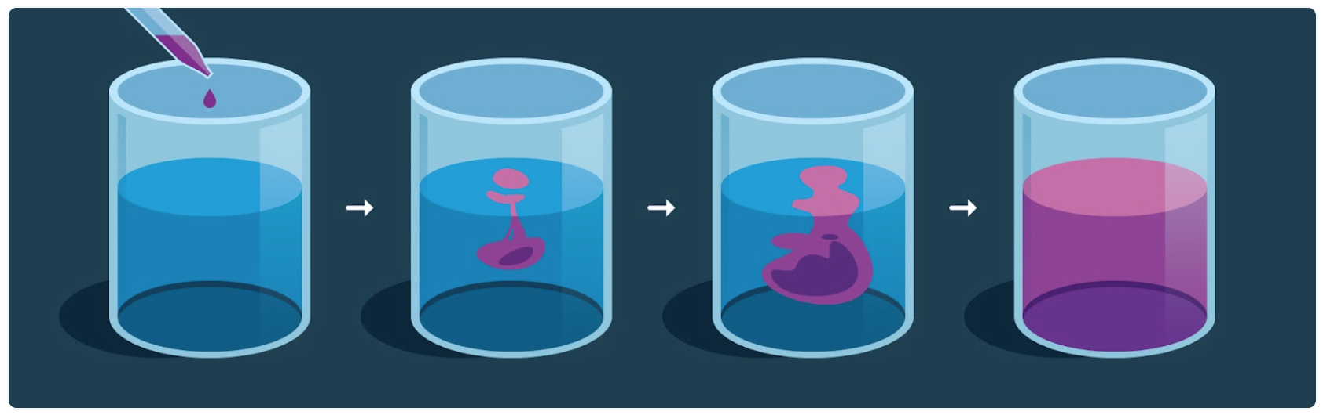
Inspiration from Physics
Another example, this time from statistical physics
Notes:
Think about what happens when you mix milk with coffee…
In the first instance, you drop some milk into the coffee, and it is all concentrated in one location, and the pattern it makes is very complicated. There are only very limited numbers of ways that the cup of coffee can make this pattern.
Conversely, when you let the coffee sit for a while, the milk will disperse evenly throughout the coffee, and what you are left with is a uniform distribution of milk (and probably a cold cup of coffee).
This process is diffusion.

Slide 13
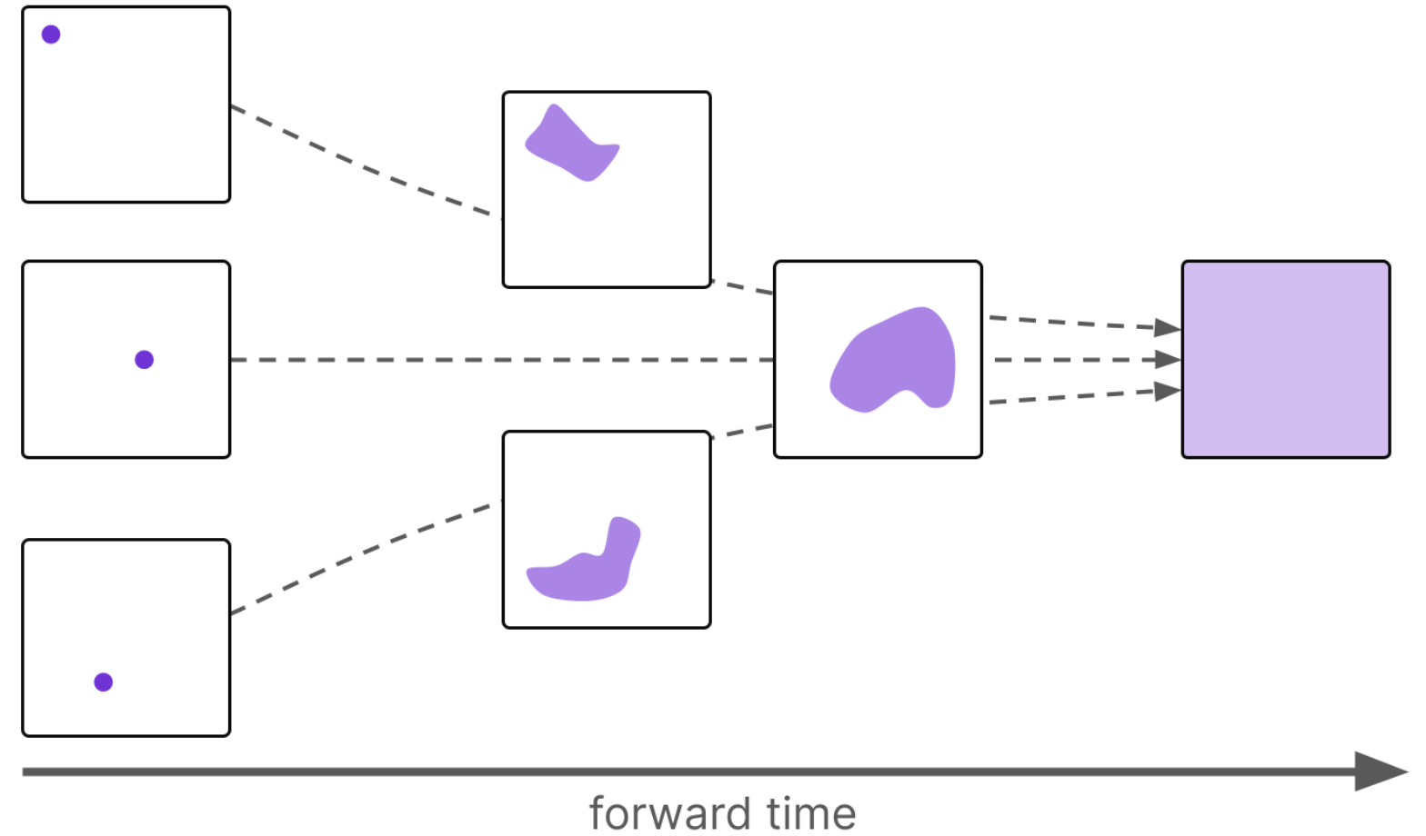
Inspiration from Physics
Regardless of where we place the initial milk drop, the end result is the same…

Slide 14
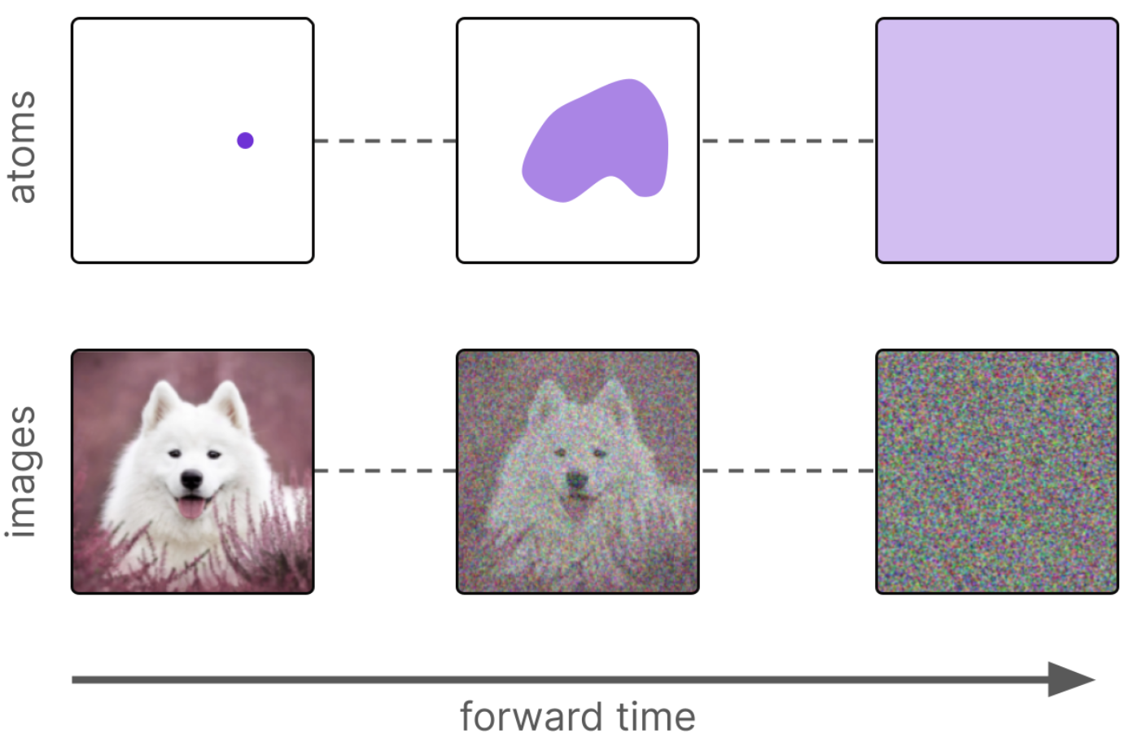
Inspiration from Physics
Coffee or pixels in an image…

Slide 15
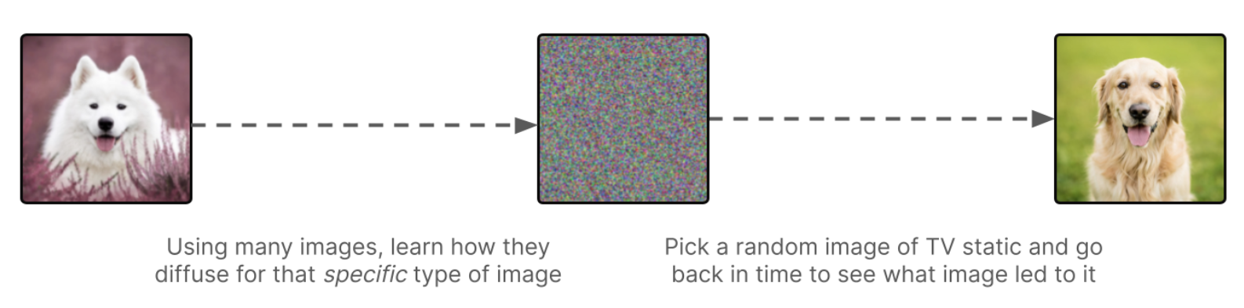
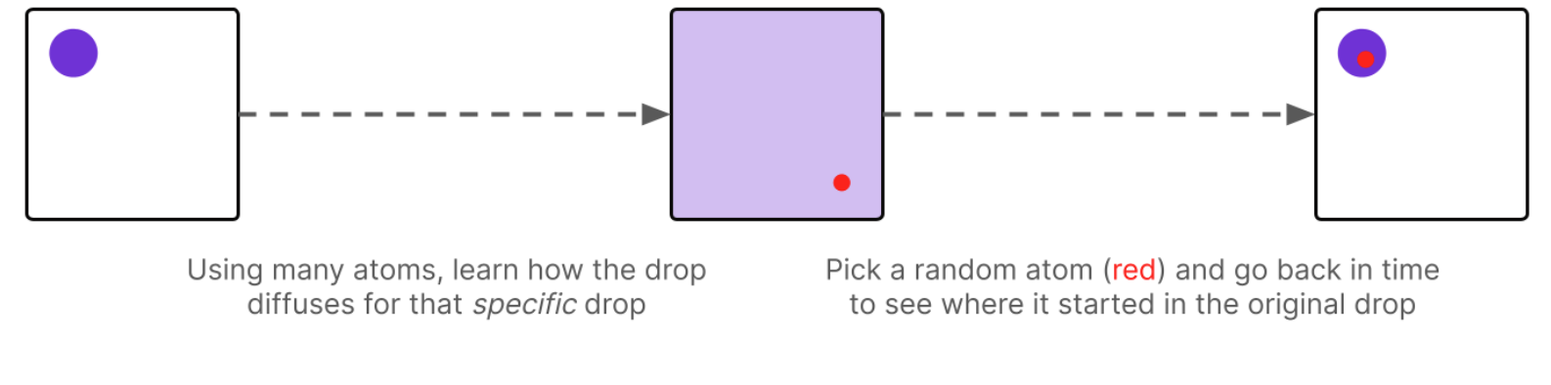
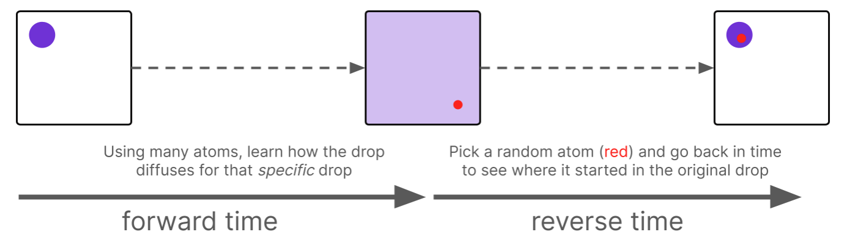
Inspiration from Physics
This is great, but why does it help us…?
It is difficult to sample from real distributions, because we cannot write down the equation of the distribution…
But we can sample from a Normal distribution very easily…

Slide 16
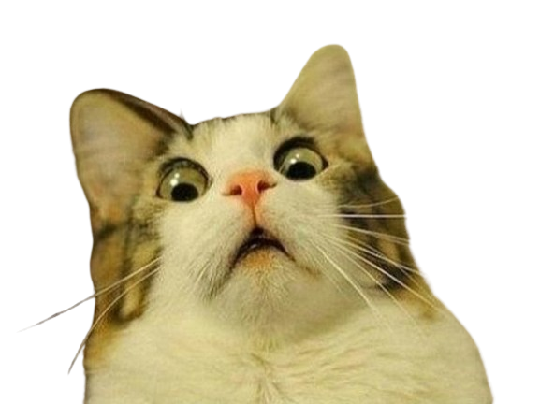
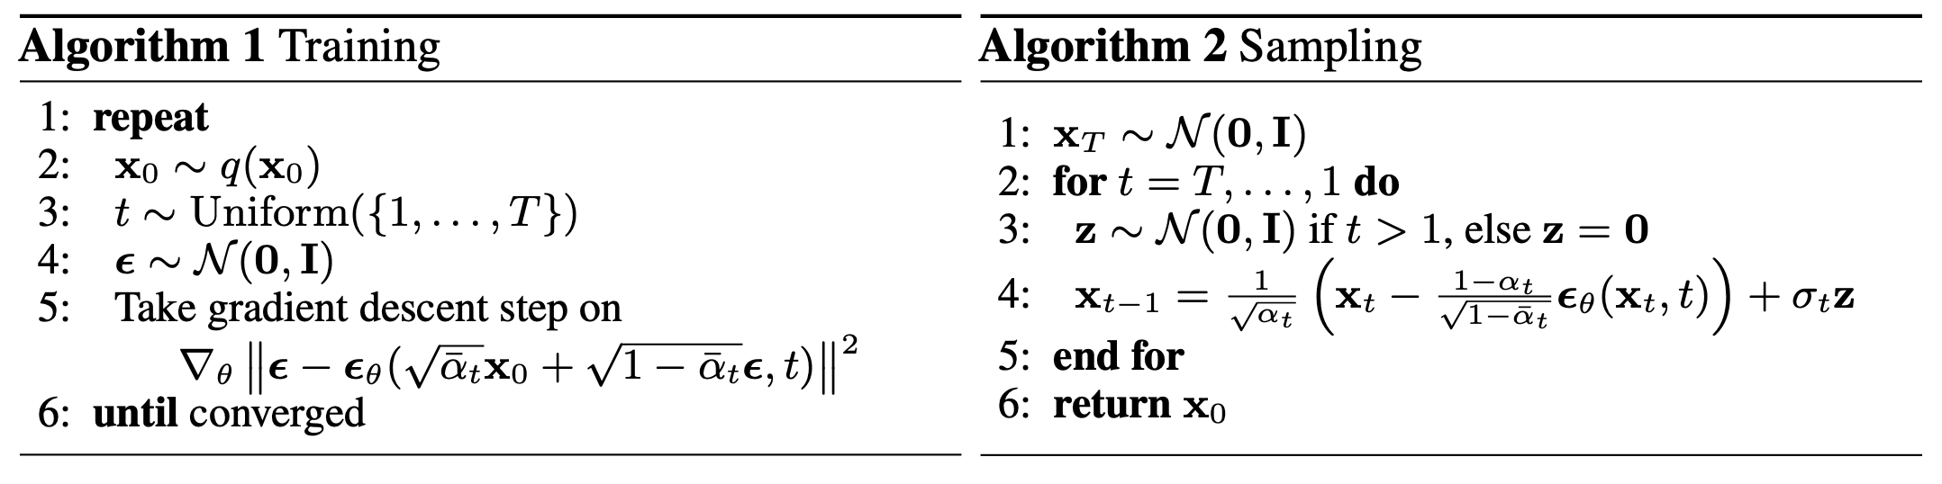
Building Blocks
Here is the algorithm for diffusion…
Notes:
By the end of the session today, I’m hoping that we can get at least a general idea of what these steps mean, without really caring too much about the mathematical detail…I’ll briefly explain the left hand algorithm now. It might not make too much sense immediately, but hopefully, later on, it should.
Get a random training sample
Draw a timestep uniformly at random from [1, T]
Generate some noise from a normal distribution
Feed your image plus noise into the model. The model will then train on this noise.

Slide 17
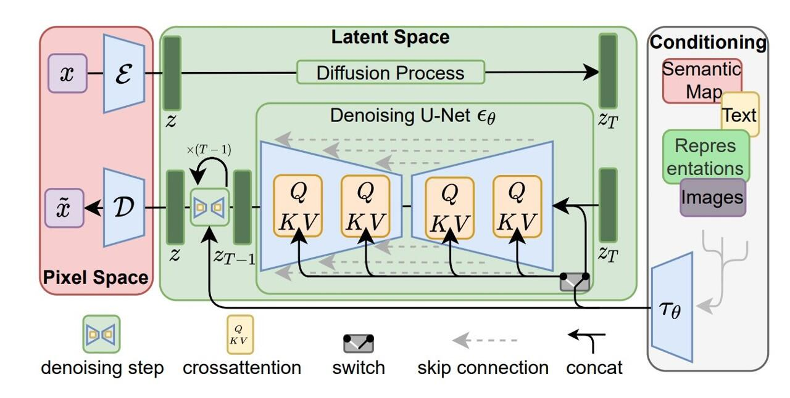
Building Blocks
Perhaps this makes more sense…

