Slide 1

Introduction to Agentic AI
Fariba & Radzim

Slide 2
Outline
LLMs
What is an AI Agent
The Agent Loop
Tools & Tool Calling
LLMs, Workflows vs Agents
Orchestration & Guardrails

Slide 3

What are LLMs
Reference: Most of the content in this workshop is taken from the Hugging Face AI Agents Course.
huggingface.co/learn/agents-course/en/unit0/introduction

Slide 4
The underlying systems of LLMs
system_message = {
"role": "system",
"content": "You are a professional customer service agent. Always be polite, clear, and helpful."
}

Slide 5
Conversations: user and assistant Messages
conversation = [
{"role": "user", "content": "I need help with my order"},
{"role": "assistant", "content": "I'd be happy to help. Could you provide your order number?"},
{"role": "user", "content": "It's ORDER-123"},
]

Slide 6
What is an AI agent?
Agency + Autonomy
Agency: Ability to take actions
eg. tool use / APIs
Autonomy: Degree of independent decision making
less guidance
chooses intermediate steps

Slide 7

The agent loop

Slide 8
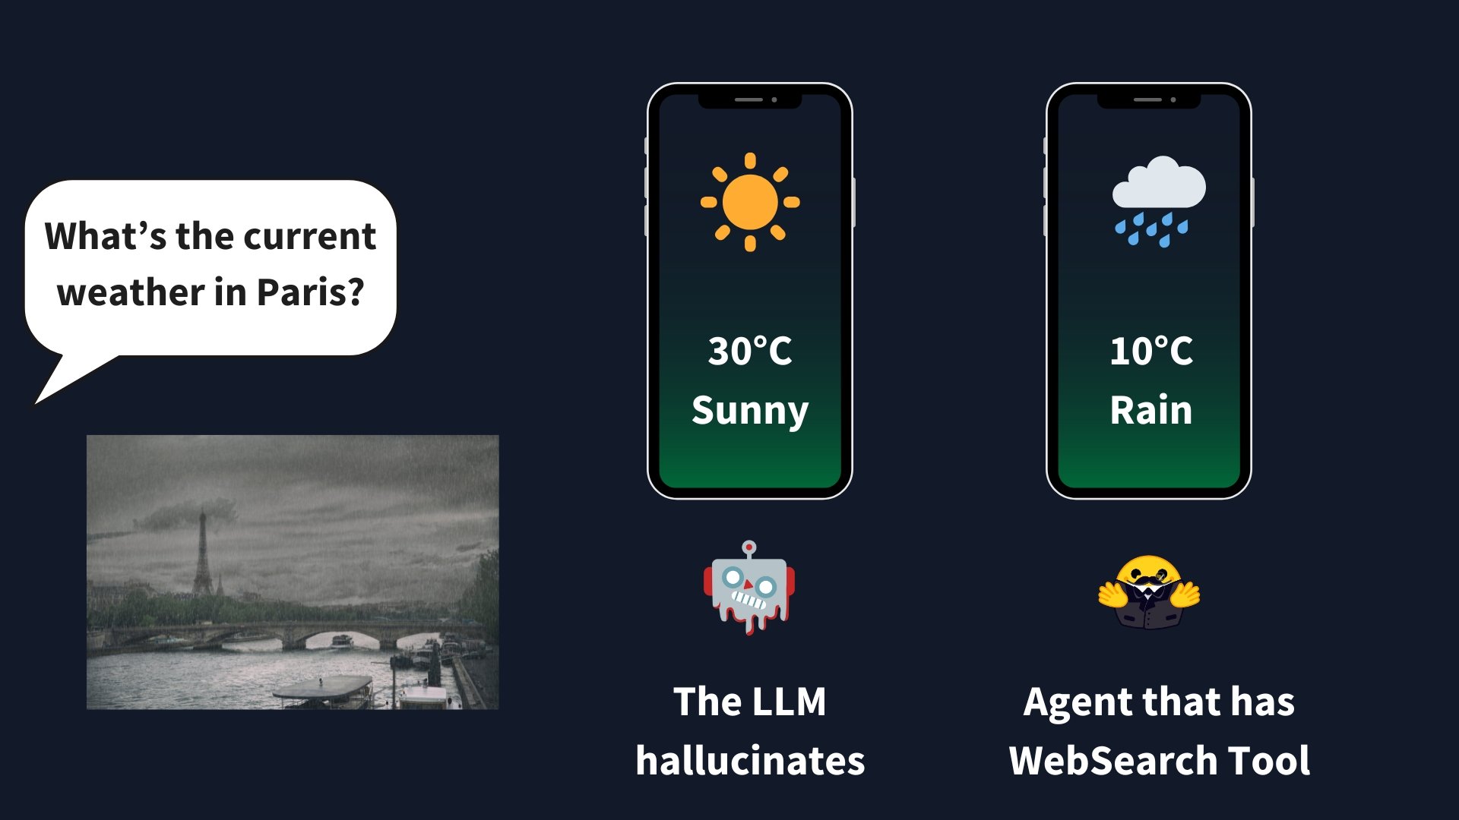
What are tools?
A Tool is a function given to the LLM. This function should fulfill a clear objective.
Web search
Image generation
Retrieval
API interface

Slide 9
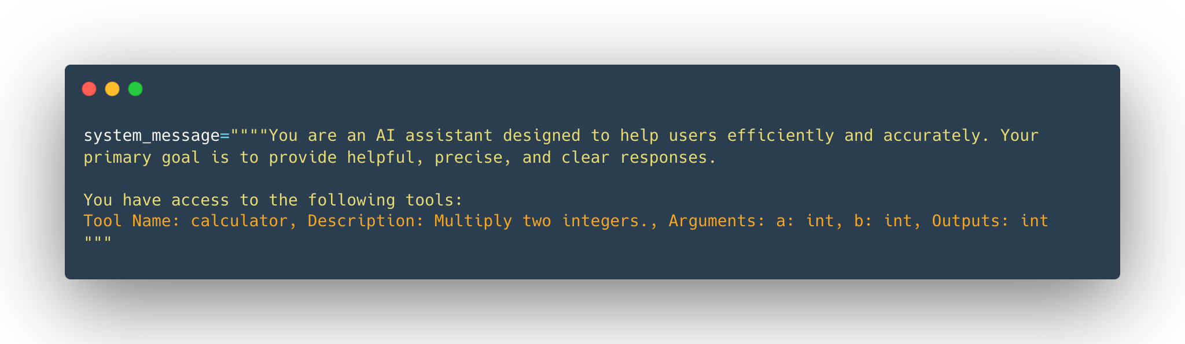
How do tools work
def calculator(a: int, b: int) -> nt:
"""Multiply two integers"""
return a * b
print(calculator.to_string())

Slide 10
Examples of agent actions
Type of Action | Description
Information Gathering | Performing web searches, querying databases, or retrieving documents.
Tool Usage | Making API calls, running calculations, and executing code.
Environment Interaction | Manipulating digital interfaces or controlling physical devices.
Communication | Engaging with users via chat or collaborating with other agents.

Slide 11
Information access in agents
Context
Retrieval
Memory
Information visible to the current model call
A method for locating relevant external information
Selected information preserved across steps or sessions

Slide 12
LLM, fixed workflow and agentic system
STANDALONE LLM
FIXED WORKFLOW
AGENTIC SYSTEM
One model call
Predetermined steps
Chooses the next step
Answers from context
Model fills specific stages
Calls tools
No action
Limited adaptation
Can loop or delegate

Slide 13
When to use agents/when to avoid them
Do I need flexibility in the workflow to efficiently solve the task at hand?

Slide 14
Framework choices examples
Plain Python
Small or deterministic workflow
LangGraph
Explicit stateful orchestration
Microsoft AutoGen
Multi-agent frameworks
Google ADK
Multi-agent frameworks
LlamaIndex
Data-centric agent applications

Slide 15
Orchestration is the entire coordination problem
MANAGER
decompose and integrate
SEARCH AGENT
collect sources
CODE AGENT
analyse data
REVIEW AGENT
check evidence

Slide 16
Blackboard for coordination
Blackboard
shared workspace
SEARCH AGENT
collect sources
CODE AGENT
analyse data
REVIEW AGENT
check evidence

Slide 17
Guardrails
Guardrails: What is the agent allowed to do?
  Never spend > £50
  Ask before sending email
  Stop after 10 iterations
  Do not delete files

Slide 18
Agents security
Least privilege
Expose only necessary tools and credentials
Validation
Check before execution
Budgets
Limit steps, time, tokens and money
Isolation
Restrict code, filesystem and network access
Approval
Pause before consequential actions

Slide 19
A few questions for every agent
What goal does the agent have?
Which tools and permissions does it need?
What can go wrong?
How will we test whether it succeeded?

