Slide 1
Model Types

Slide 2
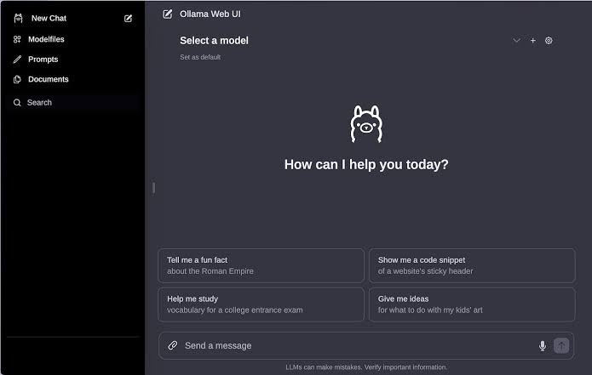
LLM

Slide 3



Image Generation, Video Generation

Slide 4

Text to Speech, Speech to Text

Slide 5
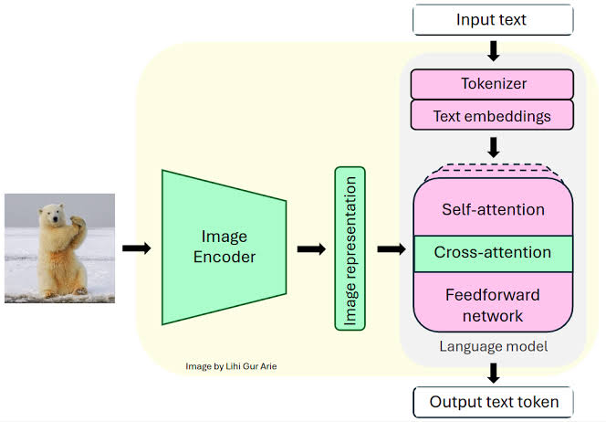
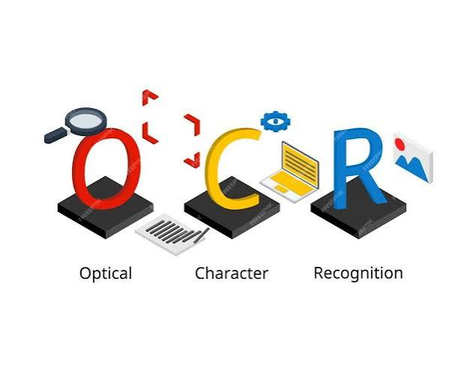

OCR, Vision, Multimodal

Slide 6
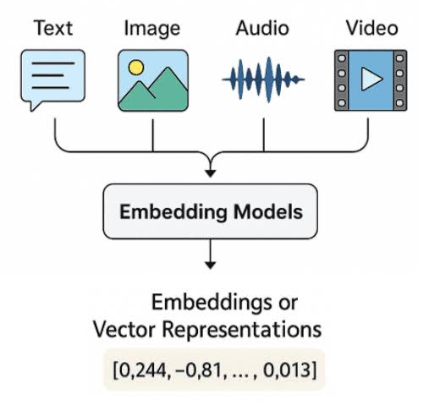
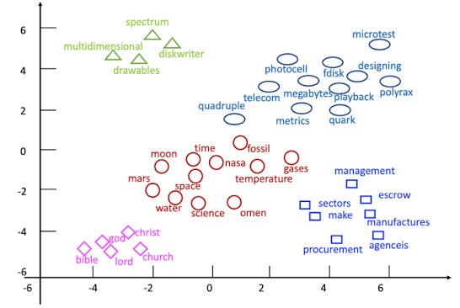
Embeddings

