Slide 1
Practicalities
How can you actually use LLMs?

Slide 2
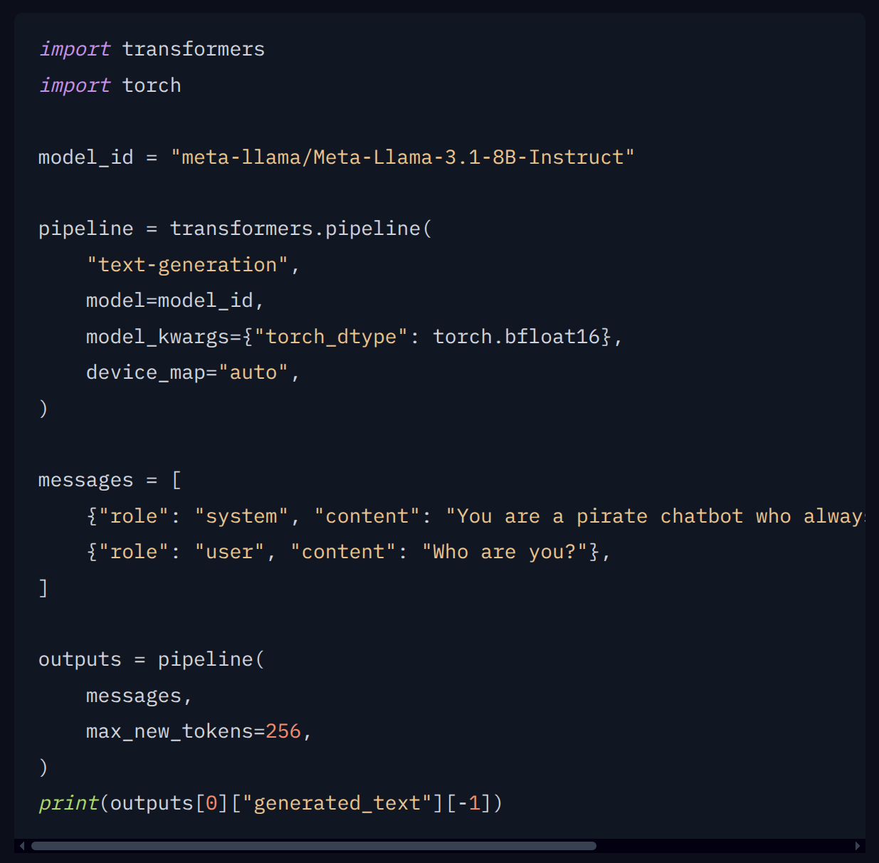
Hugging Face
Almost every model will have example code on how to run it

Slide 3
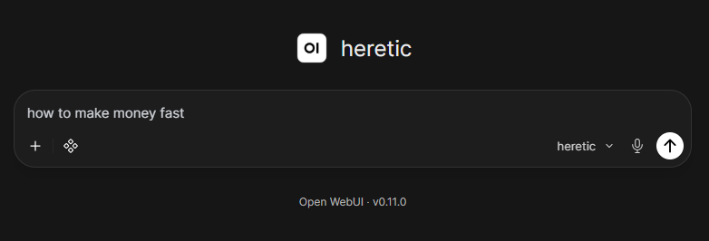
Abliterated models
Notes:
https://zenithllms.chat/

Slide 4
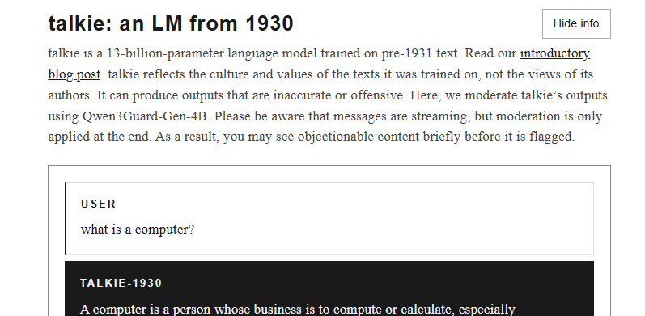
Vintage models
Notes:
https://talkie-lm.com/chat

Slide 5







AWS
Microsoft
Google

Slide 6
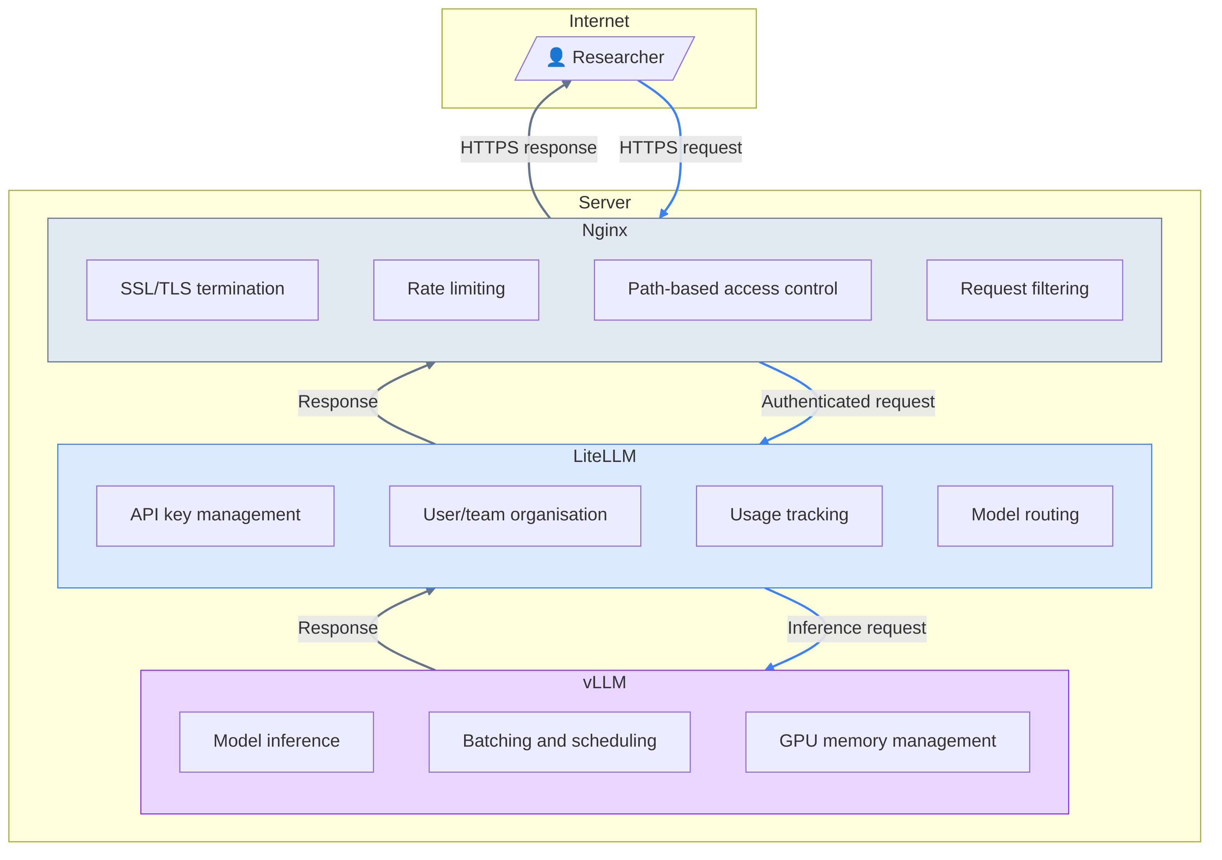
Serving LLMs

Slide 7

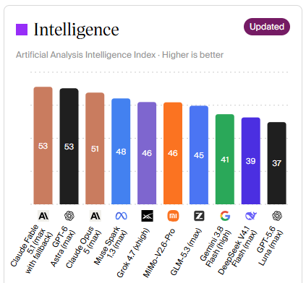

What model to choose?
AI = water in the tap?
FORMAT
A JSON

Slide 8
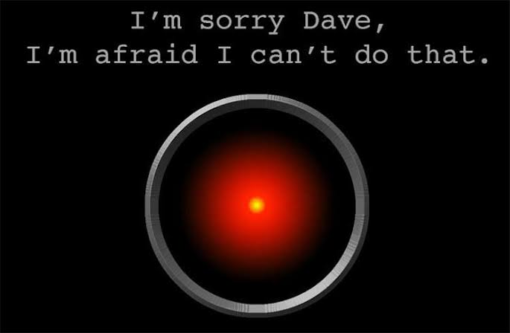


Alignment / Censorship

Slide 9
Activity
Discuss the differences between different models
  “Strength”, capability
  Behaviour
    Style
    Censorship
    Engagement bait
  Access
    Local / Online
    Free / Paid
  Ownership
    Proprietary / open weights
    American, Chinese, European (Mistral/LeChat), British (?)
    Alignment with owner
    Political position

Slide 10




Frameworks

