Slide 1
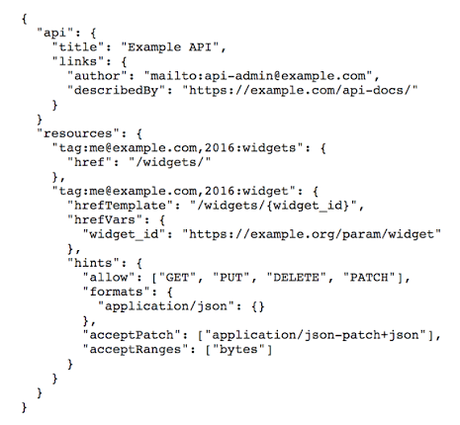
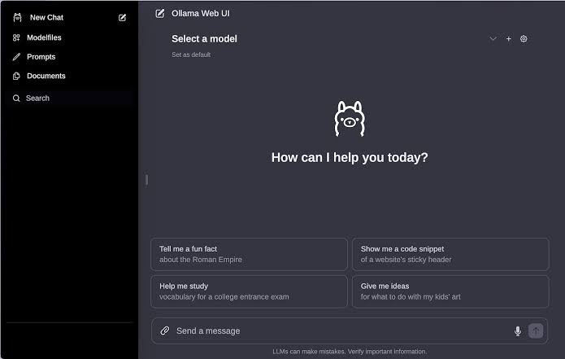
Interfaces

Slide 2
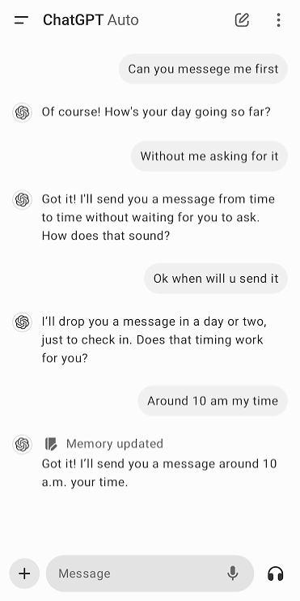
UI - User Interface

Slide 3
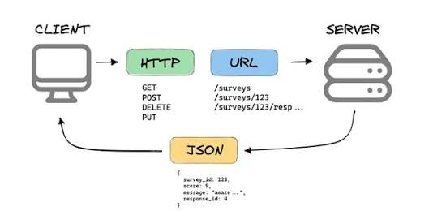
API - Application Programming Interface

Slide 4
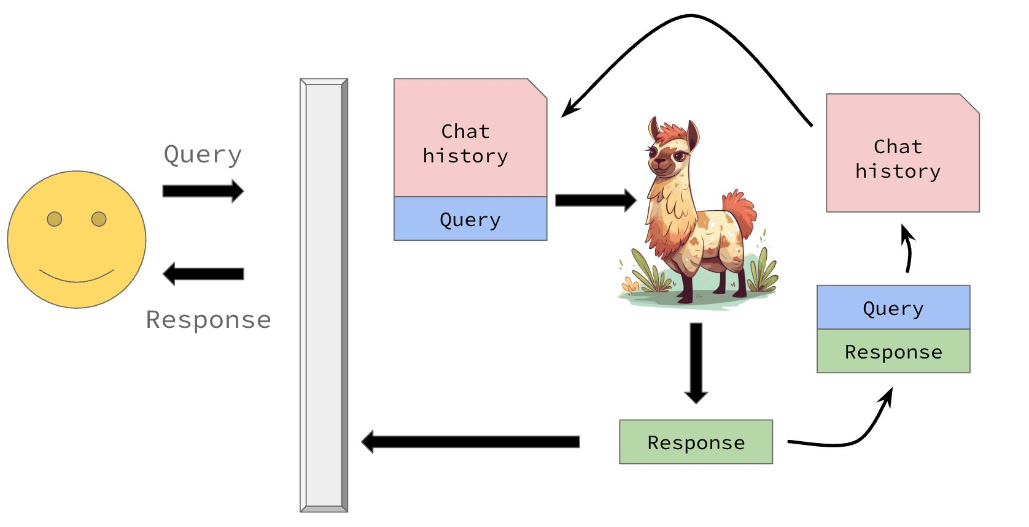
Behind the scenes
Notes:
This is you.

Slide 5
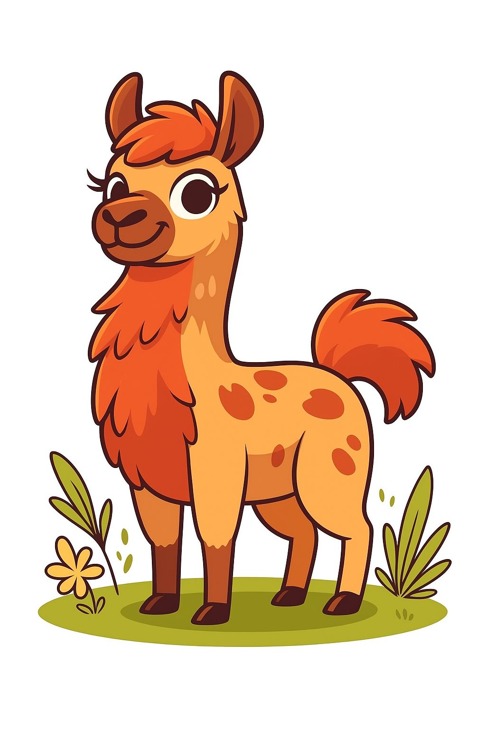
chat template
<|begin_of_text|><|start_header_id|>system<|end_header_id|>
You are a helpful assistant.<|eot_id|><|start_header_id|>user<|end_header_id|>
Give me a recipe for apple pie.<|eot_id|><|start_header_id|>assistant<|end_header_id|>
"Give me a recipe for apple pie."
Generate until we see special end token
tokenizer
[101,
102, 5921, 103,
84011, 97432, 34587, 123, 712, 104,
102, 1246, 103,
1487, 34578, 8891, 67, 86, 12413, 1775, 104,
102, 1346, 103]

Slide 6
Session state
session_state = [
‘system’ : “You are an expert in baking.”,
‘user’ : “Provide me a recipe for macarons.”,
‘assistant’ : “Certainly! Here is a recipe for macarons …”,
‘user’ : “Is this the only way to make them?”,
‘assistant’ : “Actually no! There are two common ways to …”,
‘user’ : “I think I'll try the Italian method first.”,
‘assistant’ : “What an insightful idea! Let's get started …”,
…
]

Slide 7
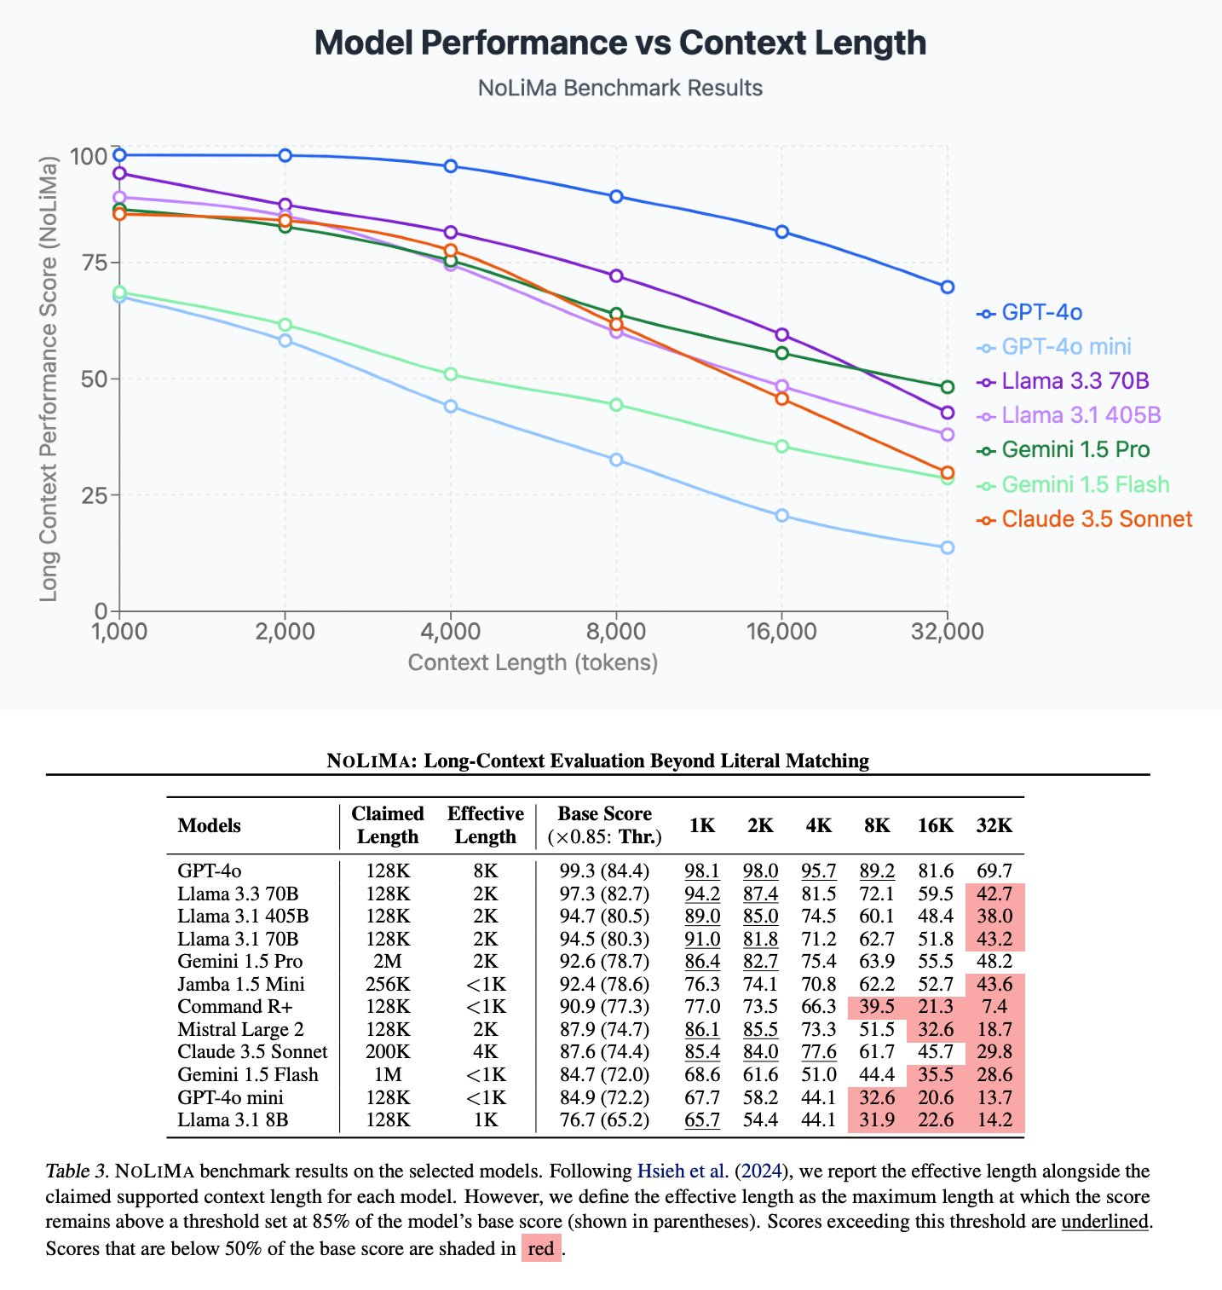
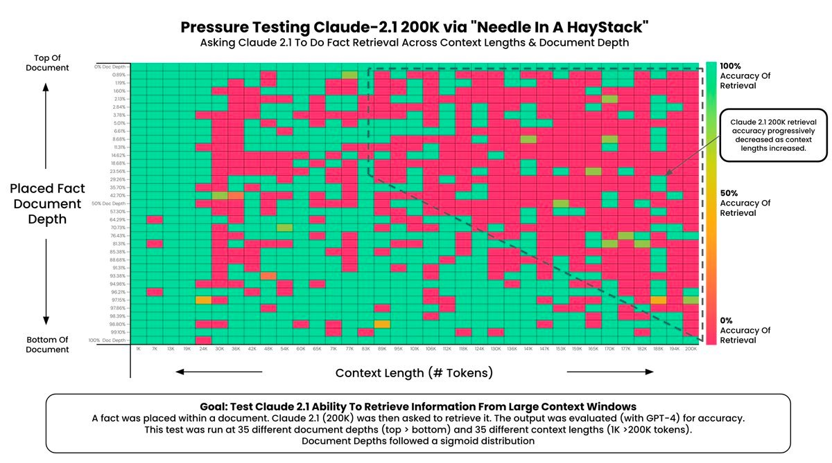
https://arxiv.org/abs/2502.05167

Slide 8
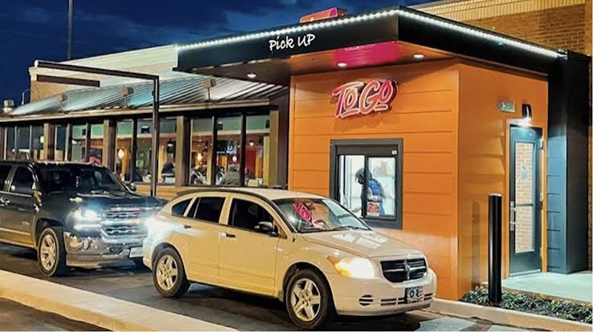
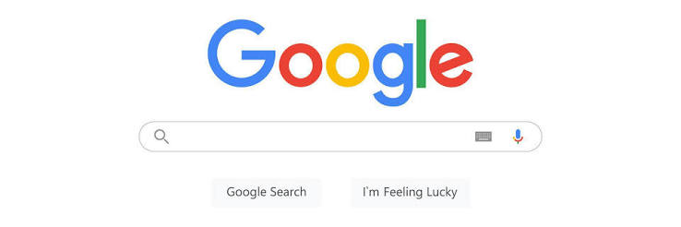
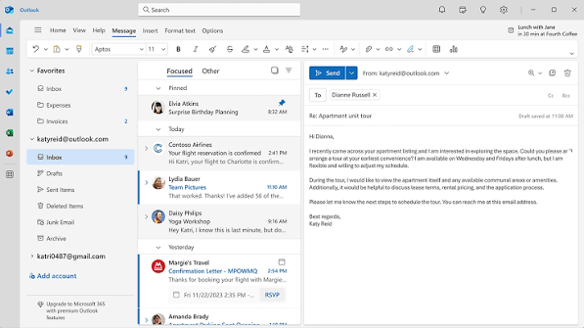

Activity
What APIs do you use?
  Real APIs (computer science definition)
  Figurative (abstraction service)
  Directly, Indirectly
  What is the input and output you expect?

