Slide 1
Practicalities
How can you actually use LLMs?

Slide 2
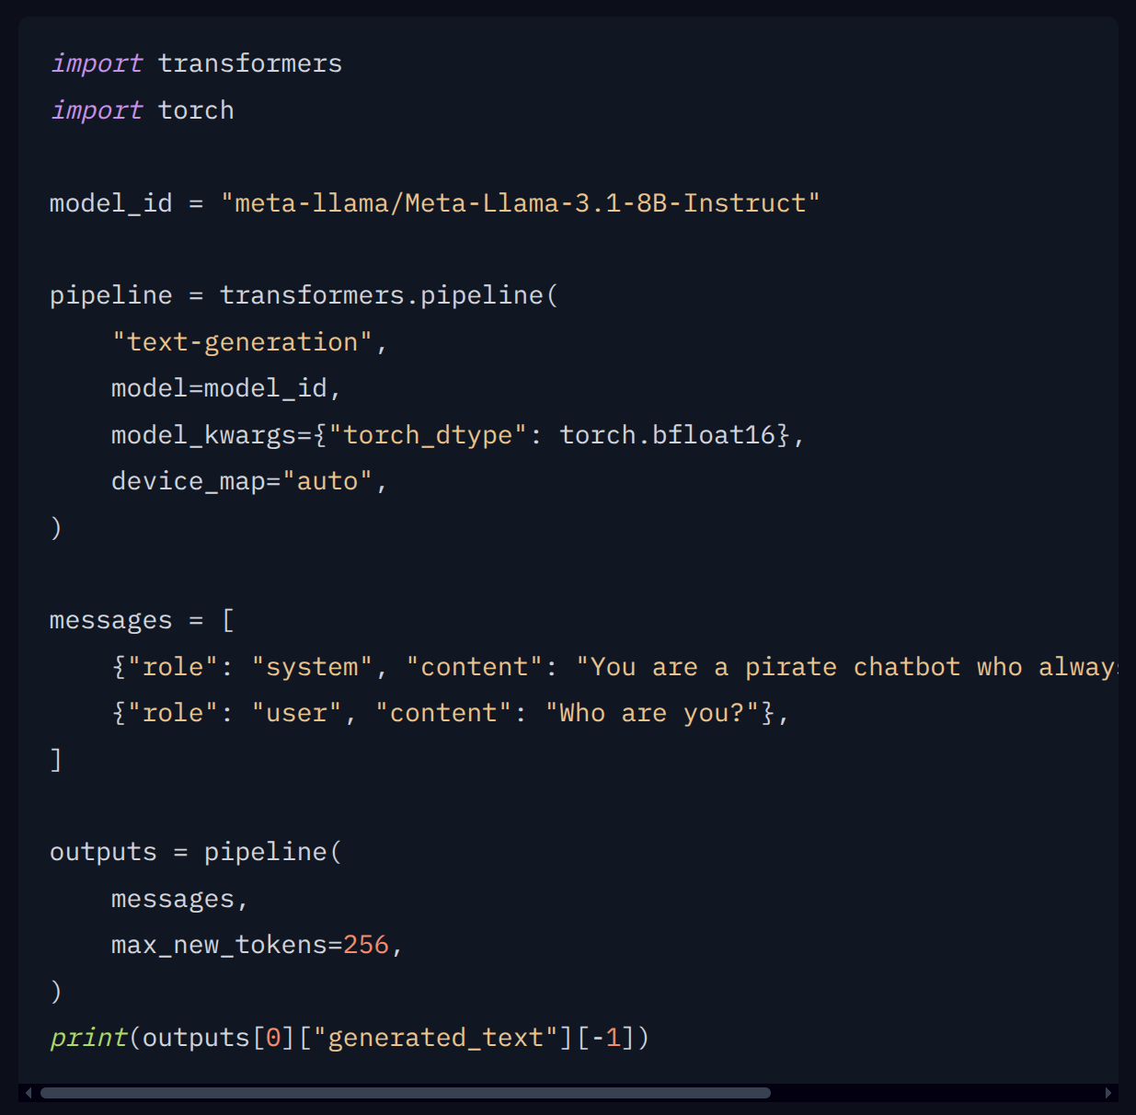
Hugging Face
Almost every model will have example code on how to run it

Slide 3
Model Types

Slide 4
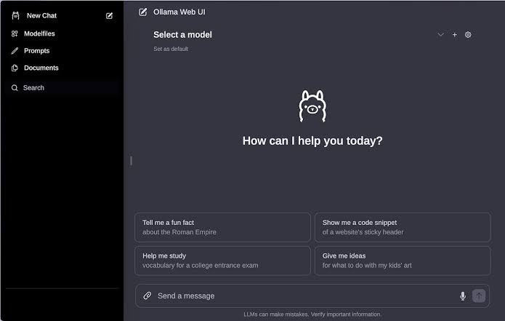
LLM

Slide 5
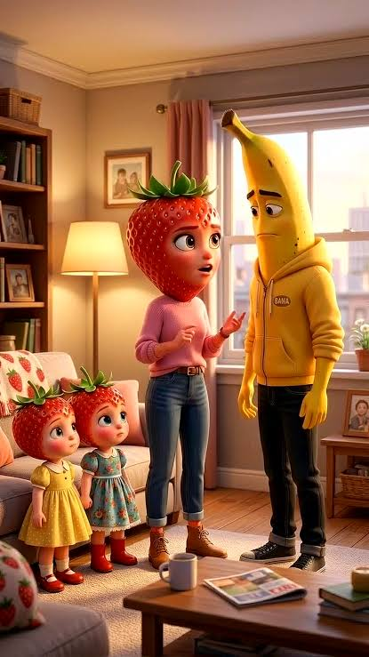
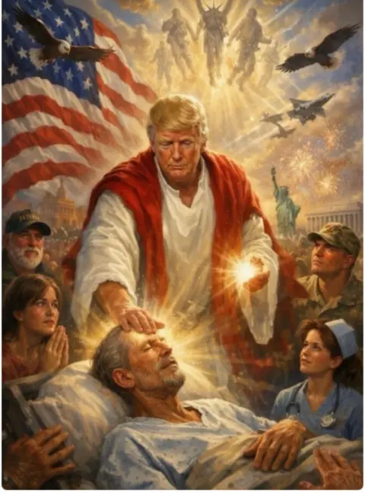

Image Generation, Video Generation

Slide 6

Text to Speech, Speech to Text

Slide 7
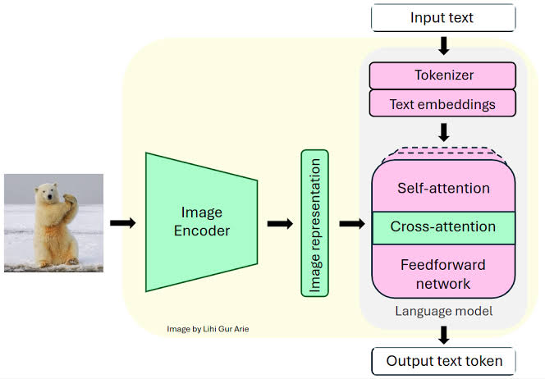
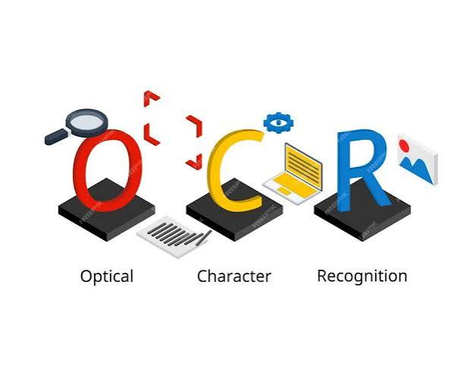
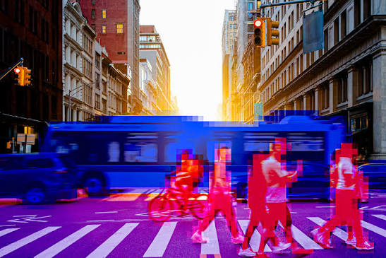
OCR, Vision, Multimodal

Slide 8
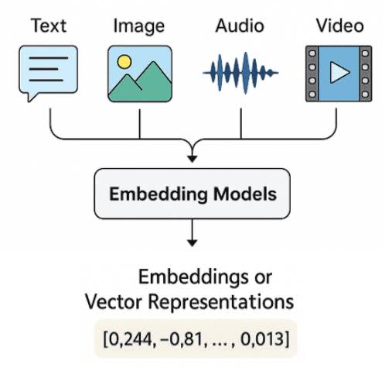
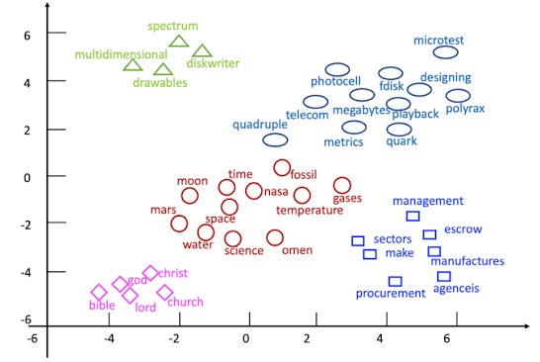
Embeddings

Slide 9
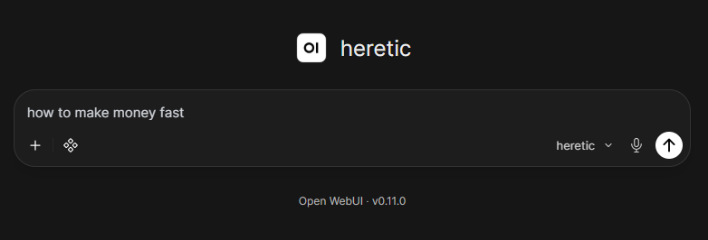
Abliterated models
Notes:
https://zenithllms.chat/

Slide 10
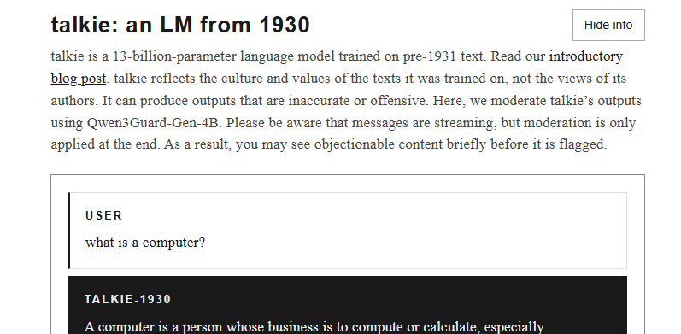
Vintage models
Notes:
https://talkie-lm.com/chat

Slide 11



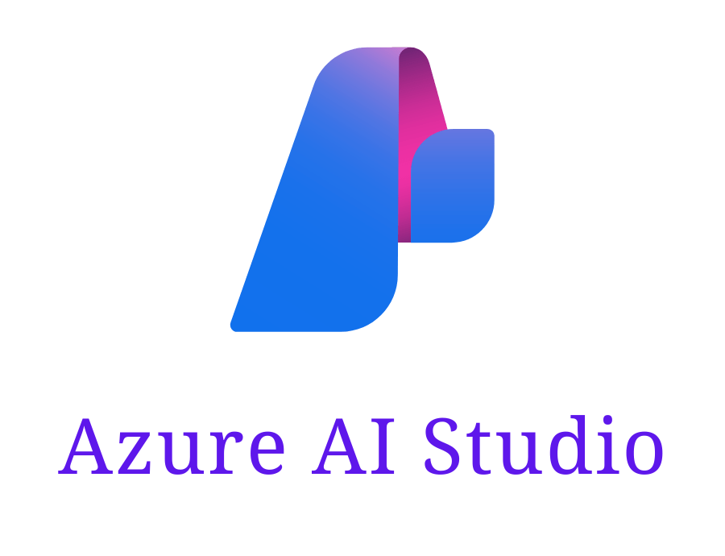



AWS
Microsoft
Google

Slide 12
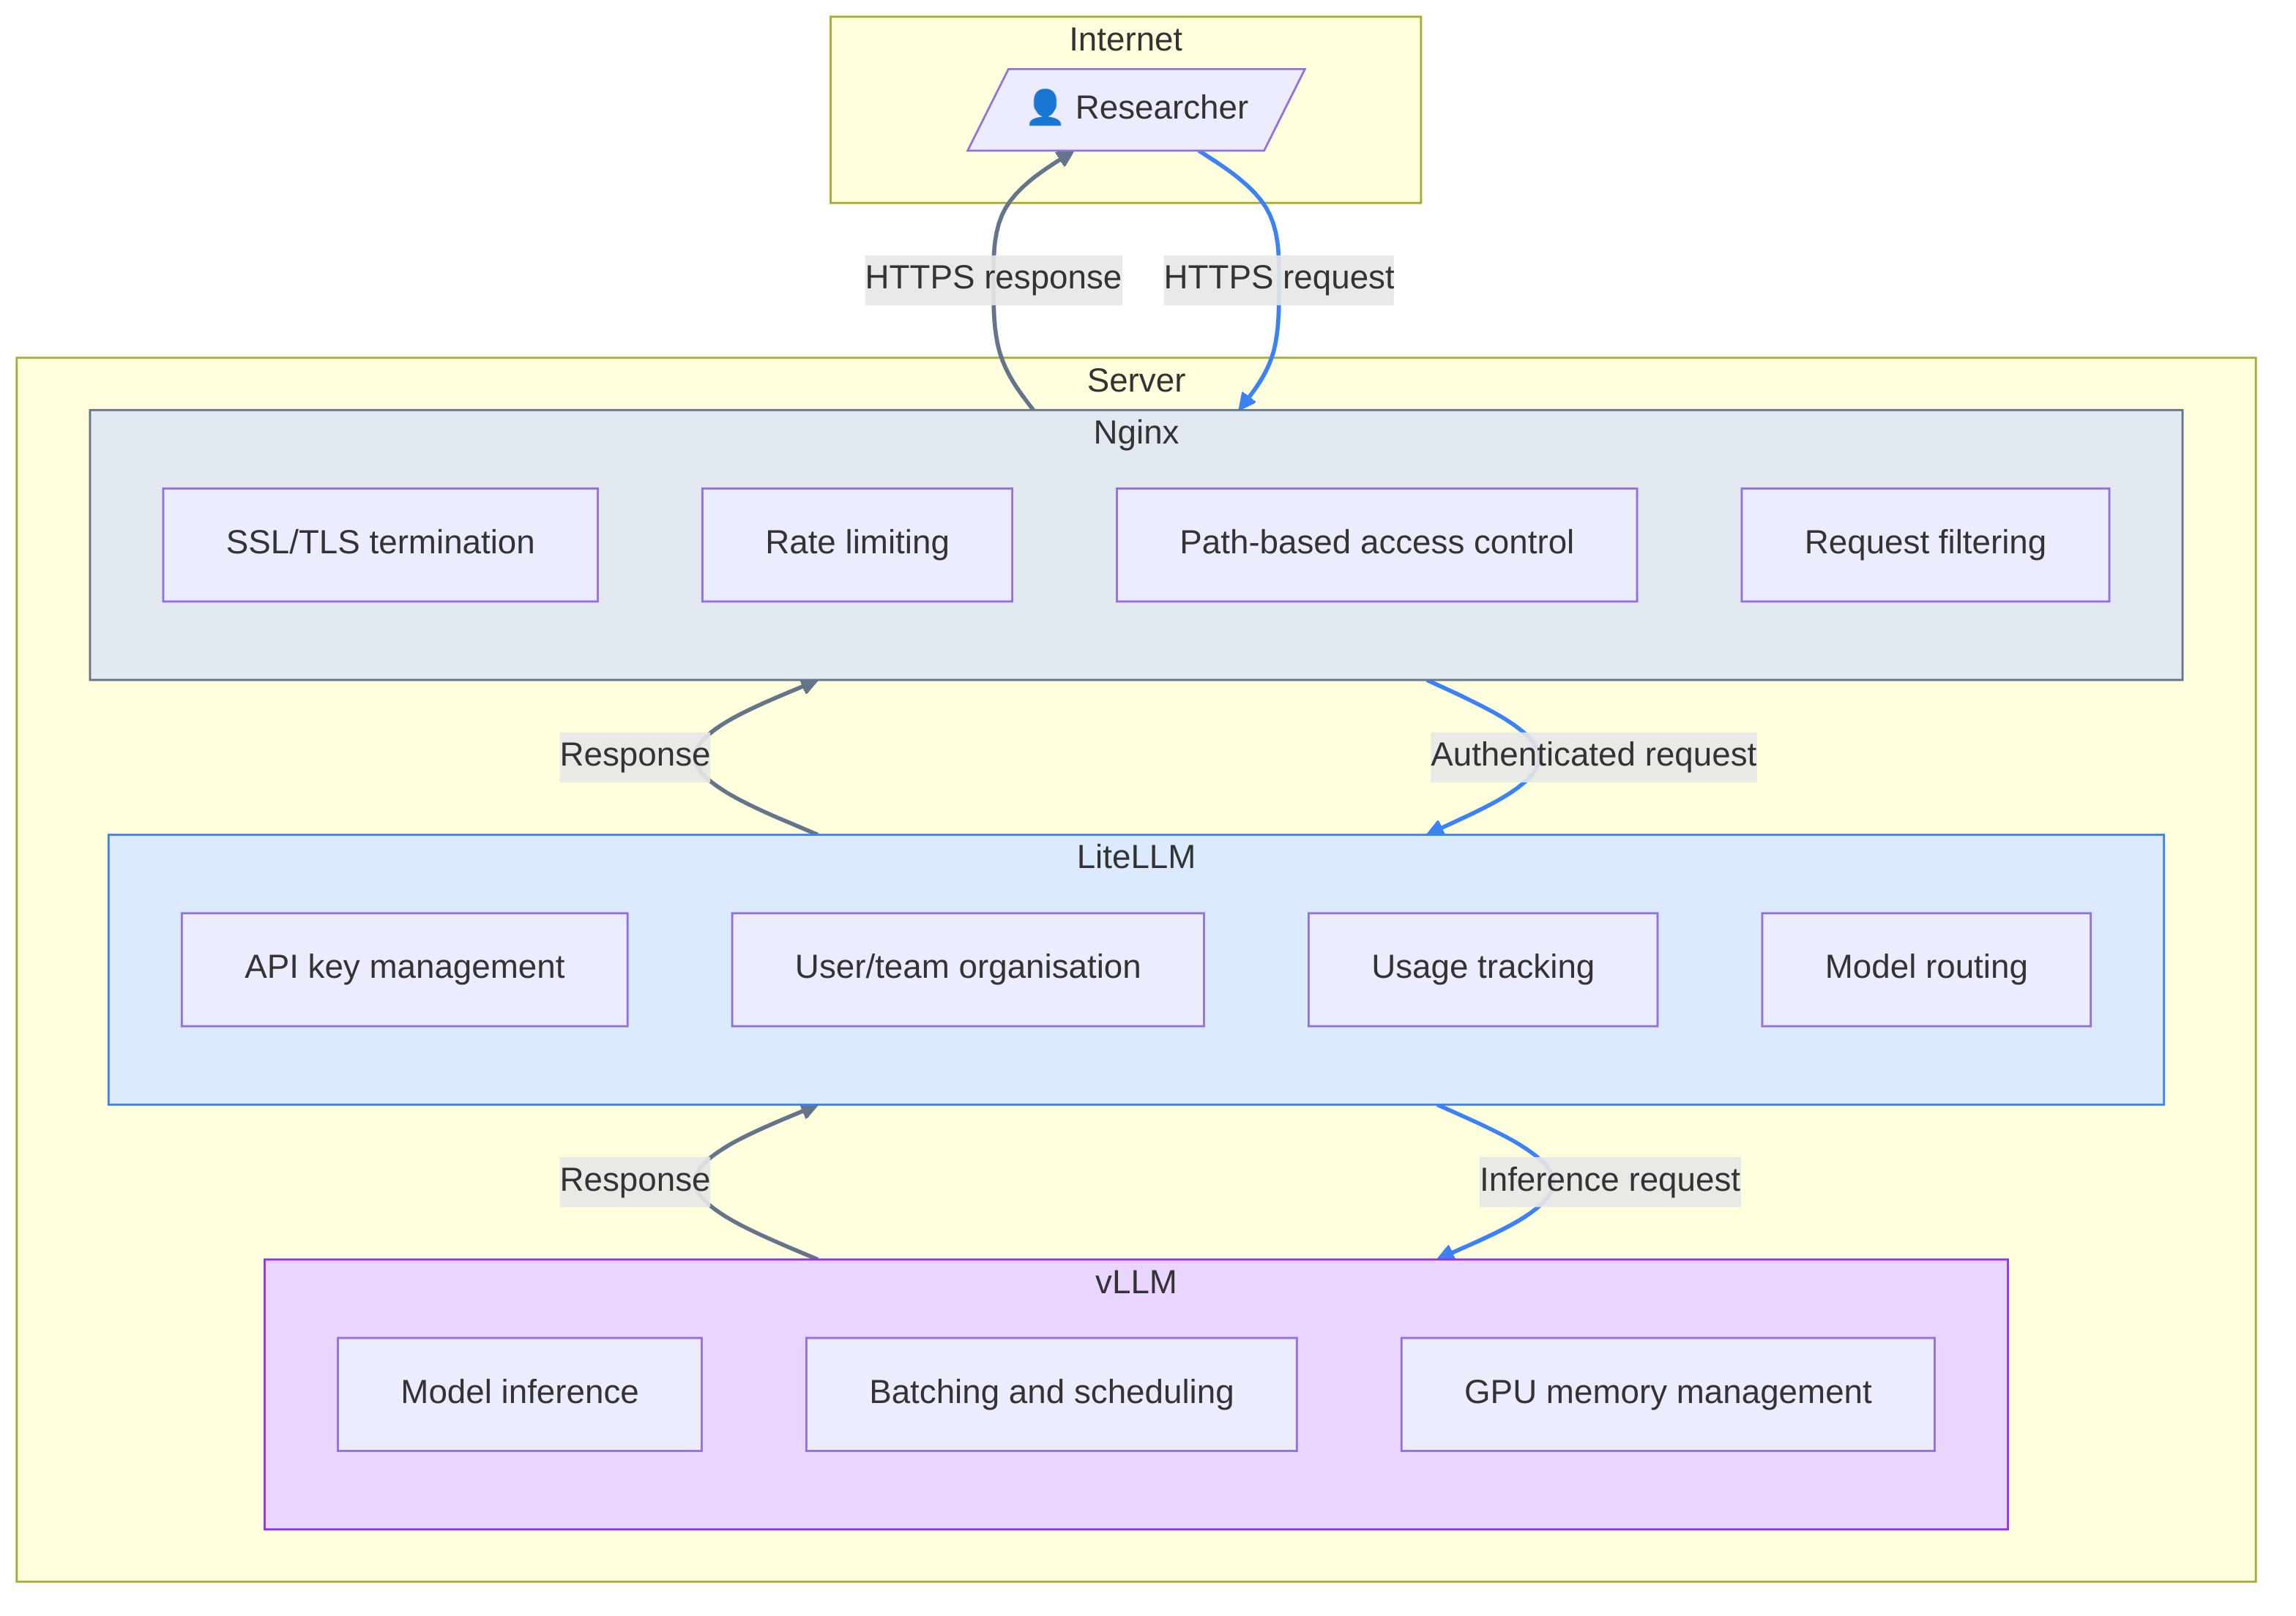
Serving LLMs

Slide 13

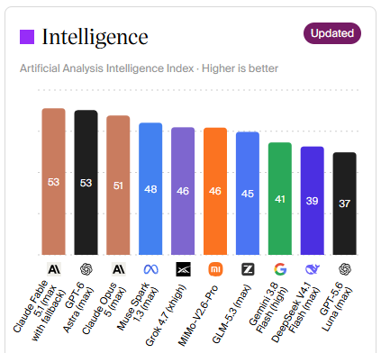

What model to choose?
AI = water in the tap?
FORMAT
A JSON

Slide 14
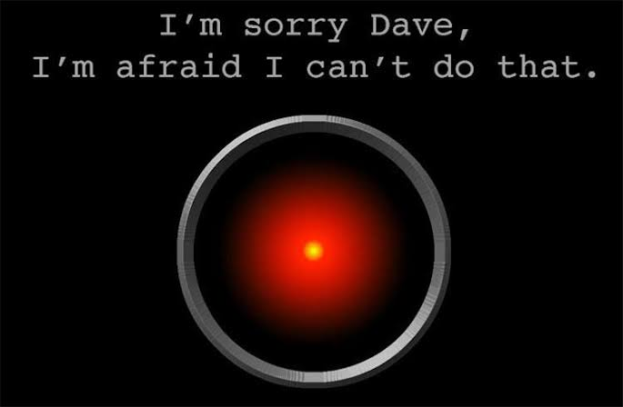


Alignment / Censorship

Slide 15
Activity
Discuss the differences between different models
  “Strength”, capability
  Behaviour
    Style
    Censorship
    Engagement bait
  Access
    Local / Online
    Free / Paid
  Ownership
    Proprietary / open weights
    American, Chinese, European (Mistral/LeChat), British (?)
    Alignment with owner
    Political position

Slide 16




Frameworks

