Slide 1
Practicalities
How can you actually use LLMs?

Slide 2
What is the task?
This might sound stupid and obvious but:
Think about what you are trying to do, and see if anybody else has done something similar!

Slide 3

What is the task?
Regular google search
Hugging Face

Slide 4
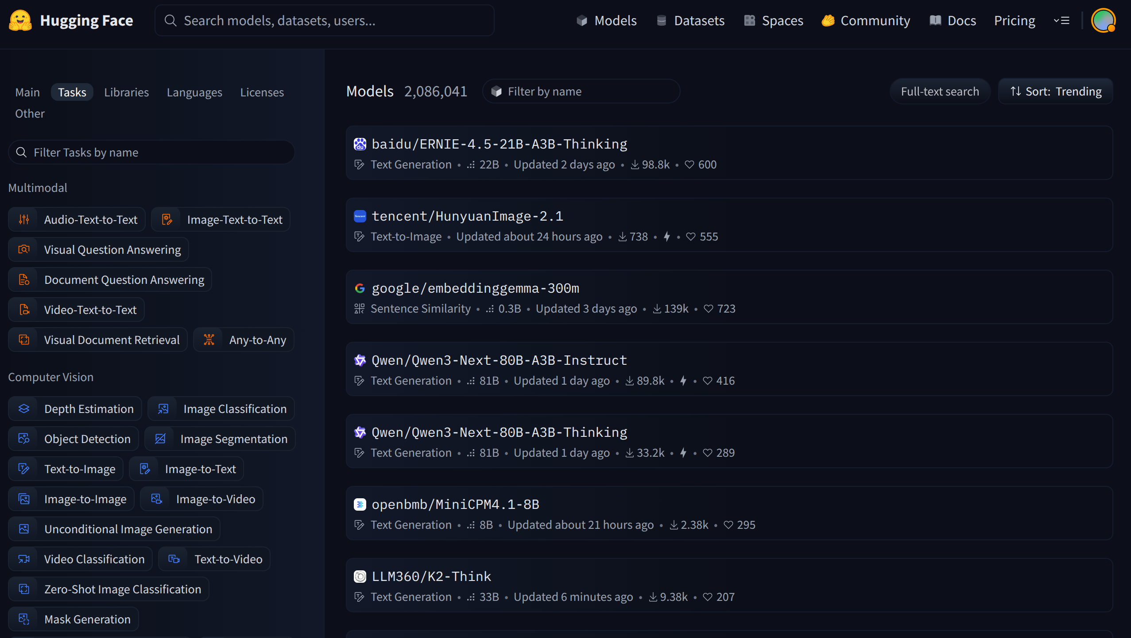
Check Hugging Face

Slide 5
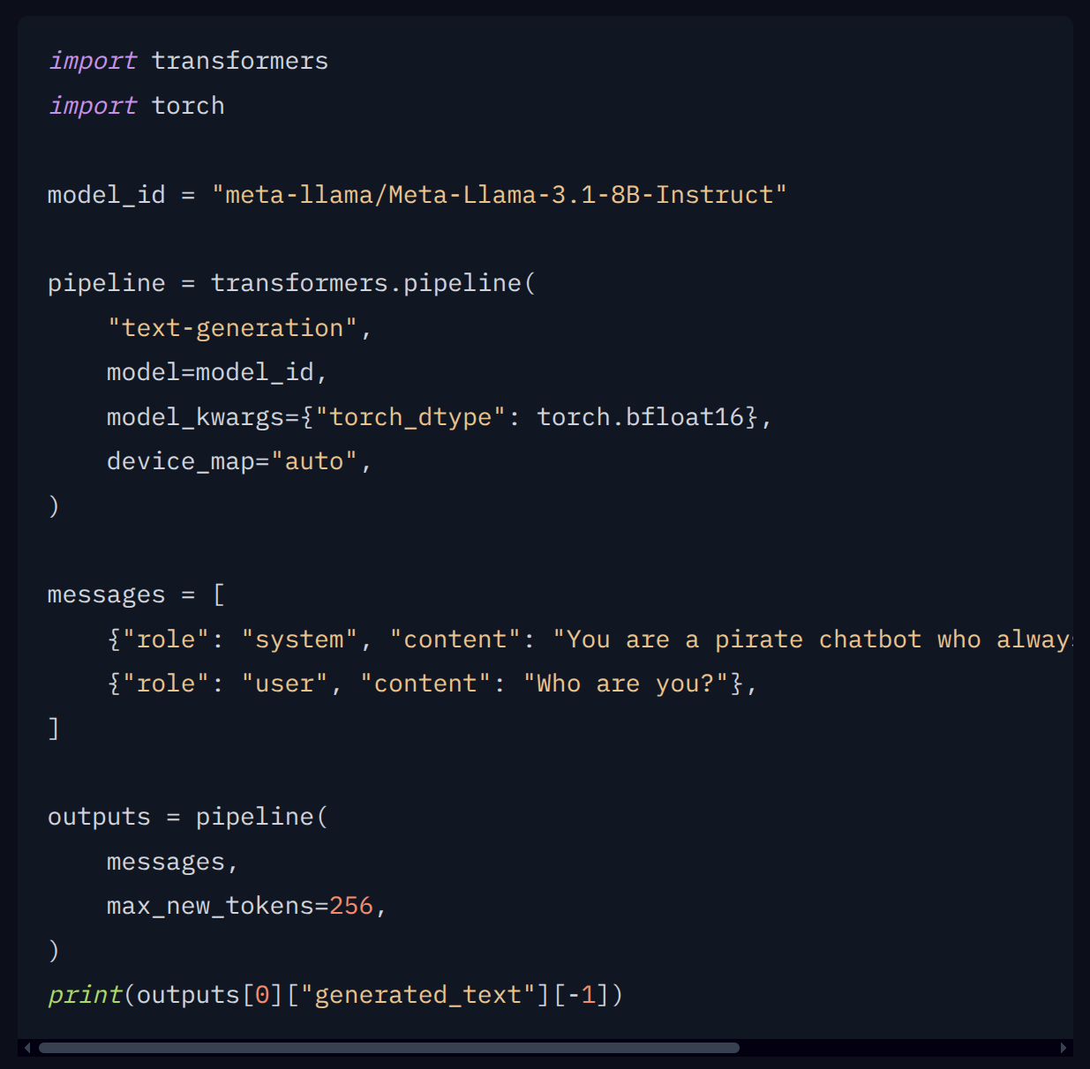
Hugging Face
Almost every model will have example code on how to run it

Slide 6

Serving LLMs
How big does your model need to be?
Start small
Basic prompting
In-context learning methods
Fine-tuning is for specialist applications
Throughput or Latency?

Slide 7
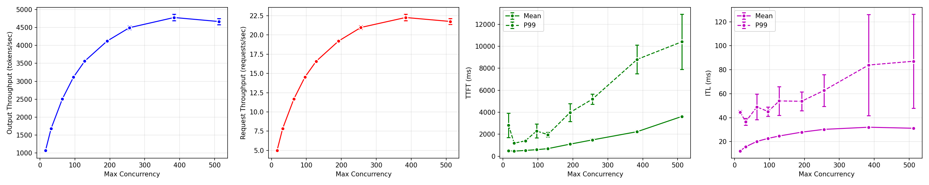
Serving LLMs
How big does your model need to be?
Start small
Basic prompting
In-context learning methods
Fine-tuning is for specialist applications
Throughput or Latency?

Slide 8
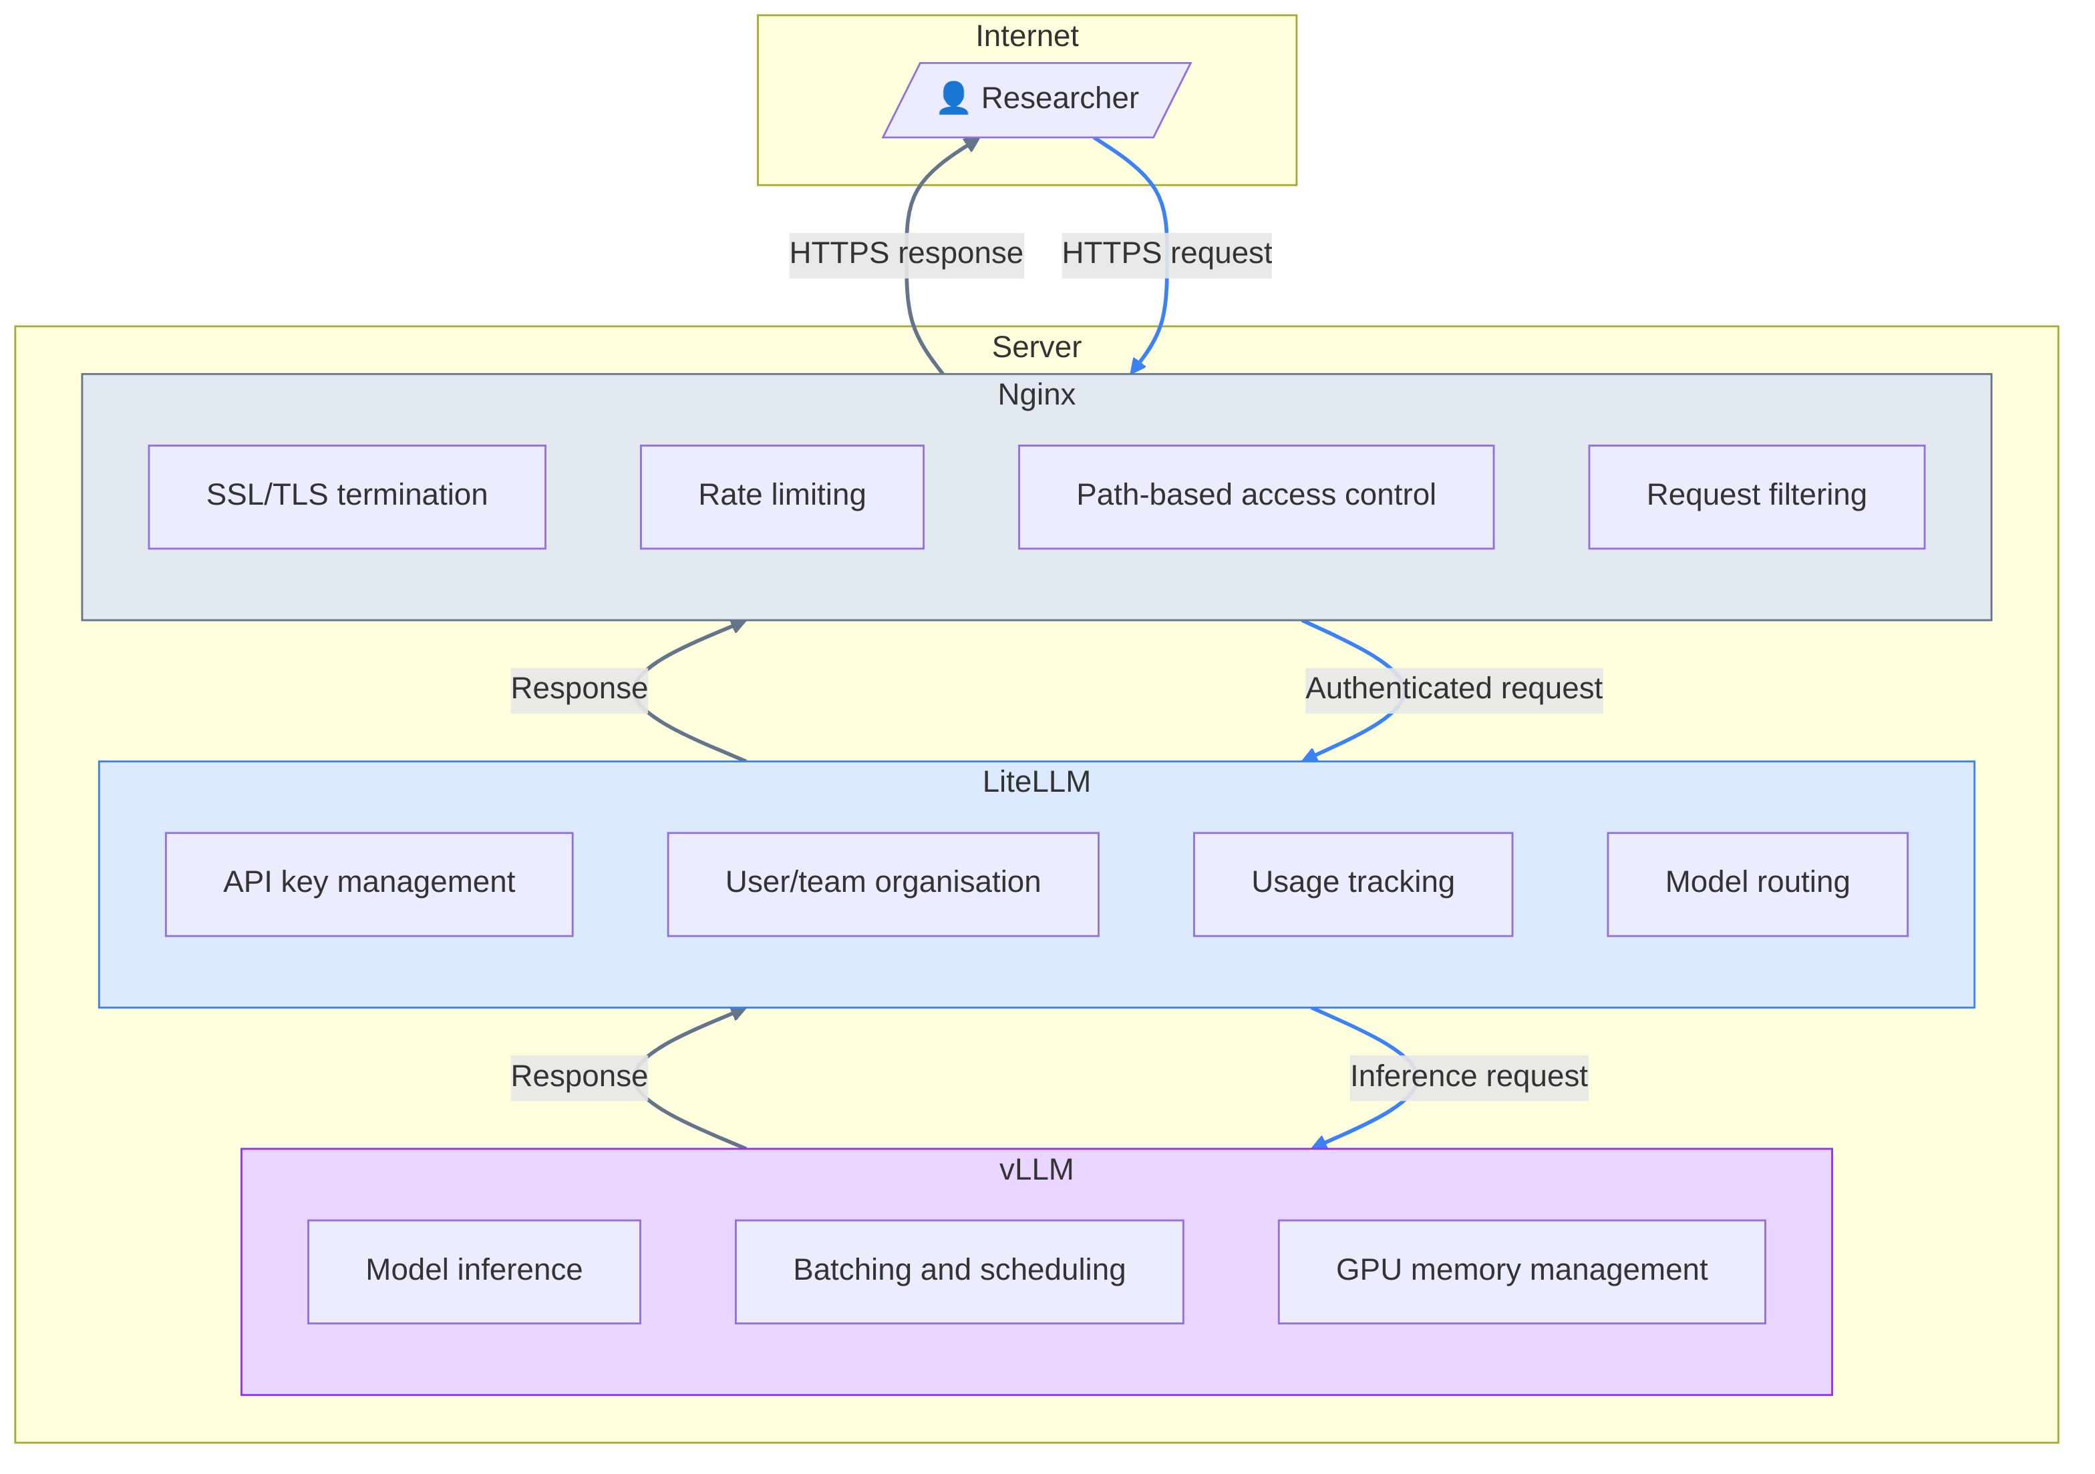
Serving LLMs

Slide 9

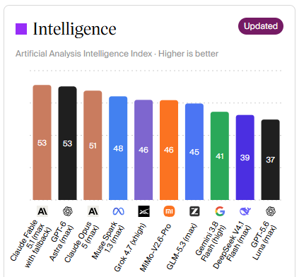

AI = water in the tap?
FORMAT
A JSON

Slide 10
Activity
Discuss the differences between different LLMs
  "Strength"
  Behaviour
    Style
    Censorship
    Engagement bait
  Access
    Local / Online
    Free / Paid
  Ownership
    Proprietary / open weights
    American, Chinese, European (Mistral/LeChat), British (?)
    Alignment with owner
    Political position

Slide 11
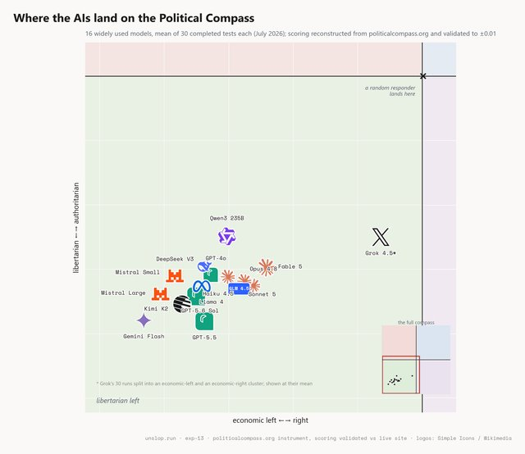
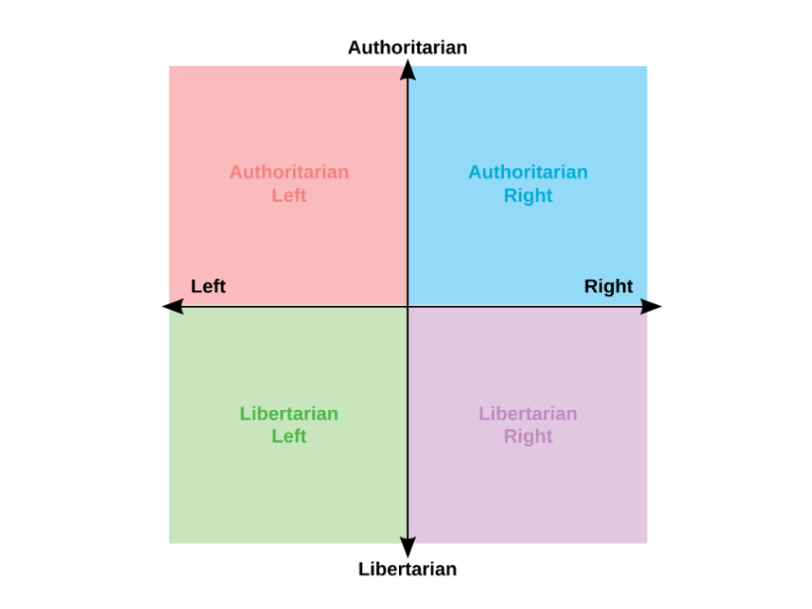
Political Compass

Slide 12

Bidirectional Encoder Representations from Transformers
‘[CLS]’
‘the’
‘cat’
‘[MASK]’
‘on’
‘the’
‘mat’
‘[SEP]’
101
1996
4937
103
2006
1996
13523
102
‘the’
‘cat’
‘sat’
‘on’
‘the’
‘mat’
‘sat’ | 0.19
‘was’ | 0.14
‘lay’ | 0.07
‘hippo’ | 0.000001
Notes:
BERT is what we call a masked token predictor. Here we have the same example. Except this time, we have masked the token “sat”. The job for bert is to predict this masked token. You see on the right, lots of different options. BERT will actually predict the probability of every possible token being the next token. So let’s say each token is a word, and suppose there are 200,000 words to choose from, then you’ll end up with 200,000 numbers. And the biggest number is the most likely next token. We’ll come back to this right hand side. But first I want to look at what’s going on in the left hand side.

Slide 13
Embeddings
Consider using a BERT-like model – they can do so much!
Q&A
Sentiment
Entity extraction
Classification

Slide 14




Frameworks

Slide 15







AWS
Microsoft
Google

Slide 16
SWE with LLMs
This is just some practical advice that I have found helpful, and is mostly my personal opinion

Slide 17
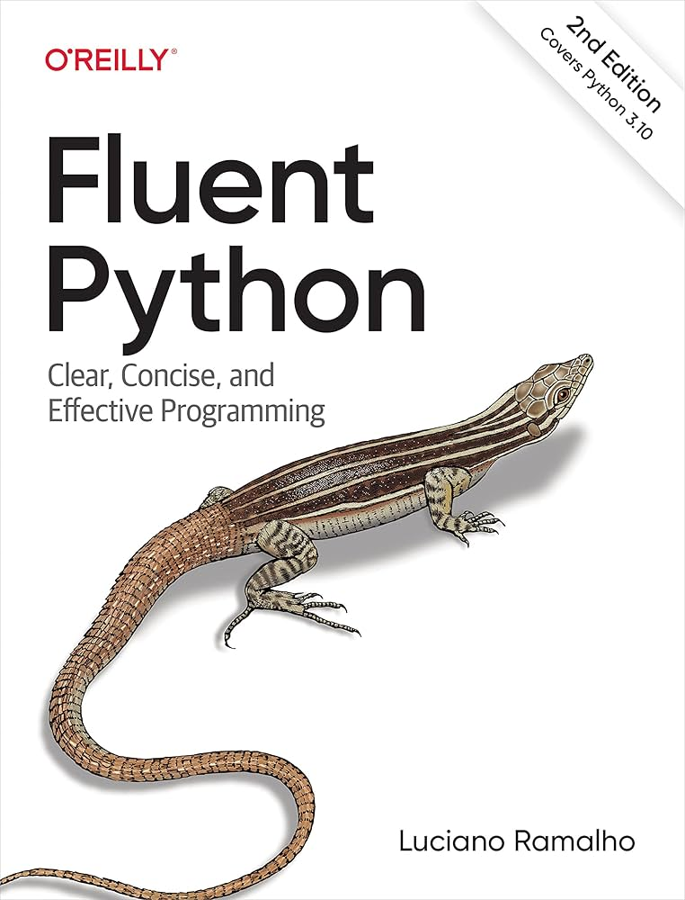

SWE with LLMs
Use UV
Use config files in yaml format
Validate your config files
Dump output
Setup CLI
Learn to use your cloud provider SDK / CLI
Become fluent in your language

Slide 18
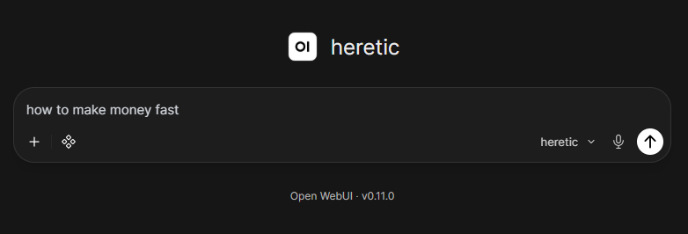
Abliterated models
Notes:
https://zenithllms.chat/

Slide 19
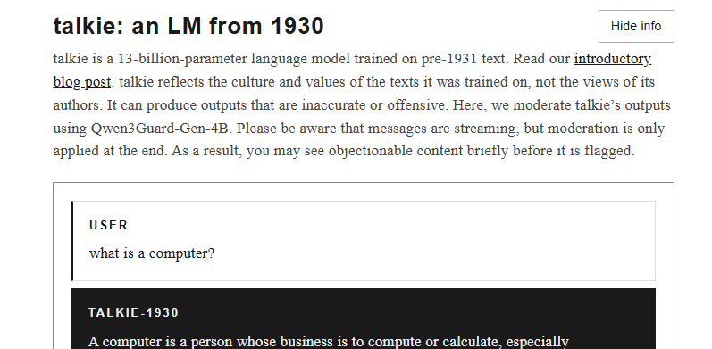
Vintage models
Notes:
https://talkie-lm.com/chat

Slide 20
Activity
Try out https://talkie-lm.com/chat

