Slide 1

Interaction

Slide 2
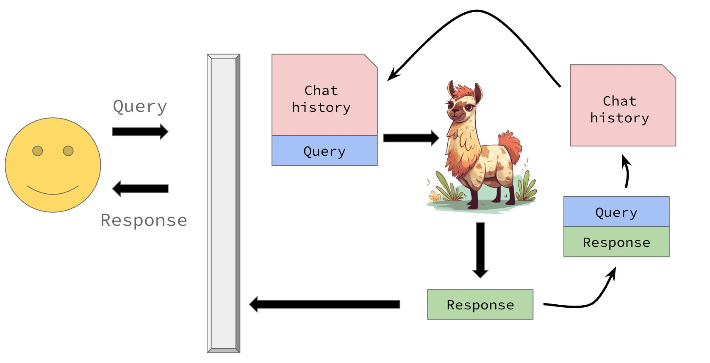
Before we begin
Notes:
This is you.

Slide 3
How do we, as mere humans, who can only type in plain text, interact with these models?

Slide 4
The OpenAI API
What is an API?
It is a way of defining how you interact with a piece of software
What is the OpenAPI?
It is just a specific type of API!
Think about what happens when you order food at a restaurant...

Slide 5
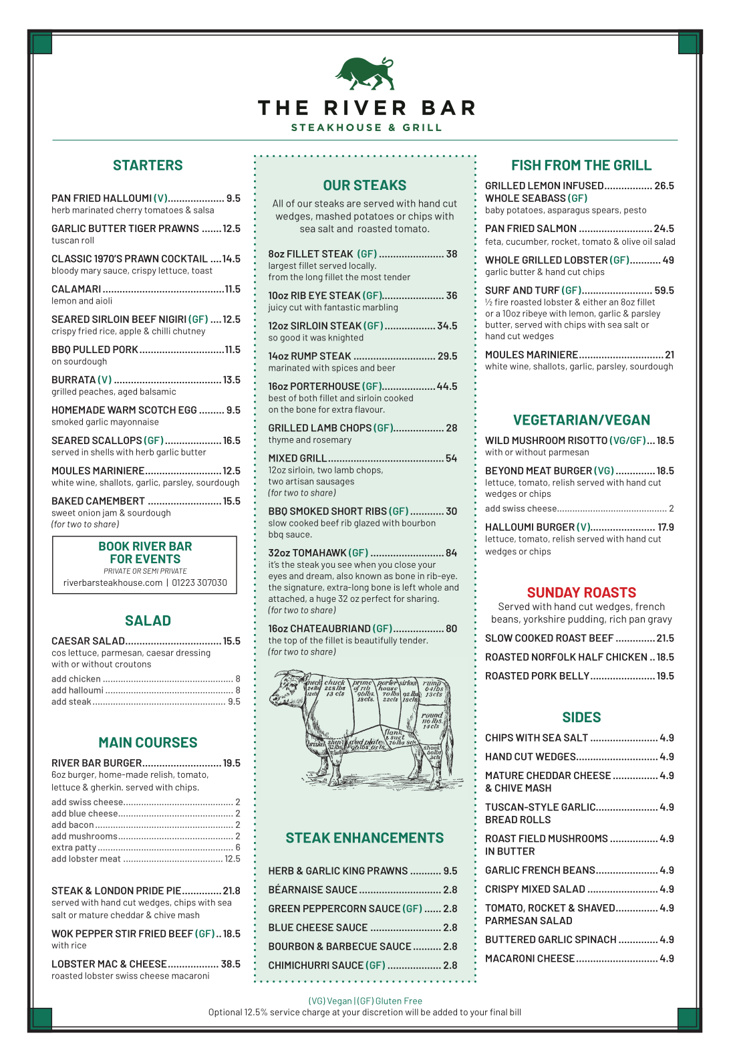
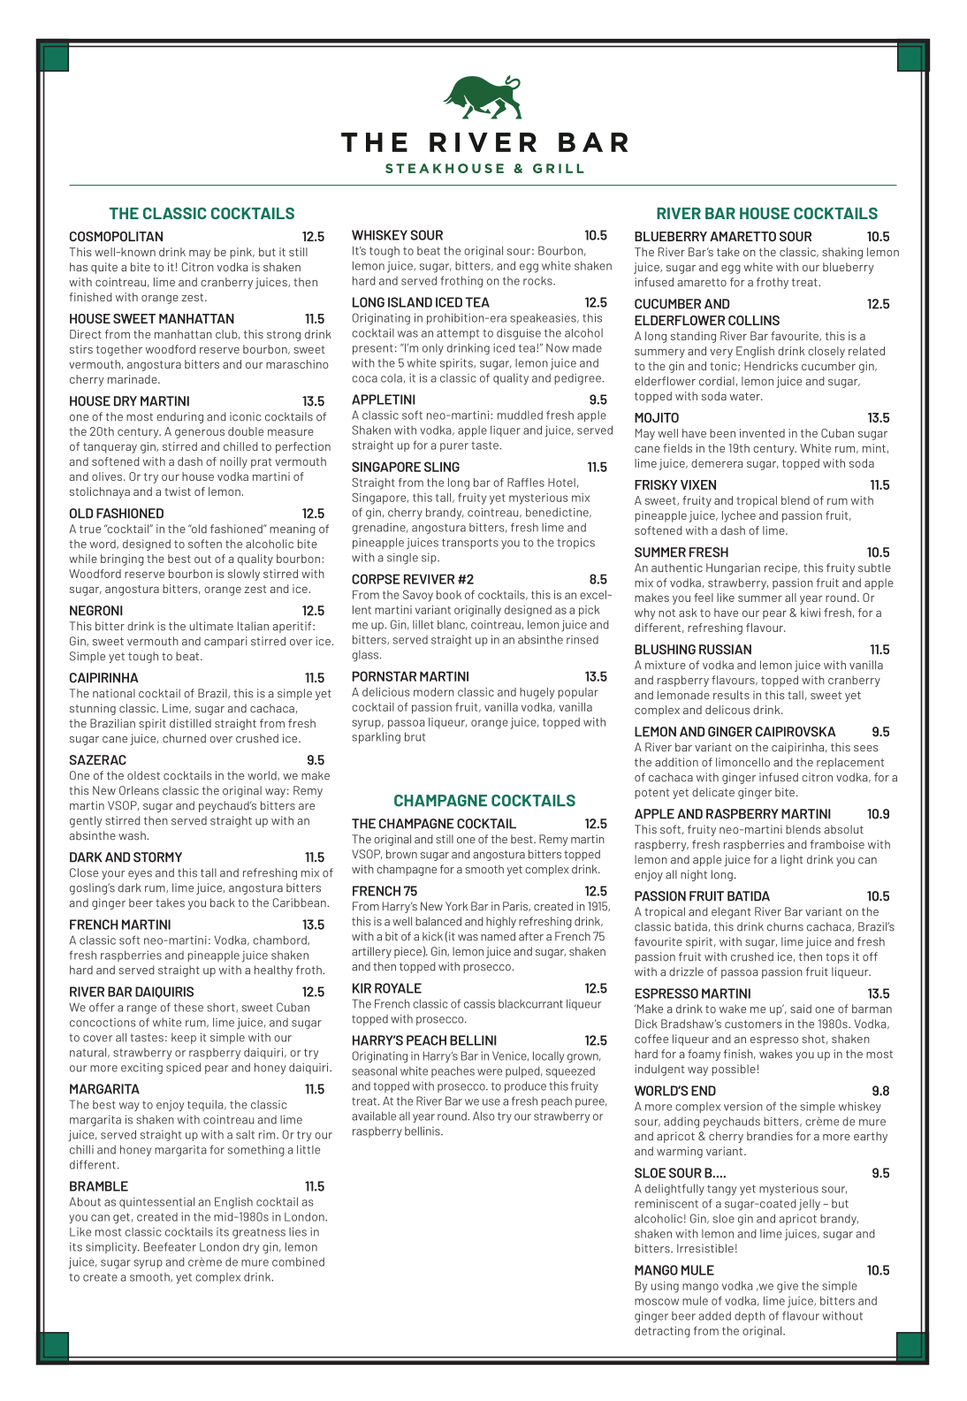

Slide 6





Slide 7

chat template
<|begin_of_text|><|start_header_id|>system<|end_header_id|>
You are a helpful assistant.<|eot_id|><|start_header_id|>user<|end_header_id|>
Give me a recipe for apple pie.<|eot_id|><|start_header_id|>assistant<|end_header_id|>
"Give me a recipe for apple pie."
Generate until we see special end token
tokenizer
[101,
102, 5921, 103,
84011, 97432, 34587, 123, 712, 104,
102, 1246, 103,
1487, 34578, 8891, 67, 86, 12413, 1775, 104,
102, 1346, 103]

Slide 8
Activity
What APIs do you use?
  Real APIs (computer science definition)
  Figurative (abstraction service)
  Directly
  Indirectly

Slide 9

The OpenAI API
The OpenAI API makes it very convenient to "communicate" with LLMs
You can basically wrap any generative LLM in the OpenAI API...

Slide 10
Session state
LLMs, as a fundamental unit, are stateless...
...so a software engineer has to "manage" a conversation

Slide 11
Session state
Notes:
This is you.

Slide 12
How do we manage session state?
LLMs have distinct input and output patterns...
‘system’ : “You are an expert in baking.”
‘user’ : “Provide me a recipe for macarons.”
‘assistant’ : “Certainly! Here is a recipe for macarons …”
Almost all LLMs follow this pattern...
...break this pattern, and you'll soon see the model produce nonsense.

Slide 13
How do we manage session state?
‘system’ : “You are an expert in baking.”
‘user’ : “Provide me a recipe for macarons.”
‘assistant’ : “Certainly! Here is a recipe for macarons …”
‘user’ : “Is this the only way to make them?”
‘assistant’ : “Actually no! There are two common ways to …”
‘user’ : “I think I'll try the Italian method first.”
‘assistant’ : “What an insightful idea! Let's get started …”

Slide 14
How do we manage session state?
session_state = [
‘system’ : “You are an expert in baking.”,
‘user’ : “Provide me a recipe for macarons.”,
‘assistant’ : “Certainly! Here is a recipe for macarons …”,
‘user’ : “Is this the only way to make them?”,
‘assistant’ : “Actually no! There are two common ways to …”,
‘user’ : “I think I'll try the Italian method first.”,
‘assistant’ : “What an insightful idea! Let's get started …”,
…
]

Slide 15


Slide 16
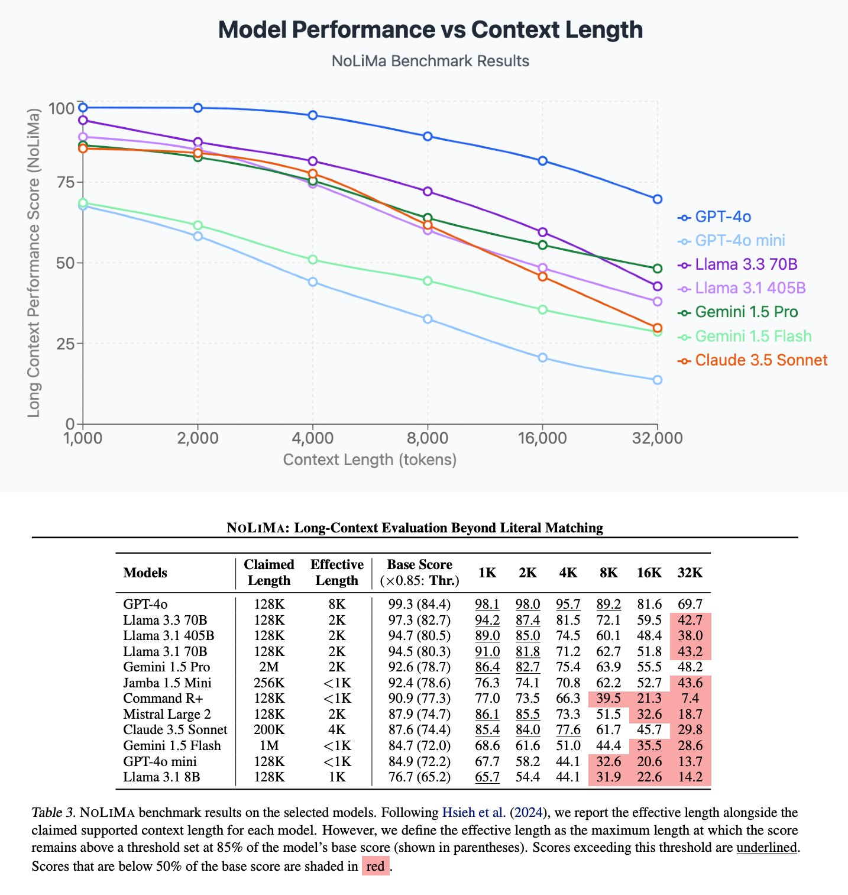
https://arxiv.org/abs/2502.05167

Slide 17
Activity
Estimate the size of *your* context window
  Expressed in tokens
  Is it measurable that way?
  Short term vs long term
  Training data vs context window

